Slide 1

Bluetooth based Management and
Advertisement Utility for Malls
Mohd Sadique

Slide 2
OBJECTIVES
This multi-utility for Malls is aimed for outlets providing
them facility for managing customers’ visits, purchasing
history and store’s details and at the same time giving an
option to customers to receive updates on their mobile sets
about different offers and sales as soon as they enter the mall.
To develop inter platform application that will store details
of all loyal customers in a database including their visits,
purchasing history, and personal details.
All the updates and changes will be carried out maintaining
the integrity of the database.

Slide 3
The registered customers will have an option to select one of these two:
1)Notify
2)Do not Disturb
Every outlet can have its own application or register to
a Central application employed in the mall.
Anticipate the need and potential of sales opportunities.

Slide 4
Challenges in the way
Handling Bluetooth connectivity
Inter Platform communication ,i.e. communication between a computer and a mobile device
Managing large Database of customers, stores and
shopping history and use this to decide loyal customers and offers

Slide 5
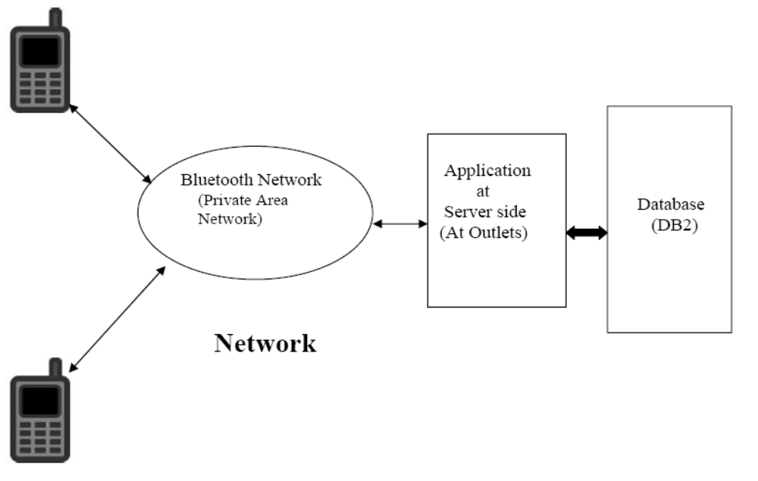
PRODUCT LOOK UP
CLIENTS SERVER

Slide 6
PRODUCT FUNCTIONALITIES
Service Level Agreements : It contains the agreements of providing the services related to product and customer.
Customer’s Information: It maintains all the details (Visits, Contact, Preferences of the customer
Transaction Details : Details of purchases of each customers will be stored to study and analyze the shopping habits of every
customers and their preferences.
Respect to privacy : Customers will have an option to select the way they want to be updated or not at all..They can refuse to install the application on their device /opt for “Do Not Disturb”, if they don’t want to be informed about any offers or sales.

Slide 7
Data Security : The database will have a admin login with password, avoiding the misuse of any info by other staffs.The application for their phone will be very small requiring
memories of few KBs and easy to handle.
Secure Connection : Though the outlet won’t transmit any
confidential data over the network, still all the messages will
be encrypted with 8 bit ciphering and will be decrypted by the
mobile application.
Maintaining Logs : All the activities will be stored in the a log file.

Slide 8
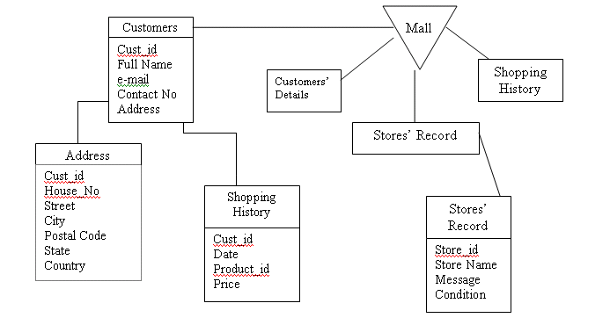
Database Design

Slide 9
Advertisement
This will use the PRIVATE AREA NETWORK (PAN) created by Bluetooth Technology
Send messages to the privileged customers about offers in specific stores
Send advertisements about offers which requires fulfillment of some specific requirements.

