Slide 1
Relational Query Optimization
Chapter 15
Instructor: Mohammad Sadoghi
msadoghi@purdue.edu
Notes:
1
The slides for this text are organized into chapters. This lecture covers Chapter 15, and discusses relational query optimization in depth.
It should be covered after Chapter 8, which provides an overview of storage and indexing. At the instructor’s discretion, it can also be omitted without loss of continuity in other parts of the text. (In particular, Chapter 20 can be covered without covering this chapter, though this material gives more insight into the workings of a DBMS.)
This chapter is most appropriate for a course with an implementation emphasis, and is a candidate for omission in a course with an applications emphasis.

Slide 2
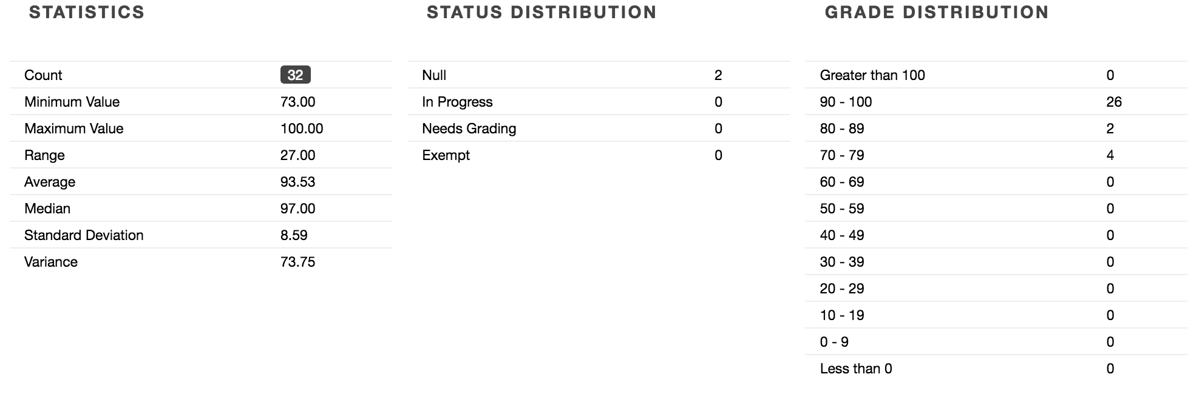
Programming Assignment 2 Results

Slide 3
Highlights of System R Optimizer
Impact:
  Most widely used currently; works well for < 10 joins.
Cost estimation: Approximate art at best.
  Statistics, maintained in system catalogs, used to estimate cost of operations and result sizes.
  Considers combination of CPU and I/O costs.
Plan Space: Too large, must be pruned.
  Only the space of left-deep plans is considered.
    Left-deep plans allow output of each operator to be pipelined into the next operator without storing it in a temporary relation.
  Cartesian products avoided.
Notes:
2

Slide 4
Overview of Query Optimization
Plan: Tree of R.A. ops, with choice of alg for each op.
  Each operator typically implemented using a `pull’ interface: when an operator is `pulled’ for the next output tuples, it `pulls’ on its inputs and computes them.
Two main issues:
  For a given query, what plans are considered?
    Algorithm to search plan space for cheapest (estimated) plan.
  How is the cost of a plan estimated?
Ideally: Want to find best plan. Practically: Avoid worst plans!
We will study the System R approach.
Notes:
2

Slide 5
Schema for Examples
Sailors (sid: integer, sname: string, rating: integer, age: real)
Reserves (sid: integer, bid: integer, day: dates, rname: string)
Similar to old schema; rname added for variations.
Reserves:
  Each tuple is 40 bytes long, 100 tuples per page, 1000 pages.
Sailors:
  Each tuple is 50 bytes long, 80 tuples per page, 500 pages.
Notes:
3

Slide 6
Query Blocks: Units of Optimization
SELECT S.sname
FROM Sailors S
WHERE S.age IN
(SELECT MAX (S2.age)
FROM Sailors S2
GROUP BY S2.rating)
An SQL query is parsed into a collection of query blocks, and these are optimized one block at a time.
Nested blocks are usually treated as calls to a subroutine, made once per outer tuple. (This is an over-simplification, but serves for now.)
Outer block
Nested block
For each block, the plans considered are:
  All available access methods, for each reln in FROM clause.
  All left-deep join trees (i.e., all ways to join the relations one-at-a-time, with the inner reln in the FROM clause, considering all reln permutations and join methods.)
Notes:
7

Slide 7
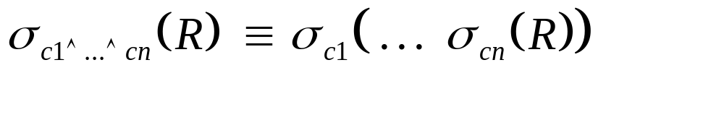
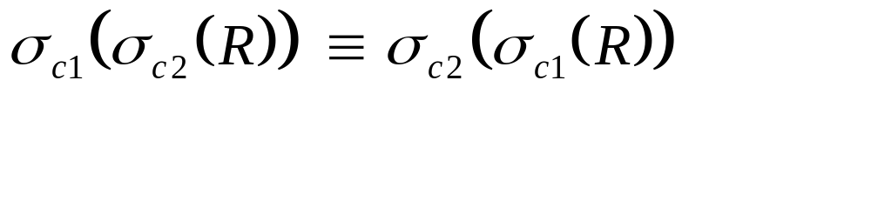
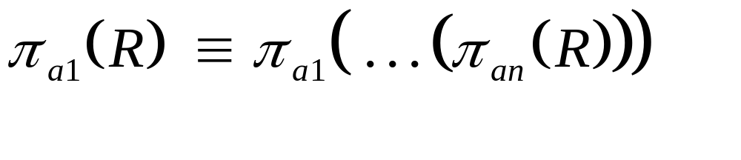




Relational Algebra Equivalences
Allow us to choose different join orders and to `push’ selections and projections ahead of joins.
Selections: (Cascade)
(Commute)
Projections:
(Cascade)
Joins:
R (S T) (R S) T
(Associative)
(R S) (S R)
(Commute)
Show that:
R (S T) (T R) S
Notes:
10

Slide 8

More Equivalences
A projection commutes with a selection that only uses attributes retained by the projection.
Selection between attributes of the two arguments of a cross-product converts cross-product to a join.
A selection on just attributes of R commutes with R S. (i.e., (R S) (R) S
Similarly, if a projection follows a join R S, we can `push’ it by retaining only attributes of R (and S) that are needed for the join or are kept by the projection.
Notes:
11

Slide 9
Enumeration of Alternative Plans
There are two main cases:
  Single-relation plans
  Multiple-relation plans
For queries over a single relation, queries consist of a combination of selects, projects, and aggregate ops:
  Each available access path (file scan / index) is considered, and the one with the least estimated cost is chosen.
  The different operations are essentially carried out together (e.g., if an index is used for a selection, projection is done for each retrieved tuple, and the resulting tuples are pipelined into the aggregate computation).
Notes:
12

Slide 10
Cost Estimation
For each plan considered, must estimate cost:
  Must estimate cost of each operation in plan tree.
    Depends on input cardinalities.
    We’ve already discussed how to estimate the cost of operations (sequential scan, index scan, joins, etc.)
  Must also estimate size of result for each operation in tree!
    Use information about the input relations.
    For selections and joins, assume independence of predicates.
Notes:
8

Slide 11
Cost Estimates for Single-Relation Plans
Reduction factor (RF)
Index I on primary key matches selection:
  Cost is Height(I)+1 for a B+ tree, about 1.2 for hash index.
Clustered index I matching one or more selects:
  (NPages(I)+NPages(R)) * product of RF’s of matching selects.
Non-clustered index I matching one or more selects:
  (NPages(I)+NTuples(R)) * product of RF’s of matching selects.
Sequential scan of file:
  NPages(R).
Note: Typically, no duplicate elimination on projections! (Exception: Done on answers if user says DISTINCT.)
Notes:
13

Slide 12
Example
SELECT S.sid
FROM Sailors S
WHERE S.rating=8
  Each tuple is 50 bytes long, 80 tuples per page, 500 pages.
  50 Index pages
  (10 distinct ratings)
If we have an index on rating:
  (1/NKeys(I)) * NTuples(R) = (1/10) * 40000 tuples retrieved.
  Clustered index: (1/NKeys(I)) * (NPages(I)+NPages(R)) = (1/10) * (50+500) pages are retrieved. (This is the cost.)
  Unclustered index: (1/NKeys(I)) * (NPages(I)+NTuples(R)) = (1/10) * (50+40000) pages are retrieved.
If we have an index on sid:
  Would have to retrieve all tuples/pages. With a clustered index, the cost is 50+500, with unclustered index, 50+40000.
Doing a file scan:
  We retrieve all file pages (500).
Notes:
14

Slide 13
Queries Over Multiple Relations
Fundamental decision in System R: only left-deep join trees are considered.
  As the number of joins increases, the number of alternative plans grows rapidly; we need to restrict the search space.
  Left-deep trees allow us to generate all fully pipelined plans.
    Intermediate results not written to temporary files.
    Not all left-deep trees are fully pipelined (e.g., SM join).
D
D
C
C
A
B
C
D
A
B
A
B
Notes:
15

Slide 14
Enumeration of Left-Deep Plans
Left-deep plans differ only in the order of relations, the access method for each relation, and the join method for each join.
Enumerated using N passes (if N relations joined):
  Pass 1: Find best 1-relation plan for each relation.
  Pass 2: Find best way to join result of each 1-relation plan (as outer) to another relation. (All 2-relation plans.)
  Pass N: Find best way to join result of a (N-1)-relation plan (as outer) to the N’th relation. (All N-relation plans.)
For each subset of relations, retain only:
  Cheapest plan overall, plus
  Cheapest plan for each interesting order of the tuples.
Notes:
16

Slide 15
Enumeration of Plans (Contd.)
ORDER BY, GROUP BY, aggregates etc. handled as a final step, using either an `interestingly ordered’ plan or an addional sorting operator.
An N-1 way plan is not combined with an additional relation unless there is a join condition between them, unless all predicates in WHERE have been used up.
  i.e., avoid Cartesian products if possible.
In spite of pruning plan space, this approach is still exponential in the # of tables.
Notes:
16

Slide 16
Cost Estimation for Multirelation Plans
SELECT attribute list
FROM relation list
WHERE term1 AND ... AND termk
Consider a query block:
Maximum # tuples in result is the product of the cardinalities of relations in the FROM clause.
Reduction factor (RF) associated with each term reflects the impact of the term in reducing result size. Result cardinality = Max # tuples * product of all RF’s.
Multirelation plans are built up by joining one new relation at a time.
  Cost of join method, plus estimation of join cardinality gives us both cost estimate and result size estimate
Notes:
9

Slide 17
Example
Sailors:
B+ tree on rating
Hash on sid
Reserves:
B+ tree on bid
sname
Pass1:
  Sailors: B+ tree matches rating>5, and is probably cheapest. However, if this selection is expected to retrieve a lot of tuples, and index is unclustered, file scan may be cheaper.
    Still, B+ tree plan kept (because tuples are in rating order).
  Reserves: B+ tree on bid matches bid=100; cheapest.
sid=sid
bid=100
rating > 5
Reserves
Sailors
Pass 2:
  We consider each plan retained from Pass 1 as the outer, and consider how to join it with the (only) other relation.
    e.g., Reserves as outer: Hash index can be used to get Sailors tuples
    that satisfy sid = outer tuple’s sid value.
Notes:
17

Slide 18
Nested Queries
SELECT S.sname
FROM Sailors S
WHERE EXISTS
(SELECT *
FROM Reserves R
WHERE R.bid=103
AND R.sid=S.sid)
Nested block is optimized independently, with the outer tuple considered as providing a selection condition.
Outer block is optimized with the cost of `calling’ nested block computation taken into account.
Implicit ordering of these blocks means that some good strategies are not considered. The non-nested version of the query is typically optimized better.
Nested block to optimize:
SELECT *
FROM Reserves R
WHERE R.bid=103
AND S.sid= outer value
Equivalent non-nested query:
SELECT S.sname
FROM Sailors S, Reserves R
WHERE S.sid=R.sid
AND R.bid=103
Notes:
18

Slide 19
Summary
Query optimization is an important task in a relational DBMS.
Must understand optimization in order to understand the performance impact of a given database design (relations, indexes) on a workload (set of queries).
Two parts to optimizing a query:
  Consider a set of alternative plans.
    Must prune search space; typically, left-deep plans only.
  Must estimate cost of each plan that is considered.
    Must estimate size of result and cost for each plan node.
    Key issues: Statistics, indexes, operator implementations.
Notes:
19

Slide 20
Summary (Contd.)
Single-relation queries:
  All access paths considered, cheapest is chosen.
  Issues: Selections that match index, whether index key has all needed fields and/or provides tuples in a desired order.
Multiple-relation queries:
  All single-relation plans are first enumerated.
    Selections/projections considered as early as possible.
  Next, for each 1-relation plan, all ways of joining another relation (as inner) are considered.
  Next, for each 2-relation plan that is `retained’, all ways of joining another relation (as inner) are considered, etc.
  At each level, for each subset of relations, only best plan for each interesting order of tuples is `retained’.
Notes:
20

