Slide 1
Paxos Made Simple
John Nguyen
Slides adapted from Leslie Lamport and Thomas Marshall
Notes:
Hello today we will talk about Paxos Consensus Algorithm

Slide 2
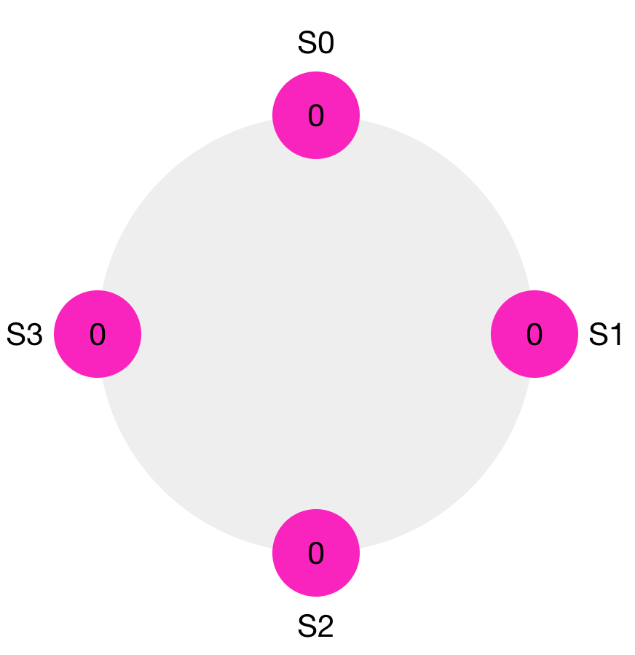
Problem
How to agree on a value in a distributed system that tolerate non-malicious failures?
Notes:
Say the words on the slide*
Imagine the computer to be your bank’s servers. Every single server should reflect the same balance of your account. The problem is since these servers are different machines and could be geographically distant from each other, they need to communicate over a network connection which may or may not be reliable. So how do they all show the same value? Answer: They follow what is called a ‘consensus protocol’ to come to an agreement. Paxos is one such protocol.
The problem is many servers could be proposing what they think is the correct balance at the same time. If the proposed balances by different servers are different, then the system as a whole cannot come to a consensus of what the actual balance is and your bank can’t tell you how much money you have.

Slide 3
Problem
Distributed consensus problem
  Group of processes must agree on a single value
  Value must be proposed
  After value is agreed upon, it can be learned
Notes:
To formalize our problem,
say *words on side

Slide 4
Requirements
Safety
Liveness

Slide 5
Properties: Safety
Only a proposed value is chosen
Only a single value is chosen.
Only chosen values are learned by processes

Slide 6
Properties: Liveness
  Some proposed value is eventually chosen if fewer than half of processes fail
  If a value has been chosen, a process can eventually learn the value.

Slide 7
Paxos‘s notation
Classes of agents:
  Proposers
  Acceptors
  Learners
A process can act as more than one clients (usually 3).
Assumption: asynchronous, non-byzantine model

Slide 8
Paxos Phase 1 (prepare)
Proposer:
    Each proposal should be of form <n, v> where n is strictly increasing
    A proposer sends a prepare request with number n to majority of acceptors.
Acceptors:
  If n > n*
    N* = n ← promise not to accept any new proposals n’ < n
    If no prior proposal accepted
      Reply <promise, n, Ø>
    Else
      Reply <promise, n, (na , va) >
  Else
    Reply reject
Notes:
The acceptor needs to reply
That it it will respond with a promise that it will not accept any other requests with a lower proposal number.
If it has accepted a prior proposal then it will respond to the current proposal with the highest prior proposal number

Slide 9
Phase 1 Example
Proposal is <5, 100>
Acceptor
  Already accepted proposals
  For example, if it has accepted <1, 20>, <2, 30> and <4, 40>
  it will respond with <4, 40>
  Did not accepted any proposal
  <5, 100>

Slide 10
Paxos Phase 2 (accept)
  If the proposer receives a response YES to its prepare requests from a majority of acceptors, then it sends an accept request to each of those acceptors for a proposal numbered n with a value v which is the value of the highest-numbered proposal among the responses.
  If an acceptor receives an accept request for a proposal numbered n, it accepts the proposal unless it has already responded to a prepare request having a number greater than n.

Slide 11
Paxos algorithm
Phase 3 (learn):
  Learners need to know which value has been chosen
  Elect a set of “distinguished learners”
    Acceptors respond with to learn requests with their acceptance
    These distinguished learners informs other learners

Slide 12
Definition of chosen
A value is chosen at proposal number n iff majority of acceptor accept that value in phase 2 of the proposal number.

Slide 13
Progress
Proposers can continually propose higher and higher proposal numbers without any ever being accepted
Distinguished Proposer: the only one trying to initiate proposals

Slide 14
Paxos’s properties
P1: Any proposal number is unique.
P2: Any two set of acceptors have at least one acceptor in common.
P3: the value sent out in phase 2 is the value of the highest-numbered proposal of all the responses in phase 1.

Slide 15
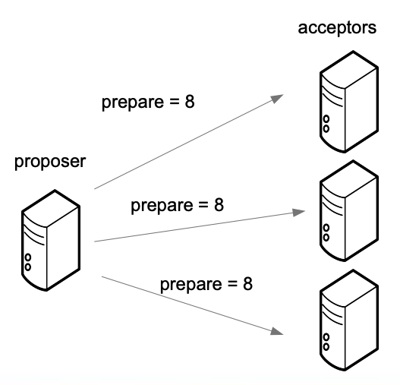
Example

Slide 16
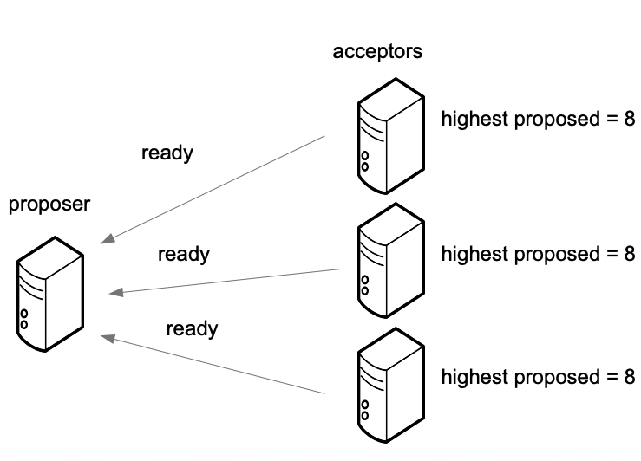
Example

Slide 17
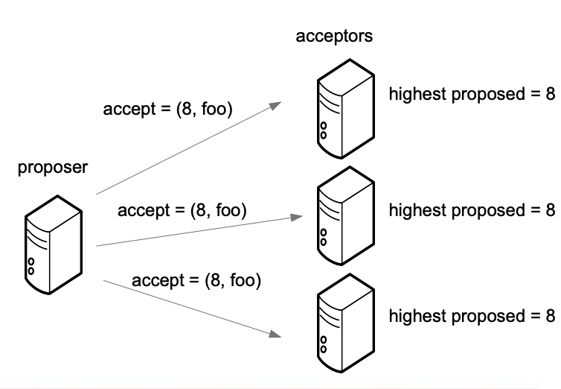
Example

Slide 18
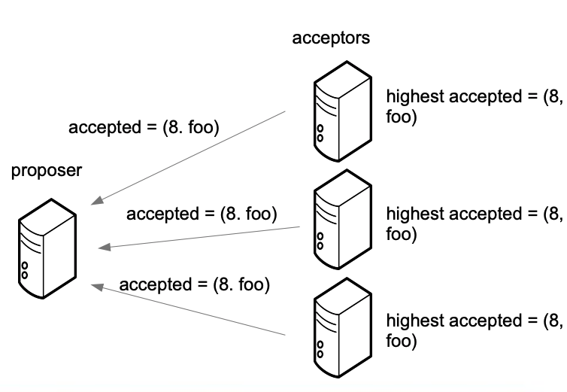
Example

Slide 19
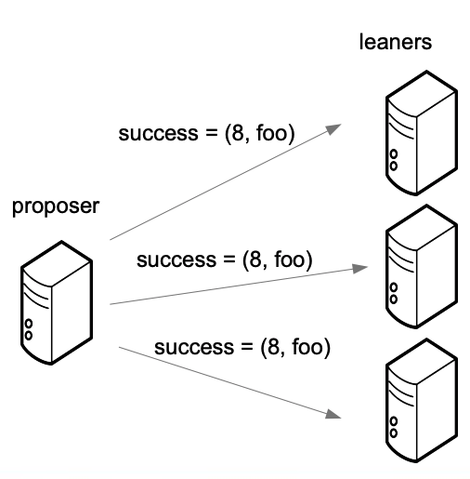
Example

