Slide 1
BEAT: Asynchronous BFT Made Practical
Presenters : Aviral, Rahul, Pavan, Vikhas, Rithvik
Notes:
“Today we’re presenting BEAT, a family of fully asynchronous BFT protocols designed to make asynchronous consensus practical.”
“We’ll walk through why fault tolerance matters, what SMR is, the challenges with asynchronous consensus, and how BEAT improves over prior protocols like HoneyBadgerBFT.”

Slide 2


Why do we even need Fault-Tolerant Distributed Systems?
Request
Response
Single Server → Single point of failure or compromise
Notes:
“If we rely on a single server, it's a single point of failure or compromise.”
“Failures can occur due to crashes, bugs, attacks, or network partitions.”
“Distributed systems need to remain correct and available even when components fail.”

Slide 3

State Machine Replication (SMR)
Can tolerate minority of replicas being faulty or malicious
Client can obtain the correct answer by majority vote
Notes:
“If we rely on a single server, it's a single point of failure or compromise.”
“Failures can occur due to crashes, bugs, attacks, or network partitions.”
“Distributed systems need to remain correct and available even when components fail.”

Slide 4
Why do we need State Machine Replication (SMR)?
Distributed Systems must remain correct and available despite failures
Single Server → Single point of failure
Replicated servers diverge → inconsistent state
What We Want
A system that behaves like one reliable machine, even if some replicas fail
Strong consistency across replicas
Notes:
“Distributed systems must maintain correctness and availability despite failures.”
“Single servers fail; multiple servers may diverge and become inconsistent.”
“SMR gives us a single logical machine that stays consistent even when some replicas fail.”
Correctness (no double writes, no corruption)
Consistency (everyone sees the same state)
Availability (system survives failures)

Slide 5
What is State Machine Replication (SMR)?
SMR Idea
Replicate the same deterministic state machine across multiple nodes
Ensure all replicas:
  Start from the same state
  Operations are deterministic
  Replicas execute operations in the same order (total oder)
Why this works?
Replication → Availability
Ordered Execution → Consistency
Determinism → Identical State
Notes:
State Machine Replication is a simple but powerful idea: each server runs the same state machine, and they all execute the exact same sequence of inputs. As long as the state machine is deterministic, every replica ends up in the same state.
This is how systems achieve strong consistency and high reliability.

Slide 6
Total order?
Notes:
“The next few slides illustrate why total ordering matters.”
“Total ordering means all replicas must process operations in exactly the same sequence.”

Slide 7
Total order?
Deposit $100
$100
$200
Deposit $100
$100
$200
$100

Slide 8
Total order?
Deposit $100
10% Tax
$100
$200
$180
Deposit $100
10% Tax
$100
$200
$180
$100

Slide 9
Total order?
10% Tax
Deposit $100
$100
$90
$190
10% Tax
Deposit $100
$100
$90
$190
$100

Slide 10
Total order?
10% Tax
Deposit $100
$100
$90
$190
Deposit $100
10% Tax
$100
$200
$180
$100

Slide 11
Why we need consensus protocols?
The missing piece
SMR only works if all replicas agree on
Which transaction comes next
In what order
Even if some replicas lie or fail
Consensus protocols solve
Ordering of transactions
Handling failures (crashes or Byzantine)
Ensuring all replicas converge
Notes:
“SMR only works if all replicas agree on the next transaction and its position in the log.”
“Consensus protocols enforce agreement even when some replicas are malicious or faulty.”
“They ensure convergence and prevent diverging histories.”

Slide 12
Asynchrony vs Partial Synchrony
Asynchronous
No bounds on message transmission delays or process execution rates
Protocols are more robust to timing and denial of service attacks
Deterministic ordering is impossible (FLP Impossibility), so the protocols are probabilistically live
Partially Synchronous
Bounds exist, but are unknown to the participants in the system
Basically, before some unknown time, the Global Stabilization Time (GST), the network behaves asynchronous. After GST, the network behaves like a synchronous system. Every message is delivered within some known bound Δ
Notes:
“In asynchronous networks, message delays have no upper bound.”
“FLP tells us deterministic liveness is impossible here.”
Probabilistic liveness: The protocol makes progress with probability 1 (or very close to 1), but not deterministically in every execution.
It uses randomness — often through: common coins
“Asynchronous protocols use randomness to ensure probabilistic liveness.”
“Partial synchrony assumes the network eventually stabilizes after GST.”
“PBFT operates in this model; BEAT is fully asynchronous.”

Slide 13
Challenges and opportunities of asynchronous BFT
No timeouts or clocks you can trust
Need to tolerate arbitrary delays
Broadcast and agreement become expensive
Current async protocols (e.g., HoneyBadgerBFT) have:
  Performance (latency and throughput) issues
  No one-size-fits-all design
Notes:
“Asynchronous systems cannot use timeouts reliably.”
“Broadcast and agreement are expensive without timing assumptions.”
“HoneyBadgerBFT solved async BFT but suffers from high latency and CPU overhead.”
“There is no one-size-fits-all design: workloads vary, batch sizes vary.”

Slide 14
Challenges and opportunities of asynchronous BFT
Append-only ledger vs Smart Contracts:
The former corresponds to append-only, linearizable storage systems (hereinafter, BFT storage), and the latter corresponds to general SMR.
General SMR requires each replica to maintain a copy of all service state to support contracts that operate on that state.
In contrast, BFT storage may leverage erasure coding to reduce overall storage by allowing servers to keep only fragments
Flexible Read:
Some systems benefit from flexible reading, i.e., reading just a portion of data as needed, instead of reading the whole block.
This can be challenging when we use erasure coding as the underlying storage mechanism.
Notes:
“General SMR requires replicas to store full state, but BFT storage systems can use erasure coding to reduce storage.”
BFT Storage only allows read and write operations whereas general SMR needs to support arbitrary transactions
“Flexible reads—reading only needed fragments—become complicated under erasure coding.”
“BEAT addresses these challenges with new engineering and coding techniques.”

Slide 15
Enter BEAT
BEAT | New Techniques | Features | Applicability
BEAT-0 | more efficient labeled threshold encryption and coin flipping; more flexible and efficient erasure coding support | baseline protocol; outperform HoneyBadgerBFT in all metrics | general SMR
BEAT-1 | replacing AVID broadcast with Bracha’s broadcast | Latency optimized | General SMR
BEAT-2 | client-side labeled CCA threshold encryption | Latency optimized Additional achieve casual order | General SMR Anonymous networks
BEAT-3 | a novel protocol combining AVID-FP and ABA | Storage, bandwidth, throughput optimized | BFT Storage
BEAT-4 | extending fpcc to single fragments and pyramid codes; a novel AVID-FP saving bandwidth | Further saving read bandwidth | BFT Storage
Notes:
“BEAT introduces a family of asynchronous BFT protocols optimized for different workloads.”
“Each BEAT variant focuses on a different dimension: latency, throughput, bandwidth, or flexible reads.”
“BEAT builds upon HoneyBadgerBFT but improves cryptography, broadcast efficiency, and coding.”

Slide 16
Comparison with PBFT
Feature | PBFT | BEAT
Network Model | Partial Synchrony (Relies on timing bounds) | Asynchronous (No timing assumptions)
Liveness Under Attack | Can stall (zero throughput) if network is slow/attacked | Guaranteed progress even under network attacks
Scalability | O(nB): Slows down significantly as more nodes are added | O(B) (BEAT3): Optimal bandwidth; performance is independent of node count
Primary Design | General-purpose "one-size-fits-all" | Modular family (specialized for different needs)
Notes:
“PBFT is partially synchronous and relies on timeouts and view changes.”
“BEAT is fully asynchronous and avoids any timing assumptions.”
“PBFT has lower latency in stable networks but cannot guarantee liveness under arbitrary delays.”
“BEAT maintains safety and probabilistic liveness even in unpredictable networks.”

Slide 17
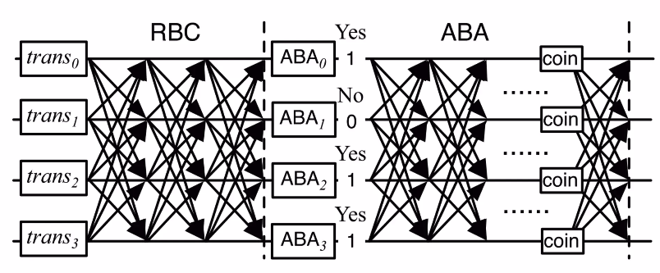
Quick recap of HoneyBadger BFT
Implements total order using Asynchronous Common Subset (ACS)
Implements ACS, in turn using Reliable broadcast (RBC) and asynchronous binary Byzantine agreement (ABA).
Notes:
Overview :
We will look into RBC in detail to understand bracha and AVID.
There are two spots where the crypto encryption is done, one is before the data enters the RBC phase, it encrypts the raw batch of transactions and encrypts them using the cryptograph algorithms. Inside every single ABA box on the right side of the diagram. When the voting gets stuck (deadlock), the ABA protocol calls for a random number. The nodes execute the Coin Flip Protocol. Generated the coin by verifying Threshold Signatures (which used pairings). This meant every time the network stuttered, it had to do "Calculus." Uses the CKS Direct Coin protocol on P-256. Now, every time the network stutters, it just does "Algebra."
Each node participates in the AVID protocol for every proposed batch. As soon as a node successfully reconstructs a specific batch—proving it is available—it casts a 'Yes' (1) vote in the ABA instance corresponding to that batch.
If the voting gets stuck in a deadlock, we use a Random Cryptographic Coin Flip to break the tie and force the network to agree on a value.
Crucially, we don't wait for everyone. As soon as we have 'Yes' votes for a supermajority of batches (N-f), we stop waiting.
The result is a Binary Vector (e.g., 1, 0, 1) telling us which batches to accept. To ensure Total Order, we take the accepted batches, sort them deterministically by the Proposer's ID, and execute them. Since everyone sorts the same ingredients by the same rule, everyone writes the exact same ledger history.

Slide 18
Reliable Broadcast [RBC]
A Designated replica (the broadcaster) broadcasts a message to all the replicas, with the following guarantees :
If any correct replica delivers a broadcast message B, then all correct replicas deliver B.
If the broadcaster is correct, then every correct replica delivers the broadcaster’s message.
Communication complexity:
Bracha’s broadcast : O(n^2 * B) to broadcast a message B
Erasure-coded variant of Bracha’s broadcast (AVID broadcast) : O(n *B)
Notes:
So we have two main mathematical gurantees:
If any correct node delivers a message, the protocol guarantees that all correct nodes will eventually deliver it. We either all get it, or none of us do.
If the sender is honest, that message will not be lost.
There are two main algorithm that we will quickly go through it is bracha’s algorithm which has a communication complexity of O(n^2 * B)
Each node sends the message to N other nodes.
The message size is B.
and AVID Broadcast which has a complexity of 0(n*B)
There are N nodes.
Each node sends its fragment to N other nodes.
The size of the data sent is B/N.
Total Traffic: N*N*(B/N) = N*B

Slide 19
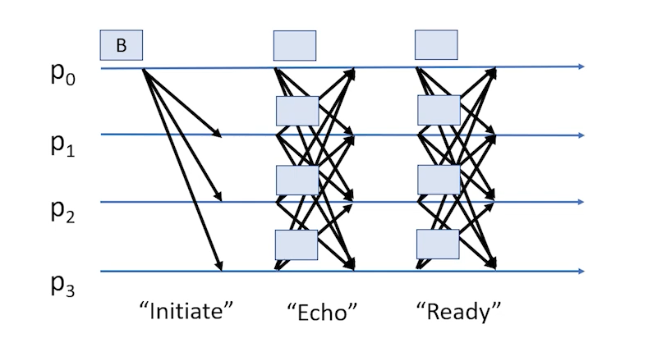
Reliable Broadcast - Bracha
Notes:
Phase 1: Initiate (The Proposal)
The Broadcaster sends the message (or in BEAT's case, the erasure-coded fragments) to all replicas.
Each of the replicas only know for themselves that they have received the message….To solve this, we move to the Echo phase.
Phase 2: Echo (The Verification) To solve this, we move to the Echo phase.
As soon as each replica’s get the initial message, they broadcast an 'Echo' to everyone else.
Wait till 2/3rd of the network receives and has the data.
Phase 3: Ready (The Lock-In)
Even with echoes there may be some honest nodes that still lag behind but here amplification happens and then if f+1 people confirm then it will catch up.
But here the communication complexity is O(N^2)
Comparison with PBFT ?
You can think of RBC as 'PBFT without the Ordering.' It uses the exact same three-step handshake (Propose -> Verify -> Commit) to ensure security. The main difference is that PBFT crashes if the leader dies, whereas RBC just lets that specific message fail while the rest of the system keeps running.

Slide 20
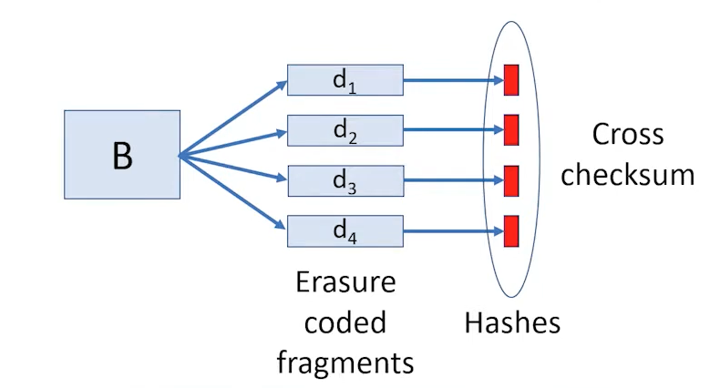
AVID (Asynchronous Verifiable Information Dispersal) protocol
We erasure encode the broadcast message (B) the data into n fragments.
Cross-checksum(d_{i}) = hash(d₁,d₂….d_{n})
Broadcaster sends replica R_{i} fragment d_{i} and cross-checksum of all the fragments
Notes:
First, the sender takes the Block B and uses Erasure Coding to split it into N fragments (d1 to d4).
Hashing: "Next, the sender calculates the Hash of every single fragment."
The sender bundles all these red hashes together into a list called the Cross-Checksum.
Now the sender transmits. Node 1 gets Fragment 1 + the cross checksum. Node 2 gets Fragment 2 + the Cross check sum No one gets the full block.

Slide 21
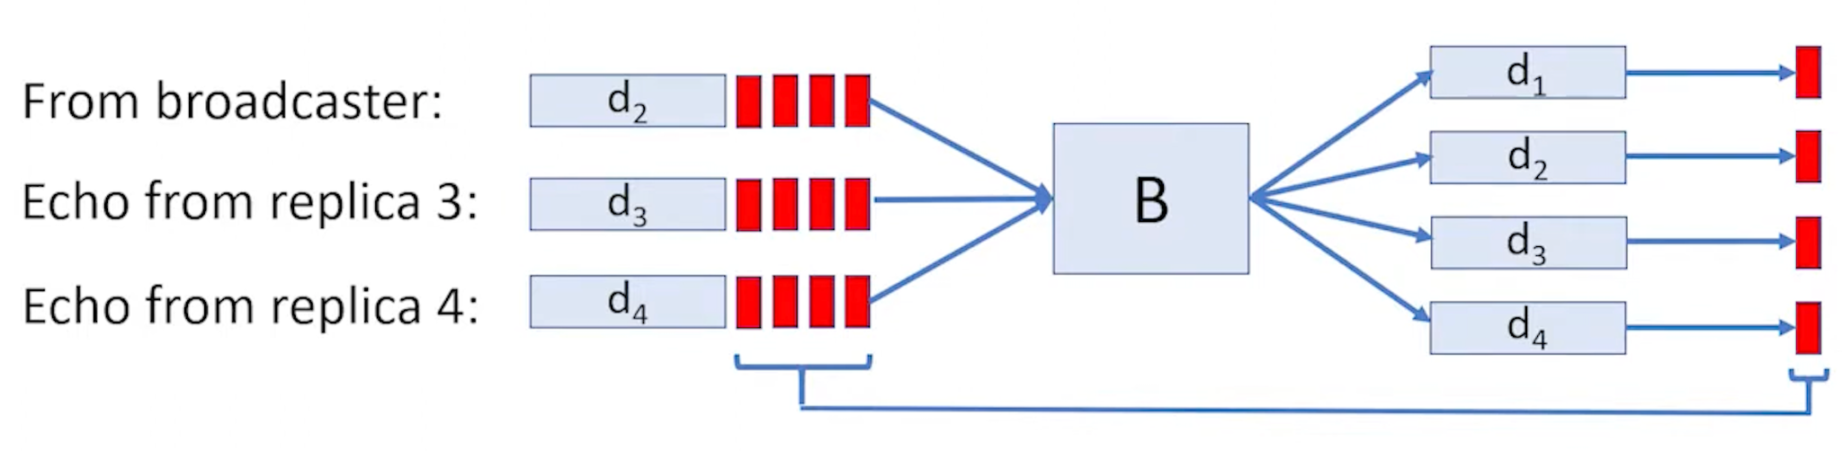
AVID (Asynchronous Verifiable Information Dispersal) protocol
During the echo phase a replica R_{i} send the fragment d_{i} and it’s cross-checksum to other replicas
Communication complexity is O(n.B), where n is the number of replicas and B is the broadcast message size
The image explains the reconstruction process for a block from different fragments
Notes:
Replica 2 receives fragment d2 and the Cross-Checksum list from the Broadcaster. When it receives echoes of d3 and d4 from peers, it hashes them and validates them against that list before accepting them.
//// It doesn't wait for all fragments; it waits until it collects f+1 valid pieces (the reconstruction threshold). Once it has enough,
So then replica 2 tries to reconstruct Block B. Finally, to verify integrity, it re-encodes Block B into all potential fragments, recalculates their hashes, and confirms they match the original Cross-Checksum list perfectly.

Slide 22
Introducing BEAT0
The Baseline Improvement: Same architecture as HBBFT, better engineering.
Crypto Upgrade: Replaces pairing-based crypto (slow) with standard Elliptic Curve (P-256). Also upgrades security.
Coin Flip: Direct Threshold Coin-Flipping (faster) instead of Threshold Signatures.
Erasure Coding: Uses C/C++ based Jerasure library (fast) instead of Python-based zfec.
Notes:
Intro: While HoneyBadger was a theoretical breakthrough, its implementation had bottlenecks. BEAT0 is essentially HoneyBadgerBFT v2.0 and is the baseline protocol of the BEAT family. It keeps the exact same architecture but swaps out the slow parts like cryptography and coding for fast.
There are two spots where the crypto encryption is done, one is before the data enters the RBC phase, it encrypts the raw batch of transactions and encrypts them using the cryptograph algorithms. Inside every single ABA box on the right side of the diagram. When the voting gets stuck (deadlock), the ABA protocol calls for a random number. The nodes execute the Coin Flip Protocol. Generated the coin by verifying Threshold Signatures (which used pairings). This meant every time the network stuttered, it had to do "Calculus." Uses the CKS Direct Coin protocol on P-256. Now, every time the network stutters, it just does "Algebra."
First: It moves the slow pairing based cryptography, which is like we do encryption by multiplying all the signatures of the senders and compress it into one tiny signature to verify it, to standard elliptic curves referred to as P-256 which is recognized by NIST and used by everyone like (Google, Amazon, Banks) and this is the standard cryptography used to secure the internet as well.
Pairing involves high software intensive operations and P-256 involves hardware intensive tasks by the modern computers have built in special circuits that makes it possible to compute it easily. It is complex but still is proven to be faster and for better security. By implementing this there is also a security update as Honeybadger was using a 80 bit security which could be cracked by supercomputers in few months whereas now it’s being shifted to 128 bit security which will take indefinite time for even supercomputers to crack and overall also made the encryption/decryption 3x faster.
Second : HoneyBadger generated randomness as a side effect of creating a cryptographic signature. This required heavy, slow math. BEAT0 uses a protocol designed specifically to generate randomness directly using fast, standard math. It cuts out the 'Signature' middleman and the slow math that came with it.
Third : It swaps the Python erasure coding library for Jerasure (C++). This allows the network to scale beyond 128 nodes which was the hard limit for Honeybadger implementation.
So these 3 changes, results in significant performance gains, stronger security, higher speed, better scalability without changing the core logic.

Slide 23
The "Labeled" Threshold Encryption
The Problem: In HBBFT, encryption was somewhat generic. An adversary might try to replay old ciphertexts or confuse the system.
The Fix: BEAT0 uses Labeled Threshold Encryption.
Every encrypted batch is tagged with a label: lb = (Epoch_Number, Node_ID).
Why? Uniqueness. A node will only accept one ciphertext for (Epoch 5, Node 3). If a malicious node tries to send a different ciphertext for the same slot, the protocol instantly rejects it. This prevents replay attacks and confusion.
Uses scheme called TDH2 (by Shoup and Gennaro) to implement this.
Notes:
Replay Attack: A malicious node could take a valid ciphertext from Epoch 1 and broadcast it again in Epoch 5. Why is this bad? If the system isn't careful, it might decrypt the old batch again, leading to duplicate transactions or wasted computation.
Malleability (CCA): In some weaker crypto schemes (CPA-secure), an attacker can take a ciphertext C and modify it slightly to create C' which decrypts to a related message. Why is this bad? An attacker could mess with the decryption process, potentially tricking nodes into revealing information or halting the consensus .
TDH2 provides Chosen Ciphertext Attack (CCA) security. This guarantees that an adversary cannot modify a ciphertext without breaking it entirely. It enforces a strict "integrity check" on the encrypted data.

Slide 24
BEAT1: Overview
BEAT1 = BEAT0 + Replacement with Bracha’s Broadcast
Focus: Reduces latency for small batches
Same security model as original BEAT
Best when workload is light or batches are small
It is still asynchronous
Notes:
BEAT1 is basically BEAT0, but with one important change — it replaces the erasure-coded broadcast with Bracha’s Broadcast.
The main goal of BEAT1 is to reduce latency, especially when the system is processing small batches of transactions.
Even with this change, the protocol still keeps the same security model, and it remains a fully asynchronous BFT system.
So overall, BEAT1 is best when the workload is light or when batches are small.
Bracha’s Broadcast is a simple reliable broadcast protocol used in Byzantine systems.
Its goal is: make sure all honest nodes receive the exact same message from a sender, even if the sender is malicious.
It works using three message steps:
SEND — The sender sends its message to everyone.
ECHO — When a node receives the message, it “echoes” it to everyone else.
READY — Once enough matching ECHOs are received, nodes send READY messages.
When enough READY messages are collected, the message is delivered.
Because everyone keeps echoing and confirming, even if some nodes lie or go silent, the honest nodes will still agree on the same message.
“Bracha’s broadcast, on the other hand, doesn’t use erasure coding at all. It just uses a simple SEND → ECHO → READY message pattern.
It has more message exchanges, but the operations are lightweight and almost no expensive cryptography is involved.”

Slide 25
Why was BEAT1 Created?
Researchers found that in HoneyBadgerBFT, when the network load is small, the erasure-coded broadcast (AVID) creates high latency.
This is because:
Erasure-coding + Dispersal + Verification Involves high CPU workload
Bracha’s Broadcast Advantages:
No erasure coding required
Fewer cryptographic operations
Lower CPU usage
Faster in practice for small batch sizes
Notes:
BEAT1 was created because researchers noticed a problem in HoneyBadgerBFT.
When the network load is small, the erasure-coded broadcast — called AVID — ends up creating high latency.
This happens because the erasure-coding process, the dispersal of coded fragments, and the verification steps all require a lot of CPU work, even when the message size is tiny.
Bracha’s Broadcast solves this because it avoids erasure coding completely.
It requires fewer cryptographic operations, uses less CPU, and is simply faster in practice for small batches.
So the motivation for BEAT1 is mainly to remove unnecessary overhead when the system is lightly loaded.

Slide 26
What BEAT1 Changes?
In Beat 0
Reliable broadcast uses erasure-coded broadcast (AVID)
Complexity: O(n)
In Beat 1
Reliable broadcast uses Bracha’s Broadcast
Complexity: O(n²)
Even though O(n²) sounds worse, in practice for small batch size:
Bracha’s Broadcast is CPU-cheap
Far fewer cryptographic operations
Removes erasure coding overhead
Notes:
BEAT1 changes only one major component: the broadcast mechanism.
In BEAT0, reliable broadcast uses erasure-coded AVID, which has a theoretical complexity of O(n), but is very heavy in real CPU cost.
In BEAT1, they switch to Bracha’s Broadcast, which has O(n²) complexity.
Even though O(n²) sounds worse on paper, it is actually much faster for small batch sizes because it avoids all the erasure coding overhead.
So in practice, Bracha’s Broadcast is CPU-cheap, it does fewer cryptographic operations, and it removes the heavy encoding and verification steps.
That’s the main reason BEAT1 performs better under light workloads.

Slide 27
BEAT2: Overview
Moves threshold encryption from replicas clients
Introduces causal ordering of transactions
Goal: Achieve the lowest latency in the BEAT family
Still fully asynchronous and BFT
Why Client-Side Encryption?
Problem in BEAT1 / BEAT0:
Replicas perform threshold encryption every epoch
Expensive cryptographic operations
Increases latency
BEAT2 Solution: Client encrypts their own transactions and replicas do much less work
Notes:
BEAT2 focuses on reducing latency even more.
Its main idea is to move threshold encryption from the replicas to the clients.
This means clients encrypt their own transactions before sending them to the system.
By doing this, replicas have far less cryptographic work to do, which dramatically speeds up the protocol.
BEAT2 also introduces causal ordering, so if one transaction depends on another, they will always be delivered in the correct order.
“In BEAT0 and BEAT1, replicas are responsible for threshold encryption every single epoch.
This is a very expensive cryptographic operation and becomes a major source of latency.
BEAT2 solves this by pushing encryption to the client side.
Clients encrypt their own transactions, and replicas only process the ciphertext.
This reduces replica workload and leads to much faster consensus.
So the main contribution here is shifting the heavy crypto away from the consensus path.”

Slide 28
BEAT2: Casual Ordering + Tradeoffs
Causal Ordering:
If T2 depends on T1 T1 is delivered first
Prevents adversarial reordering
Important for payments, trading, dependent operations
Tradeoffs:
Slightly weaker censorship resistance
May require anonymity (e.g., Tor)
Clients must handle encryption
Notes:
BEAT2 also introduces causal ordering.
This means that if a transaction T2 depends on T1, the system ensures T1 is always delivered first.
This prevents any adversary from reordering dependent operations and is especially important in payments, trading systems, and any application where order matters.
There are a few tradeoffs:
Censorship resistance becomes slightly weaker because attackers might delay messages from specific clients.
To avoid that, clients may need to use anonymous networks like Tor.
And since clients do the encryption, they handle a bit more work.
But overall, BEAT2 gives the lowest latency in the entire BEAT family.
1. Why BEAT2 is slightly weaker
“In BEAT2, encryption happens on the client side, not at the replicas.
This means replicas immediately see which client sent a ciphertext, even though they don’t know the contents inside it.
A malicious leader or corrupted replicas could selectively delay or ignore messages from certain clients.”
Use this if someone asks “Why is it weaker?”
✅ 2. What kind of censorship can happen?
“It’s not content-based censorship because the transaction is still encrypted.
The attacker cannot read the transaction.
But they can censor based on the sender identity, for example ignoring or delaying transactions from a particular client.”
Use if someone asks “What does censorship mean here?”

Slide 29
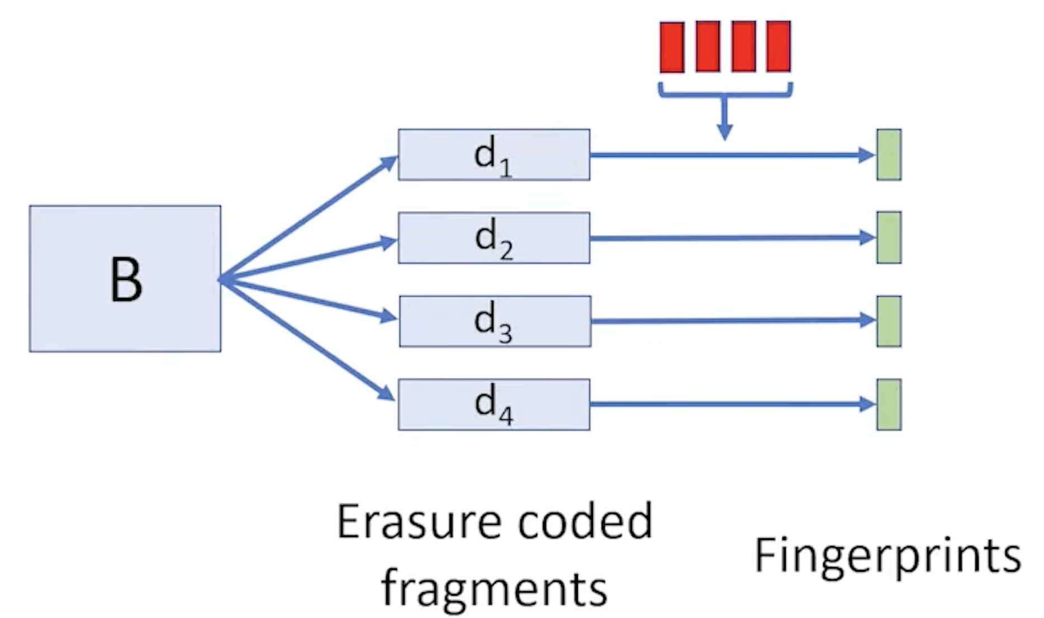
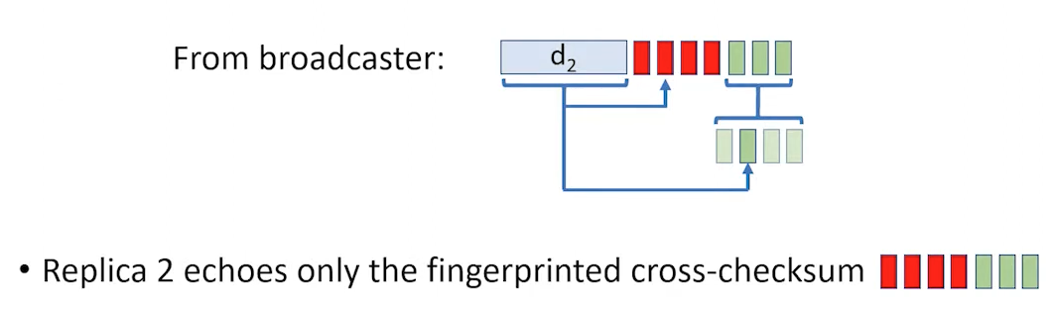
AVID-FP (Asynchronous Verifiable Information Dispersal with Fingerprinted Cross-Checksum) protocol
There is no costly echo phase of sending the fragment to every replica, a replica only echoes it’s fingerprint along with it’s cross-checksum
By using homomorphic fingerprints a specific replica can verify that the fragment belongs to the original block without needing to see or download the rest of the data.
Notes:
This entire process is required because it generates the fingerprinted cross-checksum—the small piece of metadata that allows each receiving server to independently verify its fragment is consistent with the whole original block without having to download or reconstruct the data. This local verification capability is the foundation of BEAT3's O(B) bandwidth efficiency.
fragment belongs with the original block

Slide 30
AVID-FP (Asynchronous Verifiable Information Dispersal with Fingerprinted Cross-Checksum) protocol
The (n, m) AVID-FP is defined by the constraints: n = m + 2f and m ≥ f + 1, where total number of replicas is n, the reconstruction threshold is m and f is the number of Byzantine Faults
Communication complexity is O(B) where B is the broadcast message size
Notes:
$n$ (Total Servers): The total number of server replicas participating in the dispersal protocol.
$m$ (Reconstruction Threshold): The minimum number of fragments needed to successfully reconstruct the original data block.
$f$ (Byzantine Faults): The maximum number of servers that are assumed to be faulty or malicious.
Communication complexity is a fundamental metric used in distributed systems and algorithms to measure the total amount of information (bits) that must be exchanged among parties to successfully complete a protocol or task.
It quantifies the overhead of communication required for a distributed system to achieve its goals, such as consensus or data dispersal.

Slide 31
BEAT 3
Asynchronous BFT storage system
Bandwidth, throughput, and scalability optimized.
BEAT 3 uses bandwidth-efficient AVID-FP
AVID-FP sends the broadcast message only once.
Bandwidth required is O(B) compared to HoneyBadgerBFT’s implementation which has bandwidth of O(n.B), where n is the number of replicas and B is the broadcast message size
Notes:
Bandwidth-efficient describes any protocol, algorithm, or system designed to minimize the total volume of data transmitted across a network to complete a given task, thereby maximizing the utilization of the available network capacity (bandwidth).
In essence, it focuses on achieving the maximum amount of useful work for the fewest number of bits exchanged.

Slide 32
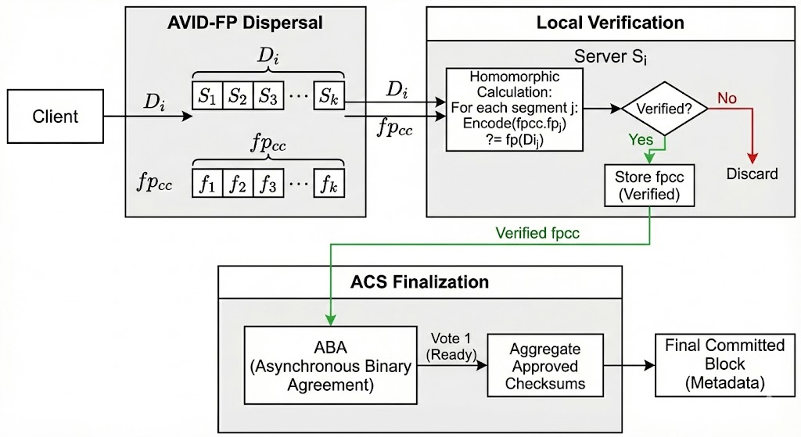
Steps involved in BEAT 3 are:
Notes:
AVID-FP dispersal: The client uses Erasure Coding to divide the large batch B into N small fragments (d₁, d₂, d₃ ….. d_{n})
Local verification: When a server receives its fragment d_{i}, it performs a mathematical calculation using the Homomorphic Fingerprints
ACS Finalization: ACS manages parallel ABA instances to vote on the availability of each node's checksum, then aggregates the approved metadata to form the final committed block.
That is a clear and accurate summary of the three core stages of the BEAT3 protocol's execution logic, demonstrating how it achieves consensus¹.
Here is an explanation of what each stage contributes to the overall BFT system:
The Three Stages of the BEAT3 Protocol
1. AVID-FP Dispersal (The Network Efficiency Phase)
This stage ensures the system minimizes bandwidth costs and efficiently distributes data fragments²².
Mechanism: The client (proposer) applies Erasure Coding to the large transaction batch ($B$) to create $N$ small, redundant fragments ($d_1, d_2, \dots d_n$)³.
Efficiency: The client sends only one unique fragment ($d_i$) and the full Fingerprinted Cross-Checksum (fpcc) metadata package to each server⁴.
Goal: The data moves across the network exactly once, achieving $O(B)$ bandwidth complexity⁵.
2. Local Verification (The Mathematical Trust Phase)
This is the critical step that replaces the wasteful network echo found in older protocols, establishing immediate trust in the received fragment⁶.
Mechanism: The server uses the Homomorphic Fingerprints contained within the fpcc to perform a local mathematical check on its fragment ($d_i$)⁷.
Goal: The server confirms two things: 1) The fragment is uncorrupted, and 2) It is a mathematically valid piece of the original global block⁸.
Result: The server verifies consistency without needing to download any data from its neighboring replicas⁹.
3. ACS Finalization (The Consensus Phase)
This stage uses the verified metadata (the checksums) to achieve total order and finalize the block commitment¹⁰.
Mechanism: The ACS (Asynchronous Common Subset) framework manages $N$ parallel instances of ABA (Asynchronous Binary Agreement)¹¹. Each ABA instance votes (0 or 1) on whether a specific node's checksum was successfully dispersed and locally verified¹².
Aggregation: ACS collects all the checksums that received a "Yes" vote, and that approved metadata list becomes the final committed block for the epoch¹³.
Result: The network successfully agrees on a consistent, totally ordered sequence of transactions using only minimal metadata exchange¹⁴.

Slide 33
BEAT4: Flexible Read Capability
The Library Analogy:
Imagine needing a single chapter from a book.
Traditional BFT:
You must checkout the entire library shelf (download the full block) to verify the one chapter.
BEAT-4 (Pyramid Codes):
You can check out just the specific chapter you need. It reduces access overhead by 50% with only ~10% additional storage overhead.
BEAT4 solves this by making partial reads much more bandwidth-efficient.
Notes:
Optimized bandwidth for read operation:
In many blockchain systems, when a client needs only a small part of a large block -say one transaction or the first few lines of a contract - they are still forced to download the entire block.
This reduces read bandwidth by nearly 50%, while increasing storage by just around 10%.

Slide 34
How Does BEAT4 Work?
Pyramid Codes:
Like classic erasure coding, but arranged so fragments are grouped and each group gets its own local redundancy. This means small parts can be reconstructed using only group members, not the whole set.
Fingerprinted Cross-Checksums:
Every fragment comes with cryptographic proofs ensuring the client knows its fragment is authentic and fits the original block, even if some servers are malicious.
AVID-FP-Pyramid Protocol:
A process for distributing, validating, and retrieving fragments, specifically built to work with pyramid codes and reduce read bandwidth for partial access.
Notes:
pyramid codes – which are like traditional erasure codes but structured into groups that each have their own small, cheap-to-use redundancy.
Fingerprinted Cross-Checksums:
This ensures each fragment is verifiable—so even if some servers are malicious, the client can still trust the fragment’s correctness.
AVID-FP-Pyramid, which handles how data is encoded, distributed, verified, and later retrieved.

Slide 35
Pyramid Codes - steps
1. Start with an (n, m) systematic MDS code
m = 6 data fragments {d1, d2, d3, d4, d5, d6}
n = 9 coded fragments {d1, d2, d3, d4, d5, d6, d7, d8, d9}
So, there are Δ = n − m = 3 redundant fragments → d7, d8, d9
MDS property: any 6 of these 9 fragments can recover the original data.
2. Divide the m data fragments into L groups
L = 2
So each group has m/L = 3 data fragments:
Group S₁ → d1, d2, d3
Group S₂ → d4, d5, d6
3. Keep some redundant fragments as GLOBAL
Let’s take d8 and d9 as global redundant fragments.
Notes:
MDS guarantees something important: any 6 fragments can recover the original data.

Slide 36
Pyramid Codes - steps
4. Create LOCAL redundant fragments for each group
Remaining redundant budget:
Δ₀ = Δ − Δ₁
Δ = 3, Δ₁ = 2 → Δ₀ = 1 local redundant fragment per group.
Build a local redundant fragment:
Take the original MDS redundant fragment (say d7) and zero out coding coefficients not in the group.
For group S₁ (d1, d2, d3):
d7–1 = b71·d1 + b72·d2 + b73·d3
For group S₂ (d4, d5, d6):
d7–2 = b74·d4 + b75·d5 + b76·d6
d7–1 + d7–2 = original fragment d7
Notes:
We still have one redundant fragment left: d7.
We split d7 into two local versions—one per group.
To do that, we zero out all coefficients that don’t belong to the group.
So pyramid codes preserve linearity while enabling local repair.

Slide 37
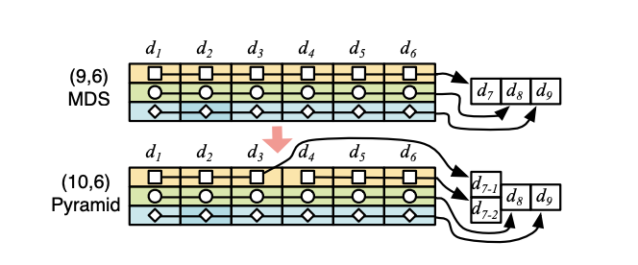
Pyramid Codes - steps
5. Now your pyramid code looks like this
Data fragments (m):
d1, d2, d3, d4, d5, d6
Local redundant fragments (Δ₀ per group):
Group 1: d7–1
Group 2: d7–2
Global redundant fragments (Δ₁):
d8
d9
Total fragments:
n' = m + Δ₀ L + Δ₁
n' = 6 + (1×2) + 2 = 10
Recovery:
To recover d1 (lost):
Check group S₁
Need only: d2 + d3 + d7–1
If multiple fragments in S₁ are lost:
Compute d7 using d7–1 + d7–2
Use global MDS decoding
Fig: A basic (10,6) pyramid code from a (9,6) MDS code
Notes:
This is where the 50% bandwidth savings comes from.
If more fragments are lost inside the group, we fall back to global decoding, but that’s rare.
Known fragments:
d3 (survived)
d4, d5, d6 (other group)
d8, d9 (global redundancy)
d7 (reconstructed)
That’s 6 valid fragments, which is enough to decode the original (9,6) MDS code.
So with these:
—We run the standard Reed–Solomon MDS decoding to recover d1 and d2.

Slide 38
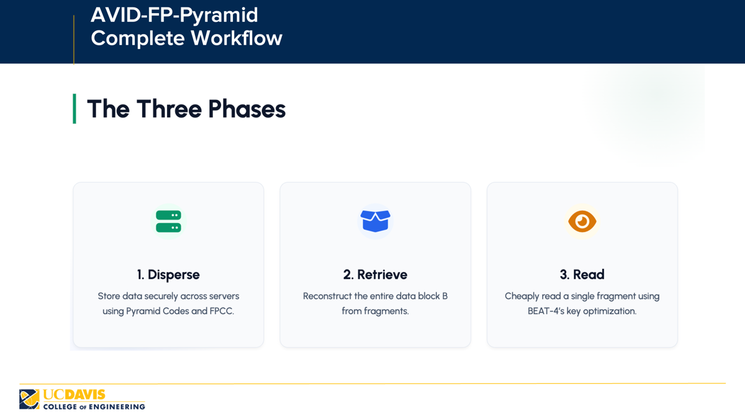
Notes:
Disperse — store the encoded fragments across servers.
Retrieve — reconstruct the full block when needed.
Read — efficiently read just a single fragment, which is BEAT-4’s main optimization.

Slide 39
AVID-FP-Pyramid Complete Workflow
Phase 1: Disperse (Encode & Build)
Step 1- Encode
The client applies an (n, m) pyramid erasure code to the block.
Produces n total fragments.
m data fragments.
Δ₀ L local redundant fragments.
Δ₁ global redundant fragments.
Step 2 - Build FPCC
Fingerprinted Cross-Checksum consists of 2 arrays:
fpcc. cc [] : Hash of every fragment.
fpcc. fp[] : Fingerprints of original m fragments.

Slide 40
AVID-FP-Pyramid Complete Workflow
Step 3 - Send Fragments
Client sends fragment dᵢ and the same FPCC to each server i.
Step 4 - Server Verification
Server checks Hash Match: fpcc.cc[i] = h(dᵢ)
Server checks Fingerprint Match: fingerprint(r, dᵢ) == encode(fpcc.fp)
where r = H(fpcc.cc[1], …, fpcc.cc[n]) is a random key
Step 5 - Echo & Ready
Servers exchange echoes. After 2f + 1 readies, the fragment is dispersed. FPCC ensures no Byzantine server can cheat.
Notes:
This FPCC contains:
Hashes of all fragments,
Fingerprints of the m original data fragments.
The client will send each server: its own fragment and the entire FPCC.
After verification, servers exchange ‘echo’ and ‘ready’ messages among themselves.
Once they see 2f + 1 matching ‘ready’ messages, the fragment is officially considered dispersed.

Slide 41
AVID-FP-Pyramid Complete Workflow
Phase 2: Retrieve
Client wants the entire data block B
Step 1- Collect FPCC
Wait for f+1 matching FPCCs to ensure you are reconstructing the correct block.
Step 2- Collect Fragments
Gather m + Δ₀(L-1) consistent fragments. This is the threshold for full pyramid-code reconstruction.
Step 3 - Decode
Use pyramid decoding to return complete block B. This works even if f servers are byzantine.
Notes:
First, it collects FPCC from f+1 servers to ensure consistency.
Next, it collects m + д₀(L − 1) consistent fragments — this is the number needed for full reconstruction under pyramid codes.
Finally, it runs the pyramid decoding algorithm to get back the entire block.
Even if up to f servers are malicious, retrieval is guaranteed to succeed.

Slide 42
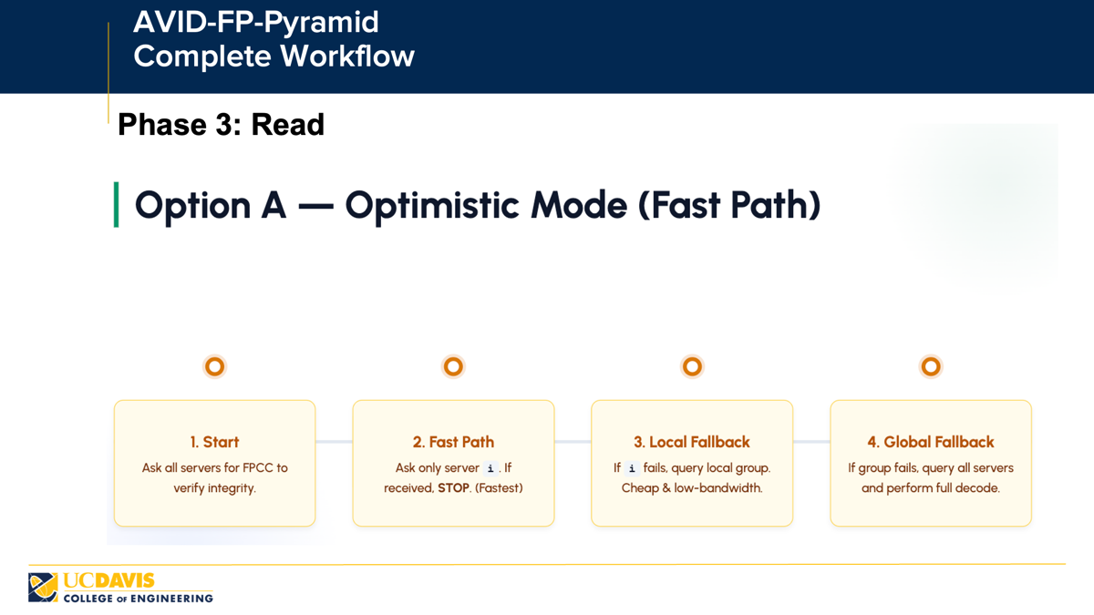
Notes:
In Optimistic Mode, the client wants just one fragment.
First, it gets FPCC from all servers. This is small and cheap.
Only if the entire group is corrupted do we fall back to a full global decode.
This layered fallback strategy makes reads extremely efficient.

Slide 43

AVID-FP-Pyramid Complete Workflow
Phase 3: Read
Predictable Performance
In this mode, the client skips trying server i individually.
Strategy:
Ask the entire local group directly.
Benefits:
Predictable bandwidth usage.
Stil 50% cheaper than full MDS decoding.
Notes:
Instead of trying server i first, the client skips directly to the entire local group.
Even then, reading from the local group is still about 50% cheaper than reading using a full MDS code.
So Optimistic Mode is best for speed, while Balanced Mode is best for predictable bandwidth usage.

Slide 44
Evaluation
Amazon EC2
Up to 92 nodes from ten different regions in different continents
Evaluate the protocols under different network sizes (number of replicas) and contention levels (batch sizes)
Vary the batch size where nodes propose 1 to 20,000 transactions at a time
“LAN tests”: nodes are selected from the same Amazon EC2 region
“WAN tests”: nodes are uniformly selected from different regions

Slide 45
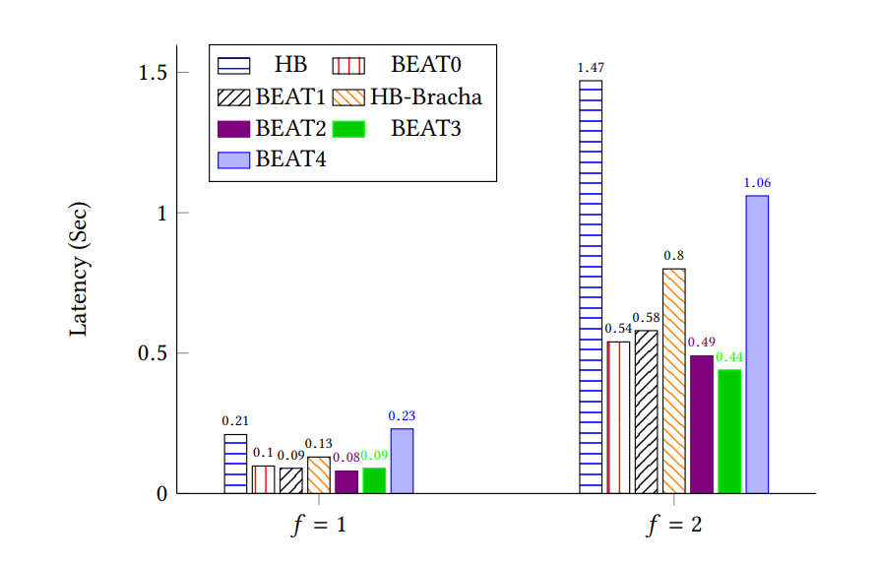
Latency in LAN Settings

Slide 46
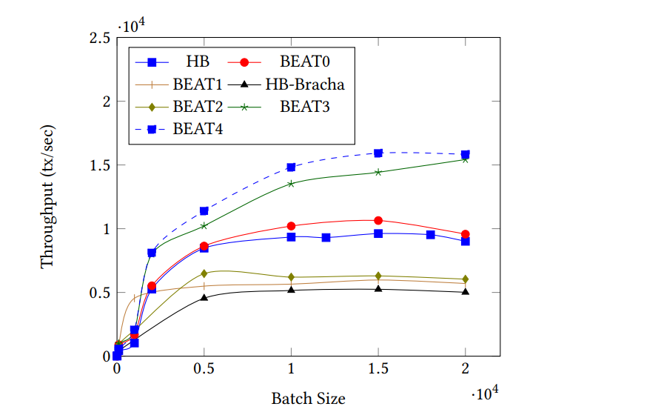
Throughput in LAN Setting ( f = 1 )

Slide 47
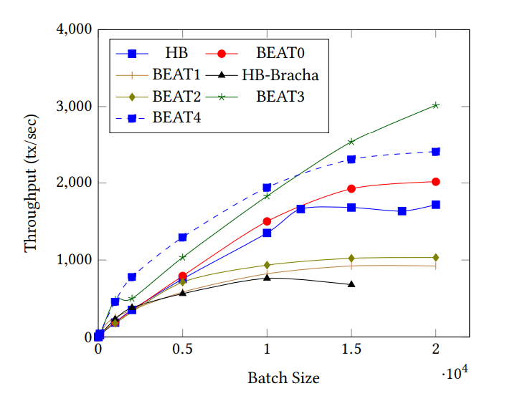
Throughput in WAN Setting ( f = 1 )

Slide 48
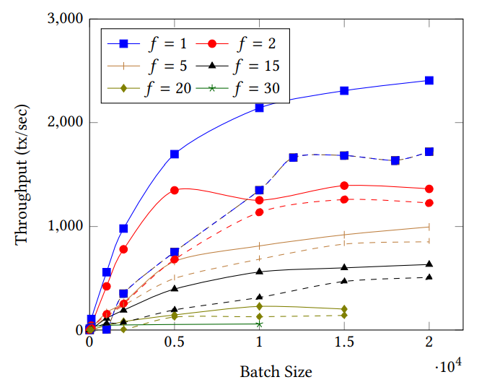
Scalability: BEAT3 vs. HoneyBadgerBFT
Solid lines: BEAT3
Dashed lines: HB

Slide 49
What and why does the client encrypt in BEAT 2?
BEAT2 is the privacy-preserving, censorship-resistant variant of BEAT.
The replicas should not see the contents of the client’s request until it is safely committed.
The client encrypts the whole request with a symmetric key K, and then encrypts K using threshold public key encryption.
  This results in an opaque blob that replicas cannot read until commitment.
Notes:
This prevents censorship and malicious reordering based on request content.
This includes:
Operation payload (e.g., “transfer A→B”)
Metadata the replicas will eventually need
All application-level data

Slide 50
How does the client encrypt it?
Layer 1 (Symmetric encryption):
Generates a random symmetric key K
Encrypts the request payload
Layer 2 — Threshold Encryption (Client + Replicas)
Gets the threshold public key pk_T (system-wide)
Encrypts the symmetric key:
Notes:
This prevents censorship and malicious reordering based on request content.
This includes:
Operation payload (e.g., “transfer A→B”)
Metadata the replicas will eventually need
All application-level data

Slide 51
How does the Decryption happen?
BEAT2 uses threshold decryption (t+1-of-n):
Each replica holds one share of the private key
No single replica can decrypt the request alone
After consensus commits the request, replicas produce partial decryptions
These partial decryptions are combined to recover the symmetric key K
Then replicas can decrypt the actual payload
Notes:
This prevents censorship and malicious reordering based on request content.
This includes:
Operation payload (e.g., “transfer A→B”)
Metadata the replicas will eventually need
All application-level data

