Slide 1
HotStuff-1: Linear Consensus with One-Phase Speculation
Authors: Dakai Kang, Suyash Gupta, Dahlia Malkhi, Mohammad Sadoghi
Presenters: Regan Yang, Tiching Kao, Yoshiki Yamaguchi, Steven Shoemaker

Slide 2
Table of Contents
Introduction
Speculative Execution
Streamlined Speculative Execution
Slotting
Reference

Slide 3
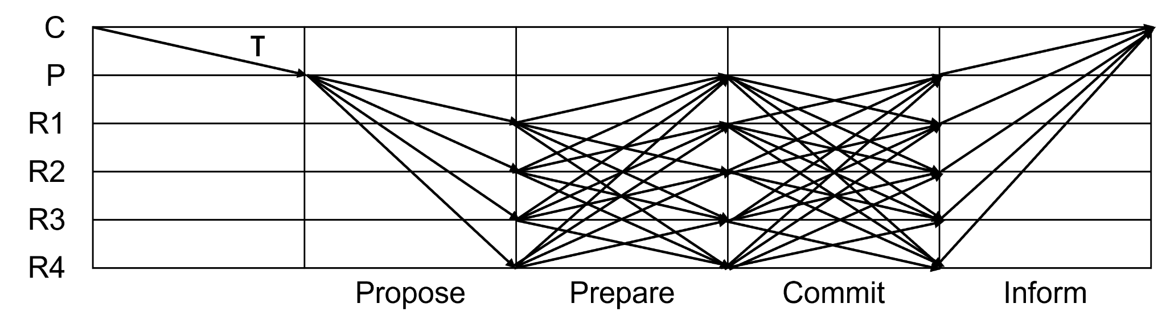
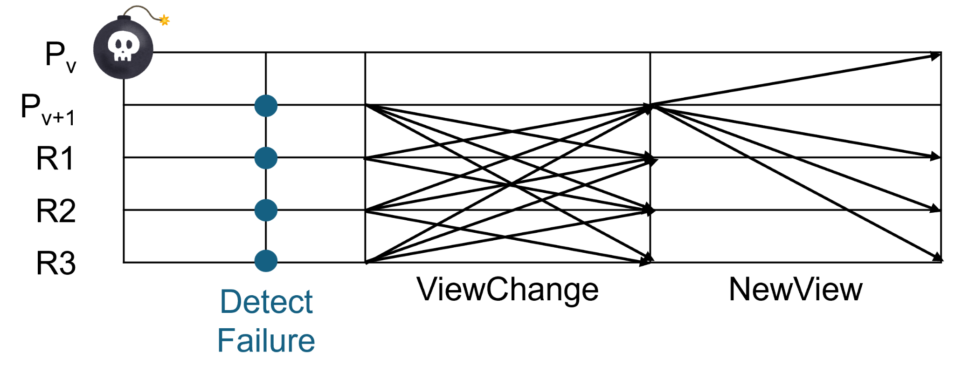
Introduction: Problems of PBFT [1]
High latency due to 3-Phase Consensus
  Propose phase + Prepare phase + Commit phase ⇒ 3Δ
High communication cost among replicas
Expensive View Change
No pipelining
O(n^2)
O(n^2)
Expensive!! ⇒ O(n^2)
[1] Maofan Yin, Dahlia Malkhi, Michael K. Reiter, Guy Golan Gueta, and Ittai Abraham. 2019. HotStuff: BFT Consensus with Linearity and Responsiveness. In Proceedings of the 2019 ACM Symposium on Principles of Distributed Computing (PODC '19). Association for Computing Machinery, New York, NY, USA, 347–356. https://doi.org/10.1145/3293611.3331591
Notes:
In both prepare and commit, every replica talks to all others → O(n²) communication.
During a view change, the new leader must collect logs from 2f+1 replicas and forward them — that’s expensive.
PBFT also has no pipelining — it can process only one block at a time.

Slide 4
Introduction: HotStuff [2]
Linear communication BFT
Uses Quorum Certificate (QC) to prove safety
3.5-phase design (Prepare, Pre-commit, Commit, and Decide)
Responsive view change using QC instead of full logs
[2] Maofan Yin, Dahlia Malkhi, Michael K. Reiter, Guy Golan Gueta, and Ittai Abraham. 2019. HotStuff: BFT Consensus with Linearity and Responsiveness. In Proceedings of the 2019 ACM Symposium on Principles of Distributed Computing (PODC '19). Association for Computing Machinery, New York, NY, USA, 347–356. https://doi.org/10.1145/3293611.3331591
Notes:
HotStuff improves scalability while keeping the same fault tolerance — up to f faults among 3f + 1 replicas.
The key idea is the Quorum Certificate, or QC. A QC proves that 2f + 1 replicas voted for a block.
Each block includes the QC of its parent, forming a chain of proofs.
Step 1: The leader proposes cmd₁, collects 2f+1 votes, and forms a QC → prepare is done.

Slide 5
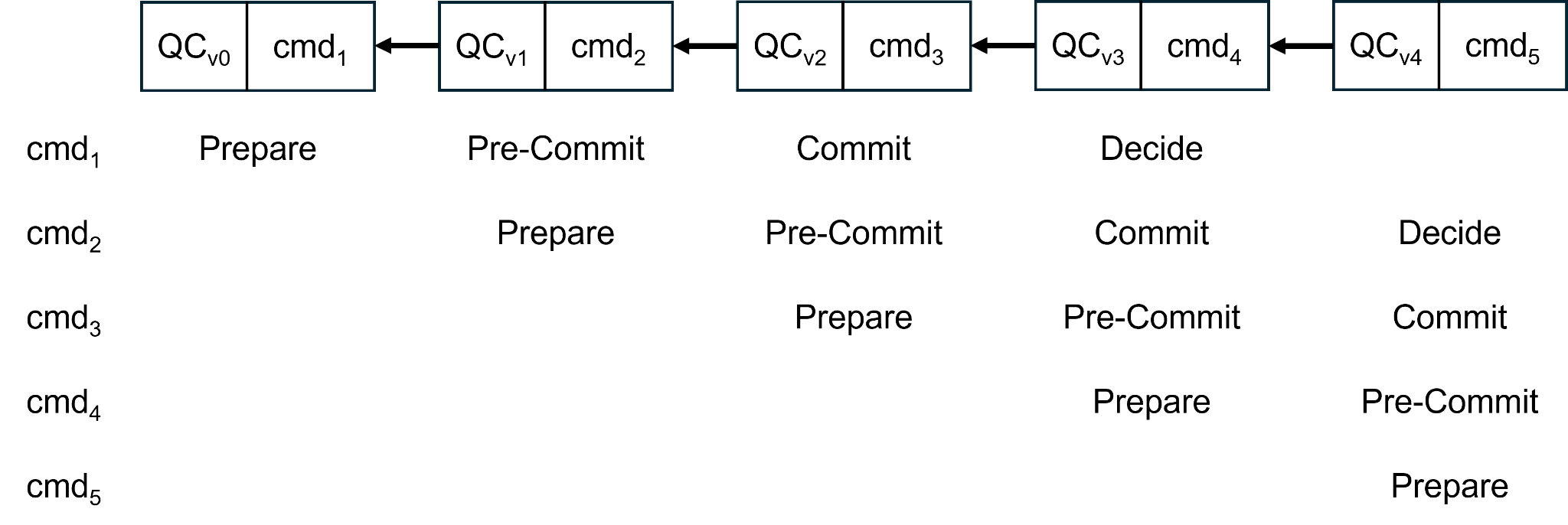
Introduction: HotStuff [2]
Linear communication BFT
Uses Quorum Certificate (QC) to prove safety
3.5-phase design (Prepare, Pre-commit, Commit, and Decide)
Responsive view change using QC instead of full logs
[2] Maofan Yin, Dahlia Malkhi, Michael K. Reiter, Guy Golan Gueta, and Ittai Abraham. 2019. HotStuff: BFT Consensus with Linearity and Responsiveness. In Proceedings of the 2019 ACM Symposium on Principles of Distributed Computing (PODC '19). Association for Computing Machinery, New York, NY, USA, 347–356. https://doi.org/10.1145/3293611.3331591
Notes:
Step 2: The next leader proposes cmd₂, extending cmd₁.
The QC confirms cmd₁ was safely prepared.

Slide 6
Introduction: HotStuff [2]
Linear communication BFT
Uses Quorum Certificate (QC) to prove safety
3.5-phase design (Prepare, Pre-commit, Commit, and Decide)
Responsive view change using QC instead of full logs
[2] Maofan Yin, Dahlia Malkhi, Michael K. Reiter, Guy Golan Gueta, and Ittai Abraham. 2019. HotStuff: BFT Consensus with Linearity and Responsiveness. In Proceedings of the 2019 ACM Symposium on Principles of Distributed Computing (PODC '19). Association for Computing Machinery, New York, NY, USA, 347–356. https://doi.org/10.1145/3293611.3331591
Notes:
So this round acts as pre-commit for cmd₁ and prepare for cmd₂.

Slide 7
Introduction: HotStuff [2]
Linear communication BFT
Uses Quorum Certificate (QC) to prove safety
3.5-phase design (Prepare, Pre-commit, Commit, and Decide)
Responsive view change using QC instead of full logs
[2] Maofan Yin, Dahlia Malkhi, Michael K. Reiter, Guy Golan Gueta, and Ittai Abraham. 2019. HotStuff: BFT Consensus with Linearity and Responsiveness. In Proceedings of the 2019 ACM Symposium on Principles of Distributed Computing (PODC '19). Association for Computing Machinery, New York, NY, USA, 347–356. https://doi.org/10.1145/3293611.3331591
Notes:
Step 3: Then, cmd₃ extends cmd₂.
Votes for cmd₃ form a new QC — this becomes the commit certificate for cmd₁.

Slide 8
Introduction: HotStuff [2]
Linear communication BFT
Uses Quorum Certificate (QC) to prove safety
3.5-phase design (Prepare, Pre-commit, Commit, and Decide)
Responsive view change using QC instead of full logs
[2] Maofan Yin, Dahlia Malkhi, Michael K. Reiter, Guy Golan Gueta, and Ittai Abraham. 2019. HotStuff: BFT Consensus with Linearity and Responsiveness. In Proceedings of the 2019 ACM Symposium on Principles of Distributed Computing (PODC '19). Association for Computing Machinery, New York, NY, USA, 347–356. https://doi.org/10.1145/3293611.3331591
Notes:
Now cmd₁ has three consecutive QCs — prepare, pre-commit, commit — satisfying the 3-chain rule.

Slide 9
Introduction: HotStuff [2]
Linear communication BFT
Uses Quorum Certificate (QC) to prove safety
3.5-phase design (Prepare, Pre-commit, Commit, and Decide)
Responsive view change using QC instead of full logs
[2] Maofan Yin, Dahlia Malkhi, Michael K. Reiter, Guy Golan Gueta, and Ittai Abraham. 2019. HotStuff: BFT Consensus with Linearity and Responsiveness. In Proceedings of the 2019 ACM Symposium on Principles of Distributed Computing (PODC '19). Association for Computing Machinery, New York, NY, USA, 347–356. https://doi.org/10.1145/3293611.3331591

Slide 10
Introduction: HotStuff [2]
Linear communication BFT
Uses Quorum Certificate (QC) to prove safety
3.5-phase design (Prepare, Pre-commit, Commit, and Decide)
Responsive view change using QC instead of full logs
[2] Maofan Yin, Dahlia Malkhi, Michael K. Reiter, Guy Golan Gueta, and Ittai Abraham. 2019. HotStuff: BFT Consensus with Linearity and Responsiveness. In Proceedings of the 2019 ACM Symposium on Principles of Distributed Computing (PODC '19). Association for Computing Machinery, New York, NY, USA, 347–356. https://doi.org/10.1145/3293611.3331591
Notes:
Step 4: When cmd₄ is proposed, the leader sends a decide message with the commitQC of cmd₁.
Replicas that receive it mark cmd₁ as committed and execute its transactions.

Slide 11
Introduction: HotStuff [2]
Linear communication BFT
Uses Quorum Certificate (QC) to prove safety
3.5-phase design (Prepare, Pre-commit, Commit, and Decide)
Responsive view change using QC instead of full logs
[2] Maofan Yin, Dahlia Malkhi, Michael K. Reiter, Guy Golan Gueta, and Ittai Abraham. 2019. HotStuff: BFT Consensus with Linearity and Responsiveness. In Proceedings of the 2019 ACM Symposium on Principles of Distributed Computing (PODC '19). Association for Computing Machinery, New York, NY, USA, 347–356. https://doi.org/10.1145/3293611.3331591

Slide 12
Introduction: HotStuff [2]
Linear communication BFT
Uses Quorum Certificate (QC) to prove safety
3.5-phase design (Prepare, Pre-commit, Commit, and Decide)
Responsive view change using QC instead of full logs
[2] Maofan Yin, Dahlia Malkhi, Michael K. Reiter, Guy Golan Gueta, and Ittai Abraham. 2019. HotStuff: BFT Consensus with Linearity and Responsiveness. In Proceedings of the 2019 ACM Symposium on Principles of Distributed Computing (PODC '19). Association for Computing Machinery, New York, NY, USA, 347–356. https://doi.org/10.1145/3293611.3331591

Slide 13
Introduction: HotStuff [2]
Linear communication BFT
Uses Quorum Certificate (QC) to prove safety
3.5-phase design (Prepare, Pre-commit, Commit, and Decide)
Responsive view change using QC instead of full logs
[2] Maofan Yin, Dahlia Malkhi, Michael K. Reiter, Guy Golan Gueta, and Ittai Abraham. 2019. HotStuff: BFT Consensus with Linearity and Responsiveness. In Proceedings of the 2019 ACM Symposium on Principles of Distributed Computing (PODC '19). Association for Computing Machinery, New York, NY, USA, 347–356. https://doi.org/10.1145/3293611.3331591

Slide 14
Introduction: HotStuff [2]
Linear communication BFT
Uses Quorum Certificate (QC) to prove safety
3.5-phase design (Prepare, Pre-commit, Commit, and Decide)
Responsive view change using QC instead of full logs
[2] Maofan Yin, Dahlia Malkhi, Michael K. Reiter, Guy Golan Gueta, and Ittai Abraham. 2019. HotStuff: BFT Consensus with Linearity and Responsiveness. In Proceedings of the 2019 ACM Symposium on Principles of Distributed Computing (PODC '19). Association for Computing Machinery, New York, NY, USA, 347–356. https://doi.org/10.1145/3293611.3331591
Notes:
HotStuff overlaps multiple phases — while cmd₁ is being decided, cmd₂ is in commit, cmd₃ in pre-commit, and cmd₄ in prepare.
➡ This keeps the pipeline, enabling continuous progress.

Slide 15
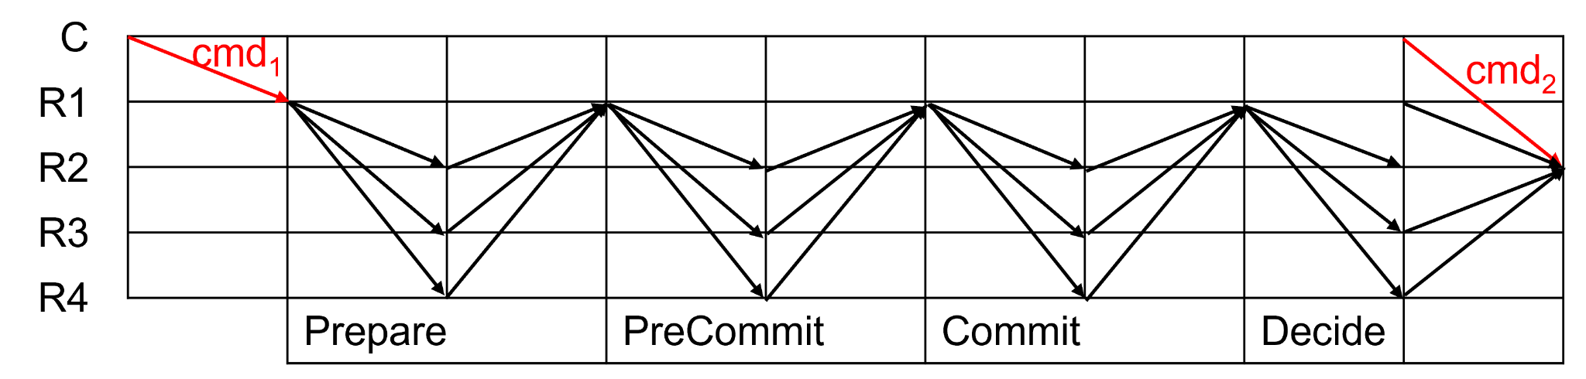
Introduction: Problems of HotStuff [3]
High latency due to 3.5-Phase Consensus
  4 broadcast steps + 3 voting steps ⇒ 7Δ (PBFT ⇒ 3Δ)
Leader Slowness
Tail-forking between leaders
[3] Dakai Kang, Suyash Gupta, Dahlia Malkhi, and Mohammad Sadoghi. 2025. HotStuff-1: Linear Consensus with One-Phase Speculation. Proc. ACM Manag. Data 3, 3, Article 171 (June 2025), 29 pages. https://doi.org/10.1145/3725308
Notes:
To commit one block, HotStuff needs four broadcasts and three voting rounds — about 7Δ total.
The decide phase doesn’t need voting, so it’s half a round.
➡ In total, 3.5 phases = 7Δ of latency.

Slide 16
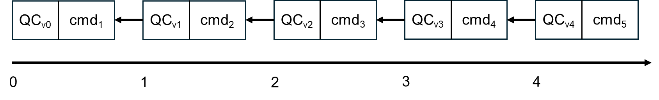
Introduction: Problems of HotStuff [3]
High latency due to 3.5-Phase Consensus
  4 broadcast steps + 3 voting steps ⇒ 7Δ (PBFT ⇒ 3Δ)
Leader Slowness
Tail-forking between leaders
Timer Length: 3 second
Average View Duration for Honest Leaders: 1s
All leaders are
well-behaving
1 txn/s
Leader of cmd2 is slow
0.6 txn/s
[3] Dakai Kang, Suyash Gupta, Dahlia Malkhi, and Mohammad Sadoghi. 2025. HotStuff-1: Linear Consensus with One-Phase Speculation. Proc. ACM Manag. Data 3, 3, Article 171 (June 2025), 29 pages. https://doi.org/10.1145/3725308
Notes:
Each view has one leader who decides when to propose the next block.
Normally, the leader proposes immediately after collecting 2f+1 votes.
But a selfish leader may delay proposing until right before timeout, to maximize profit.
While waiting, all other replicas are idle, and the system makes no progress.
Throughput drops from 1 tx/sec to about 0.6 tx/sec.

Slide 17
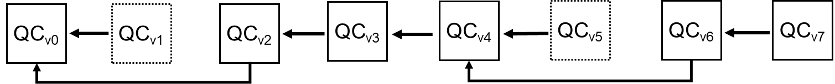
Introduction: Problems of HotStuff [3]
High latency due to 3.5-Phase Consensus
  4 broadcast steps + 3 voting steps ⇒ 7Δ (PBFT ⇒ 3Δ)
Leader Slowness
Tail-forking between leaders
Number of Replica: 4
All leaders are well-behaving
1 txn/s
R3 is Byzantine: cmds from R2 are intentionally ignored by R3
0.75 txn/s
[3] Dakai Kang, Suyash Gupta, Dahlia Malkhi, and Mohammad Sadoghi. 2025. HotStuff-1: Linear Consensus with One-Phase Speculation. Proc. ACM Manag. Data 3, 3, Article 171 (June 2025), 29 pages. https://doi.org/10.1145/3725308
Notes:
A block commits only if three consecutive QCs are chained — the 3-chain rule.
Tail-forking = R3 “pretends” to continue R2’s work.
R3 ignores R2’s block, uses old QC (from R1).
Looks like a valid 3-chain → but it’s fake.
➡ Tail-forking hurts liveness, increasing latency and reducing throughput.

Slide 18
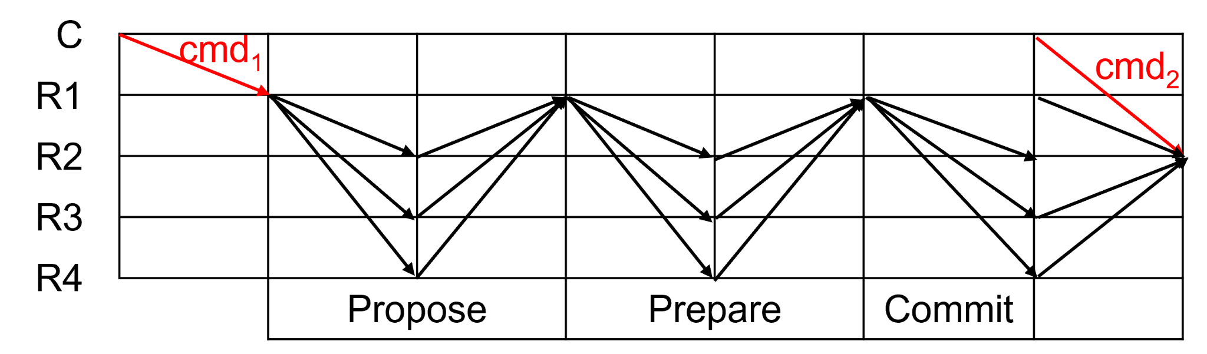
Introduction: HotStuff-2 [4]
Reduces HotStuff’s 3.5 phases ⇒ 2.5 phases
  Removes Pre-commit
Preserves safety and responsiveness
  Same guarantees as HotStuff despite fewer phases
Focuses on phase reduction ⇒ other limitations remain
  3 broadcast steps + 2 voting steps ⇒ 5Δ (HotStuff ⇒ 7Δ, PBFT ⇒ 3Δ)
[4] Dahlia Malkhi and Kartik Nayak. 2023. Hotstuff-2: Optimal two-phase responsive bft. Cryptology ePrint Archive (2023).
Notes:
HotStuff-2 focuses mainly on phase reduction, keeping the same safety and responsiveness.
➡ Problems like leader slowness and tail-forking remain unsolved.

Slide 19
Basic HotStuff-1
Overview
  Maintains linear communication (O(n)) and safety
  Reduces phases from 2.5 to 1.5 via speculation
    2 broadcast steps + 1 voting step ⇒ 3Δ (HotStuff-2 ⇒ 5Δ, HotStuff ⇒ 7Δ, PBFT ⇒ 3Δ)
  Resolves high latency using speculation

Slide 20
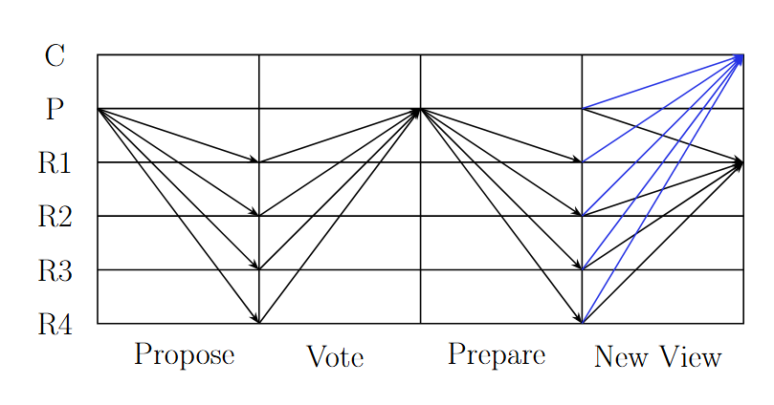
Basic HotStuff-1

Slide 21
Note on Prepare Certificates
Prepare certificates are created using threshold shares made from previous certificates.
2f+1 shares
P(5)
B5, P(4)
P(5) extends P(4)
Executing B5 means executing all previous blocks

Slide 22
Speculative Execution
Replica Perspective:
I received a new prepare certificate
Let’s execute the transaction and tell the client.
How can this be safe?

Slide 23
Safe Speculative Execution
Clients need 2f+1 responses
  Client observes commit phase
  2f+1 = client knows f+1 non-faulty prepares
Prefix Speculation Rule: Preceding blocks have been committed
No Gap Rule: Only execute blocks prepared in the same view

Slide 24
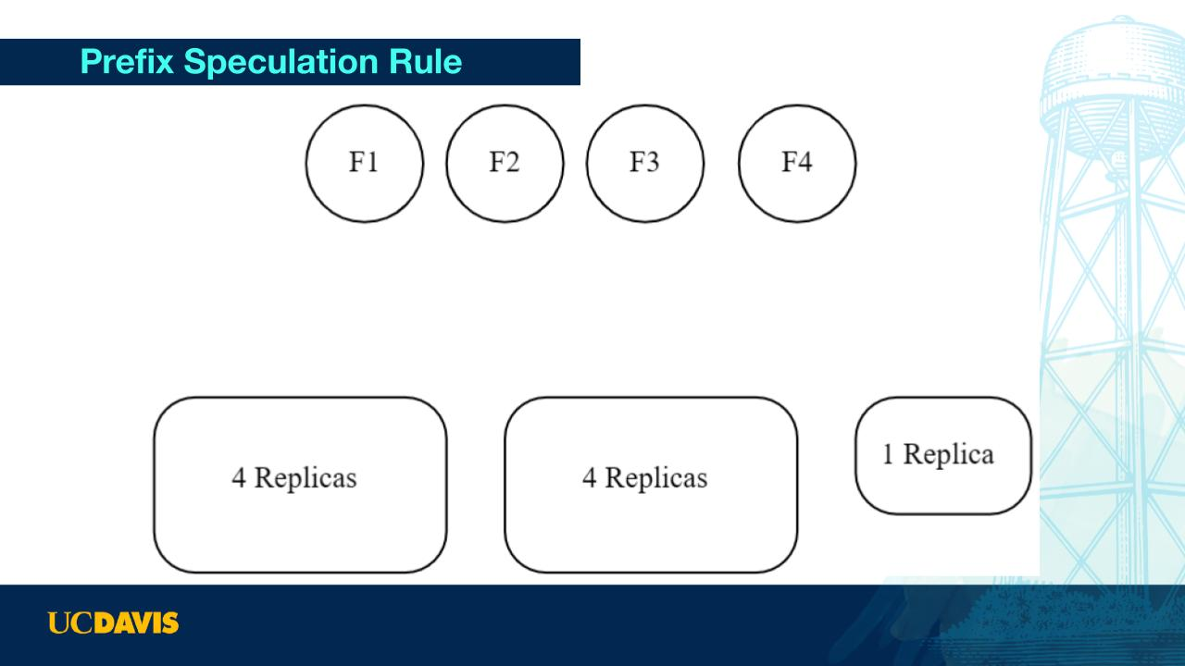
Propose1
B1

Slide 25
Vote1
Share(1)
Share(1)
Share(1)

Slide 26
Prepare1
P(1)
P(1)

Slide 27
Speculate1
Client received:
B1: 8
P(1)

Slide 28
Propose2
B2
Client received:
B1: 8
P(1)

Slide 29
Vote2
Client received:
B1: 8
P(1)
Share(2)
Share(2)

Slide 30
Prepare2
P(2)
Client received:
B1: 8
P(1)
P(2)

Slide 31
Speculate2
Client received:
B1: 8
B2: 8
P(1)
P(2)

Slide 32
Propose3
B3,P(1)
Client received:
B1: 8
B2: 8
P(3) will extend P(1)
P(1)
P(2)

Slide 33
Vote3
Client received:
B1: 8
B2: 8
P(1) Share(3)
P(2)
Share(3)

Slide 34
Prepare2
P(3)
Client received:
B1: 8
B2: 8
P(3)
P(1)
P(2)

Slide 35
Speculate3
Client received:
B1: 8+1=9
B2: 8
B3: 1
P(3) is new: Let’s speculate on it.
(Rule broken B1 not committed)
P(3)
P(1)
P(2)

Slide 36
Propose4
B4, P(2)
Client received:
B1: 8+1=9
B2: 8
B3: 1
P(4) will extend P(2)
B1 rolled back
P(3)
P(1) P(2)
P(2)

Slide 37
No Gap Rule
Propose3
B3,P(1)
Client received:
B1: 8+1
B2: 8
I’ve never seen P(1):
Let’s speculate on it!
P(1)
P(1)
P(2)

Slide 38
No Gap Rule
Propose4
B4, P(2)
Client received:
B1: 8+1=9
B2: 8
P(4) will extend P(2)
B1 rolled back
P(2)
P(1) P(2)
P(2)

Slide 39
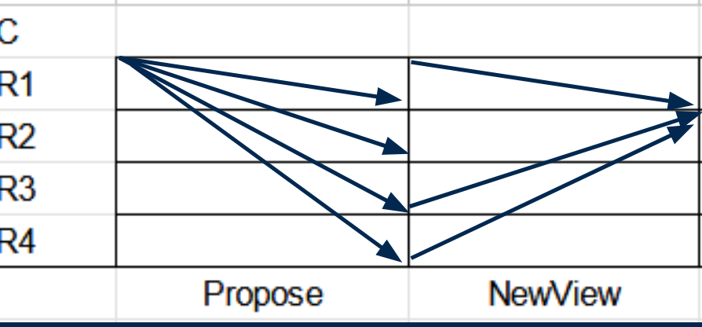
Streamlined Speculation
X
Difference
  Streamlined hotstuff-1 overlaps second phase of view v with first phase of view v+1 from basic hotstuff-1
  Only need prefix commit rule
    E.g can only commit block B_{w-1} in view w-1 if in current view w, P(w) extend P(w-1)
Follows prefix speculation rule and no gap rule
Potential to increase throughput by 2x!
✔
Notes:
One proposal every phase, No specific commit phase

Slide 40
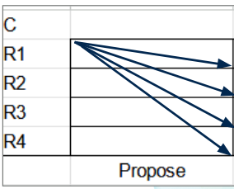
Protocol-Propose Phase
When L_{v} receives n-f NewView messages and check if it can form a prepare certificate
  If can’t, keeps trying till it receives n NewView messages or get timeout
Extend highest certificate seen to create new proposal m
  View V
  B_{v}
  P(Vlp)
      Vlp is highest view for replica
Broadcast m to all replicas

Slide 41
Execute and Ledge Update (Replicas)
When replicas receive a Propose message m
  Commit Rule- w is any view
    If P(w) extends P(w-1) then replica R executes all transactions up to B_{w-1}
    Adds blocks < B_{w-1} to global ledger
  If meets no gap rule (w = v-1) and meets Prefix Speculation rule (block for P(v-2)) in global ledger)
    speculatively execute B_{v-1}
    Adds to local ledger B_{v-1}
      Replica will make sure there’s no conflict with local ledger before adding
    Sends reply to client
  Check if P(w) in m is ≥ P(Vlp)
    If it is, update highest certificate, and send NewView message with P(Vlp) and signature to L_{v+1}

Slide 42
Timeout for Replica
Timeout
  Creates NewView message with:
    empty threshold signature + highest P(vlp)
  Sends it to leader in v+1

Slide 43
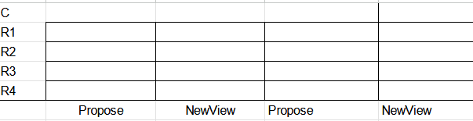
Example-Basic
V
V+1
v-2
v-1
L_{v}:
B_{v}
P(V-1) extends P(V-2)
R:
Commit B_{v-2}
Spec exec B_{v-1}
P(V-2) => P(V-1)
L_{v+1}:
B_{v+1}
P(V)
R:
Commit B_{v-1}
Spec exec B_{v-1}
P(V-1) => P(V)
Notes:
Most basic case, R1 is the leader has P(V-2) and Bv-1 and broadcast message, replicas send v-2 to client

Slide 44
Tail-Forking Attack
V
V+1
v-2
L_{v}:
B_{v}
P(V-1) extends P(V-2)
R:
Commit B_{v-2}
Spec exec B_{v-1}
P(V-2) => P(V-1)
L_{v+1}:
No P(V)!
B_{v+1}
P(V-1)
R:
Vote on B_{v+1}
P(V-1)
Notes:
Most basic case, R1 is the leader has P(V-2) and Bv-1 and broadcast message, replicas send v-2 to client

Slide 45
The Cost of Streamlining
New problems in streamlined (HotStuff) model:
D₅ Higher Latency than stable-leader (which can speculatively execute)

Slide 46
The Cost of Streamlining
New problems in streamlined (HotStuff) model:
D₅ Higher Latency than stable-leader (which can speculatively execute)
HotStuff-1 introduces speculative execution of its own, Fixing D₅

Slide 47
The Cost of Streamlining
New problems in streamlined (HotStuff) model:
D₅ Higher Latency than stable-leader (which can speculatively execute)
HotStuff-1 introduces speculative execution of its own, Fixing D₅
D₆ Intentional Leader Slowness (↑↑ latency)
D₇ Tail Forking Attack (↑↑ latency, possible failure to commit)

Slide 48
Slotting
At a high level: Let each leader propose multiple Blocks B
Notes:
NOTES: Slotting example is next

Slide 49
Non-Slotting (Streamlined)
View v
View v+1
Leader Lv
Leader Lv
Generate P(v-1)
Create B_{v}
Generate P(v)
Create B_{v+1}
Send P(v-1)
Propose B_{v}
ViewChange: Send δ^{Bv}_{R}
Send P(v)
Propose B_{v+1}
ViewChange: Send δ^{Bv}_{R}
ViewChange: Send δ^{Bv-1}_{R}
All Other Replicas
All Other Replicas
Note P(v-1), execute B_{v-1}
Vote on B_{v}
Note P(v), execute B_{v}
Vote on B_{v+1}
Notes:
NOTE: Prefix Commit Rule

Slide 50
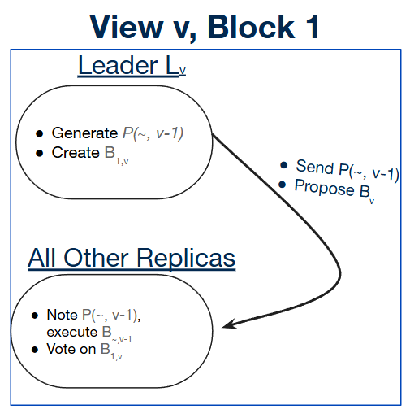
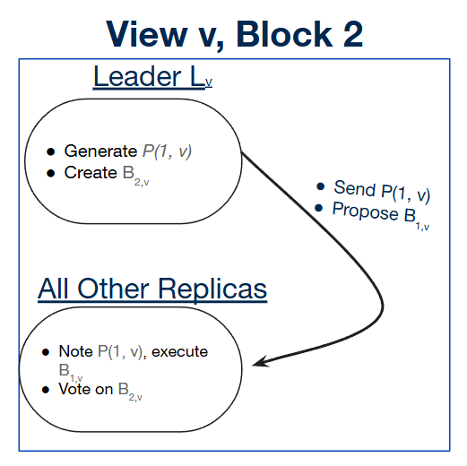
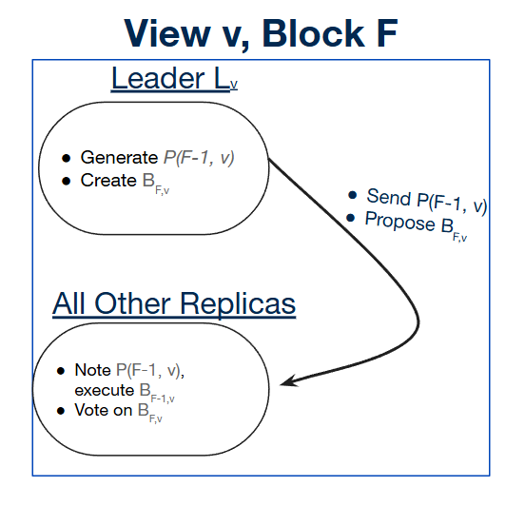
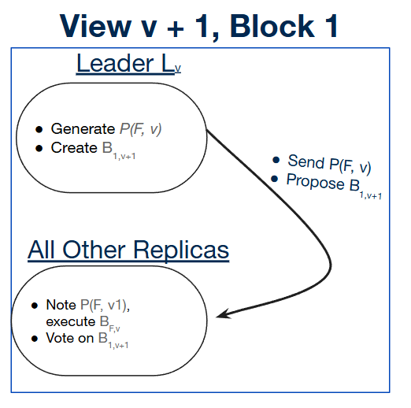
Slotting (Streamlined)
New-Slot: Send δ^{B2v}_{R}
New-Slot: Send δ^{B1v}_{R}
…
New-Slot: Send δ^{BF-1v}_{R}
New-View: Send δ^{BFv}_{H}
New-Slot: Send δ^{B1v+1}_{R}
…
Notes:
NOTE: LEADER SLOWNESS is next, “we’ve talked about the solution, lets talk about the problem”

Slide 51
D₆ Intentional Slowness
View v
Deadline to submit B_{v}
Current time
…
Time
Block B_{v}
𝜏₁
𝜏₂
…
Notes:
NOTE: Mention BLOCKCHAIN and financial trading

Slide 52
D₆ Intentional Slowness
View v
Deadline to submit B_{v}
𝜏_{last-1}
Current time
…
Time
Block B_{v}
𝜏₁
…
𝜏_{last-1}

Slide 53
D₆ Intentional Slowness
View v
Deadline to submit B_{v}
𝜏_{last-1}
𝜏_{last}
Current time
…
Time
Block B_{v}
𝜏₁
…
𝜏_{last}

Slide 54
Default: Submit Here
View v
Deadline to submit B_{v}
𝜏_{last-1}
𝜏_{last}
Current time
…
Time
Block B_{v}
𝜏₁
…
𝜏_{last}
Submit:

Slide 55
Case 1 - No New 𝜏
View v
Wait until the deadline
𝜏_{last-1}
𝜏_{last}
Current time
…
Time
Block B_{v}
𝜏₁
…
𝜏_{last}
Submit:
(same as submitting immediately)

Slide 56
Case 2 - New 𝜏
View v
Wait until the deadline
𝜏_{last-1}
𝜏_{last}
𝜏$$$
Current time
…
Time
Block B_{v}
𝜏₁
…
𝜏_{last-1}
𝜏$$$
Submit:
(Much greater reward)

Slide 57
D₆ Intentional Slowness
A primary only stands to benefit by waiting until the last possible second to propose
Notes:
NOTE: not MALICIOUS, this is RATIONAL
NOTE: Immediate swap to solution next

Slide 58
Solving D₆ /w Slotting
Submit as much as possible
View v
𝜏_{last-1}
𝜏_{last}
𝜏$$$
Block1,v fills
Block2,v fills
Close to timeout
…
Time
Block B_{1,v}
Block B_{2,v}
Block B_{3,v}
𝜏₁
𝜏₂
…
𝜏_{last-1}
𝜏_{last}
…
𝜏$$$

Slide 59
Benefits of HotStuff-1
New problems in streamlined (HotStuff) model:
D₅ Higher Latency than stable-leader (which can speculatively execute)
Fixed with speculative execution in HotStuff-1
D₆ Intentional Leader Slowness (↑↑ latency)
Fixed with slotting in HotStuff-1
D₇ Tail Forking Attack (↑↑ latency, possible failure to commit)

Slide 60
Tail-Forking
Every replica keeps a copy of the highest P(v_{lp}) it’s seen
View v
Leader Lv
Generate P(v-1)
Create B_{v}
Send P(v-1)
Propose B_{v}
ViewChange: Send δ^{Bv-1}_{R}
ViewChange: Send δ^{Bv}_{R}
All Other Replicas
Note P(v-1), execute B_{v-1}
Vote on B_{v}
Notes:
NOTE: SKIP this and the next TWO slides

Slide 61
Tail-Forking
Every replica keeps a copy of the highest P(v_{lp}) it’s seen
View v
Leader Lv
Generate P(v-1)
Create B_{v}
Send P(v-100)
Propose B_{v} from P(v -100)
ViewChange: Send δ^{Bv-1}_{R}
ViewChange: Send δ^{Bv}_{R}
All Other Replicas
Note P(v-1), execute B_{v-1}
Vote on B_{v}

Slide 62
Tail-Forking
Every replica keeps a copy of the highest P(v_{lp}) it’s seen
View v
Leader Lv
Generate P(v-1)
Create B_{v}
Send P(v-100)
Propose B_{v} from P(v -100)
ViewChange: Send δ^{Bv-1}_{R}
ViewChange: Send δ^{Bv}_{R}
All Other Replicas
Note P(v-100)
That’s outdated! Don’t execute B_{v}

Slide 63
Tail-Forking
View v
View v+1
Leader Lv
Leader Lv
Generate P(v-1)
Create B_{v}
Generate P(v)
Create B_{v+1}
Send P(v-1)
Propose B_{v}
ViewChange: Send δ^{Bv}_{R}
Send P(v)
Propose B_{v+1}
ViewChange: Send δ^{Bv}_{R}
ViewChange: Send δ^{Bv-1}_{R}
All Other Replicas
All Other Replicas
Note P(v-1), execute B_{v-1}
Vote on B_{v}
Note P(v), execute B_{v}
Vote on B_{v+1}

Slide 64
Tail-Forking
View v
View v+1
Leader Lv
Leader Lv
Generate P(v-1)
Create B_{v}
“Not Enough Votes” (lie)
Create B_{v+1} from P(v-1)
Send P(v-1)
Propose B_{v}
Send P(v-1)
Propose B_{v+1}
ViewChange: Send δ^{Bv-1}_{R}
ViewChange: Send δ^{Bv}_{R}
ViewChange: Send δ^{Bv}_{R}
All Other Replicas
All Other Replicas
Note P(v-1), execute B_{v-1}
Vote on B_{v}
Note P(v), execute B_{v}
Vote on B_{v+1}

Slide 65
Tail-Forking
View v
View v+1
Leader Lv
Leader Lv
Generate P(v-1)
Create B_{v}
“Not Enough Votes” (lie)
Create B_{v+1} from P(v-1)
Send P(v-1)
Propose B_{v}
Send P(v-1)
Propose B_{v+1}
ViewChange: Send δ^{Bv-1}_{R}
ViewChange: Send δ^{Bv}_{R}
ViewChange: Send δ^{Bv}_{R}
All Other Replicas
All Other Replicas
Note P(v-1), execute B_{v-1}
Vote on B_{v}
Do not note P(v), do not execute B_{v}
Vote on B_{v+1}

Slide 66
Tail-Forking
View v
View v+1
Leader Lv
Leader Lv
Generate P(v-1)
Create B_{v}
“Not Enough Votes” (lie)
Create B_{v+1} from P(v-1)
Send P(v-1)
Propose B_{v}
Send P(v-1)
Propose B_{v+1}
ViewChange: Send δ^{Bv-1}_{R}
ViewChange: Send δ^{Bv}_{R}
ViewChange: Send δ^{Bv}_{R}
All Other Replicas
All Other Replicas
Note P(v-1), execute B_{v-1}
Vote on B_{v}
Do not note P(v), do not execute B_{v}
Vote on B_{v+1}
Notes:
NOTE: Naive solution on the next slide

Slide 67
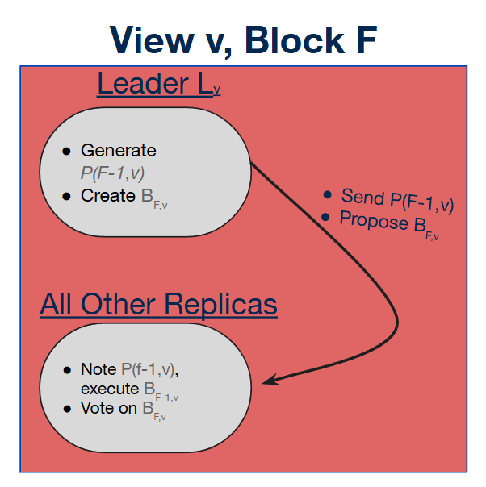
Tail-Forking
New-Slot: Send δ^{B2v}_{R}
New-Slot: Send δ^{B1v}_{R}
…
New-Slot: Send δ^{BF-1v}_{R}
New-View: Send δ^{BFv}_{H}
New-Slot: Send δ^{B1v+1}_{R}
…
Notes:
NOTE: “This is not enough” on the next slide

Slide 68
Tail-Forking
That protects more transactions, but it doesn’t eliminate tail forking
Notes:
NOTE: Mention carry blocks here

Slide 69
Tail Forking - Carry Blocks
HotStuff-1 completely prevents tail forking for view v when:
v’s leader L_{v} has proposed at least 2 blocks (B_{s-1,v}, B_{s,v})
The final block has f+1 votes

Slide 70
Tail Forking - Carry Blocks
New-Slot: Send δ^{B1v}_{R}
New-View: Send δ^{B1v}_{H}
L_{v+1} wants to lie about Block B_{2,v}
f + 1 replicas have seen B_{2,v}
What happens?
Notes:
NOTE: Start by explaining the order of certificate extension here

Slide 71
Tail Forking - Carry Blocks
New-Slot: Send δ^{B1v}_{R}
New-View: Send δ^{B1v}_{H}
2f replicas have only QC from slot_{1,v}
f+1 replicas demand QC from slot_{2,v}
We can’t reach a 2f + 1 quorum

Slide 72
Tail Forking - Carry Blocks
New-View: Send δ^{B1v}_{H}
Block B_{1,v+1} is allowed to extend it’s QC from Block B_{1,v}
BUT, it has to use B_{2,v} as a “carry block”
Notes:
NOTE: The next slide is the last one

Slide 73
Benefits of HotStuff-1
New problems in streamlined (HotStuff) model:
D₅ Higher Latency than stable-leader (which can speculatively execute)
Fixed with speculative execution in HotStuff-1
D₆ Intentional Leader Slowness (↑↑ latency)
D₇ Tail Forking Attack (↑↑ latency, possible failure to commit)
Fixed with slotting in HotStuff-1

Slide 74
Reference
[1] Maofan Yin, Dahlia Malkhi, Michael K. Reiter, Guy Golan Gueta, and Ittai Abraham. 2019. HotStuff: BFT Consensus with Linearity and Responsiveness. In Proceedings of the 2019 ACM Symposium on Principles of Distributed Computing (PODC '19). Association for Computing Machinery, New York, NY, USA, 347–356. https://doi.org/10.1145/3293611.3331591
[2] Maofan Yin, Dahlia Malkhi, Michael K. Reiter, Guy Golan Gueta, and Ittai Abraham. 2019. HotStuff: BFT Consensus with Linearity and Responsiveness. In Proceedings of the 2019 ACM Symposium on Principles of Distributed Computing (PODC '19). Association for Computing Machinery, New York, NY, USA, 347–356. https://doi.org/10.1145/3293611.3331591
[3] Dakai Kang, Suyash Gupta, Dahlia Malkhi, and Mohammad Sadoghi. 2025. HotStuff-1: Linear Consensus with One-Phase Speculation. Proc. ACM Manag. Data 3, 3, Article 171 (June 2025), 29 pages. https://doi.org/10.1145/3725308
[4] Dahlia Malkhi and Kartik Nayak. 2023. Hotstuff-2: Optimal two-phase responsive bft. Cryptology ePrint Archive (2023).

