Slide 1
Proof-of-Execution: Reaching Consensus through Fault-Tolerant Speculation
Authors
Suyash Gupta, Jelle Hellings, Sajjad Rahnama, Mohammad Sadoghi (ExpoLab, UC Davis)
Presenters
Sophie Quynn, Nachiket Subbaraman, Josh Hutton
Notes:
This paper comes out of ExpoLab at UC Davis.

Slide 2

Background
Federated data management - reaching agreement on updates to common database
Federated decentralized environment - each stakeholder manages their own replicas
  Replicas of each stakeholder can fail -> Byzantine Fault Tolerant (BFT) protocols
Replica R1
Consensus Protocol
Replica R2
Replica R3
Notes:
In federated data management, a single database is managed by stakeholders
One can achieve federated data management by replicating the common database among all stakeholders and the sequence of transactions that update its contents. This is achieved by consensus protocols.
BFT consensus aims to order client requests among replicas such that all non-faulty replicas reach agreement on an ordering of the requests.

Slide 3
Introduction
Majority of these systems still use PBFT
Proof-of-Execution (PoE) is a scalable and reliable consensus protocol that can replace PBFT
  Only requires 3 linear phases (as opposed to PBFT’s 2 quadratic phases)
  Signature-scheme agnostic
  Avoids response aggregation
Partially synchronous networking model
Certify
R1
Inform
Propose
R1
Support
R2
R2
Primary
Client
Client
Primary
R3
Request
R3
R4
R4
Notes:
This paper explores design principles enabling a scalable and reliable agreement protocol
As opposed to PBFTs 2 quadratic phases
If majority of non faulty replicas did not respond
Message Authentication Codes or Threshold Signatures
By enabling all replicas to respond to the client, instead of just one (SBFT)
Authors assume a partially synchronous networking model - guarantee liveness during periods of synchrony, where messages sent by non faulty replicas are received within some maximum delay.
Liveness - messages are eventually received

Slide 4


Speculative Execution
Replicas execute requests after they get prepared (no commit phase)
Malicious primary can send request to only a subset of replicas
Full PoE - client receives responses from majority of non-faulty replicas
  Requests persist in time
Otherwise -> safe rollback via novel view-change algorithm
Certify
R1
Inform
Propose
R1
Support
R2
R2
Primary
Client
Client
Primary
R3
Request
R3
R4
R4
Notes:
After replicas get prepared, they do not broadcast a commit message
As you can see, the client receives responses from all the non faulty replicas, so the request will persist.
However, if the primary is malicious, it may not send requests to R1 and R3, so the client does not receive a sufficient amount of responses.
Then, replicas would rollback their state using a novel view-change algorithm.

Slide 5
Out-of-order processing
BFT systems generally agree on request ordering before execution
  Prevents concurrent execution
PoE uses out-of-order processing
  Primary continuously proposes requests
  Maximizes throughput in high-message delay environment
Active Window: Replicas process any request k within a lower and upper bound
Low
Hi
1
2
3
4
5
7
8
9
Requests Timeline
Notes:
PoE uses out-of-order processing
Primary continuously proposes requests even when previous proposals are still being processed by the system
Eliminates impact of high message delays
Diagram: All requests before request 3 were processed. The system is still processing requests 3-7.
The active window size is only limited by the memory of replicas
Responses to Prof. Questions
1. Out-of-order processing:
1. Requests in the active window can be proposed, supported, or certified by replicas in different orders.
2. Replicas can process any request k if it falls within the active window.
2. Concurrent execution:
1. A few BFT systems execute prior to ordering, which incurs verification of results prior to committing changes.
3. PoE lies in between total ordering and concurrent execution
4. Out-of-order execution = speculative execution
1. Replicas can execute transactions before they agree on their ordering
1. Traditional BFT protocols require consensus on ordering before execution
2. Replicas might rollback the transaction during recovery from primary failure
3. Partial ordering: Each replica executes transaction k once its logged executions for prior k-1 transactions
5. Requests within the active window are processed as a batch to maximize primary throughput

Slide 6
Comparisons to other protocols
Resilience: Maximum number of faulty replicas that protocol can tolerate
Protocol | Phases | Messages | Resilience | Requirements
Zyzzyva | 1 | O(N) | 0 | Reliable clients
PoE | 3 | O(3N) | f | Sign. Agnostic
PBFT | 3 | O(N + 2N^2) | f | N/A
HotStuff | 8 | O(8N) | f | Sequential Consensus
SBFT | 5 | O(5N) | 0 | Optimistic Path
Notes:
PoE has a resilience of f, which means that it can tolerate f faulty replicas
Among the protocols with resilience f, it has the lowest number of phases and messages
Further, it has the bonus of being signature agnostic, while the other protocols have specific requirements

Slide 7
Guarantees and Requirements
PBFT guarantees preservation upon: 2f + 1 prepares.
PoE guarantees preservation upon: 2f+1 speculative executions.
Safety and liveness are guaranteed*
Notes:
Hello, I am Josh. Before getting into the details of the algorithm, I would like to start by specifying the differences between PBFT and PoE from the perspective of the client, and the guarantees of preservation. Click
In PBFT, once 2f + 1 replicas have prepared a transaction, it is guaranteed to be preserved.
PBFT requires prepare and commit quorums of 2f+1, and the client is guaranteed execution of its transaction once it receives f+1 responses. Click
On the other hand, PoE only guarantees preservation of a transaction once 2f+1 inform messages have been sent to the client. Click
Safety is guaranteed, and liveness is guaranteed during periods of bounded message delay (that is, after Global Stabilization Time when the partially synchronous network is in its synchronous state)
Safety is guaranteed due to speculative non-divergence. Once 2f+1 non-faulty replicas speculatively execute a transaction T, all non-faulty replicas will eventually execute it (after rolling back other transactions).
Liveness is only guaranteed after GST, when the partially synchronous network is in its synchronous state.

Slide 8
Authentication: MAC vs TS
Message Authentication Codes (MAC): secret keys for every communicating pair.
Threshold Signatures
Notes:
In order to understand the algorithm, we need to understand the authentication techniques used in the paper. Messages are authenticated, so non-faulty replicas cannot be impersonated. This algorithm considers two forms of authentication, Message Authentication Codes and Threshold Signatures. Click
Message Authentication Codes involve using secret keys for every pair of nodes that are communicating with each other. Communication is still quadratic (all-to-all)., but this can still be useful if we have a small number of replicas (16 or under).
The main interesting authentication technique used in this paper is Click Threshold Signatures. In order to illustrate this, imagine that the primary has a box. Click

Slide 9
Threshold Signatures
…
P
…
R₁
R₂
R₃
R₄
Notes:
SLOW DOWN
Threshold signatures work by requiring a Click specified number of signature shares from other replicas. If a replica is agreeing to a certain transaction, it will Click compute its signature share, and Click send it to the primary.
(do 5 clicks) This continues until the primary receives enough signature shares (2f+1) from distinct replicas, to fill up the box. Once it has, it can then Click send out the completed threshold signature to all replicas, which can be verified using a public key.
(make sense?)

Slide 10
Normal Case
Threshold Signature
Speculative Execution
c
T
P
R₁
R₂
R₃
Propose
Support
Certify
Inform
View-commit
1. Signed transaction ⟨T⟩_{c}
2. View number v
3. Transaction number k
Notes:
SLOW DOWN
Let’s go over a normal case with no byzantine replicas, or network faults. Here we have the client, the primary, and 3 non-faulty replicas. Click
First, the client sends a signed transaction to the primary, Click and the primary proposes it, just like in PBFT.
Unlike PBFT, PoE does not Click have a prepare phase with an all-to-all communication saying what each replica received from the primary. Instead Click PoE has a support phase in which each replica computes a signature share and sends a support message to the primary.
After the primary receives 2f+1 distinct signature shares, Click it can compute a single signature, and Click send a certify message containing the signature to all replicas.
SLOW DOWN
The replica receives the valid certify message, that it verifies using a public key. At this point, the support and certify phases are equivalent to the prepare phase in PBFT. Receiving a certify message gives a replica the same information as receiving 2f+1 prepare messages in PBFT. You know that 2f+1 replicas have contributed to the threshold signature supporting this transaction for this round. Once the certify message is received. Click view-commits the transaction as the k-th transaction. The view-commit contains Click the signed transaction from the client, Click the current view, and Click which number transaction this is.
With no network issues, out-of-order processing is unnecessary, as a replica should always receive transactions in the order they are to be executed.
With network issues, due to out-of-order processing, the transactions may be view committed out of order. But, view-committed transactions must be executed in order. In order to execute transaction number k, all transactions before k must already be executed.
(Look up, does that make sense)
Once the transaction is executed, speculative execution allows the replicas to directly inform the client at this point (I will go into detail on this in a moment) We do not need an equivalent of the commit phase, with another set of back and forth communication with the replicas and the primary. Click. Once the client receives 2f+1 inform messages, it has its proof of execution that all non-faulty replicas have (or will) execute it.
Are there any questions?
Like PBFT guaranteeing quorum can be reached for at most one transaction in a round, if a single replica view-commits a transaction in a round, it is guaranteed that no other transaction can be view-committed (by a non-faulty replica).
I would like to emphasize this, because this point is really important for understanding why we are allowed to have speculative execution and roll back transactions.

Slide 11
View-Commit Transaction Uniqueness
f faulty
f faulty
3f+1
Total replicas
2f+1
Non-faulty
replicas
f
A
f+1
B
Notes:
To quickly recap the intuition behind it. Click
We have 3f+1 total replicas, but Click f of them can be faulty, leaving 2f+1 non-faulty replicas. In order to try and reach quorum on two transactions, A and B, we can assume that the f faulty replicas would double vote. Click But, no matter how you split it, you will not reach 2f+1 replicas on both transactions. Click If B has the bare minimum to reach 2f+1, Click A is just short of reaching 2f+1.
So, for a single value of k, a replica will either speculatively execute the majority transaction, or do nothing.
Is it clear why this is the case?

Slide 12
Speculative Execution in Practice
2f+1 informs
guarantees
c
T
P
R₁
R₂
R₃
Propose
Support
Certify
Inform
2f+1 informs = at least f+1 non-faulty informs
3f+1 - (f+1) = 2f (not enough)
Notes:
SLOW DOWN
Let’s take a look at why speculative execution allows the replicas to inform the client directly after only 3 phases of linear communication. Think about what needs to happen for R2 to receive a valid certify message. Click, Click The primary proposes a transaction, and we know that at least Click 2f+1 replicas have received that same proposal, because of the threshold signature. Click At this point, R2 has received a certify message, but it does not know if any other replicas have received this certify message. However, Click speculative execution allows the replica to communicate directly with the client at this point, instead of doing another round of threshold signature communication with the primary. Because, at this point, the transaction is still not guaranteed to be executed until the client has received Click 2f+1 inform messages.
By pushing back the point at which execution of a transaction is guaranteed, along with the ability to rollback transactions, we can inform the client directly at this point.
Once 2f+1 inform messages have been sent, we know that at least Click f+1 non-faulty replicas have sent an inform message. This means that during the recovery or view-change algorithm you cannot Click form a 2f+1 quorum without at least 1 of these f+1 replicas (again, basically the same intuition as before). We have 3f+1 replicas, and at least f+1 non-faulty replicas have executed this transaction. This leaves only 2f total replicas that may not recover it (whether they were in the dark, or malicious). It is at this point, that the execution of the transaction is guaranteed.
Is this clear?
Going back Backwards Click a few times to this stage, at this point, R2 will have executed the transaction, but it may still be rolled back. If the other Replicas did not receive the certify message, they may time out, and R2, as the only one that informed the client, is not guaranteed to have its view-change request processed. Click Click

Slide 13
Byzantine Case
c
T
P
R₁
R₂
B
Propose
Support
Certify
Inform
Notes:
Now, if one of the non-primary replicas is byzantine, but we have no network faults, the byzantine replica does not stop the client from receiving 2f+1 inform messages saying their transaction has been executed.
If you would like to use message authentication codes instead of threshold signatures, you can replace the Click all-to-one Support and one-to-all Certify phases with a single all-to-all Support phase.

Slide 14
Using MACs
c
T
P
R₁
R₂
B
Propose
Support
Inform
Notes:
There are some other changes that have to be made to support MACs. This is because, with MACs, you cannot forward messages without the possibility of tampering with them, so client requests and other forwarded messages need to be reworked, but making these changes is the same as allowing MACs to be used with PBFT, so they are not described in detail in the paper.

Slide 15
View-Change Algorithm
c
T
P
R₁
R₂
R₃
Failure
View-Change Request
New View Proposal
VC-Request: View, list of transactions Executed
Notes:
SLOW DOWN
The view-change algorithm is pretty similar to what we went over last week, up until the point where the replicas process the proposal.
Let’s take a look from the perspective of R2 Click Click In the event of failure, a replica cannot distinguish between a bad network, and a malicious primary Click so it will default to sending a view-change request. This can occur if it does not receive a message or heartbeat within an established timeframe. This includes if a client notices it is not getting a response to its transaction. In that case, it will broadcast its request to all replicas. Those replicas will forward that request to the primary, and if that times out, they will also begin a view-change request.
Once f+1 replicas have sent out a view-change request, it is impossible to reach a quorum, so the non-faulty replicas will join in.
At this point, Click R2 starts receiving view-change requests from others, and eventually (after the new primary R1 has received 2f+1 view-change requests), it sends out a New View proposal. Click
The new primary will consolidate the lists of transactions, and sends out the new proposal to all replicas. Click Each view change request contains the current faulty view, and a list of transactions it has executed in that view. Each view change request needs to have a consecutive sequence of certify messages received from the previous primary, and their corresponding transactions. The messages from non-faulty replicas will be guaranteed to be consecutive if the network is reliable.
Click Here’s what it might look like from an outside perspective, but I wanted to illustrate it just from the perspective of one replica.

Slide 16
Rollback
New View Proposal
R2 log
R3 log
k=1
k=1
k=1
k=2
k=2
k=2
k=3
k=3
k=4
k=4
k=4
k=5
k=5
k=5
Out-of-order
Processing
k=6
Speculative execution
Notes:
Once the New View proposal is received, each replica goes through all transactions in order, comparing it to the transactions it has executed. If there is a discrepancy, it will roll back transactions to synchronize its logs.
Click Out-of-Order execution may leave a replica with transactions that it has processed, but cannot execute because it is missing a previous transaction.
Click Speculative execution may leave a replica with an extra transaction that is not included in the new view proposal, and needs to be rolled back
As mentioned previously, up to 2f replicas may inform the client that it has speculatively executed a transaction, but it is not guaranteed at that point and may still be rolled back.

Slide 17
Motivation Behind Evaluation
Overall Goal: Show that PoE achieves higher throughput and/or lower latency than state‐of‐the‐art BFT protocols in a realistic environment
How does PoE perform when compared to other protocols, especially under failure conditions?
How scalable is PoE when increasing the number of replicas?
How does PoE perform when out-of-order processing is disabled?
Does PoE see benefits in performance when batching client requests?
How does PoE perform under zero payload conditions?
Throughput
measured as transactions per second
Latency
measured as the time from when the client sends a request to when it receives a response
Notes:
Intro: This paper bridges the gap between theory and practice by evaluating PoE against other modern & baseline BFT protocols.
Additional goal is showcasing that ResilientDB can be used as a testing environment to implement and compare modern, high-throughput BFT protocols
See the paper for results on batching and Zero Payload experiments

Slide 18
Evaluation Landscape
Environment
  ResilientDB Fabric (batching, parallel pipeline architecture)
  Scale from 4 to 91 replicas
  320k clients
Experiment
  Run for 180s
  Data is collected for the last 120s (steady-state)
Benchmarking Configurations
  No Failures: all replicas are live and responsive; measures baseline performance
  Backup Failure: one non-primary replica is crashed to assess system resilience and recovery impact
  Primary Failure: let the primary fail, causing clients to timeout & forward requests to backup replicas; initiate view-change
Notes:
Environment
batching of client and replica messages
parallel pipeline to balance replica workflows
Implemented in a Cloud environment

Slide 19
Comparison Protocols
Protocol | Description
PoE | Linear three-phase protocol with no twin-path model; maintains high performance even under replica failures
PBFT | Widely-used baseline protocol for BFT performance studies; uses a three-phase commit with static primaries
Zyzzyva | Optimistic protocol using a twin-path model; achieves low latency in fault-free cases with trusted clients
SBFT | Safety-focused version of Zyzzyva; retains twin-path design with stronger guarantees and a 4-round fast path
HotStuff | Modern BFT protocol with linear communication and rotating primaries
Notes:
Zyzzyva
twin path protocol
Default fast path that is optimized for no failures
no commit step, speculative execution as long as 3f+1 matching replies received by client the transaction is executed
As soon as a client timeouts (backup failure), replicas switch to the slow path (similar to PBFT)
With a new view, back to fast path.
SBFT (Scalable Byzantine Fault Tolerant)
A safer version of Zyzzyva; doesn’t rely on clients initiate slow path
The fast path allows up the f faulty replicas
Hotstuff
Rotates primary after each consensus decision to minimize the influence of a single replica
Requires sequential processing, not compatible with out-of-order processing

Slide 20
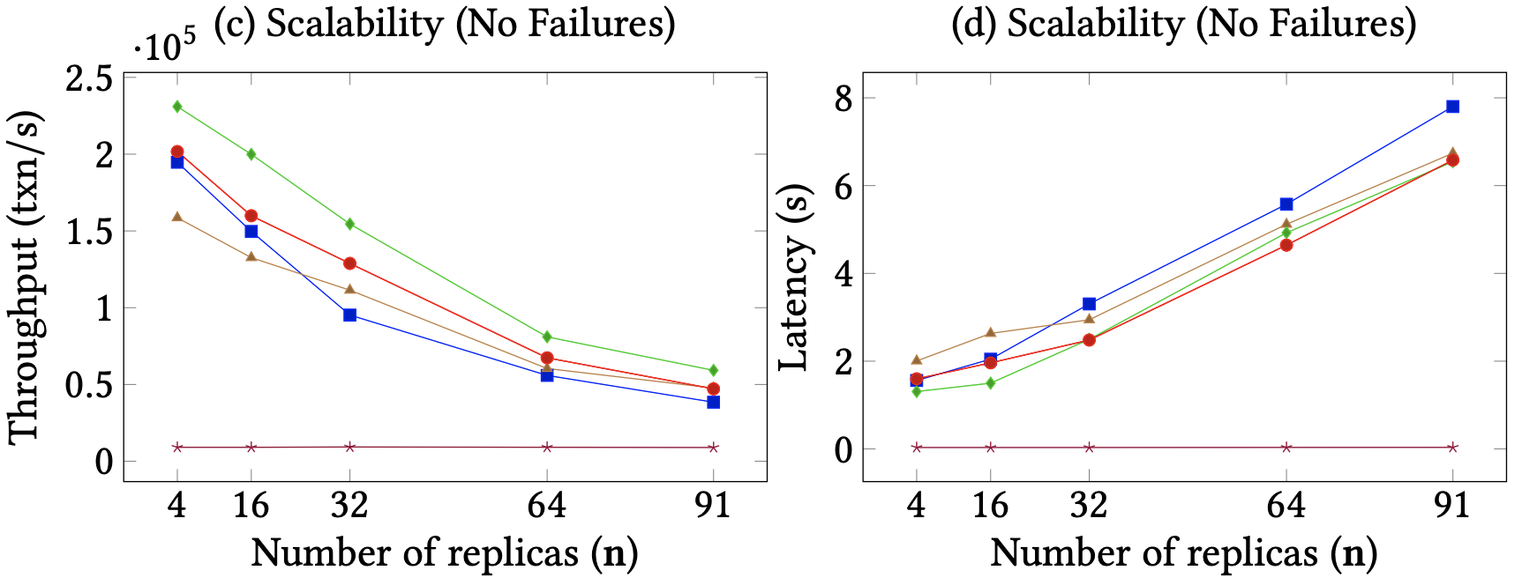
Experimental Results: Scalability (No Failures)
Key Finding
PoE has lower throughput than Zyzzyva, but similar latency - Zyzzyva requires replies from all replicas, while PoE clients wait for nf replies
Notes:
Zyzzyva uses speculative execution, but is optimized for the failure-free case - fewer communication rounds
Hotstuff doesn’t use out-of-order processing so it has the lowest performance

Slide 21
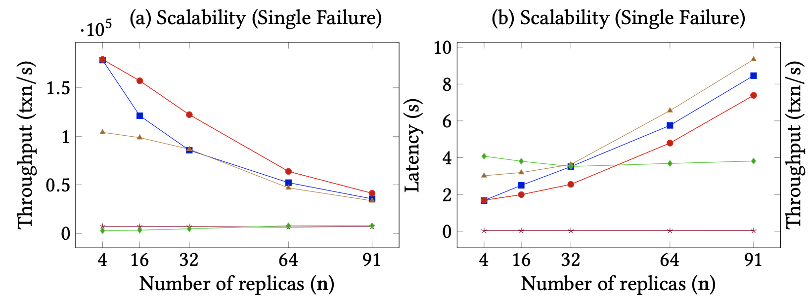
Experimental Results: Scalability (Single Failure)
Key Finding
PoE exhibits high throughput and low latency under failures due to its three-phase linear protocol that is resilient to failures
Notes:
3 phase linear protocol + out-of-order processing allows PoE to have higher through and lower latency that PBFT and SBFT
Zyzzyva performance is as low as HotStuff, which doesn’t use out-of-order processing, in the case of a failure because it reverts to the slow path

Slide 22
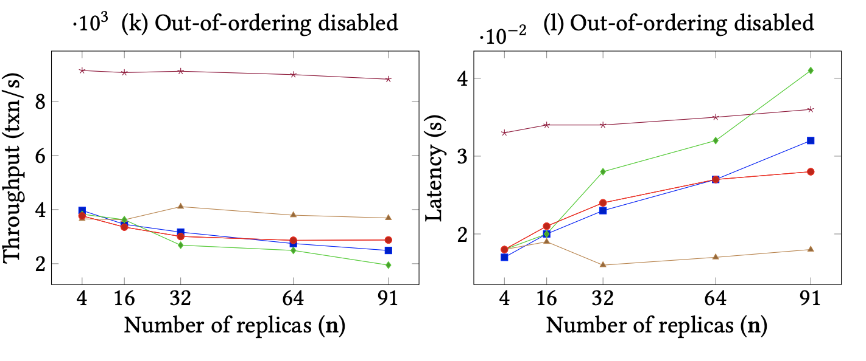
Experimental Results: Out-of-ordering Disabled
Key Finding
HotStuff, the only protocol without out-of-order processing, performs best when it’s disabled since rotating primaries enables pipelining of four requests
Notes:
Overall, when looking at the throughput & latency of HotStuff, which doesn’t rely on out-of-order processing, the performance is significantly dropped when compared to previous slides.
Thus, out-of-order processing is an essential feature of modern, high throughput BFT protocols.

Slide 23
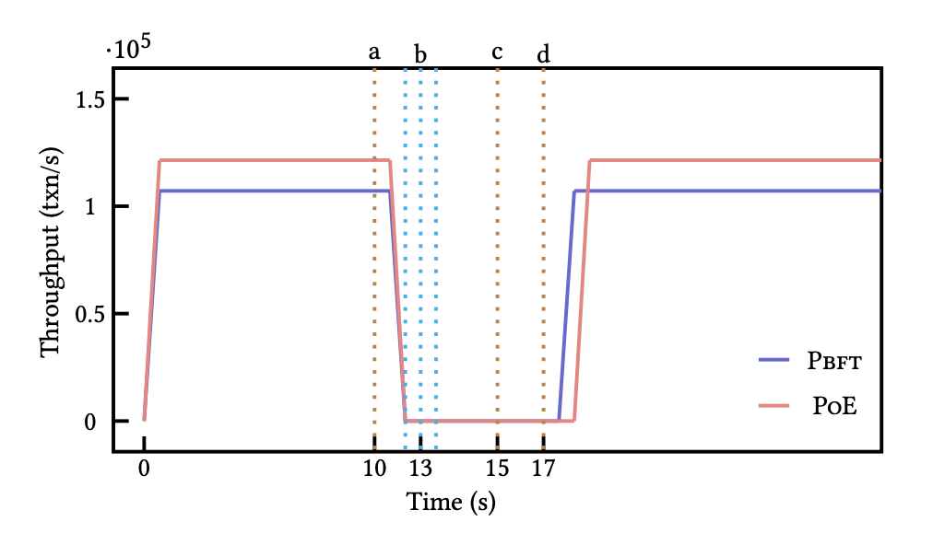
Experimental Results: Primary Failure-View Change
Let the primary replica complete consensus for 10s (~ a million transactions) and then fail; clients timeout while awaiting response
Experiment with 32 nodes
View-Change Protocol
(a): Replicas detect primary failure and broadcast vc-request
(b): Replicas receive vc-request messages from other replicas
(c): Replicas receive nv-propose message from the new primary
(d): State recovery
Key Finding
PoE initially takes longer to execute than PBFT due to rollback, but quickly recovers to achieve higher throughput
Notes:
Study the impact of of a benign primary failure on PoE vs. PBFT; primary failure requires backup replicas run the view-change protocol
Zyzzyva has an unsafe view-change algorithm and SBFT’s view-change algorithm is no less expensive than Pbft (Zyzzyva and SBFT also have significant reduction in throughput)
For HotStuff, we do not show results as it changes primary at the end of every consensus.
PoE takes longer to execute due to the “rollback” stage in step (d): state recovery
PoE has higher throughput during PBFT because of the reduced messages (communication between replicas) due to 3 linear phases rather than 2 quadratic phases

Slide 24
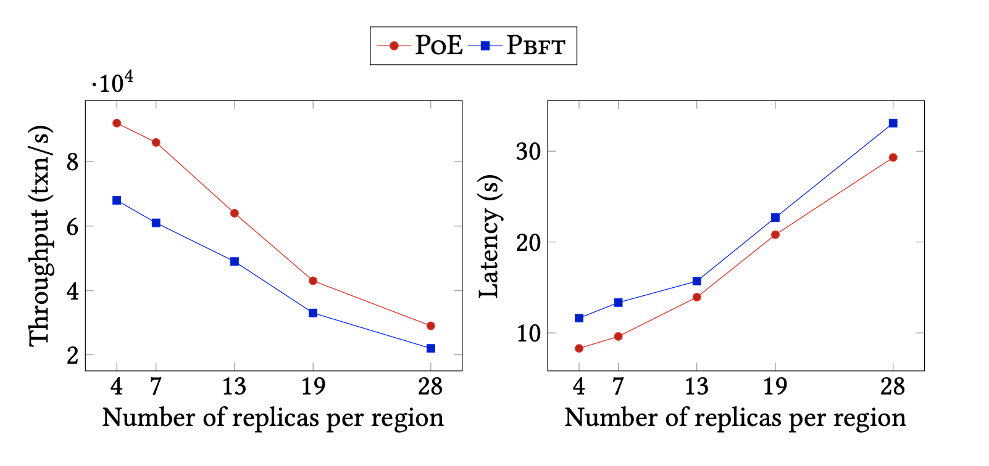
Experimental Results: WAN Scalability
Deploy PoE and PBFT on a wide-area network in the presence of a single failure
Clients and replicas across five locations: Oregon, Iowa, Montreal, the Netherlands, and Taiwan
Vary the total number of replicas from 20 to 140; equally distributed across each region
Key Finding
PoE achieves up to 1.41× higher throughput and incurs 28.67% less latency than PBFT

Slide 25
Paper Conclusions
Introduces Proof-of-Execution (PoE): a Byzantine fault-tolerant consensus protocol using speculative execution and out-of-order processing
Achieves safety and liveness with only three linear communication phases (with TSs), provided the system satisfies n > 3f
Significantly improves throughput and latency (up to ~80% over PBFT)
Rollbacks may occur if speculation fails, but correctness is preserved
PoE is well-suited for high-throughput, permissioned blockchain and data-management systems

Slide 26
Appendix: Additional Slides

Slide 27
ResilientDB for Implementation
Enables testing in a real-world, deployed environment: bridging theory and practice
Provides a replicated transactional engine and a high-throughput permissioned blockchain fabric
Supports flexible experimentation with multiple consensus protocols
Uses a parallel, pipelined architecture to balance replica workloads
Reduces communication overhead through batching of client transactions
Maintains a secure and efficient ledger for consistent state management

