Slide 1
Task Management
Mohamed Saeed

Slide 2

Case study
How didn’t get overwhelmed by task?
How to keep track of task flow?
How to organize project tasks?
How to track projects timeline?
How to control and manage resources?

Slide 3

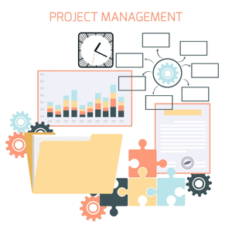
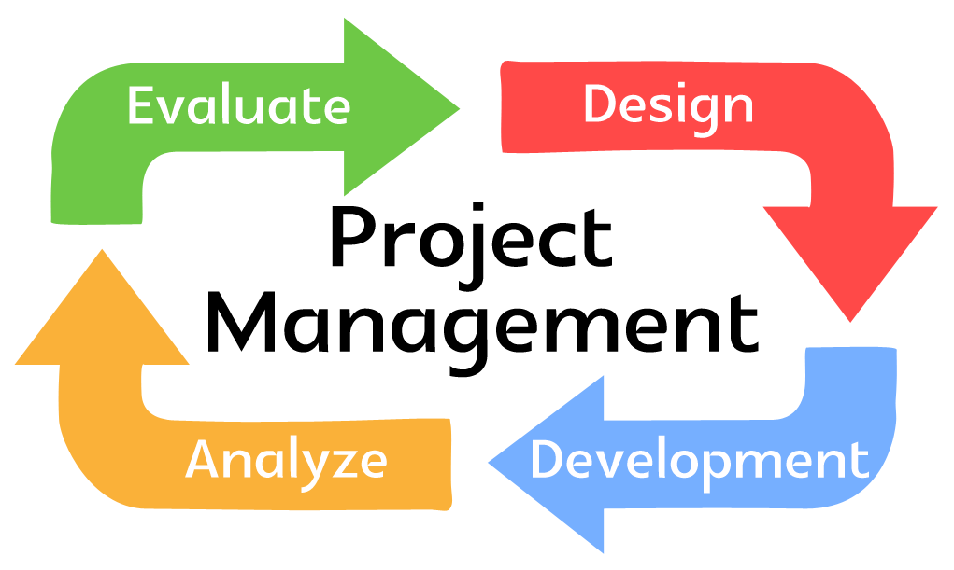
Solution
Now you can manage your projects and tasks from simple
Interface which will allow you to create and manage project timeline and track your invested resources.

Slide 4
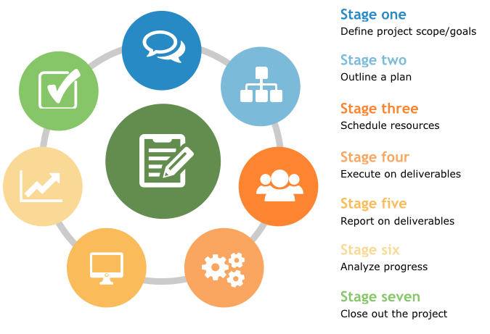
Solution
Provide you very simple management tool and report tool to visualize project progress.
which will help to:
Plan
Assign and schedule resource
Execute
Report
And help you to deliver your project with a comfort and trust.

Slide 5
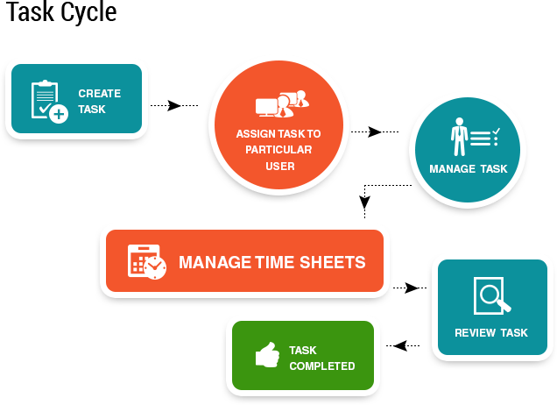
Solution
Very simple work flow to create tasks and manage it.

Slide 6
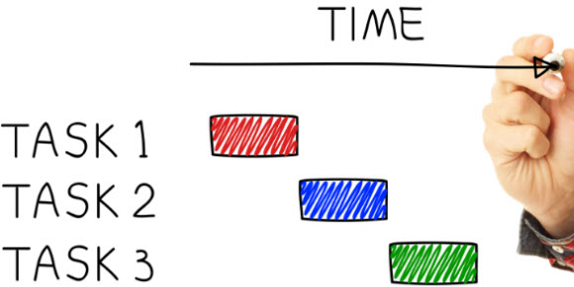
Solution
Very simple status to track tasks workflow:
To Do
In Progress
Done

Slide 7
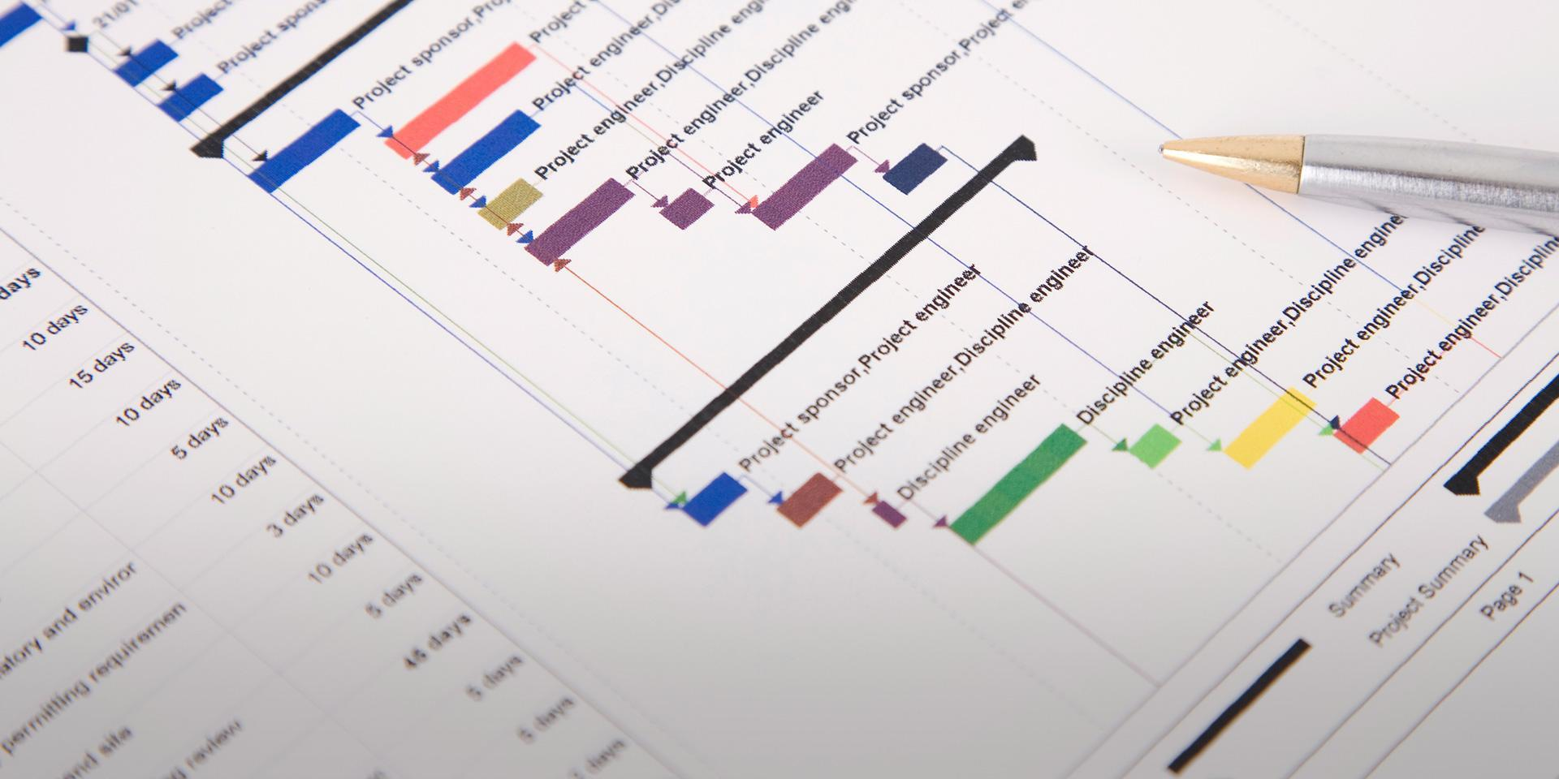
Solution
You can track project
and tasks timeline in
Easy and simple view

Slide 8
Thanks

