Slide 1
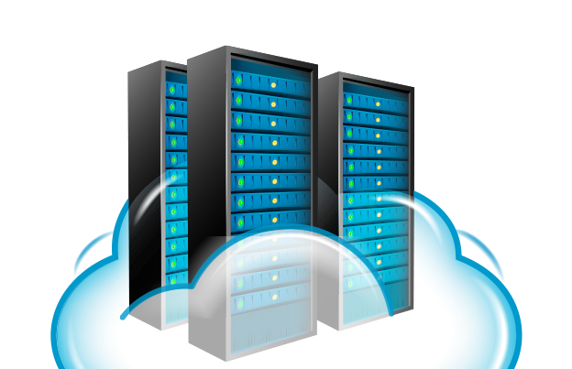
OUR PRESENTATION
CLOUD COMPUTING
(THE ULTRON OF TECHNOLOGY)

Slide 2
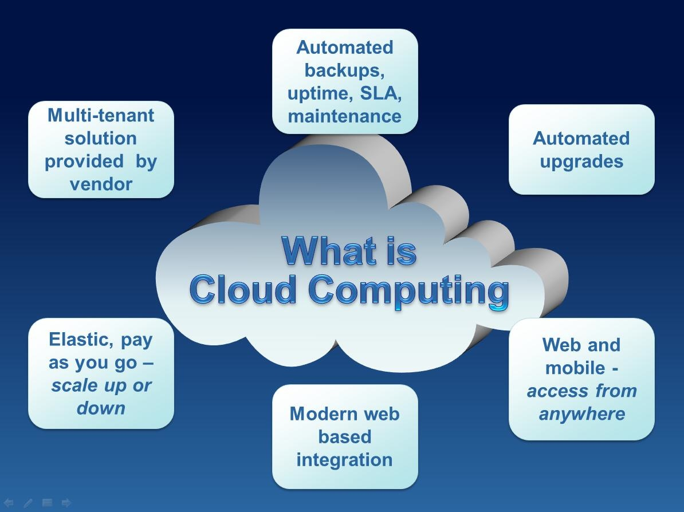
WHAT IS CLOUD COMPUTING ?
cloud computing means storing and accessing data and programs over the Internet instead of your computer's hard drive.
The term cloud is just a metaphor for the Internet.

Slide 3
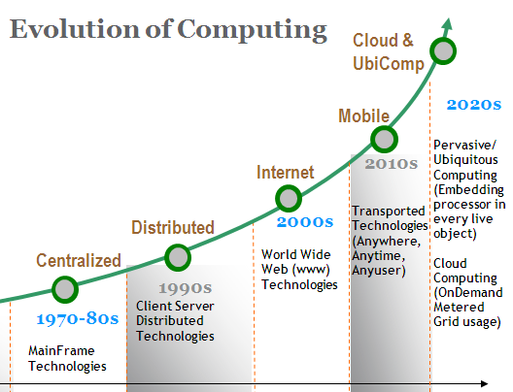
ORIGIN AND EVOLUTION OF CLOUD COMPUTING
•Time sharing systems
•Mainframe computing systems
•Transactional computing systems
•Grid computing systems

Slide 4
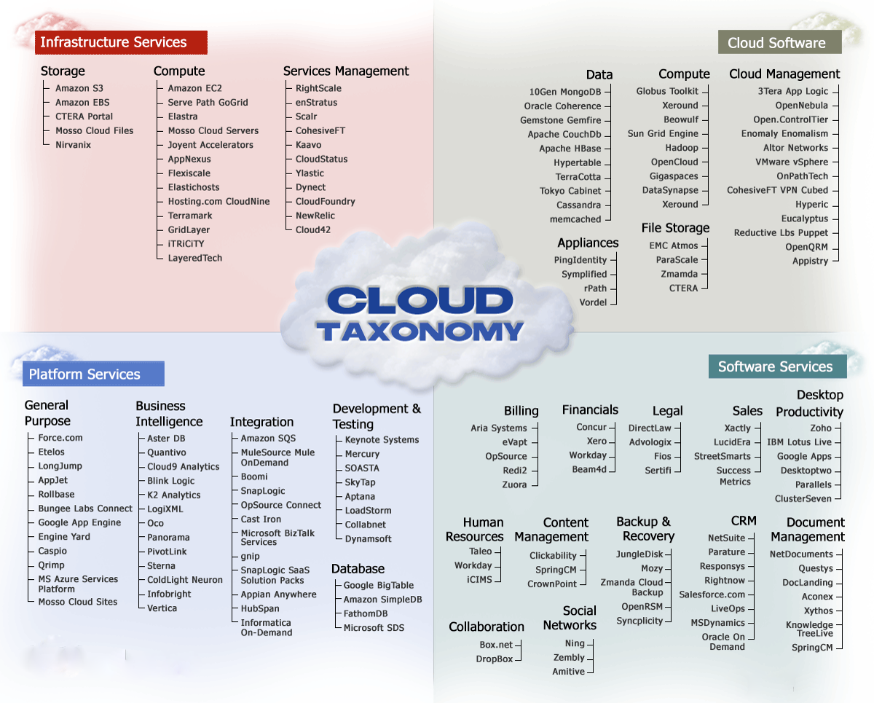
CLOUD TAXONOMY:
Infrastructure Services
Cloud Service
Platform Services
Software Services

Slide 5
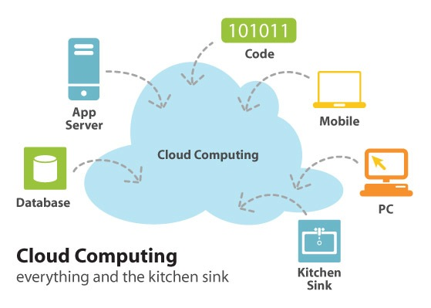
WORKING OF CLOUD:
There are certain services and models working behind the scene making the cloud computing feasible and accessible to end users. Following are working cloud computing.
Deployment models and Service models.

Slide 6
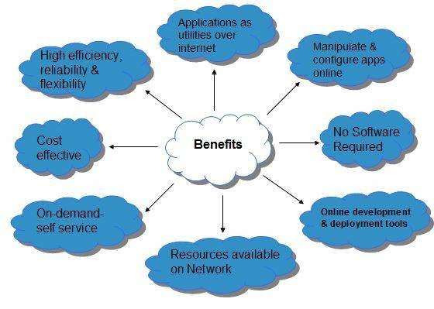
BENEFITS
•Storage and Scalability
•Backup and Recovery
•Mobility
•Cost efficiency
•IT innovation

Slide 7
CHALLENGES
Alignment with the needs of the business / user / non-computer specialists / community and society.
Need to address the scalability issue: large scale data, high performance computing, automation, response time, rapid prototyping, and rapid time to production.
Need to effectively address (i) ever shortening cycle of obsolescence, (ii) heterogeneity and (iii) rapid changes in requirements.
Transform data from diverse sources into intelligence and deliver intelligence to right people/user/systems.

Slide 8
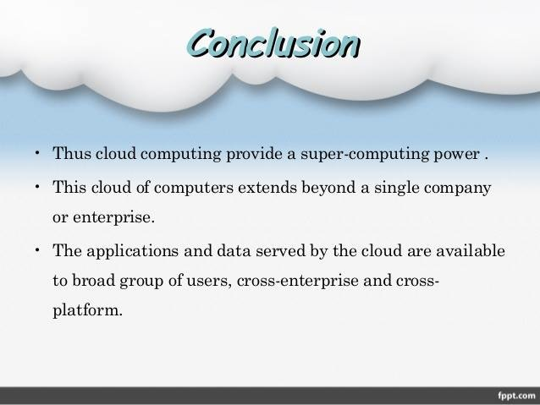
OUR CONCLUSION
A comprehensive look at the path to cloud migrations.
IT just scratching surface of cloud computing technology.
Virtualization to cloud planning, executing a private cloud migration.
Devise a cloud security strategy for governance needs.

Slide 9
THANK YOU!
SAHIL AFRID 150030590 & PRAVEEN 150030040

