Slide 1
Bugs within Modern Web Applications
A survey of the modern bug-fixing process

Slide 2
Javascript - Modern Web Development
Functional
Synchronous
Weakly Typed
WALA can generate CFGs for basic Javascript (Not very powerful yet)
Difficulties in JavaScript data analysis discussed later

Slide 3
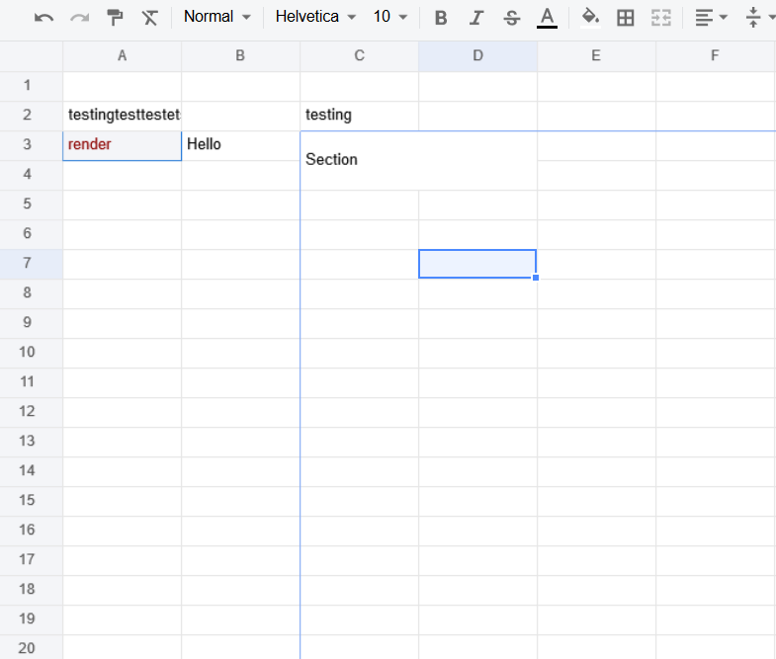
X-Spreadsheets
Open source spreadsheet editor
Can be easily added to javascript projects
Recently released (September 2018)
Many easily reproducible bugs
Many bugs and desired functionalities remain to be addressed

Slide 4

Nuclear
Open source music streaming app
Searches for free music sources
Written for Electron
Alpha build released over a year ago
Easily reproducible bugs currently present
Many desired functionalities being coded

Slide 5
X-Spreadsheets - A Study of Classic JS Debugging

Slide 6
Recursion
A Bug Fix by Levi Clark

Slide 7

The Failure
The application crashes when users enter recursive references into cells.

Slide 8
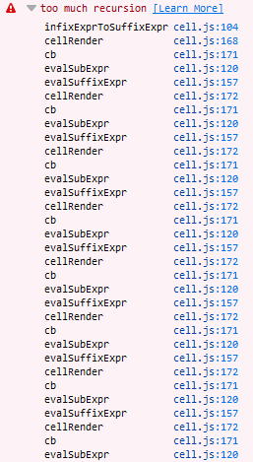
Finding the Bug
The console was reporting continuous recursive calls to four functions:
infixExprToSuffixExpr
cellRender
cb
evalSubExpr
So, I first had to find these functions and evaluate their usage.

Slide 9
Call Graph (Render Cell Dominates)
Render Cell (CB)
Evaluate Suffix Exp
Evaluate Sub Expression

Slide 10
The Bug
There was no recursive reference checking in the cells’ render functions. Upon entering the render function with a recursive cell state, the recursive failure was initiated. The call graph shows a possible loop, and there is no check to ensure it doesn’t loop infinitely.
Allowed
A -> B -> C
A -> B -> C && A -> C
A -> B (Twice)
Not Allowed
A -> B -> A
A -> A
A -> B -> B

Slide 11
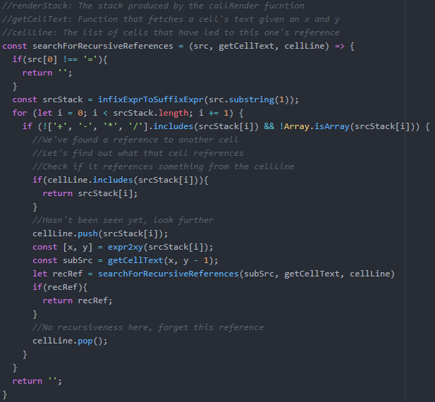
The Fix

Slide 12
New Call Graph
DFS for Recursive References
Render Cell (CB)
Evaluate Suffix Exp
Evaluate Sub Expression

Slide 13
Off by One
A Bug Fix by a Different Person

Slide 14
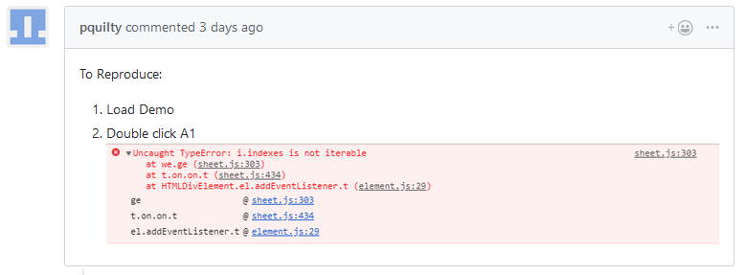
The Failure (With Reproduction Steps)
The application doesn’t let users easily enter information into the first row of cells.

Slide 15
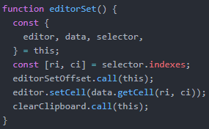
Finding the Bug
The development build produced the below stacktrace
Going to the editorSet() function reveals that selector.indexes should have already been set
So, a developer must find the setting of selector.indexes

Slide 16
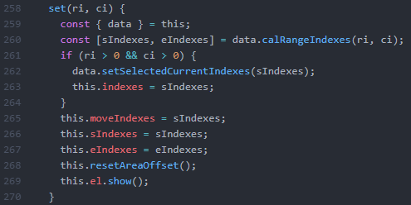
Finding the Bug
The only place indexes are set are within the set function
So, we look for invocations of this function
By logging entries into this function, we can see that this function is often called initially with ri and ci of 0.
(A lazy approach to data analysis)
This leads a developer to guess that line 261 holds an off by one error

Slide 17
The Bug
Line 261 of the selector class (Which holds callbacks to cell functions) had an off by one error. So, during initialization of the application, the selector’s first row and columns of callbacks weren’t initialized. Therefore, when a user tried to access method within these cells, they got a null error.

Slide 18
Call Graph (CallBack Setting Cond.)
Set Callback Function
Set the callback
Set other info

Slide 19
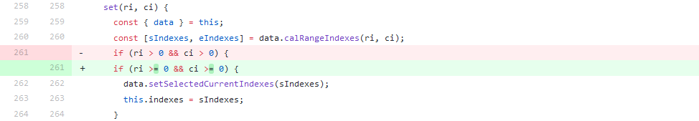
The Fix

Slide 20
Nuclear - A Study of Outside Sources

Slide 21
The API
The case of the missing music

Slide 22

The Failure (With Reproduction Steps)

Slide 23
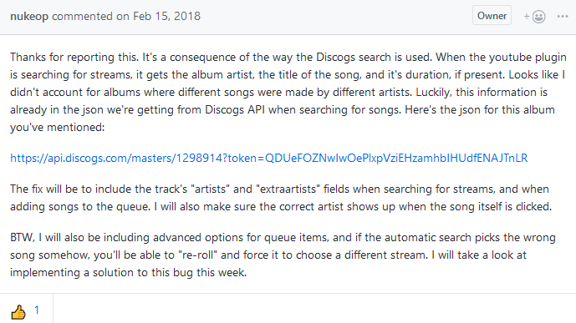
Developer Comment

Slide 24
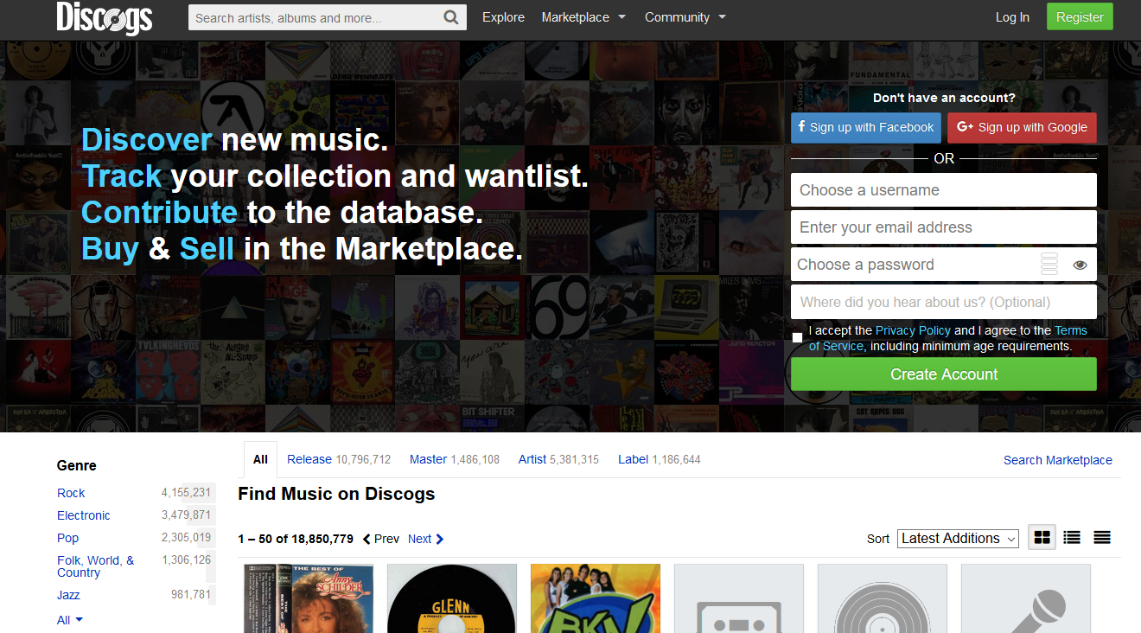
Discogs?

Slide 25
Interesting Implications
Many Javascript applications draw data from a number of sources in order to provide users with an experiences that are both:
More Stable Overall
Quick to Build
The shape of this data is relatively unknown prior to entering the system. This can change remotely. It’s up to developers to ensure that their updates (and others’ updates to their data) don’t break functionality. This makes certain types of data flow analysis slightly more difficult.

Slide 26
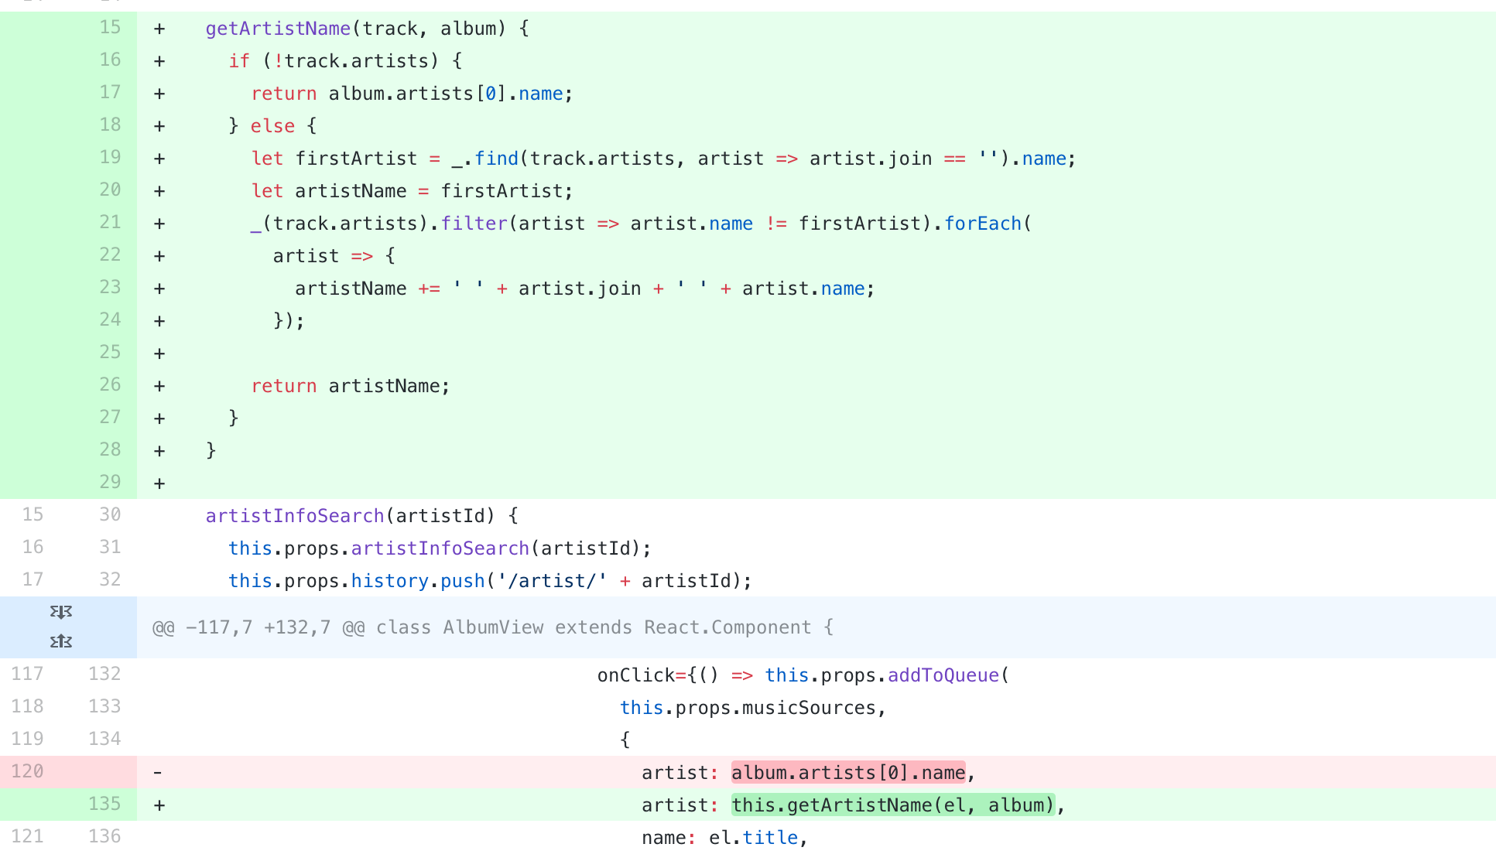
The Fix

Slide 27
The Browser
The case of the missing UI

Slide 28
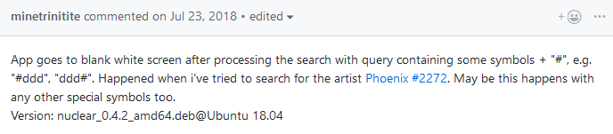
The Failure (With Reproduction Steps)

Slide 29
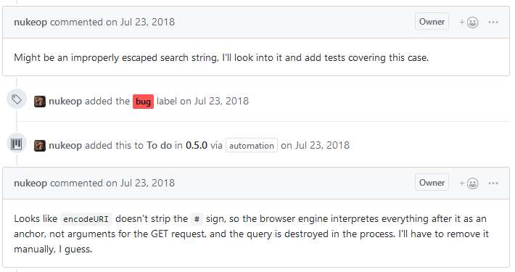
Developer Comment

Slide 30
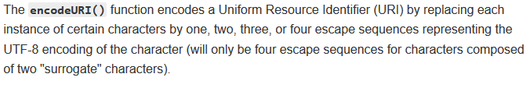
EncodeURI? (From Mozilla)

Slide 31
EncodeURI
EncodeURI is not native to javascript, but is included as a helper functions in all major browsers. However, as time goes on, browsers will change. This makes automated more difficult as well (at this level). Good automated testing would require a consideration of multiple platforms, as opposed to a classic static analysis of a single codebase.

Slide 32
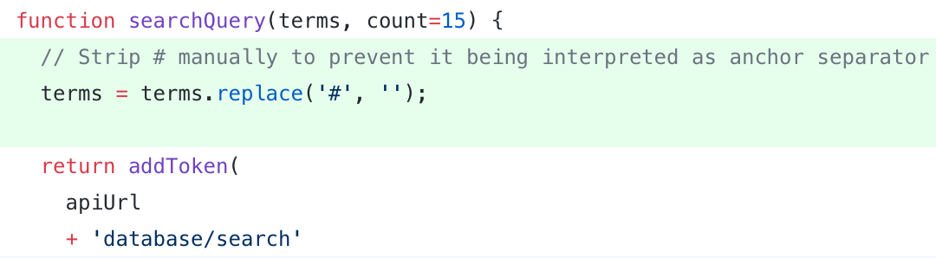
The Fix

Slide 33
NPM
The case of the missing application

Slide 34
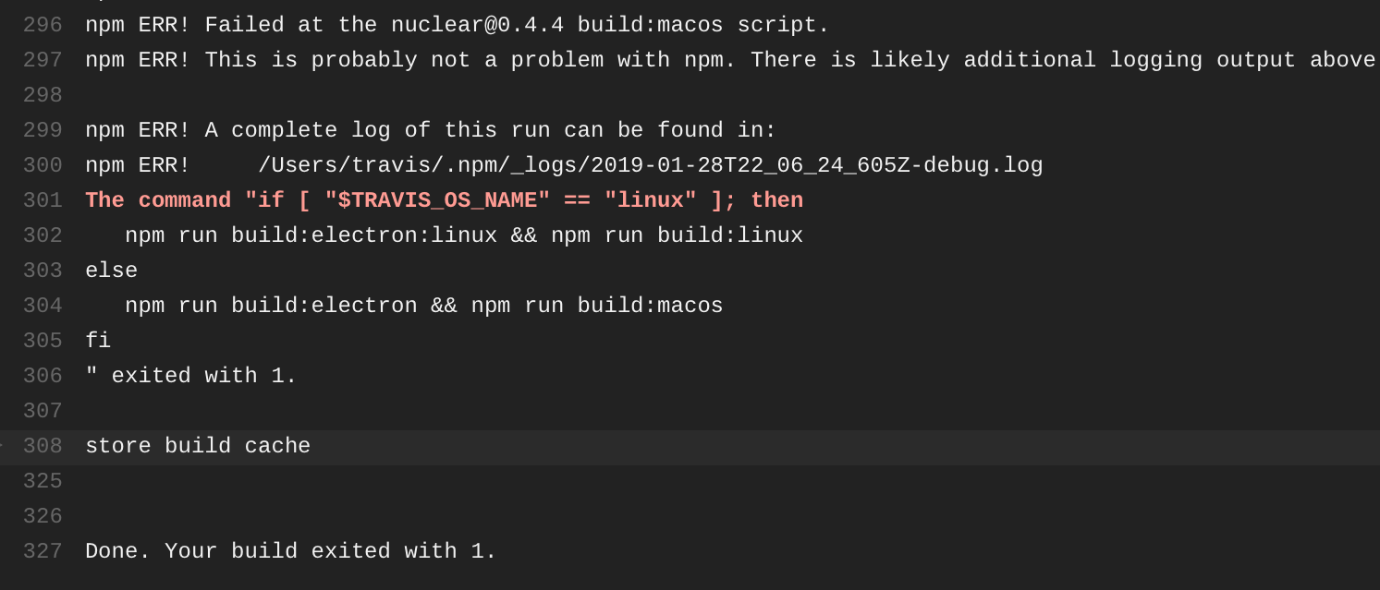
The Failure

Slide 35
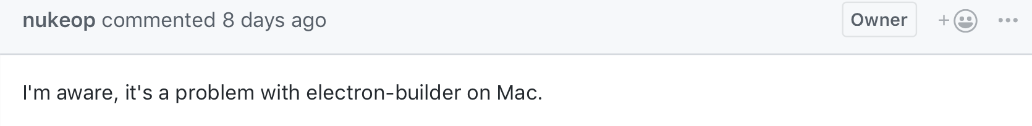
Developer Comment

Slide 36
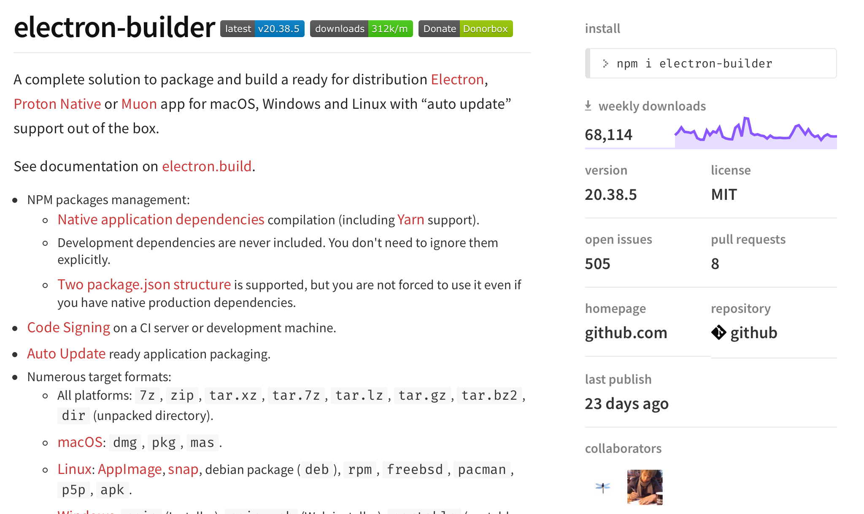
Electron-Builder?

Slide 37
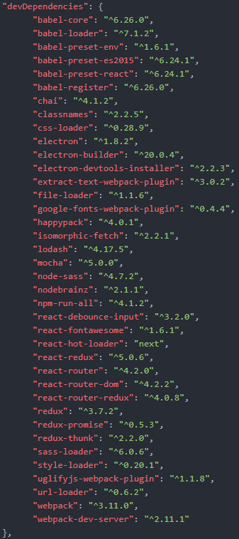
Relevant Points
This project is an example of a typical JS project.
The project has a huge amount of dependencies
These dependencies themselves have many dependencies
Etc.

Slide 38

Dependency Overload
Total dependencies: ~ 962
Total Size: ~ 304 MB
Actual code written: < 1MB
Increases difficulty of automatic detection
(Or perhaps simplifies if treated properly)
Improvements to dependency management systems play a role in this
"The hope is that the progress in hardware will cure all software ills. However, a critical observer may observe that software manages to outgrow hardware in size and sluggishness."
~Niklaus Wirth

Slide 39
The Hurdles I See
Static Analysis Incorporating Dependent Code
Static Analysis Given Outside Sources With Data Variability
Variable Pseudo-Native Functionality in Javascript
Many modern solutions exists to patch missing functionality, but analysis tools would need to evolve along with them

Slide 40
Sources
“EncodeURI().” MDN Web Docs, 29 Oct. 2018, developer.mozilla.org/en-US/docs/Web/JavaScript/Reference/Global_Objects/encodeURI.
Myliang. “Myliang/x-Spreadsheet.” GitHub, 3 Feb. 2019, github.com/myliang/x-spreadsheet.
Nukeop. “Nukeop/Nuclear.” GitHub, 1 Feb. 2019, github.com/nukeop/nuclear/.
Reiser, Martin. The Oberon System: User Guide and Programmer's Manual. ACM Press, 1994.
Madsen, Magnus, et al. “Practical Static Analysis of JavaScript Applications in the Presence of Frameworks and Libraries.” Proceedings of the 2013 9th Joint Meeting on Foundations of Software Engineering - ESEC/FSE 2013, 2013, doi:10.1145/2491411.2491417.

