Slide 1
Debugging with Debuggers
A practical aspect of the theory we learnt
Oyendrila Dobe - 513X survey

Slide 2
What I plan to present...
Large scale uses of debugging
Windows Error Reporting (WER) - an introduction (SOSP 2009)
REPT: Reverse Debugging of Failures in Deployed Software - used to better utilize WER (OSDI 2018)
WHYLINE - a start of a art debugger that uses ‘Why’s to find faults (CHI 2004)
Delta debugging
How useful are modern debugging tools to developer
A Study on the Use of IDE Features for Debugging (MSR 2018)
On the Dichotomy of Debugging Behavior Among Programmers (2018)
Are Automated Debugging Techniques Actually Helping Programmers? (ISSTA 2011)

Slide 3
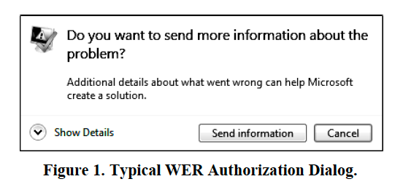
What is Windows Error Reporting (WER) (SOSP’ 09)?
WER is a distributed system that automates the processing of error reports
It basically does the following:
automatically generates error reports for applications and operating systems,
reports them to Microsoft
automatically diagnose them
Notes:
Developed by microsoft …..
Read slide
If you have used a windows machine, and have successfully crashed an application on it, you would usually encounter this dialog box, asking for your permission to submit the error to WER

Slide 4
Overview of how it works
Aggregates error reports likely originating from the same bug into a collection called a bucket
one bug per bucket and finally, one bucket per bug
Client-side labelling
Server-side classification
Does a progressive data collection
Preserves user privacy by asking for consent
Provides solution if error has known solution
Does a statistics-based debugging
Notes:
first bucketing heuristics run on the client
primary goal - produce a unique bucket label based purely on local information that is likely to align with other reports caused by the same bug
heuristics for server-side bucketing attempt to classify error reports to maximize programmer effectiveness
Like analyzing memory dump, to find which thread context or stack frame is responsible
start with little data and ask for more if needed

Slide 5
Great job Microsoft! But….
WER helps, but does not replace other methods for improving software quality.
WER helps to us rank all bugs and to find bugs not exposed through other techniques.
Execution logs help, but high performance overhead for always-on tracing
Challenging for developers to debug using limited memory dump information
Need practical algorithm to recreate failure!
Notes:
static analysis or model checking used to find errors early in development
This is where REPT comes to play

Slide 6
REPT: Reverse Debugging of Failures in Deployed Software
(OSDI ’18)
Also called time-travel debugging
Kind of a record-replay system
Design choices:
Uses memory dump instead of online dump
Analysis on binary level instead of source code level
Uses concrete execution instead of symbolic
Notes:
Records system (collect data about system state) and helps in replaying the failure
Uses memory dump instead of online dump to reduce performance overhead
Need not care about different programmimg languages, need not care about availability of full source code or dependencies
Symbolic is great in helping to recover data values, but For long execution traces constraints gathered may grow to be too large to solve in limited time

Slide 7
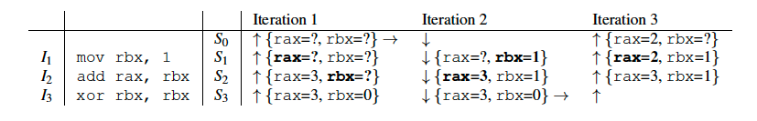
Challenges and how they overcome them
Handling irreversible instructions (e.g., xor rax rax)
Combine forward and reverse analysis
Notes:
REPT is to keep using the memory values that are possibly valid to infer other values, and to correct the values later if the values turn out to be invalid based on conflicts.

Slide 8
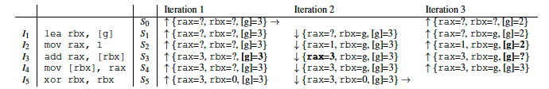
Challenges continued...
Missing memory writes
Use error correction
Also….

Slide 9
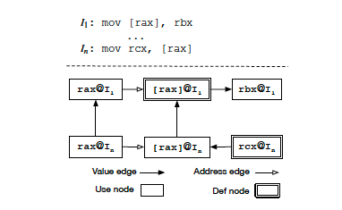
Uses a data interference graph
Notes:
tracks how a data value is inferred in either forward or backward directions while a data flow graph tracks the program’s data flow in just one direction.

Slide 10
One last challenge...
Handling concurrency
Uses timing information logged by hardware per instruction
Uses the concept that memory writes are the only operations whose orders may affect data recovery
Divides into subsequences merges into single conceptual instruction
Notes:
REPT first divides them into subsequences, then merges them into a single conceptual
instruction sequence based on the inferred orders.
For two subsequences whose order cannot be inferred, REPT arbitrarily inserts one before the other in the newly constructed sequence.

Slide 11
WHYLINE - reinvented debugging using ‘WHY”s
(ICSE’ 08- Distinguished paper)
For JAVA, based on ALICE WHYLINE
Motivation:
Slicing tools require a choice of variable
Querying tools require a person to write an executable expression about data
If the developer chooses code irrelevant to the bug, irrelevant answers are produced - Garbage In Garbage OUT
Whyline allows developers to choose a why did or why didn’t question about program output

Slide 12
Example scenario
Testing a simple painting application
Problem was that the RGB color sliders did not create the right colors.
After program halts, Whyline loads the whole trace…..

Slide 13
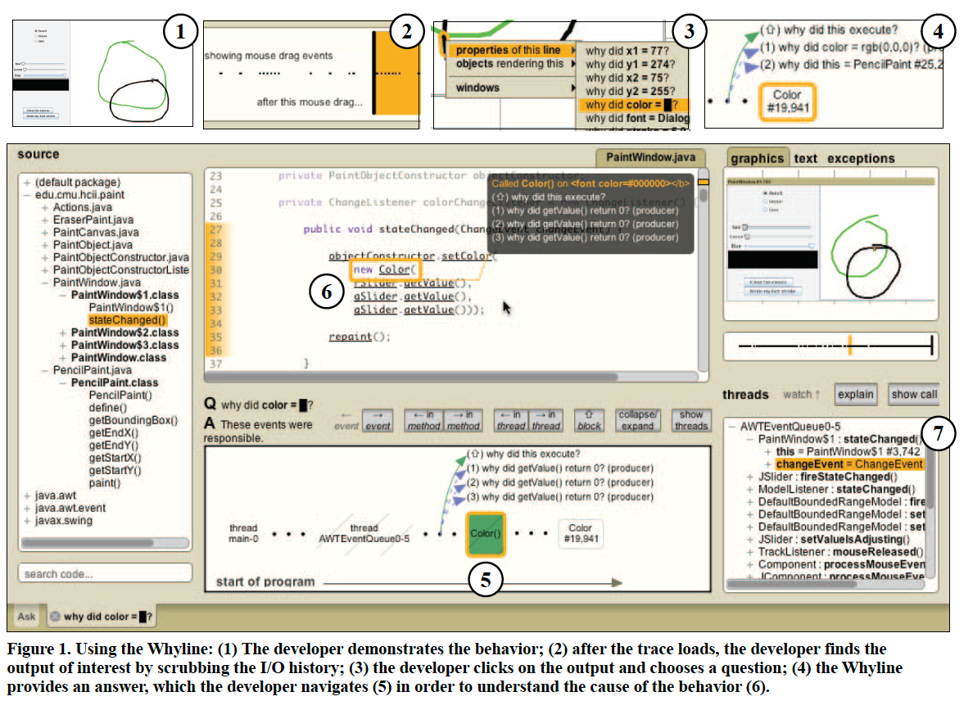

Slide 14
Has limitations, but definitely an Innovation...
Since trace-based, cannot span for more than a few minutes
Tracing makes it a ‘very’ heavy tool
Memory demands grows as the trace grows
If program knowledge is encrypted, questions will be encrypted
Notes:
Because the Whyline extracts all of the knowledge about a program from the program itself, any limitation on the knowledge
encoded in a program limits the Whyline’s utility.

Slide 15
These do look good on toy examples.
But how far do these debuggers actually help developers?

Slide 16
Are Automated Debugging Techniques
Actually Helping Programmers? (ISSTA’ 11, MSR’ 18, ICSE’ 18)
Hypothesis 1 - Programmers who debug with the assistance of automated debugging tools will locate bugs faster
Hypothesis 2 - The effectiveness of an automated tool increases with the level of diculty of the debugging task.
Hypothesis 3 - The effectiveness of debugging when using a ranking based automated tool is affected by the rank of the faulty statement.

Slide 17
Research questions posed...
How do developers navigate a list of statements ranked by suspiciousness?
Does perfect bug understanding exist?
What are the challenges involved in using automated debugging tools?
How effective are debugging tools in reducing time and effort ?
When do developers start using debuggers and how does their editing change while using a debugger?
How much are developers actually aware of debugger features?

Slide 18
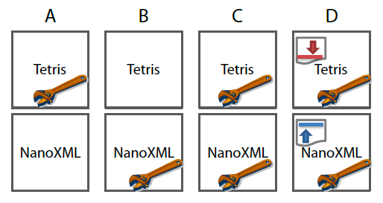
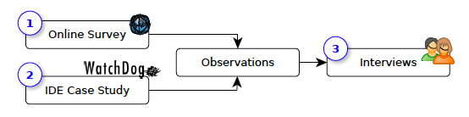
Different survey cases have been used…
And another paper did a case study using Visual Studio’s debugging features
Notes:
The tetris paper provided Tarantula as the state-of-the-art debugger

Slide 19
Results of the surveys summed up
Debugging time is equal or greater when debugger is used
‘Experts’ are faster with debugger
Developers hardly use IDE-provided debugger
Feature awareness is lacking
Smaller classes are debugged more than larger classes
Most developers are still more comfortable with ‘printf’ debugging
Notes:
they may frequently apply small
edits to the source code when they develop code, but apply less
frequent or larger edits while repairing defects.

Slide 20
Improvements they want…
Make the core features easier to use while preserving all existing functionality. (Although more advanced features are seldom used)
Back-in-time debugging
Better search algorithm along with existing ranking algorithm
Programmers do not really follow linearity as suggested by ranking algorithms
Notes:
We observed that a common cause of frustration during
debugging is the inability to distinguish irrelevant state-
ments from relevant ones.
Hence quit debugger

Slide 21
References
Debugging in the (very) large: ten years of implementation and experience
{REPT}: Reverse Debugging of Failures in Deployed Software
Designing the whyline: a debugging interface for asking questions about program behavior
A Study on the Use of IDE Features for Debugging - Carnegie Mellon ...
On the dichotomy of debugging behavior among programmers
Are Automated Debugging Techniques Actually Helping Programmers?

