Slide 1
Departmental Project 2
Presented by – Mohit Saharan
Advisor – Dr. Pravata K. Mohanty
Comparison of CORSIKA hadronic interaction generators with GRAPES-3 data

Slide 2
Outline
Cosmic rays
Aim of this study
Simulation of monoenergetic showers
Simulation of showers with variable energy
Comparison of simulation results with GRAPES-3 data
Future plans

Slide 3
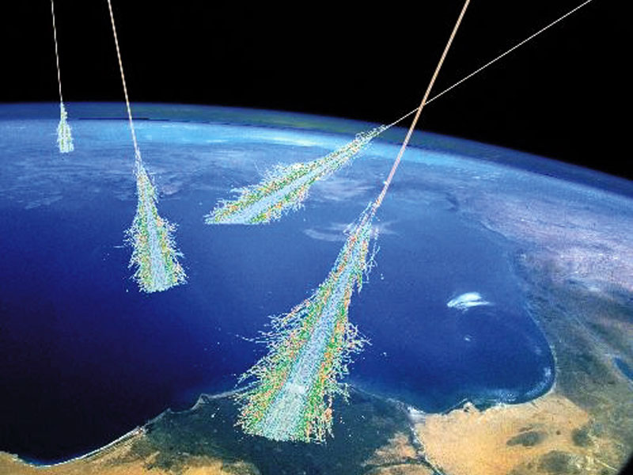
Cosmic rays
High energy particles originating from outer space
Mostly protons (90%), helium (9%), heavier nuclei,
minute fraction of high energy electrons, positrons
Direct detection by balloon experiments, satellite borne detectors
  Constraints on exposure time and detector area
High energy CRs are detected by doing indirect measurements
  Ground based detector arrays: Effectively large surface area of detector, long exposure time

Slide 4
Cosmic rays
Origin, acceleration, and propagation?
Composition of cosmic ray sources
Detectable shower secondaries
  Electron, muon, hadron, and photons
  Characteristics depend on energy and mass of the primary cosmic ray particle
Muon component is a very sensitive parameter for distinguishing between various primary nuclei

Slide 5
Aim of this study
To find a hadronic interaction generator which agrees the best with GRAPES-3 data
Cosmic ray composition
Simulation of monoenergetic air showers using different hadronic interaction generators
  varying primary energy
  varying primary mass
Realistic simulation of proton initiated showers
Comparison of the resulting muon multiplicity distributions

Slide 6
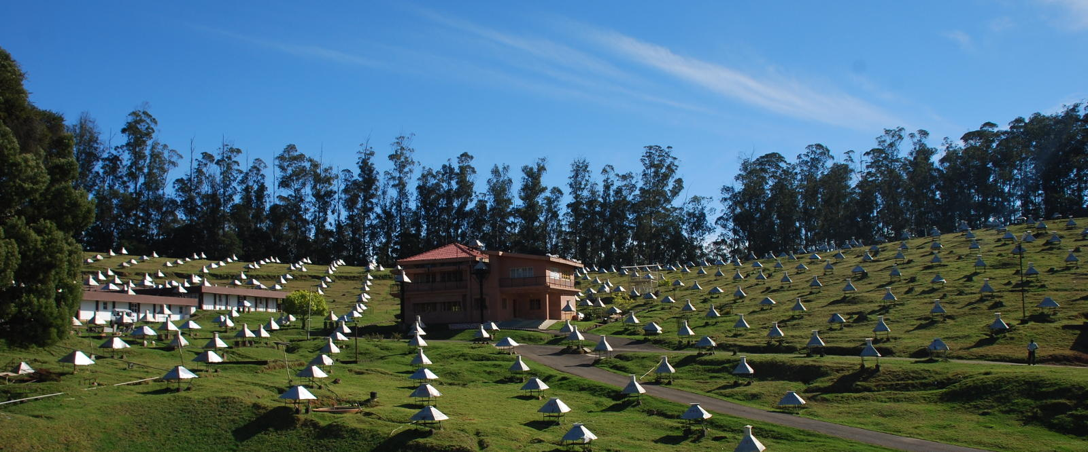
GRAPES-3 Experiment
Gamma Ray Astronomy at PeV Energies – Phase 3

Slide 7
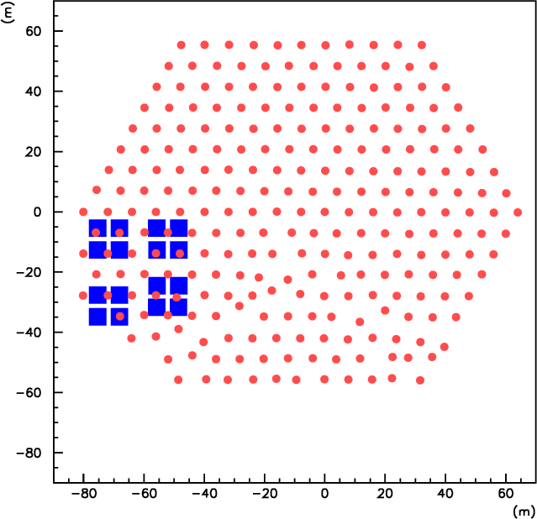
GRAPES-3 Experiment
400 plastic scintillator detectors (1 m²)
Array covers an area of 25000 m²
Large area (560 m²) tracking muon detector
Muon detector
  16 muon modules (35 m² each)
  Each module has 232 proportional counters

Slide 8
CORSIKA simulation package
High energy hadronic interaction generators
  SIBYLL
  QGSJETII
Low energy hadronic interaction generators
  FLUKA

Slide 9
Simulation of monoenergetic showers
PCRs
  Lighter (H, He)
  Medium (C,N,O)
  Heavier (Al, Fe, Co)
θ = 0°
E = 10 TeV, 100 TeV, and 1000 TeV
50,000 events simulated at 10 TeV and 100 TeV
2400 events simulated at 1000 TeV

Slide 10
Comparison of Pre-LHC and Post-LHC generators
Pre-LHC: SIBYLL-2.1 and QGSJETII-03
Post-LHC: SIBYLL-2.3c and QGSJETII-04
Proton initiated showers

Slide 11
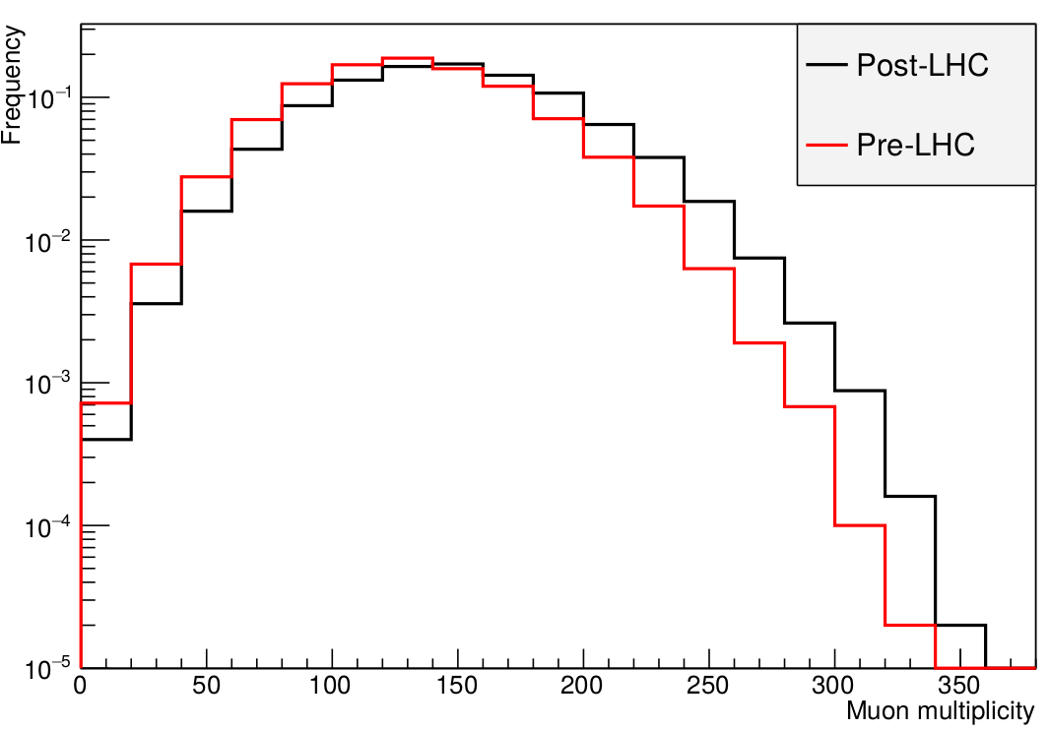
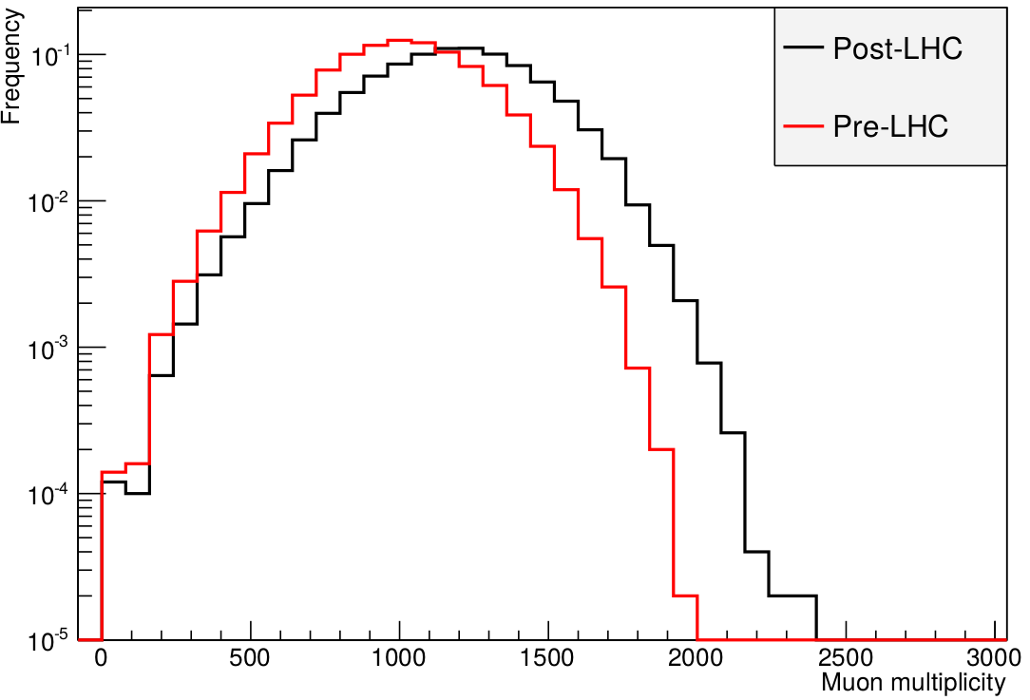
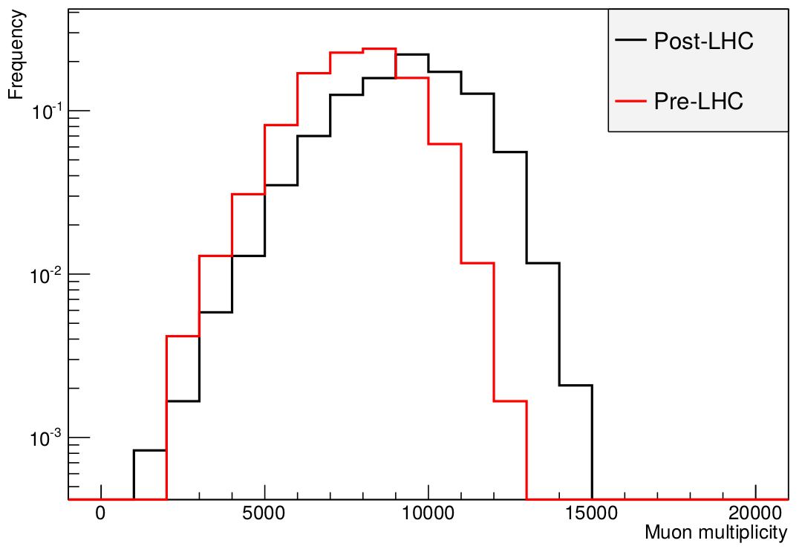
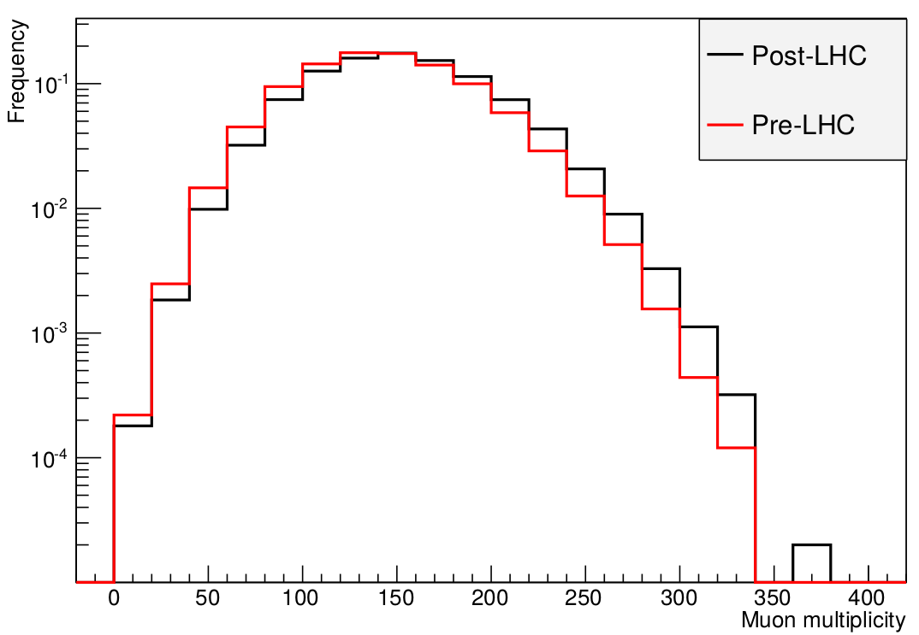
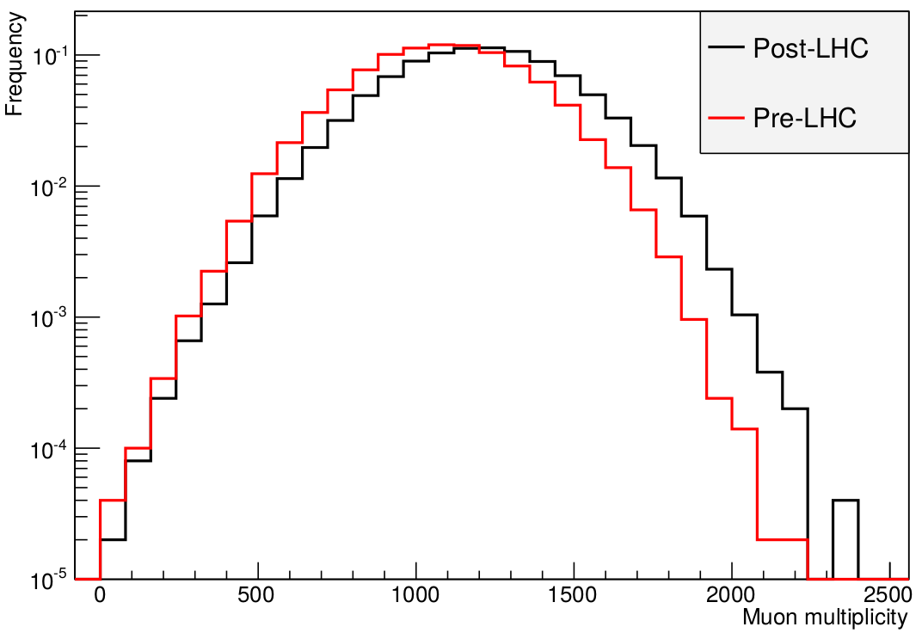
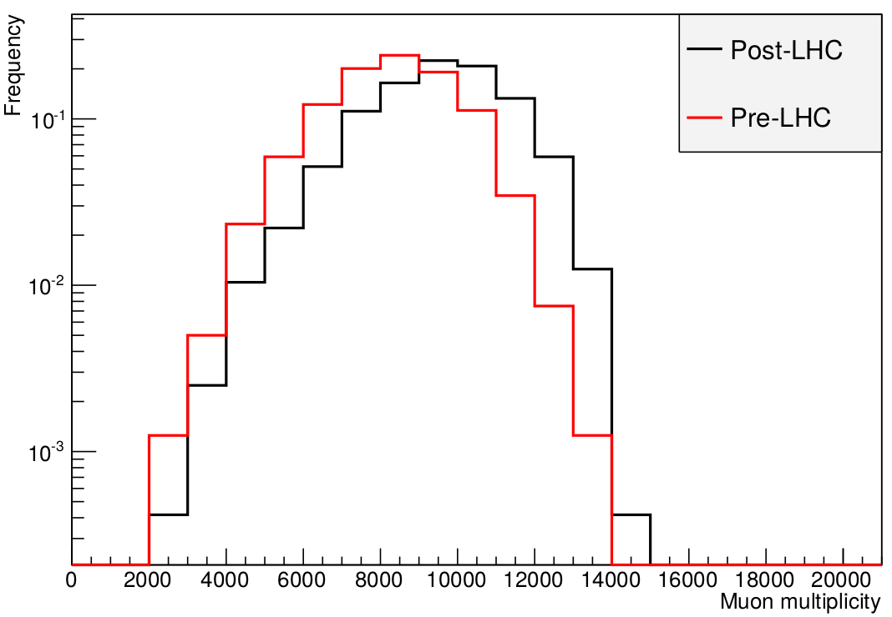
Pre-LHC and Post-LHC generators
SIBYLL
10 TeV
100 TeV
1000 TeV
QGSJETII
10 TeV
100 TeV
1000 TeV

Slide 12
Pre-LHC and Post-LHC generators
 | SIBYLL-FLUKA |  | QGSJETII-FLUKA |  | Q vs S
 | Median | % Increase | Median | % Increase | % Increase
10 TeV
Pre-LHC | 130 |  | 142 |  | 9.2
Post-LHC | 146 | 12.3 | 150 | 5.6 | 2.7
100 TeV
Pre-LHC | 1006 |  | 1088 |  | 8.2
Post-LHC | 1180 | 17.3 | 1200 | 10.3 | 1.7
1000 TeV
Pre-LHC | 7866 |  | 8327 |  | 5.9
Post-LHC | 9393 | 19.4 | 9586 | 15.1 | 2.1

Slide 13
Comparison between Post-LHC generators
SIBYLL 2.3c and QGSJETII-04

Slide 14
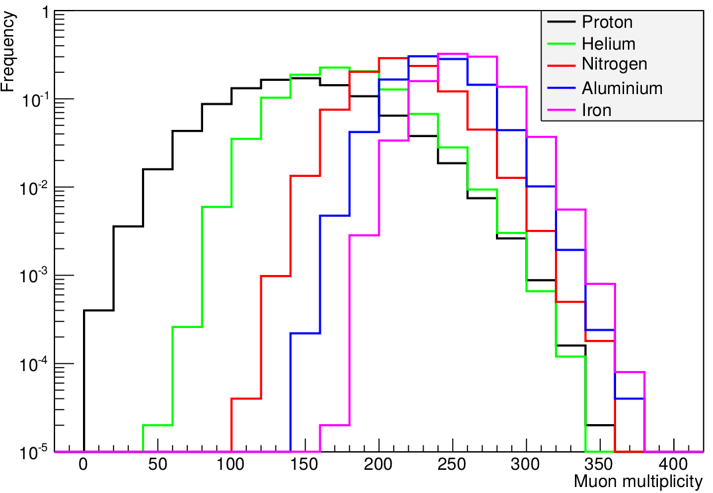
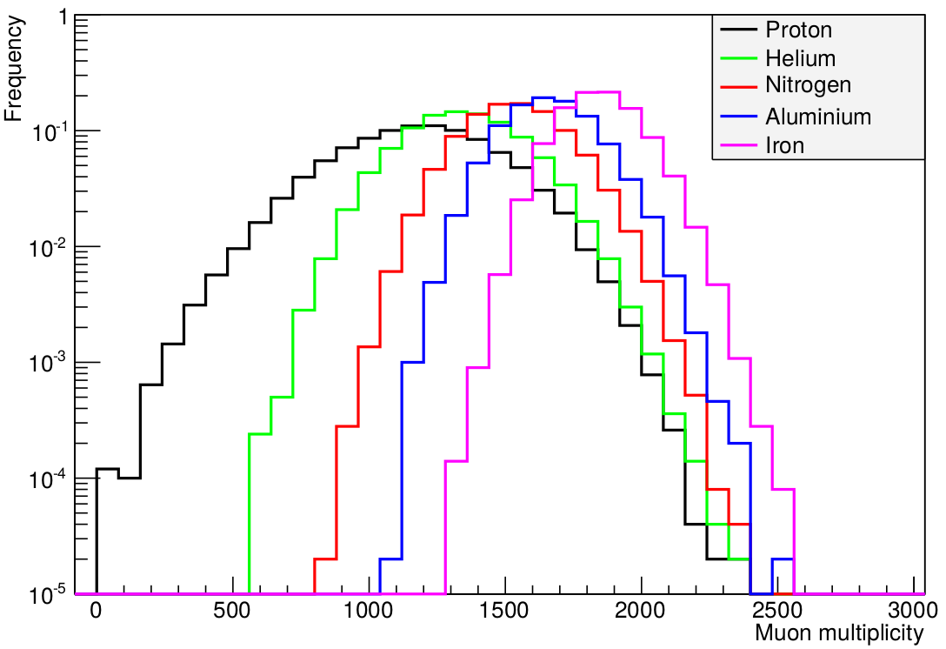
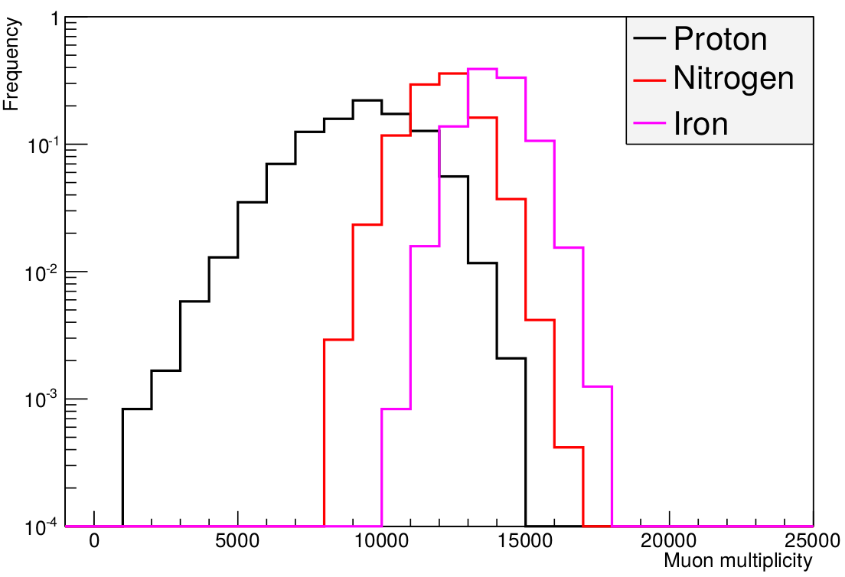
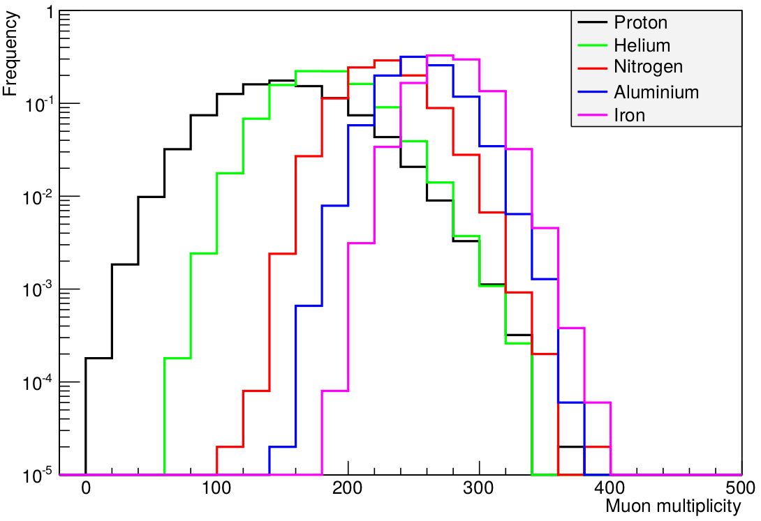
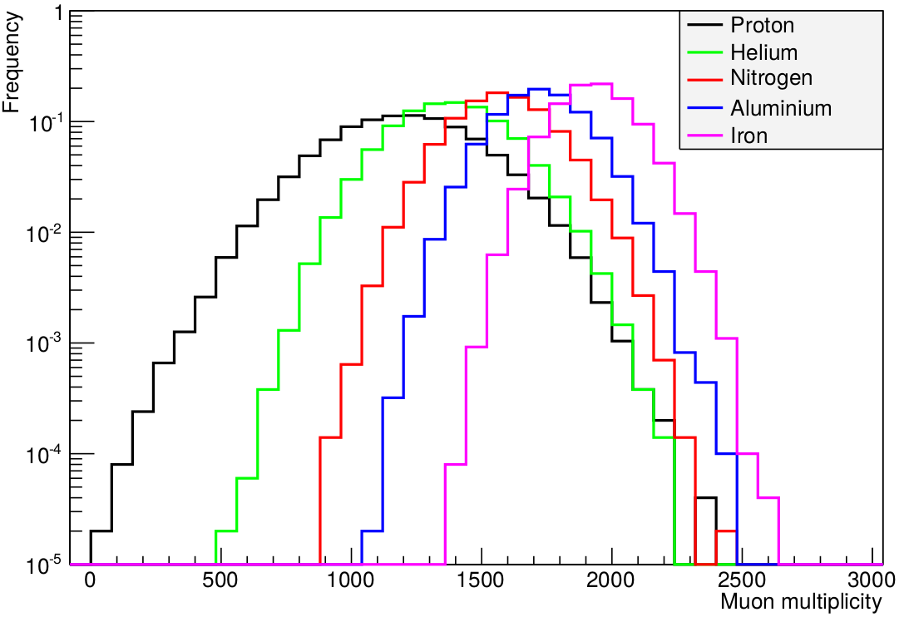
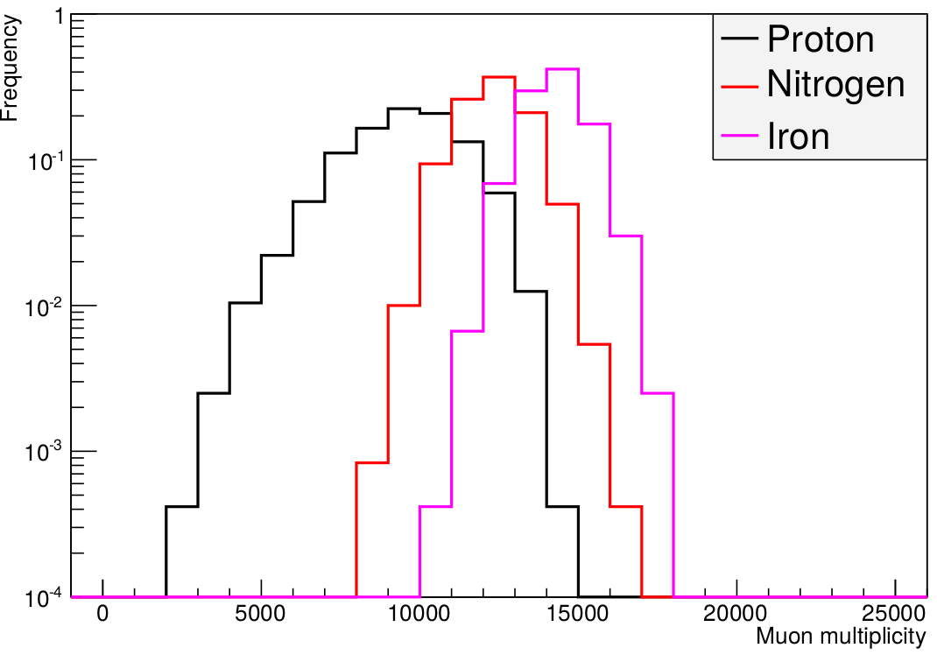
Post-LHC generators: SIBYLL 2.3c and QGSJETII-04
SIBYLL-2.3c
10 TeV
100 TeV
1000 TeV
QGSJETII-04
10 TeV
100 TeV
1000 TeV

Slide 15
Simulation for E = 10 TeV
 | SIBYLL-FLUKA |  | QGSJETII-FLUKA |  | Q vs S
 | Median | % Increase | Median | % Increase | % Increase
H | 146 |  | 150 |  | 2.7
He | 174 | 19.2 | 182 | 21.3 | 4.6
N | 214 | 46.6 | 227 | 51.3 | 6.0
Al | 239 | 63.7 | 254 | 69.3 | 6.3
Fe | 259 | 77.4 | 278 | 85.3 | 7.3
QGSJETII-04 produces more 2.7% to 7.3 % more muons as compared to SIBYLL-2.3c.
Muon multiplicity increases with mass number

Slide 16
Simulation for E = 100 TeV
 | SIBYLL-FLUKA |  | QGSJETII-FLUKA |  | Q vs S
 | Median | % Increase | Median | % Increase | % Increase
H | 1180 |  | 1200 |  | 1.7
He | 1340 | 13.6 | 1375 | 14.58 | 2.6
N | 1531 | 29.8 | 1577 | 31.42 | 3.0
Al | 1659 | 40.6 | 1724 | 43.67 | 3.9
Fe | 1845 | 56.4 | 1931 | 60.92 | 4.7
QGSJETII-04 produces more 1.7% to 4.7 % more muons as compared to SIBYLL-2.3c.
Muon multiplicity increases for more massive nuclei

Slide 17
Simulation for E = 1000 TeV
 | SIBYLL-FLUKA |  | QGSJETII-FLUKA |  | Q vs S
 | Median | % Increase | Median | % Increase | % Increase
H | 9393 |  | 9586 |  | 2.1
N | 12132 | 29.2 | 12337 | 28.7 | 1.7
Fe | 13874 | 47.7 | 14284 | 49.0 | 3.0
Data generated only for H, N, and Fe
QGSJETII-04 produces more 1.7% to 3.0 % more muons as compared to SIBYLL-2.3c.
Muon multiplicity increases for more massive nuclei

Slide 18
Analysis of spectrum data
Bin No | Energy Range (TeV) | No. of events
Pre-LHC (SIBYLL – 2.1)
1 | 63.10 – 100.00 | 99900
2 | 100.00 – 158.49 | 45700
3 | 158.49 – 251.19 | 20900
4 | 251.19 – 398.11 | 9500
5 | 398.11 – 630.96 | 4400
6 | 630.96 – 1000.0 | 2000
Bin No | Energy Range (TeV) | No. of events
Post-LHC (SIBYLL – 2.3c)
1 | 63.10 – 100.00 | 30,00,000
2 | 100.00 – 158.49 | 13,72,000
3 | 158.49 – 251.19 | 6,27,000
4 | 251.19 – 398.11 | 2,86,500
5 | 398.11 – 630.96 | 1,31,100
6 | 630.96 – 1000.0 | 59,800
0°<θ<25°
MMD for shower size (N_{e}) - 10^{4.0} to 10^{5.5} with bin width = 10^{0.5}
Comparison with 2014 data

Slide 19
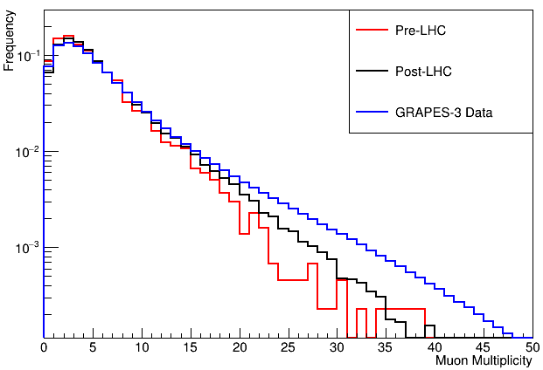
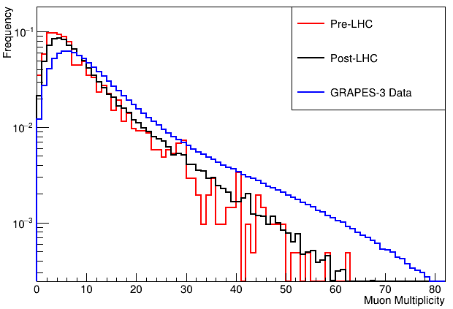
Comparison of simulation results with GRAPES-3 data
Shower Size – 10^{4.0} to 10^{4.5}
Shower Size – 10^{4.5} to 10^{5.0}

Slide 20
Summary
Monoenergetic showers induced by different primaries (Post-LHC)
  MM of QGSJETII-04 is 1.7% to 7.3% higher than that of SIBYLL-2.3c.
Proton initiated monoenergetic showers (Post-LHC and Pre-LHC)
  MM of SIBYLL-2.3c is 12.3% to 19.2% higher than that of SIBYLL-2.1
  MM of QGSJETII-04 is 5.6 to 15.1% higher than that of QGSJETII-03
Proton initiated spectrum data
  Post-LHC simulation data shows better agreement with GRAPES-3 data

Slide 21
Future Work
Generation of spectrum data for He, N, Al, and Fe
Comparison with GRAPES-3 data to find the composition of cosmic rays for 63 TeV<E<1000 TeV

Slide 22
Backup slides
Shower Size – 10^{5.0} to 10^{5.5}

Slide 23
Obtaining shower parameters
The EAS direction theta and phi was calculated by a chi^2 minimization of the relative arrival times of particles. N_{e} was obtained by fitting the Nishimura-Kamata-Griesen (NKG) lateral distribution function to observed densities.
  Write NKG function here
Age (s) was calculated by the maximum likelihood algorithm MINUIT. Procedure!

Slide 24
