Slide 1
Departmental Project 2
Presented by – Mohit Saharan
Advisor – Dr. Pravata K. Mohanty
Comparison of CORSIKA hadronic interaction generators with GRAPES-3 data

Slide 2
Outline
Cosmic rays
Aim of this study
Simulation of monoenergetic showers
Simulation of showers with variable energy
Comparison of simulation results with GRAPES-3 data
Future plans

Slide 3
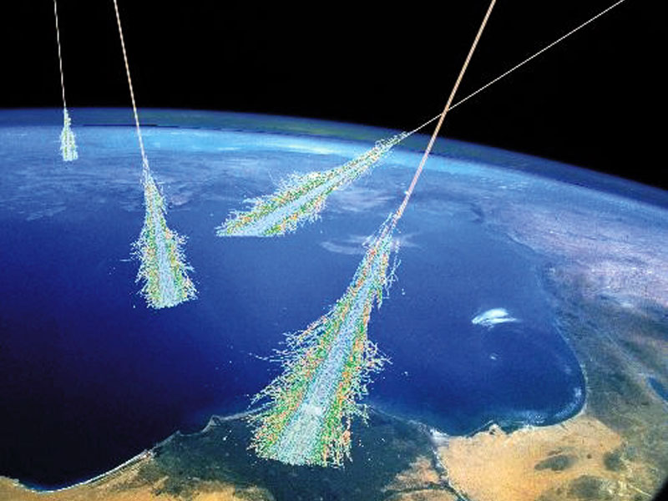
Cosmic rays
High energy particles originating from outer space
Mostly protons (90%), helium (9%), heavier nuclei,
minute fraction of high energy electrons, positrons
Direct detection by balloon experiments, satellite borne detectors
  Constraints on exposure time and detector area
High energy CRs are detected by doing indirect measurements
  Ground based detector arrays: Effectively large surface area of detector, long exposure time

Slide 4
Cosmic rays
Origin, acceleration, and propagation?
Composition of cosmic rays
Detectable shower secondaries
  Electron, muon, hadron, and photons
  Characteristics depend on energy and mass of the primary cosmic ray particle
Muon component is a very sensitive parameter for distinguishing between various primary nuclei

Slide 5
Aim of this study
To find a hadronic interaction generator which agrees the best with GRAPES-3 data
Cosmic ray composition
Simulation of monoenergetic air showers using different hadronic interaction generators
  varying primary energy
  varying primary mass
Realistic simulation of proton initiated showers
Comparison of the resulting muon multiplicity distributions

Slide 6
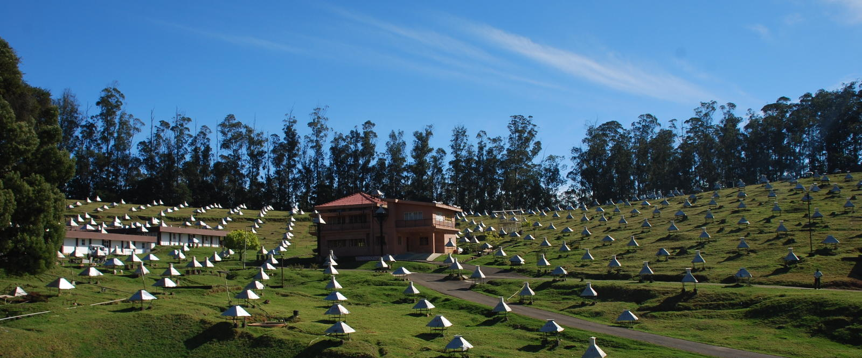
GRAPES-3 Experiment
Gamma Ray Astronomy at PeV Energies – Phase 3

Slide 7
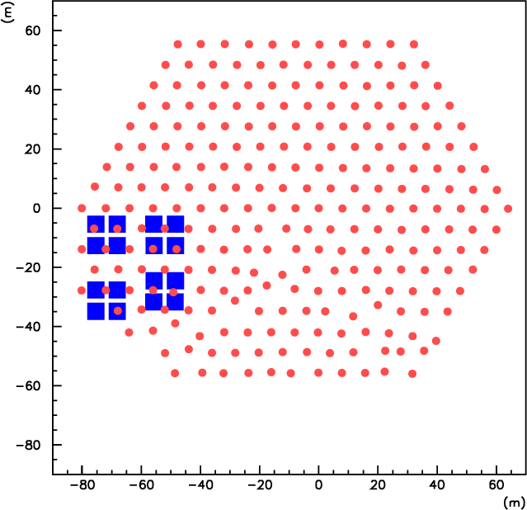
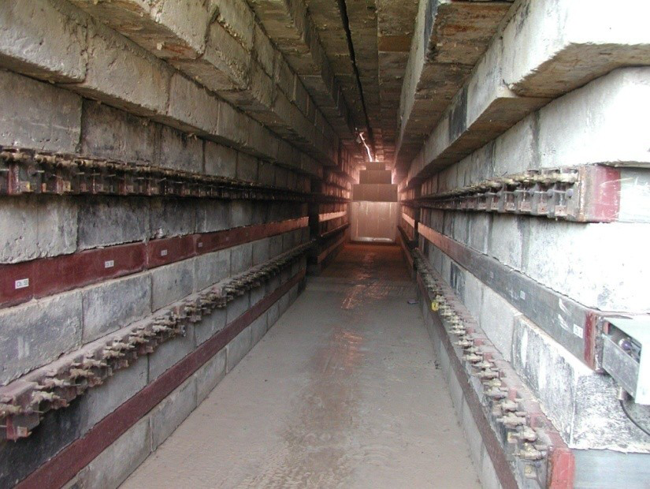
GRAPES-3 Experiment
Located in Ooty, India; 2200 m above
sea level
400 plastic scintillator detectors (1 m²)
Array covers an area of 25000 m²
Large area (560 m²) tracking muon detector
Muon detector
  16 muon modules (35 m² each)
  Each module has 232 proportional counters

Slide 8
CORSIKA simulation package
High energy hadronic interaction generators
  SIBYLL
  QGSJETII
Low energy hadronic interaction generators
  FLUKA

Slide 9
Simulation of monoenergetic showers: Part 1
Primary
  H
θ = 0°
E = 10 TeV, 100 TeV, and 1000 TeV
50,000 events simulated at 10 TeV and 100 TeV
2400 events simulated at 1000 TeV
Pre-LHC: SIBYLL-2.1 and QGSJETII-03
Post-LHC: SIBYLL-2.3c and QGSJETII-04

Slide 10
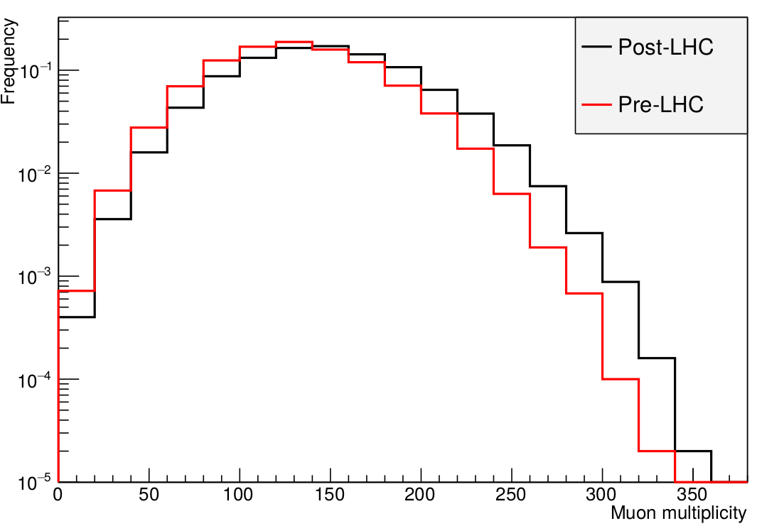
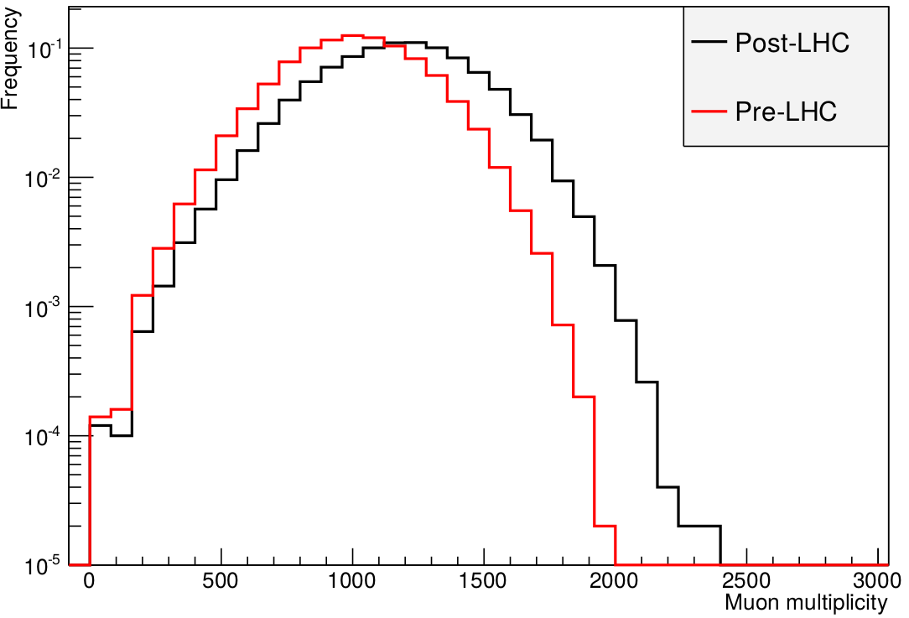
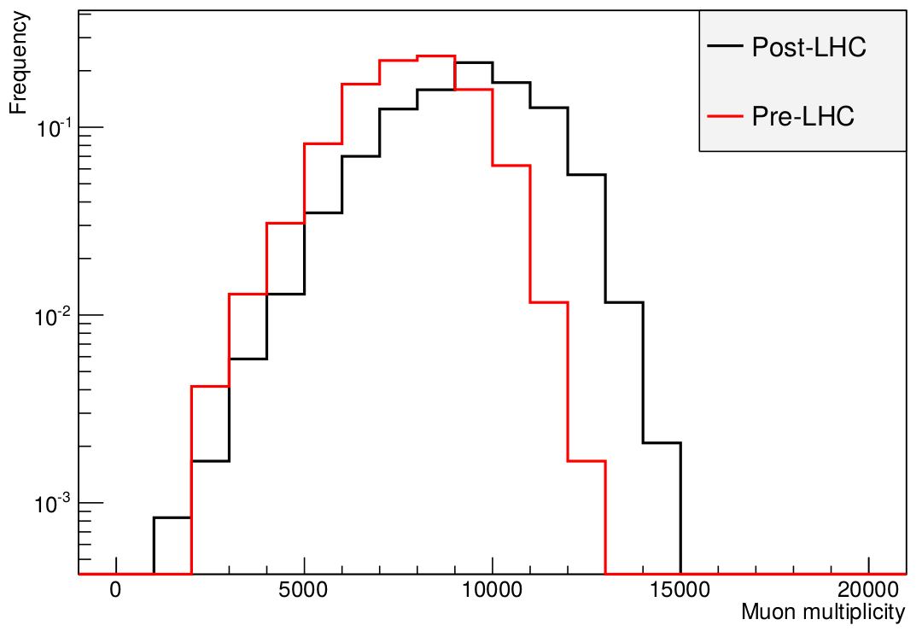
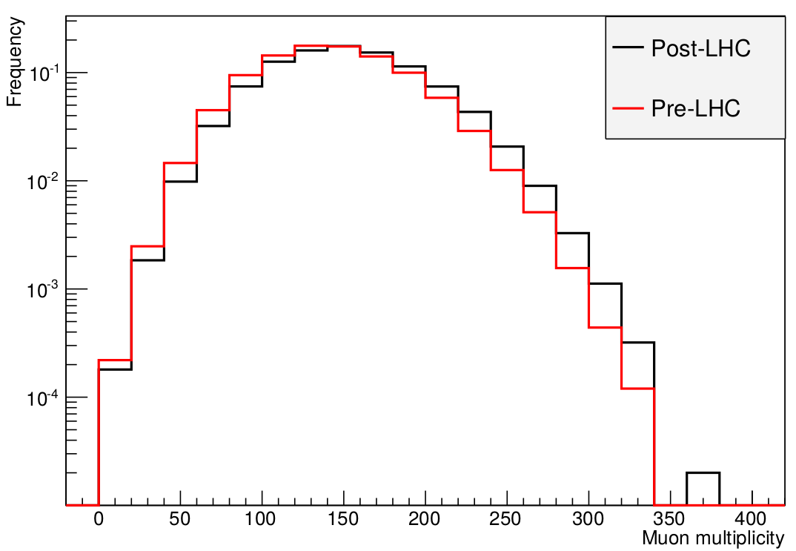
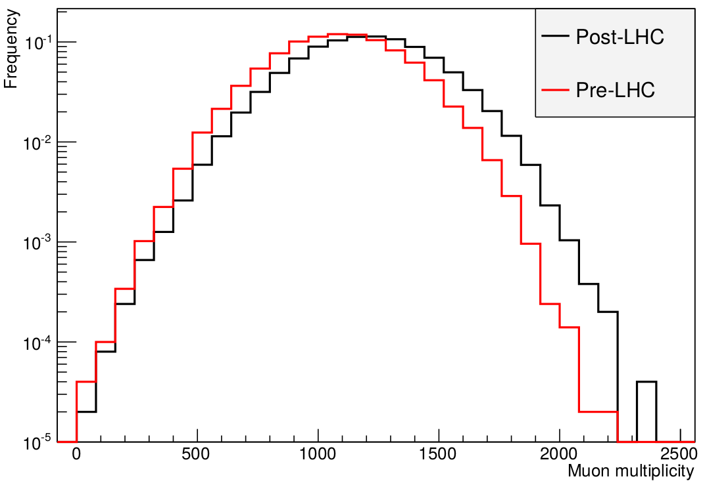
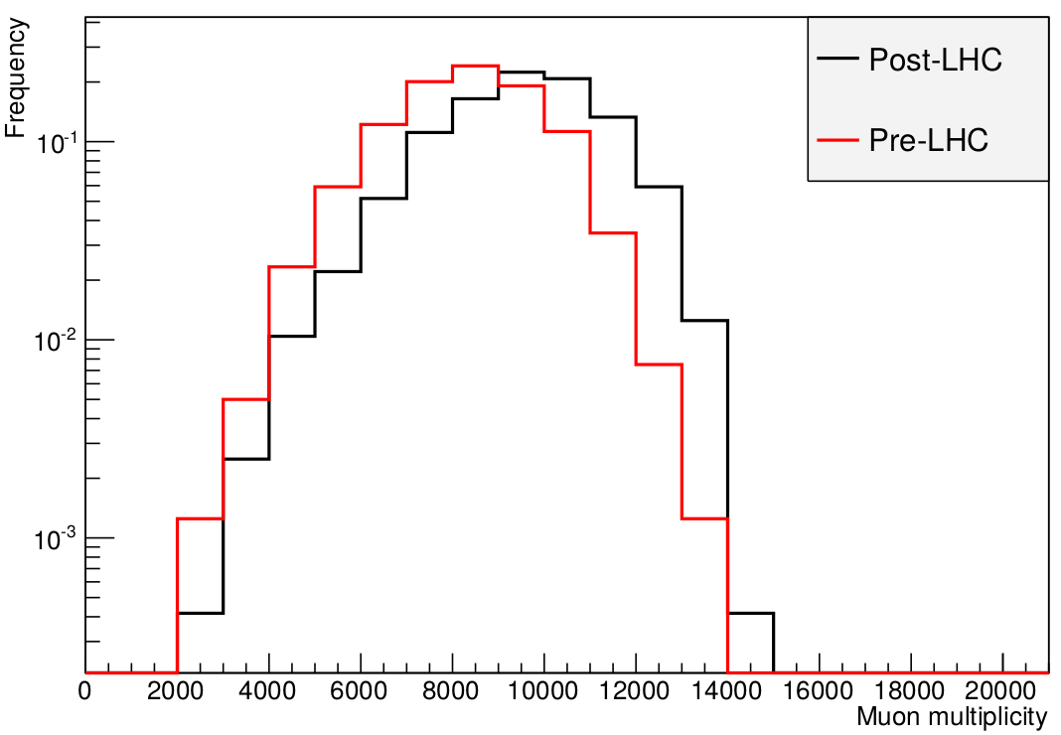
Muon multiplicity distributions
SIBYLL
No. of events
10 TeV
100 TeV
1000 TeV
Muon Multiplicity
QGSJETII
10 TeV
100 TeV
1000 TeV

Slide 11
Pre-LHC and Post-LHC generators
Energy |  | SIBYLL-FLUKA |  | QGSJETII-FLUKA
 |  | Median | % Increase | Median | % Increase
10 TeV | Pre-LHC | 130 |  | 142
 | Post-LHC | 146 | 12 | 150 | 6
100 TeV | Pre-LHC | 1006 |  | 1088
 | Post-LHC | 1180 | 17 | 1200 | 10
1000 TeV | Pre-LHC | 7866 |  | 8327
 | Post-LHC | 9393 | 19 | 9586 | 15
Post-LHC SIBYLL produced 12% to 19 % more muons as compared to Pre-LHC SIBYLL
Post-LHC QGSJETII produced 6% to 15 % more muons as compared to Pre-LHC QGSJETII

Slide 12
Pre-LHC and Post-LHC generators
Energy |  | SIBYLL-FLUKA |  | QGSJETII-FLUKA |  | Q vs S
 |  | Median |  | Median |  | % Increase
10 TeV | Pre-LHC | 130 |  | 142 |  | 9.2
 | Post-LHC | 146 |  | 150 |  | 2.7
100 TeV | Pre-LHC | 1006 |  | 1088 |  | 8.2
 | Post-LHC | 1180 |  | 1200 |  | 1.7
1000 TeV | Pre-LHC | 7866 |  | 8327 |  | 5.9
 | Post-LHC | 9393 |  | 9586 |  | 2.1
Pre-LHC : 6% to 8% difference
Post-LHC : 2% to 3% difference
Difference decreases with increasing energy

Slide 13
Simulation of monoenergetic showers:
Part 2
PCRs
  Lighter (H, He)
  Medium (C,N,O)
  Heavier (Al, Fe, Co)
θ = 0°
E = 10 TeV, 100 TeV, and 1000 TeV
50,000 events at 10 TeV and 100 TeV
2400 events at 1000 TeV
At 1000 TeV, data generated only for H, N, and Fe
Post-LHC generators

Slide 14
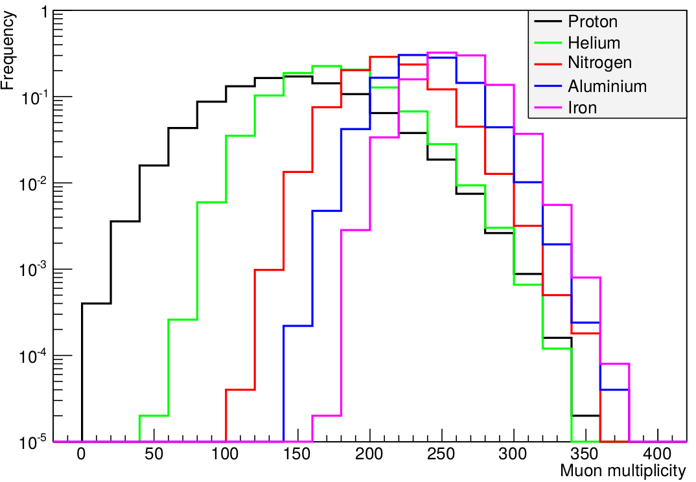
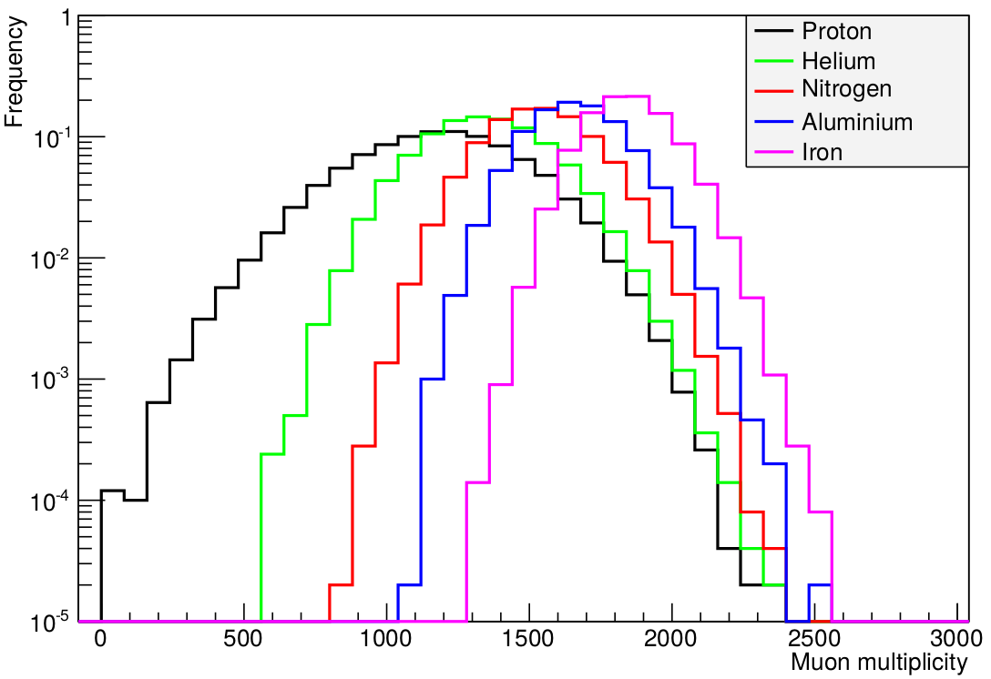
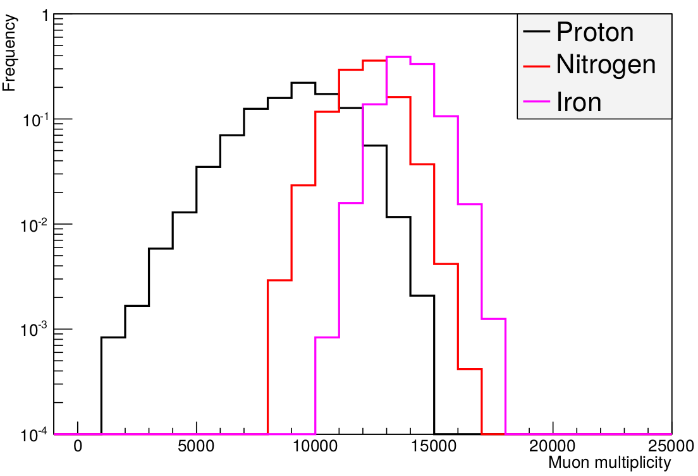
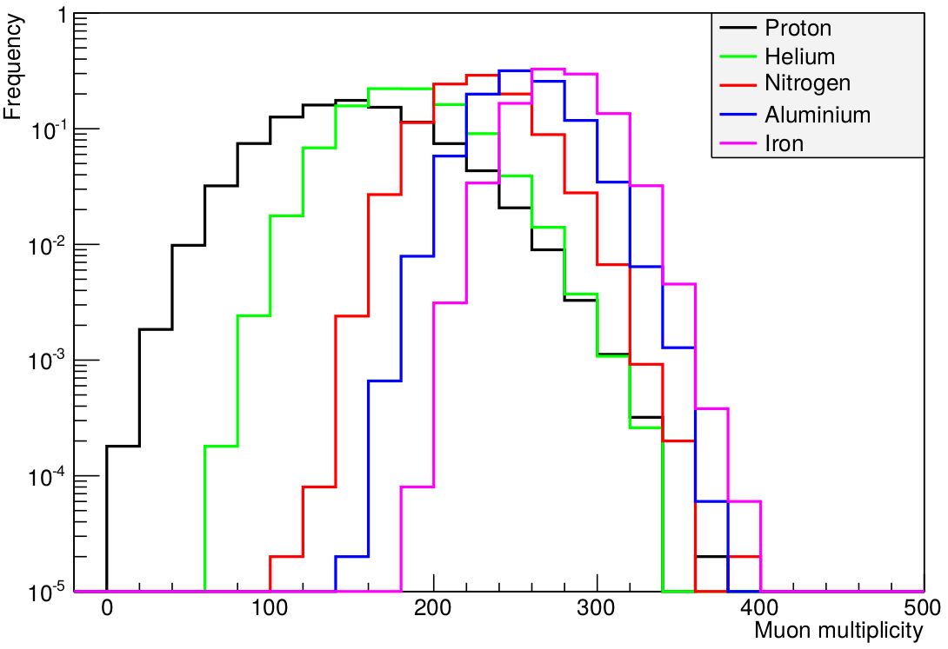
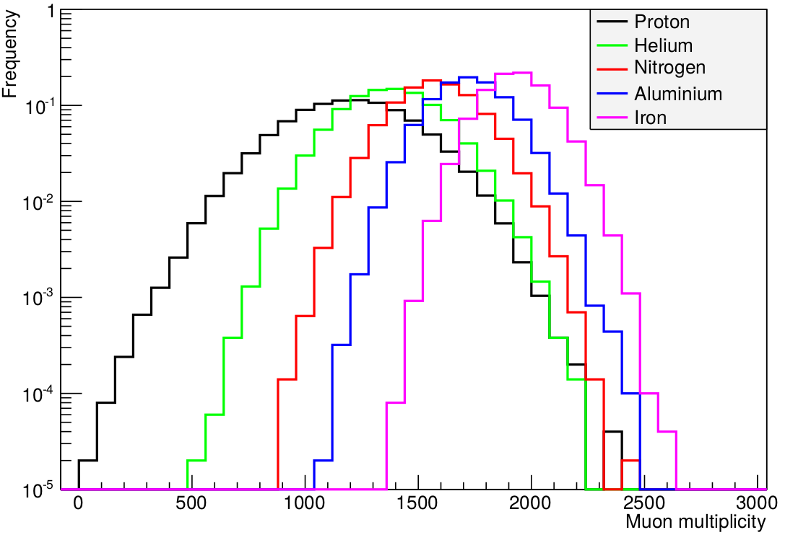
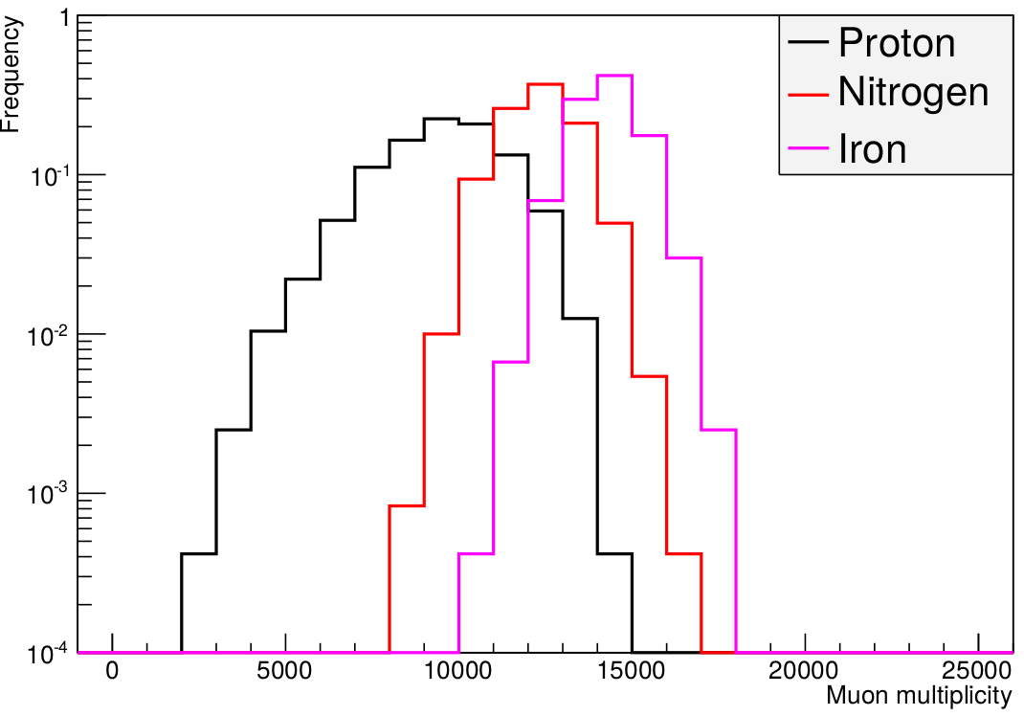
Muon multiplicity distributions
SIBYLL
10 TeV
100 TeV
1000 TeV
No. of events
Muon Multiplicity
QGSJETII
10 TeV
100 TeV
1000 TeV

Slide 15
Simulation for E = 10 TeV
 | SIBYLL-FLUKA |  | QGSJETII-FLUKA
 | Median | % Increase | Median | % Increase
H | 146 |  | 150
He | 174 | 19 | 182 | 21
N | 214 | 47 | 227 | 51
Al | 239 | 64 | 254 | 69
Fe | 259 | 77 | 278 | 85
Muon multiplicity increases with mass number
SIBYLL: Fe produced 77% more muons than H
QGSJETII: Fe produced 85% more muons than H

Slide 16
Simulation for E = 10 TeV
 | SIBYLL-FLUKA |  | QGSJETII-FLUKA |  | Q vs S
 | Median |  | Median |  | % Increase
H | 146 |  | 150 |  | 2.7
He | 174 |  | 182 |  | 4.6
N | 214 |  | 227 |  | 6.0
Al | 239 |  | 254 |  | 6.3
Fe | 259 |  | 278 |  | 7.3
QGSJETII produced ~ 3% to 7 % more muons as compared to SIBYLL
Difference increases with mass number

Slide 17
Simulation for E = 100 TeV
 | SIBYLL-FLUKA |  | QGSJETII-FLUKA
 | Median | % Increase | Median | % Increase
H | 1180 |  | 1200
He | 1340 | 14 | 1375 | 15
N | 1531 | 30 | 1577 | 31
Al | 1659 | 41 | 1724 | 44
Fe | 1845 | 56 | 1931 | 61
Muon multiplicity increases with mass number
SIBYLL: Fe produced 56% more muons than H
QGSJETII: Fe produced 61% more muons than H

Slide 18
Simulation for E = 100 TeV
 | SIBYLL-FLUKA |  | QGSJETII-FLUKA |  | Q vs S
 | Median |  | Median |  | % Increase
H | 1180 |  | 1200 |  | 1.7
He | 1340 |  | 1375 |  | 2.6
N | 1531 |  | 1577 |  | 3.0
Al | 1659 |  | 1724 |  | 3.9
Fe | 1845 |  | 1931 |  | 4.7
QGSJETII produced 2% to 5 % more muons as compared to SIBYLL
Difference increases with mass number

Slide 19
Simulation for E = 1000 TeV
 | SIBYLL-FLUKA |  | QGSJETII-FLUKA
 | Median | % Increase | Median | % Increase
H | 9393 |  | 9586
N | 12132 | 29.2 | 12337 | 28.7
Fe | 13874 | 47.7 | 14284 | 49.0
Data generated only for H, N, and Fe
Muon multiplicity increases with mass number
SIBYLL: Fe produced 48% more muons than H
QGSJETII: Fe produced 49% more muons than H

Slide 20
Simulation for E = 1000 TeV
 | SIBYLL-FLUKA |  | QGSJETII-FLUKA |  | Q vs S
 | Median |  | Median |  | % Increase
H | 9393 |  | 9586 |  | 2.1
N | 12132 |  | 12337 |  | 1.7
Fe | 13874 |  | 14284 |  | 3.0
QGSJETII produced 2% to 3.0 % more muons as compared to SIBYLL
Difference is almost constant with increasing mass number

Slide 21
Simulation of proton initiated showers with variable energy
Bin No | Energy Range (TeV) | No. of events analysed
 |  | Pre-LHC | Post-LHC
1 | 63.10 – 100.00 | 99900 | 30,00,000
2 | 100.00 – 158.49 | 45700 | 13,72,000
3 | 158.49 – 251.19 | 20900 | 6,27,000
4 | 251.19 – 398.11 | 9500 | 2,86,500
5 | 398.11 – 630.96 | 4400 | 1,31,100
6 | 630.96 – 1000.0 | 2000 | 59,800
0°<θ<25°
Shower size (N_{e}) - 10^{4.0} to 10^{5.5} with bin width = 10^{0.5}
Comparison with 2014 data

Slide 22
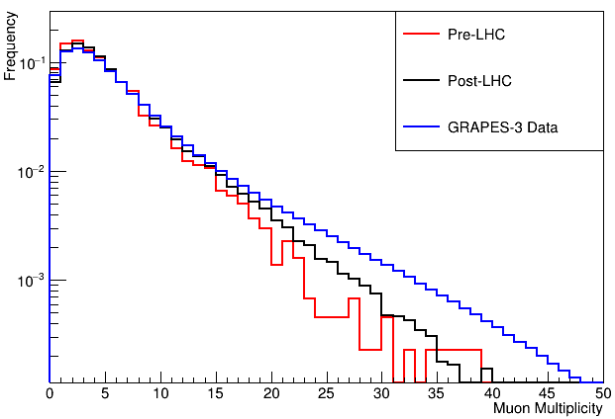
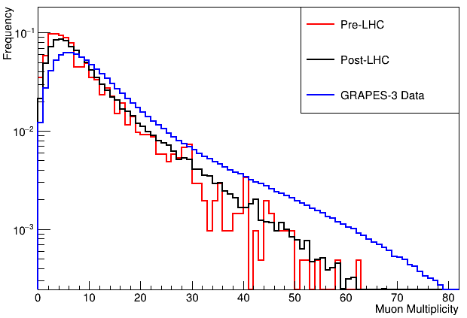
Comparison of simulation results with GRAPES-3 data
Shower Size – 10^{4.0} to 10^{4.5}
Shower Size – 10^{4.5} to 10^{5.0}

Slide 23
Summary
Post-LHC generators give higher muon multiplicity
  SIBYLL: 12% - 19% more muons in Post-LHC
  QGSJETII: 6% - 15% more muons in Post-LHC
In Post-LHC, QGSJETII gives higher muon multiplicity than SIBYLL
  2% to 7% more muons in QGSJETII
Proton initiated spectrum data
  Post-LHC simulation data shows better agreement with GRAPES-3 data

Slide 24
Future Work
Generation of spectrum data for He, N, Al, and Fe
Comparison with GRAPES-3 data to find the composition of cosmic rays for 63 TeV<E<1000 TeV

Slide 25
Backup slides
Shower Size – 10^{5.0} to 10^{5.5}

Slide 26
Obtaining shower parameters
The EAS direction theta and phi was calculated by a chi^2 minimization of the relative arrival times of particles. N_{e} was obtained by fitting the Nishimura-Kamata-Griesen (NKG) lateral distribution function to observed densities.
  Write NKG function here
Age (s) was calculated by the maximum likelihood algorithm MINUIT. Procedure!

Slide 27
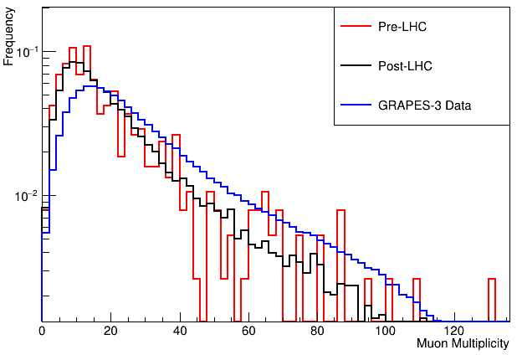

Slide 32
Pre-LHC and Post-LHC generators
Energy |  | SIBYLL-FLUKA |  | QGSJETII-FLUKA |  | Q vs S
 |  | Median | % Increase | Median | % Increase | % Increase
10 TeV | Pre-LHC | 130 |  | 142 |  | 9.2
 | Post-LHC | 146 | 12.3 | 150 | 5.6 | 2.7
100 TeV | Pre-LHC | 1006 |  | 1088 |  | 8.2
 | Post-LHC | 1180 | 17.3 | 1200 | 10.3 | 1.7
1000 TeV | Pre-LHC | 7866 |  | 8327 |  | 5.9
 | Post-LHC | 9393 | 19.4 | 9586 | 15.1 | 2.1

