Slide 1
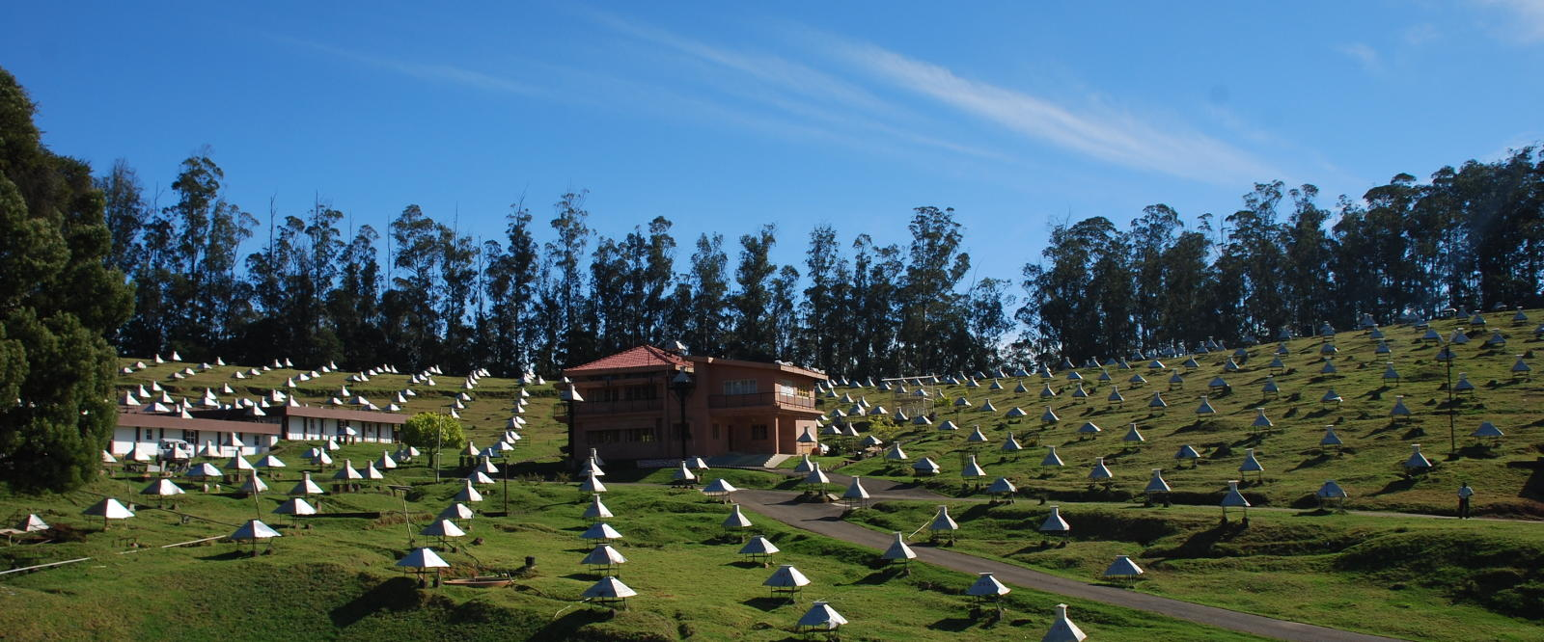
Departmental Project 2
Presented by – Mohit Saharan
Advisor – Dr. Pravata K. Mohanty
Comparison of CORSIKA hadronic interaction generators with GRAPES-3 data

Slide 2
Outline
Cosmic rays
Aim of this study
Simulation of monoenergetic showers
Simulation of showers with variable energy
Comparison of simulation results with GRAPES-3 data

Slide 3
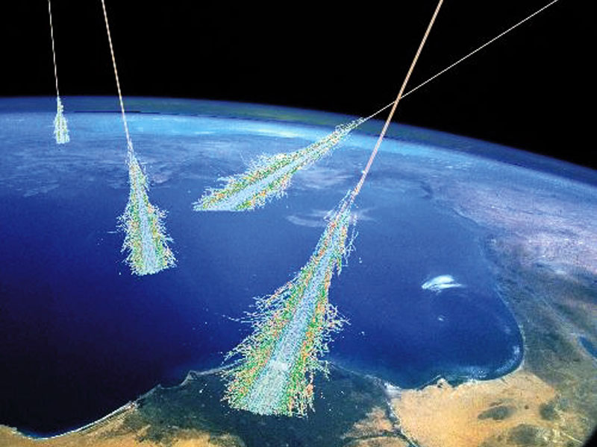
Cosmic rays
High energy particles originating from outer space
Mostly protons (90%), helium (9%), heavier nuclei,
minute fraction of high energy electrons, positrons
Observable shower secondaries
  Electron, muon, hadron, and photons
  Characteristics depend on energy and mass of the primary cosmic ray particle
Origin, acceleration, and propagation?
Composition of cosmic rays
Simulation of air showers

Slide 4
Aim of this study
To find the best suited hadronic interaction generator for GRAPES-3 experiment
Cosmic ray composition
HOW?
Simulation of monoenergetic air showers using different hadronic interaction generators (Mumbai)
  varying primary energy
  varying primary mass
Realistic simulation of showers (Ooty)
Comparison of the resulting muon multiplicity (number of muons per shower) distributions

Slide 5
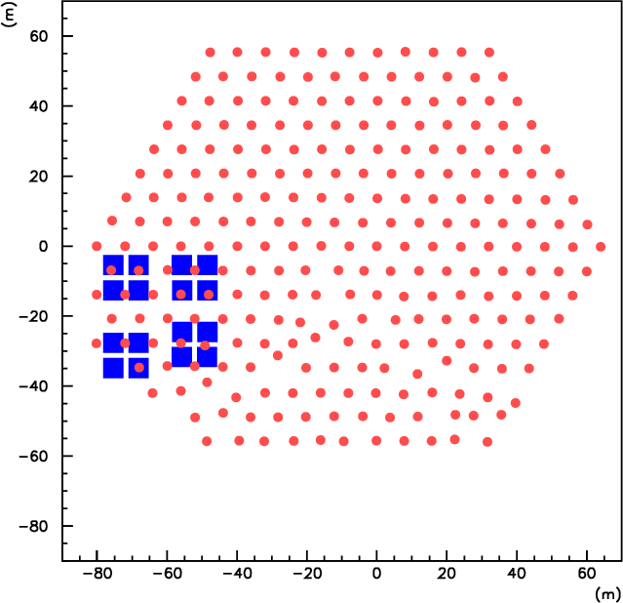
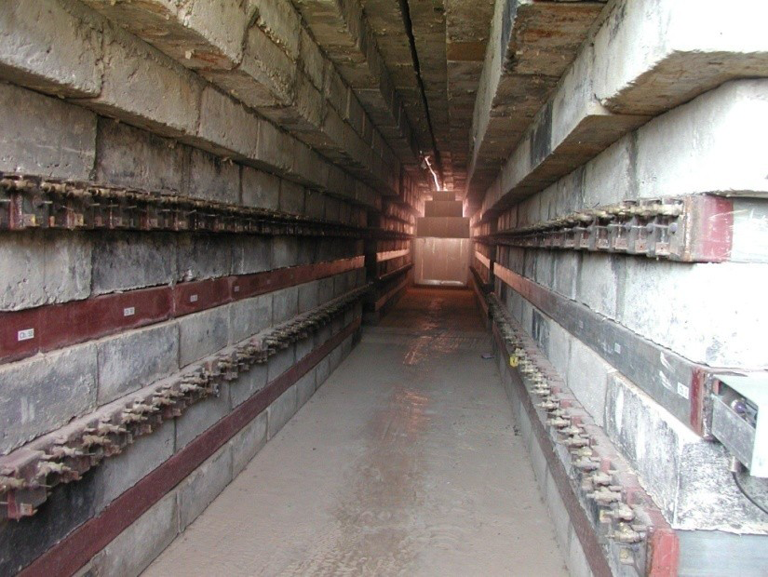
GRAPES-3 Experiment
Located in Ooty, India; 2200 m above
m.s.l.
400 plastic scintillator detectors (1 m²)
Array covers an area of 25000 m²
Large area (560 m²) tracking muon detector
Muon detector
  16 muon modules (35 m² each)
  Each module has 232 proportional counters

Slide 6
CORSIKA simulation package
High energy hadronic interaction generators
  SIBYLL
  QGSJETII
Low energy hadronic interactions were treated using FLUKA

Slide 7
Simulation of monoenergetic showers: Part 1
Primary
  H
θ = 0°
E = 10 TeV, 100 TeV, and 1000 TeV
50,000 events - 10 TeV and 100 TeV
2400 events -1000 TeV
Pre-LHC: SIBYLL-2.1 and QGSJETII-03
Post-LHC: SIBYLL-2.3c and QGSJETII-04

Slide 8
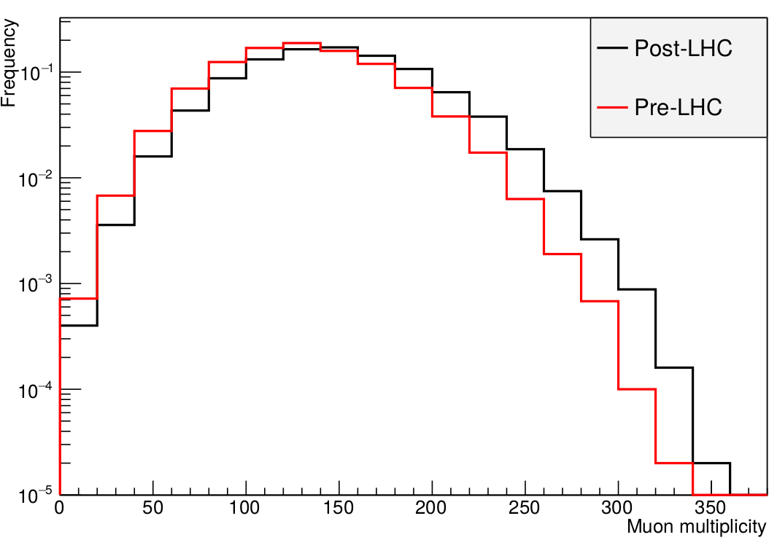
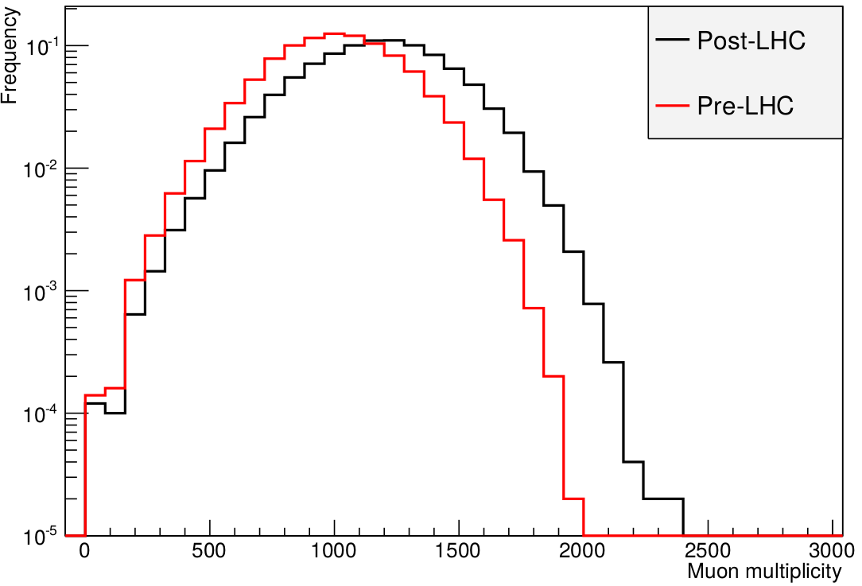
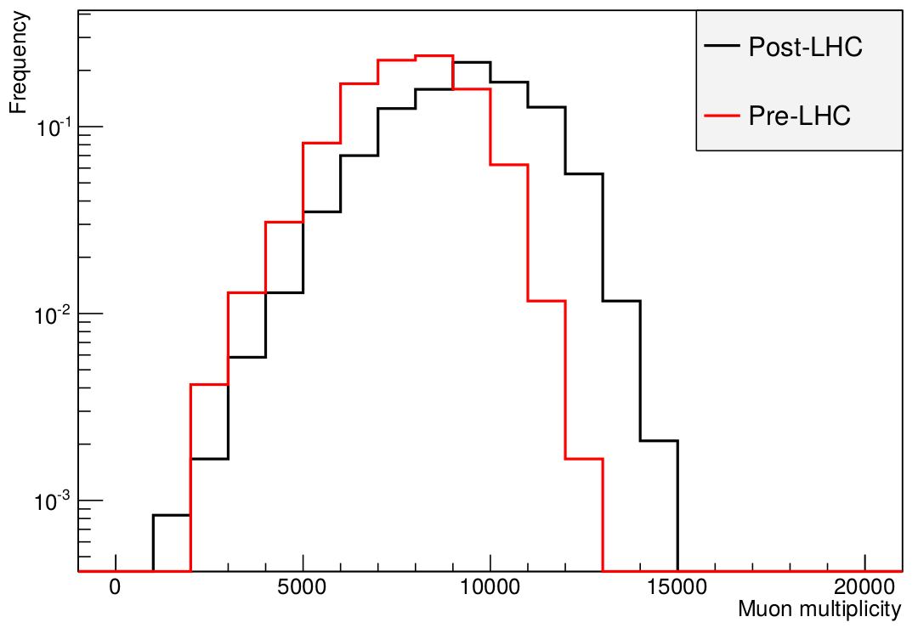
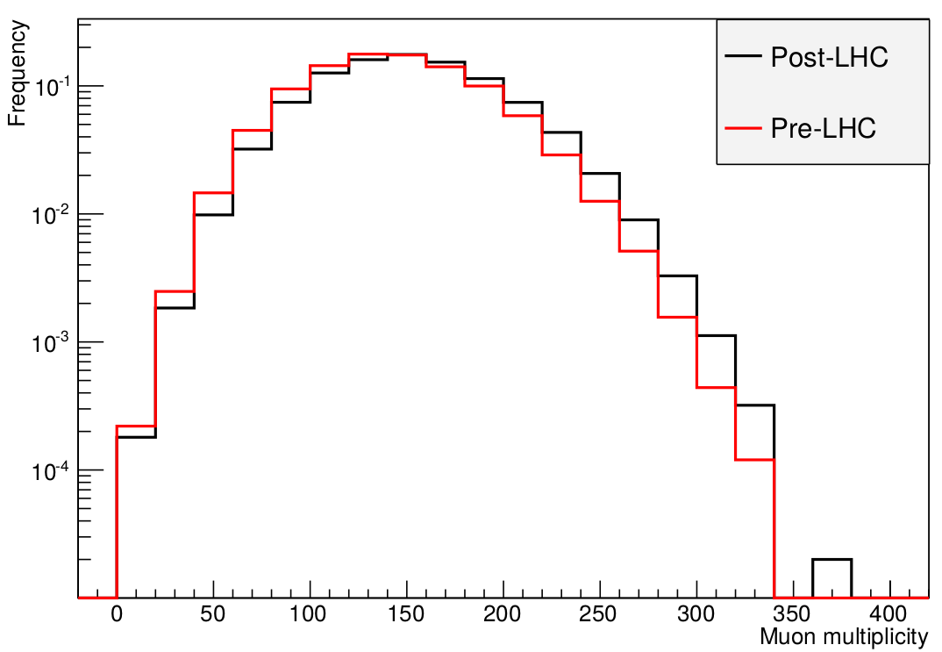
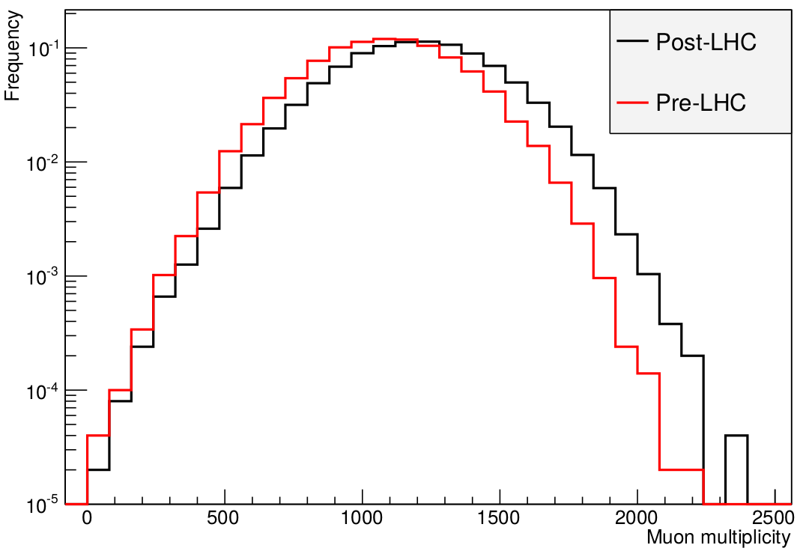
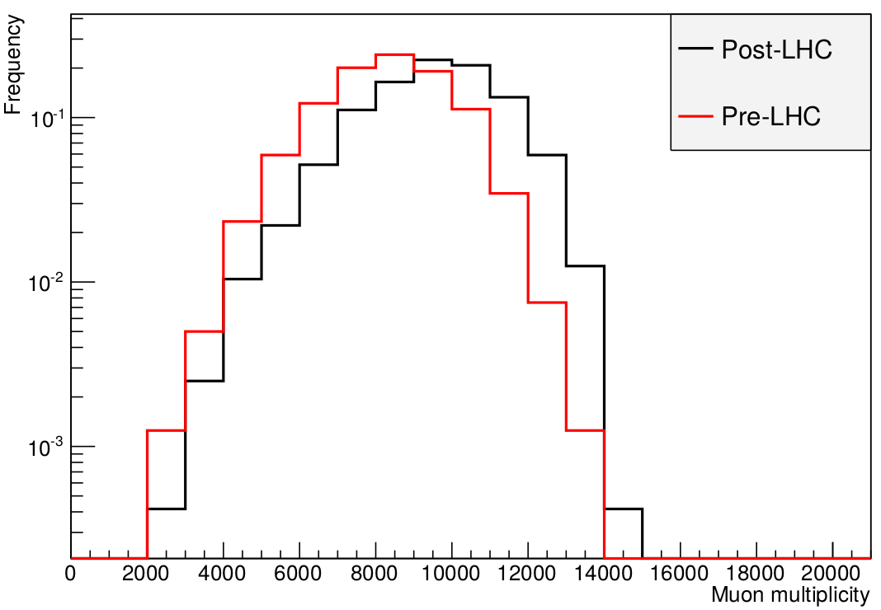
Muon multiplicity distributions
SIBYLL
No. of events
10 TeV
100 TeV
1000 TeV
Muon Multiplicity
QGSJETII
10 TeV
100 TeV
1000 TeV

Slide 9
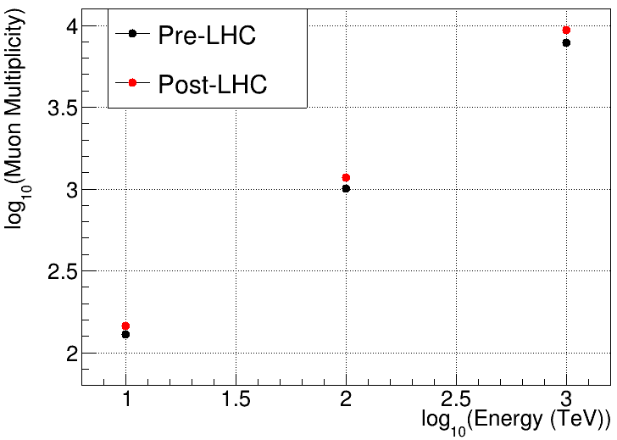
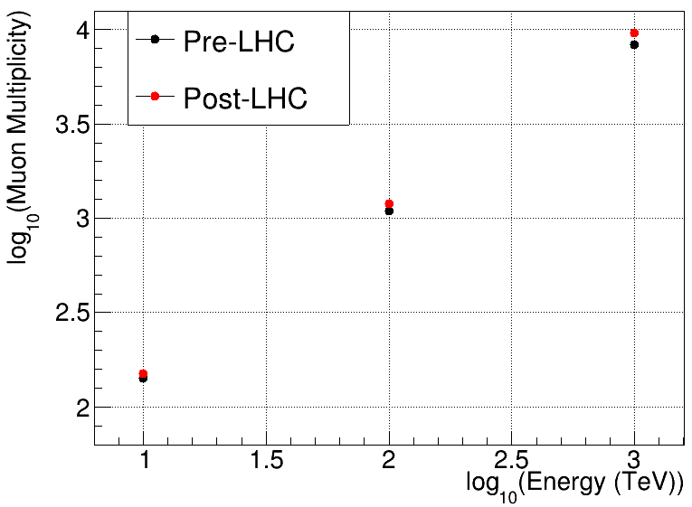
Pre-LHC and Post-LHC generators
SIBYLL
QGSJETII
More muons by Post-LHC:
  SIBYLL: 12% to 19 % more
  QGSJETII: 6% to 15% more

Slide 10
Pre-LHC and Post-LHC generators
SIBYLL
QGSJETII
More muons by QGSJETII:
  Pre-LHC: 6% to 9% more
  Post-LHC: 2% to 3% more

Slide 11
Simulation of monoenergetic showers:
Part 2
Comparison of post-LHC generators
PCRs
  Lighter (H, He)
  Medium (C,N,O)
  Heavier (Al, Fe, Co)
θ = 0°
E = 10 TeV, 100 TeV, and 1000 TeV
50,000 events at 10 TeV and 100 TeV
2400 events at 1000 TeV
At 1000 TeV, data generated only for H, N, and Fe

Slide 12
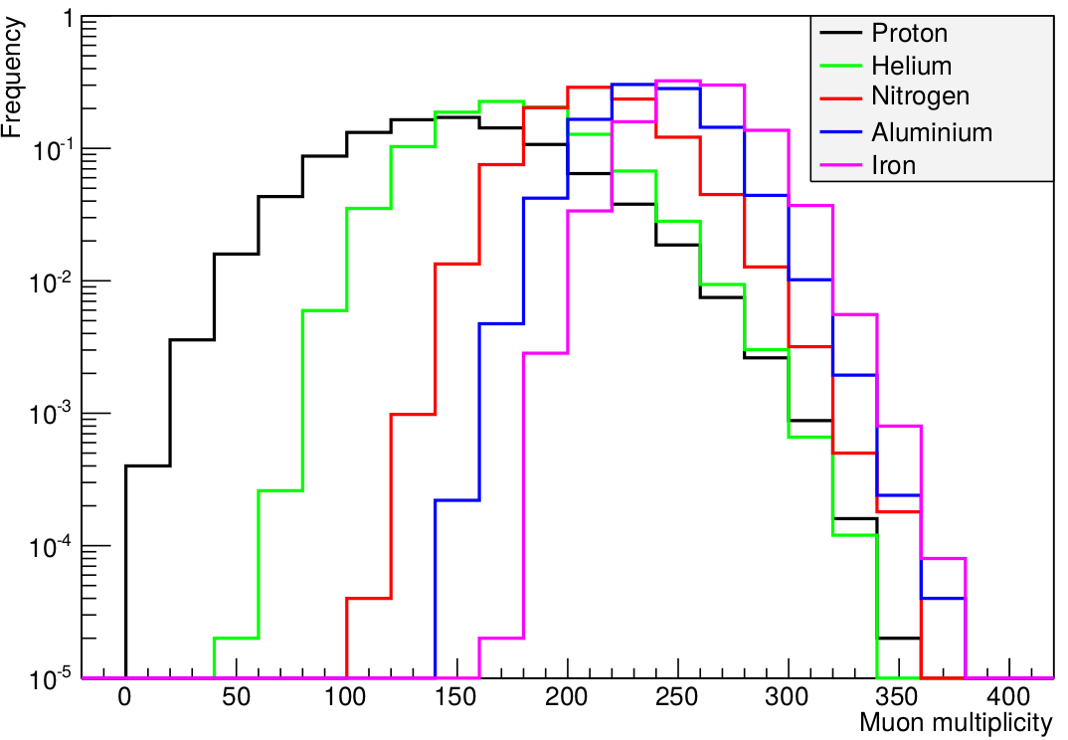
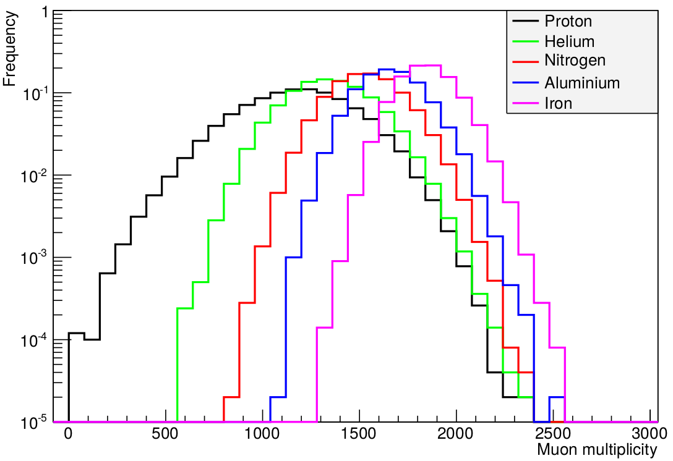
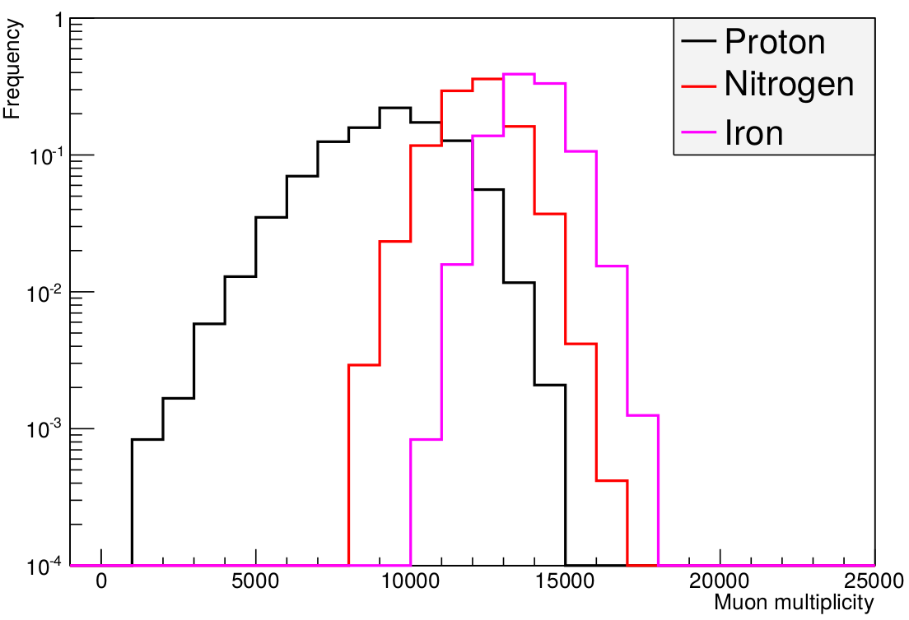
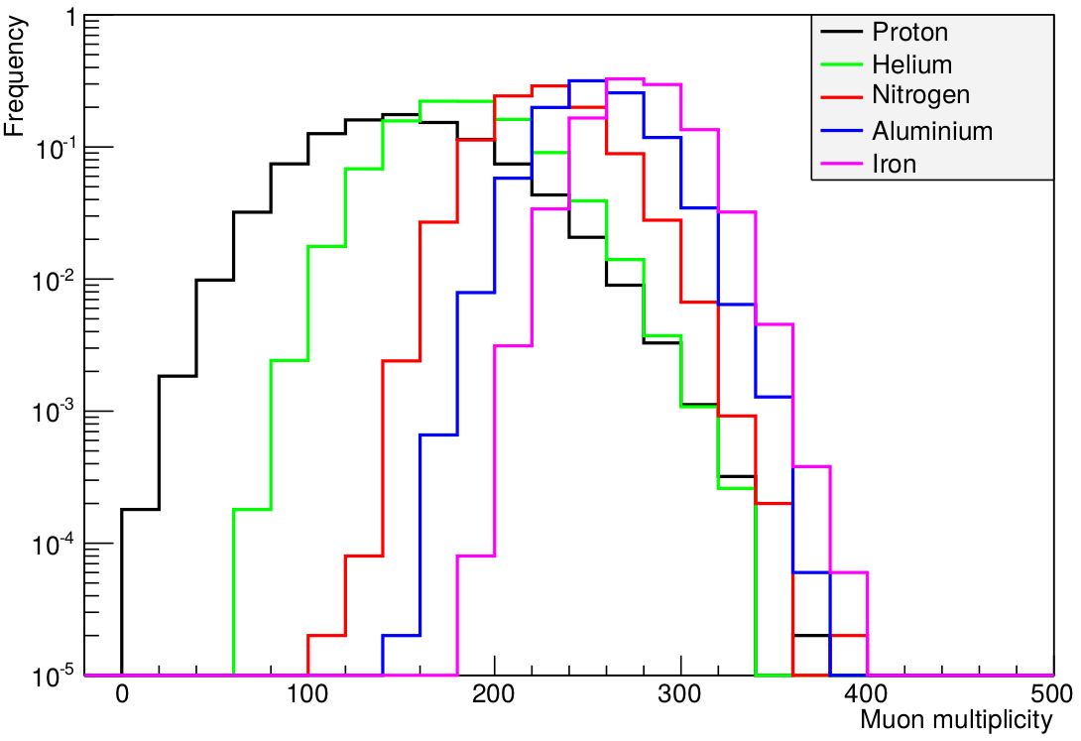
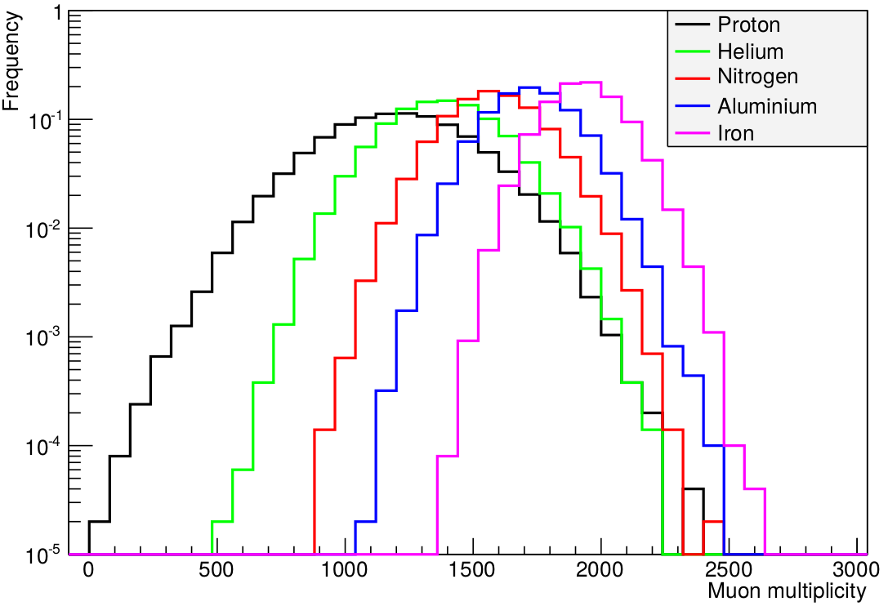
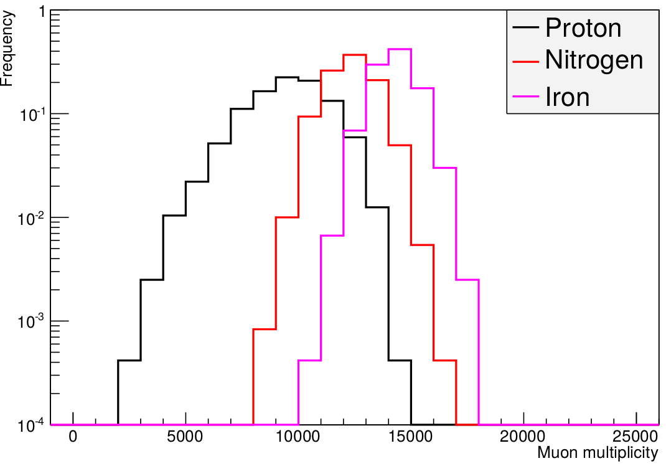
Muon multiplicity distributions
SIBYLL
10 TeV
100 TeV
1000 TeV
No. of events
Muon Multiplicity
QGSJETII
10 TeV
100 TeV
1000 TeV

Slide 13
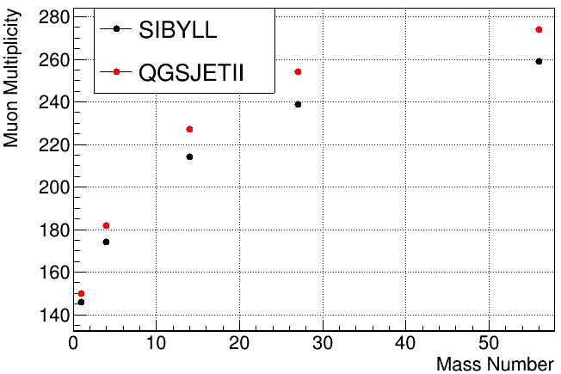
Simulation for E = 10 TeV
Muon multiplicity increases with mass number
More muons by Fe w.r.t H:
  SIBYLL: 77% more
  QGSJETII: 85% more
QGSJETII vs SIBYLL
  3% to 7% more
  Difference increases with mass number

Slide 14
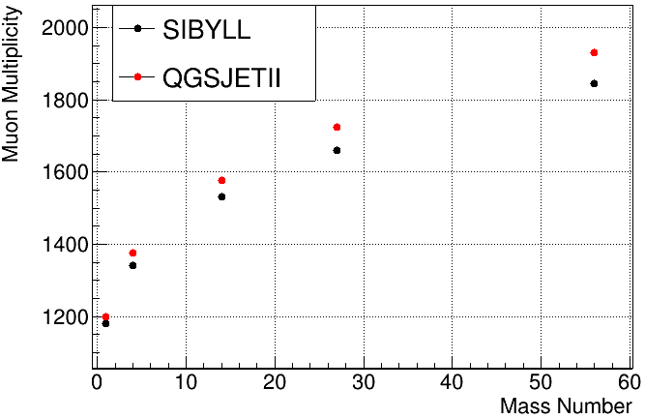
Simulation for E = 100 TeV
Muon multiplicity increases with mass number
More muons by Fe w.r.t H:
  SIBYLL: 56% more
  QGSJETII: 61% more
QGSJETII vs SIBYLL
  2% to 5% more
  Difference increases with mass number

Slide 15
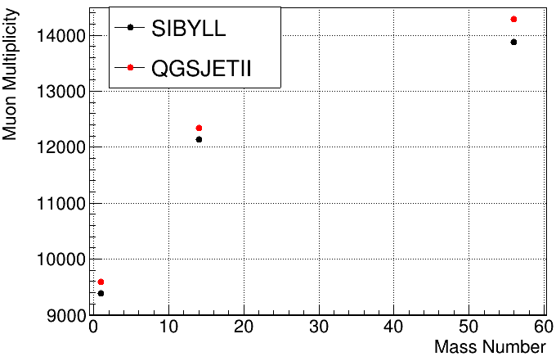
Simulation for E = 1000 TeV
Muon multiplicity increases with mass number
More muons by Fe w.r.t H:
  SIBYLL: 48% more
  QGSJETII: 49% more
QGSJETII vs SIBYLL
  2% to 3% more
  Difference is relatively less

Slide 16
Simulation of showers with variable energy
Simulation of monoenergetic showers
  Improvement in Post-LHC generators
  Characteristics of generators: 1) for different primaries, 2) at different energies
  Can’t do realistic simulations directly

Slide 17
Proton initiated showers
Bin No | Energy Range (TeV) | No. of events
 |  | Pre-LHC (SIBYLL)
1 | 63.10 – 100.00 | 99,900
2 | 100.00 – 158.49 | 45,700
3 | 158.49 – 251.19 | 20,900
4 | 251.19 – 398.11 | 9,500
5 | 398.11 – 630.96 | 4,400
6 | 630.96 – 1000.0 | 2,000

Slide 18
Proton initiated showers
Bin No | Energy Range (TeV) | No. of events
 |  | Pre-LHC (SIBYLL) | Post-LHC (SIBYLL)
1 | 63.10 – 100.00 | 99,900 | 30,00,000
2 | 100.00 – 158.49 | 45,700 | 13,72,000
3 | 158.49 – 251.19 | 20,900 | 6,27,000
4 | 251.19 – 398.11 | 9,500 | 2,86,500
5 | 398.11 – 630.96 | 4,400 | 1,31,100
6 | 630.96 – 1000.0 | 2,000 | 59,800
~30 times larger data set; generated in Ooty cluster (~1200 cores)
Analysis framework improved
  Realistic muon detection for simulation data
Testing

Slide 19
Proton initiated showers
Bin No | Energy Range (TeV) | No. of events
 |  | Pre-LHC (SIBYLL) | Post-LHC (SIBYLL)
1 | 63.10 – 100.00 | 99,900 | 30,00,000
2 | 100.00 – 158.49 | 45,700 | 13,72,000
3 | 158.49 – 251.19 | 20,900 | 6,27,000
4 | 251.19 – 398.11 | 9,500 | 2,86,500
5 | 398.11 – 630.96 | 4,400 | 1,31,100
6 | 630.96 – 1000.0 | 2,000 | 59,800
0°<θ<25°
Shower size (N_{e}) - 10^{4.0} to 10^{5.5} with bin width = 10^{0.5}
Comparison with 2014 data

Slide 20
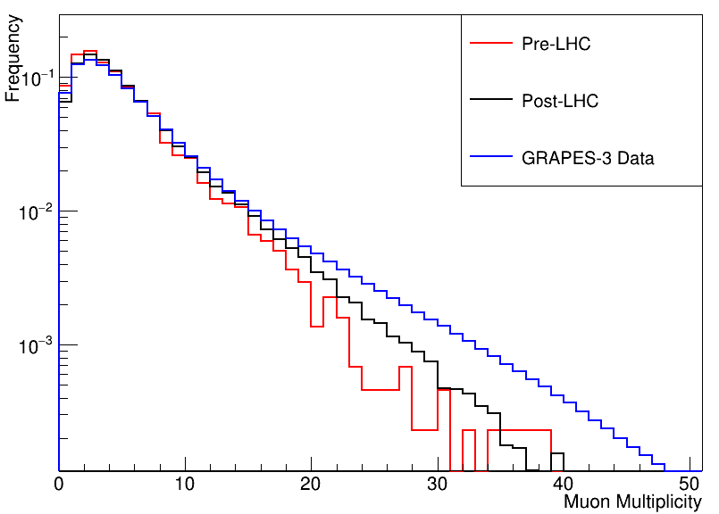
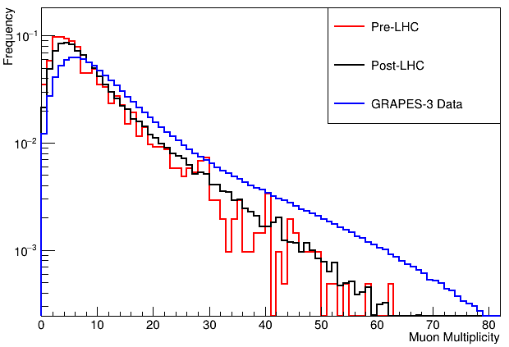
Comparison of simulation results with GRAPES-3 data
Shower Size – 10^{4.0} to 10^{4.5}
Shower Size – 10^{4.5} to 10^{5.0}
Work on GRAPES-3 data – Diptiranjan Pattanaik

Slide 21
Summary
Post-LHC generators give higher muon multiplicity
  SIBYLL: 12% - 19% more muons in Post-LHC
  QGSJETII: 6% - 15% more muons in Post-LHC
In Post-LHC, QGSJETII gives higher muon multiplicity than SIBYLL
  2% to 7% more muons in QGSJETII
  Difference decreases with increasing energy
Proton initiated shower data
  Post-LHC simulation data shows better agreement with GRAPES-3 data

Slide 22
Future plans of GRAPES-3 group
Generation of variable energy showers with He, N, Al, and Fe
Comparison with GRAPES-3 data to find the composition of cosmic rays for 63 TeV<E<1000 TeV
  Gives the generator which agrees with GRAPES-3 data

Slide 23
It’s a team effort!
GRAPES-3 Group
Prof. Sunil Gupta
Prof. S. Dugad
Dr. P. K. Mohanty
Mr. B Hari Haran
Mr. S. D. Morris
Mr. L. V. Reddy
Mr. P. K. Naik
Meeran Zuberi
Jhansi Bhavani
Diptiranjan Pattanaik
Fahim Varsi
Medha Chakraborty
Shekhar Sharma
Piyush Kumar
Team at Ooty and other collaborators

Slide 25
Obtaining shower parameters
The EAS direction theta and phi was calculated by a chi^2 minimization of the relative arrival times of particles. N_{e} can be obtained by fitting the Nishimura-Kamata-Griesen (NKG) lateral distribution function to observed densities.

Slide 26
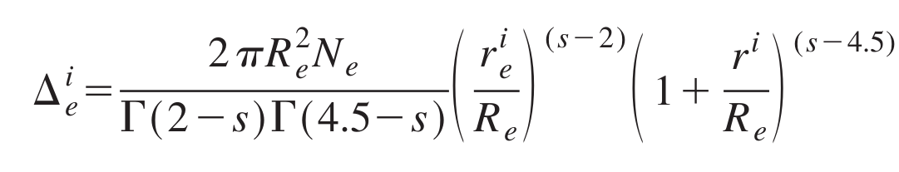
Delta is avg particle density over ith detector located at a distance r_{i} from the shower core
Re = Moleire radius (105 m at ooty)

Slide 27
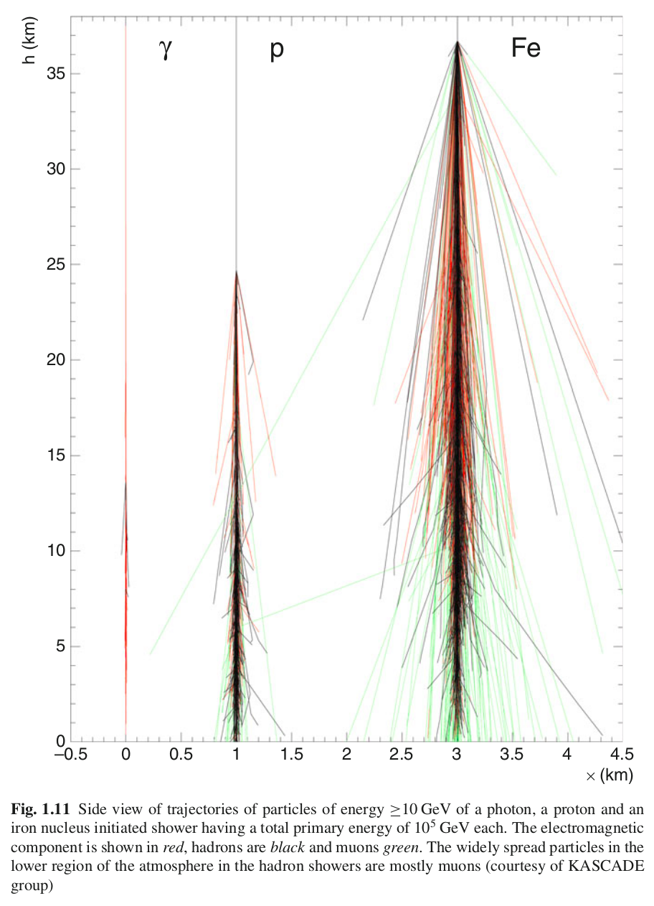
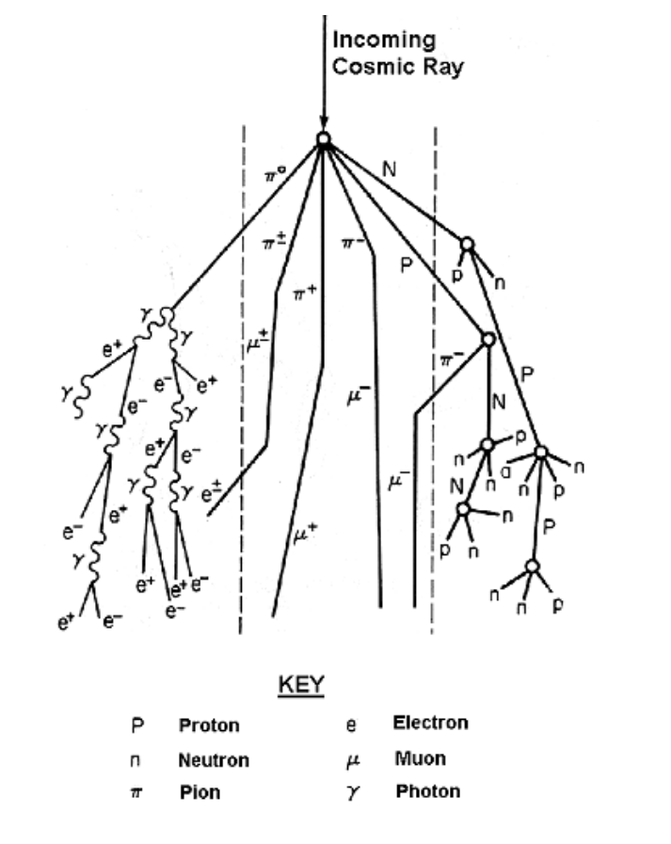
Shower

Slide 28
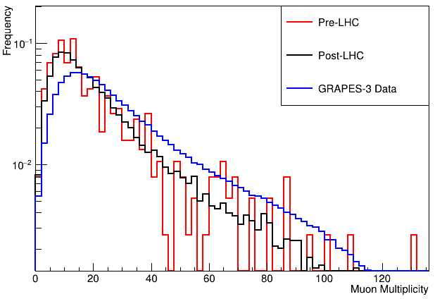
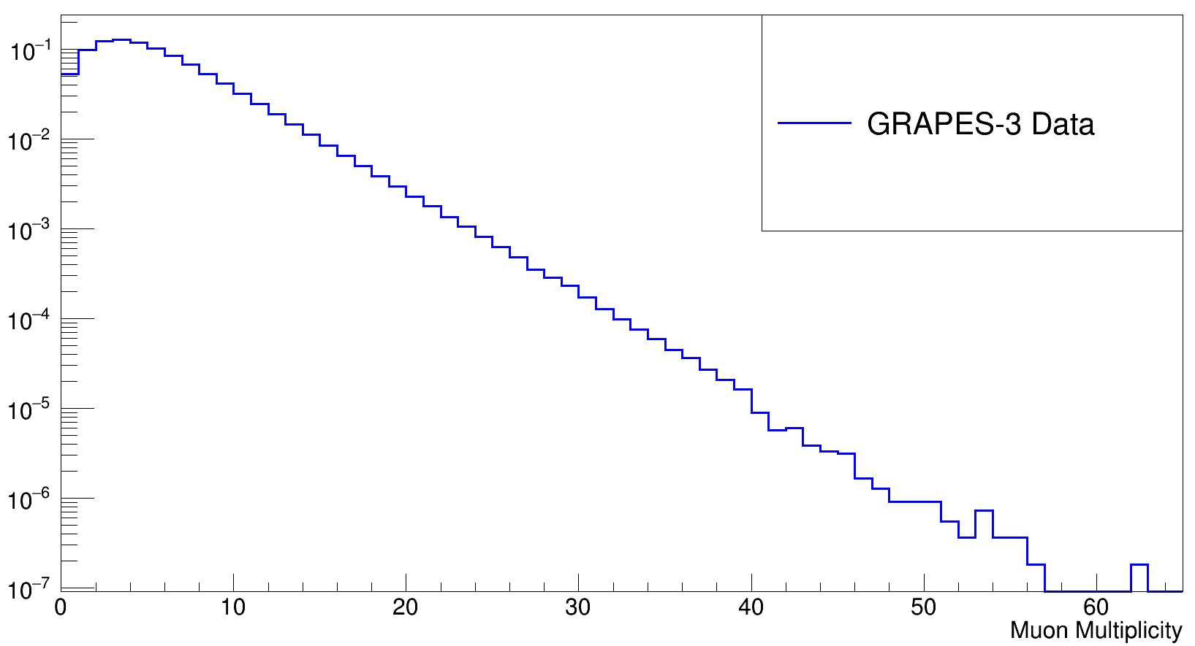
Comparison of simulation results with GRAPES-3 data
Shower Size – 10^{5.0} to 10^{5.5}

Slide 29
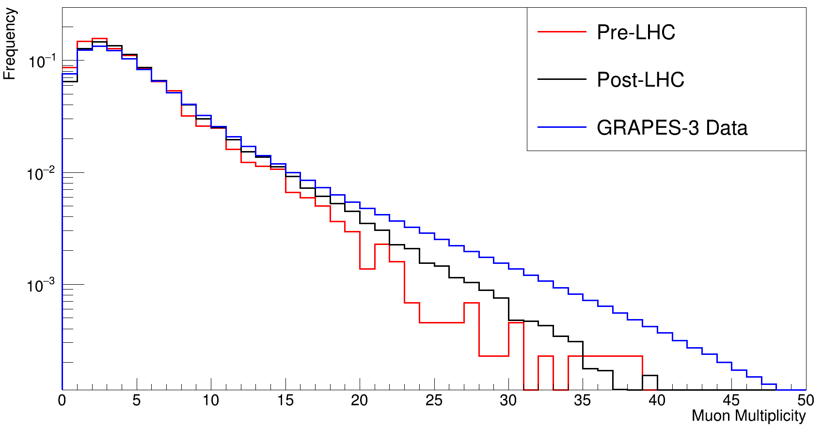
bin2

Slide 30
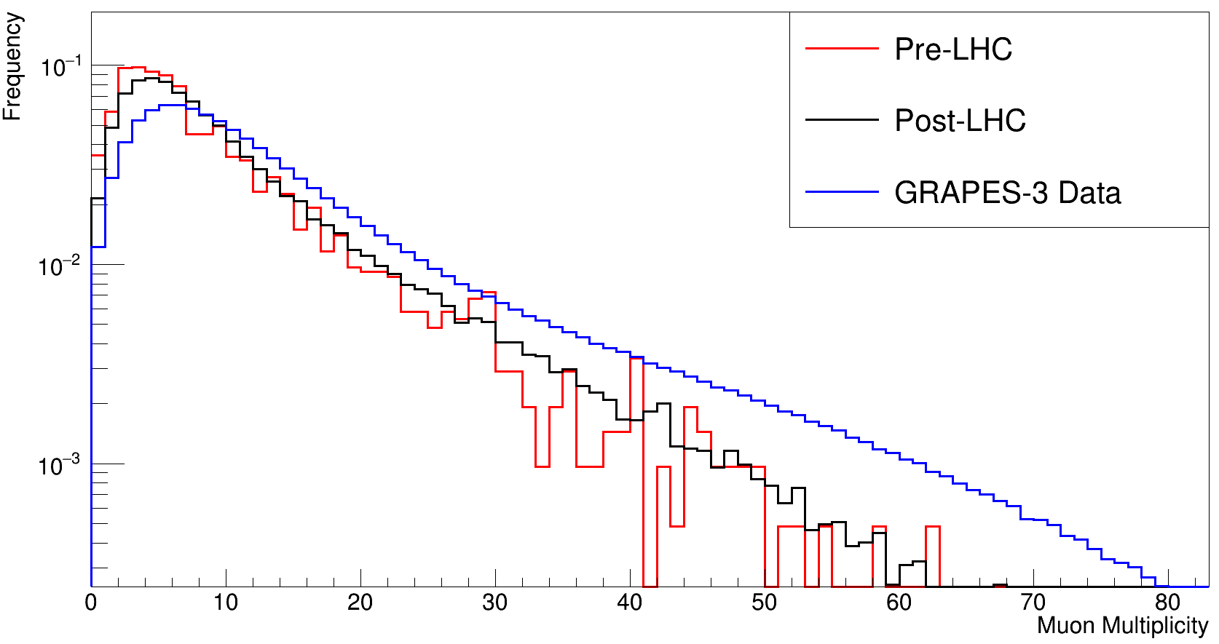
bin3

Slide 31
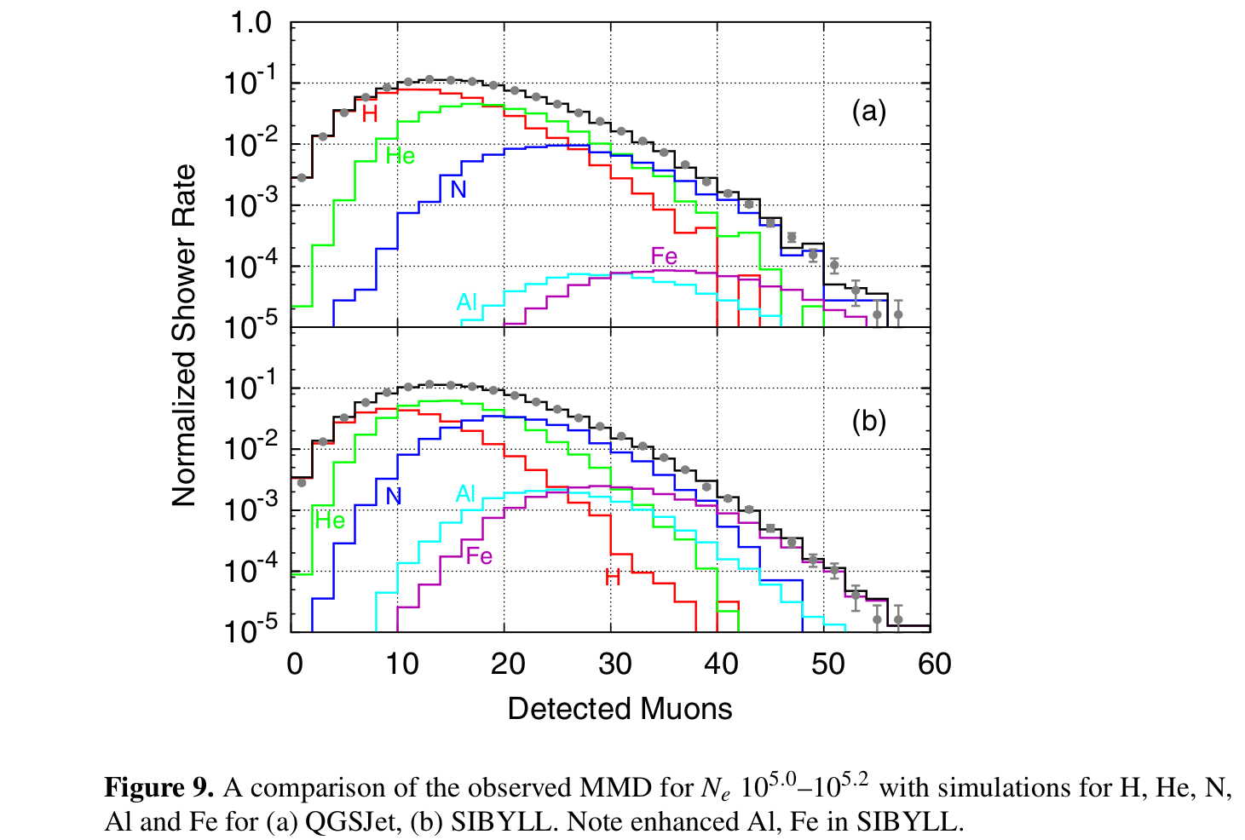

Slide 32
Pre-LHC and Post-LHC generators
Energy |  | SIBYLL-FLUKA |  |  | QGSJETII-FLUKA |  |  | Q vs S
 |  | Median | S.E. | % | Median | SE | % | %
10 TeV | Pre-LHC | 130 | 0.19 |  | 142 | 0.2 |  | 9.2
 | Post-LHC | 146 | 0.2 | 12.3 | 150 | 0.2 | 5.6 | 2.7
100 TeV | Pre-LHC | 1006 | 1.44 |  | 1088 | 1.2 |  | 8.2
 | Post-LHC | 1180 | 1.3 | 17.3 | 1200 | 1.2 | 10.3 | 1.7
1000 TeV | Pre-LHC | 7866 | 32.99 |  | 8327 | 33.7 |  | 5.9
 | Post-LHC | 9393 | 18.9 | 19.4 | 9586 | 18.8 | 15.1 | 2.1

Slide 33
Simulation for E = 10 TeV
 | SIBYLL-FLUKA |  |  | QGSJETII-FLUKA |  |  | Q vs S
 | Median | SE | % | Median | SE | % | %
H | 146 | 0.21 |  | 150 | 0.20 |  | 2.7
He | 174 | 0.15 | 19.2 | 182 | 0.15 | 21.3 | 4.6
N | 214 | 0.12 | 46.6 | 227 | 0.12 | 51.3 | 6.0
Al | 239 | 0.11 | 63.7 | 254 | 0.11 | 69.3 | 6.3
Fe | 259 | 0.10 | 77.4 | 278 | 0.10 | 85.3 | 7.3

Slide 34
Simulation for E = 100 TeV
 | SIBYLL-FLUKA |  |  | QGSJETII-FLUKA |  |  | Q vs S
 | Median | SE | % | Median | SE | % | %
H | 1180 | 1.29 |  | 1200 | 1.23 |  | 1.7
He | 1340 | 0.96 | 13.6 | 1375 | 0.94 | 14.58 | 2.6
N | 1531 | 0.81 | 29.8 | 1577 | 0.80 | 31.42 | 3.0
Al | 1659 | 0.73 | 40.6 | 1724 | 0.73 | 43.67 | 3.9
Fe | 1845 | 0.64 | 56.4 | 1931 | 0.64 | 60.92 | 4.7

Slide 35
Simulation for E = 1000 TeV
 | SIBYLL-FLUKA |  |  | QGSJETII-FLUKA |  |  | Q vs S
 | Median | SE | % | Median | SE | % | %
H | 9393 | 18.79 |  | 9586 | 18.79 |  | 2.1
N | 12132 | 21.20 | 29.2 | 12337 | 21.22 | 28.7 | 1.7
Fe | 13874 | 18.87 | 47.7 | 14284 | 18.79 | 49.0 | 3.0

