Slide 1
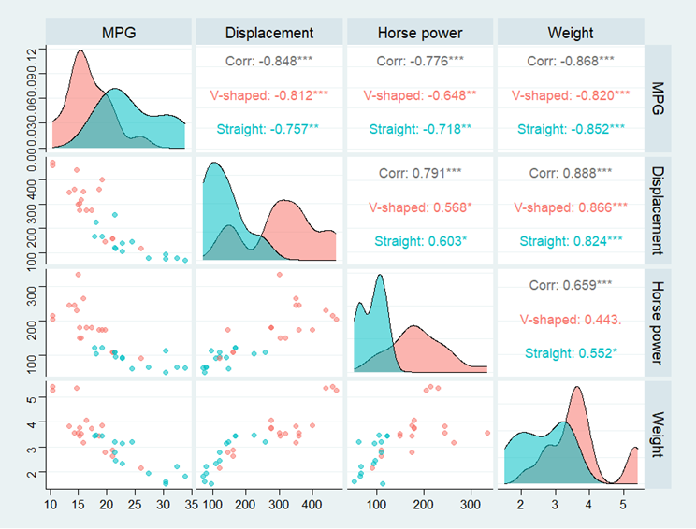
Statistics for Business and Economics
Mohammad Saifuddin
MS in Applied Statistics,
University of Dhaka

