Slide 1
Exploring the Factors That Affect Student Performance
The study looks at 395 students taking Mathematics in two schools in Portugal.
Students are graded from 0 to 20, and a score of 10 or higher is considered a pass.
The main goal is to find out which factors may be related to students' academic performance.

Slide 2
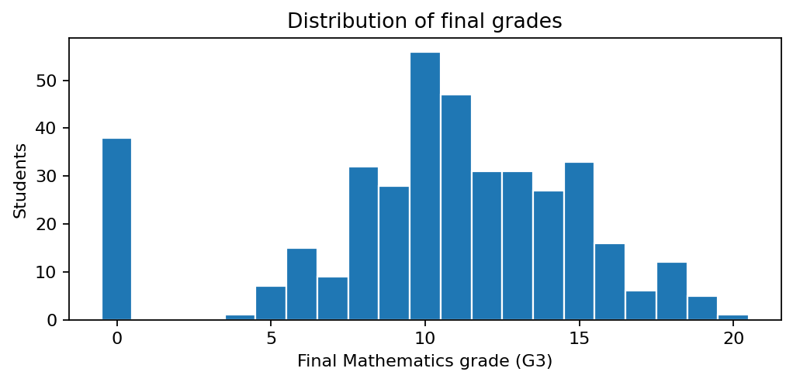
What do the grades show?
• Average final grade: 10.4/20
• 67.1% of students passed
• Some students received zero as a final grade

Slide 3
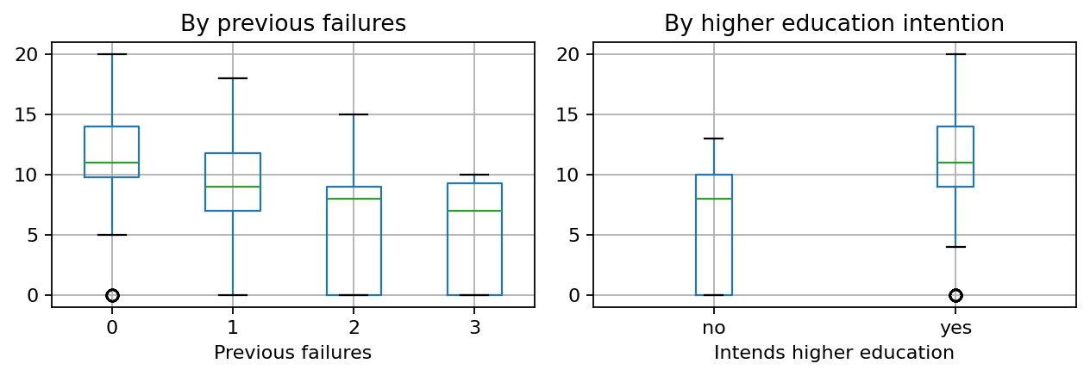
A key warning sign
• Students with previous class failures tend to have lower final grades
• The relationship remains after adjusting for other selected characteristics
• This is a risk marker, not proof of a cause

Slide 4
What do the models add?
• Each additional previous failure is associated with about 2.0 fewer grade points
• The linear model explains only 16% of grade variation
• Many important factors are not captured

Slide 5
What schools should take away
• Consider supportive follow-up for students with prior failures
• Avoid treating group associations as individual diagnoses
• Results are observational, from two schools, and not proven to generalise
• Evaluate any intervention before claiming it works

