Slide 1
Fat Composition Measurements with Smartphone Integration
Team Quadcopter: Marty Alcala, Brandon Bruen,
John Bush (JD), Philip Gordon
ECE 4012 L2A: Professor Bhatti

Slide 2
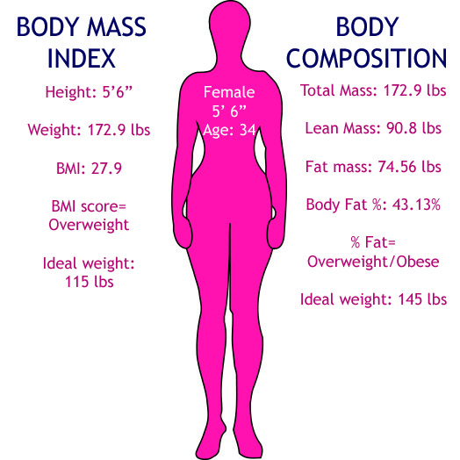
Initial Motivation
http://news.medill.northwestern.edu/chicago/news.aspx?id=221734&print=1
Notes:
Initially, we saw a need for a cheap, fast, and non-invasive body composition analyzer.
BMI vs. Body Composition
Many medical professionals question the merits of BMI, as such, the more readily available/accurate we can make a body composition device, the better the alternative that we can offer.
http://news.medill.northwestern.edu/chicago/news.aspx?id=221734&print=1

Slide 3
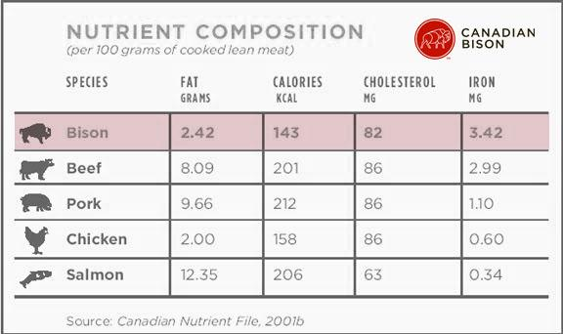
Motivation
http://www.canadianbison.ca/consumer/Why_Bison/nutrition.htm
Notes:
However, while we still see the need for increased accuracy in body composition analysis, logistical concerns with the IRB prohibit our pursuit of that line of thinking.
However, while we would not be able to use live subjects, we can still help improve the general health of the population by providing a device that will quickly and accurately determine the fat content of meats that they consume.
http://www.canadianbison.ca/consumer/Why_Bison/nutrition.htm

Slide 4
Existing Technology
•Dual-Energy X-Ray Absorptiometry
•Hydrostatic Weighing
•Boil testing
•Bioelectrical impedance

Slide 5
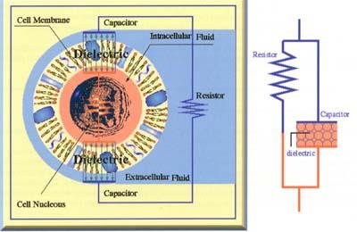
Bioelectrical Impedance
http://www.betterhealththruresearch.com/BioelectricImpedanceAnalysis.htm
Notes:
http://www.betterhealththruresearch.com/BioelectricImpedanceAnalysis.htm

Slide 6
Qualitative Goals
Determine fat percentage using AC small signal analysis
Combine resistive and reactive measurements for data acquisition
Upload data to mobile devices using Bluetooth
Create user friendly application for data management

Slide 7
Specifications
Target Subject | Cuts of Meat
Meat Fat % Accuracy | 10-20%
Test Duration | <10 Seconds
Device Weight | <3 lbs
Signal Voltage | 3.3 - 5 V
Number of Probes | 2 - 4

Slide 8
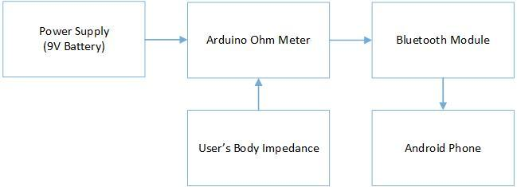
Design Approach
(3.3V Source)

Slide 9
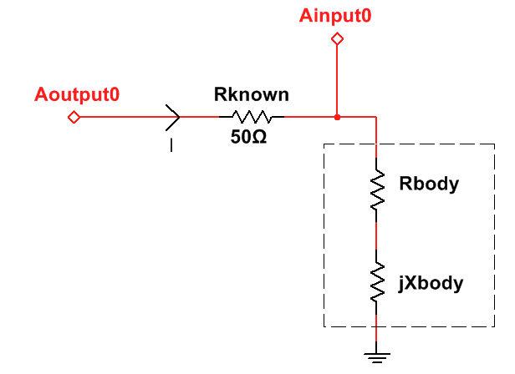
Arduino Ohm Meter
Input signal from Arduino Pin Aoutput0 (high kHz, 400uA)

Slide 10
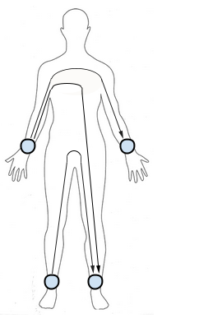
Regression Model
FFM (kg) = 0.7* (Ht²/R_{body}) +.18*BW - .18*Age + .12*X_{body} - 2.5 [1]
Ht² - Height of the subject squared
R_{body} - Real resistance of subject’s body
BW - Bodyweight of subject
Age - Age of subject
X_{body} - Imaginary reactance of subject’s body
Notes:
NEED REFERENCE for equation (She mentioned it in the proposal)

Slide 11
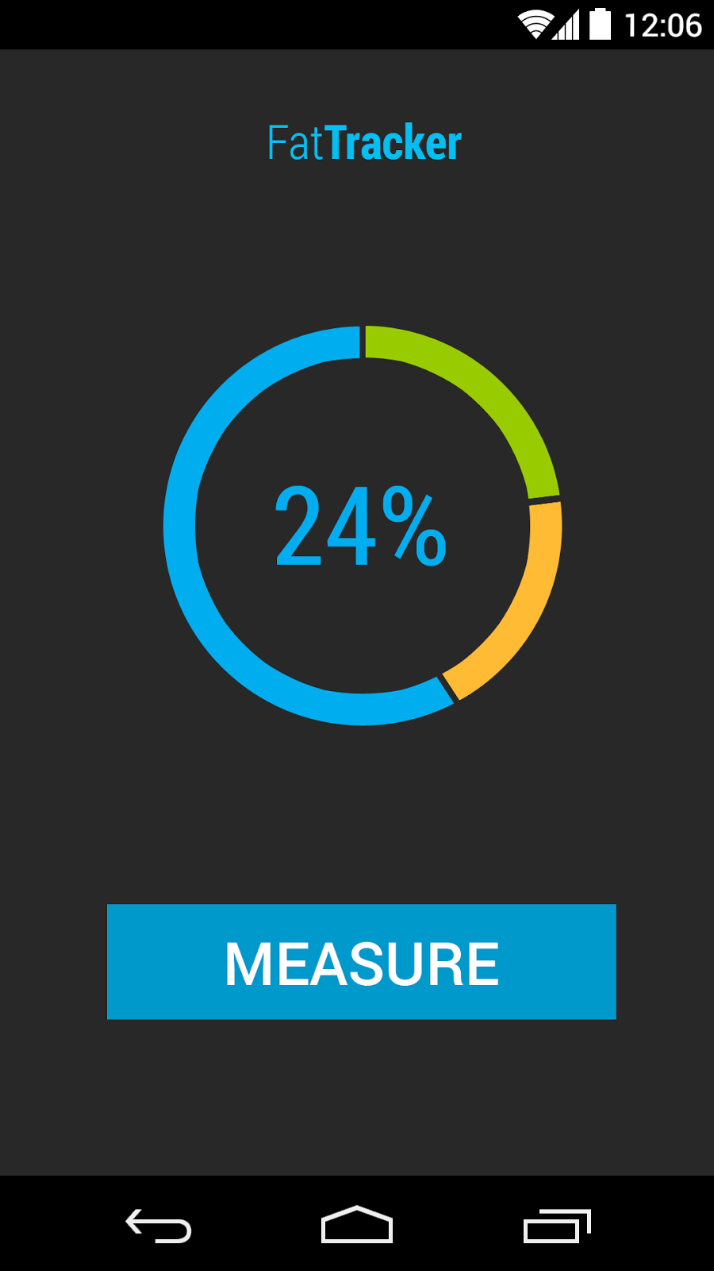
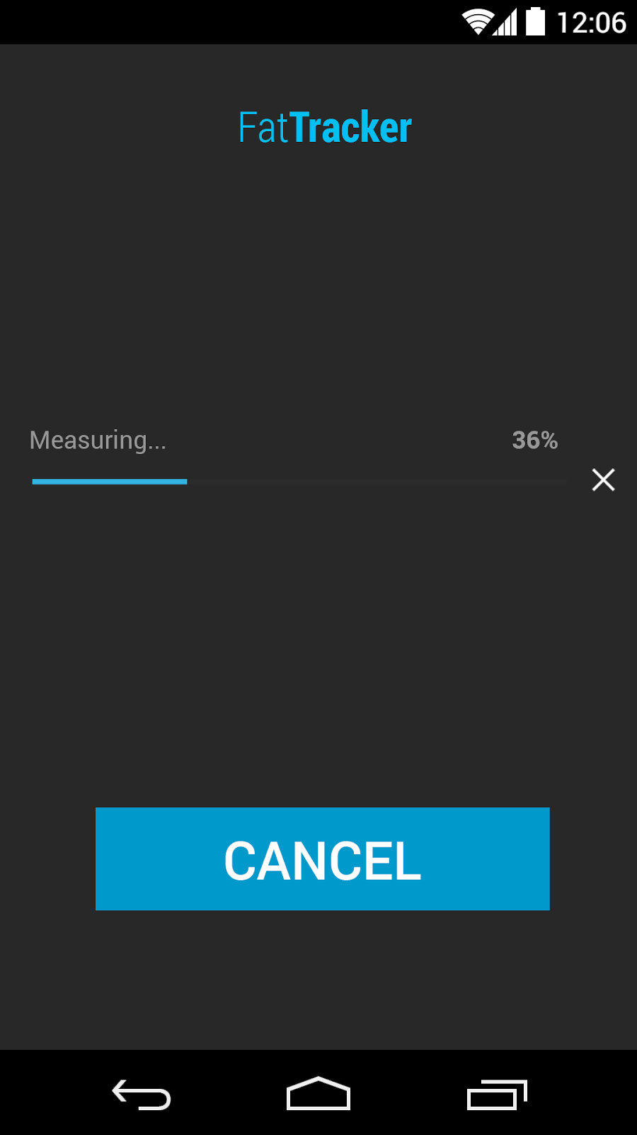
Mobile App Interface
Display of latest measurement
Measurement in progress

Slide 12
Benchmarking Data Sets
Temperature
Meat Type
Age
Density
Combination of types

Slide 13
Benchmarking Method
Weigh meat
Run small AC signal test and collect data
Put meat in water to calculate density
Boil meat until all fat is collected on top
Weigh fat and meat again
Calculate overall fat content
Add to existing model

Slide 14
Benchmarking Method
Upper and lower limits also need to be added
Upper limit will be measured through a brick of suet (100% fat)
Lower limit will be an average of the AC signal test on the post cooked meats

Slide 15
Design Expo
Logistics:
Impractical for frequent demonstration
Scheduled times for several demonstrations throughout the expo
Demonstration:
We will bring meat and store it in a cooler
Show our product by using our device and accompanying smartphone application
Notes:
To demonstrate our product, we really would like to actually demonstrate it in front of people. Due to switching from Human to Meat test subjects, frequent testing will most likely not be viable.
What we will do instead, is schedule times for us to do demonstrations regularly throughout the Design Expo.
In our demonstration we will describe to our audience what the theory is behind our product: the ability to measure, accurately, the fat content of a subject based using Bioelectric-Impedance-Analysis. We will demonstrate this by having a cooler of several types of meat for us to be able to actively test. Our results will be shown to the audience as well as what numbers should be expected for the result.

Slide 16
Current Status
Right Now:
Ready to order parts and begin assembling, programming, and developing model
Anticipated Challenges:
Data points: accuracy of model is dependent on our testing
Limits on meat subjects: to much variation between types of animals?
Notes:
Our Current Status. Right now we are ready to get to work. Our plan is to order parts first thing next week. We have decided to even beginning next week use the time allocated for this class each week to begin work immediately and if needed, we will start meeting at other times as well.
One big challenge is going to be building our model that we will use to calculate Fat Percentage. We are not entirely sure what we will encounter when we begin to test meats. There also could be variations in different types of meat so great that we may need to limit ourself to one type, say beef.

Slide 17
Schedule
Phase 1: (8/28 - 9/30)
Philip, Brandon: Hardware Development, Baseline Testing, Beginning of Model Development
Marty, JD: Arduino Programming, Application Development
Phase 2: (10/1 - 10/31)
All: Model Development, U/I Improvements
Phase 3: (11/1 - 11/21)
All: Improvements, Preparing Demonstration
Notes:
When boiled down, our schedule can be viewed as a three phase plan.
In our original idea, we were going to be using equations that others had already developed in order to get estimate body fat percentage.
With our new implementation, we will have to work to generate our own model. This ties back into the potential issue of too much variation between different meat types.
All of that being said, Phase one will solely be spent on hardware development and programming of our microcontroller. Philip and Brandon will be taking the lead on hardware development and baseline testing with the disassembly and baseline testing of the Omron Body fat analyzer.
Marty and I will be working to program our hardware and begin development of our smartphone application.
It is our goal that if we can get our hands on our supplies by sometime next week that we can work dilligently right from the start to get our hardware and base programming done by the end of September.
The reason for this is we cannot begin to develop our model until we have a system that can perform measurements on our subjects.
Phase 2 will be focused on Meat Testing and developing a model by which we can estimate the fat percentage of the meat we are testing. We have designated a generous amount of time for this due to unknowns such as differences in meat types and any other unknowns we may run across.
Our goal is to be done with Phase 2 by the end of October.
Phase 3 will begin once we have a product that meets our requirements so that we can improve our application user interface and prepare to have our product in presentable fashion. We will also spend this time preparing our final deliverables ready for submission.

Slide 18
References
[1] N. Macias. (2007, Aug. 15). Body fat measurement by bioelectrical impedance and air displacement plethysmography: a cross-validation study to design bioelectrical impedance equations in Mexican adults [Online]. Available: http://www.ncbi.nlm.nih.gov/pmc/articles/ PMC2020472/#!po=3.12500
[2] Y. Hui. (2012) Handbook of Meat and Meat Processing, 2nd Edition, Boca Raton
[3] S. Nielsen. (2003) Food Analysis Vol. 1, New York
[4] Y. Hui. (2001) Meat Science and Applications. New York

