Slide 1
Fat Analysis of Meat with Smartphone Integration
Team Quadcopter: Marty Alcala, Brandon Bruen,
John Bush (JD), Philip Gordon
ECE 4012 L2A: Professor Bhatti
Notes:
JD
Hey everyone, We, as you all know are team quadcopter. We have developed a meat fat analyzer that will estimate the fat composition of a piece of pork.

Slide 2
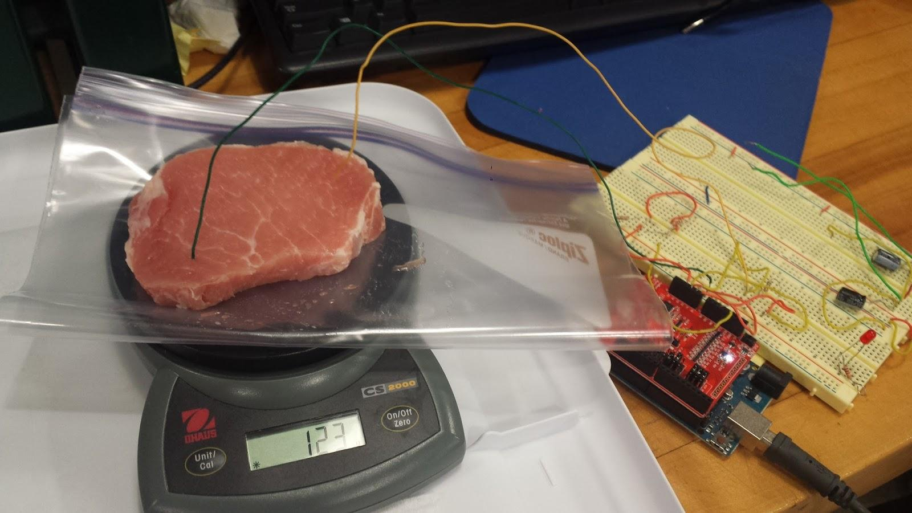
The FatAnalyzer
Estimates the Fat % of Pork Chops
Test lasts less than 10 seconds
Android and iOS Support
Notes:
JD
We have made a device that as you all know tests the composition of a pork chop and returns to the user an estimated percentage. We will get into the way this was done a bit later.
Our device is paired with a smartphone app via bluetooth to control the device and read results. We have Android and iOS support.
The user can start and stop the test from their phone as well as see the results.

Slide 3
Instructions
Weigh the Pork
Insert Probes into opposite ends of the meat
Begin test on the FatAnalyzer app
The results are displayed on the app
Notes:
JD
Our device is simple to use.
Simply weigh the meat, insert the wire probes into opposite ends, and begin the test through the app.
Once the test is complete, the results will be presented to the user on their phone.

Slide 4
Hardware
Arduino Uno
RedBearLab Bluetooth Low Energy Shield
Simple set up with a 14.84 kOhm Resistor
Other:
Smartphone with the FatAnalyzer app installed
Scale that measures in grams
Notes:
JD
Lets take a look at the hardware.
Our device is designed around the Arduino Uno. We are using analog pins on the device to measure the current through a known resistance, and then using that to find the resistance of the pork in question.
The arduino is paired with a RedBearLab Bluetooth Shield. This device allows us to pair the FatAnalyzer with a smartphone.
To use it, you will also need a scale, and a Bluetooth Low energy capable smartphone

Slide 5
Software
Arduino uses short voltage pulses to test resistance of meat
Current is determined with the known resistance
Plugs values for Resistance and Weight into the developed model
Send Results to the Application via Bluetooth
Smartphone Application
Notes:
JD
On the software side, there are two code components. The smartphone app, and the arduino’s code.
The arduino applies a voltage to the circuit, measuring the voltage drop across a known resistor to find the current. Ohms law then allows us to calculate the resistance of the meat.
The values for weight in grams and resistance are then plugged into the regression model we developed. The results yield the fat percentage of the pork. That info is then sent to the user via bluetooth.

Slide 6
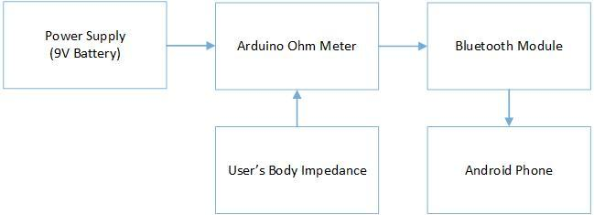
The System
(3.3V Source)
Notes:
Marty
As you have all seen many times this fall, are system set up is fairly simple. You have the Arduino Ohm meter that tests the pork resistance. The arduino interacts with the bluetooth module, which sends the data to the smartphone. The user can also start the test from the phone.

Slide 7
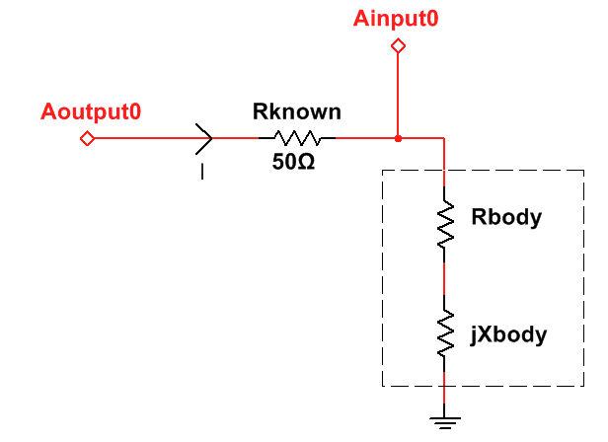
Arduino Ohm Meter
Input Voltage from Arduino Pin Aoutput0
Notes:
Marty
Here is a visual representation of the ohm meter.
The current through the system is measured from these two points.

Slide 8
Bluetooth
The Arduino is connected to RedBearLab’s BLE shield
Code is designed to actively ensure that the phone is connected to the FatAnalyzer
Works on iOS and Android via Cordova (Write once, run everywhere!)
Notes:
Marty
On the Bluetooth front, Our code is constantly making sure that connection is established and maintained so that the user is not annoyingly disconnected mid test.
The app will not work unless a connection is established.

Slide 9
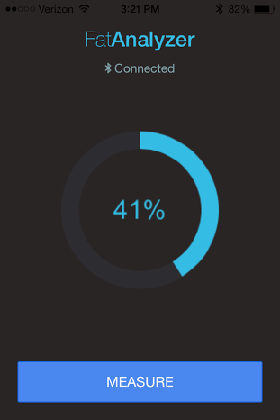
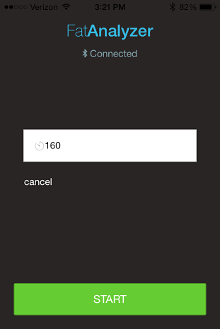
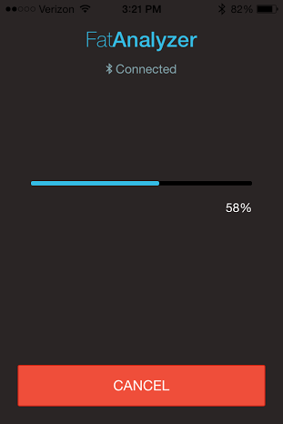
Mobile App Interface
Notes:
Marty
Here is a screen capture of our application. It runs on both android and iOS. The user will begin the test from the app.
A progress bar details the progress of the test and the results are displayed when completed.
The user can also cancel the test at any time.

Slide 10
Biological Challenges
Meat begins to “charge up” slowly when a voltage is applied across it, causing the resistance reading to increase with time
Used a quick pulse approach to counteract this. The results are even more interesting..
Notes:
Marty

Slide 11
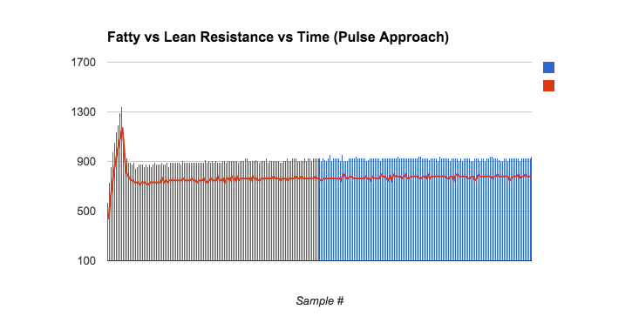
Biological Discoveries
Fatty Pork
Lean Pork
Notes:
Marty

Slide 12
Generated Pork Regression Model
Linear regression Number of obs = 53
F( 2, 50) = 67.27
Prob > F = 0.0000
R-squared = 0.8619
Root MSE = 5.2629
--------------------------------------------------------------------------------
| Robust
leanweight | Coef. Std. Err. t P>|t| [95% Conf. Interval]
---------------+----------------------------------------------------------------
resistanceohms | -.0047503 .002185 -2.17 0.034 -.009139 -.0003616
weightg | .5542703 .0496811 11.16 0.000 .4544829 .6540577
_cons | 1.207298 5.077608 0.24 0.813 -8.991377 11.40597
--------------------------------------------------------------------------------
Notes:
Philip
Mention R^2 value, P value weights for resistance and weight.

Slide 13
Fat Computation
Take computed lean weight from regression
Assume 35% water weight
Fat weight = Total Weight - Lean Weight - Water Weight
Fat percentage = Fat weight/(Non-water weight)
Notes:
Philip
Water weight did not vary from piece to piece so it’s value in the regression model was negligible. Fat percentage is measured compared to non-water weight because a consumer does not think of a lean piece of meat to include water or hydration level.

Slide 14
Testing
Meat resistance was tested using the FatAnalyzer
That data was collected along with the weight and length of the pork
The Pork was then boiled down until fat and lean mass were separated and all water weight was removed
Notes:
Philip
Now in order to generate this model, extensive testing was done.
All in all our final model was made using the results from ADSFASDF pork chops.
First the resistance was measured using the FatAnalyzer. The pork was also weighed.
To determine how much fat was in each piece, they were boiled down, usually for 1-2 hours, until the fat had could be separated from the meat. This process also removed the water from the meat.
This allowed for the determination of, water weight, lean weight, and fat weight. From there Fat percentage was calculated.

Slide 15
Specifications
Specification | Objective | Final Implementation
Target Subject | Cuts of Meat | Pork Chops
Meat Fat % Accuracy | 10-20% | 14%
Test Duration | <10 Seconds | <10 Seconds
Device Weight | <3 lbs | 0.60 lbs
Signal Voltage | 3.3 - 5 V | 5 V
Number of Probes | 2 - 4 | 2
Notes:
Philip
As you can see, our results were favorable.
Here we have our design specifications shown next to our results. We managed to achieve them all.
We did not specify an OS for the smartphone app because we wanted to attempt to get it to work on both.

Slide 16
Design Issues Encountered
Original idea involved testing complex impedance of meat
Include capacitance as another parameter in the model
Through significant testing, it was found that complex impedance was a minimal factor
Issues with Microcontroller selection
Started and ended with Arduino
Notes:
Brandon
It was not smooth sailing to get here. however.
Our two main issues are very much related
Originally, our goal was to model the complex impedance of the meat. As a result, it was necessary to model the capacitance of the meat. Much of the first month of design was spent finding a microcontroller that was fast enough to be able to see the rise time of the meat. This was imperative to find Capacitance.
We went from Arduino, to Beaglebone, to TI Launchpad. We learned a lot about sample rates haha.
Ultimately we arrived at a working solution on the launchpad. We were then able to measure Capacitance. While working on issues where it appeared that the meat was charging, we began to have a more stable model. It was at that time that we found that Capacitance was fairly insignificant to the accuracy of the model.
As a result, Capacitance was cut from testing. This allowed us to move back to the Arduino, as originally planned.

Slide 17
Design Issues Encountered
Similarity between subjects
Because all subjects were prepared similarly within batches, there is very little variation between non-measured parameters within a sample group.
Breaks down when samples from different sources tested.
Non-ideal testing methods
A more absolute fat-testing method was cost prohibitive.
Notes:
Brandon

Slide 18
Next Steps
Increased testing for parameterization of more attributes of meat.
Allows for a more robust model over various metrics
We feel this product could be much more widely applied
Chicken, beef, fish, etc.
Human testing
Original Plan
Notes:
Brandon
We really feel that this idea could be greatly improved.
With enough time and testing, models could be developed for any form of meat.
Our original goal was to develop a model that would allow for the accurate testing of Human body fat. When we learned we couldn’t do that, we were disappointed but we continued on.
We believe that with enough variables, arm lenght, height, weight, age, etc. That our device could be used to significantly out perform current on the market Body Fat Analyzers.

Slide 19
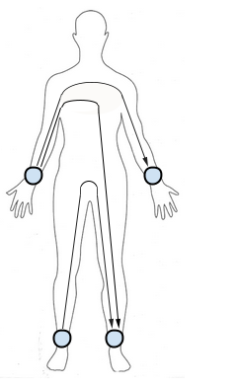
Next Steps: Human Testing
FFM (kg) = 0.7* (Ht²/R_{body}) +.18*BW - .18*Age + .12*X_{body} - 2.5 [1]
Ht² - Height of the subject squared
R_{body} - Real resistance of subject’s body
BW - Bodyweight of subject
Age - Age of subject
X_{body} - Imaginary reactance of subject’s body
Notes:
Brandon
If applied to a human, We would have wanted to see the results of having 4 points of testing. As you can see here, there are a lot of factors that could be used to generate a very accurate model.

Slide 20
Demonstration
Notes:
Brandon
To conclude we would like to demonstrate our device.
Professor Bhatti, would you please start the test from this phone and tell us the results.
Now, since our model is limited to pork, there isn’t terribly much variation from pork chop to pork chop so there isnt much wow factor.
But regardless, we feel that this was a good proof of concept that this product could be applied to a wider range of meats to become a more valuable item, or even shifted to test on humans with favorable results.

Slide 21
Mobile App Interface
Notes:
Marty
Here is a screen capture of our application. It runs on both android and iOS. The user will begin the test from the app.
A progress bar details the progress of the test and the results are displayed when completed.
The user can also cancel the test at any time.

Slide 22
Arduino Ohm Meter
Input Voltage from Arduino Pin Aoutput0
Notes:
Marty
Here is a visual representation of the ohm meter.
The current through the system is measured from these two points.

Slide 23
Conclusion
We have a product that is fairly accurate
This is likely due to little variation between samples
Weight is the most significant variable
As a proof of concept, this is a viable solution, but not a marketable product
Too many variables for such a small subject
Could be more viable with human subjects
Notes:
JD
In conclusion, we have a product that is accurate. Much of this is due to little variation from subject to subject. While resistance was significant, Weight was far more important.
We have reached the conclusion that without significant improvements, this is not a marketable product.

Slide 24
Questions
Notes:
Brandon and All
To conclude we would like to demonstrate our device.
Professor Bhatti, would you please start the test from this phone and tell us the results.
Now, since our model is limited to pork, there isn’t terribly much variation from pork chop to pork chop so there isnt much wow factor.
But regardless, we feel that this was a good proof of concept that this product could be applied to a wider range of meats to become a more valuable item, or even shifted to test on humans with favorable results.

Slide 25
References
[1] N. Macias. (2007, Aug. 15). Body fat measurement by bioelectrical impedance and air displacement plethysmography: a cross-validation study to design bioelectrical impedance equations in Mexican adults [Online]. Available: http://www.ncbi.nlm.nih.gov/pmc/articles/ PMC2020472/#!po=3.12500
Bibliography:
Y. Hui. (2012) Handbook of Meat and Meat Processing, 2nd Edition, Boca Raton
S. Nielsen. (2003) Food Analysis Vol. 1, New York
Y. Hui. (2001) Meat Science and Applications. New York

