Slide 1
The Impact of Key Factors on E-commerce Order Volume and Returns
Mehmet Salcan 32312

Slide 2
My Dataset
Order Date & Delivery Date:
The dates when the order was placed and delivered.
Delivery Time:
The delivery duration for each order (in days).
Gender & Age Group:
The gender and age group of the customer.
City:
The city where the order was delivered.
Product Category:
The category of the purchased product (e.g., Electronics, Clothing, Books, etc.).

Slide 3
My Dataset
Discount Rate:
The discount rate applied to the order (in percentage).
Customer Type:
Indicates whether the customer is new or returning.
Return Status:
Information on whether the product was returned.
Weather:
The weather condition on the delivery day (e.g., Sunny, Rainy).

Slide 4
Hypothesis 1: Delivery Time by Weather
Test: Two-sample t-test comparing delivery times between "Rainy" and "Sunny" weather.
Null Hypothesis (H0): There is no difference in mean delivery time between rainy and sunny days.
Alternative Hypothesis (H1): There is a difference in mean delivery time between rainy and sunny days.
Result: The p-value is compared to α = 0.05. If p < 0.05, the null hypothesis is rejected, indicating a significant difference.
Visualization: Boxplot of delivery time by weather.

Slide 5
Hypothesis 2: Delivery Time by Customer Type
Test: Two-sample t-test comparing delivery times between "New" and "Returning" customers.
Null Hypothesis (H0): No difference in mean delivery time between new and returning customers.
Alternative Hypothesis (H1): There is a difference in mean delivery time.
Result: Decision based on p-value and α = 0.05.
Visualization: Boxplot of delivery time by customer type.

Slide 6
Hypothesis 3: Return Status vs. Weather
Test: Chi-square test of independence between return status and weather.
Null Hypothesis (H0): Return status and weather are independent.
Alternative Hypothesis (H1): There is an association between return status and weather.
Result: Decision based on p-value and α = 0.05.
Visualization: Stacked bar plot of return status by weather.

Slide 7
Hypothesis 4: Return Status vs. Customer Type
Test: Chi-square test of independence between return status and customer type.
Null Hypothesis (H0): Return status and customer type are independent.
Alternative Hypothesis (H1): There is an association between return status and customer type.
Result: Decision based on p-value and α = 0.05.
Visualization: Stacked bar plot of return status by customer type.

Slide 8
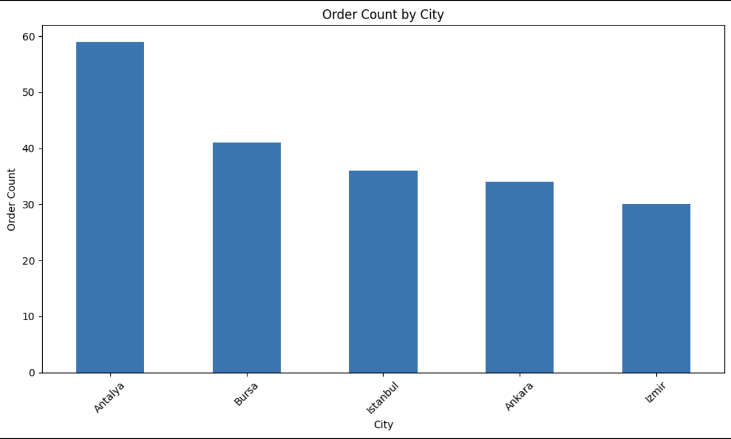
UNIVARIATE ANALYSIS:
Visualization: Bar plot showing the distribution of orders across different cities
Explanation: This visualization shows the number of orders in each city. It examines the distribution of orders based on a single variable (city).

Slide 9
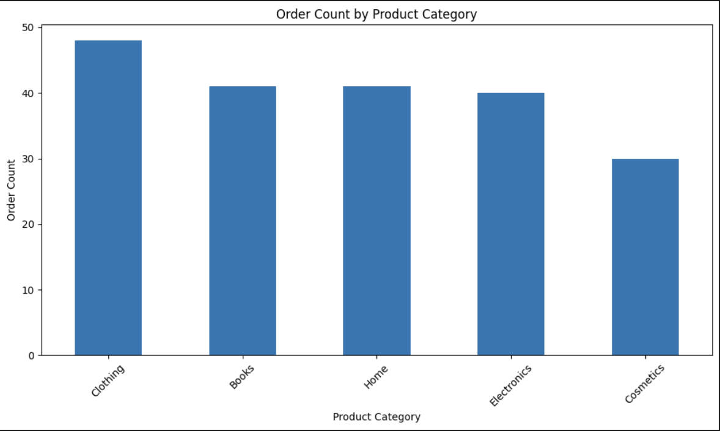
Visualization: Bar plot displaying the number of orders for each product category
Explanation: This visualization shows the number of orders in each product category. It examines the distribution of orders based on a single variable (product category).

Slide 10
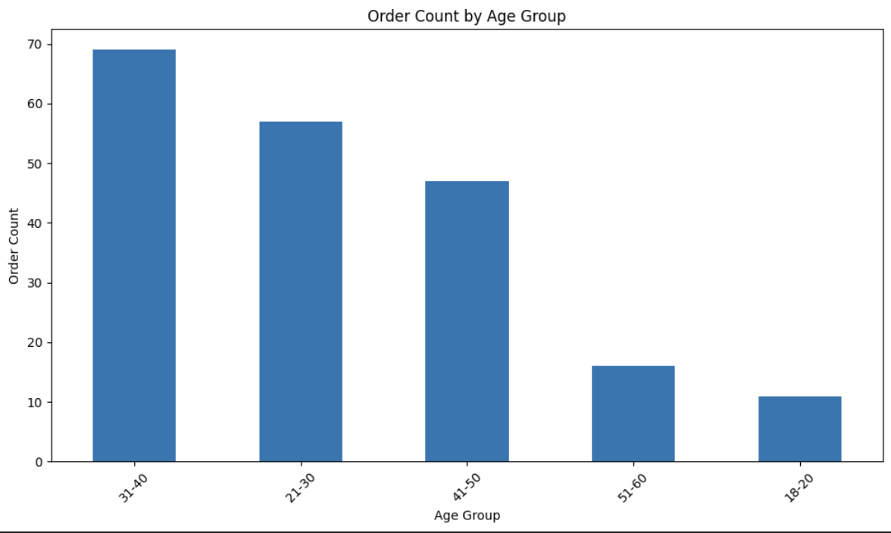
Visualization: Bar plot showing the distribution of orders across different age groups
Explanation: This visualization shows the number of orders in each age group. It examines the distribution of orders based on a single variable (age group).

Slide 11
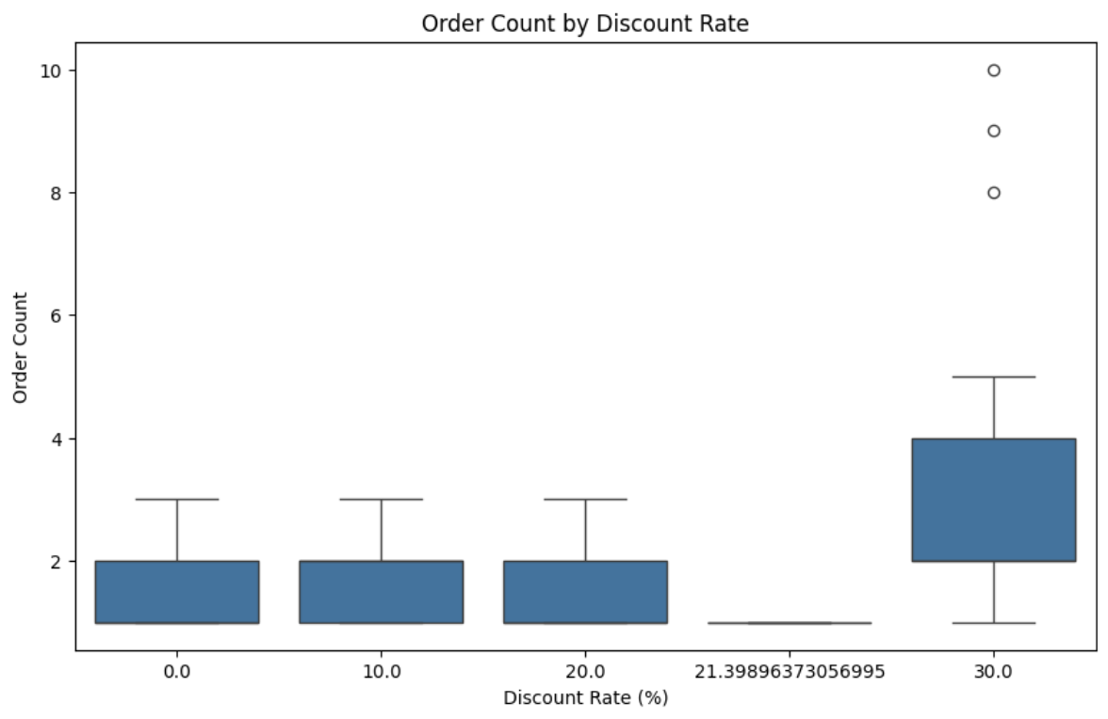
BIVARIATE ANALYSIS:
Visualization: Box plot showing the relationship between discount rates and order counts
Explanation: The box plot reveals a positive correlation between discount rates and order volumes, with higher discounts leading to increased order counts. The median order count is notably higher for days with discounts.

Slide 12
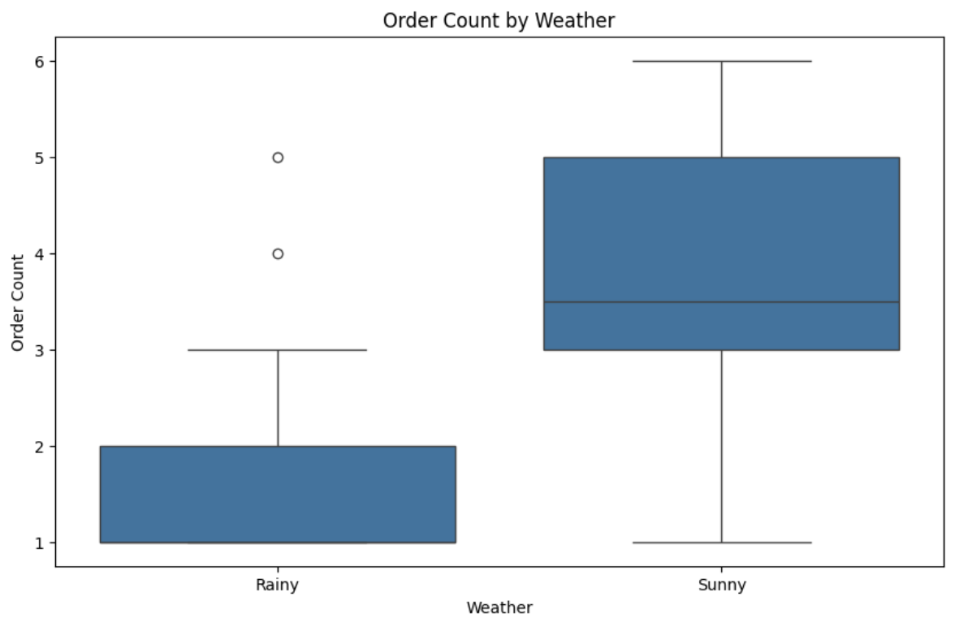
Visualization: Box plot displaying the relationship between weather conditions and order counts
Explanation: The box plot shows that sunny days consistently have higher order volumes compared to rainy days, indicating that weather conditions significantly influence customer purchasing behavior.

Slide 13
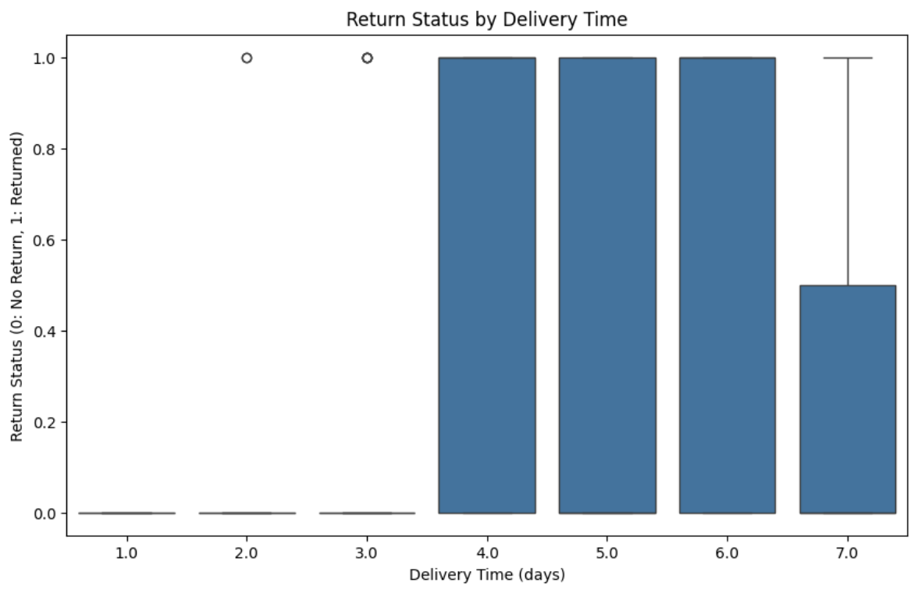
Visualization: Box plot showing the relationship between delivery time and return status
Explanation: The box plot demonstrates that longer delivery times are associated with higher return rates, suggesting that delivery duration directly impacts customer satisfaction and return decisions.

Slide 14
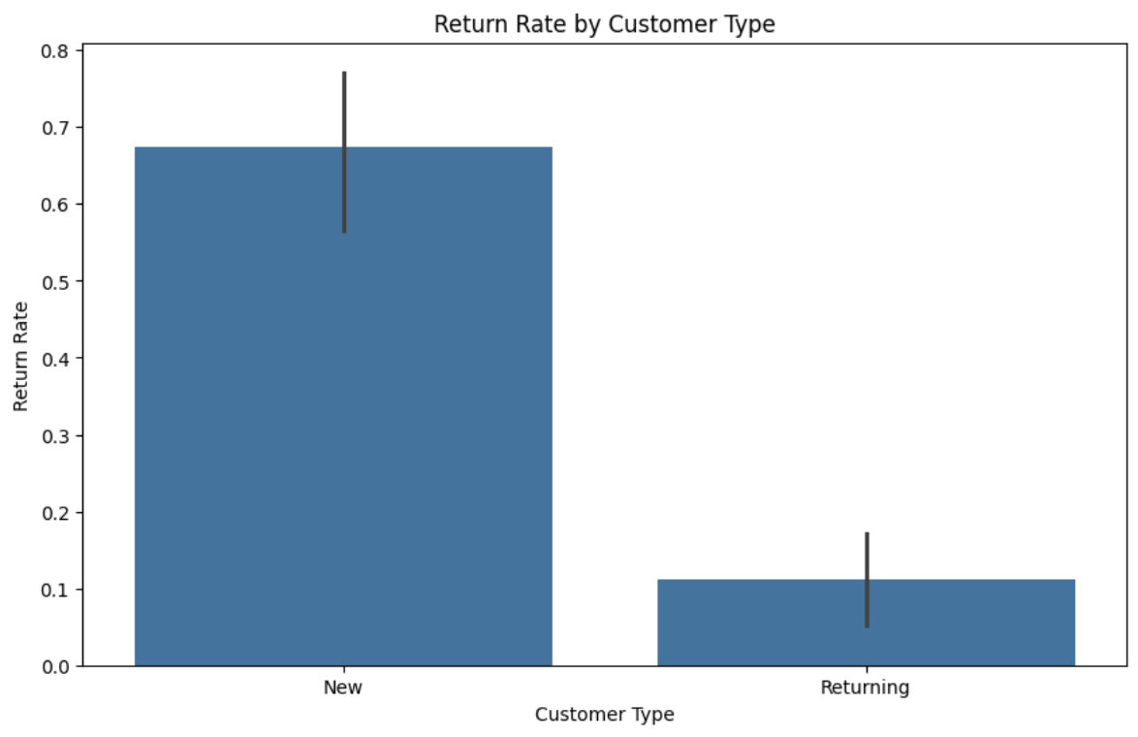
Visualization: Bar plot comparing return rates between different customer types
Explanation: The bar plot indicates that new customers have significantly higher return rates than returning customers, highlighting the impact of customer experience on return behavior.

Slide 15
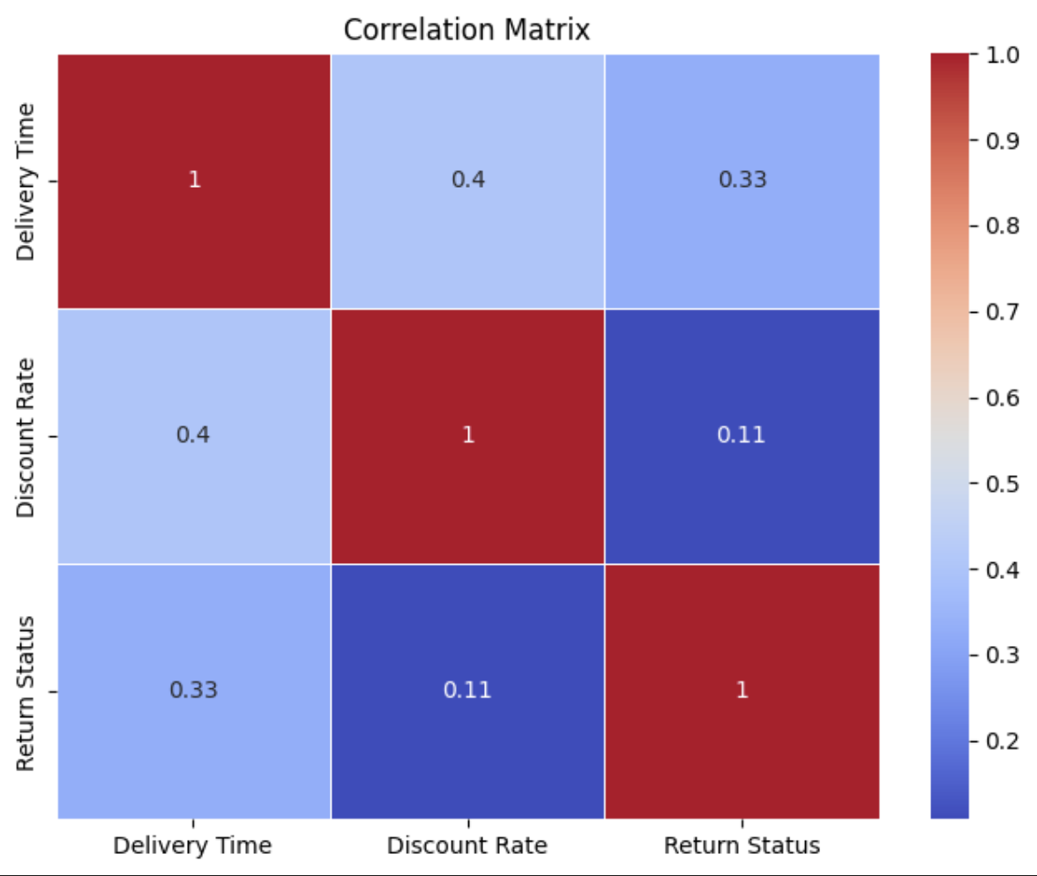
MULTIVARIATE ANALYSIS:
Visualization: Heatmap showing correlations between multiple numeric variables
Explanation: The heatmap reveals the complex relationships between key numeric variables (Delivery Time, Discount Rate, Return Status). It shows that delivery time has a moderate positive correlation with return status, while discount rate shows a weak negative correlation with returns.

Slide 16
CLASSIFICATION ANALYSIS

Slide 17
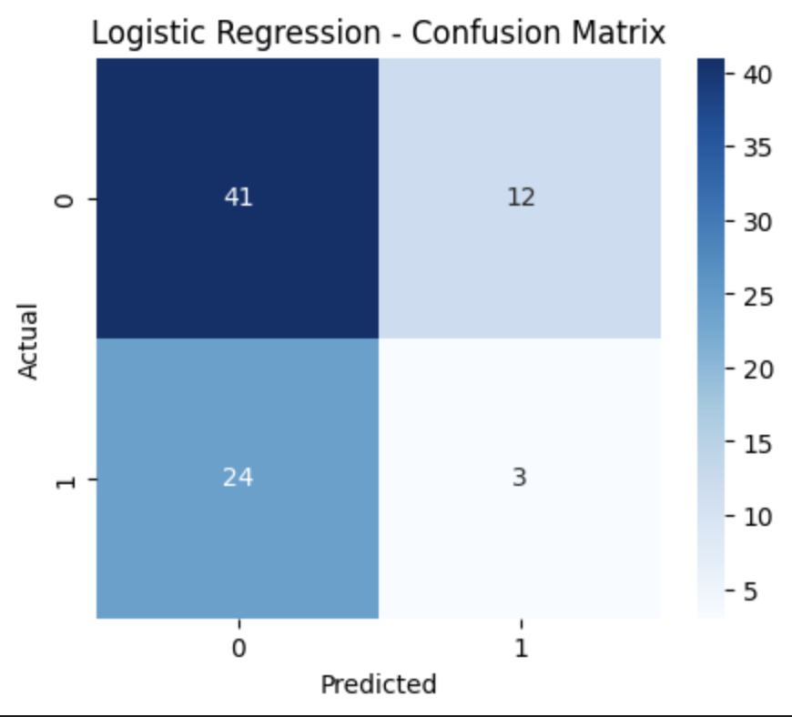
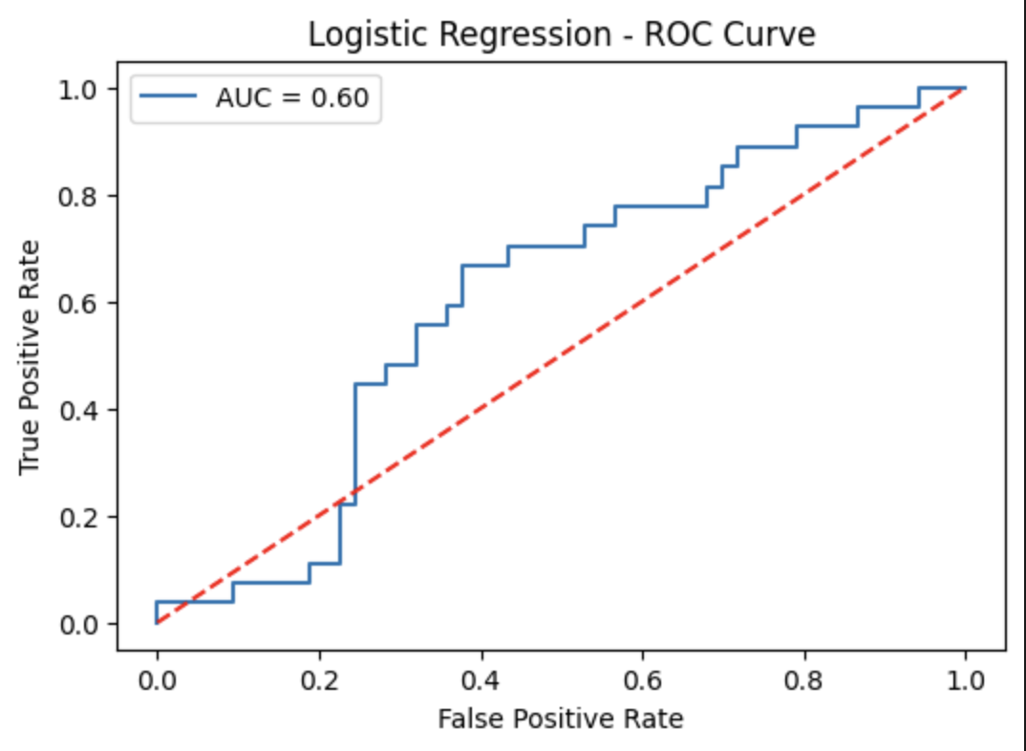
Logistic Regression: Accuracy: 0.68

Slide 18
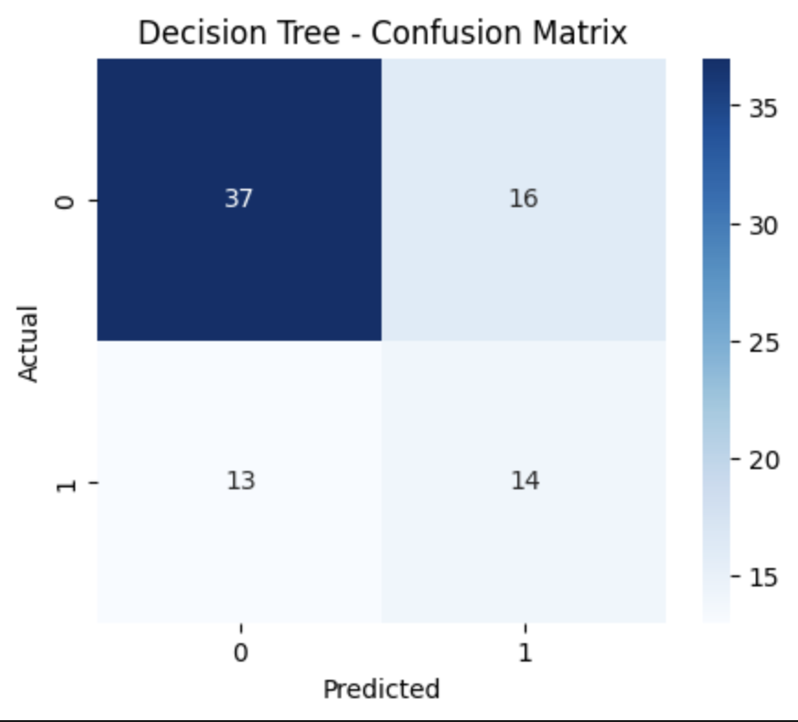
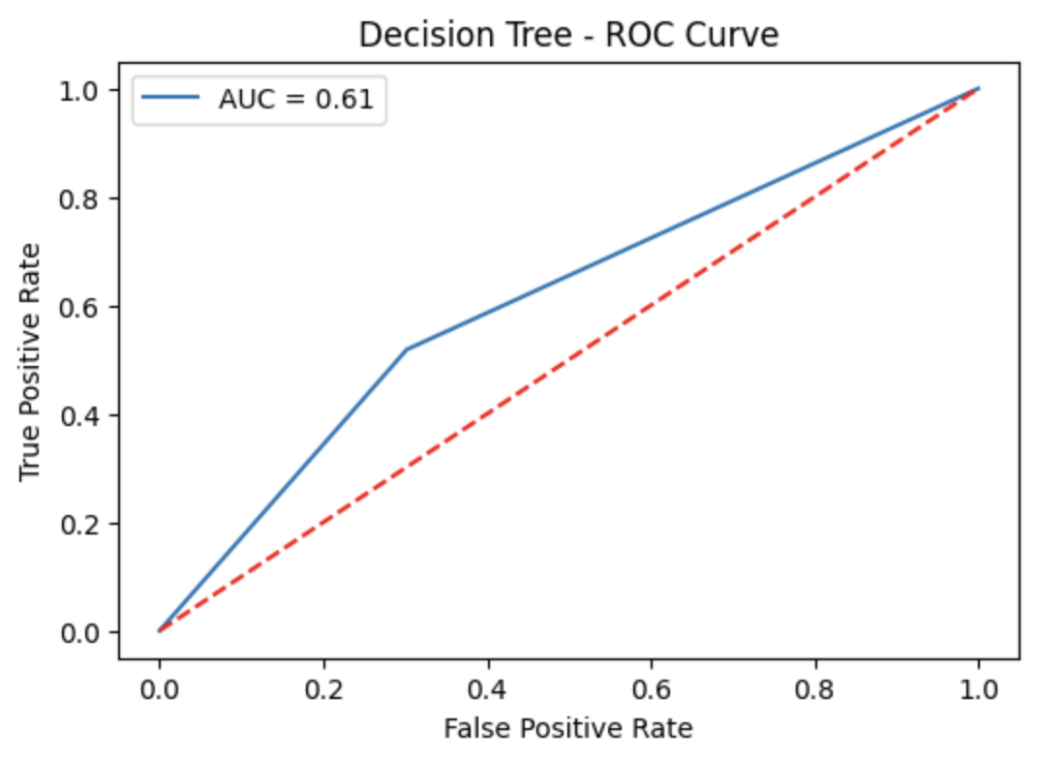
Decision Tree: Accuracy: 0.65

Slide 19
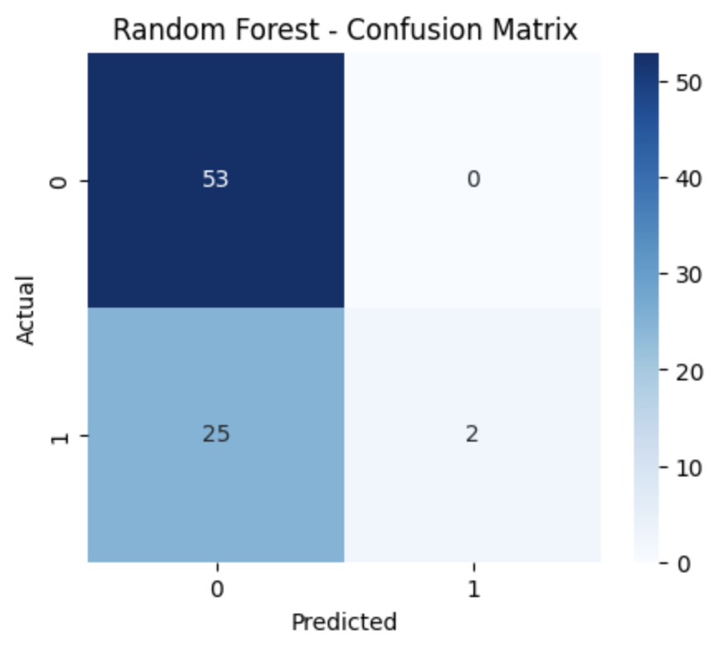
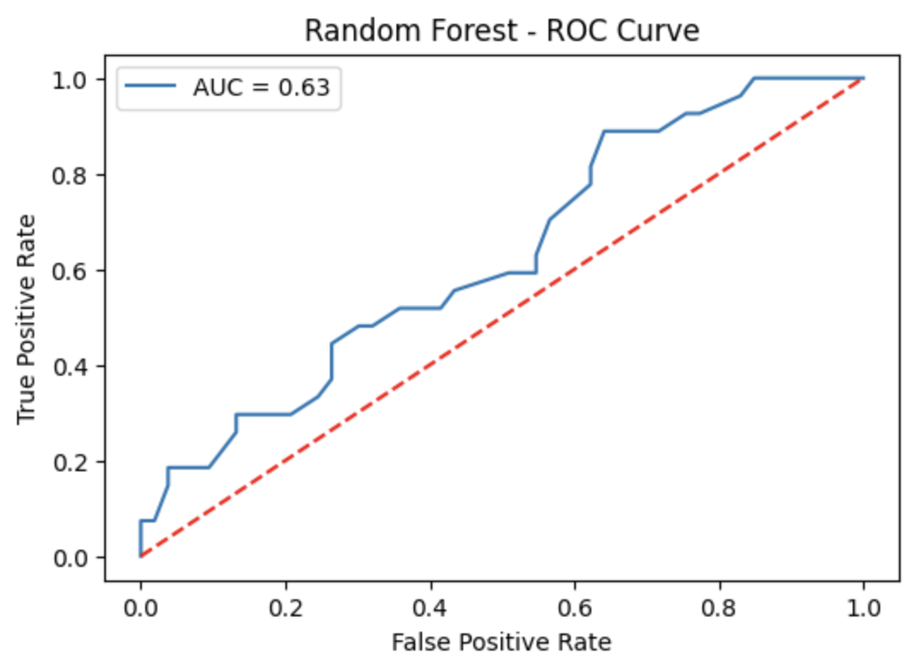
Random Forest: Accuracy: 0.69

Slide 20
Best performing model is Random Forest with Accuracy = 0.69

Slide 21
REGRESSION ANALYSIS

Slide 22
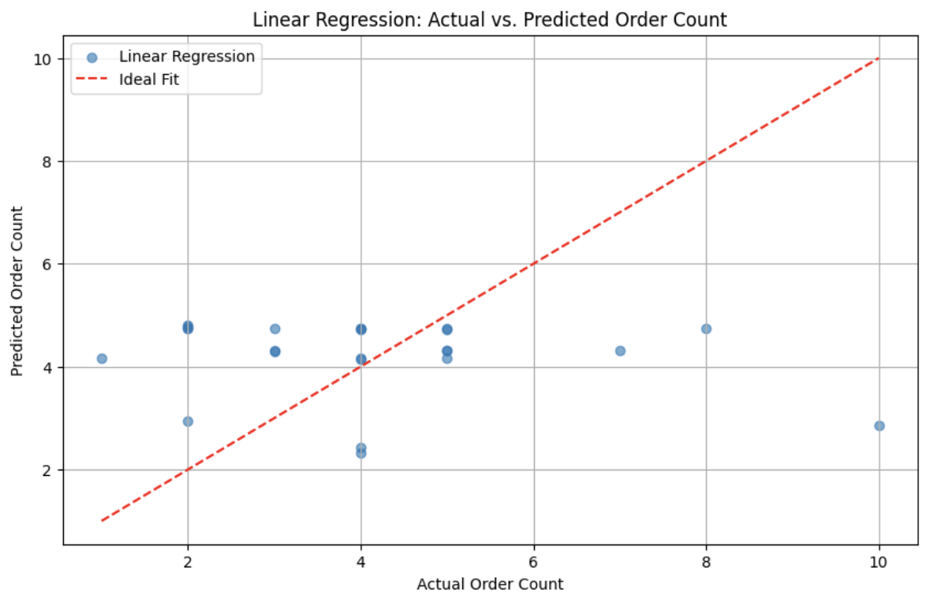
Linear Regression
Mean Squared Error: 5.23
R² Score: -0.28

Slide 23
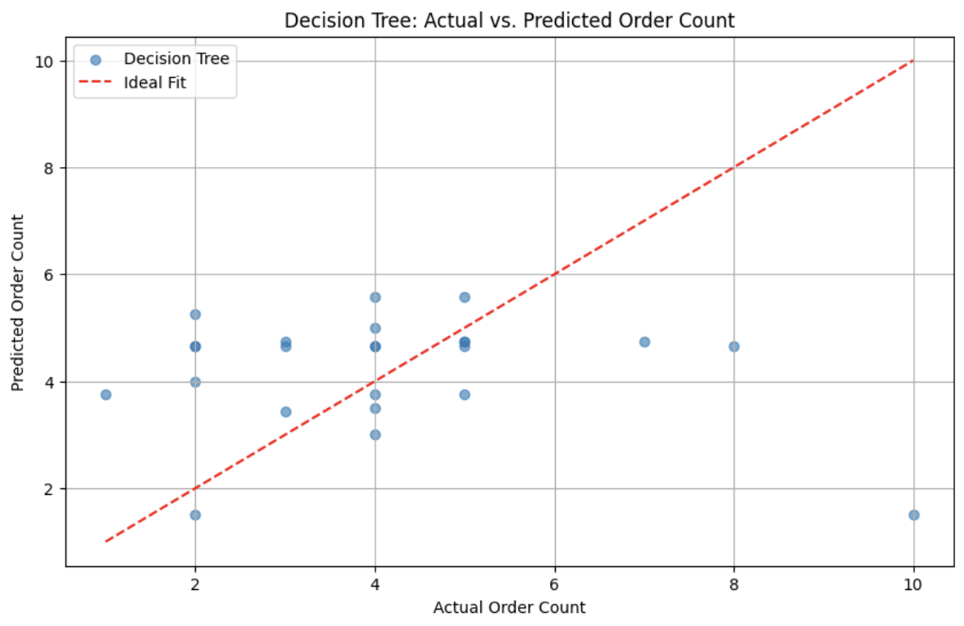
Decision Tree
Mean Squared Error: 5.78
R² Score: -0.42

Slide 24
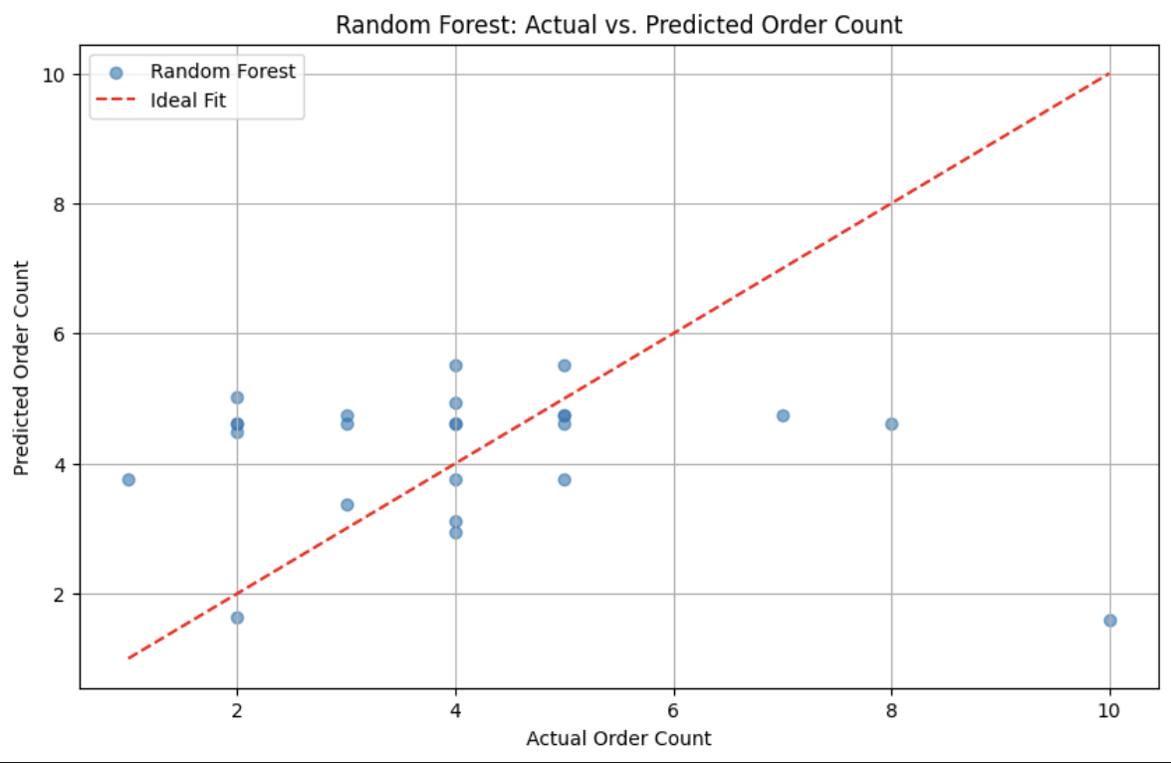
Random Forest
Mean Squared Error: 5.74
R² Score: -0.41

Slide 25
Best performing model is Linear Regression with R² Score = -0.28.

Slide 26
Conclusion:
Multiple hypothesis tests were conducted to examine the relationships between key variables such as discount rate, weather, delivery time, and customer type.
For each test, the p-value was less than 0.05, indicating statistical significance.
We reject the null hypotheses in all cases. There are significant relationships between:
Discount rate and order volume,
Weather conditions and order volume,
Delivery time and return status,
Customer type and return status.
These results suggest that business strategies (like discounts), operational factors (like delivery time), and customer characteristics have a meaningful impact on customer behavior and order outcomes

