Slide 1

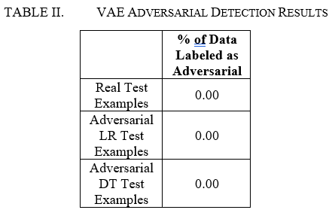
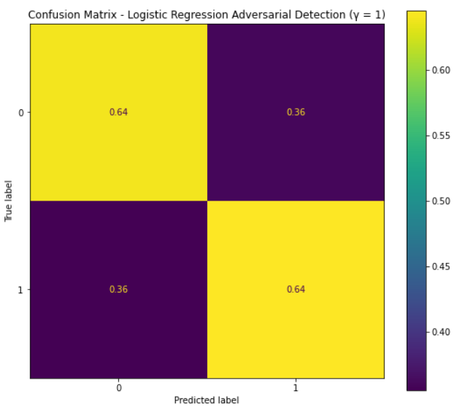
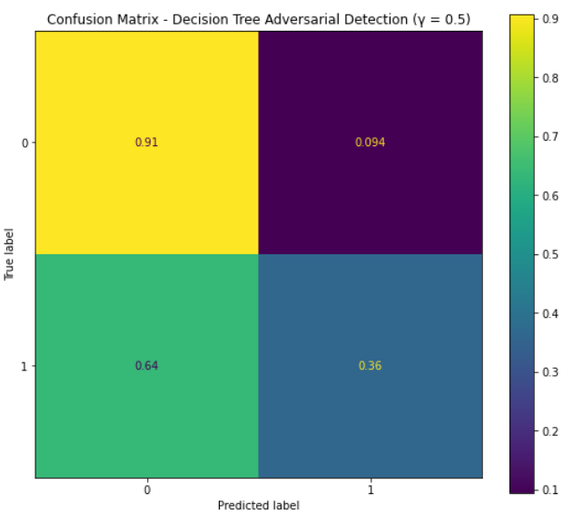

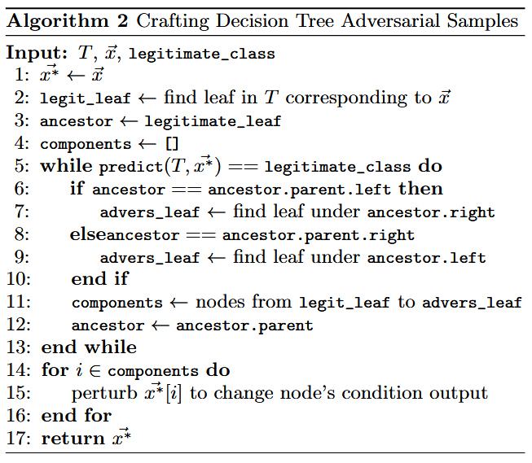

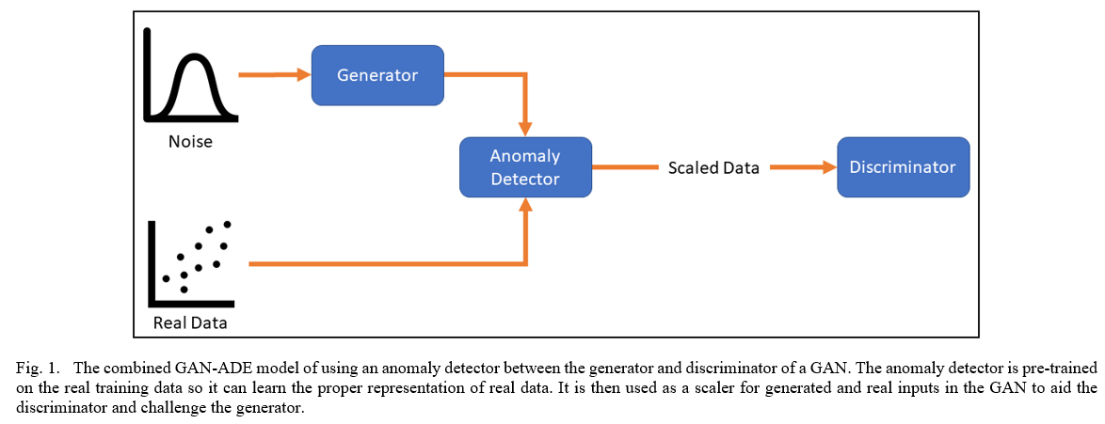
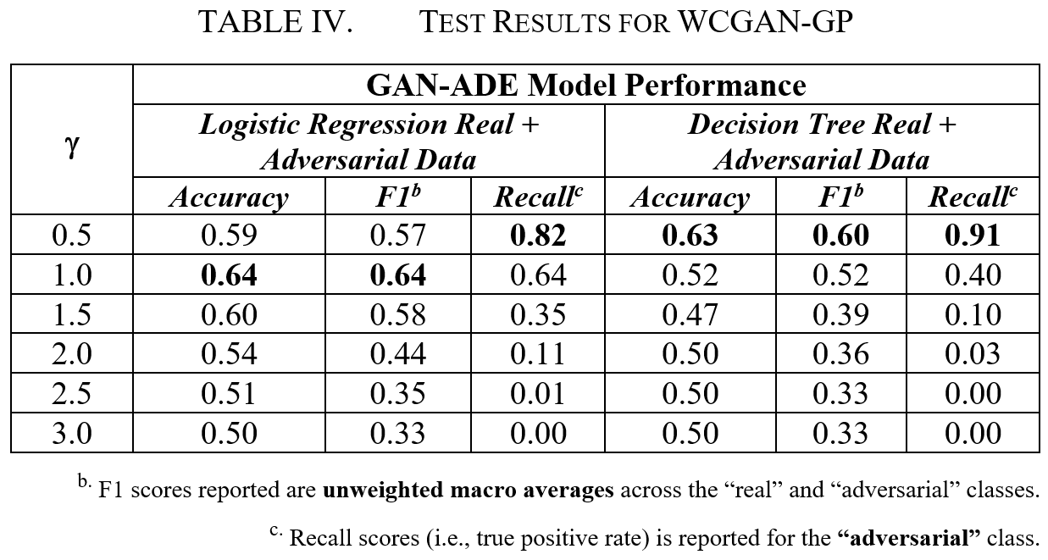
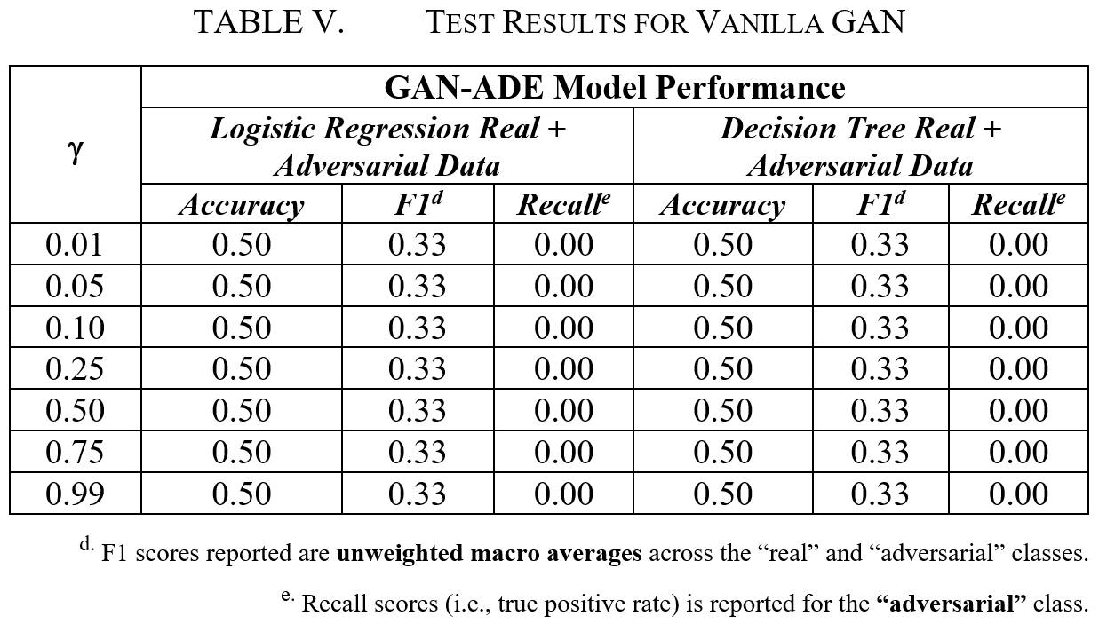
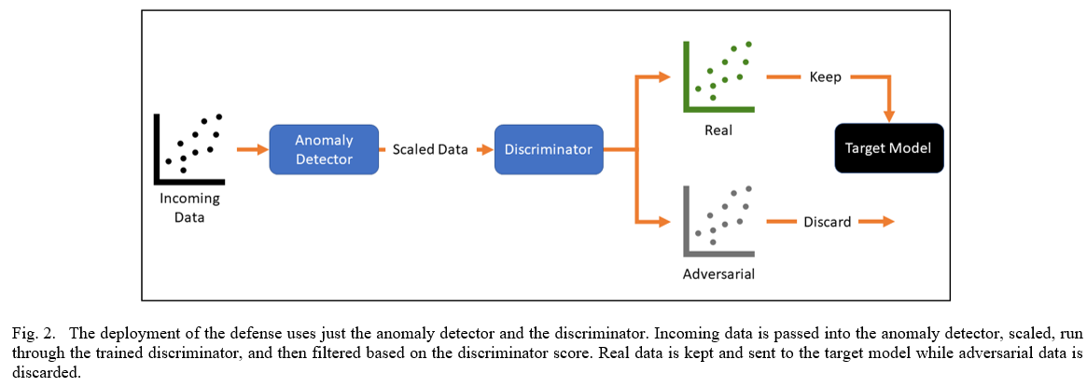
Detecting Adversarial Examples with
Anomaly Detector Enhanced GANs (GAN-ADE)
Michael Salceda – msalceda@gwu.edu
School of Engineering & Applied Sciences
Abstract
Methodology
Results
Results
The increase in data availability and need for quick analysis has accelerated the push for machine learning solutions. With the heightened adoption of ML applications, securing and protecting those applications has been increasingly prioritized. To aid in those efforts, this paper attempts to construct a model- and domain-agnostic defense amid the sea of image and neural network-based attacks and defenses in the adversarial ML field. Using two different attacks to generate effective adversarial examples for testing, I achieve some promising results utilizing a novel architecture called GAN-ADE for detecting those adversarial examples, hopefully paving the way for some new ideas to expand this area of research.
Data
The data used in my experimentation is the “Covertype” data set [2]. The dataset has a total of 581,012 samples with 54 features and seven classes – each class corresponds to a particular forest cover type (1 = “Spruce/Fir”, 2 = “Lodgepole Pine”, etc.). More details on the dataset can be found at [2].
Evasion Attacks
For my experiments, I utilized two evasion attacks for testing: the “Fast Gradient Sign Method” (FGSM) [5] and the decision tree attack described in [11].
FGSM:
Decision Tree Attack:
Defense (GAN-ADE)
The idea behind GAN-ADE (Fig. 1) is to combine the abilities of anomaly detection models to identify outliers with the expressive and generative capabilities of GANs in order to build a more knowledgeable discriminator. The anomaly detector helps in scaling the generated data and real data by the probability of being anomalous, which in turn, helps the discriminator better tell real from potentially adversarial. The generator also must work harder to fool both the anomaly detector and the discriminator.
Once GAN-ADE is done training, to deploy, only the anomaly detector and discriminator are used as shown in Fig. 2. For my experiments, I utilized a variational autoencoder [7] for my anomaly detector and tested two GAN architectures: a Wasserstein Conditional GAN with gradient penalty (WCGAN-GP) using a combination of concepts from [6] and [10], and a vanilla GAN [4].
Using just the VAE trained on the training data to attempt to detect adversarial examples was ineffective as the VAE was unable to find any “anomalous” data points with a probability of being anomalous above 50% (Table II). While it correctly labeled none of the real test examples as adversarial, it did not identify any of the adversarial examples generated by the FGSM and decision tree attacks as adversarial.
Utilizing both the VAE and a GAN as outlined in the GAN-ADE defense, I was able to achieve more promising results with the WCGAN-GP architecture (Table IV). Unfortunately, the vanilla GAN did not give anything of note (Table V). The γ in the following tables refers to the “threshold” in which to label a sample “real” or “adversarial”.
For the WCGAN-GP, a sample was labeled as “adversarial” if the output of the discriminator fell outside of the range defined by:
where µ_{train_dis_score} is the mean of the discriminator scores on the training data and σ_{train_dis_score} is the standard deviation of the discriminator scores on the training data.
For the vanilla GAN, since the last layer of the discriminator is a sigmoidal, γ simply represents a cutoff value. Any vanilla GAN discriminator output below γ is labeled as “adversarial”.
The two figures below show the confusion matrices for the best performing γ threshold (in terms of F1 score) with the two adversarial test sets using the WCGAN-GP-based GAN-ADE (top: logistic regression; bottom: decision tree). NOTE: A label of “1” means real and a label of “0” means adversarial.
Conclusion
My work has shown that it is possible to detect adversarial examples without modifying or accessing the target model. I found that utilizing a simple VAE for adversarial detection is not enough and neither is using a vanilla GAN combined with a VAE anomaly detector. It was only with the WCGAN-GP architecture that I was able to get some promising results in being able to successfully filter out adversarial examples.
Future work includes the further tuning and development of both components of this defense: the anomaly detector and the GAN. I did not heavily invest in tuning the anomaly detector or the GAN, and there are many parameters that could be modified.
In the end, there is still much room for improvement in this space. Detecting adversarial examples is a challenging and ever-evolving area of research so hopefully this work can serve as a starting point for some new ideas.
Introduction
In today’s world, there is no shortage of data being generated and collected. Due to the increase in data volume and complexity, efforts to analyze that data are relying more heavily on machine learning (ML) to get to actionable insights quickly. However, people are becoming more privacy- and security-conscious, causing both public and private sectors to become more cognizant or the inputs and outputs of their ML applications. Because of this attention, research into adversarial ML is becoming more and more important.
A key issue in adversarial ML is defending against attacks where the attacker can generate adversarial examples for a model to make the model perform in an unexpected way, e.g., misclassifying an input with high confidence [13]. The best defense against these kinds of attacks (“evasion” attacks) is preventing the adversarial data from reaching the target model in the first place so, in this work, I explore and test a way to detect and filter out adversarial examples with the additional challenges of: (1) only using the input training data and (2) not being able to access and/or modify the target model.
To limit the scope of this work, I focused specifically on evasion attacks – attacks to make a target model behave incorrectly. Effectively crafting a defense for this kind of attack necessitates the restrictions set by the challenges mentioned in the introduction.
References
[1] D. A. Bierbrauer, A. Chang, W. Kritzer, and N. D. Bastian, "Cybersecurity Anomaly Detection in Adversarial Environments," arXiv e-prints, p. arXiv:2105.06742, 2021.
[2] J. A. Blackard and D. J. Dean. Covertype Data Set, UCI Machine Learning Repository
[3] A. Borji, "Pros and Cons of GAN Evaluation Measures: New Developments," arXiv e-prints, p. arXiv:2103.09396, 2021.
[4] I. J. Goodfellow et al., "Generative Adversarial Networks," arXiv e-prints, p. arXiv:1406.2661, 2014.
[5] I. J. Goodfellow, J. Shlens, and C. Szegedy, "Explaining and Harnessing Adversarial Examples," arXiv e-prints, p. arXiv:1412.6572, 2014.
[6] I. Gulrajani, F. Ahmed, M. Arjovsky, V. Dumoulin, and A. Courville, "Improved training of wasserstein GANs," presented at the Proceedings of the 31st International Conference on Neural Information Processing Systems, Long Beach, California, USA, 2017.
[7] D. P. Kingma and M. Welling, "Auto-Encoding Variational Bayes," arXiv e-prints, p. arXiv:1312.6114, 2013.
[8] A. Krizhevsky, "Learning Multiple Layers of Features from Tiny Images," 2009.
[9] Y. LeCun and C. Cortes. The MNIST Database of Handwritten Digits
[10] M. Mirza and S. Osindero, "Conditional Generative Adversarial Nets," arXiv e-prints, p. arXiv:1411.1784, 2014.
[11] N. Papernot, P. McDaniel, and I. Goodfellow, "Transferability in Machine Learning: from Phenomena to Black-Box Attacks using Adversarial Samples," arXiv e-prints, p. arXiv:1605.07277, 2016.
[12] P. Samangouei, M. Kabkab, and R. Chellappa, "Defense-GAN: Protecting Classifiers Against Adversarial Attacks Using Generative Models," arXiv e-prints, p. arXiv:1805.06605, 2018.
[13] C. Szegedy et al., "Intriguing properties of neural networks," arXiv e-prints, p. arXiv:1312.6199, 2013.

