Slide 1
EMSE 6586 - Million Song Data Analysis
Sean Kim & Michael Salceda

Slide 2
Data Description

Slide 3
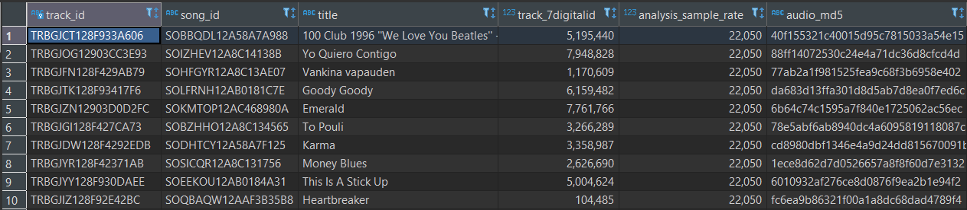
What is this data?
Collection of songs and its associated metadata collected by the Echo Nest
Metadata includes things like:
Duration
Artist
“Danceability”
Etc.
Each row in the dataset is a specific song identified by a unique ID
For this project, we are using a SUBSET of the entire set - 10,000 songs instead of the full 1,000,000

Slide 4
How is this data formatted?
Group 0
Dataset 0
Dataset 1
Original data is formatted as HDF5 files (.h5 file extension)
Hierarchical Data Format - created by NCSA for storing large amounts of data
Uses the idea of “groups” and “datasets”
Group: similar to a folder/container
Dataset: arrays of data
Good for:
Storing large amounts of structured data
Having a flexible way to efficiently store complex data structures
Being slightly annoying to parse with pandas if it doesn’t follow a strict format
Dataset 2
Group 1
Dataset 0
Group 2
Dataset 1
…

Slide 5
Database Selection & Design

Slide 6
A Tale of Two Databases
MongoDB
Less reliant on data structure so easier to load data in
Less reliant on data structure so harder to enforce data constraints (deduplication, weird values, etc.)
Using MQL (MongoDB Query Language) can be pain - especially with complex aggregations
PostgreSQL
Heavily relies on explicit data structure and relationships so easy to enforce data constraints
Heavily relies on explicitly data structure and relationships so harder to load stuff in
Using SQL can be easier than MQL

Slide 7
There were three different database designs we explored.

Slide 8
Release Attributes
PK | release_7digitalid
 | release
Song Attributes
PK | song_id
 | title
 | year
 | genre
Song Analyses
FK | song_id
FK | artist_id
FK | release_7digitalid
 | loudness
 | danceability
 | bars_start[ ]
 | …
Artist Analyses
FK | artist_id
 | artist_mbtags
 | artist_familiarity
 | artist_hotttnesss
 | similar_artists
Artist Attributes
PK | artist_id
 | artist_location
 | artist_latitude
 | artist_longitude
 | artist_name
Design Option 1

Slide 9
Design Option 1 Trade-offs
Pros:
Easy to pull in relevant information from other tables without complex JOINs
Easier to update/add information to a subset of tables without affecting others
Cons:
Tables not directly connected have to be bridged using “Songs Analyses” table (e.g., “Release Attributes” and “Artist Attributes”)
More processing needed upfront on data ingestion
More complex design structure
“The One Table to Rule Them All”

Slide 10
Musicbrainz
PK | song_id
FK | artist_id
FK | release_7digitalid
 | segments_start[ ]
 | title
 | artist_name
 | …
Song Analysis
PK | song_id
FK | artist_id
 | danceability
 | segments_start[ ]
 | title
 | loudness
 | …
Metadata
PK | song_id
FK | artist_id
FK | release_7digitalid
 | artist_latitude
 | artist_name
 | release
 | …
Design Option 2

Slide 11
Design Option 2 Trade-offs
Pros:
Data is naturally formatted in this way so it’s easy to design
Less code overhead to create and populate the tables
Should one or two tables get lost/deleted/etc. due to issues, one or both of the other tables contain the same information
Cons:
Multiple columns appear across all three tables - perhaps this is too much redundancy
The size of the data would be much greater since all three tables would have so much information
“Redundancy, Redundancy, Redundancy”

Slide 12
Song Info
PK | song_id
 | artist_id
 | release_7digitalid
 | title
 | artist_name
 | year
 | genre
 | danceability
 | key
 | time_signature
 | time_signature_confidence
 | …
Design Option 3

Slide 13
Design Option 3 Trade-offs
Pros:
Slightly more code complexity than option 2, but not as complex as option 1
Everything is in one place so queries are super simple to write - no need for complex JOINs
Cons:
Table size is bigger since more there is more redundancy in the data
Less efficient to update columns
e.g., changing “Prince” to “The Artist Formerly Known as Prince” would need to go through ALL of his songs to change that value vs only changing one row in option 1
“Keep It Simple, Stupid”

Slide 14




Final Database Design & Implementation
Database Design
Chose Option 3 (“KISS”)
Fairly easy to implement
Data size was small enough that it was okay to have a single large table
Easier to run queries on this design
Database Implementation
Custom Docker image with PostgreSQL Docker image as base
Added additional steps:
Install prerequisite packages (Python, conda, etc.)
Download the dataset
Run our custom initialization scripts
Converted H5 to DataFrames
Created the PostgreSQL table
Uploaded the data into PostgreSQL

Slide 15
Dataset Analysis

Slide 16
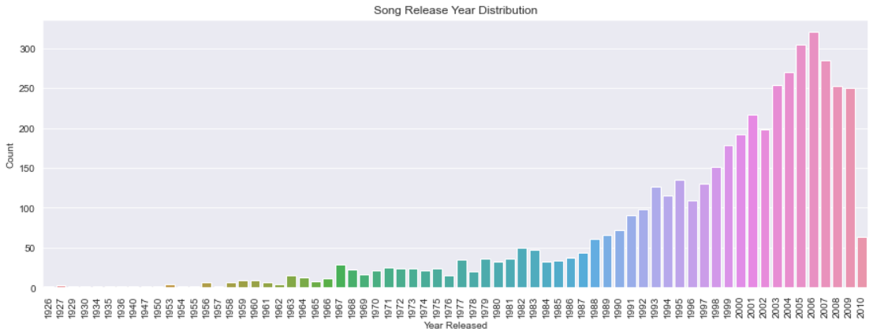
Question/Goal - How has music changed (if at all) throughout the years; can we predict release year by song attributes?

Slide 17
Exploratory Analysis
Did the rise of technology/music streaming change music at all?
Of the 10,000 rows in the dataset, only just under half have valid years
Big label imbalance with the year distribution heavily skewed towards the 90s and mid 2000s
This can cause misleading classification results
Because of the nature of the data (different songs being very unique), how severe the imbalance is, and a relatively small (ish) dataset, we cannot simply under or oversample to fix
Not a total fix, but decided to create a new feature called “decade” (going to predict this new label)

Slide 18
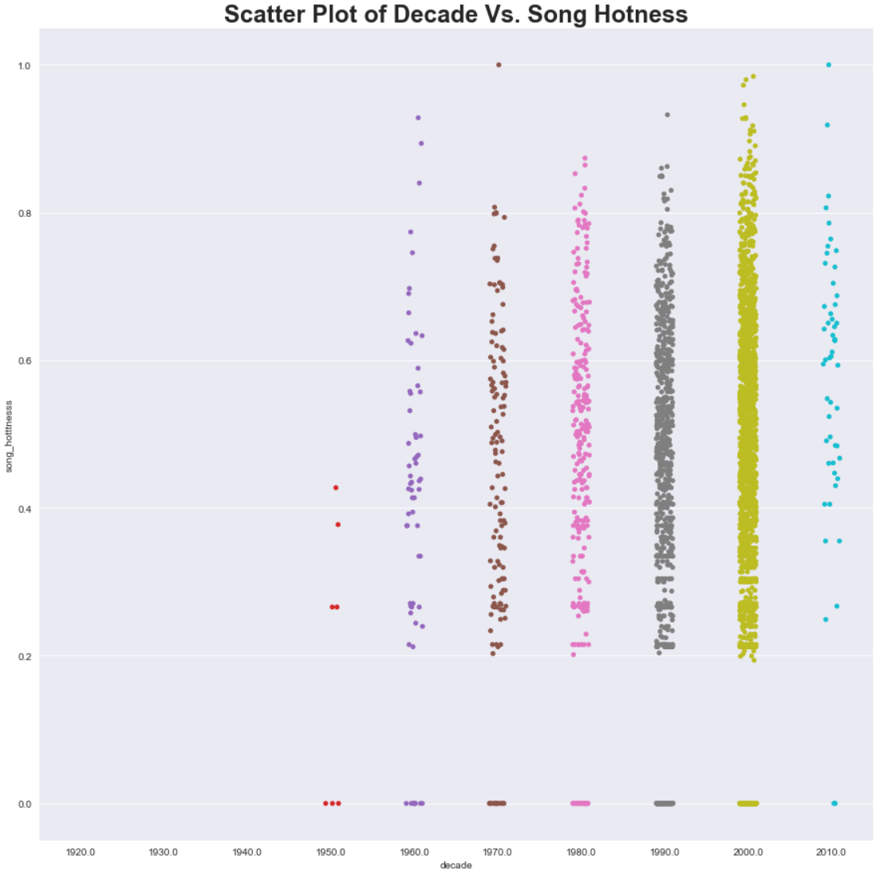
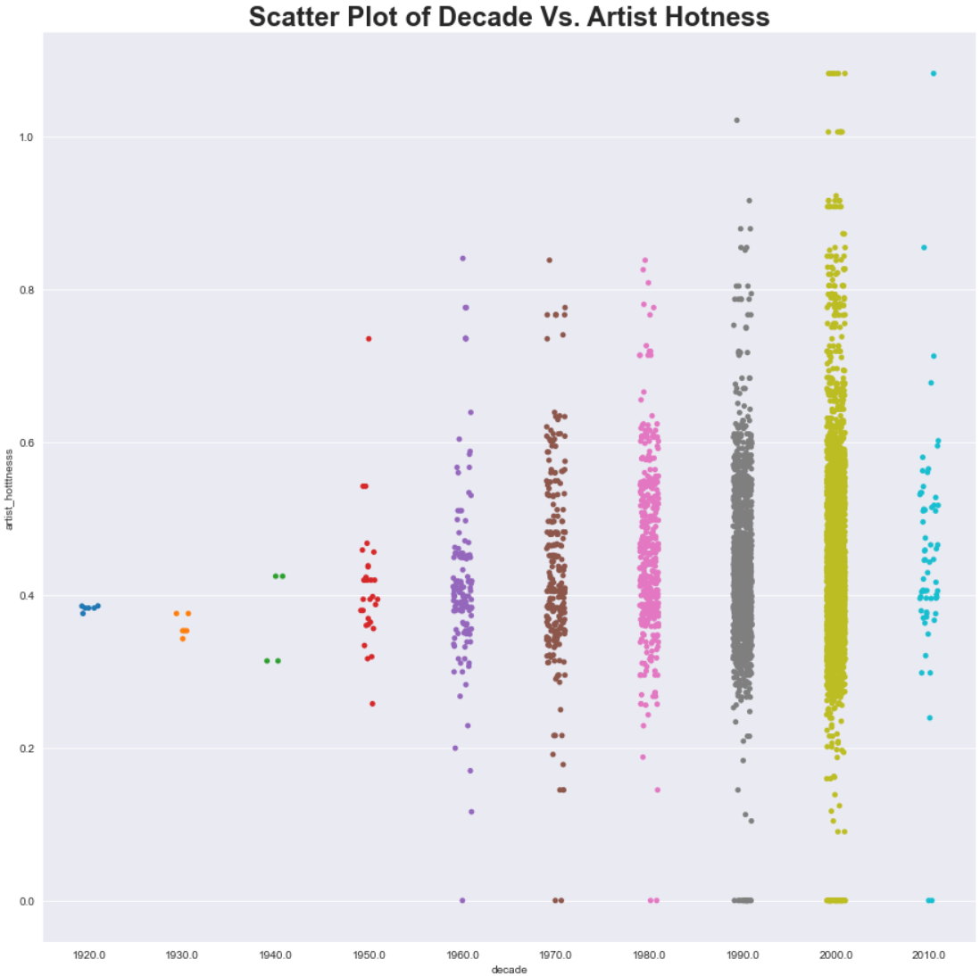

Slide 19
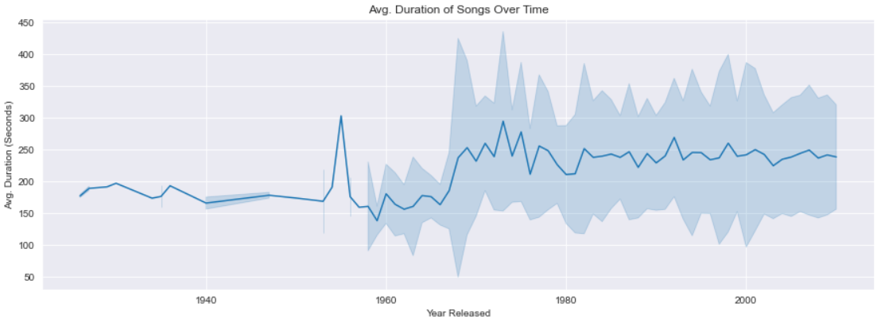
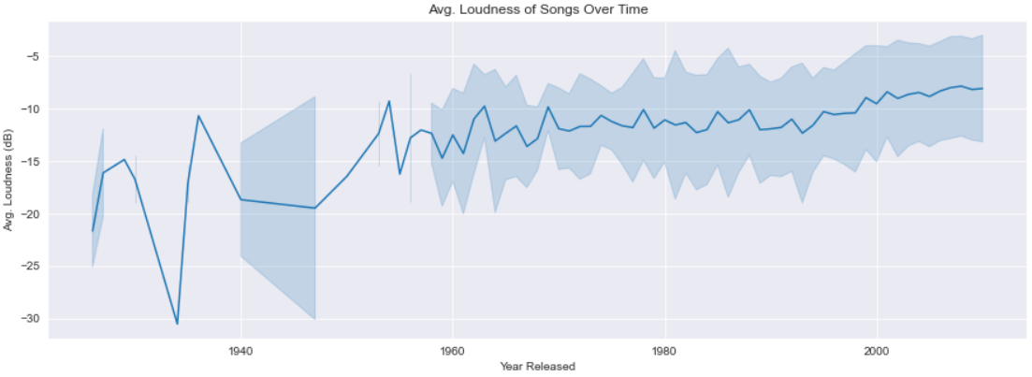

Slide 20
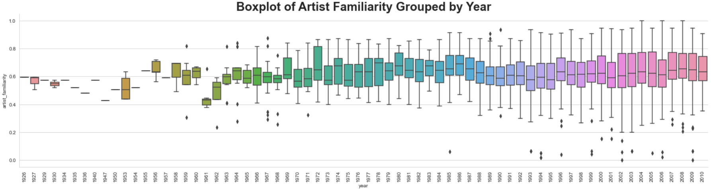
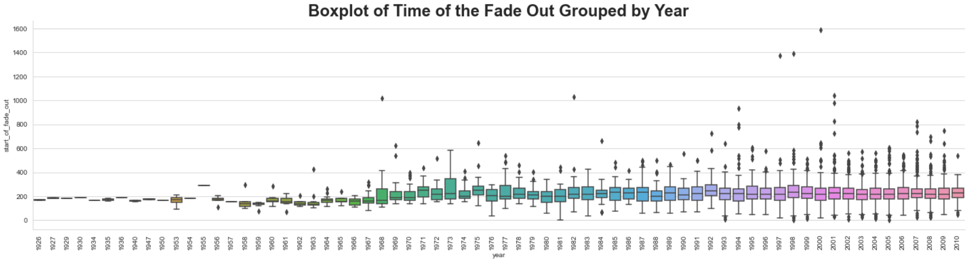

Slide 21
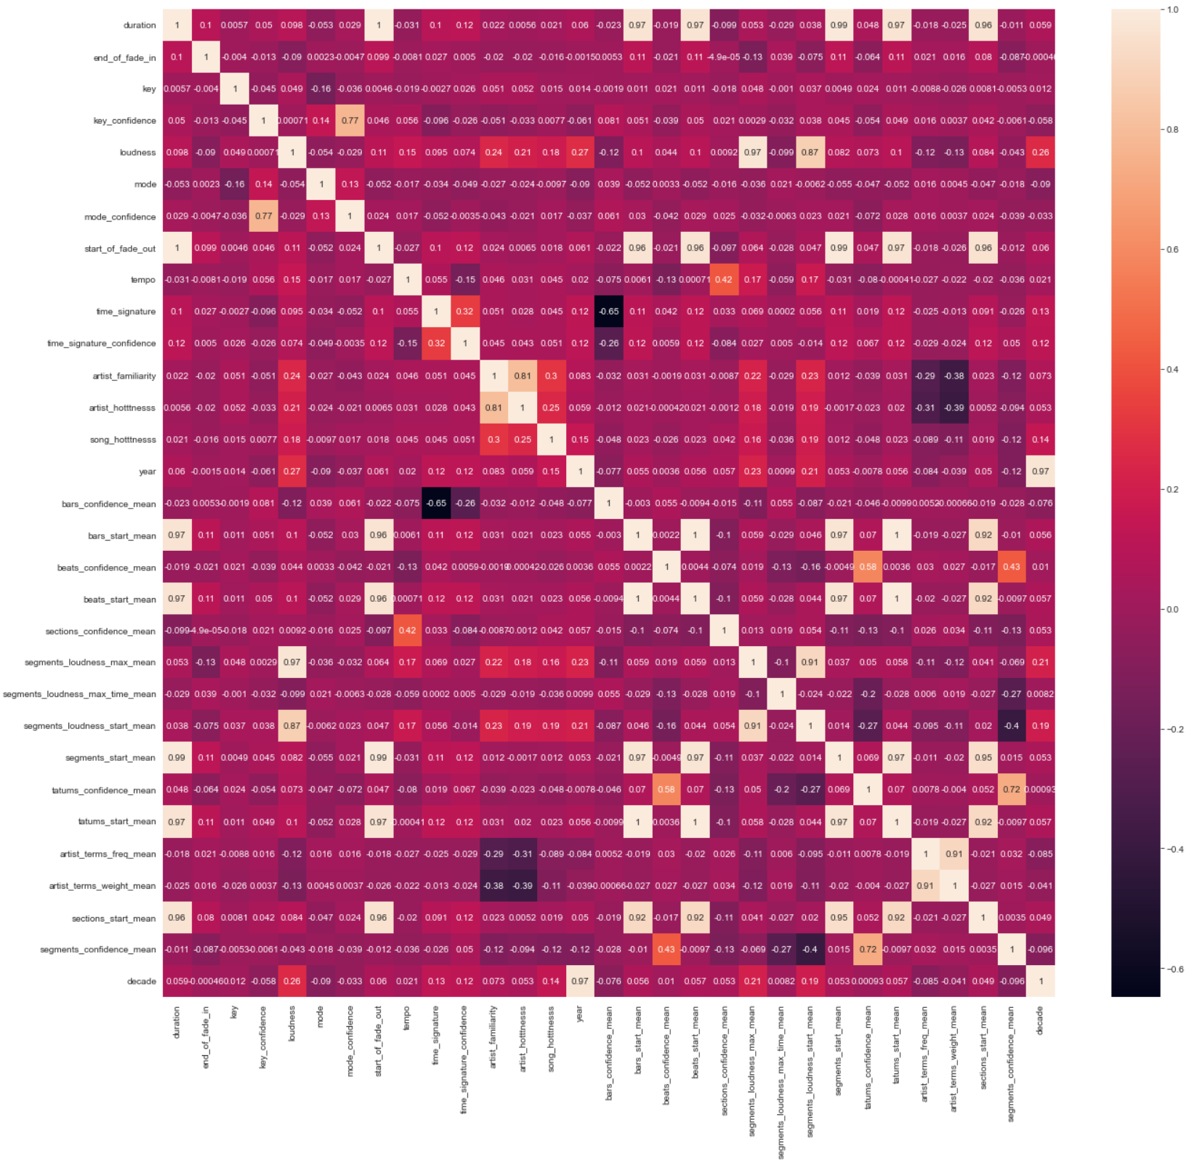

Slide 22
Data Wrangling/Preparation
Dropped features that were not necessary for modeling
Track_id, song_id, title, analysis_sample_rate (all records had the same value), audio_md5, energy (all records had the same value), etc.
Converted float array features into single value features by taking the mean value
Ex: segments_loudness_max represents the max loudness (in dB) for each segment in the song
Segments are delimited by note onsets, or other discontinuities in the song’s signal
Each segments max loudness is recorded in its corresponding indices in the float array
Segments_loudness_max replaced by segments_loudness_max_mean
Next found features that had missing data
Features with some missing data included artist_familiarity, song_hotness, and others
Missing data was filled with 0s

Slide 23
Modeling
Used Logistic Regression and Random Forest Classifier to try and predict the decade label
Used RandomSearchCV for hyperparameter tuning and 3-fold cross validation
Trained one Logistic Regression model using all of the features
Parameter search space included C, multi_class, and max_iter parameters
0.56 overall f1 score
Trained another Logistic Regression model after removing features with high multicollinearity
Same parameter search space
0.55 overall f1 score
Trained Random Forest Classifier
Parameter search space included n_estimators and max_features
0.56 overall f1 score
Feature importance on next slide

Slide 24
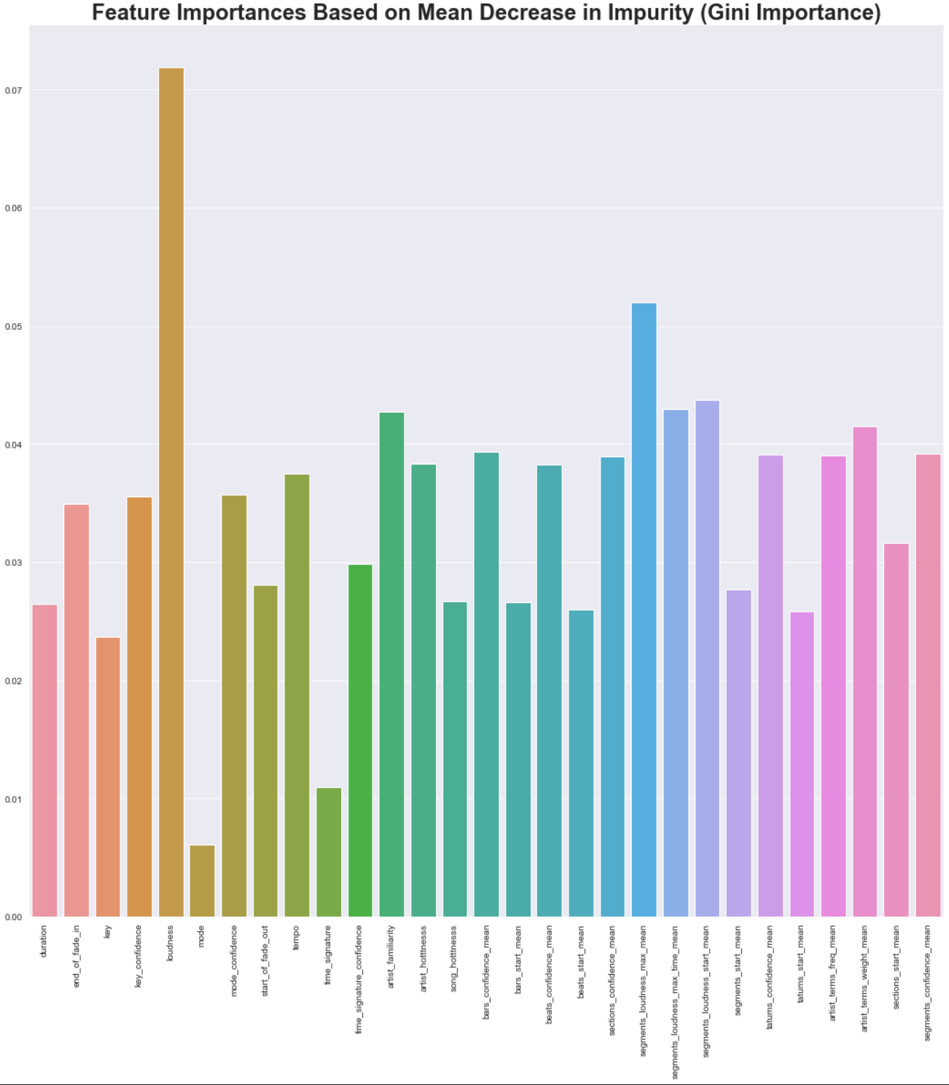

Slide 25
Issues and Where to Improve for the Future
Dataset population (label imbalance)
As seen earlier, data is very skewed towards the 90s and 2000s making it difficult to properly train a classifier to learn and predict release decade
When predicting, some decades (1920s for example) were never predicted as the classifier was trained on very few examples of 1920s songs
Severe label imbalance leads to misleading classifier results
Data sample size (subset vs full dataset)
From the million songs dataset subset (10,000 songs), only about half had valid year values
Rather small sample to build an accurate and unbiased classifier
Full dataset is almost 300 Gb, would likely have to use a distributed/scalable computing technique such as MapReduce
Better handling of missing data
Some missing data could have been sourced and joined through other supplementary datasets listed on the million songs website (or third party APIs)
Dataset does not provide any actual audio to work with, entirely metadata
The metadata is good, but maybe not suitable for every classification task

Slide 26
Thank You!

