Slide 1
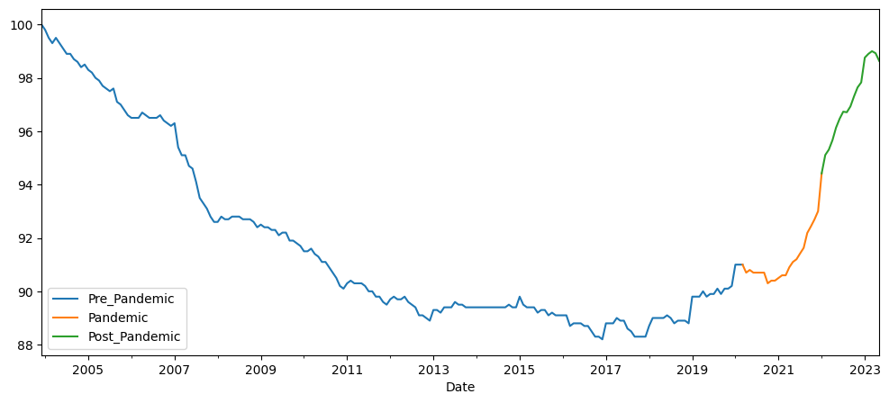
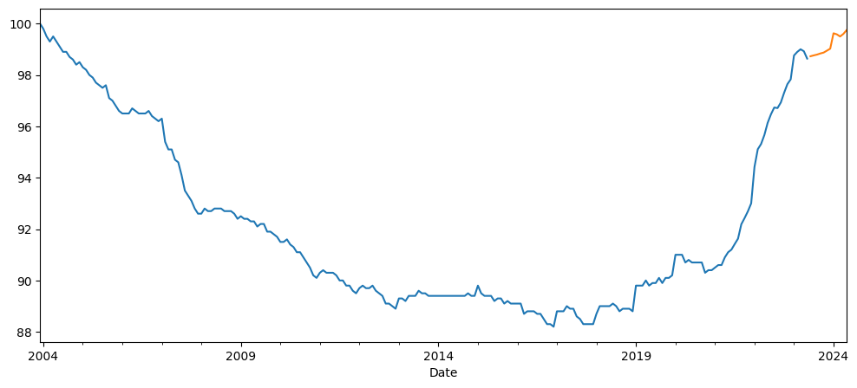
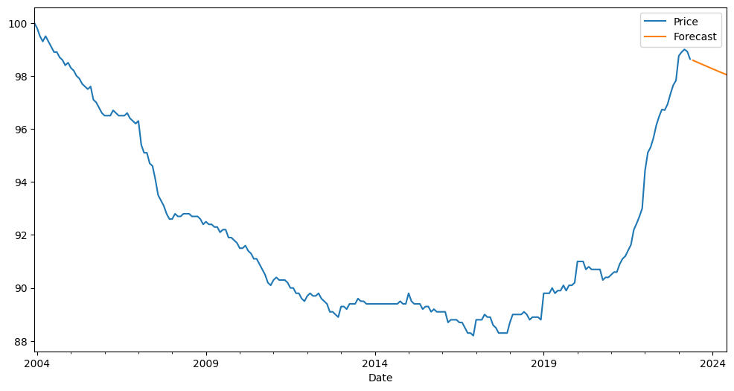
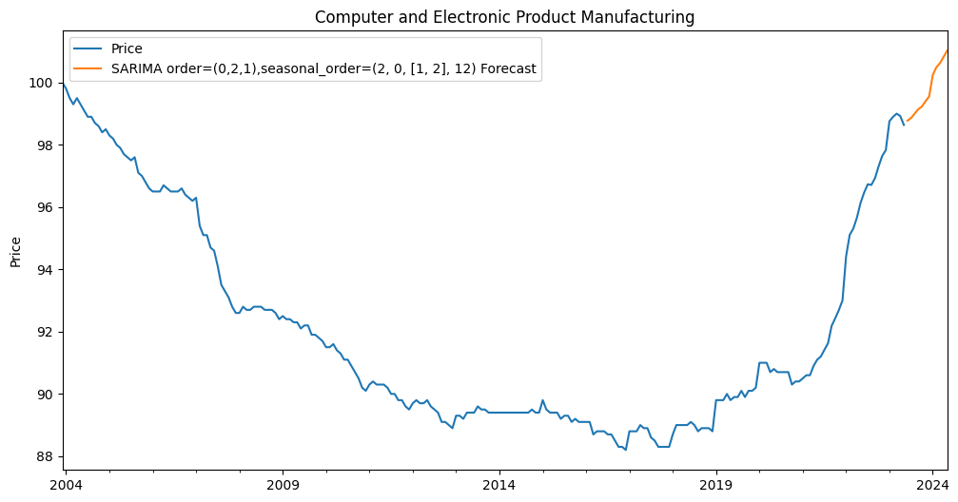
334000 - Computer and Electronic Product Manufacturing
Prediction models:
1- Holt-Winters Method
RMSE = 1.48
Mean price = $92.04
2- AR Method
RMSE = 5
4- SARIMA Method
3- ARIMA Method
RMSE = 1.19
RMSE = 1.16

Slide 2
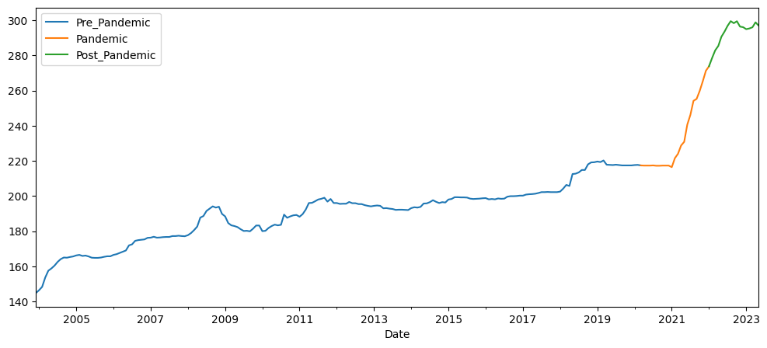
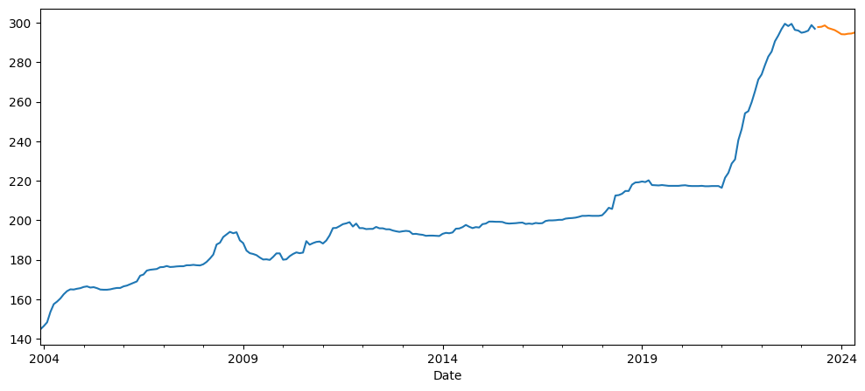
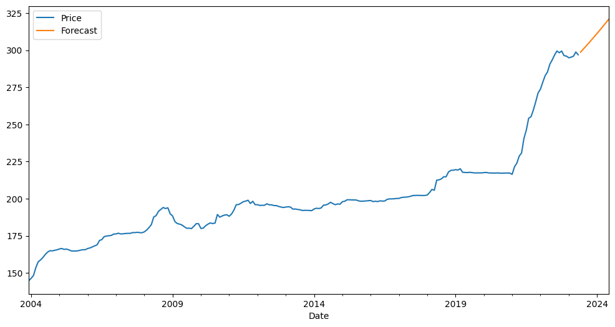
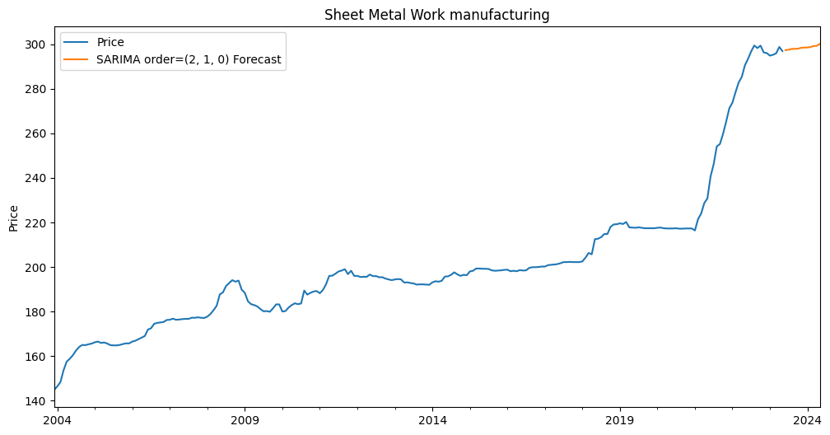
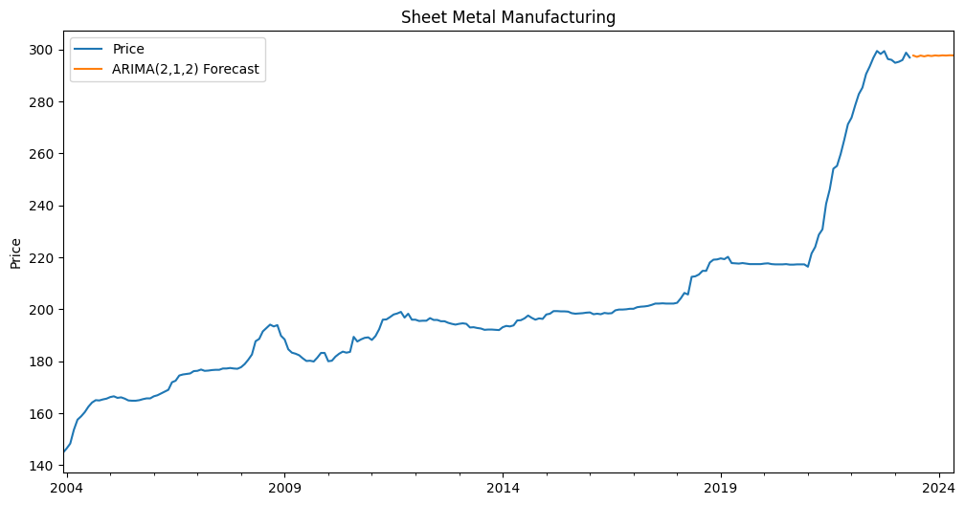
332322_Sheet Metal Work manufacturing
Prediction models:
1- Holt-Winters Method
RMSE = 24.7
Mean price = $201.22
2- AR Method
RMSE = 41.39
4- SARIMA Method
3- ARIMA Method
RMSE = 8.22
RMSE = 15.44

Slide 3
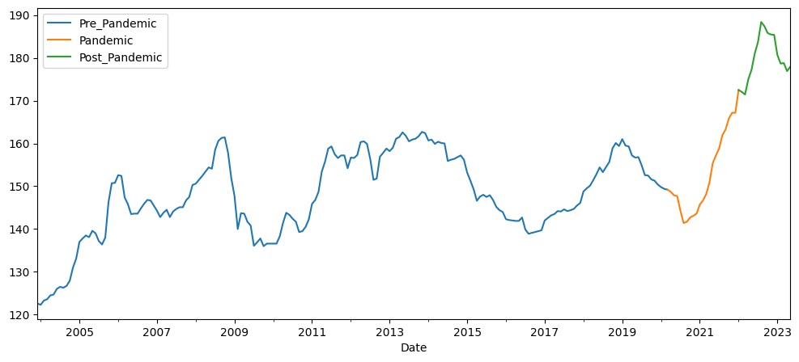
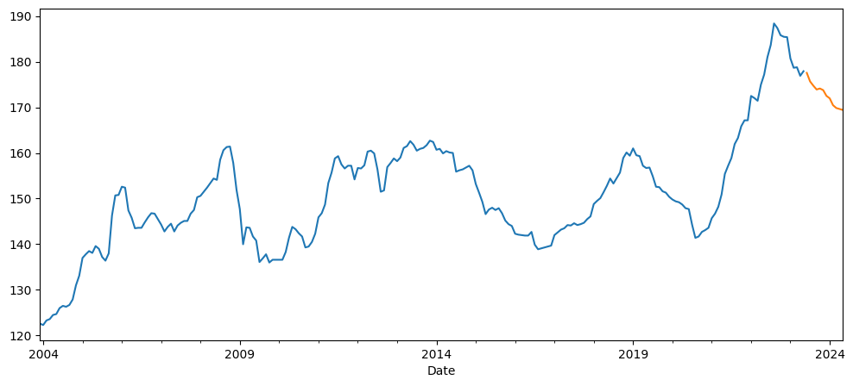
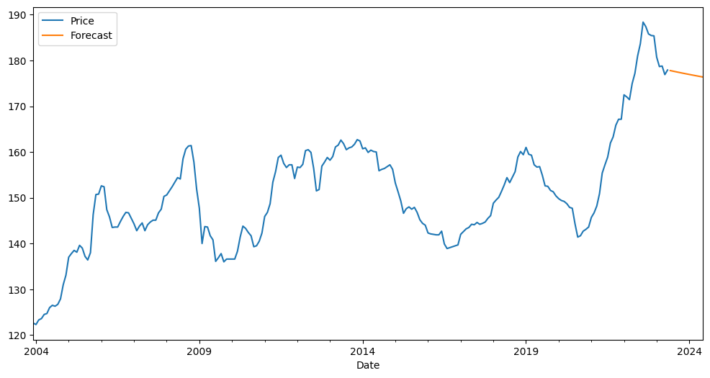
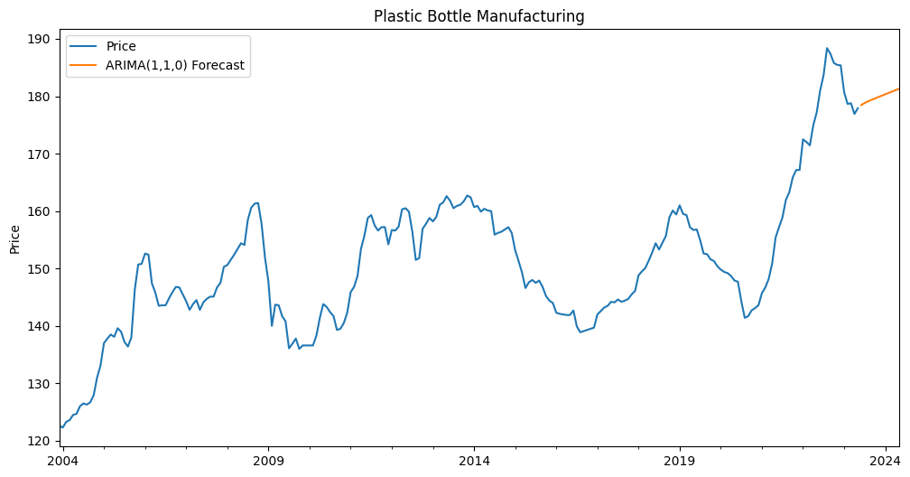
32616_Plastics bottle manufacturing
Prediction models:
1- Holt-Winters Method
Mean price = $150.54
RMSE = 11.35
2- AR Method
RMSE = 13.02
3- ARIMA Method
RMSE = 5.46

