Slide 1

8
Organizational
Structure

Slide 2
Designing Organizational Structure
Organizing: the process by which managers establish working relationships among employees to achieve goals.
  Organizational Structure: formal system of task & reporting relationships showing how workers use resources.
  Organizational design: managers make specific choices resulting in a given organizational structure.
Successful organizational design depends on the organization’s unique situation.

Slide 3
Factors Affecting Organizational Design
Figure 8.1
Environment
Determine design
or organizational
structure
Strategy
Technology
Human
Resources

Slide 4
Determinants of Structure
  The environment: The quicker the environment changes, the more problems face managers.
    Structure must be more flexible when environmental change is rapid.
      Usually need to decentralize authority.
  Strategy: Different strategies require the use of different structures.
    A differentiation strategy needs a flexible structure, low cost may need a more formal structure.
    Increased vertical integration or diversification also requires a more flexible structure.

Slide 5
Determinants of Structure
  Technology: The combination of skills, knowledge, tools, equipment, computers and machines used in the organization.
    More complex technology makes it harder for managers to regulate the organization. Technology can be measured by:
      Task Variety: new problems a manager encounters.
      Task Analyzability: programmed solutions available to a manager to solve problems.
    High task variety and low analyzability present many unique problems to managers.
      Flexible structure works best in these conditions.
    Low task variety and high analyzability allow managers to rely on established procedures.

Slide 6
Technology & People
  Small Batch Technology: produces small quantities of one-of-a-kind products.
    Based on the skills of the workers who need a flexible structure.
  Mass Production Technology: automated machines make high volumes of standard products.
    Workers perform repetitive tasks so a formal structure works well.
  Continuous Process Technology: totally mechanized systems of automatic machines.
    Workers must watch for unexpected problems and react quickly. A flexible structure is needed here.

Slide 7
Determinants of Structure
  Human Resources: the final factor affecting organizational structure.
    Higher skilled workers who need to work in teams usually need a more flexible structure.
    Higher skilled workers often have professional norms (CPA’s, physicians).
  Managers must take into account all four factors (environment, strategy, technology and human resources) when designing the structure of the organization.

Slide 8
Job Design
Job Design: group tasks into specific jobs.
    Results in a division of labor between workers that is effective and efficient.
  Job simplification: reduction of the tasks each worker performs.
    Too much and boredom results.
  Job enlargement: increase tasks for a given job to reduce boredom.
  Job enrichment: increases the degree of responsibility a worker has over a job.
    can lead to increased worker involvement.

Slide 9
Job Characteristics Model
Figure 8.2
Skill Variety
Task Identity
Task Significance
Meaningfulness
of work
High:
Motivation
Performance
Satisfaction
Responsibility
for Work
Outcomes
Autonomy
Knowledge of
results of
work
Feedback

Slide 10
Job Characteristics Model
  Jobs have five characteristics describing extent of:
    Skill variety: employee uses a wide range of skills
    Task identity: worker involved in all tasks of job from beginning to end of the production process
    Task significance: worker feels the task is meaningful to organization.
    Autonomy: employee has freedom to schedule tasks and carry them out.
    Feedback: worker gets direct information about how well the job is done.
  These affect the motivation, satisfaction and performance of employees.

Slide 11
Grouping Jobs into Functions
Once tasks are grouped into jobs, managers must decide how to group jobs together.
  Function: people working together with similar skills, tools or techniques to perform their jobs.
    Functional structure consists of departments such as marketing, production, and finance.
      Workers can learn from others doing similar tasks.
      Easy for managers to monitor and evaluate workers.
      Hard for one department to communicate with others.
      Managers can become preoccupied with their department and forget the firm
Pros
Cons

Slide 12
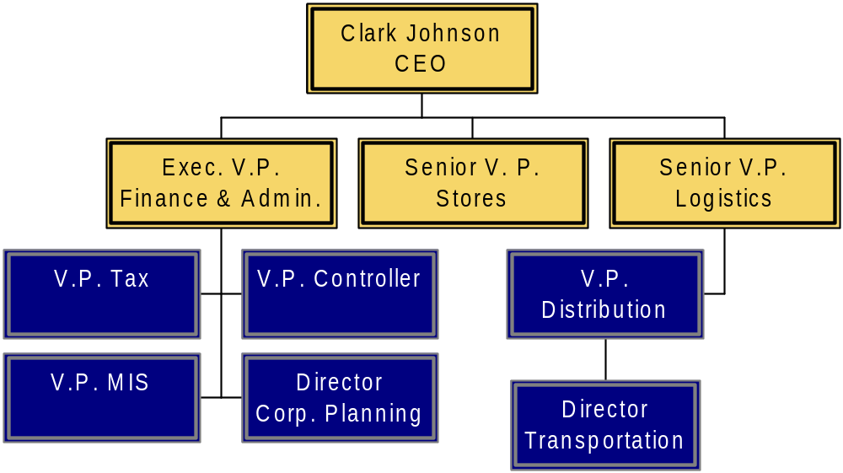
A Sample of Pier 1’s Functional Structure
Figure 8.3

Slide 13
Divisional Structures
A division is a collection of functions working together to produce a product.
    Divisions create smaller, manageable parts of a firm.
      Divisions develop a business-level strategy to compete.
      A division has marketing, finance, and other functions.
      Functional managers report to divisional managers who then report to corporate management.
  Product structure: divisions created according to the type of product or service.
  Geographic structure: divisions based on the area of a country or world served.
  Market structure: divisions based on the types of customers served.

Slide 14
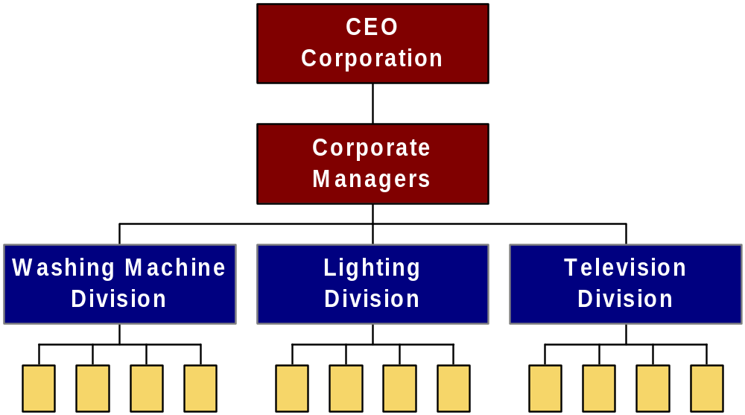
Product Structure
Figure 8.4a

Slide 15
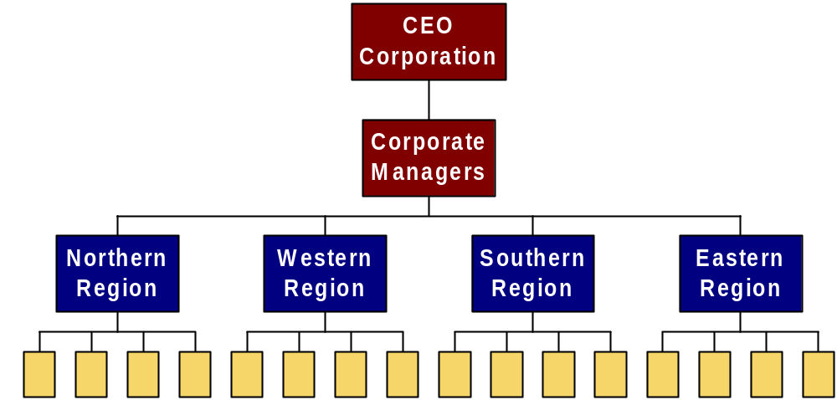
Geographic Structure
Figure 8.4 b

Slide 16

Market Structure
Figure 8.4c

Slide 17
Global Structures
When managers find different problems or demands across the globe, global solutions are needed.
  Global geographic structure: different divisions serve each world region.
    For customer needs that vary between regions.
  Global product structure: Customers in different regions buy similar products so firms keep most functional work at home and set up a division to market product abroad.

Slide 18
Coordinating Functions
To ensure sufficient coordination between functions, managers delegate authority.
  Authority: the power vested in the manager to make decisions and use resources.
  Hierarchy of authority: describes the relative authority each manager has from top to bottom.
    Span of Control: refers to the number of workers a manager manages.
    Line authority: managers in the direct chain of command for production of goods or services. Example: Sales
    Staff authority: managers in positions that give advice to line managers. Example: Legal

Slide 19
Tall & Flat Organizations
  Tall structures have many levels of authority relative to the organization’s size.
    As levels in the hierarchy increase, communication gets difficult.
    The extra levels result in more time being taken to implement decisions.
    Communications can also become garbled as it is repeated through the firm.
  Flat structures have few levels but wide spans of control.
    Results in quick communications but can lead to overworked managers.

