Slide 1

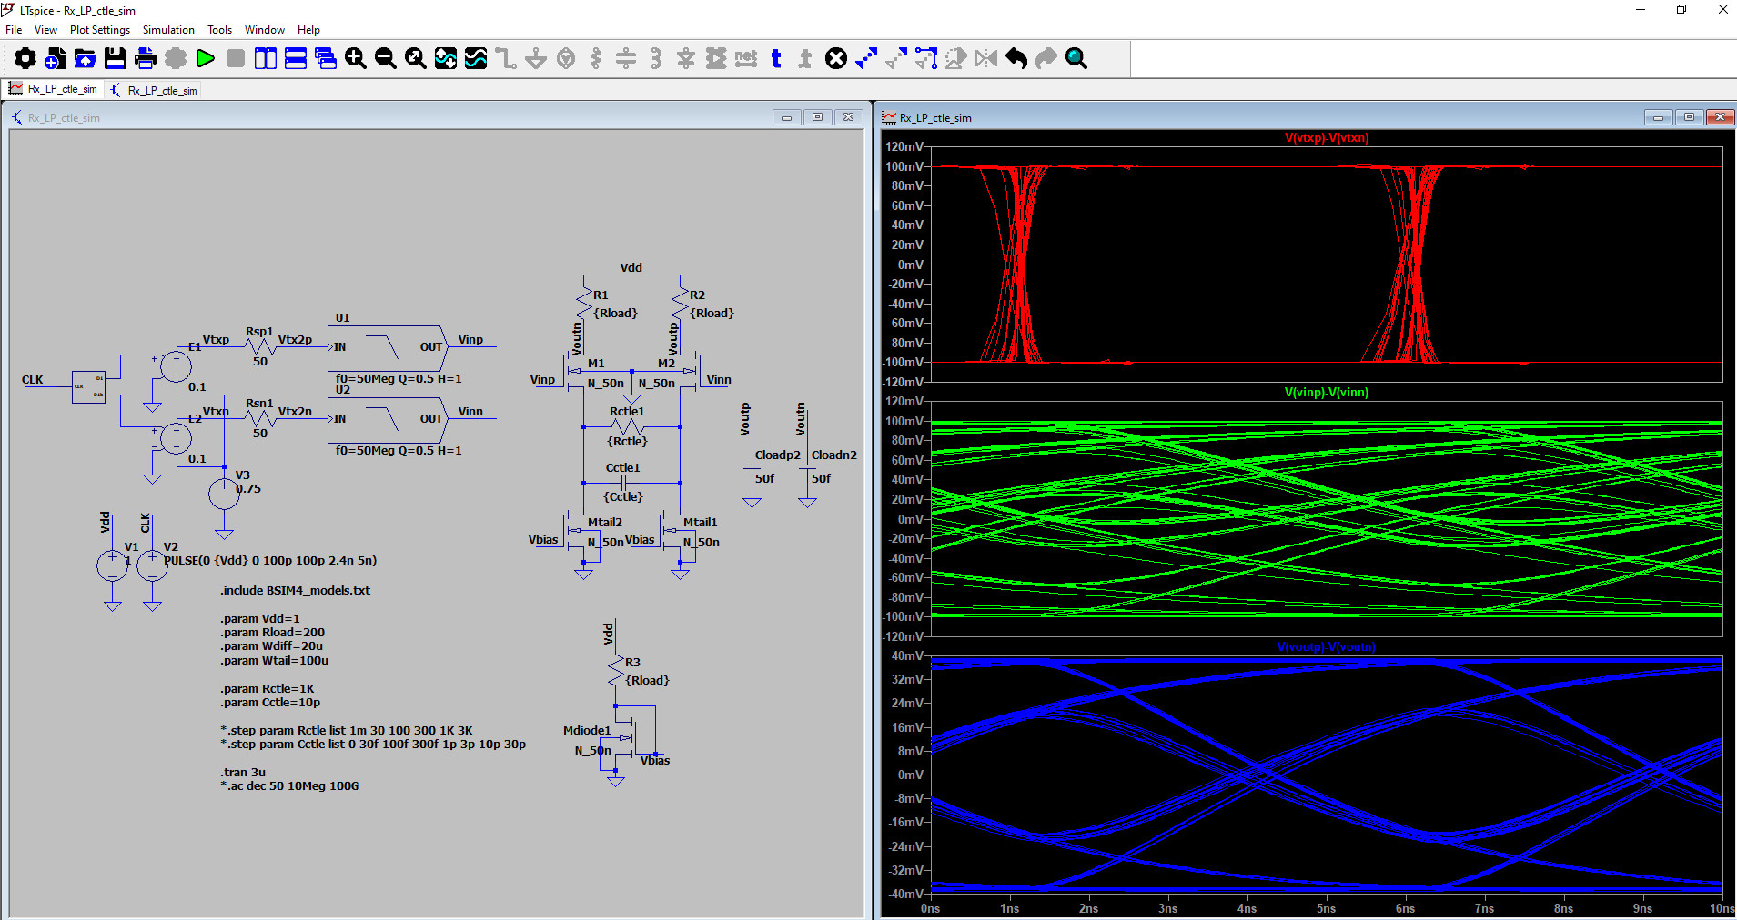
Analog Training 101
1. Introduction
Manuel Salim
Circuify Semiconductors
April 4th, 2025
manuel.salim@circuify.com
msalimm@hotmail.com

Slide 2
Overview
Presentation of the instructor
Objective
Program
Resources

Slide 3
Instructor
Manuel Salim Maza.
manuel.salim@circuify.com msalimm@hotmail.com
Ph. D in Electronics 2005,
M.C 2001, Bach. 1998.
+15 year exp. Industrial analog IC design: I/O, Transmitter, Clock {dividers, drivers, distribution} and Special cells (2005 to date).
8 year Academic exp.
Personal: Family, Videogames, Anime, Series, Movies.

Slide 4
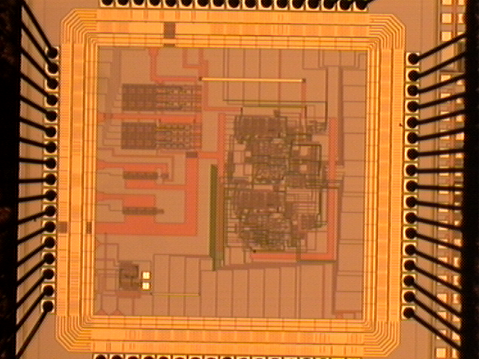
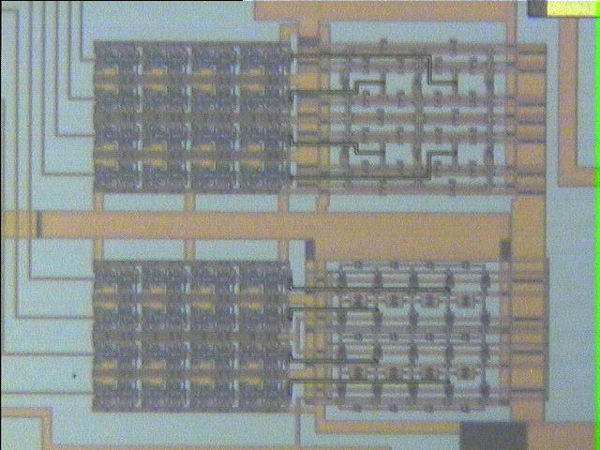
RDR02
Coupled Oscillators
16 Coupled 3-inv. rings
190μm
2-stagesVCO
4 Freq. Div.
16 Coupled Relaxation osc.
Noise resistant DataPath
Slide 3

Slide 5
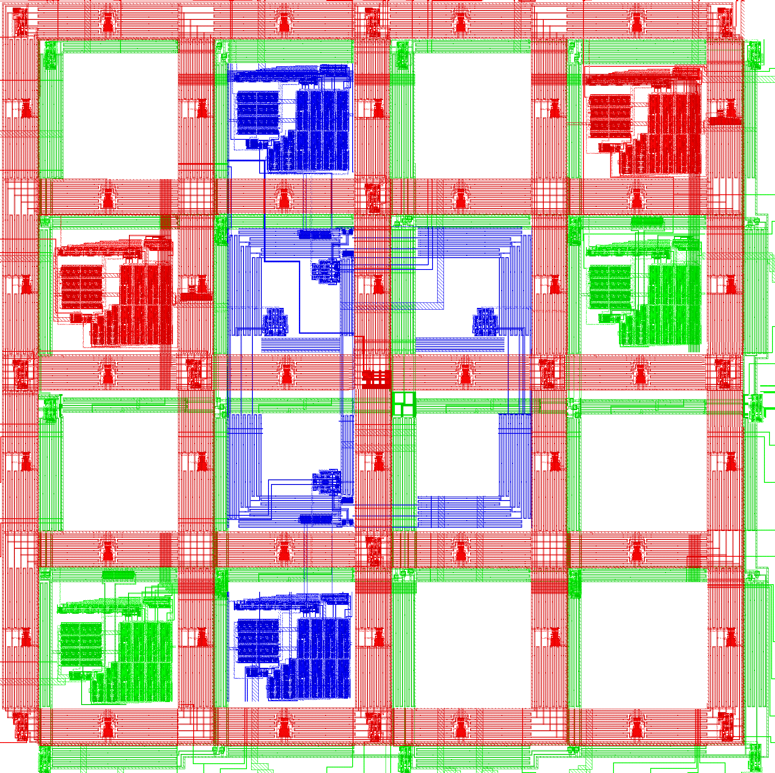
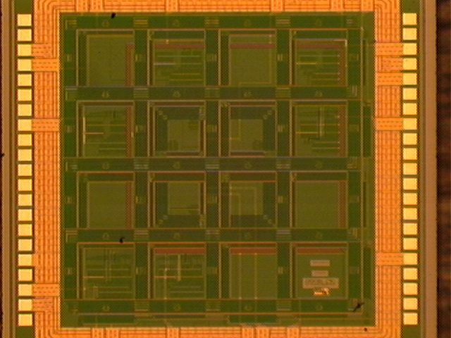
RDR04
Coupled Rings
Coupled VCOs
Mesh
6 4x4 bits serial convolvers; 32 Frequency Dividers; Control Logic and I/O Registers.
Slide 4

Slide 6
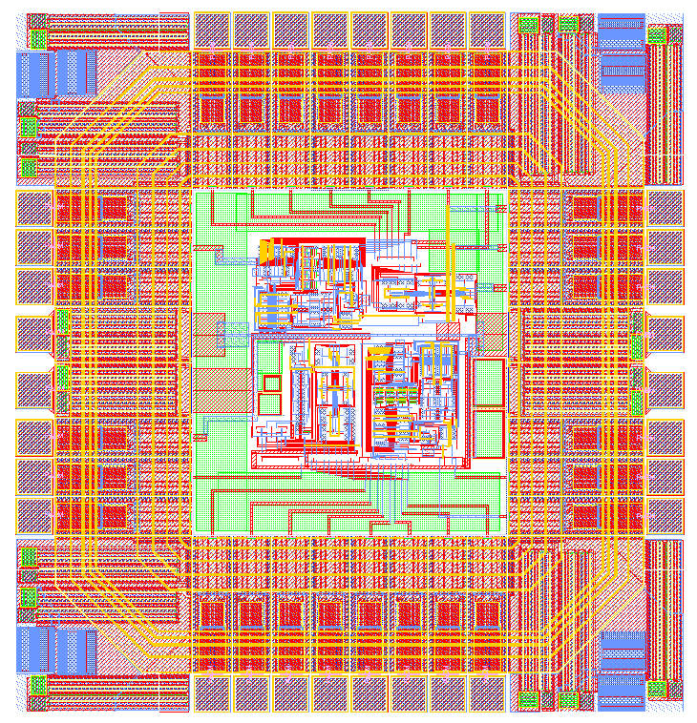
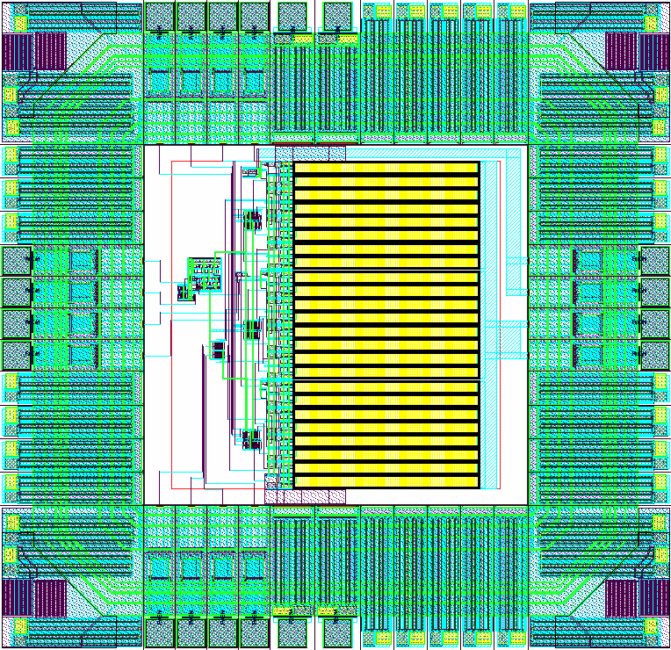
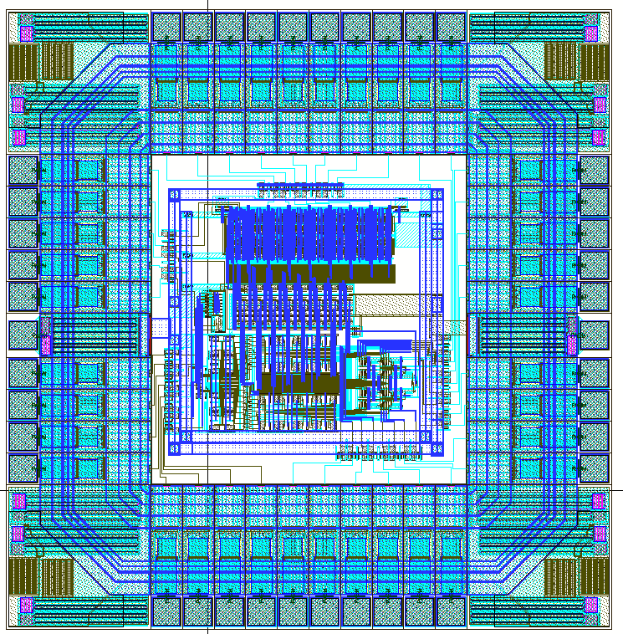
ORION08
CDR
Clock and Data Recovery System with PLL, oversampling and decision
Transmitter
Programmable impedance, amplitude and emphasis
Phase Selector
8-to-32 Interpolator and 32-to-1 Synchronous multiplexer
NCSG Organizational Changes, 30 August 2005, Slide <number>
Slide 5

Slide 7
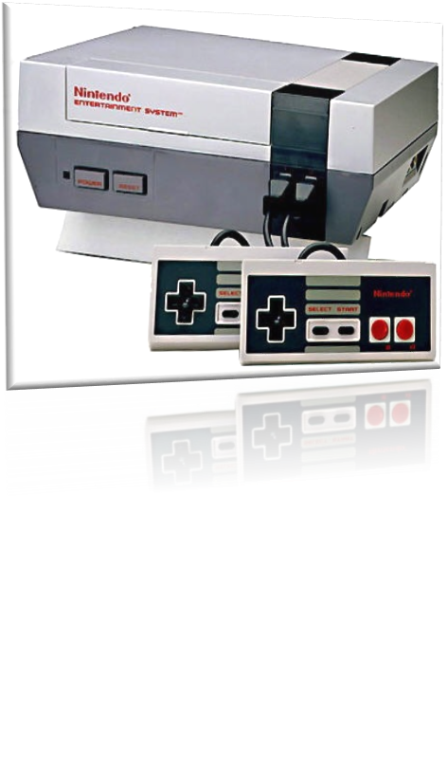
NES
Alejandro Lizaola Haro, José Gilberto Beltrán Becerra, Ricardo Dávila Castro, Alejandro Moreno, Manuel Salim Maza,
“Design Methodology for High-Level Model based on an 8-Bit Entertainment System”. XVII workshop Iberchip, Bogota, Colombia, 23-25 Febrero 2011.
“Implementación de mapeadores para un modelo de referencia de una consola de videojuegos basada en NES”. X Congreso Internacional Sobre Innovación y Desarrollo Tecnológico (CIINDET 2013, ISBN 978-607-95255-4-5), Cuernavaca, Morelos, México, March 13-15th, 2013.
NCSG Organizational Changes, 30 August 2005, Slide <number>
Slide 6

Slide 8
SerDes products
Project | SoC | Family | Technology | Year
DDR2 | - | 1G | 90nm SOI | 2005
Lynx14 | 8569, 8156 | 3G | 45nm SOI | 2007
Lynx15 | P2020 | 3G | 45nm SOI | 2007
Lynx16 | P1020,P1021, P1024/25, P1010 | 3G | 45nm SOI | 2008
Lynx18 | P1022,P1010 | 3G | 45nm SOI | 2008
Lynx19 | 8157, 8158 | 5G | 45nm SOI | 2010
Lynx20 | P2040, P3041, P5020, BAE licensed | 5G | 45nm SOI | 2010
Lynx25 | 9132, P2021, C290 | 5G | 45nm SOI | 2010
Lynx26 | 9164(B4), T4, DFE, T1040, T2080 | 10G | 28nm | 2012
Lynx27 | SC408x | 5G | 45nm SOI | 2010
Lynx28 | P5040 | 5G | 45nm SOI | 2010
Lynx29 | P5040 | 5G | 45nm SOI | 2010
Lynx32 | TestVehicule | 28G | 28nm | 2013
Lynx33 | LS1 | 10G | 28nm | 2013
Lynx34 | LS2/LS3 | 10G | 28nm | 2013
Lynx35 | Product. Same for Lynx40. | 28G | 28nm | 2013
Lynx37 | TestVehicule and derivative. Same for Lynx35. | 28G | 16nm FinFET | 2013
Lynx42 | Derivative | 28G | 16nm FinFET | 2017
Lynx Clkgen 1 and 2 | Clock generation PLL lane with several divider support. | 15G | 16nm FinFET | 2018-2019
Lynx46 and FTPLL | Frequency tracker and PON, DDR, SSC support added. | 15G | 16nm FinFET | 2018-2019

Slide 9
FSL
SerDes Roadmap
MC92600
(1999)
SGMII
1.25 Gbps
(2001)
PCI-EXP
2.5 Gbps
(2003)
SRIO
3.125 Gbps
(2003)
(XAUI)
SATA
3.0 Gbps
(2005)
0.25um -> 90nm
8548(2004)
837x(2006)
USB3.0/SuperSpeed
5 Gbps
(2008)
CPRI
6.144 Gbps
(2009)
QSGMII
5 Gbps
(2007)
PCI-EXP
5 Gbps
(2006)
8157 (2010)
P4080 (2009)
45nm
12.5 Gbps
PCI-EXP
8 Gbps
(2010)
IEEE 802.3ap
(XFI/KR)
10.3125 Gbps
(2010)
Interlaken
(2008)
SATA
6 Gbps
(2008)
16 Gbps
28nm
T4/B4 (2012)
25/28 Gbps
16nmFF+
TV1 (2015)

Slide 10
Objective
General Objective:
Transistor level IC digital and analog design.
Particular Objective:
- Logic gates design.
- Storage, Timing and Synchronization elements design.
- Clock Distribution and Power Network design.
- IC integration design.
- Signal routing, floorplanning and layout techniques.

Slide 11
Program
Characterization of CMOS structures.
Combinational CMOS circuits.
Sequential CMOS circuits.
Subsystem design.
Memory design.

Slide 12
Bibliography
Digital Integrated Circuits: a design perspective, 2ª Edición, Jan M. Rabaey, Anantha Chandrakasan, and Borivoje Nikolic, Prentice Hall, 2002.
Deep-Submicron CMOS ICs, Harry Veendrick, Kluwer Academia Publishers, 2000
Principles of CMOS VLSI Deign, 2a edición, Neil Weste, Kamran Eshraghian, Addison-Wesley Publishing Company.
Analysis and Design of Digital Integrated Circuits, David A. Hodges, Horace G. Jackson, Resve Saleh.
CMOS Digital Integrated Circuits Analysis & Design, Sung-Mo Kang Steve, Yusuf Leblebici, Third edition Mc Graw Hill Higher Education.
Digital Integrated Circuit Design, Ken Martin, Oxford University Press, 1999.

Slide 13
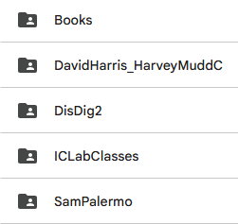
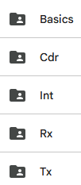

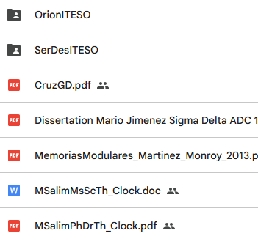
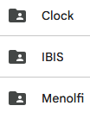
Drive

Slide 14
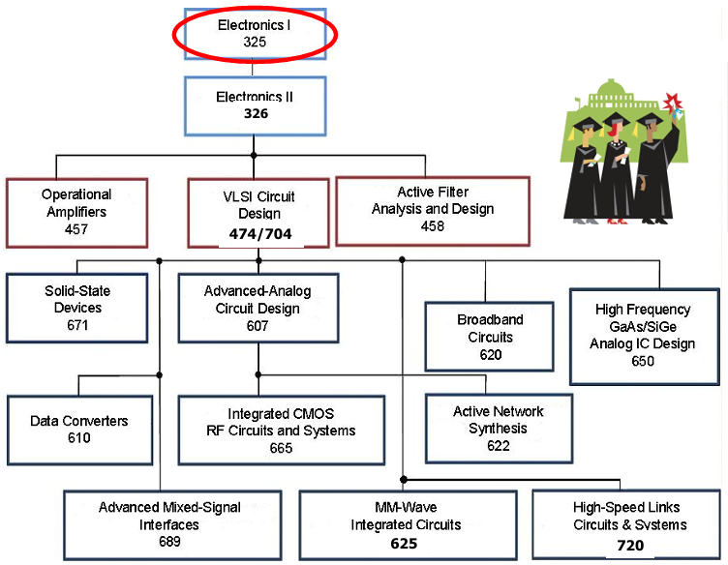
Analog Circuit Sequence

Slide 15
True/Real/Hardcore Analog Agenda
Owner | Hrs | Topics
Greg | 5 | Current Mirror
Greg | 3 | Differential Pair
Erick | 5 | OTA and Opamps
Greg | 3 | Comparator (SA, latch, kick backnoise)
Manuel | 5 | Filters (Analog, Hi/Low Pass, Quadratic, Z multiplier, L synth, CMFB)
Erick | 5 | PLL 101 (PFD, CP, Loop filter, LC/Ring VCO, FreqDiv)
Manuel | 5 | Sigma Delta ADC 101
Ernesto | 5 | Verilog-A, AMS
Manuel | 3 | Transmitter
Manuel | 3 | Receiver
Manuel | 3 | Clock Divider, Driver, Net

Slide 16
Homework, Simulation hands on and show
Owner | Topics
IJKL? | Inverter Schematic, Symbol and simulation.
Luisa | Inverter/XOR/DelayCell Layout and PostLayout.
Alfonso | Cmlbuf versions Layout and PostLayout.
Karla | Phase Interpolator simulations/optimization
Josue | Charge Pump
Iuri | AMS
Manuel | Flip-flops

