Slide 1

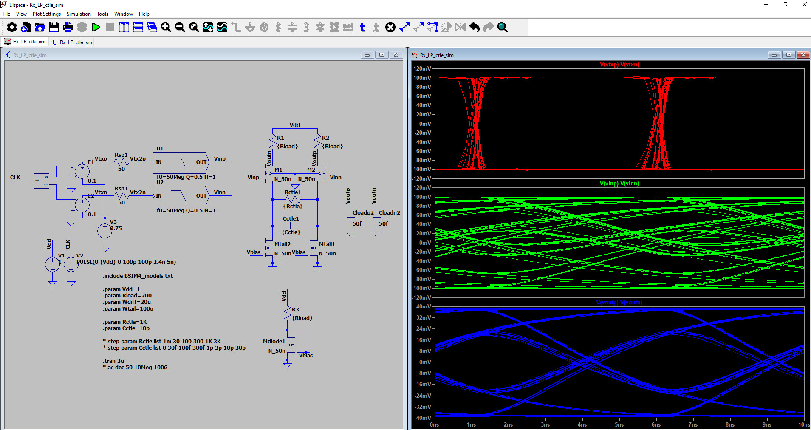
Analog Training 101
3. Characterization
Manuel Salim
Circuify Semiconductors
April 4th, 2025
manuel.salim@circuify.com
msalimm@hotmail.com

Slide 2
Overview
CMOS Inverter
Delay estimation
Noise margin
Power consumption
CMOS transmission gate
SPICE simulation
No ideal effects

Slide 3
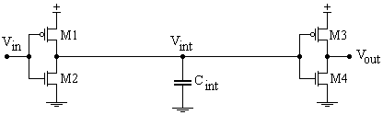
CMOS Inverter
Vin
Vout
1st Inverter
CLoad
2nd Inverter
1
0
1
0
1
0
1
0
1
1
0
1
0
0
Inversor
Buffer
Complementary Inverter, circuit perspective
Slide <number>

Slide 4
Layout
Vdd
Vdd
Vdd
Vss
A
X
A
X
Vdd
Vss
Vss
Vss
Abutment, alignment, and pitch matching, Less Drains=Less load. Stick Diagrams.
http://courses.cs.washington.edu/courses/cse468/00wi/admin/Slides/Lecture9/sld001.htm
http://www.cadence.com/rl/Resources/datasheets/Virtuoso_Layout_Migrate.pdf
http://www.ece.tamu.edu/~spalermo/ecen474/lecture05_ee474_layout.pdf
Slide <number>

Slide 5
Cadence Virtuoso Layout Hotkeys/Shortcuts
Display/View/Zoom
z | Zoom in (box)
Ctrl/Shift-z | Zoom in/out by 2
f | Fit in window
Ctrl/Shift-f | Show/Hide hierarchy
Ctrl-r | Redraw
k | Create ruler
Shift-k | Delete all rulers
Create
r | Create rectangle
p | Create path
Shift-p | Create polygon
l | Create label
i | Create instance
o | Create contact
Edit
F4 | Switch selection mode (Full/Partial)
u | Undo
Shift-u | Redo
m | Move
s | Stretch
c | Copy
Shift-o | Rotate
del | Delete
q | Properties
Ctrl-a | Select all
Ctrl-d | Select none
Hierarchy
Shift-x | Descend into cell (new window)
x | Descend into cell (edit in place)
Shift-s Search, and Replace. Very useful.
Read further: homes.esat.kuleuven.be/.../cadence%20virtuoso%20layout%20intro.doc
http://bwrcs.eecs.berkeley.edu/Classes/icdesign/ee141_s04/CadenceLabs/Lab2/VirtuosoTutorial.htm
http://www.edaboard.com/thread127485.html (leBindKeys.il)
https://groups.google.com/forum/#!topic/comp.cad.cadence/96LNInhjYlI

Slide 6
VTC (Voltage Transfer Curve)
Ideal
Vout
Vout
VM
Vin
t
VM
Vin
Vout
Real
Vout
VM
Vin
t
VM
Vin
Slide <number>

Slide 7
Logic Vth Design
Vout
Vout
VM1
VM2
VM3
Vin
t
VM3
VM1
Vin
VM2
Aspect Ratio, r
Typical 2.5-3.5; Practical 2
Slide <number>

Slide 8
Delay and Ramp
τpHL
Vout
90%
50%
tpHL
tpLH
10%
tfall
trise
Vin
t
Vout
Vin
t
Slide <number>

Slide 9
Eye Diagram
tpHLmax
tpLHmax
Vout
90%
50%
tpHLmin
tpLHmin
10%
Vin
JitterHL
JitterLH
t
Vout
90%
50%
Jitter
V Cross
10%
Vin
t
Slide <number>

Slide 10
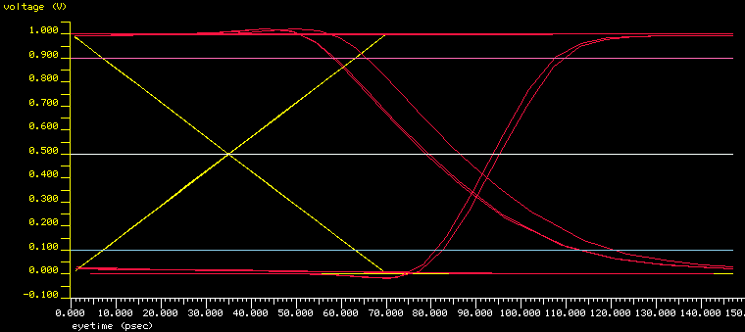
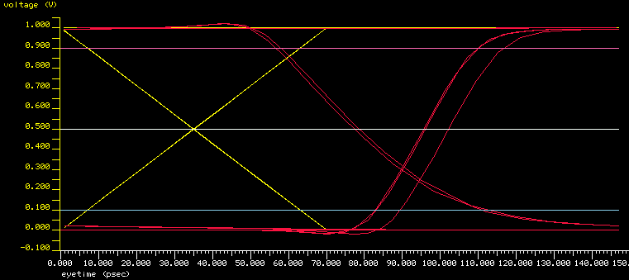
Eye Waveforms and Measurements TYP
IS0
IS1
Worst Eye (ps)
90% vdd
RampM
Worst Delay (ps)
50% vdd
Unbalance (ps)
Cross below 50%
10% vdd
RampN
Slide <number>

Slide 11
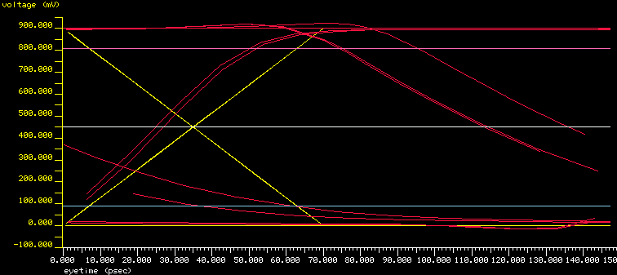
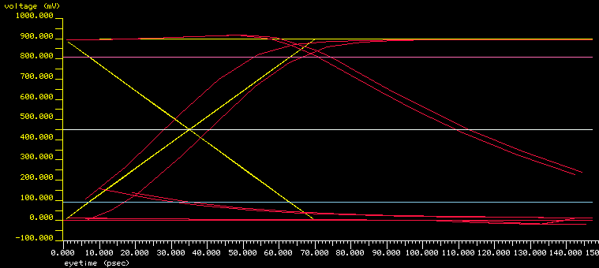
Eye Waveforms WCS
IS0
IS1
Cross above 90%?
No, ~15% and lower than typ
Slide <number>

Slide 12
Elmore Delay
Input step
Vdd Range | Lumped RC | Distributed RC
0-50% | 0.69 RC | 0.38 RC
0-63% | 1 RC | 0.5 RC
10-90% | 2.2 RC | 0.9 RC
0-90% | 2.3 RC | 1 RC
CMOS 0.25μm
λn≈60m V⁻¹
λp≈-100m V⁻¹
Slide <number>

Slide 13
Elmore Delay on Trees
T1 = R1 ( C1 + C2 + C3 + C4 )
T2 = R1 ( C1 + C2 + C3 + C4 ) + R2 C2
= T1 + R2 C2
= R1 ( C1 + C3 + C4 ) + ( R1 + R2) C2
T3 = R1 ( C1 + C2 + C3 + C4 ) + R3 ( C3 + C4 )
= T1 + R3 ( C3 + C4 )
= R1 ( C1 + C2 ) + ( R1 + R3) ( C3 + C4 )
T4 = R1 ( C1 + C2 + C3 + C4 ) + R3 ( C3 + C4 ) + R4 C4
= T3 + R4 C4
= R1 ( C1 + C2 ) + ( R1 + R3 ) C3 + ( R1 + R3 + R4 ) C4
R2
2
C2
Vin
R1
1
R3
3
R4
4
C1
C3
C4
Read further: http://en.wikipedia.org/wiki/Elmore_delay
http://www.engr.uconn.edu/~tehrani/teaching/ece3421/Lec-06.pdf
https://www.ece.cmu.edu/~ee760/760docs/lec18.pdf
http://www.inf.ufsc.br/~santos/ine5442/slides/aulas15-16.pdf (Inductance pp12-15)
http://www.cerc.utexas.edu/~jaa/vlsi/lectures/6-2.pdf (Logical Effort)
Slide <number>

Slide 14
Practice 1
Tech | 0.35um CMOS
Vdd | 3, 2.7, 2.4
CLoad | 50, 150, 450 fF
fin | 100, 200, 400 MHz
tramp in | 100, 200, 400 ps
Wp/Wn | 2/1, 6/3, 18/9
Tappering | 1, 2, 3
tramp out | <200ps
Layout | 2/1, 20/10, 200/100
Wfing | <10um
Layout Width | <50um
Vin
Vout
CLoad
Vin
Vo1
Vo2
Vout
CLoad
Inverter Chain
Slide <number>

Slide 15
Industrial/Commercial Tools
Industry uses Cadence or Synopsis.
Plus in-house tools i.e. for simulation and/or layout.
SKILL (Cadence) or TCL (Synopsys) allows automation of the tools.
They can be used to create and modify digital and analog layout by scripting.
It is very powerful for large and/or repetitive layouts.
They can be very regular, complex, small or large layouts.
https://www.cadence.com/en_US/home/training/all-courses/83018.html
https://www.youtube.com/@cadencedesignsystems/videos
https://iccircle.com/static/upload/img20240131000233.pdf
https://www.youtube.com/watch?v=tDlqehgsXeU&list=PL7RgIZHyx4rXYaYvb-1gWu91wZkm-t_pY&index=3

Slide 16
Free/Open Tools
You can use LTspice or:
  Install Skywater 130 in Windows +magic+xschem+ngspice+etc
  Enable virtualization in bios advanced.
  Press F1/F8 at start laptop for bios/uefi.
Read further on Sky on Win:
  https://philipwig.com/tutorials/installing-skywater/
  https://positivefb.com/skywater-130nm-installation/
Under Circuify project, Open tools at our server supported by Angel+Josue.
  How to install IIC-OSIC tools

Slide 17
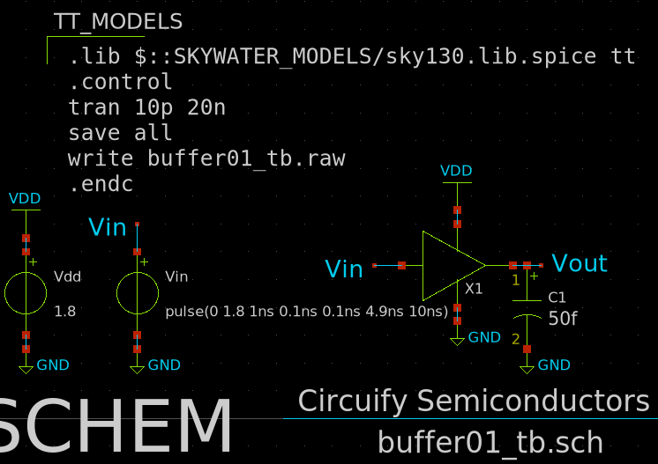
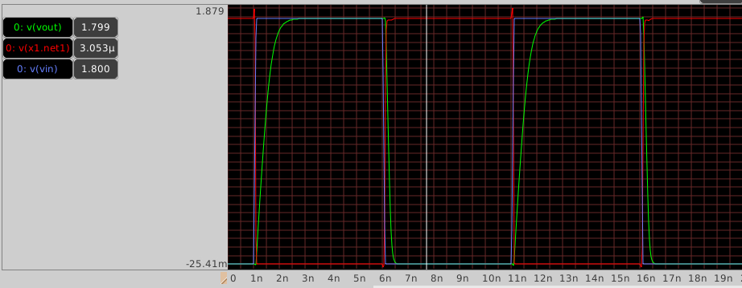
Schematic
@/foss/designs/buffer01_tb.sch
As bminch's Creating a Hierarchical Schematic in Xschem .
Carefull with symbol ports and half grid for drawing.
Plot with external viewer and manually. Raw may be @ /headless/.xschem/simulations
ngspice user manual

Slide 18
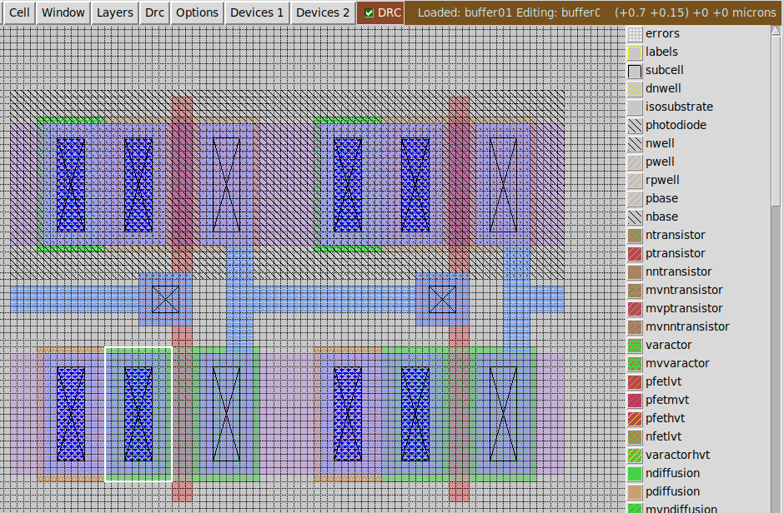
Layout
@/foss/designs/layout/
buffer01_tb.sch
As bminch's Creating a Hierarchical Layout in Magic Using the Sky130 PDK .
I made A Y at center, not bottom. I created ports on top.
Numbers @ top right are XY from (origin) and from white box.
1st diffusion is 10x20 grid, 0.5x1 um.
Don’t move/copy (north) by 0.5, only integers.

Slide 19
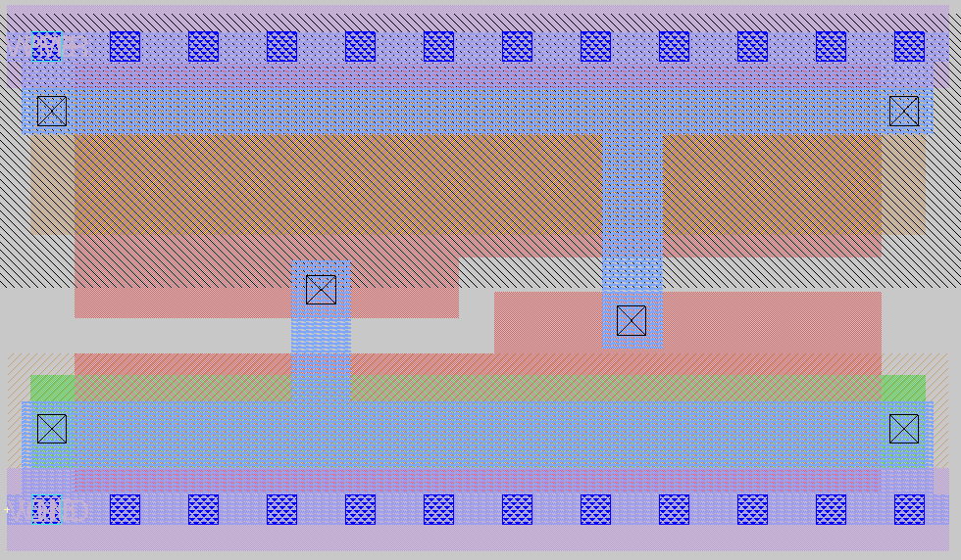
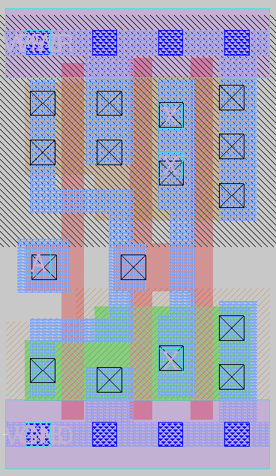
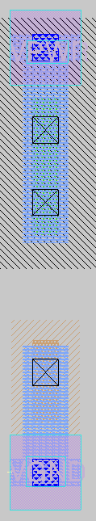
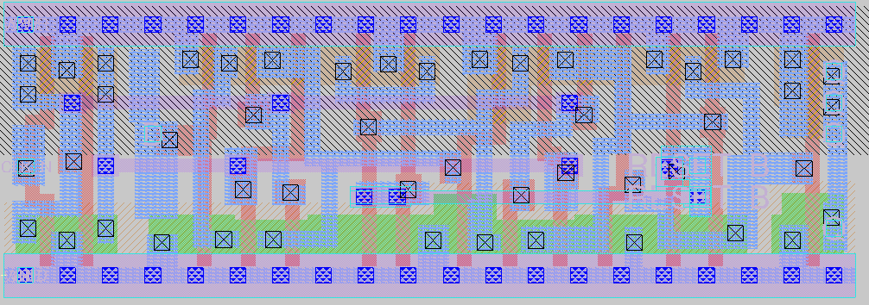
Std layouts
@/foss/pdks/sky130A/libs.ref/sky130_fd_sc_hd/mag
There are more libs @ .ref level
M1 and M3 horizontal, M2 vertical.
decap_12
buf_2
tapvpwrvgnd_1
dfrtn_1

Slide 20
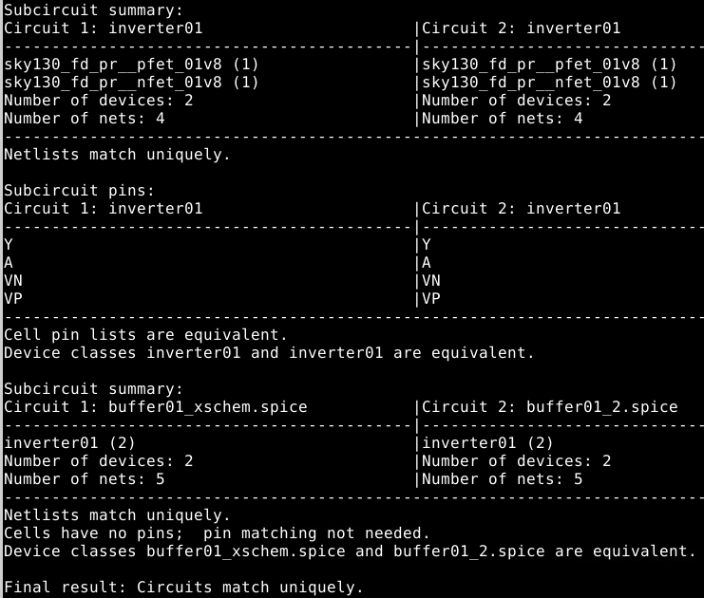
LVS
@/foss/designs/layout/buffer01[_xschem].spice
As bminch's LVS Tutorial Using Netgen and Part2 .
Remember I put ports in layout? That help for PostL Sim because they add .subckt and .end lines. For LVS you need to remove them in the extraction file in a copy (~2).
Check my examples buffer01_[xschem]2.spice for the versions commenting them.
Just run:
netgen -batch lvs buffer01_xschem.spice buffer01_2.spice /foss/designs/pdks/sky130A/libs.tech/netgen/sky130A_setup.tcl
Extracted netlist DO NOT contain RC parasitics, only mos. Need to check.

Slide 21
More videos
Efabless Webinar - Analog layout using Magic and Klayout
Lab Practical Videos - CMOS Inverter Layout using MAGIC VLSI
Electronics Lab DIY - How to Draw a Layout in Magic VLSI ? CMOS Inverter
bminch's Schematic Capture, Layout, and LVS Verification of a Current-Mirror Differential Amplifier
bminch's Creation, LVS Verification, and Transient Simulation of a Four-Bit Shift Register from D Flip-Flops
bminch's Layout Design, Layout-Driven Schematic Capture, and LVS Verification of a Single-Phase D Flip-Flop

Slide 22
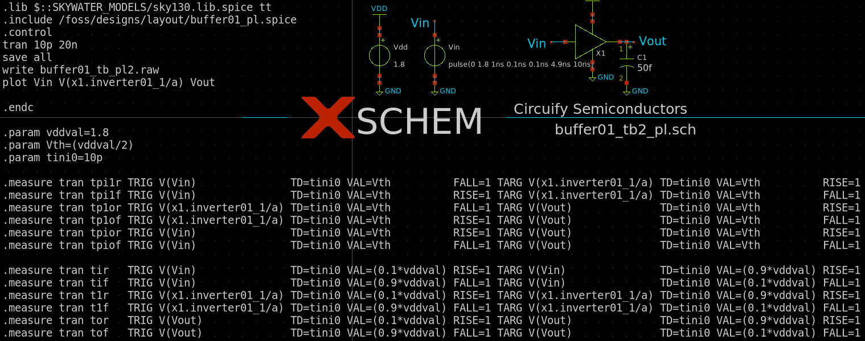
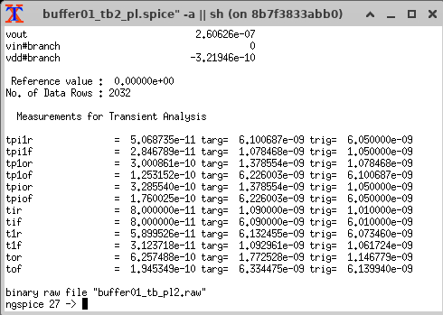
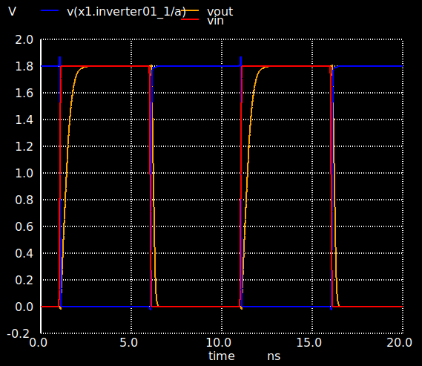
PostL Sim
@/foss/designs/buffer01_tb2_pl.sch
bminch's Magic / Xschem / Ngspice Postlayout Simulation Tutorial
I used the extracted with ports version. No problem.
I added plot and .measure
90%
tpr
tpf
tr
tf
50%
10%

Slide 23
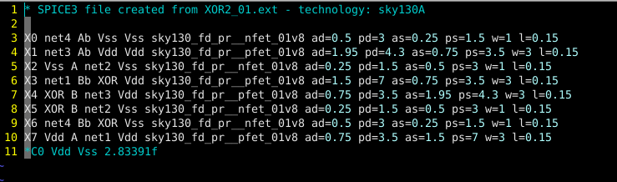
Schematic Extraction for LVS
Block Level
extract all
ext2spice scale off
ext2spice
Hierarchical Level
extract all
ext2spice hierarchy on
ext2spice scale off
ext2spice
Block Level

Slide 24
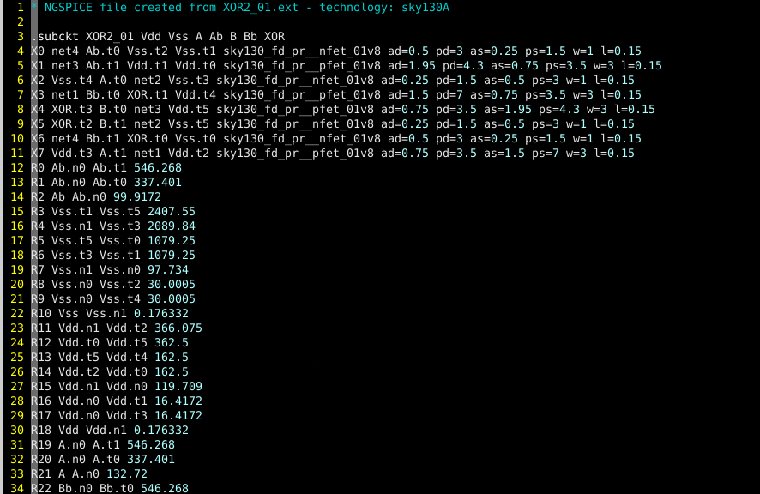
Parasitic Extraction for Spice Simulation
Block Level
extract all
ext2sim labels on
ext2sim
extresist tolerance 10
extresist
ext2spice lvs
ext2spice cthresh 0.01
ext2spice extresist on
ext2spice
Hierarchical Level
NOT SUPPORT

Slide 25
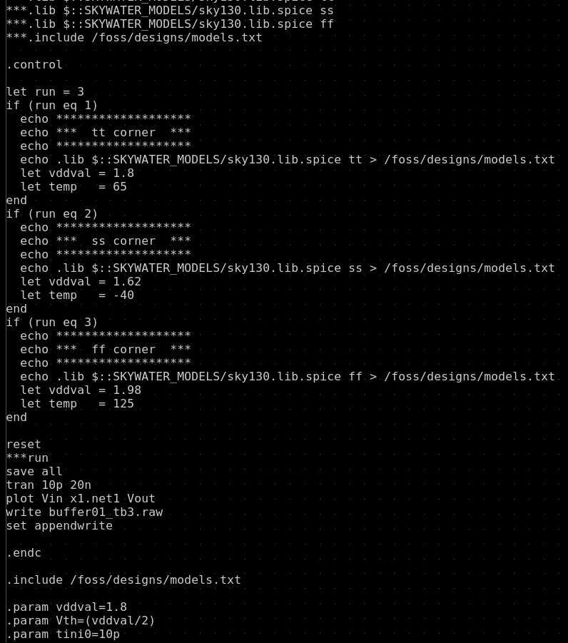
PVT 1/4
Started @/foss/designs/buffer01_tb3.sch
Problem with xschem it merges ckt with ctl. Changes in lib/inc only kick @ start.
Problem with ngspice if/alter do not wotk with .lib/.inc: Ngspice manual pp67 section 2.15
I need to separate ckt and ctl as in /foss/designs/ngspice/buffer01_tb3.{ckt,ctl}. Ckt file lowercase please.
I just edited from /headless/.xschem/simulations/buffer01_tb3.spice

Slide 26
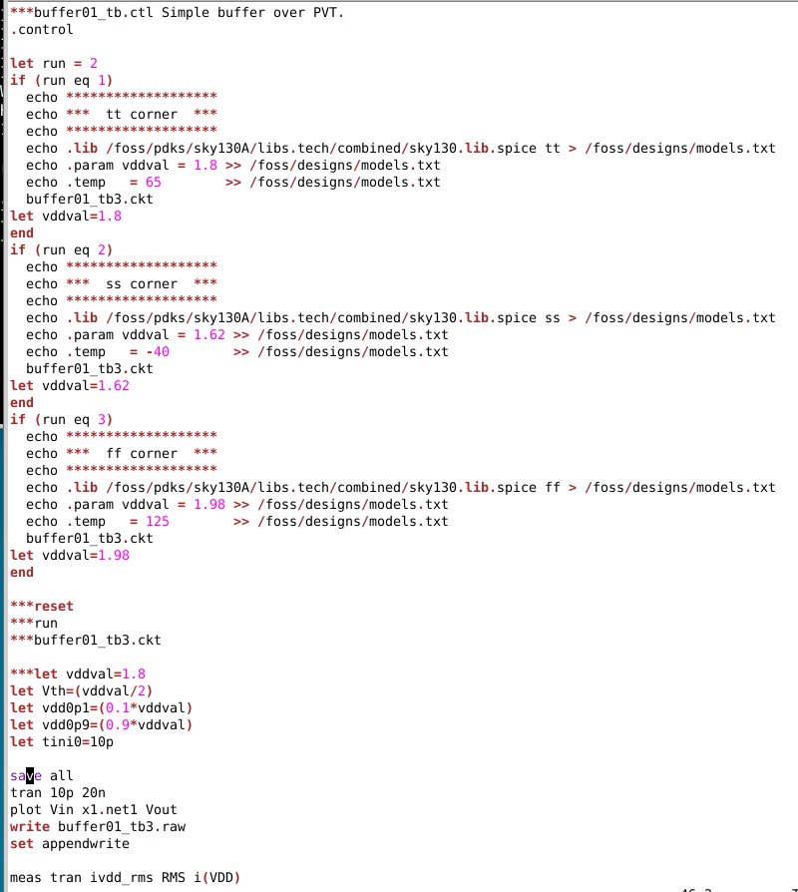
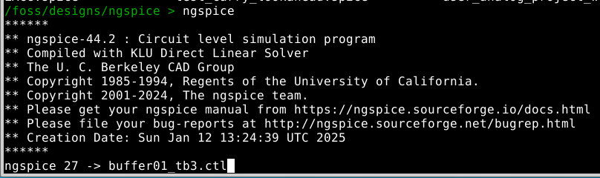
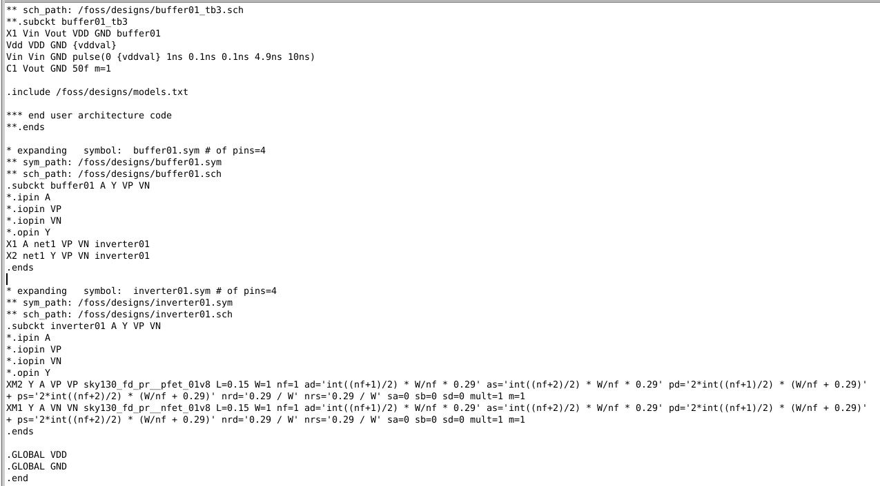
PVT 2/4
Run ngspice. Enter the ctl.
CTL
CKT

Slide 27
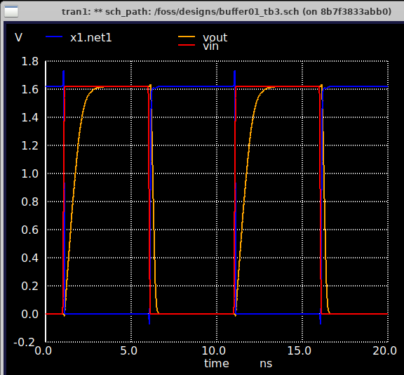
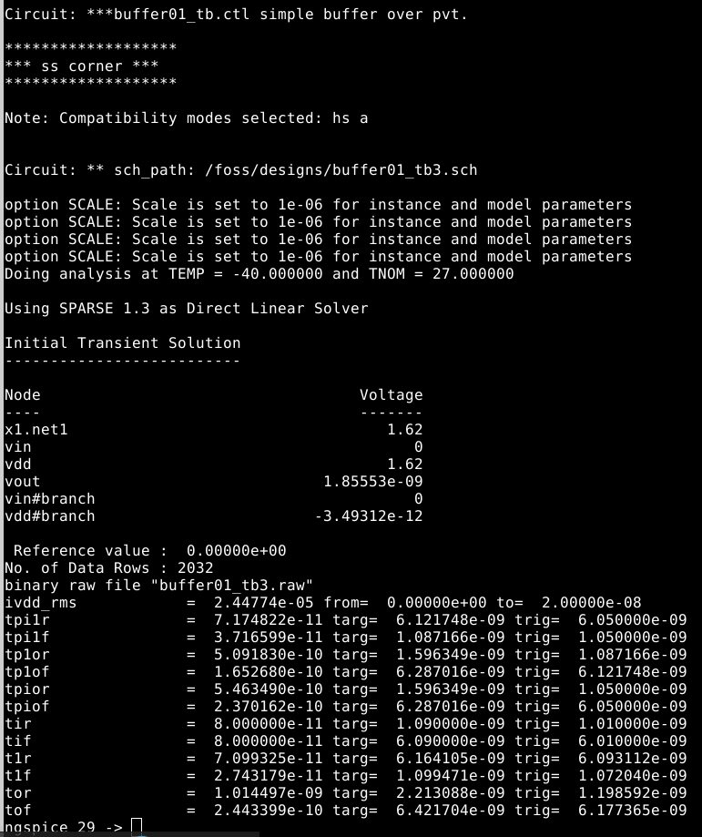
PVT 3/4
Now lib kick in every time via invoking/including full ckt.
Here is an example with ss corner.
Still need to put foreach/loops, vectors and reporting.

Slide 28
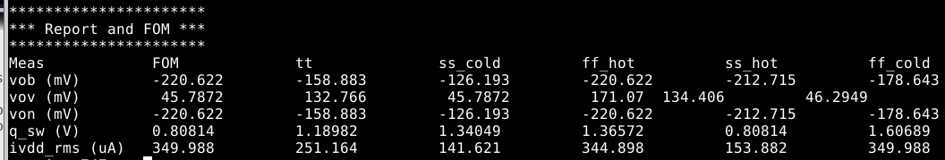
PVT 4/4
Latest examples of PVT reporting in /foss/designs/wlv/design/analog/common_logic/
~/FF03_cml_tb/FFDSRcml6_01/FF03_cml_tb8_4.ctl. This have paametric W values for optimization and reports FOM and corners in header columns and measurements in rows. Some pre-formating with mV uA.
~/buffer01_tb/PVT/test2.ctl. This have vectors and a list for measurements (meas_tags) to be print in a loop.
Still need to align better due to short or negative numbers and pull models.txt from a set variable.

Slide 29
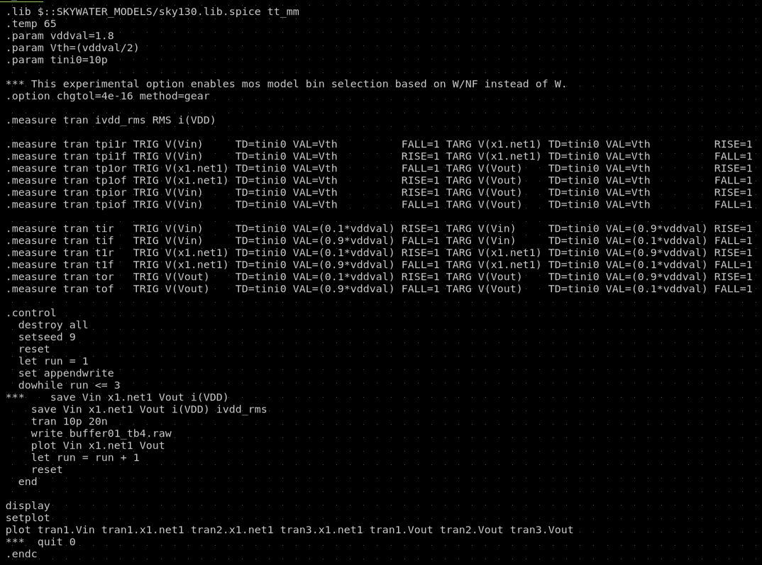
MonteCarlo 1/2
@/foss/designs/buffer01_tb4.sch
Running tt_mm 3 runs
Added meas and plot
Very useful to use destroy all, display, setplot.

Slide 30
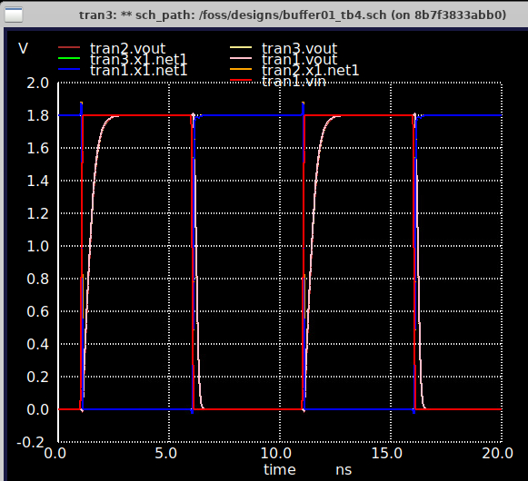
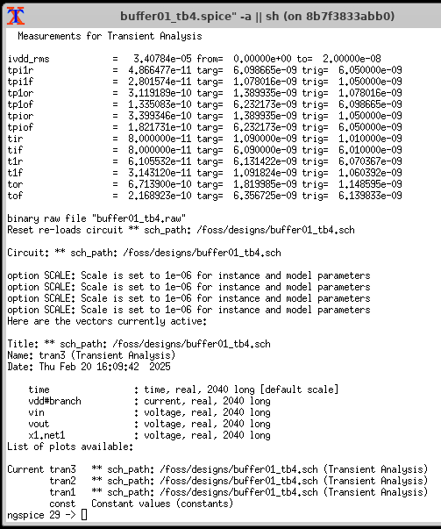


MonteCarlo 2/2
Still need vectors and reporting.
tran3
tran1
tran2

Slide 31
Operating regions
Vout
VOUT=Vin-VT0,p
A
VDD
B
VOUT=Vin-VT0,n
C
nMOS in saturation
pMOS in saturation
D
E
VT0,P
0
VT0,n
VIL
VIH
VDD+VT0,p
VDD
Vin
Region | V_{in} | V_{out} | nMOS | pMOS
A | < V_{T0,n} | V_{OH} | Cut-off | Linear
B | V_{IL} | High ≈ V_{OH} | Saturation | Linear
C | V_{th} | V_{th} | Saturation | Saturation
D | V_{IH} | Low ≈ V_{OL} | Linear | Saturation
E | > (V_{DD}+V_{T0,p}) | V_{OL} | Linear | Cut-off
Slide <number>

Slide 32
Design with Delay constraints
Saturation
Linear
Slide <number>

Slide 33
f(W_{n},W_{p})
Slide <number>

Slide 34
Limits
Aspect ratio
Slide <number>

Slide 35
Ring Oscillator
V₁
V₂
V₃
CLoad,1
CLoad,2
CLoad,3
V₃
V₂
V₁
t_{pHL3}
t_{pLH1}
t_{pHL2}
t_{pLH3}
t_{pHL1}
t_{pLH2}
t
T
Slide <number>

Slide 36
Super Buffer
1
α¹
α²
α^{N}
Cg
Cd
αCg
αCd
α²Cg
α²Cd
α^{Ν}Cg
α^{Ν}Cd
CLoad
Delay @ α=1
Slide <number>

Slide 37
Practical Guidelines
Vout
Wint Lint rw cw lw
Vout
Vin
Vin
CLoad
CLoad
Inverter Chain
Interconnection
Inverter chain optimal tappering factor, k is e=2.7. A larger factor can be used to save area; or smaller to improve delay and ramp times.
At inverter chains, final output ramp times are function of the last two stages (mainly).
When tflight > tramp/2.5, transmission line analysis must be done.
Estimation is not enough. Simulate pre and postlayout.
Slide <number>

Slide 38
Tappering examples
Vin
Vout
CLoad
1um
1.33um
4um
12um
37um
111um
333
um
1000
um
Vin
Vout
CLoad
1um
1.33um
4um
14um
48um
167um
500
um
1000
um
Vin
Vout
CLoad
1um
5um
25um
125um
500
um
1000
um
Slide <number>

Slide 39
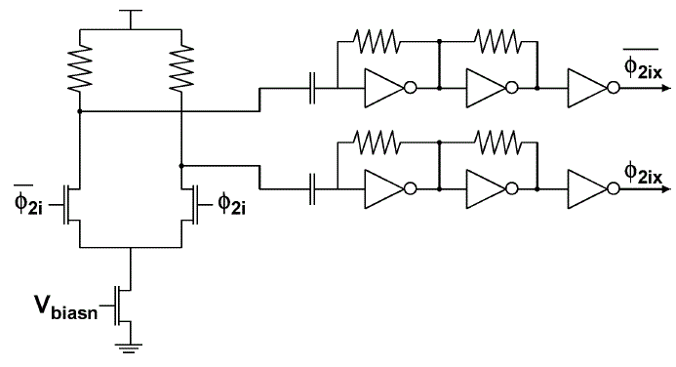
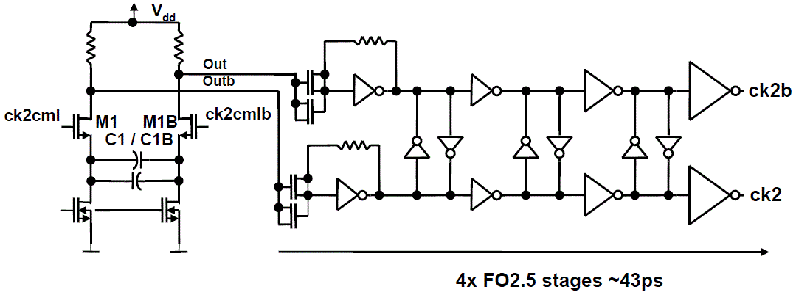
Cml2Cmos and Cross-Coupled
Cross-Coupled (CCK?)
DCD clean-up WRONG!
(DutyCyce Distortion)
Back-to-Back (b2b)
Slide <number>

Slide 40
CrossTalk
Vin0
Vout0
Vin1
Vout1
…
…
…
Vin(N-1)
Vout(N-1)
VinN
VoutN
Aggressor and Victim.
WCS when both aggressor neighbors switch to same level (0→1) into static victim (0).
Still, it is determined crosstalk.
Indetermined crosstalk is when victim also switches(1 →0) and delay is impacted.
Possible scenarios to reduce crosstalk:
Reduce speed, length or swing of attackers.
Improve return path or shielding (including vias)
Increase separations (reduce [sidewall] capacitive parasitic)
  Use more metal levels, scramble levels on neighbors
  Scramble routing on same metal level
Combinations.
Slide <number>

Slide 41
Noise margin
Vout
VOUT=VIN
Vin
Vout
VOH
VOH
NMH
VIH
Transition Region
VIL
NML
VOL
VOL
VIL
VM
VIH
Vin
V_{OH}: Minimum output voltage when the output level is logic “1”.
V_{OL}: Maximum output voltage when the output level is logic “0”.
V_{IH}: Minimum input voltage which can be interpreted as logic “1”.
V_{IL}: Maximum input voltage which can be interpreted as logic “0”.
Slide <number>

Slide 42
Hysteresis
Vin a
Vin
+
V_{M+}
Vin b
=
t
V_{M}
V_{M-}
t
t
Vout
VOUT=VIN
VOH
Vout
Without Hysteresis
Vin
Vout
t
CLoad
Vout
With Hysteresis
VOL
VM-
VOH
VM+
Vin
t
Slide <number>

Slide 43
Schmitt trigger
Mp2
Mp1
Mp3
Mp1
Mp2
Vin
Vout
Vin
Vout
Mn1
Mn1
Wp1 | 1um
Wp2 | 2.5um
Wp3 | 3u
Wn1 | 1um
Wn2 | 2.5um
Wn3 | 3u
Mn3
Mn2
Mn2
Vin
Vout
a)
Vin
Vout
CLoad
Videal
Vin
Vout
b)
CLoad
Slide <number>

Slide 44
Layout
Mp1
Vdd
Mp3
Mp2
Vin
Vout
Mp1
Mp2
Mp3
Mn2
Mn3
Mn1
A
X
Mn1
Mn2
Mn3
Vss
Slide <number>

Slide 45
Power consumption
AVG
DC
RMS
Peak
Ista|vin=0
Vin
Vout
Vin
Vout
CLoad
CLoad
Isc(fall)
Vin
VDD-VT
VT
t
ishort
Ipeak
t
Slide <number>

Slide 46
Dynamic Power
Vout
Vin
t
ic
nMOS active
nMOS active
0
t
T/2
T
pMOS active
Slide <number>

Slide 47
CMOS Tg
C
=0
VGSp
ISDp
Vin
A
B
Vout
Vin=VDD
Region 1: 0<Vout<|VTP|
ID
CLoad
IDSn
VGSn
C
=1
C
A
B
Region 2: |VTP|<Vout<(VDD-VTN)
C
Reqp
A
B
Region 3: (VDD-VTN)<Vout<VDD
Reqn
Slide <number>

Slide 48
Tg Chain
R
0
0
0
Reqn
Vin
Vout
Reqp
C
C
C
1
1
1
Req
Req
Req
Vin
Vout
C
C
C
Reqn||Reqp
Vout
(VDD –VTn)
VDD
This plot and analysis are for Tg driving a “1”.
When driving a “0”, Reqp goes to ∞.
Slide <number>

Slide 49
mopt
n
Req
Req
Req
Req
Req
Req
Vin
Vout
C
C
C
C
C
C
m
m
Slide <number>

Slide 50
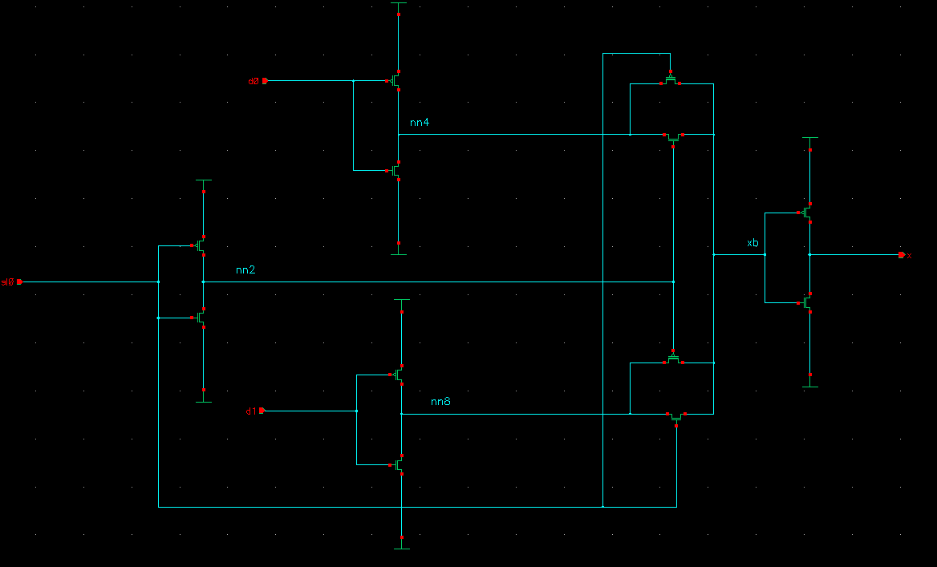
Tg mux
s d0 d1 x
0 0 X 0
0 1 X 1
1 X 0 0
1 X 1 1
Slide <number>

Slide 51
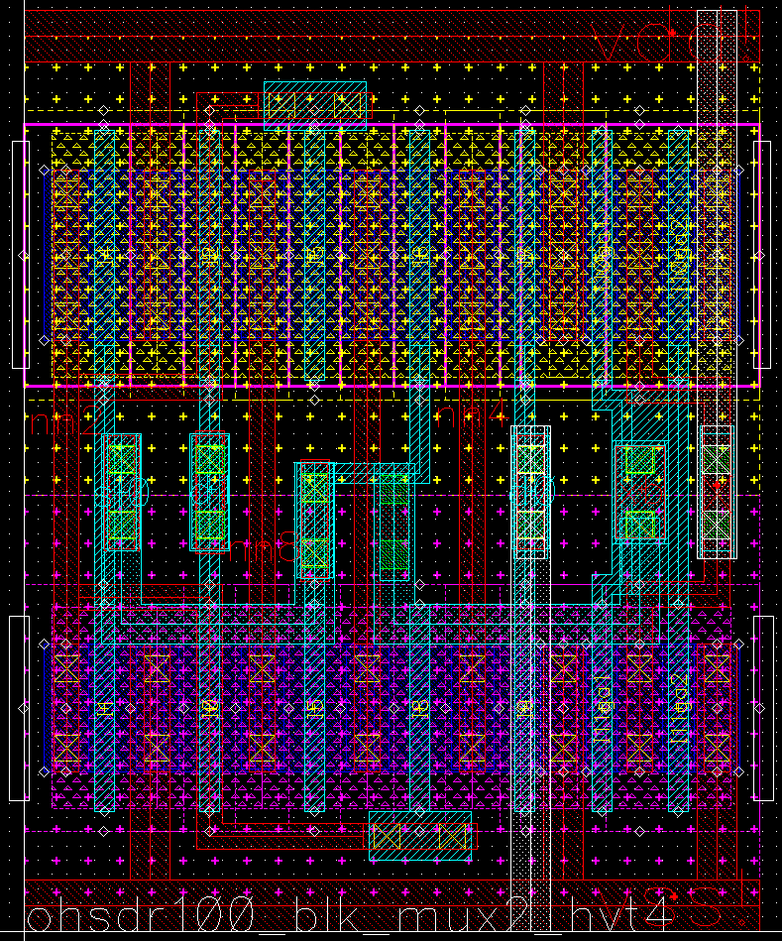
Tg mux layout
Slide <number>

Slide 52
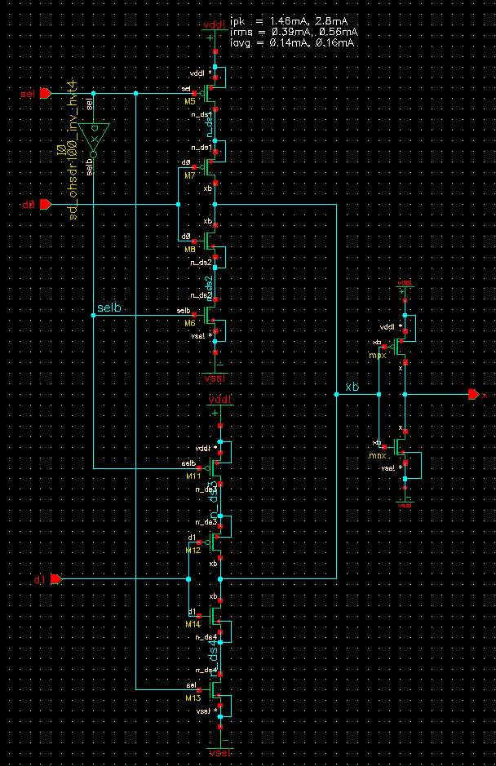
C²MOS mux
Clock Complementary MOS
Slide <number>

Slide 53
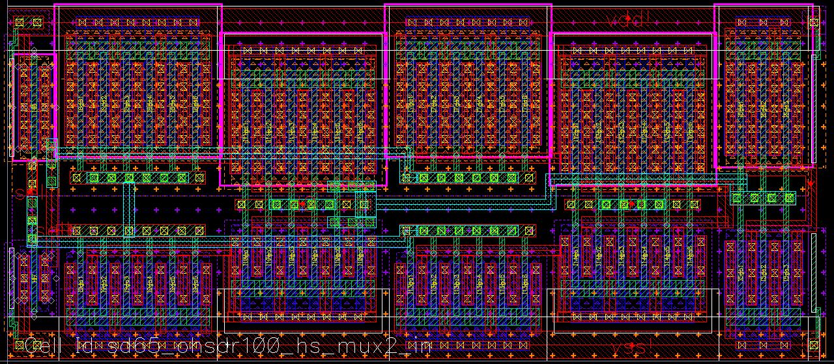
C²MOS mux layout
Slide <number>

Slide 54
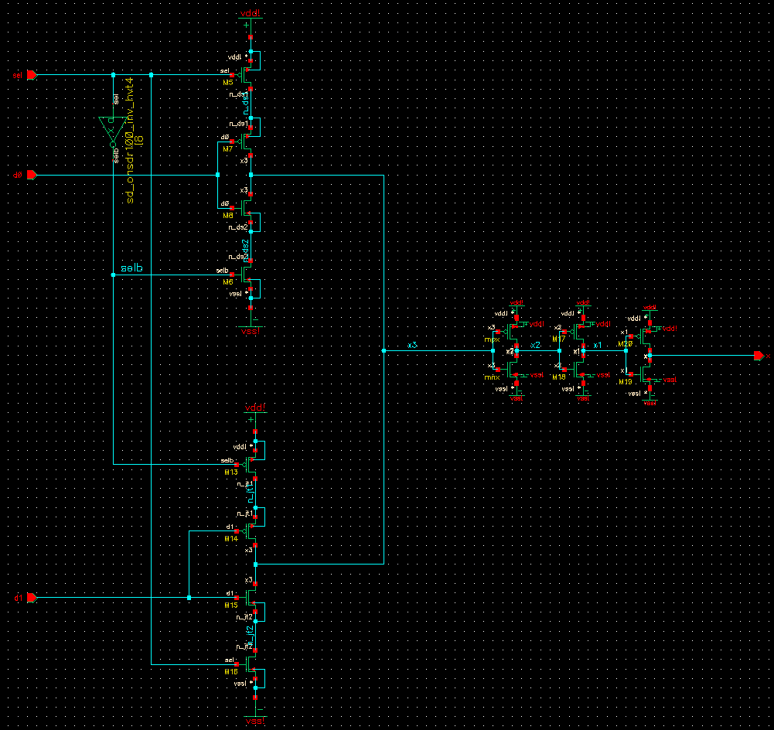
C²MOS mux buf
Slide <number>

Slide 55
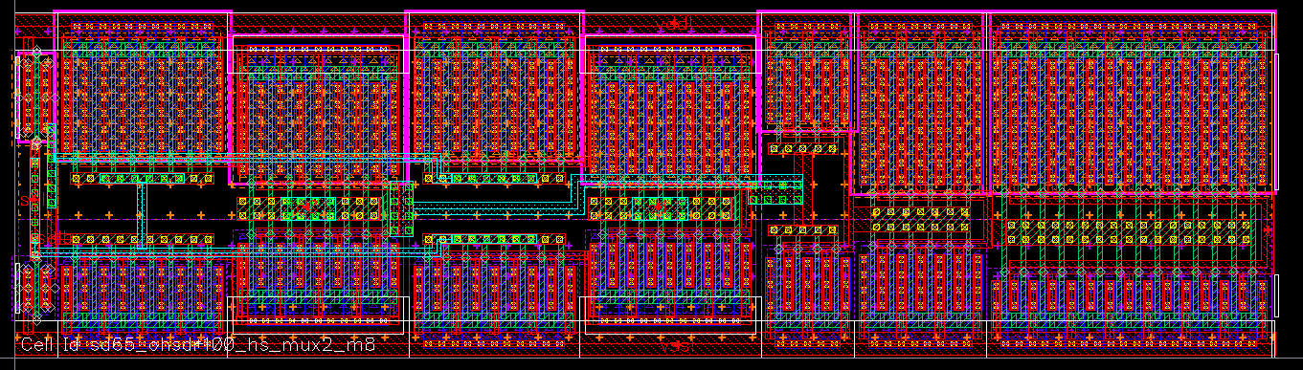
C²MOS mux buf layout
Slide <number>

Slide 56
Practice 2
2.1 a) Simulate both Schmitt Triggers, plot VTC and measure VM+, VM-, delays, ramps and power. Use L=Lmin, Wp=2um, Wn=1um, Cload=50fF… (defaults from Practice 1). Repeat 2nd ciruit using data at the table. Compare.
b) Repeat both Schmitt Triggers using and inverter (Wp=2um, Wn=1um) between videal and circuit. Are the results different? Why?
2.2 a) Simulate Tg mux with sel=0. Use L=Lmin, Wp=2um, Wn=1um, Cload=50fF… (defaults from Practice 1). Measure delays d0-xb and xb-x, measure ramps at xb and x nodes, measure power.
b) Repeat for C²MOS mux. Use L=Lmin, Wp=2um, Wn=1um, Cload=50fF… (defaults from Practice 1). Compare.
2.3 a) Simulate a Chain of 8 Tg. Use a 2um/1um inverter after Videal. Calculate delay, ramp and power. Measure delays from Vin to Vout, Vout ramps and Power.
b) Repeat inserting another inverter after the 4th Tg.
c) Repeat inserting 2 more, after 2nd and 6th Tgs. Compare.
2.4 Repeat Tg mux layout. Use L=Lmin, Wp=2um, Wn=1um.
Slide <number>

Slide 57
No ideal effects
N order effects (Vt(WLt), RLC(f))
Parasitics
PVT
Noise (Source, Device, Switching, Crosstalk)
Mismatch
Post-Layout, Post-ESD (Latchup)
(Mechanical, Electrical /Hot carriers, Radiation) Stress
Self-Heating
(Vertical, Lateral) Field Dependence
Short and Narrow Channel effects (Bird beak, Ballistic)
History and Kink effects
Slide <number>

Slide 58
SPICE simulation
Practice with SPICE at classroom and Review
Q&A
Tips and Tricks
Ring Oscillator
Eye Diagram and measurements
Transmission line simulations
Redesigns revision
Noise margins
Hysteresis circuits
Power measurements
Transmission gate circuits
Slide <number>

Slide 59
Conclusions
Inverter and Tg are the simplest gates. Useful operations and complex blocks can be done with them.
Important Figures in digital gates: V_{M}, Delay, Ramps, Power consumtion, Jitter and Vcross.
Calculations may imply so much complexity for circuits with only these gates and estimations may not be accurate.
Layout for circuits with only inverters may be very straight forward. Layouts for circuits with Tgs may be very tricky due to routing of two control signals and congestion.
Slide <number>

