Slide 1

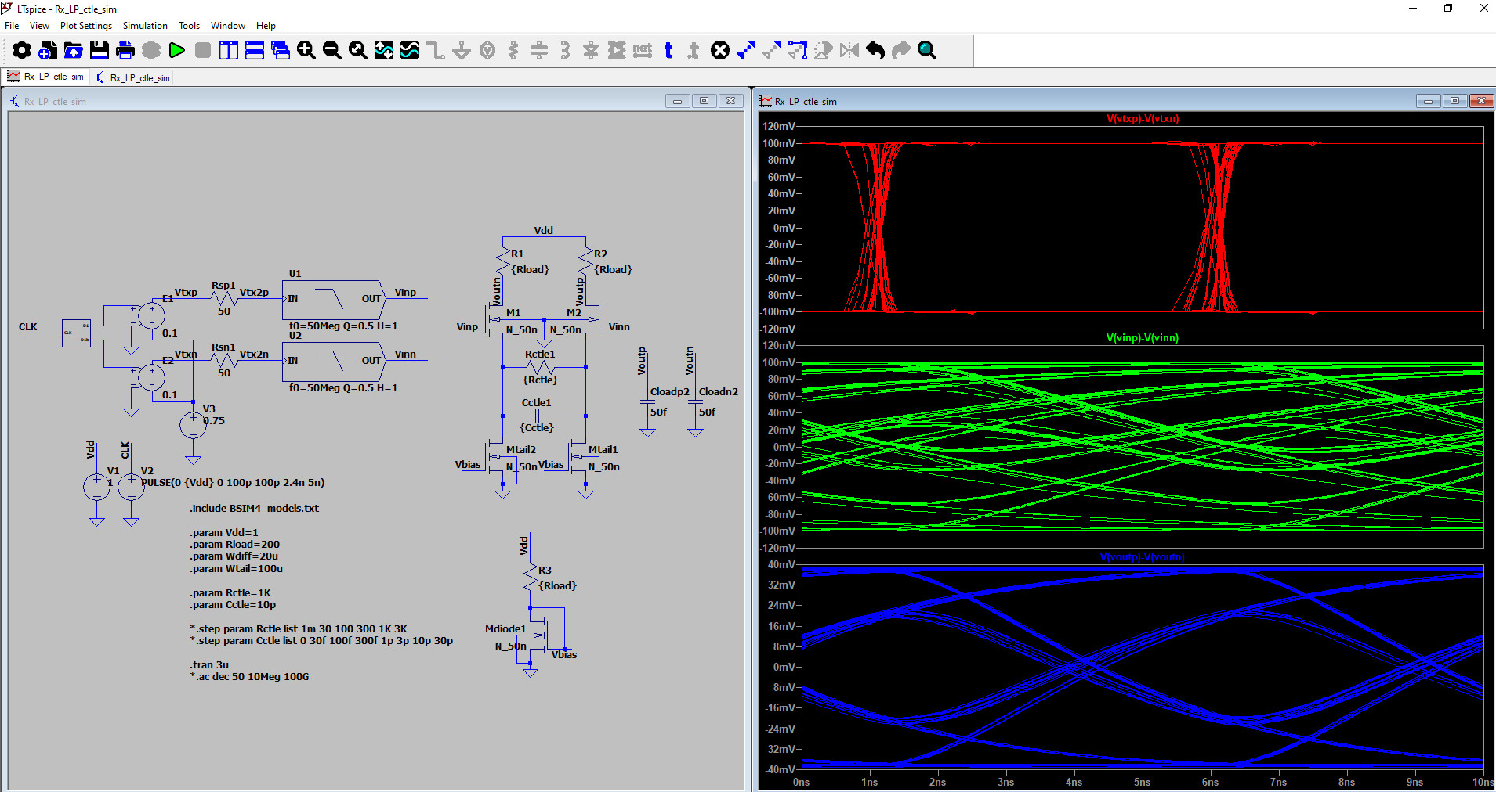
Analog Training 101
4. Combinational
Manuel Salim
Circuify Semiconductors
April 4th, 2025
manuel.salim@circuify.com
msalimm@hotmail.com

Slide 2
Overview
Static Logic styles
Dynamic Logic styles
Sizing techniques
Circuit design issues
Chapter online:
http://bwrcs.eecs.berkeley.edu/Classes/icdesign/ee141_f01/Notes/chapter6.pdf

Slide 3
Logic styles
Static
CMOS, AOI, Complex
Pseudo NMOS
Pass & Tg Logic
CPL/DPL (Complementary/Differential/ Double Pass-Transistor Logic)
Swing-Restored Pass-Transistor Logic
DCVSL (Diff. Cascode Voltage Switch)
Dynamic
CMOS / Precharge-Evaluate
Domino
Differential Domino
NORA (No Race, N-P Domino)
TSPC (True Single-Phase Clock)

Slide 4
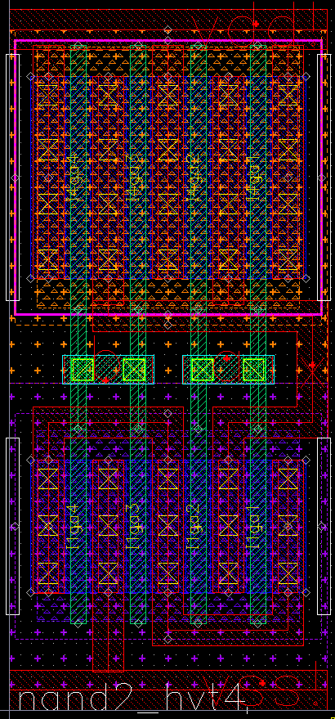
A
Nand
CMOS
B
X
Mp2
Mp1
X
A
Mn1
B
Mn2
A
B
X
C
Mp3
Mp2
Mp1
X
A
Mn1
B
Mn2
C
Mn3

Slide 5
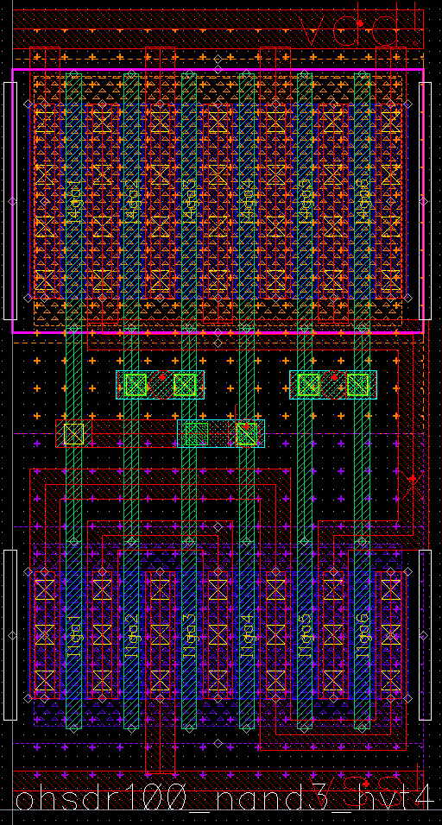
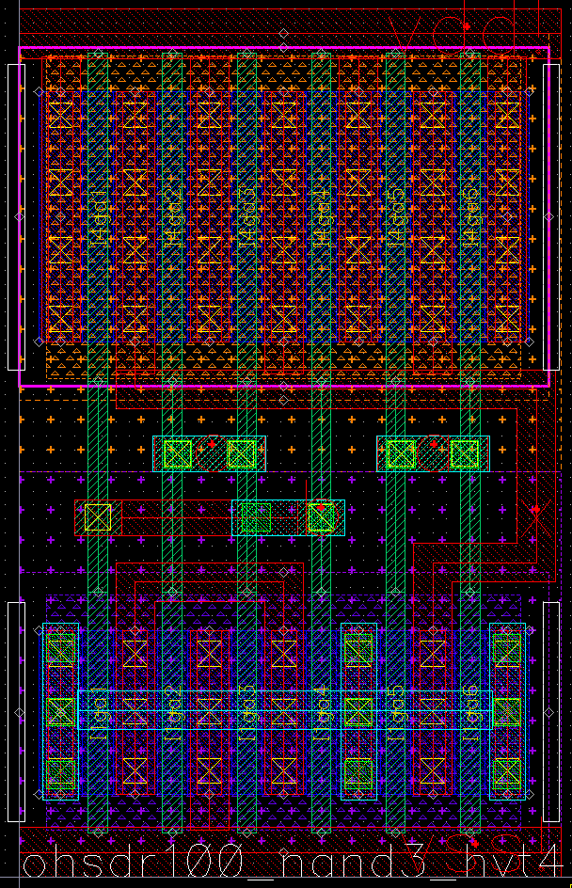
Nand3

Slide 6
Nand Properties
A=B=01
V
Mp2
Mp1
X
A=1 B=01
A
Mn1
B
Mn2
B=1 A=01
Vin
Vout
t
A=1 B=01
Input Data Pattern | Delay (ps)
A=B=0→1 | 69
A=1,B=0→1 | 62
A=0→1,B=1 | 50
A=B=1→0 | 35
A=1,B=1→0 | 76
A=1→0,B=1 | 57
A=B=01
B=1 A=01
Vin

Slide 7
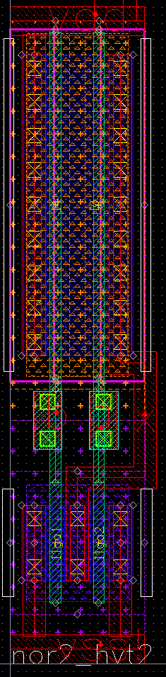
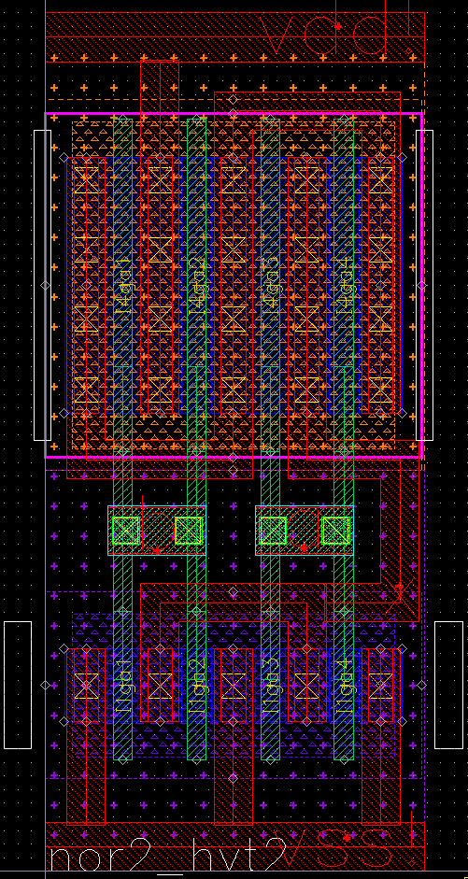
Nor
A
B
X
B
Mp2
A
Mp1
X
Mn2
Mn1
A
B
X
C
C
Mp3
B
Mp2
A
Mp1
X
Mn3
Mn2
Mn1

Slide 8
Nor
A
B
X
B
Mp2
A
Mp1
X
Mn2
Mn1
A
B
X
C
C
Mp3
B
Mp2
A
Mp1
X
Mn3
Mn2
Mn1

Slide 9
Sizing techniques
B
kp
kp
kp
kp
A
X
X
A
A
kp
kn
kn
X
B
kn
kn
kn
2kp
Kp/2
A
X
A
X
Kn/2
2kn

Slide 10
Sizing examples CMOS
2u
A
X
B
2u
2u
4u
1u
X
A
A
2u
4u
X
B
1u
1u
2u
C
2u
2u
2u
6u
X
B
A
6u
3u
A
B
6u
3u
X
X
C
1u
3u
1u
1u
[Shoji88]

Slide 11
W/L eq
W/Lpeq
A
X
W/Lp2
WLp1
B
X
W/Lp2
W/Lneq
A
A
W/Lp1
W/Ln1
X
B
W/Ln2
W/Ln1
W/Ln2

Slide 12
Topology
A
A
B
B
A
C
X
C
X
B
X
C
D
D
D
Single gate
Output node has the largest load
Largest ramp time
Layout is very compact
8 Txs
Tree structure
Delay balanced
Glitch-free
12 Txs
Chain structure
Depending on input activity, lowest power consumption can be obtained
Glitch sensitive
12 Txs

Slide 13
Boolean logic properties
associativity | A+(B+C)=(A+B)+C | A(BC)=(AB)C
commutativity | A+B=B+A | AB=BA
absorption | A+(AB)=A | A(A+B)=A
distributivity | A+(BC)=(A+B)(A+C) | A(B+C)=AB+AC
complements | A+A’=1 | AA’=0
idempotency | A+A=A | AA=A
boundedness | A+0=A | A·1=A
 | A+1=1 | A·0=0
0 and 1 are complements | 0’=1 | 1’=0
De Morgan's laws | (A+B)’=A’B’ | (AB)’=A’+B’
involution | (A’)’=A
∩/Λ/&/·=AND, U/V/|/+=OR, ¬/’/\=NOT

Slide 14
De Morgan
=
=
A | B | A’ | B’ | A’B’ | (A’B’)’ | A+B | A’+B’ | (A’+B’)’ | A+B
0 | 0 | 1 | 1 | 1 | 0 | 0 | 1 | 0 | 0
0 | 1 | 1 | 0 | 0 | 1 | 1 | 1 | 0 | 0
1 | 0 | 0 | 1 | 0 | 1 | 1 | 1 | 0 | 0
1 | 1 | 0 | 0 | 0 | 1 | 1 | 0 | 1 | 1

Slide 15
Duality applications
A
B
X
=
C
D
=
A
B
X
C
D
A
B
X
C
D
A
B
X
A
C
B
D
C
X
D
A
A
B
B
X
X
C
C
D
D

Slide 16
Aoi
Mp3
Mp2
Mp1
Mp4
Mp5
Xb
X
A
Mn1
Mn5
B
D
Mn2
Mn4
C
Mn3
A
B
Xb
C
X
D
A
B
C
X
D

Slide 17
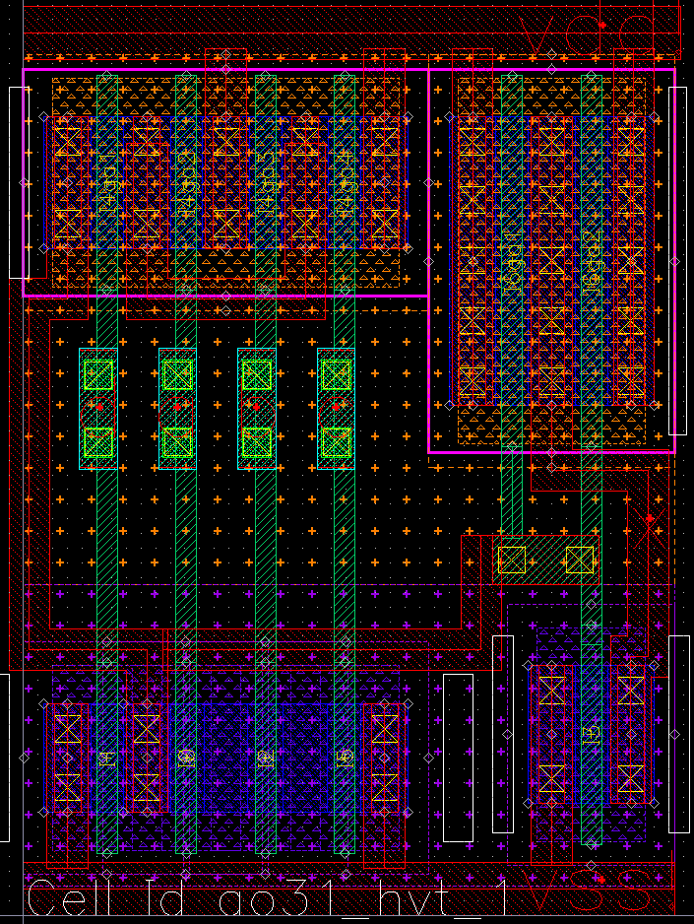
Ao31
X
A
B
D
C

Slide 18
Oai
Mp2
Mp3
Mp1
Mp4
Xb
X
C
Mn3
Mn4
A
B
Mn2
Mn1
A
Xb
B
X
C
A
B
X
C
Slide <number>

Slide 19
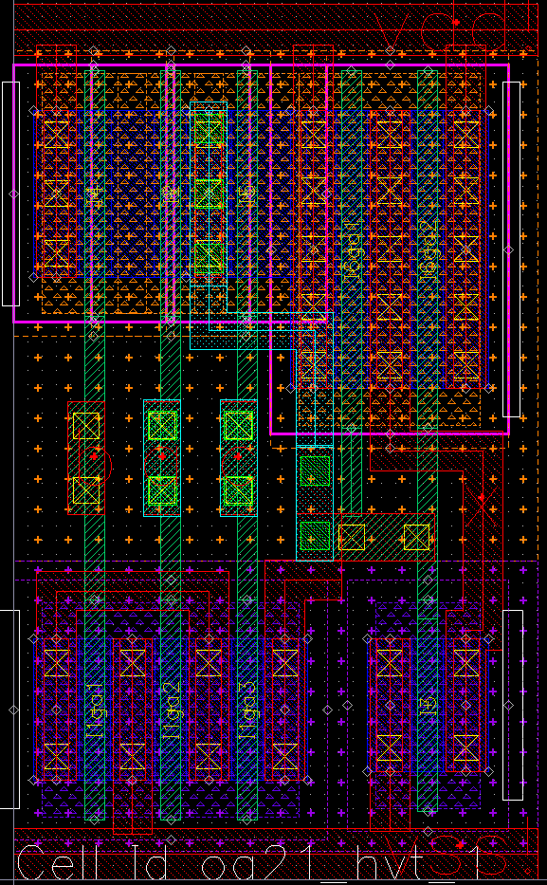
Oa21
X
C
A
B
Slide <number>

Slide 20
Sizing examples AOI
4u
4u
4u
4u
2u
Xb
X
A
3u
1u
B
D
3u
1u
C
3u
4u
2u
4u
2u
Xb
X
C
2u
1u
A
B
2u
2u
Slide <number>

Slide 21
W/L eq
Mp3
Mp2
Mp1
Mp2
Mp3
Mp4
Mp5
Mp1
Mp4
Xb
X
Xb
X
A
C
Mn1
Mn5
Mn3
Mn4
B
D
Mn2
Mn4
A
B
Mn2
Mn1
C
Mn3
Slide <number>

Slide 22
Practice 3
3.1 Characterize Nand2, Nand3, Nor2 and Nor3 (Sizing examples MOS slide). These gates are sized to be equivalent to a 2/1 inverter. Use defaults as in previous Practices 1 and 2.
Characterizations must include measurements for V_{M}, delay, ramp and power consumptions under input patterns one switching and all switching. Compare.
3.2 a) Characterize And4 single gate (Topology slide).
b) Repeat for And4 chain structure.
c) Repeat for And4 tree structure.
d) Repeat for And4 tree structure after using Duality (Duality applications slide).
Size each gate to be equivalent to a 2/1 inverter. Compare.
3.3 Which are the worst cases for Delay, Ramp and Power consumption?
Propose the worst cases for the AOI gates and verify them (Sizing examples AOI slide).
3.4 Sizing examples were given to be equivalent to a 2/1 inverter. Verify this using W/L_{eq} formulae at W/L eq CMOS and AOI slides.
3.5 a) Repeat Nand2 and Nor2 layout. Measure X & Y.
b) Make stick diagram of Nand3 and Nor3. Estimate X & Y.
Slide <number>

Slide 23
Complex
A
D
E
X
B
C
D
Mp4
A
Mp1
E
Mp5
A | B | C | D | E | X
X | 1 | 1 | X | X | 0
1 | X | X | X | 1 | 0
1 | X | X | 1 | X | 0
0 | 0 | X | X | X | 1
0 | X | 0 | X | X | 1
X | 0 | X | 0 | 0 | 1
X | X | 0 | 0 | 0 | 1
B
Mp2
C
Mp3
X
A
Mn1
B
Mn2
D
Mn4
E
Mn5
C
Mn3
Slide <number>

Slide 24
Complex VS
Before Duality
After Duality
CMOS
A
A
D
D
E
X
E
X
B
B
C
C
7 gates
6 gates
AOI
A
A
D
D
E
X
E
X
B
B
C
C
5 gates
4 gates
Complex
A
D
Where is the catch?
Supported?
E
X
B
C
1 gate
Slide <number>

Slide 25
Euler path
D
pMOS network graph
A
D
E
D
Mp4
x
A
y
A
Mp1
E
Mp5
E
B
C
B
C
Mp3
B
C
Mp2
X
X
X
A
B
A
B
A
B
Mn1
Mn2
x
D
E
C
Mn4
Mn5
Mn3
D
E
D
E
C
C
y
nMOS network graph
Common Euler path
E-D-A-B-C
Slide <number>

Slide 26
Optimized layout
Vdd
D
Mp4
A
Mp1
E
Mp5
B
C
Mp2
Mp3
X
A
Mn1
B
Mn2
E
D
A
B
C
X
D
E
C
Mn3
Mn4
Mn5
Common Euler path
E-D-A-B-C
Vss
Slide <number>

Slide 27
XOR
A
X
A
B
A
A’
B
A’
XOR
A
B
B’
B’
B
X
A’
Mp3
B’
Mp4
A | B | A⊕B XOR | A⊗B XNOR
0 | 0 | 0 | 1
0 | 1 | 1 | 0
1 | 0 | 1 | 0
1 | 1 | 0 | 1
A
Mp1
B
Mp2
X
A
Mn1
A’
Mn3
B
Mn2
B’
Mn4
Slide <number>

Slide 28
Full-Adder minterm
A | B | Cin | Cout | Sum
0 | 0 | 0 | 0 | 0
0 | 0 | 1 | 0 | 1
0 | 1 | 0 | 0 | 1
0 | 1 | 1 | 1 | 0
1 | 0 | 0 | 0 | 1
1 | 0 | 1 | 1 | 0
1 | 1 | 0 | 1 | 0
1 | 1 | 1 | 1 | 1
Cout
A\BC | 10 | 00 | 01 | 11
0 | 0 | 0 | 0 | 1
1 | 1 | 0 | 1 | 1

Slide 29
Full-Adder maxterm
A | B | Cin | Cout | Sum
0 | 0 | 0 | 0 | 0
0 | 0 | 1 | 0 | 1
0 | 1 | 0 | 0 | 1
0 | 1 | 1 | 1 | 0
1 | 0 | 0 | 0 | 1
1 | 0 | 1 | 1 | 0
1 | 1 | 0 | 1 | 0
1 | 1 | 1 | 1 | 1
Cout
A\BC | 10 | 00 | 01 | 11
0 | 0 | 0 | 0 | 1
1 | 1 | 0 | 1 | 1
NCSG Organizational Changes, 30 August 2005, Slide <number>

Slide 30
Mirror Full-Adder
Cout
C
A
B
B
A
B
C
B
C
A
A
Sum
C
A
A
A
B
C
B
A
B
B
C
N net
P net
Slide <number>

Slide 31
Carry Ripple Adder Chain
a3 b3 a2 b2 a1 b1 a0 b0
Example:
N₂ N₁₀
A: 1001 9
B: 0011 3
S₄₋₀:01100 12
A: 1001 9
B’: 1100 12
C: 0001 1
S₄₋₀:10110 22
S₃₋₀: 0110 6
A
B
A
B
A
B
A
B
S4
Cout
Cin
Cout
Cin
Cout
Cin
Cout
Cin
Sum
Sum
Sum
Sum
S3 S2 S1 S0
a3 b3’ a2 b2’ a1 b1’ a0 b0’
A
B
A
B
A
B
A
B
S4
Cout
Cin
Cout
Cin
Cout
Cin
Cout
Cin
Sum
Sum
Sum
Sum
S3 S2 S1 S0
Slide <number>

Slide 32
(A+B) / (A-B)
a3 b3 a2 b2 a1 b1 a0 b0
AddoSub
A
B
A
B
A
B
A
B
S4
Cout
Cin
Cout
Cin
Cout
Cin
Cout
Cin
Sum
Sum
Sum
Sum
S3 S2 S1 S0
Slide <number>

Slide 33
A mult B
Y= Y₃ Y₂ Y₁ Y₀
X= X₃ X₂ X₁ X₀
Y₃X₀ Y₂X₀ Y₁X₀ Y₀X₀
Y₃X₁ Y₂X₁ Y₁X₁ Y₀X₁
Y₃X₂ Y₂X₂ Y₁X₂ Y₀X₂
Y₃X₃ Y₂X₃ Y₁X₃ Y₀X₃
P₇ P₆ P₅ P₄ P₃ P₂ P₁ P₀
B
C_{in}
+
A
C_{out}
S
Y₃X₀
Y₂X₀
Y₁X₀
Y₀X₀
0
0
0
Y₂X₁
Y₁X₁
Y₀X₁
Y₃X₁
+
+
+
Y₂X₂
Y₁X₂
Y₀X₂
Y₃X₂
+
+
+
Y₂X₃
Y₁X₃
Y₀X₃
Y₃X₃
+
+
+
+
+
+
0
Booth’s Multiplication Algorithm | GeeksforGeeks
P₇ P₆ P₅ P₄ P₃ P₂ P₁ P₀
Slide <number>

Slide 34
3-to-7 BCD to Thermometer
Inputs |  | Outputs
sata_en | Equalization bits sel2-sel1-sel0 | sel7 (not used) | sel6 | sel5 | sel4 | sel3 | sel2 | sel1
0 | XXX | 1 | 1 | 1 | 1 | 1 | 1 | 1
1 | 000 | 0 | 0 | 0 | 0 | 0 | 0 | 0
1 | 001 | 0 | 0 | 0 | 0 | 0 | 0 | 1
1 | 010 | 0 | 0 | 0 | 0 | 0 | 1 | 1
1 | 011 | 0 | 0 | 0 | 0 | 1 | 1 | 1
1 | 100 | 0 | 0 | 0 | 1 | 1 | 1 | 1
1 | 101 | 0 | 0 | 1 | 1 | 1 | 1 | 1
1 | 110 | 0 | 1 | 1 | 1 | 1 | 1 | 1
1 | 111 | 1 | 1 | 1 | 1 | 1 | 1 | 1

Slide 35
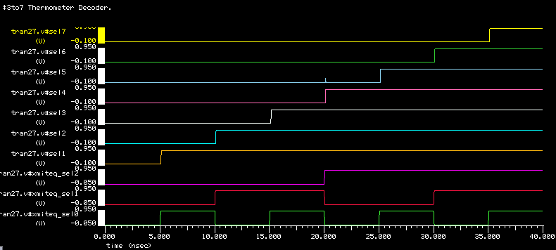
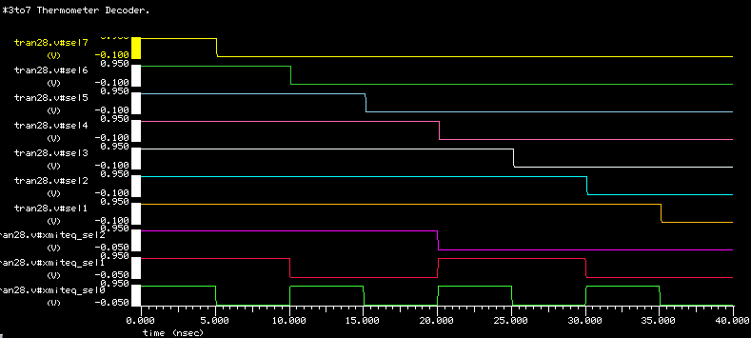
Time Waveforms
IS0
IS1
glitch
Slide <number>

Slide 36
Glitch
0
1
1
1
0
0
1→0
1→0
0→1
0→1
0→1
1→0→1 Glitch!
1→0
0→1→0 Glitch!
1
0
0
1
1
0
0→1
1→1
1→0
0→0
1→0
1→1→1 No Glitch
0→1
0→0→0 No Glitch
Glitch in a chain
1
0
X
X
0→1
0→1
0→1
1→0
1→0
1→0
0 1 1 1
0→1 0 0 0
1 1 1
0
1 0 0 0
1→0 1 1 1
0 0 0
1
Slide <number>

Slide 37
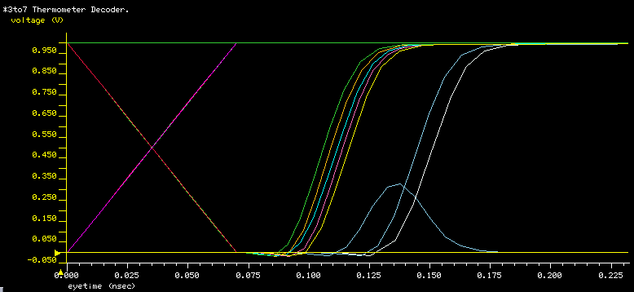
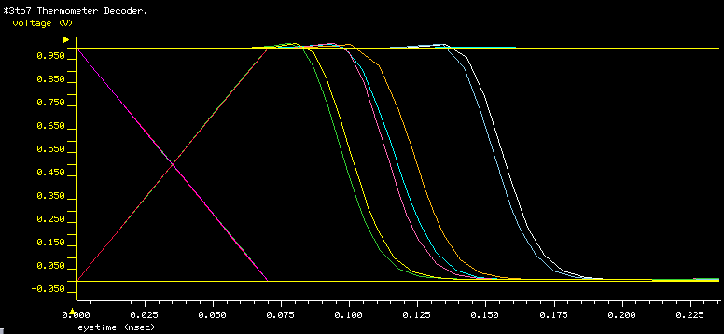
Eye Waveforms and Measurements
IS0
IS1
Worst Eye (ps)
90% vdd
Worst Delay (ps)
50% vdd
Unbalance (ps)
glitch (mV)
10% vdd
RampM
RampN
Slide <number>

Slide 38
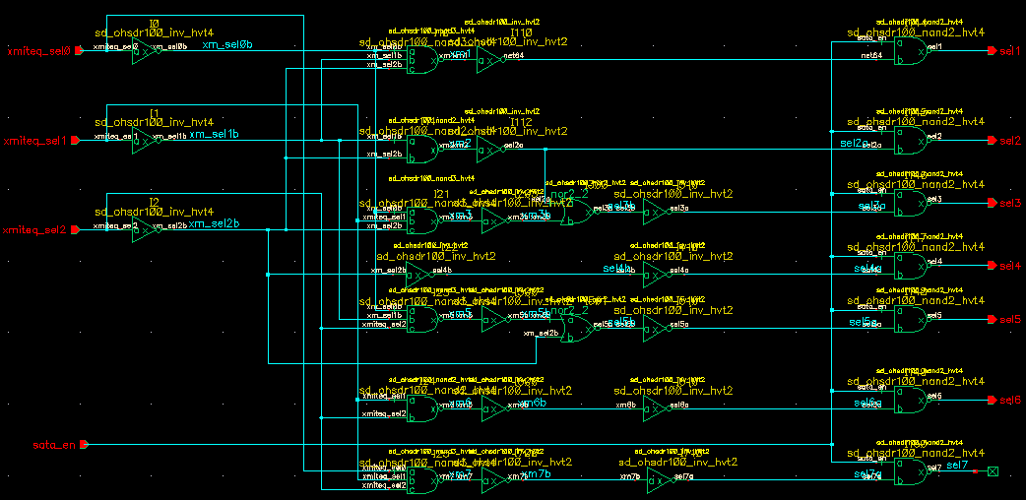
sd65_dec_eq_sata schematic
4 gates depth
6 gates depth
13 2-input,
2 3-input gates
& 15 inverters
= 94 Txs
Wsum=122um
Slide <number>

Slide 39
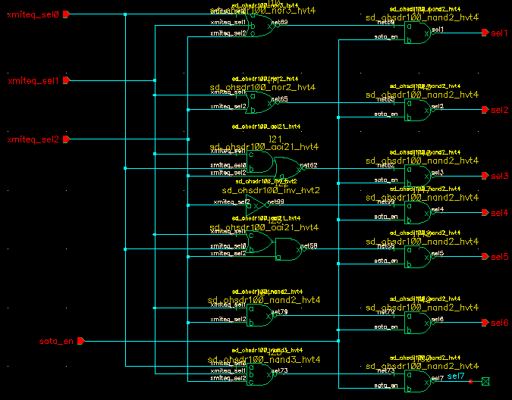
sd65_dec_eq_sata_aoi schematic
2 gates depth
aoi21
9 2-input,
4 3-input gates
& 1 inverter
= 62 Txs
Wsum=94.5
oai21
Slide <number>

Slide 40
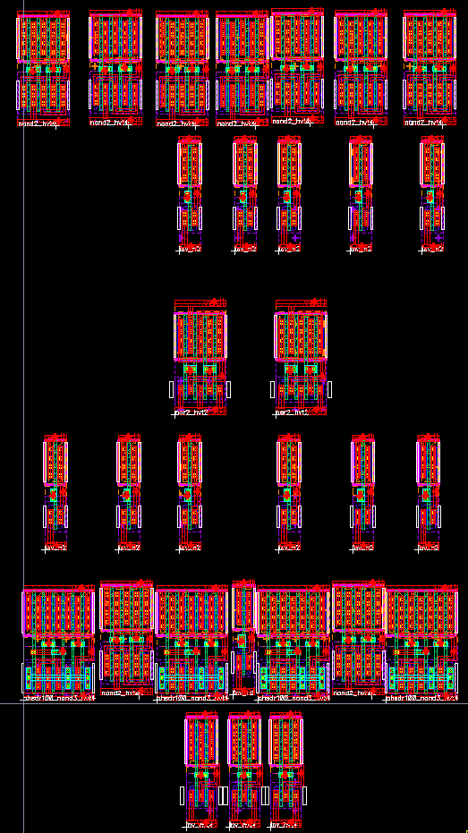
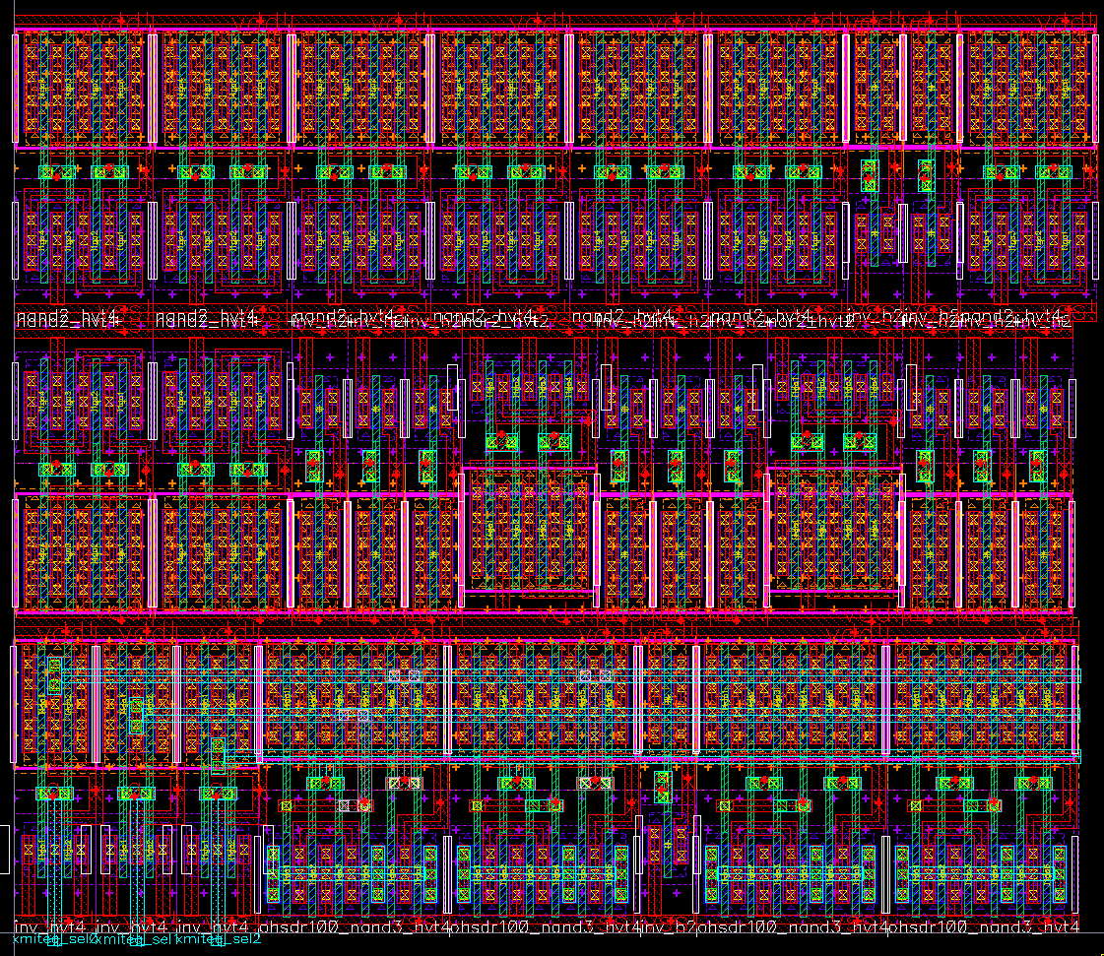
dec_eq_sata Floor-planning
Schematic can include a floorplaning and notes i.e. current(s) or recommended Metal levels, W & S.
Layout owner must get floorplaning approval before routing.

Slide 41
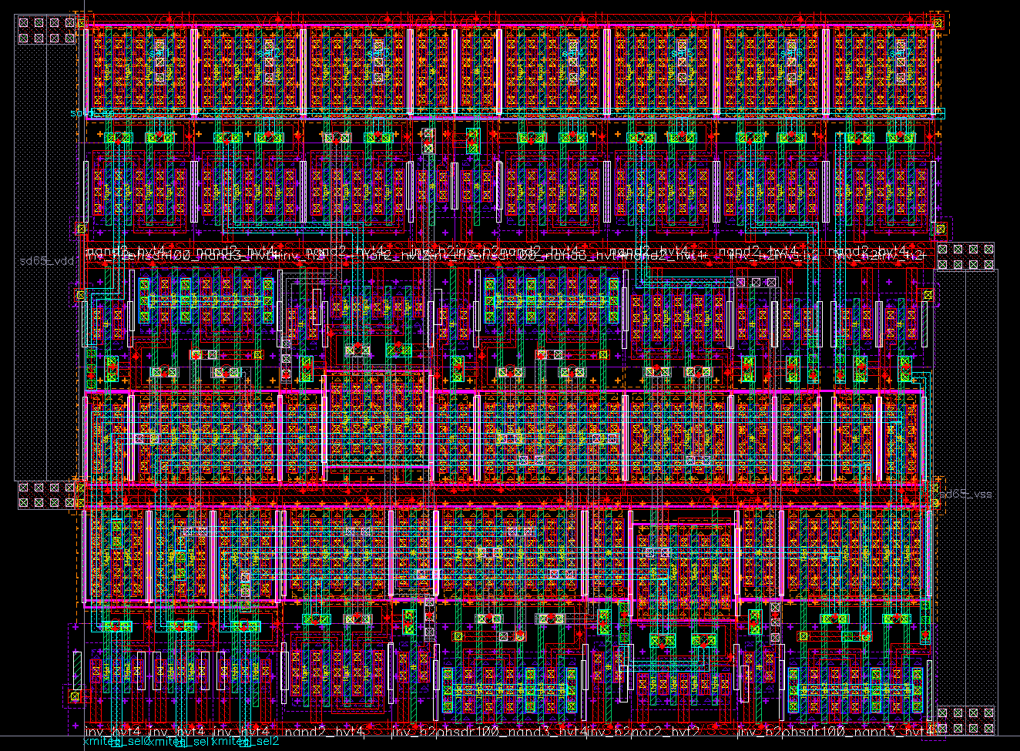
Top

Slide 42
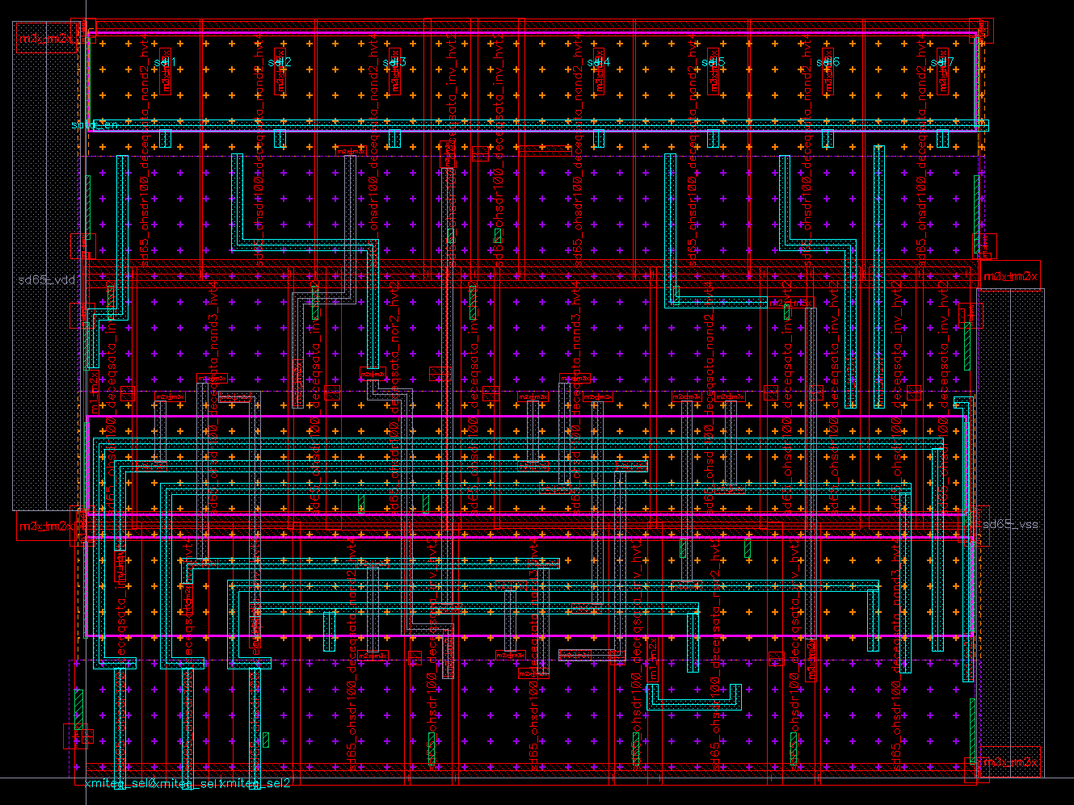
Top’

Slide 43
Conclusions
dec_eq_sata
Index | Case | Vdd | Temp | InitSt | Delay (ps) | Worst Ramp (ps) | Worst Eye (ps) | Unbalance (ps) | Glitch (V) | Irms (uA) | Pow (uW)
27 | typ | 1 | 65 | 0 | 136.04 | 43.52 | 97.14 | 55.59 | 0.54 | 56.1 | 56.1
28 | typ | 1 | 65 | 1 | 145.14 | 77.97 | 133.9 | 57.01 | 0.51 | 596.59 | 596.59
dec_eq_sata_aoi
Index | Case | Vdd | Temp | InitSt | Delay (ps) | Worst Ramp (ps) | Worst Eye (ps) | Unbalance (ps) | Glitch (mV) | Irms (uA) | Pow (uW)
27 | typ | 1 | 65 | 0 | 73.04 | 45.31 | 62.9 | 22.51 | 1.82 | 39.19 | 39.19
28 | typ | 1 | 65 | 1 | 67.7 | 68.19 | 78.39 | 13.47 | 0.65 | 600.53 | 600.53
Cell was optimized with MSoC (Modified Simplex over Corners).
Merit Figure = Max Delay + Max Ramp + Max Unbalance + Max Glitch
dec_eq_sata_aoi have less delay, area, power consumption and have better balance than dec_eq_sata.
Slide <number>

Slide 44
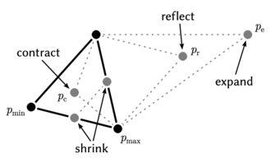
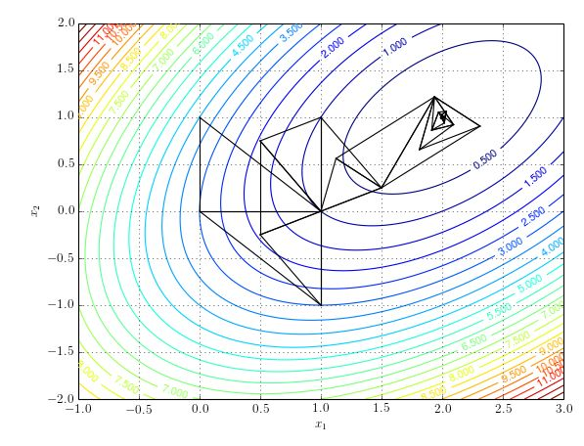
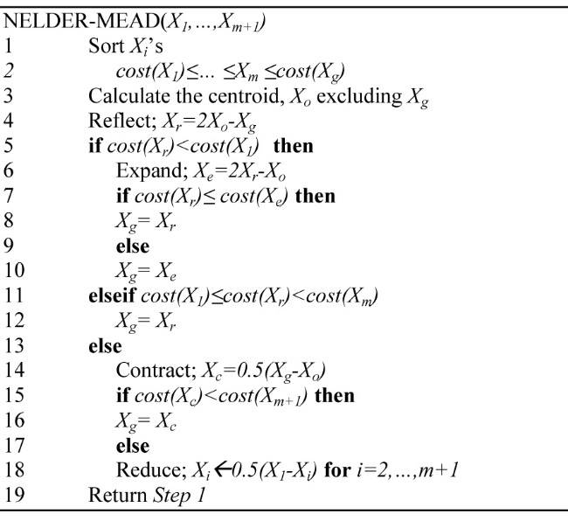
Nelder-Mead
Nelder–Mead method - Wikipedia
Slide <number>

Slide 45
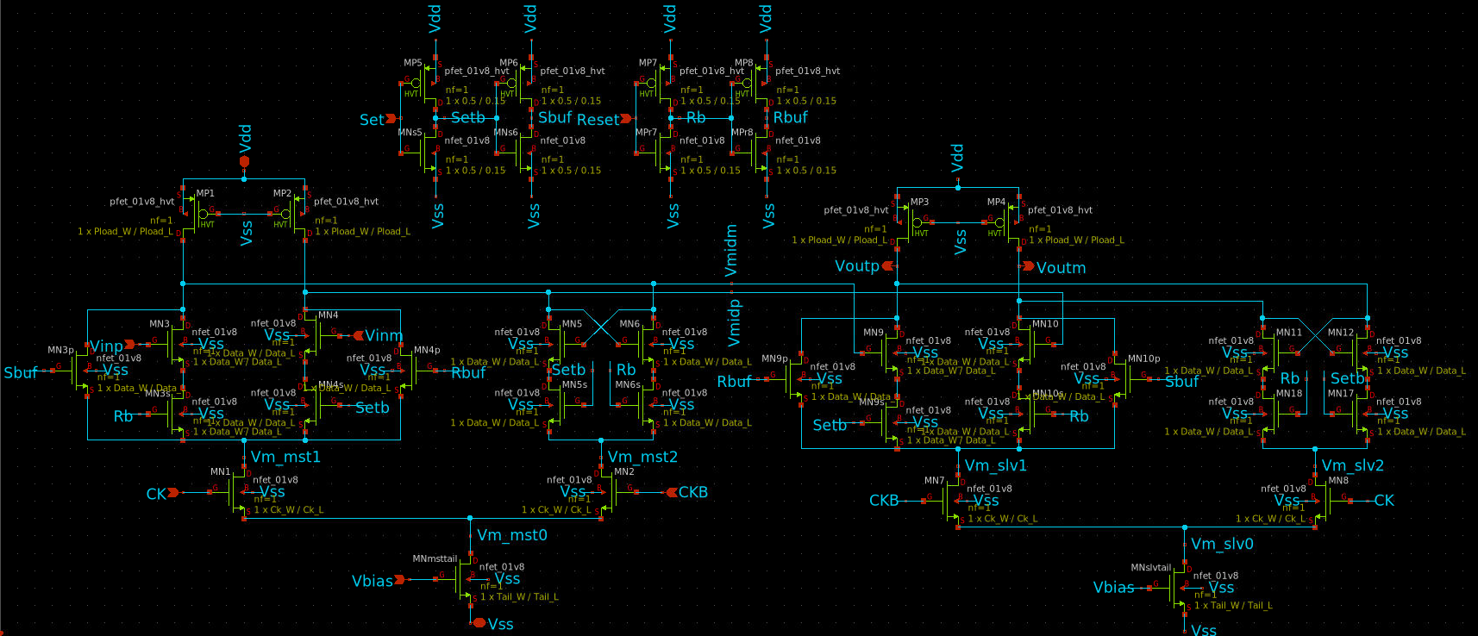
wlv_DFFcml_06
P1
P2
P3
P4
N5
N6
N11
N12
N3
N4
N10
N5s
N6s
N9
N11s
N12s
N3p
N4p
N9p
N10p
N3s
N4s
N10s
N9s
N1
N2
N7
N8
Master
Slave

Slide 46
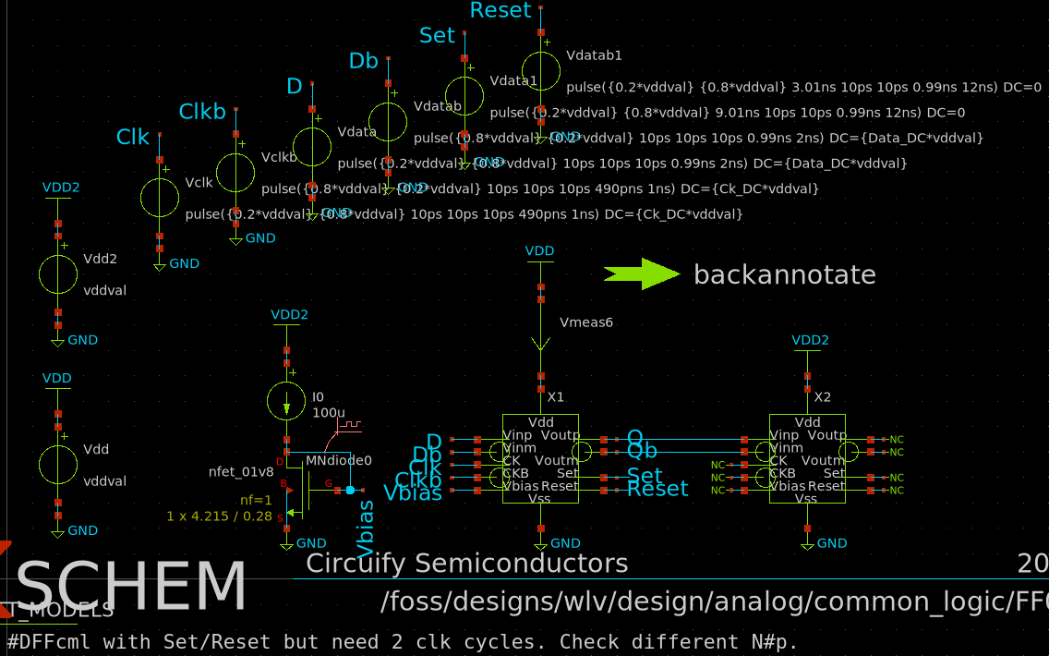
FF03_cml_tb8

Slide 47

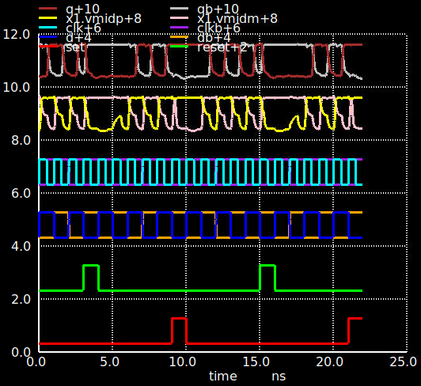


DFFcml6 ss results
Q/b
Vmidp/m
Clk/b
Swing=1.24V ok. Ivdd rms 133uA.
Von=29mV.
Need 2 clk cycles after Set/Reset.
Need to try speed up and/or different Set/Reset.
D/b
Reset
Set
SS 1.62V -40C

Slide 48

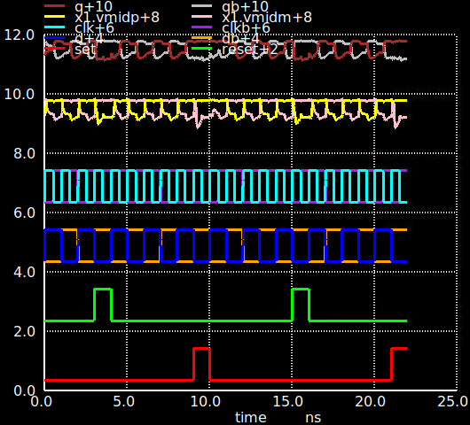

DFFcml6 tt results
Q/b
Vmidp/m
Clk/b
D/b
Swing=0.58V Not ok. Ivdd rms 186uA.
Von=71mV.
Need more swing
Reset
Set
TT 1.8V 65C

Slide 49
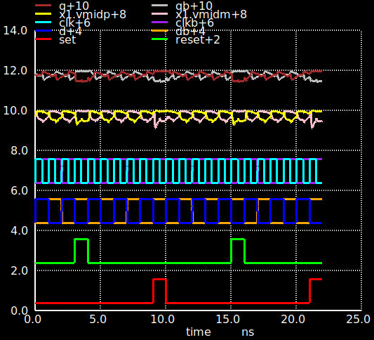


DFFcml6 ff results
Q/b
Vmidp/m
Clk/b
Swing=0.41V Not ok. Ivdd rms 236uA.
Von=87mV
Need more swing
D/b
Reset
Set
FF 1.98V 125C

Slide 50
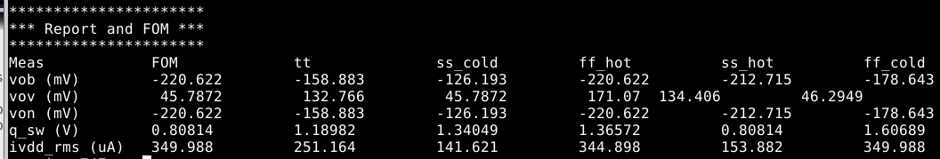
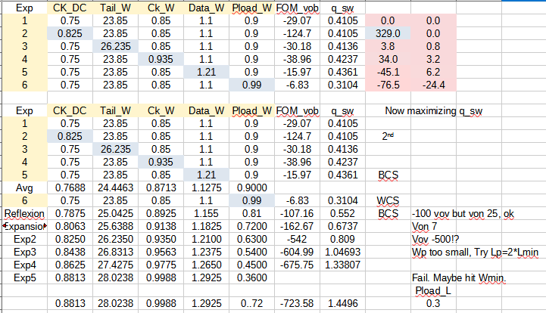
Simplex example
Slide <number>

Slide 51
Modified Simplex
Automate your measurements. Print them on file.
Propose a Merit Figure (MF=MaxDly+MaxRmp+MaxUnb+…).
Parametrize your circuits.
Set max-min data, layout (/power) constrained.
Initial trials: Script “One variable at a time”. Pull data from lists and vectors.You can use ±1-10% on each parameter.
Sort MFs and identify Worst trial.
Calculate Pivot, Reflexion and evaluate MF.
Sustitute Worst Trial with Reflexion / Expansion / ±Contraction.
If Trials>N or |MFworst-MFbest|<MFmin; return to step 6
10. End
Slide <number>

Slide 52
Modified Simplex over Corners
Script the Modified Simplex.
Verification: Run your design over corners. Some foreachs and print to file.
If some corners fail, use Modified Simplex over less corners to help you. You may relax your MF or measurements. Be creative.
Identify WSC (Worst Selected Corners) based on the components of the MF, not on worst MF.
Run the Modified Simplex using WSC. Sometimes, run it again to avoid freezing on local optimum (SA), i.e. when Worst MF cycles or goes slow.
Verify again. If necesary, change WSC and return to step 5.
End.
Slide <number>

Slide 53
4-to-15 Gray to Thermometer
 | Inputs | Outputs
Gray | sl0..3 | b15 | b14 | b13 | b12 | b11 | b10 | b9 | b8 | b7 | b6 | b5 | b4 | b3 | b2 | b1
0 | 0000 | 0 | 0 | 0 | 0 | 0 | 0 | 0 | 0 | 0 | 0 | 0 | 0 | 0 | 0 | 0
1 | 0001 | 0 | 0 | 0 | 0 | 0 | 0 | 0 | 0 | 0 | 0 | 0 | 0 | 0 | 0 | 1
3 | 0011 | 0 | 0 | 0 | 0 | 0 | 0 | 0 | 0 | 0 | 0 | 0 | 0 | 0 | 1 | 1
2 | 0010 | 0 | 0 | 0 | 0 | 0 | 0 | 0 | 0 | 0 | 0 | 0 | 0 | 1 | 1 | 1
6 | 0110 | 0 | 0 | 0 | 0 | 0 | 0 | 0 | 0 | 0 | 0 | 0 | 1 | 1 | 1 | 1
7 | 0111 | 0 | 0 | 0 | 0 | 0 | 0 | 0 | 0 | 0 | 0 | 1 | 1 | 1 | 1 | 1
5 | 0101 | 0 | 0 | 0 | 0 | 0 | 0 | 0 | 0 | 0 | 1 | 1 | 1 | 1 | 1 | 1
4 | 0100 | 0 | 0 | 0 | 0 | 0 | 0 | 0 | 0 | 1 | 1 | 1 | 1 | 1 | 1 | 1
12 | 1100 | 0 | 0 | 0 | 0 | 0 | 0 | 0 | 1 | 1 | 1 | 1 | 1 | 1 | 1 | 1
13 | 1101 | 0 | 0 | 0 | 0 | 0 | 0 | 1 | 1 | 1 | 1 | 1 | 1 | 1 | 1 | 1
15 | 1111 | 0 | 0 | 0 | 0 | 0 | 1 | 1 | 1 | 1 | 1 | 1 | 1 | 1 | 1 | 1
14 | 1110 | 0 | 0 | 0 | 0 | 1 | 1 | 1 | 1 | 1 | 1 | 1 | 1 | 1 | 1 | 1
10 | 1010 | 0 | 0 | 0 | 1 | 1 | 1 | 1 | 1 | 1 | 1 | 1 | 1 | 1 | 1 | 1
11 | 1011 | 0 | 0 | 1 | 1 | 1 | 1 | 1 | 1 | 1 | 1 | 1 | 1 | 1 | 1 | 1
9 | 1001 | 0 | 1 | 1 | 1 | 1 | 1 | 1 | 1 | 1 | 1 | 1 | 1 | 1 | 1 | 1
8 | 1000 | 1 | 1 | 1 | 1 | 1 | 1 | 1 | 1 | 1 | 1 | 1 | 1 | 1 | 1 | 1
Slide <number>

Slide 54
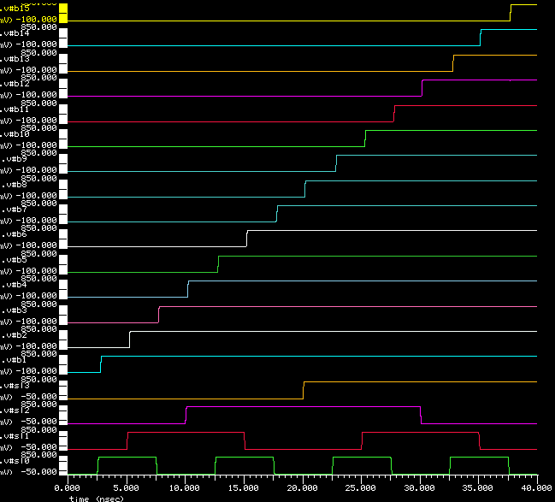
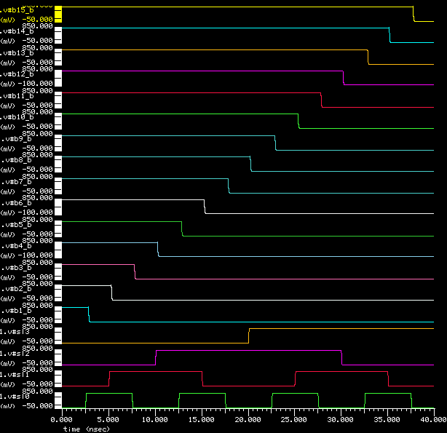
Time Waveforms IS0
b1..15
b1..15b
sl0..3

Slide 55
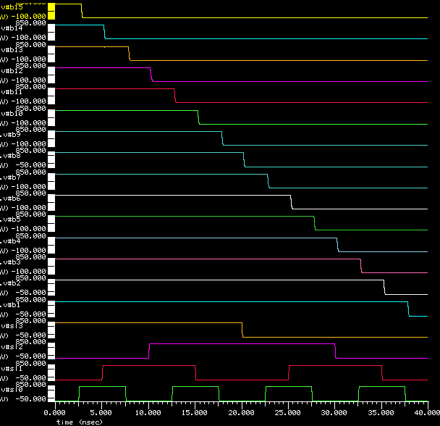
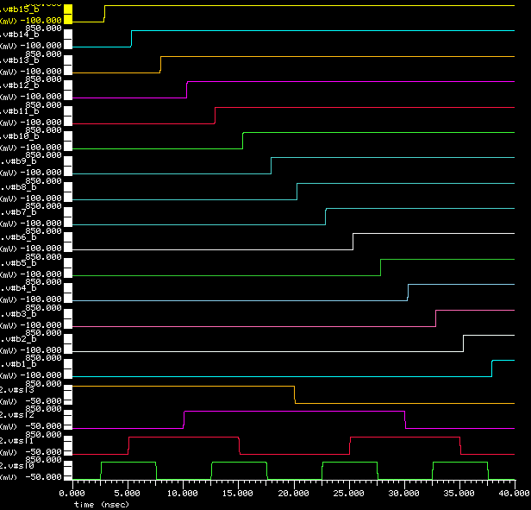
Time Waveforms IS1
b1..15
b1..15b
sl0..3

Slide 56
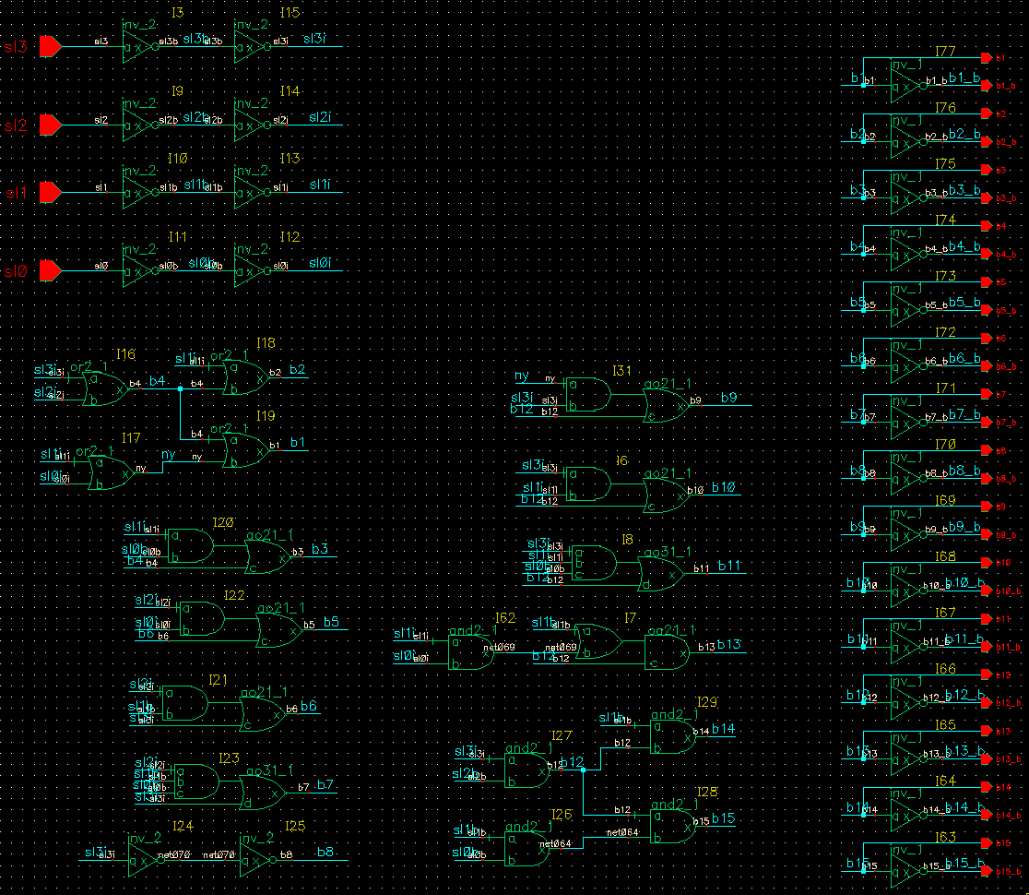
sd65_decoder_mb schematic
10 2-input, 6 3-input,
2 4-input gates
& 42 inverters = 176 Txs
Wsum=174um
2 gates depth
4 gates depth

Slide 57
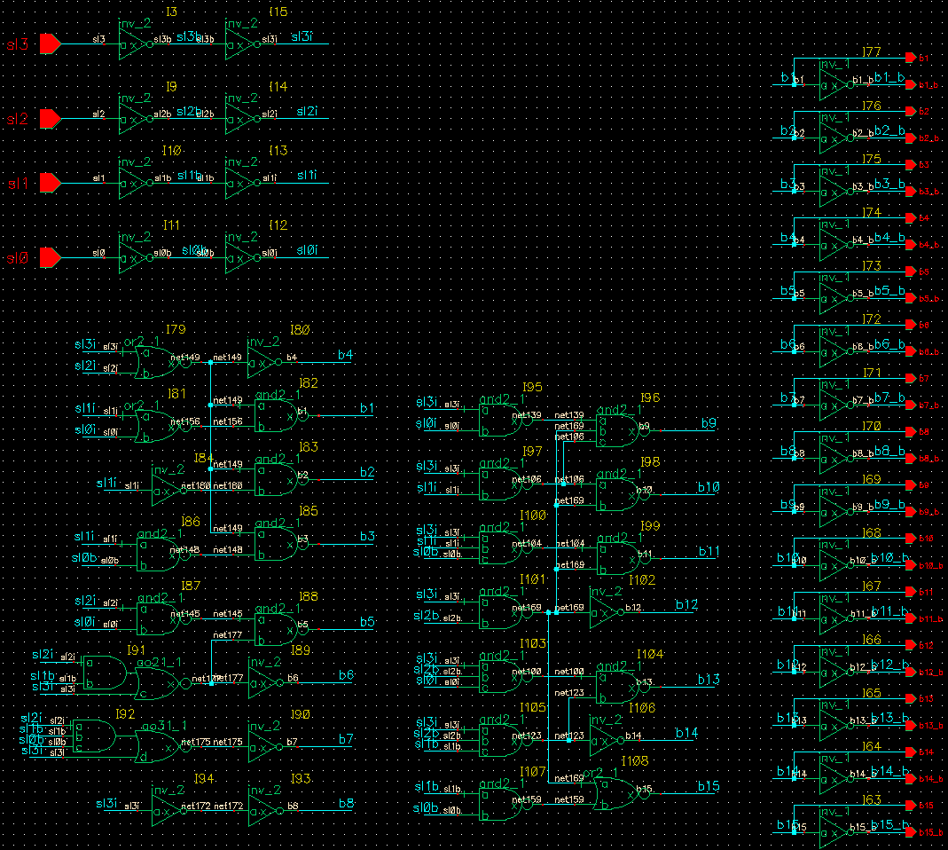
sd65_decoder_mb_dual schematic
16 2-input, 5 3-input,
1 4-input gates
& 31 inverters = 164 Txs
Wsum=152um
2 gates depth
Slide <number>

Slide 58
Conclusions
decoder_mb
Index | Case | Vdd | Temp | InitSt | Delay (ps) | Worst Ramp (ps) | Worst Eye (ps) | Unbalance (ps) | Glitch (mV) | Irms (uA) | Pow (uW)
27 | typ | 1 | 65 | 0 | 188.63 | 45.87 | 170.3 | 132.89 | 29.59 | 276.18 | 276.18
28 | typ | 1 | 65 | 1 | 195.23 | 101.45 | 141.34 | 100.18 | 33.08 | 277.22 | 277.22
decoder_mb_dual
Index | Case | Vdd | Temp | InitSt | Delay (ps) | Worst Ramp (ps) | Worst Eye (ps) | Unbalance (ps) | Glitch (mV) | Irms (uA) | Pow (uW)
27 | typ | 1 | 65 | 0 | 171.55 | 48.46 | 133.28 | 98.11 | 28.85 | 275.59 | 275.59
28 | typ | 1 | 65 | 1 | 132.72 | 99.49 | 116.99 | 64.58 | 19.85 | 282.15 | 282.15
Cell was optimized with MSoC (Modified Simplex over Corners).
Merit Figure = Max Delay + Max Ramp + Max Unbalance + Max Glitch
decoder_mb_dual have less delay, area, glitch and have better balance than decoder_mb.
Slide <number>

Slide 59
Practice 4
4.1 a) Draw Full-Adder Diagram following only N-net logic equations (Mirror Adder slide). Size it to have 2/1 inverter equivalence at every stage. Draw the stick diagram and estimate area. Count the maximum number of transistors Pmos and Nmos in stack (N_{stack-max}, P_{stack-max}).
b) Repeat for Full-Adder Diagram following only P-net logic equations.
c) Repeat for Mirror Full-Adder.
d) Compare the 3 Adders: Area, N_{stack-max}, P_{stack-max} and comment.
4.2 a) Characterize Mirror Full-adder sized at 3.1-c with 50fF loads at Cout and Sum outputs. Characterization must include delay and ramp measurements for Cout and Sum and rms power consumption for all and one input switching.
b) Propose 3 more switchings different from all and one switching, try to find worst scenarios. Add them to your characterization. Compare all and comment.
c) Check intermediate nodes waveforms. Are there glitches? Plot the worst.
4.3 a) Make a 4-bit Adder (Carry Ripple Adder Chain slide) using Mirror Full-Adder sized as 2/1 inverter. Set all outputs with 50fF loads. Simulate with an all-0 initial state and then an A+B=9+3=12 switching, C_{in}=C₀=0. Measure delay and ramp at the 5 outputs S₄₋₀ (if possible) and rms power consumption.
b) Repeat for 1+1; 3+1; 7+1; 15+1; 1+3; 1+7; 1+15. Compare and explain.

Slide 60
CMOS Conclusions
CMOS, AOI and Complex included, are the most used gates in digital design because they are very robust and easy to size.
Performance of CMOS gates depend in the number of transistors in stack and proximity of the control signal to output node.
Gate level optimization techniques: Duality, manipulation of logic equations and topologies, modularity and reuse.
Layout techniques: Stick diagram, Euler path, abutment and floorplanning.
Slide <number>

Slide 61
Pseudo Nmos
Mp0
X
Mp0
Mp0
X
X
A
Mn1
A
Mn1
A
Mn1
B
Mn2
B
Mn2
Inv
Nor2
Nand2

Slide 62
Pseudo Nmos Inverter
VTC
Vout
Performance
Size | V_{OL}(V) | P_{sta}(μW) | t_{pLH}(ps)
4 | 0.693 | 564 | 14
2 | 0.273 | 298 | 56
1 | 0.133 | 160 | 123
0.5 | 0.064 | 80 | 268
0.25 | 0.031 | 41 | 569
W/Lp=0.25
W/Lp=4
W/Lp=0.5
W/Lp=2
W/Lp=1
Vin
Slide <number>

Slide 63
Pass Transistor Logic
Lvl Restoration / Keeper
B
B’
A
A
Mr
1u
B’
X
B
X
B
Mp1
1.5u
X
Out
Or2
A
And2
Mn
0.5u
Mn1
0.5u
Vout
Vout
Wr=1.75
B=Vdd,
A=0->Vdd
Wr=1.5
A=Vdd, B=0->Vdd
A=B=0->Vdd
Wr=1
Wr=1.25
Vin
Vin
Slide <number>

Slide 64
CMOS Tg
A
B
F=AS’+BS
F=AB’+A’B
=A⊕B
A
B
S
A
F=AB’+A’B
B
A
F=AB’+A’B
B
Slide <number>

Slide 65
CMOS Tg layout
B’
A’
B
B
C
A
F=AB+A’C’+AB’C
A
B’
F
C’
V_{DD}
A’
C
Vdd
C’
B
B’
A
A’
C
C’
F
B
B’
A
A’
C
C’
Vss

Slide 66
Complementary / Diff. / Double Pass-Tx Logic
B’
B
B’
B
B
B’
A
A
A
F=AB
F=A+B
F=A⊕B
B
B
A’
A’
A’
A’
F’
F’
F’
B’
B’
A
And2/Nand2
Or2/Nor2
Xor2/Nxor2
B
B’
B
B’
6
4
A
A
F’
F’
B
6
10/12
B
6
4
A’
A’
F=AB
F=AB
B’
6
10/12
B’
And2/Nand2 + Inverters + Cross-coupled pMOS pull-up Txs (λ)
And2/Nand2 + Inverters

Slide 67
CPL Full-Adder
A
C’
B’
A’
C
Sum’
B
A
C
B
A’
C’
Sum
B’
A
A
C’
B
A’
A’
C
Cout’
B
A
A
C’
B’
A’
A’
C
Cout
B’
Slide <number>

Slide 68
Swing-restored pass-tx logic
B
B’
A
F’
B
A⊕B⊕C
A⊕B⊕C
A’
F=AB
B’
CPL: And2/Nand2 + Inverters
C’
C
C
C’
B
B’
A
F’
B’
B
B
B’
B
A
A’
A’
A
A’
Xor3/Xnor3
F=AB
B’
SRPTL: And2/Nand2

Slide 69
DCVSL (Diff. Cascode Voltage Switch)
AB
AB
A+B
A+B
A⊕B
A⊕B
A
A’
A’
A
B
B’
B
B’
B’
B
B
B’
A
A’
And2/Nand2
Or2/Nor2
Xor2/Xnor2
V
AB
Size as CMOS
Keeper is included
Going Differential?...
No: Double interconnection
A’,B’
AB
A,B
t
Slide <number>

Slide 70
Practice 5
Static
CMOS, AOI, Complex
Pseudo NMOS
Pass & Tg Logic
CPL/DPL (Complementary/Differential/ Double Pass-Transistor Logic)
Swing-Restored Pass-Transistor Logic
DCVSL (Diff. Cascode Voltage Switch)
Team 1
Team 2
Team 3
Team 4
Team 5
Team 6
5.1 Each team must characterize Nand2, Nand3, Nor2, Nor3 and Xor2 for different static logic styles as in 3.1. Draw a Full-Adder schematic. Size each stage to have 2/1 inverter performance, except for CPL. Report Tx count and Wsum. Deliver data, comparison, comments and schematic to Team 1.
5.2 Team 1 makes a single report with all logic styles, compare them and comment. Only one report is sent. Only one grade is delivered to class. Teams and team members may change dynamically as required.
Slide <number>

Slide 71
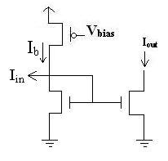
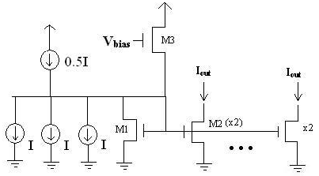
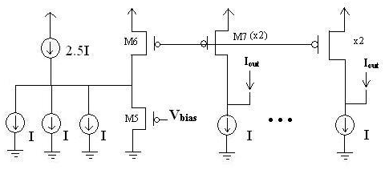
CML (Current Mode Logic). Classic.
Read further:
http://www.ece.uci.edu/~payam/CML_buffer_ISQED.pdf
http://www.youtube.com/watch?v=fXIeJVZnoaA
http://lsm.epfl.ch/files/content/sites/lsm/files/shared/Reports/martinez_report_2007.pdf
http://www.ti.com/lit/an/slla120/slla120.pdf
Inverter
NAND
NOR
Slide <number>

Slide 72
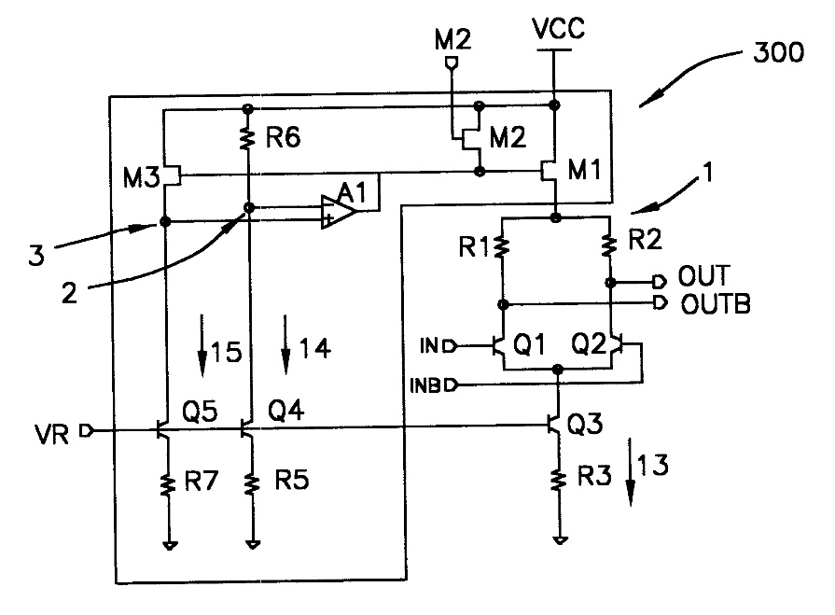

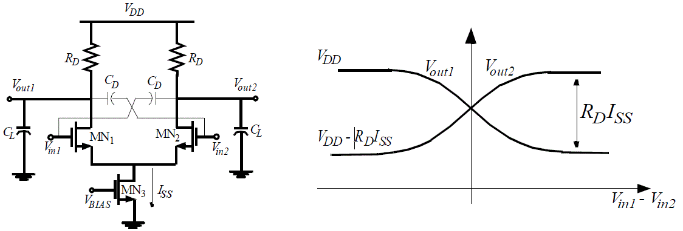
CML. High Speed.
Termination scheme
Fast, Diff and Simple
PSRR↑ Jitter↓
Reduced swing
Static consumption
Analog design
Vds-Vdsat & Vgs-Von
Area
Scaling ~2
Resistor Load?
Leakage?
Transference curve

Slide 73
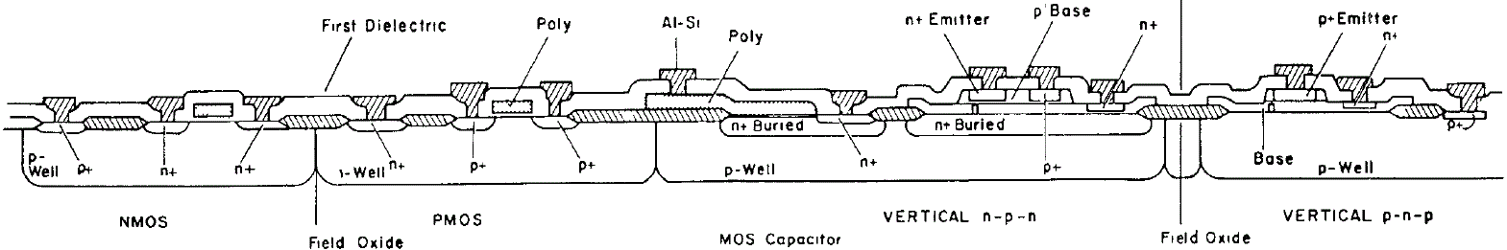
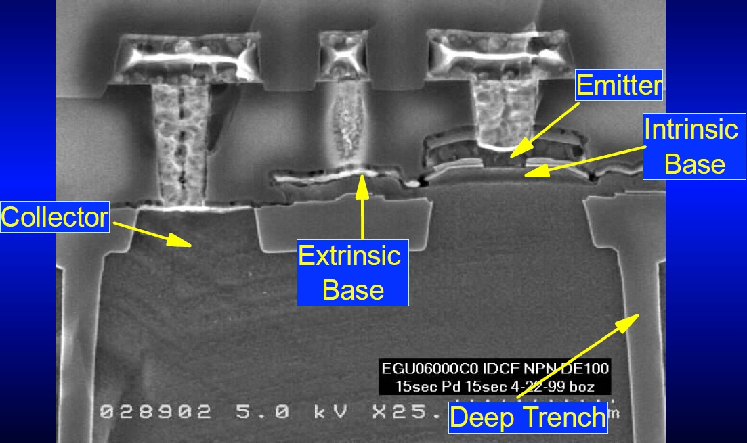
BiCMOS (Bipolar+CMOS)
Bipolar = high speed and gain, critical for high-frequency analog sections;
CMOS = excels for constructing simple, low-power logic gates.
Cost rises.

Slide 74
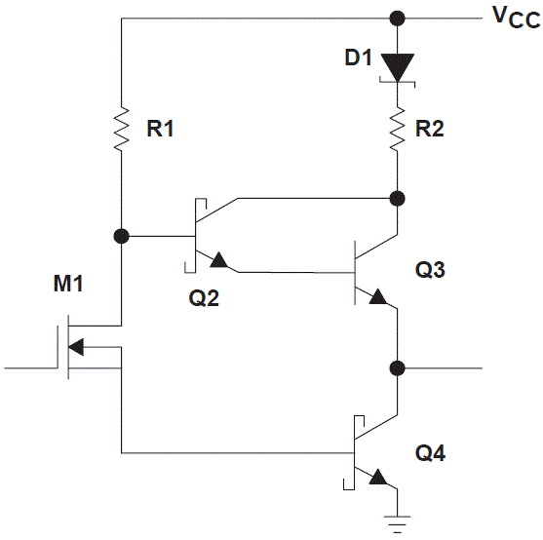
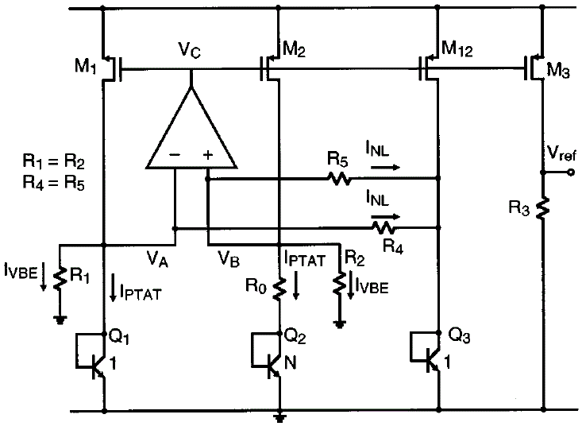
BiCMOS buffer and bandgap
Read further:
http://en.wikipedia.org/wiki/BiCMOS
http://www.st.com/web/en/about_st/bicmos.html
http://asia.stanford.edu/events/spring01/slides/harameSlides.pdf
http://www.ece.gatech.edu/academic/courses/ece4430/F09/References/Malcovati_Curvature_Compensated_BiCMOS_Bandgap_1V_Supply_JSSC01.pdf
http://www.ti.com/lit/an/scba008b/scba008b.pdf
http://www-mtl.mit.edu/researchgroups/hslee/j16.pdf

Slide 75
Dynamic: CMOS Tg
Clk’
Clk
Clk’
V₂
V₃
V₄
V₁
Clk
Clk’
Clk
Clk1’
Clk2’
Clk1’
A
Clk1
F1
Clk2
Clk1
Stage 1
Stage 2
Clk1
Clk2
Nonoverlapping clock signals

Slide 76
Precharge-Evaluation
Clk
Mp
Clk
V
Out
A
Out
C
B
t
Precharge
Evaluation
Precharge
Clk
Me
☺ As CMOS static
☺ N+2 Txs
☺ Nonratioed
☺ Dynamic power
☺ Fast
😐 Leakage
😐 Charge Sharing
😐 Cap. Coupling
😐 Clock Feedthrough
☹ Cascading

Slide 77
Signal Integrity Issues
Out’
Clk
Mbl
Clk
Mbl
Mp
Mp
Out
Out
A=0
A=0
B=0
B=0
Clk
Me
Clk
Me
Charge Sharing vs precharging critical nodes (more Area and load)
Static bleeders compensate for the charge leakage
Clk
Mp
Clk
Mp
Mbl
Clk
Out
CLoad
Out
A=0→1
A=0→1
B=0
Ca
B=0
Clk
Me
Cb
Clk
Me

Slide 78
Domino
Cascade of Dynamic n-type blocks
Clk
Clk
Mp
Clk
Mp
Out2
Mp
Out1=1
Clk
Mp
Out2=0
In
Out1
In
Clk
Me
Clk
Me
Clk
Me
Clk
Me
Remove?
Multiple output
np-domino = NORA
AND
A
A
B
X
B
X
😐 Non-inverting… Transformate→
C
C
D
D
E
Y
E
Y
F
F
G
G
H
H
OR
AND/OR

Slide 79
Multiple-output Domino Example 1
Clk
A
Clk
B
Clk
C
D
Clk
Slide <number>

Slide 80
Multiple-output Domino Example 2
Clk
C4
P4
G4
C3
P3
G3
C2
P2
G2
Manchester Carry-lookahead
C1
P1
G1
C0
Clk

Slide 81
Simple dual rail (Differential) Domino
Clk
Clk
O=AB
O=AB
A
A’
B’
B
Clk
DCVSL similar
Non-ratioed
μP popular
Area expensive
Dynamic power consumption assured each clock cycle
Slide <number>

Slide 82
NORA
Clk
Clk’
Clk
pMOS
Logic
nMOS
Logic
nMOS
Logic
Domino compatible
Allows pipelined architecture
Clk
Clk’
Clk
to nMOS stage
to pMOS stage
to nMOS stage
nMOS stages precharge
pMOS stages pre-discharge
nMOS stages precharge
pMOS stages pre-discharge
All Stages evaluate
All Stages evaluate
Clk
Slide <number>

Slide 83
φ-section
φ
φ’
pMOS
Logic
φ’
nMOS
Logic
φ-section
φ
φ
φ’
C²MOS latch
nMOS stages precharge
pMOS stages pre-discharge
nMOS stages precharge
pMOS stages pre-discharge
All Stages evaluate
All Stages evaluate
Clk
Slide <number>

Slide 84
φ’-section
φ’
φ
pMOS
Logic
φ
nMOS
Logic
φ’-section
φ ’
φ ’
φ
C²MOS latch
All Stages evaluate
nMOS stages precharge
pMOS stages pre-discharge
All Stages evaluate
nMOS stages precharge
pMOS stages pre-discharge
Clk
Slide <number>

Slide 85
Pipelined NORA CMOS system
φ-section
φ’-section
φ-section
φ-sections evaluate
φ-sections evaluate
φ-sections nMOS stages precharge & pMOS stages pre-discharge
φ-sections nMOS stages precharge & pMOS stages pre-discharge
φ’-sections nMOS stages precharge & pMOS stages pre-discharge
φ’-sections nMOS stages precharge & pMOS stages pre-discharge
Clk
φ’-sections evaluate
φ’-sections evaluate
Slide <number>

Slide 86
Zipper CMOS
ψ
φ’
ψ
Compensates charge leakage and charge sharing
pMOS
Logic
nMOS
Logic
nMOS
Logic
😐 4 Clks to route!!
φ
ψ’
φ
V_{DD}
φ
V_{DD}-|V_{Tp}|
ψ
0
V_{DD}
V_{Tn}
ψ’
0
φ’
Slide <number>

Slide 87
TSPC
φ
φ
pMOS
Logic
φ
nMOS
Logic
to next N-block
φ
φ
φ
N-block
P-block
One clock signal!
No skew
Faster
😐 N+5… it’s ok
Slide <number>

Slide 88
TSPC rising edge-triggered DFF
φ
φ
D
φ
Q
φ
Slide <number>

Slide 89
Practice 6
Dynamic
CMOS / Precharge-Evaluate
Domino
Differential Domino
NORA (No Race, N-P Domino)
TSPC (True Single-Phase Clock)
Team 1
Team 2
Team 3
Team 4
Team 5
Team 6
Characterize Manchester Carry-lookahead
6.1 Teams 2 to 6 must characterize Nand4, Nor4 and/or And4, Or4 Tree topology for different dynamic logic styles as in 5.1.
6.2 Draw the Full-Adder schematic for that logic. Size each stage to have 2/1 inverter performance. Report Tx count, W_{TOT} and estimate area. Deliver data, comparison, comments and schematic to team 1.
6.3 Team 1 compares all logic styles and comment. In addition, team 1 characterizes
Domino Manchester Carry Chain (each stage sized as 2/1 inverter).
Slide <number>

Slide 90
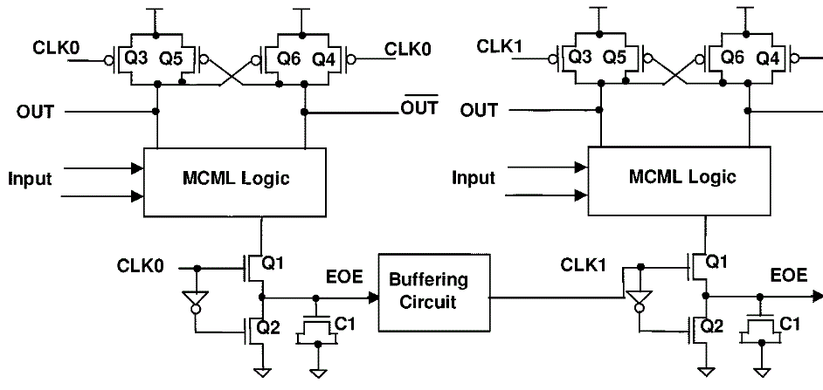
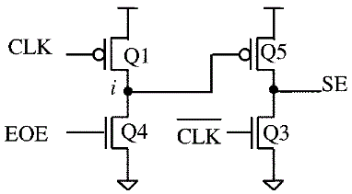
Dynamic CML. 1/2
MOS CML Logic
Read further: http://www.ece.ncsu.edu/asic/ece733/papers/Logic/DynamicCML.pdf

Slide 91
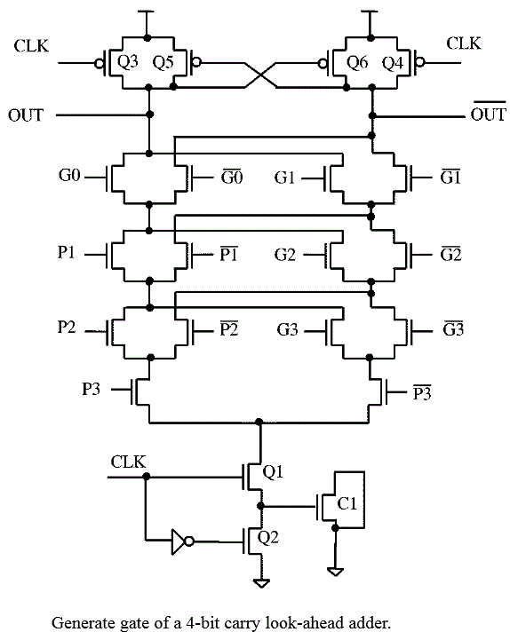
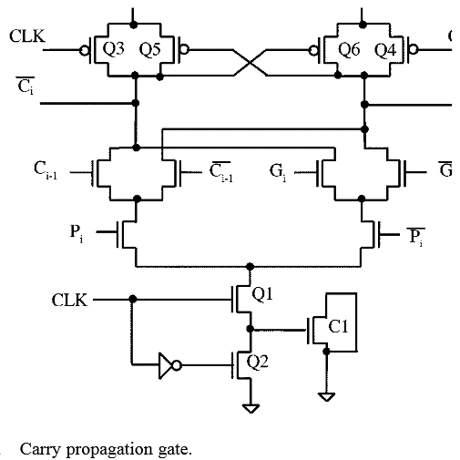
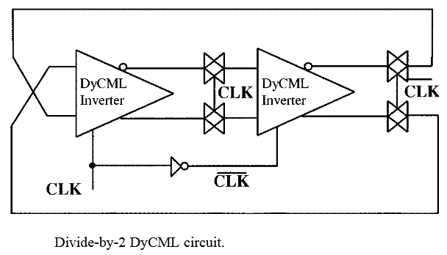
DynCML. 2/2
Very Fast
Simple
Small
Low power
Domino
+3 Tx stack

Slide 92
Styles Conclusions
There are other static styles besides CMOS. Normally they are faster or save area at cost of reliability or produce complementary signals. May be other styles that save power at the cost of speed.
Proper sizing is required of gates involved in a node with feedback.
Dynamic styles require clock signal(s). As voltage levels are stored in high impedance nodes subject to leakage, they require refresh or precharge.
Timing and integrity issues for all nodes are challenges for Dynamic design.

Slide 93
First Evaluation
You will require 3 sheets, pencil and/or pens of different colors, no books, no notebooks, and no calculator or electronic devices.
Be prepared to implement any decoder and/or 4-bit full adder with carry look-ahead in any logic style, static or dynamic.
You must demonstrate proficiency handling truth tables, logic equations, transformations, max and min terms manipulation, (Karnaugh) K-Maps and schematics.
You must be able to:
- answer direct questions about variations, logic styles comparisons and design issues.
- size any gate as a given inverter
- calculate Weq for any given N or P network
- calculate RC Elmore delays in a non-uniform RC tree.
- look for common Euler path for a given logic function or schematic.
- draw any layout using the stick technique.
You will have two hour for the evaluation.

