Slide 1

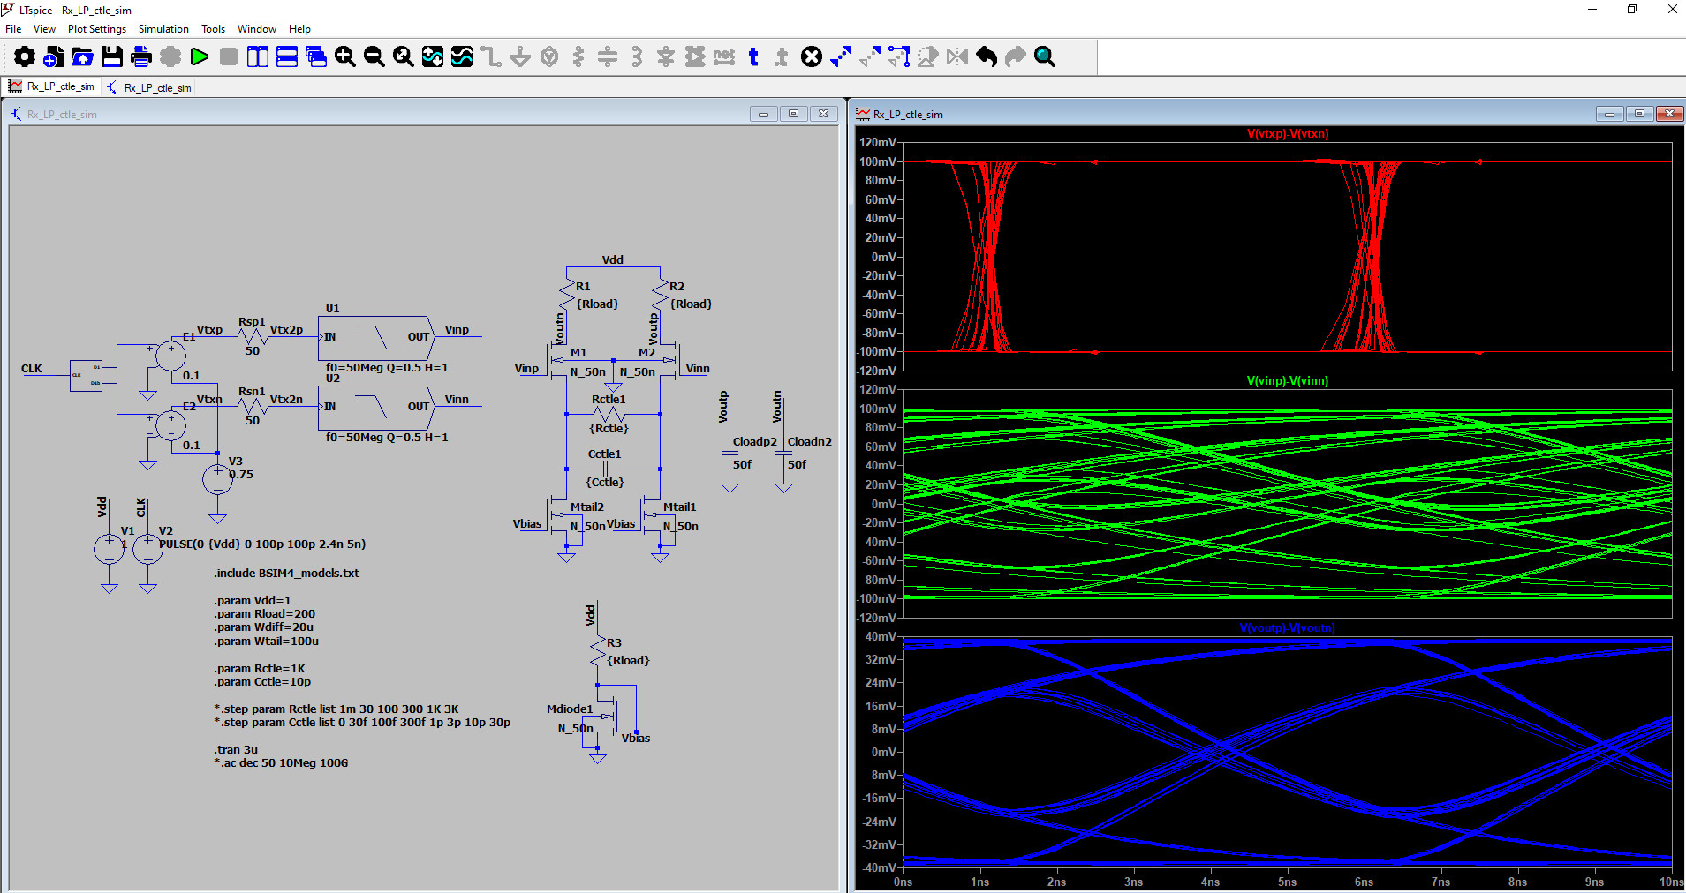
Analog Training 101
5. Sequential
Manuel Salim
Circuify Semiconductors
April 4th, 2025
manuel.salim@circuify.com
msalimm@hotmail.com

Slide 2
Overview
Latch and Flip-Flop design
Synchronization methods
Wave-pipelining
Systolic arrays

Slide 3
Introduction
Inputs
Combinational
Logic
Outputs
Current State
Next State
Q
D
Registers
(cd=contamination delay)
Clk
Clk
tsetup
thold
t
D
DATA
STABLE
tc-q
t
Q
DATA
STABLE
t
Slide <number>

Slide 4
Memory elements
Foreground (Registers) VS Background (RAM)
Static VS Dynamic
W3
W3
W2
W2
W1
W1
Bit 1
Bit 1
Bit 2
Bit 2
Bit 1
Bit 1
Bit 2
Bit 2
SRAM
DRAM
Read further:Low-cost embedded NVM for power management
Slide <number>

Slide 5
Bistability
Latches (Level-sensitive/Transparency)
Registers (Edge-triggered)
Flip-flops (Bistable cross coupled gates)
Vo1 = Vi2
Vo1
Vi2
Vi1 = Vo2
A
Vo1 = Vi2
C
Vi1
Vo2
B
Cut or Overpower the feedback loop
Vi1 = Vo2
Slide <number>

Slide 6
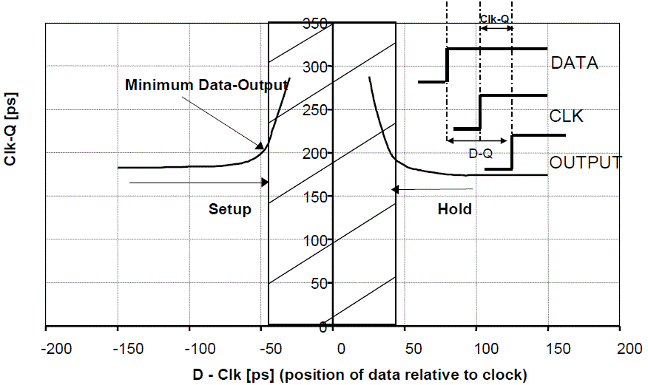
Delay VS Setup and Hold times
Read further:
http://courses.ece.ubc.ca/579/clockflop.pdf
http://nanocad.ee.ucla.edu/pub/Main/SnippetTutorial/calII.pdf
http://www.aw-bc.com/info/weste/assets/downloads/ch7.pdf
http://camars.kaist.ac.kr/~maeng/cs211/digital09/ch7.pdf
Check ICLabClasses Class07-Sequ.pdf slides 27-37

Slide 7
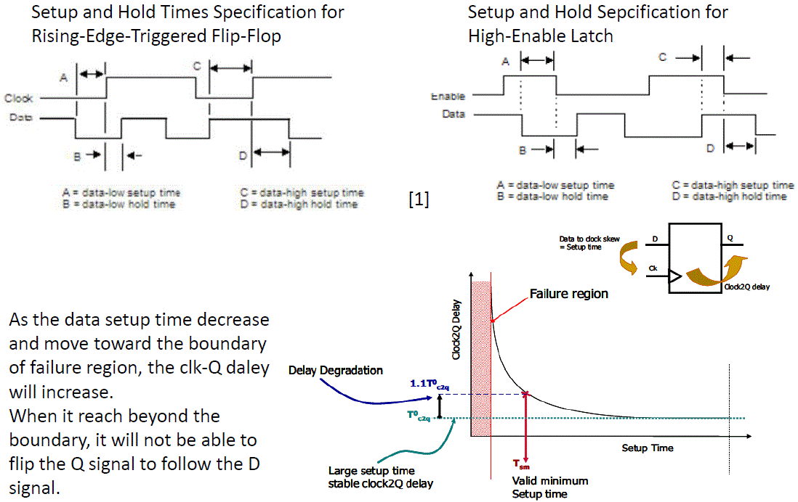
Setup and Hold Specifications

Slide 8
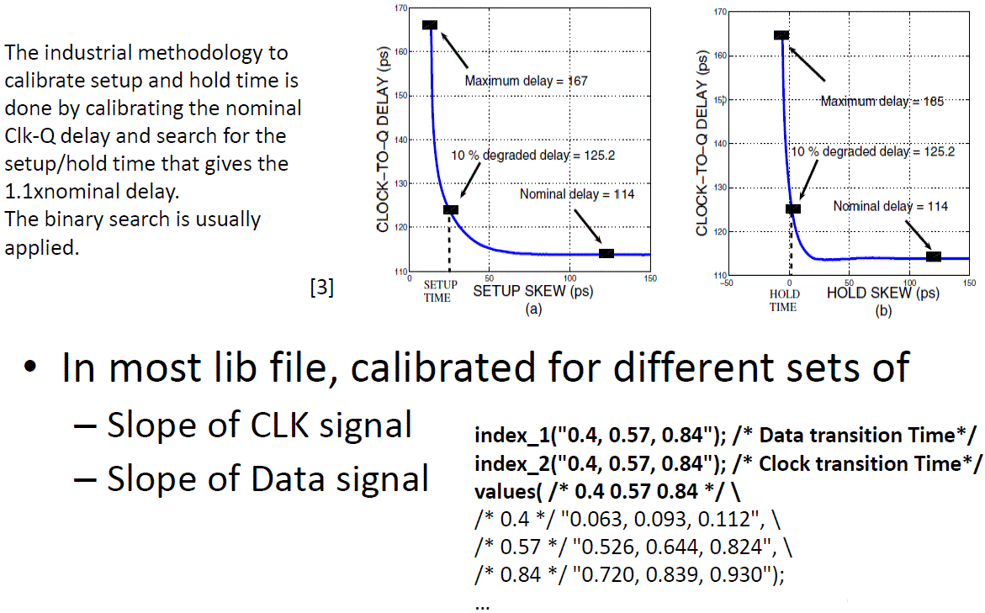
Setup and Hold Constraints

Slide 9
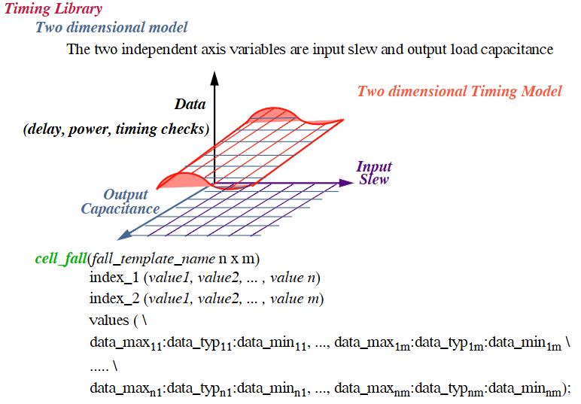
Liberty 2D tables
Read further: Liberty Timing File (LIB) in VLSI Design
Liberty Timing File (.lib) in VLSI Design & Verification Flow - Bale Tulu Kalpuga

Slide 10
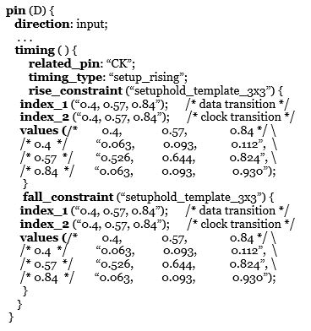
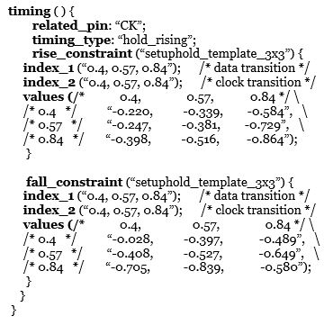
Liberty Setup and Hold
Variable 2 Index 2
Clock
Variable 1 Index 1
Data
Clk
trise=0.4
trise=0.4
Clk
trise=0.84
trise=0.84
D
tsetup=0.063
D
tsetup=0.930
t
t
Read further: https://www.physicaldesign4u.com/2020/05/how-setup-and-hold-checks-are-defined.html

Slide 11
Multiplexer-based Latches
Negative Latch
Positive Latch
1
0
Q
0
1
Q
D
D
Clk
Clk
Clk
Clk
Qb
D
Q
D
Q
Clk
Clk
Clk
2-φ Nonoverlapping clock
may be desired
Slide <number>

Slide 12
2-φ Nonoverlapping clock
Inv
Phi1
Clk
Phi2
Buff
Clk Inv Buff Phi1 Phi2
0 1 0 0 1
0→1 1→0 0→1 0 1
1 0 1 0→0 1→0 Nonoverlapping by t_{pNOR}
1 0 1 0→1 0
1 0 1 1 0
1→0 0→1 1→0 1 0
0 1 0 1→0 0→0 Nonoverlapping by t_{pNOR}
0 1 0 0 0→1
0 1 0 0 1
0’s arrive first. For NAND based ckt, 1’s arrive first.

Slide 13
Master-slave Tg
Slave
Master
0
1
Q
Clk
Clk
1
0
QM
D
QM
D
Q
Clk
Clk
Clk
Clk
Clk
Clk
Clk
Clk
D
D
QM
QM
Q
Q
t
t

Slide 14
Master-slave C²MOS
Clk
Clk
QM
D
Q
Clk
Clk
Clk
Clk
Clk
Clk

Slide 15
PowerPC Flip-Flop
Clk
Clk
D
QM
Q
Clk
Clk
Clk
Clk
Clk
Clk

Slide 16
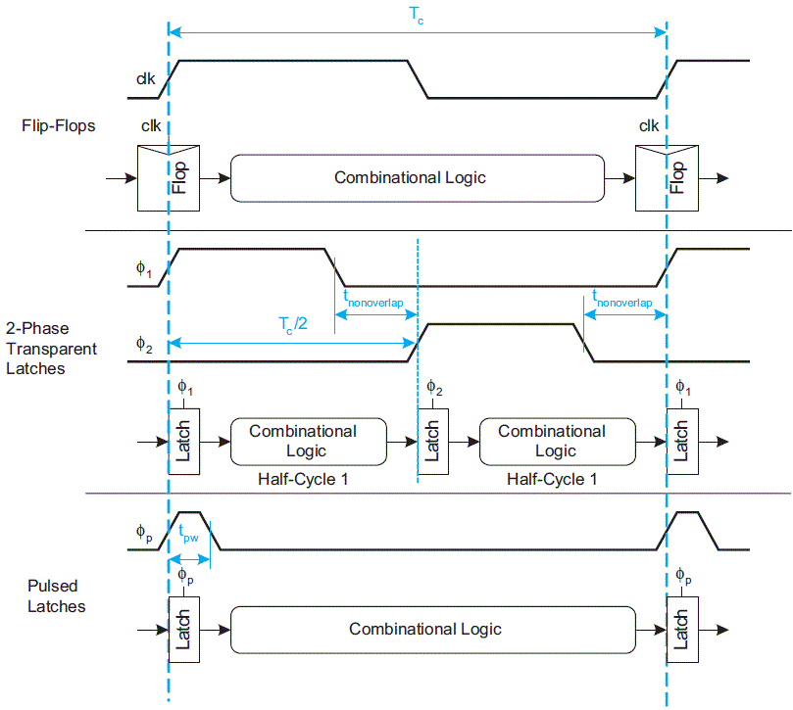
Static Sequencing Methods

Slide 17
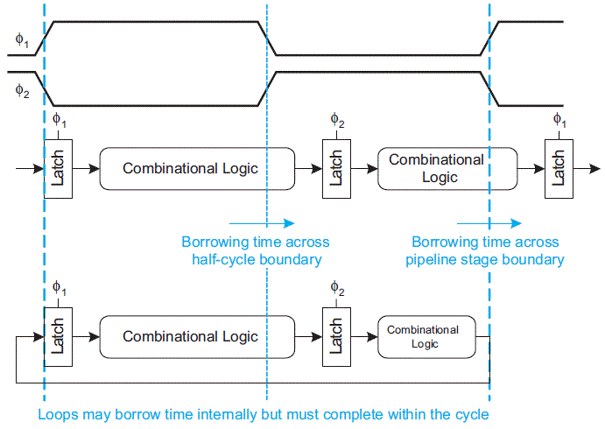
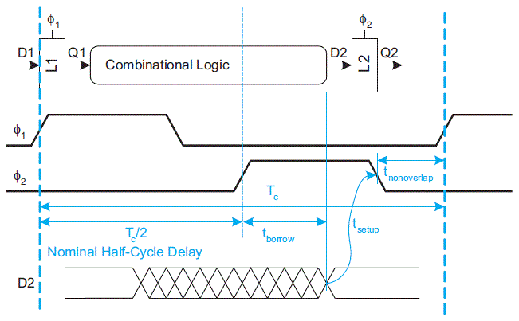

Time borrowing
When a system uses transparent latches, if one half-cycle or stage of a pipeline has too muxh logic, it can borrow time into the next half-cycle or stage.
Time borrowing can accumulate across multiple cycles.
However, in systems with feedback, the long delays must be balanced by shorter delays so that the overall loop completes in the time available
Slide <number>

Slide 18
Static SR FFs
S
Qb
S
Q
R
Q
Qb
R
2
2
Qb
Q
1
1
S | R | Q | Qb
0 | 0 | Q | Qb
0 | 1 | 0 | 1
1 | 0 | 1 | 0
1 | 1 | 0 | 0
S | R | Q | Qb
0 | 0 | 1 | 1
0 | 1 | 1 | 0
1 | 0 | 0 | 1
1 | 1 | Q | Qb
Clk
2
2
Clk
S
2
2
R
Ratioed CMOS SR latch
Slide <number>

Slide 19
Gate level Clocked
S
S
S
Qb
Q
Q
Clk
Clk
Clk
Q
Qb
Qb
R
R
R
Nor-based SR latch
Nand-based SR latch with active low inputs
Nand-based SR latch with active high inputs
D
Qb
J
S
J
S
Qb
Q
Clk
Clk
Clk
Q
Q
Qb
K
R
K
R
Nor-based D latch
Nor-based JK latch
All-Nand JK latch
http://eee.guc.edu.eg/Courses/Electronics/ELCT701%20Integrated%20Circuits%20Design/lec/ELCT701_lecture8.pdf

Slide 20
Dynamic Latches and Registers
Clk
Clk
D
Q
Clk
Clk
Dynamic edge-triggered register
Clk
Clkb
QM
Clk
D
Q
D
Q
Clkb
Clk
Clk
Pseudostatic dynamic latch
C²MOS master-slave positive edge-triggered register
Slide <number>

Slide 21
C²MOS-based dual-edge triggered register
n₁
Clk
Clkb
Clk
Clkb
QM1
QM2
D
Q
D
Clkb
Clk
Clkb
Clk
n₂
Q
n₁
Clkb
Clk
Clkb
Clk
QM2
QM1
D
Q
Clk
Clkb
Clk
Clkb
n₂
Slide <number>

Slide 22
TSPC Latches
Clk
Clk
QM1
QM1
D
Q
D
Q
Clk
Clk
A
B
QM1
Q
Clk
Clk
A
B
Slide <number>

Slide 23
Simplified TSPC Latches (split output)
A
Clk
D
Q
D
Q
Clk
A
Clk
Y
Positive edge-triggered TSPC register
Be sure node Y discharge faster than Qb or a discharge glitch at Qb will be larger
Clk
Qb
Q
X
D
Clk
Clk

Slide 24
Pulse registers
Clk
ClkG
QM1
D
Q
ClkG
ClkG
Clk
t
ClkG
t
Propagation Delay: Two Inverter Delay.
Set-up Time: Nil.
Hold Time: Glitch Time.
Disadvantage: Substantial increase in Verification complexity.
Read further: PULSE REGISTERS Advanced VLSI Design: Dynamic Registers - YouTube

Slide 25
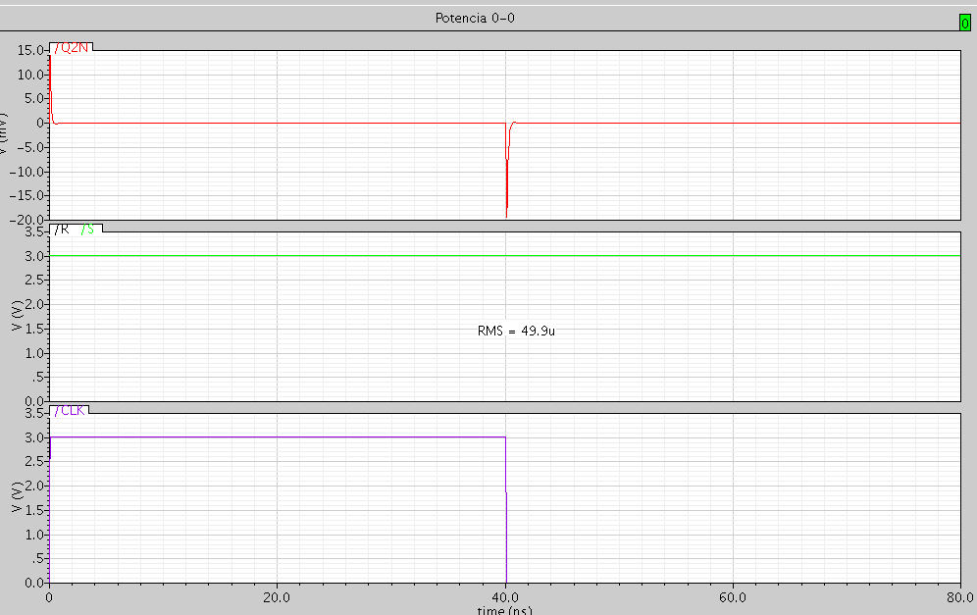
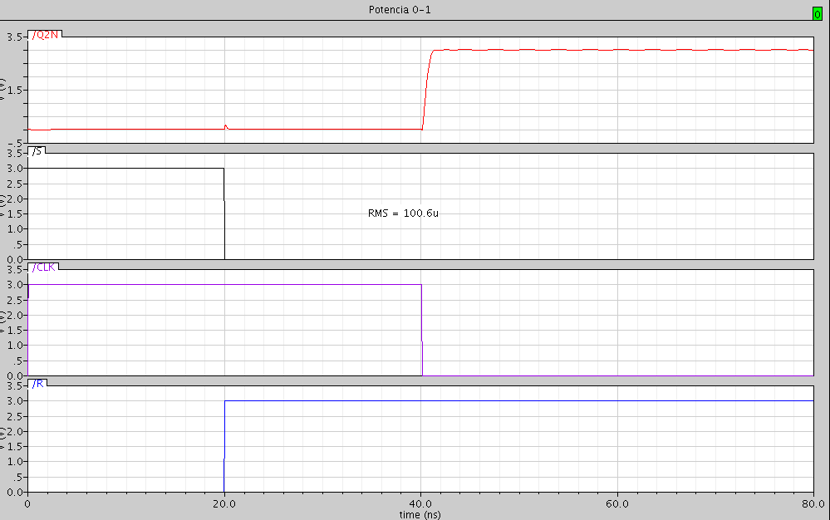
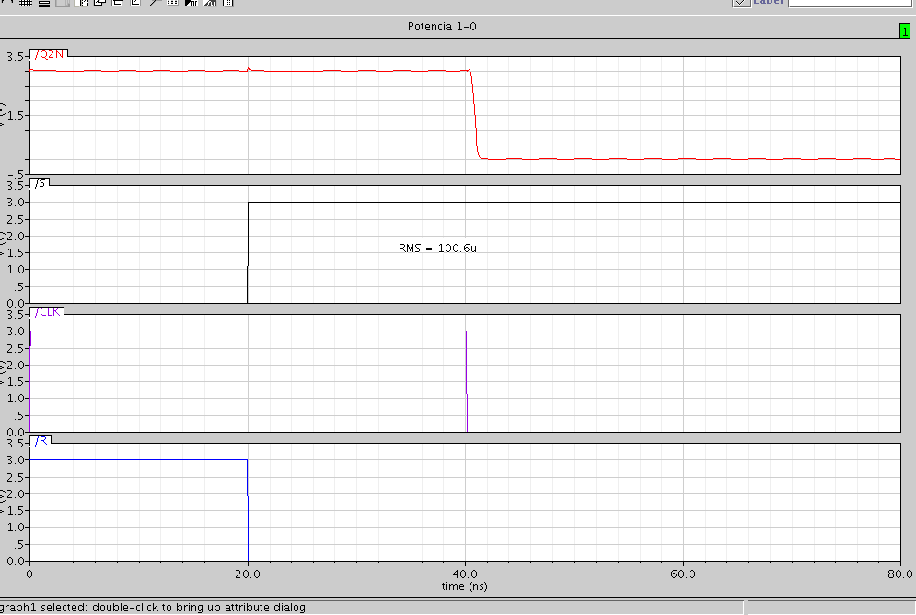

Flop Power Tests 1
p₀₋₁
p₀₋₀
0
1
p₁₋₁
p₁₋₀
Vojin G. Oklobdzija, Vladimir M. Stojanovic, Dejan M. Markovic, Nikola M. Nedovic, “System Clocking”
Slide <number>

Slide 26
Flop Power Tests 2
C
C
D
D
Ql
Ql
Qf
Qf
C
C
D
D
Ql
Ql
Qf
Qf
Test 1 and 2: high clock activity, no data and output activity.
Test 3 and 4: high data activity, no clock and output activity.
Seongmoo Heo et al., “Activity-Sensitive Flip-Flop and Latch Selection for Reduced Energy”, MIT - Laboratory for Computer Science http://www.cag.lcs.mit.edu/scale, ARVLSI, 2001.
Slide <number>

Slide 27
Flop Power Tests 3
C
C
D
D
Ql
Ql
Qf
Qf
C
C
D
D
Ql
Ql
Qf
Qf
Test 5, 6 and 7: high clock, data and output activity (Traditional).
Test 8: high clock and data activity, no output activity.
Slide <number>

Slide 28
Practice 6
Team | Latch | Flop
1 | Nor-based SR | C²MOS
2 | Nand-based SR active low | PowerPC
3 | Nand-based SR active high | PPCFF
4 | Nor-based D | SSAFF
5 | Nor-based JK | SAFF
6 | All-Nand JK | SArm110
6.1 Read Oklobdzija, Nikolic and Heo papers.
6.2 Characterize a latch and a Flip-flop. Size as usual and resize if necessary. Measure t_{setup}, t_{hold}, t_{c-q}, ramps and RMS power. Make stick diagram and estimate area.
Slide <number>

Slide 29
Conclusion
Latch is transparent in a clock semicycle. Flops have Master-Slave configuration that avoid transparency.
Flip-Flops Figures: Setup and Hold times, Clk-Q delay, Jitter, Max freq, Power consumption, Tx count and Area.
There are a lot of types of FFs around. The most simple structures are the fastest. Others sacrifice area and/or speed for power saving.
Almost every node have feedback or gating, then sizing is affected by timing (clock and/or signal arriving) and must assure switching.
Signals may look bad around Tgs or C²MOS when switching.

Slide 30
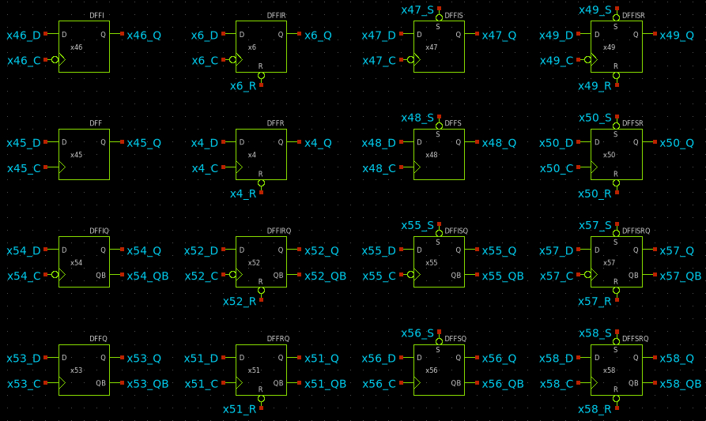
OpenTools Generic set FFs
I-Cb
Reset
Set
SR
I-Cb Qb
Q-Qb
Most are named DFF~
Q and C(Clock) pins are mandatory.
I/Q suffix for Cb/Qb pin presence.
Set/Reset shown. SD/E not shown.

Slide 31
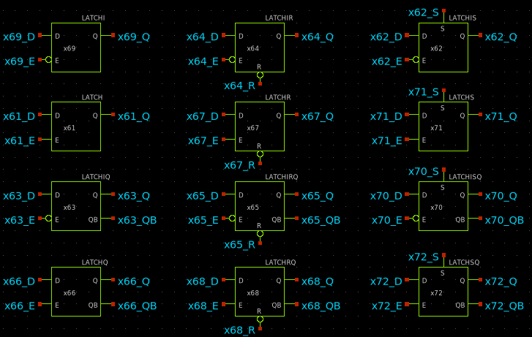
OpenTools Generic set Latches
Reset
Set
I-Eb
I-Eb Qb
Q-Qb
Most are named LATCH~
Q and E(Enable) pins are mandatory.
I/Q suffix for Eb/Qb pin presence.
S/R for Set/Reset.

Slide 32
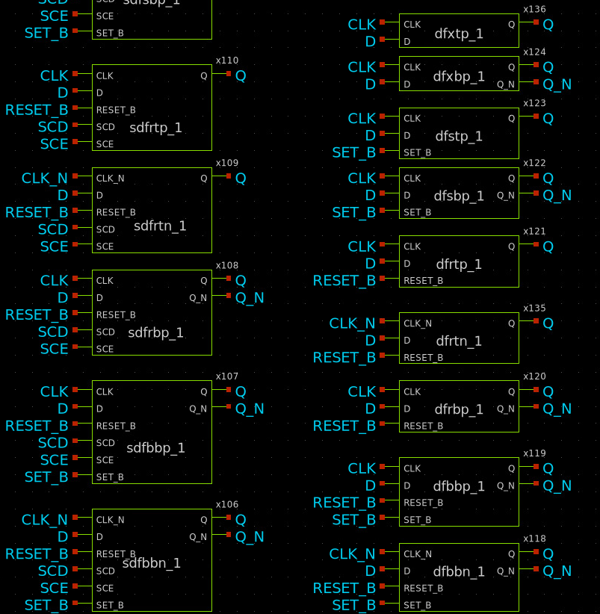
Skywater130 FFs
Dfxtp_1 is the basic DFF.
DL prefix for Latch (not shown).
CLK changes into GATE.
x after Df stands for no S/R, S for Set, R for Reset and B for both.
t stands for Q and b for both Q and Q_N presence.
p stands for positive edge or Clk. N for neg edge or CLK_N.
_1 suffix stands for strength of 1.
[S][e]d[f/l] prefix for presence of [DE]/SCD/SCE inputs.

Slide 33
Circuits with FlipFlops.
D
D
D
D
D
D
D
D
8bit Register
Parallel Load/Input and Paralel output (PIPO)
CK
CK
CK
CK
CK
CK
CK
CK
Q
Q
Q
Q
Q
Q
Q
Q
D
D
D
D
D
D
D
D
8bit Shift Register with option for Parallel Load and left or right shift or PISO.
Red connection allows circular shift or barrel (barrel shifter).
CK
M
CK
M
CK
M
CK
M
CK
M
CK
M
CK
M
CK
M
R Q L
R Q L
R Q L
R Q L
R Q L
R Q L
R Q L
R Q L
Shift can be done for more than one bit in a clock cycle but more muxing is required.
Read further: http://en.wikipedia.org/wiki/Barrel_shifter http://en.wikipedia.org/wiki/Shift_register
Slide <number>

Slide 34
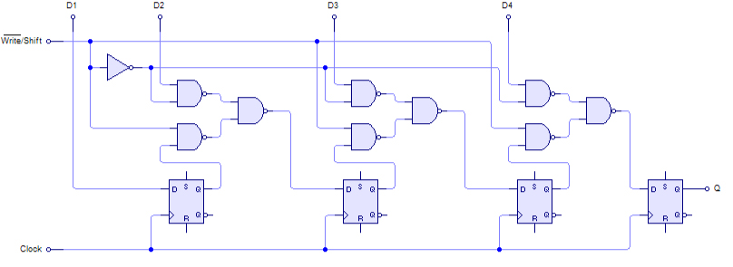
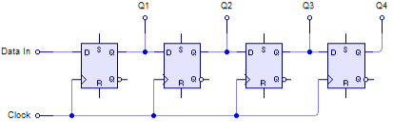
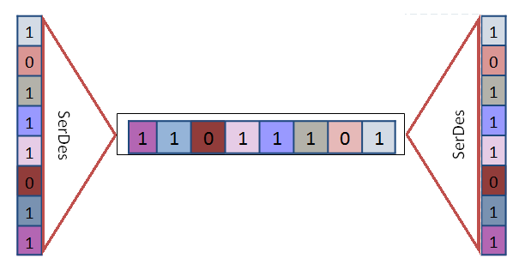
PISO/SIPO
Parallel Input Serial Output
Serial Input Parallel Output
Read further:
http://en.wikipedia.org/wiki/Shift_register
http://en.wikipedia.org/wiki/SerDes

Slide 35
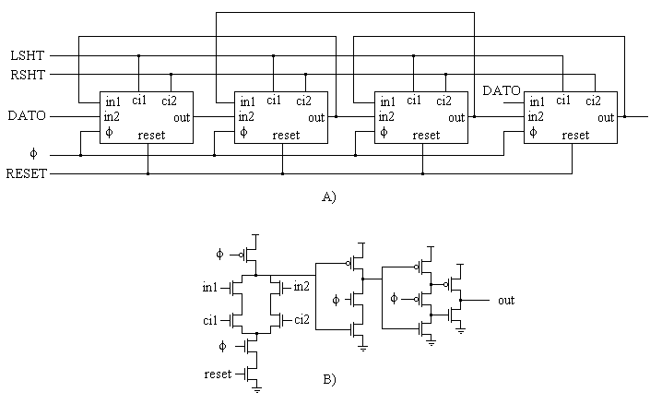
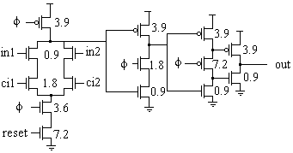
Circular/Barrel Shifter
Read further:
R. Pereira, J. A. Michell. And J. M. Solana. “Fully Pipelined TSPC Barrel Shifter for High-Speed Applications.” IEEE JSSC Vol. 30, No. 6, June 1995. Pp. 686-690.

Slide 36
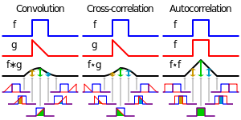

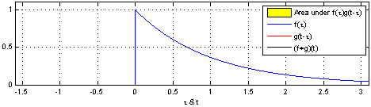
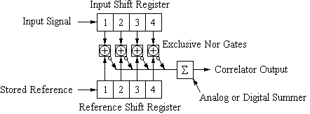
Correlators/Convolvers.
Applications: Detection and correction of errors, Delay determination (Radar), Info muxing, Pattern recognition, Synchonization (TV), Arrhytmia diagnosis.
Read further:
http://en.wikipedia.org/wiki/Convolution
Alba, Salim “Correlacionador/Convolucionador de 4 bits utilizando lógica TSPC a 400 MHz” 0.5um HP INAOE 1999 @ Reading material of course site.

Slide 37
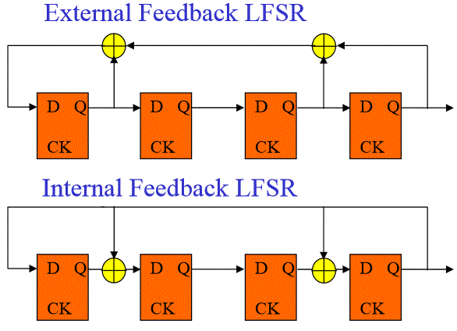
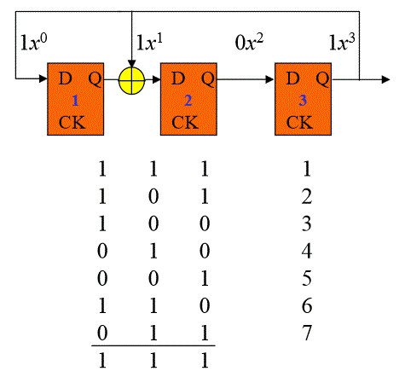
Linear Feedback Shift Register
Sequence example
(Faster)
4-1’s 3-0’s ☹
But check this
Read further:
http://en.wikipedia.org/wiki/Linear_feedback_shift_register
http://www.eng.auburn.edu/~strouce/class/elec6250/LFSRs.pdf
https://www.princeton.edu/~achaney/tmve/wiki100k/docs/Linear_feedback_shift_register.html

Slide 38
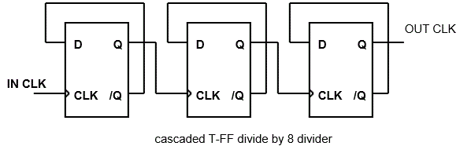
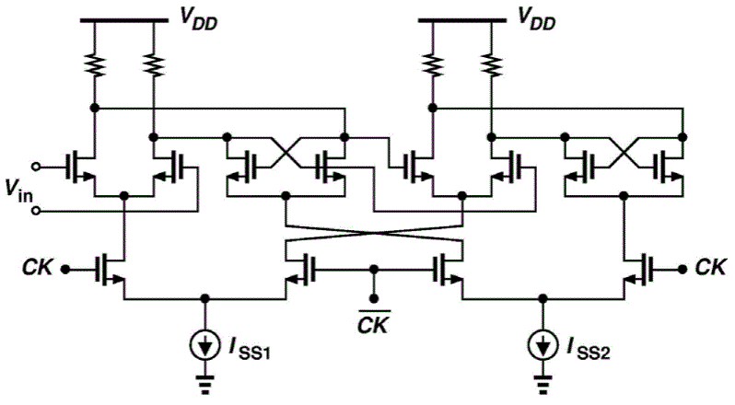
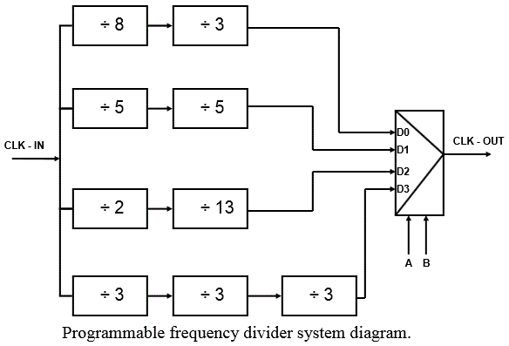
Frequency Dividers
SuperDynamic CML Flip-Flop
Read further:
http://www.mwit.ac.th/~physicslab/hbase/electronic/bincount.html
https://smartech.gatech.edu/bitstream/handle/1853/24610/barale_francesco_200808_ms.pdf
http://cc.ee.ntu.edu.tw/~jrilee/course/COMMIC08/CommIC_07.pdf

Slide 39
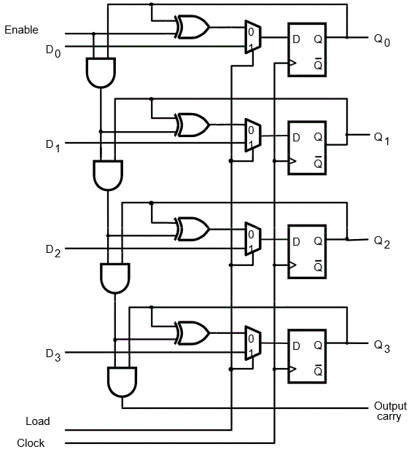
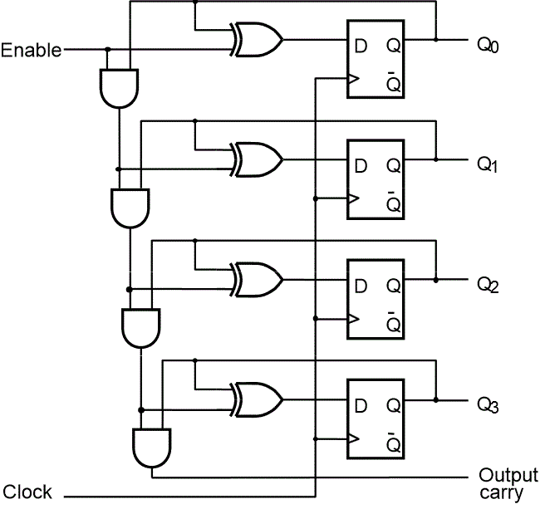
4-bit Counter with D FFs
(With Parallel load capability)
Read further: http://camars.kaist.ac.kr/~maeng/cs211/digital09/ch7.pdf

Slide 40
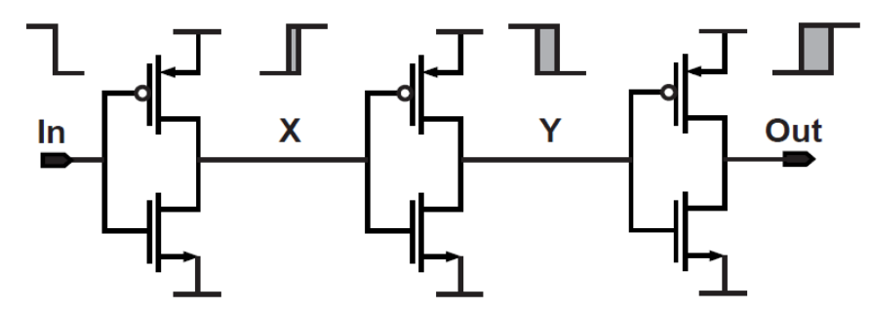
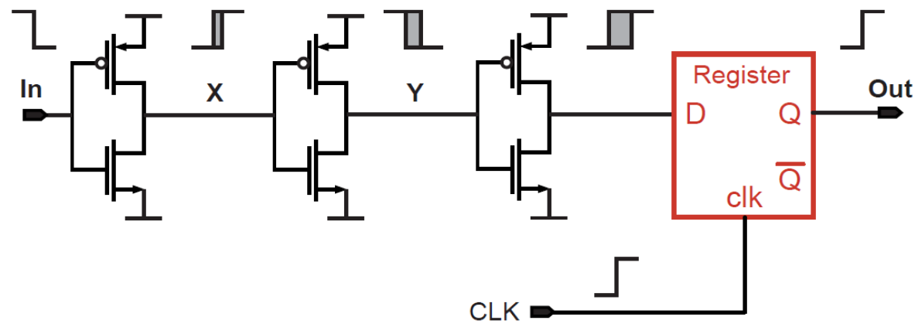
Jitter in Asynchronous vs Synchronous Dividers
Asynchronous
Jitter accumulates with the clock-to-Q delays through the divider.
Extra divider delay can also degrade PLL phase margin.
Divider output is “sampled” with high frequency clock.
Jitter on divider clock is similar to VCO output.
Minimal divider delay.
Synchronous

Slide 41
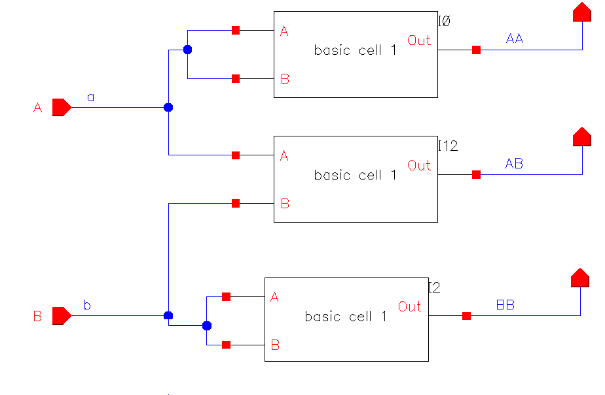
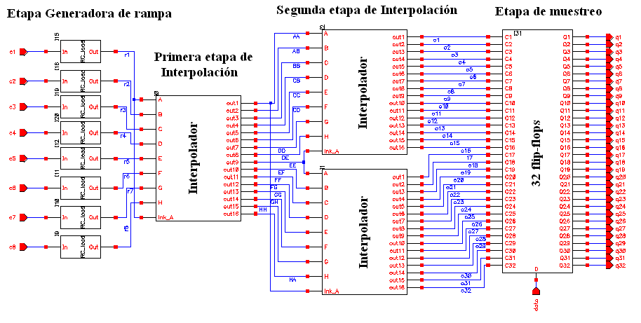
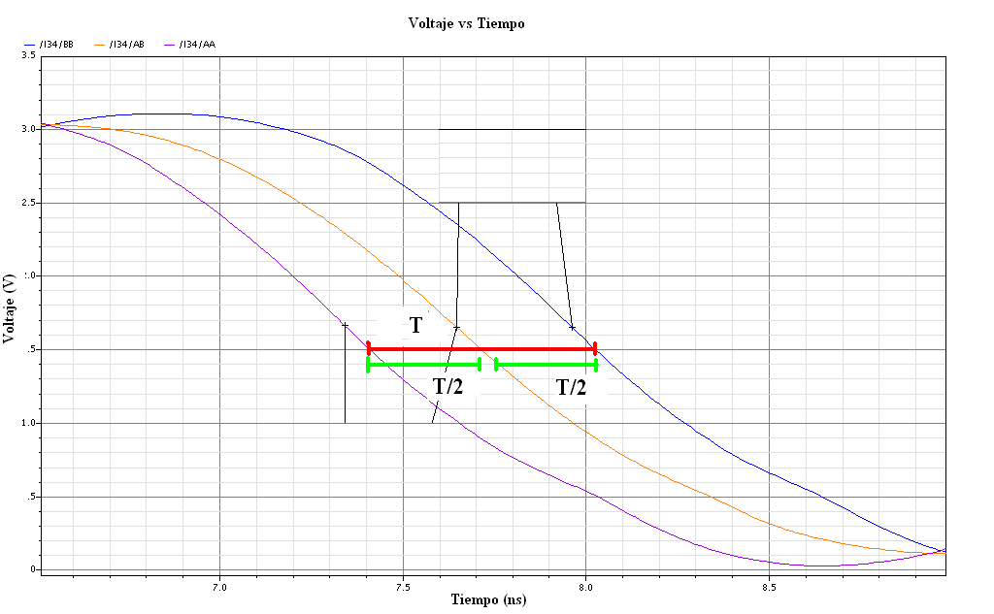
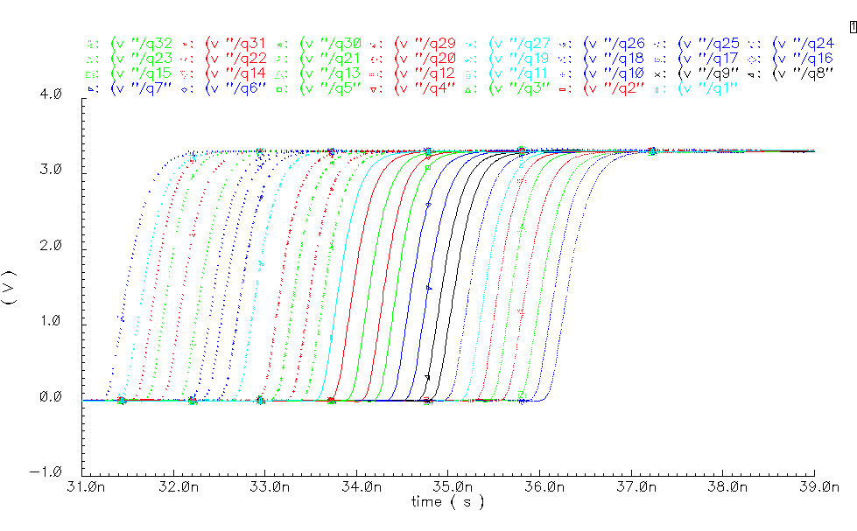
Sampling (and Interpolating)
Read further:
-Alfonso Gómez, Daniel Domínguez y Bernardo Malta “Circuito Muestreador con interpolación de 8 a 32 señales de reloj” DisDig2 project Jan 2014.
-Lixing Yang and Jiren Yuan, “An Arbitrarily Skewable Multiphase Clock Generator Combining Direct Interpolation with Phase Error Average” ISCAS’03 Volume 1, Issue , 25-28 May 2003 Page(s): I-645 - I-648 vol.1

Slide 42
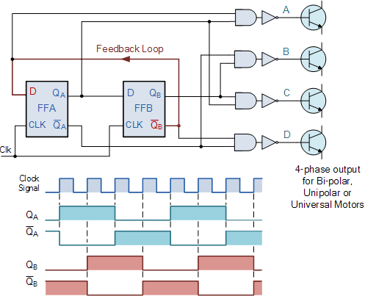
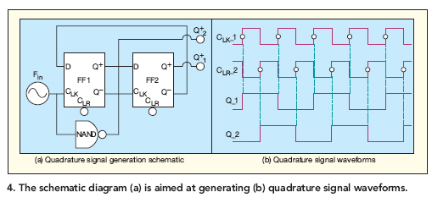
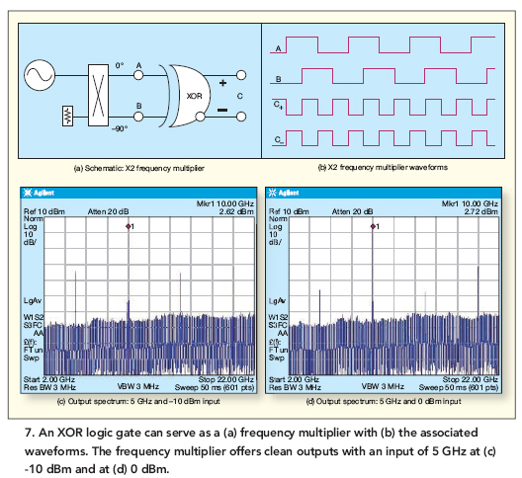
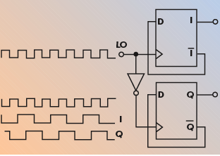
Quadrature, IQ
Original Schemaic on top have an error. Red cut fix it.
Clkb / XOR generates 2xfreq for/from IQ. Similar happens in Serialization/Deserialization and Half rate Tx.
Read further: http://en.wikipedia.org/wiki/Quadrature_phase

Slide 43
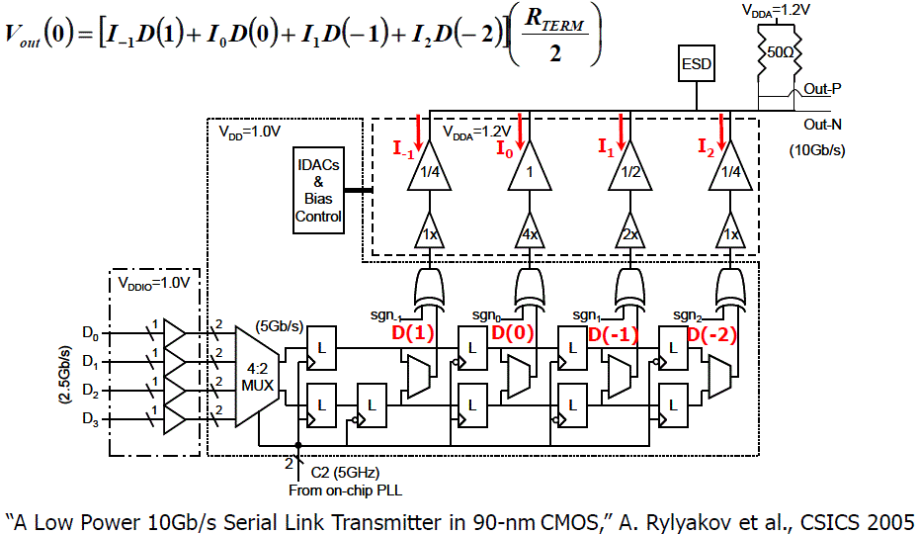
Serialization

Slide 44
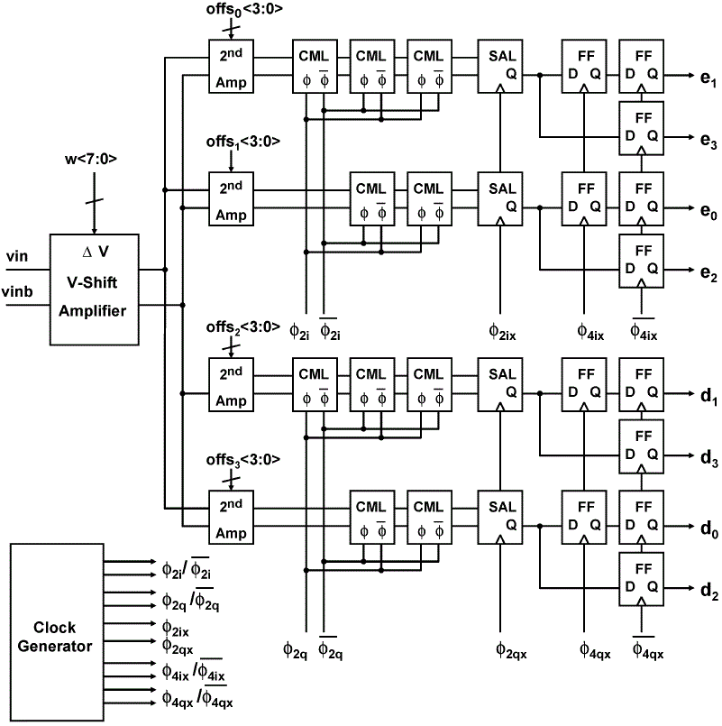
DeSerialization
Toifl, Menolfi et al “A 22-Gb/s PAM-4 Receiver in 90nm CMOS SOI Technology” IEEE JSSC Vol.41 No.4 April 2006 pp954-965

Slide 45
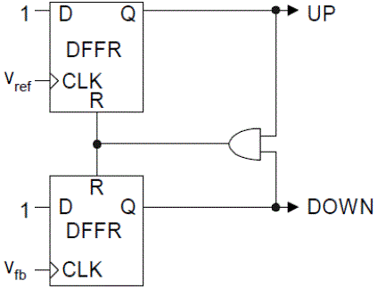
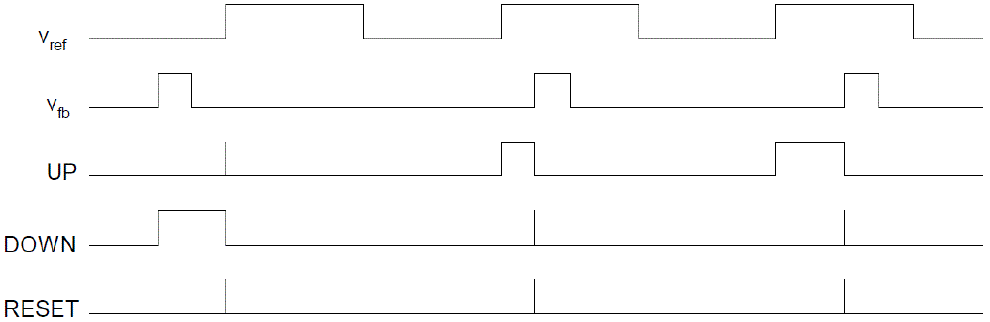
Phase Frequency Detector (PFD).
Phase Detector (PD) detects phase difference between feedback and reference clocks in PLLs.
Linear PD provide sign and magnitude (Hogge), Non-linear PD provide only sign (Alexander, Muller)
PFD allows wide freq locking range.
Edge-triggered results in duty cycle insensitivity.
Phase detector range 4π or ±2π.
Small error results in PD “dead zone”. Just add delay here.
Read further: Sam Palermo, TAMU, HSLCAS course ee720, lecture11, pp58-68

Slide 46
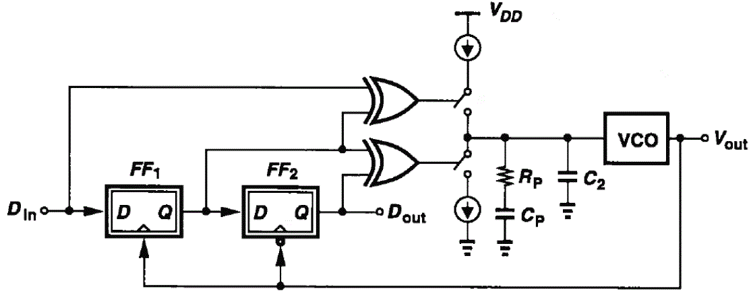
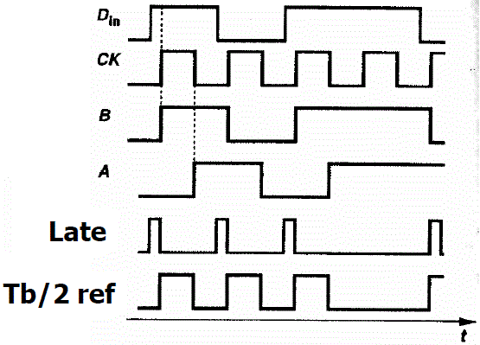
Hogge Phase Detector
Late
Tb/2
ref
CK
Linear Phase Detector (PD).
If CK is early, Late will be shorter than Tb/2 and vice-versa.
XOR outputs can directly drive the charge pump. Need a relatively high-speed charge pump.
Read further: Sam Palermo, TAMU, HSLCAS course ee720, lecture12, pp8-15

Slide 47
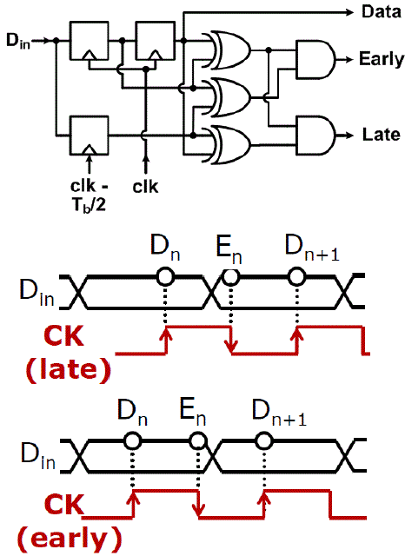
Alexander / 2x-Oversampled / Bang-bang PD
Most used CDR phase detector (PD).
Non-Linear (Binary) “Bang-Bang” PD.
PD uses 2 data samples and one “edge” sample.
If “edge” sample is same as 2nd bit (or different from 1st), then the clk is “late”.
If “edge” sample is same as 1st bit (or different from 2nd), then the clk is “early”.

Slide 48
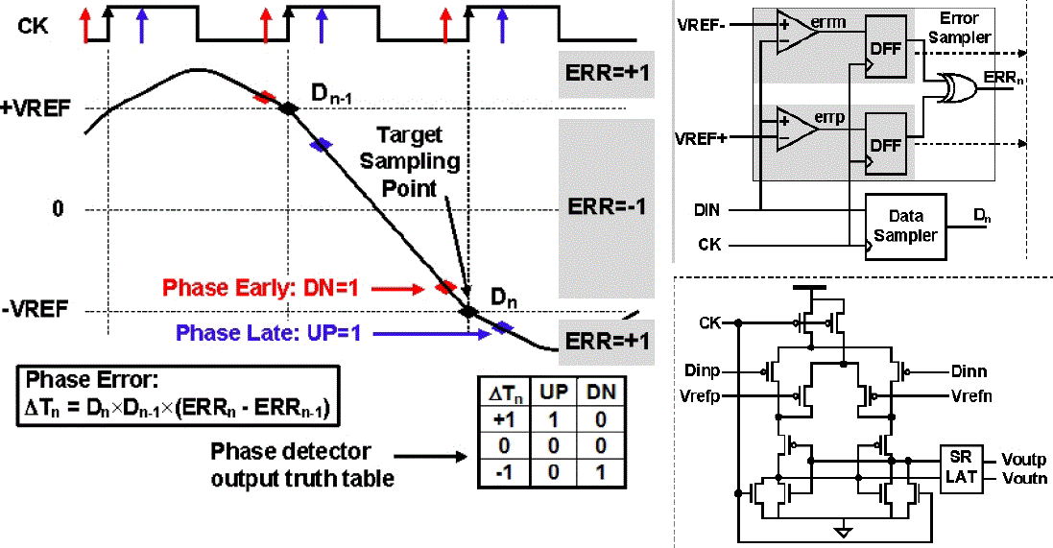
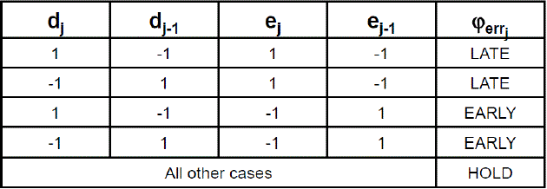
Muller-Muller Baud-Rate PD
Also commonly used as PD.
Only requires one sample clock per symbol (bit).
Attempting to find “V_{M±}“ with ±VREFs.

Slide 49
Synchronization Methods
Data Synchronization is related to data/file storage. There are tools available for file synchronization, version control (CVS, Subversion, etc.), distributed filesystems (Coda, etc.), and mirroring (rsync, etc.). Only version control and file synchronization tools can deal with modifications to more than one copy of the files.
Clock synchronization is a problem from computer science and engineering which deals with the idea that internal clocks of several computers may differ(clock drift). In serial communication, "clock synchronization" is getting one metronome-like clock signal to pulse at the same frequency as another one – frequency synchronization (plesiochronous or isochronous operation), as opposed to full phase synchronization (synchronous operation). Such "clock synchronization" is used in synchronization in telecommunications and automatic baud rate detection.
Read further:
http://en.wikipedia.org/wiki/Data_synchronization
http://en.wikipedia.org/wiki/Clock_synchronization
http://en.wikipedia.org/wiki/Clock_signal

Slide 50
Synchronous vs Asynchronous
In a synchronous system, operations are coordinated under the centralized control of a fixed-rate clock signal or several clocks. An asynchronous digital system, in contrast, has no global clock: instead, it operates under distributed control, with concurrent hardware components communicating and synchronizing on channels.
 | Advantages | Disadvantages
Asyn | Simple and Cheap (require less hardware) Set-up is faster than other transmissions, so well suited for applications where messages are generated at irregular intervals and/or the speed depends on different applications. | Large relative overhead, a high proportion of the transmitted bits are uniquely for control purposes and thus carry no useful information
Syn | Lower overhead and thus, greater throughput | Slightly more complex Hardware is more expensive
Read further:
http://en.wikipedia.org/wiki/Comparison_of_synchronous_and_asynchronous_signalling
http://en.wikipedia.org/wiki/Plesiochronous_system
http://en.wikipedia.org/wiki/Mesochronous_network
http://en.wikipedia.org/wiki/Perfect_clock_gating

Slide 51

Serial / Parallel / Pipeline
Serial
4 loads x 3 process = 12 T
Parallel
3 process = 3 T
Pipeline
3 latency + 3 more loads = 6 T
(IF = Instruction Fetch, ID = Instruction Decode, EX = Execute, MEM = Memory access, WB = Register write back)
Read further:
http://en.wikipedia.org/wiki/Parallel_computing
http://en.wikipedia.org/wiki/Pipeline
http://en.wikipedia.org/wiki/Pipeline_%28computing%29
http://en.wikipedia.org/wiki/Classic_RISC_pipeline
Slide <number>

Slide 52


Wave-Pipelining
Wave-pipelining is a method of high-performance circuit design which implements pipelining in logic without the use of intermediate latches or registers [Burlesson 1998].
Wave pipelining is a pipeline processing technique that can increase the throughput without increasing internal storage space and power consumption. Multiple data waves can propagate through the wave pipeline from the primary inputs to the primary outputs simultaneously without the use of intermediate latches or registers [Ozgun 2004].
Read further:
https://www.cs.princeton.edu/courses/archive/fall01/cs597a/wave.pdf
http://link.springer.com/article/10.1007%2FBF02409400#page-1
http://soar.wichita.edu/bitstream/handle/10057/383/t06064.pdf?sequence=3

Slide 53

Systolic Arrays
In computer architecture, a systolic array is a pipe network arrangement of processing units called cells or Data processing units (DPUs).
DPUs are similar to CPUs, (except for the usual lack of a program counter, since operation is transport-triggered).
It is a specialized form of parallel computing, where cells compute data and store it independently of each other.
Each cell shares the information with its
neighbors immediately after processing.
Examples of a systolic algorithm might be
designed for matrix multiplication and
LU and Cholesky decompositions.
Read further: http://en.wikipedia.org/wiki/Systolic_array

Slide 54
Systolic Arrays. Cont.
Only applications with regular data dependencies can be implemented on classical systolic arrays.
Like SIMD machines, clocked systolic arrays compute in "lock-step" with each processor undertaking alternate compute | communicate phases. But systolic arrays with asynchronous handshake between DPUs are called wavefront arrays. One well-known systolic array is Carnegie Mellon University's iWarp processor, which has been manufactured by Intel.
Cisco PXF network processor is internally organized as systolic array.
Pros: Faster Scalable;
Cons:
  Expensive
  Highly specialized for particular applications
  Difficult to build.

Slide 55
Conclusion
FFs allow construction of several circuits as Registers, Counters, Dividers, SerDes, Samplers and Phase Detectors. All very useful and interesting.
There are different synchronization methods, schemes and architectures; To be selected depending on the application, specs, resources and tools available.
Asynchronous can consume 40% less power vs Synchronous but Flow/Verification for Synch is easier and more available.
Wave-pipelining can increase throughput without increasing power nor area but design/verification is more complex.
Systolic arrays are very powerful “but” mostly for matrix operations (Image, Network, Scientific, etc).

Slide 56
Practice 7
Team | Ckt with FF. ~4bits. | Phase Detector
Tx | Serialization | Alexander
Rx | De-serialization | PFD
Clk | TSPC/CMOS Barrel Shifter | Hogge
Verify functionaliy of assigned ckts. Use defaults as so far (100MHz, 50fF, 3/1.5um sizing) if possible. No need to measure anything.
7.1 Verify functionality of Ckt with FF. Be warned SerDes clocks may need to be in quadrature and TSPC sizing can de different than CMOS.
7.2 Verify functionality of Phase Detector.
7.3 Estimate floorplan and area of one ckt. No need to do stick diagram if possible. You can choose from 7.1 or .7.2.

