Slide 1
CMLbuf_01
April 8th, 2025

Slide 2
Contents
CMLbuf_01 ckt, TB, results, FO=1,3

Slide 3
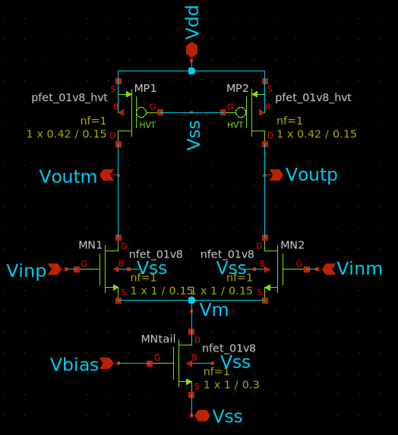
wlv_cmlbuf_01
P1
P2
N1
N2
Ntail

Slide 4
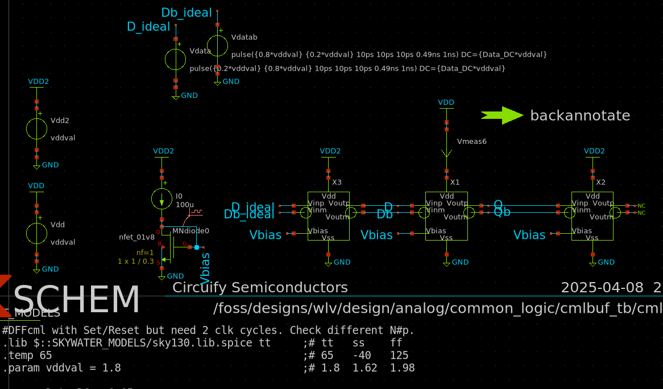
cmlbuf_tb2
Tap or FO=1

Slide 5
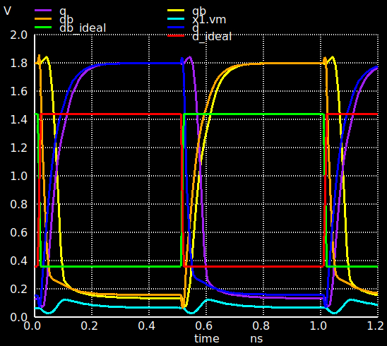
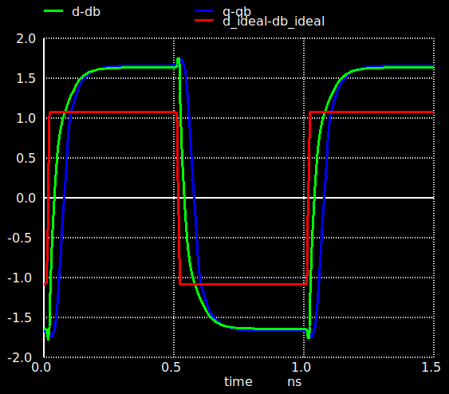
cmlbuf_01 tt wavefoms Tail W=20um
SE
Diff

Slide 6
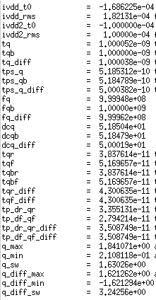
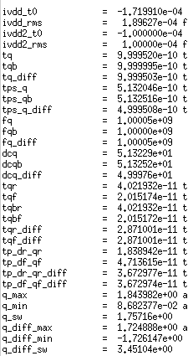
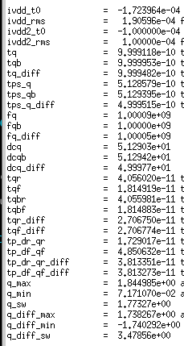
cmlbuf_01 tt tran results
Tail w=1um
Tail w=10um
Tail w=20um
Same leakage and Irms.
Same DutyCycle.
Improvement in rise/fall times W>=10um.
Almost same tp diff but SE not.
Similar diff swings

Slide 7
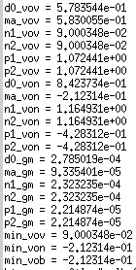
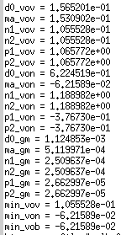
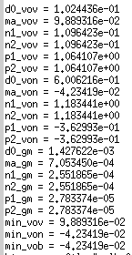
cmlbuf_01 tt op results
Tail w=1um
Tail w=10um
Tail w=20um
Improving from -200,-62,-42mV in Von Tail.
Worth try optimize but ok so far.
Von >90mV ok.

Slide 8
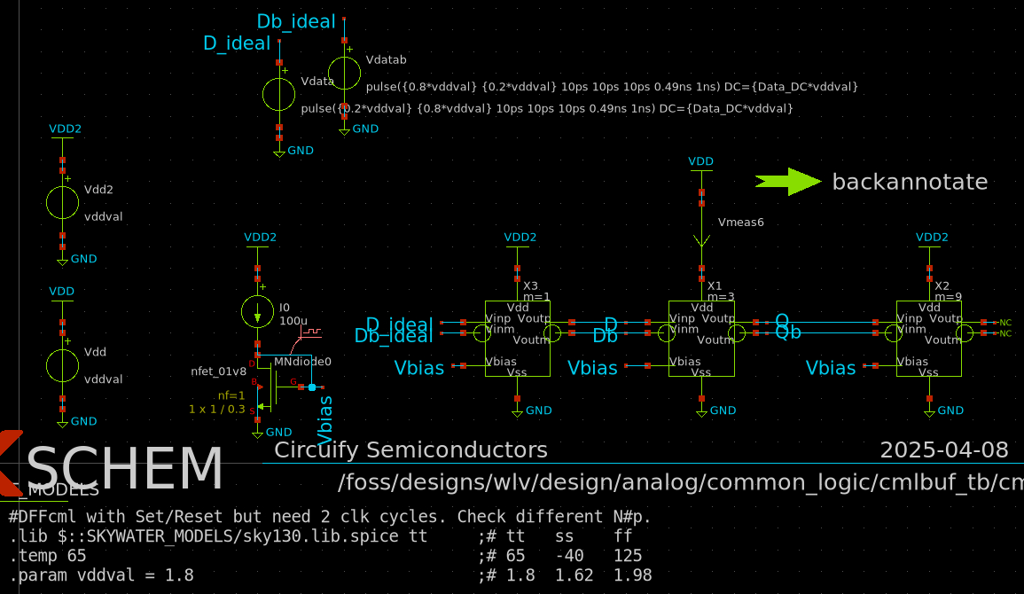
cmlbuf_tb3
Tap or FO=3

Slide 9
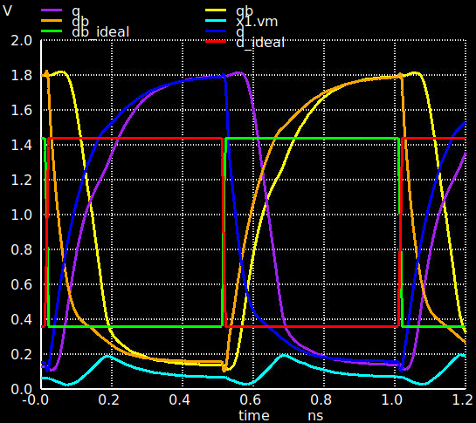
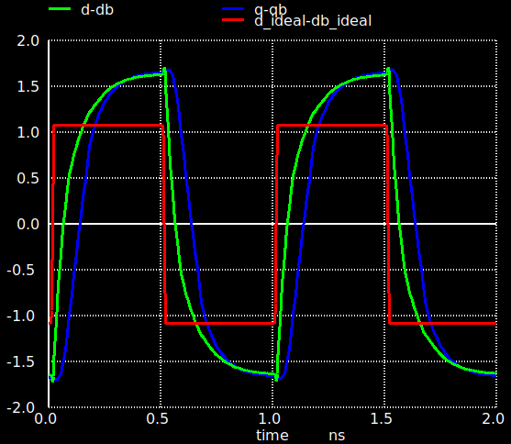
cmlbuf_02 tt wavefoms Tail W=20um
SE
Diff

Slide 10
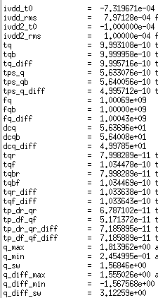
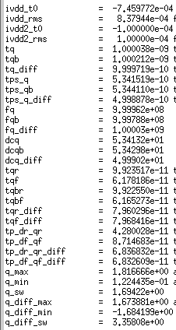
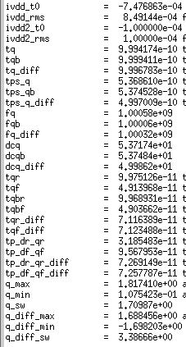
cmlbuf_02 tt tran results
Tail w=1um
Tail w=10um
Tail w=20um
Similar leakage and Irms.
Same DutyCycle.
Improvement in rise/fall times W>=10um.
Similar tp diff but SE not.
Small improvement in diff swings for W>=10um.

Slide 11
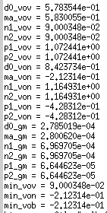
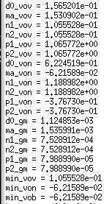
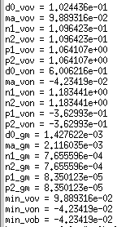
cmlbuf_02 tt op results
Tail w=1um
Tail w=10um
Tail w=20um
Improving from -212, -62,-42mV in Von Tail.
Worth try optimize but ok so far.
Von >90mV ok.
Op results didn’t change with FO.

Slide 12
cmlbuf tran results W=10um FO 1vs3
FO=1
FO=3
~4x More leakage and Irms due to FO.
Same DutyCycle.
~3x More rise/fall times due to FO.
~2x More tp diff due to FO.
Slightly less swing due to FO.

