Slide 1
CMLff_01
Sept 4th, 2025

Slide 2
Contents
wlv_DFFcml_05 specs
Schematic
ff03_cml_tb9 TB (testbech)
Waveforms
PVT PreLayout results Summary
Layout (wip)
Conclusions

Slide 3
wlv_DFFcml_05 specs
 | Wcs | Nom | Bcs | Units
Process Corner | ss | tt | ff
Voltage | 1.62 | 1.8 | 1.98 | V
Temperature | 125 | 65 | -40 | C
 | Min | Nom | Max | Units
Clk Operation frequency |  | 2.5 |  | GHz
Voltage Swing | 1 |  |  | V
DutyCycle diff | 49 | 50 | 51 | %
Ivdd rms |  |  | 600 | uA

Slide 4
wlv_DFFcml_05 corners
Corner | Process | Vdd (V) | Temp (C)
1 | tt | 1.8 | 65
2 | ss | 1.62 | -40
3 | ff | 1.98 | 125
4 | ss | 1.62 | 125
5 | ff | 1.98 | -40
6 | sf | 1.8 | 65
7 | fs | 1.8 | 65

Slide 5
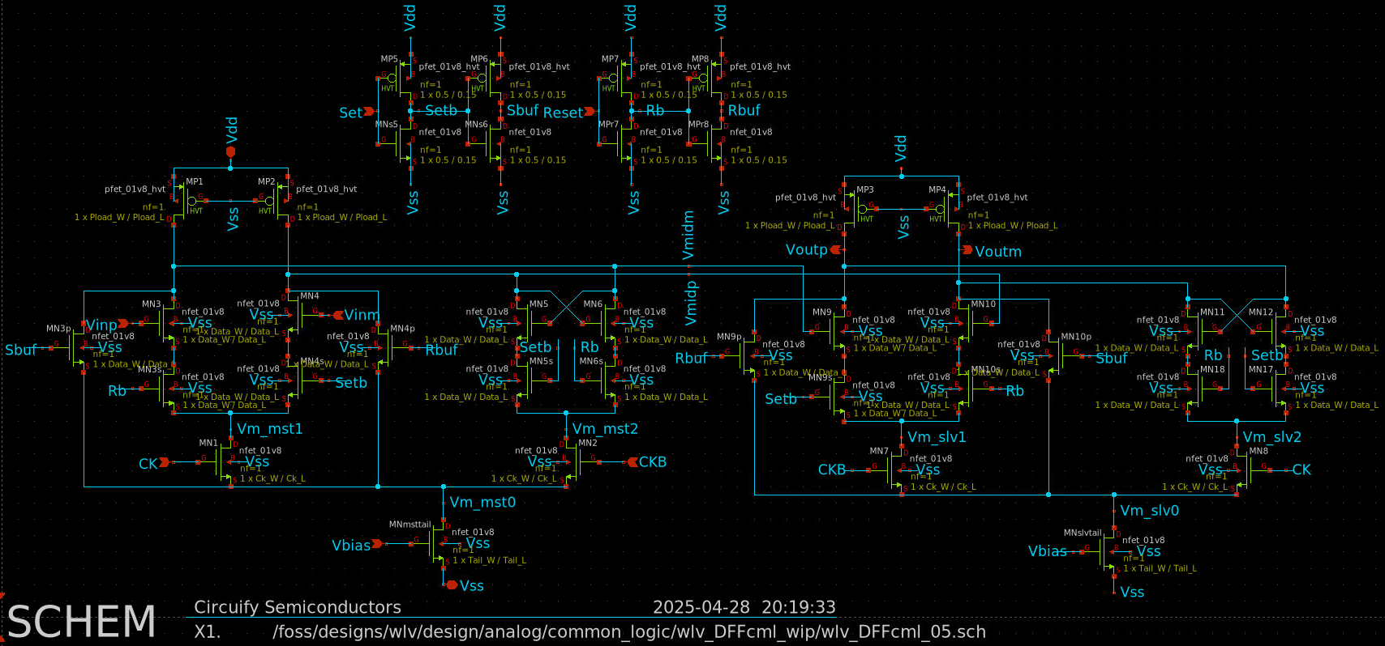
wlv_DFFcml_05 schematic par
Ploads
Ploads
Memory
Memory
Master
Tail
Tail
Slave

Slide 6
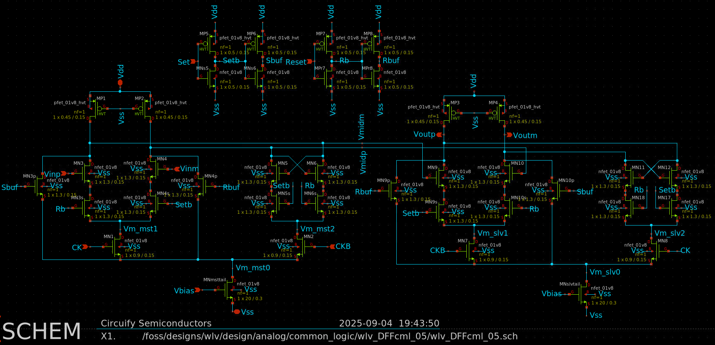
wlv_DFFcml_05 schematic nopar
Ploads
Ploads
Memory
Memory
Master
Tail
Tail
Slave

Slide 7
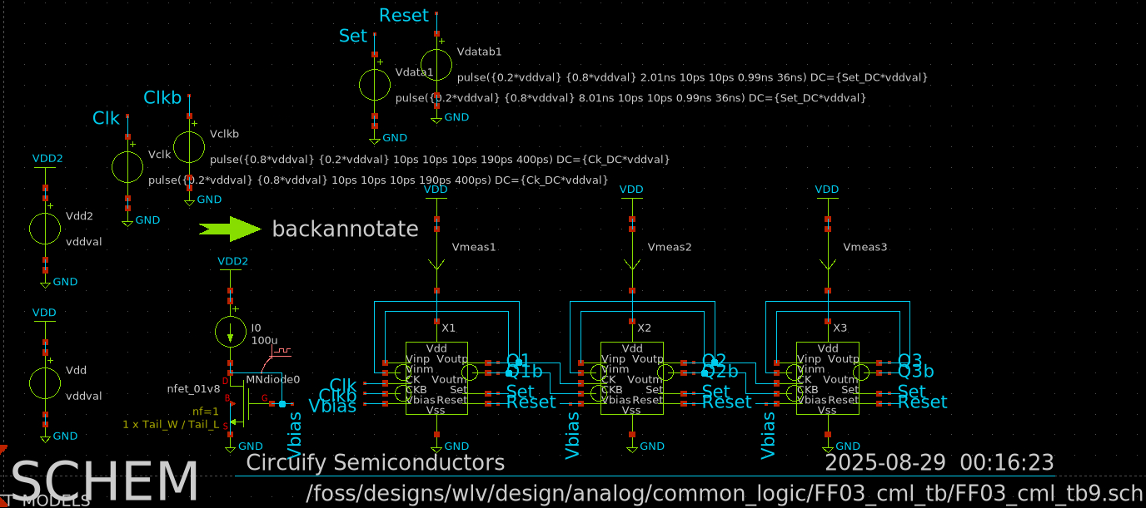
ff03_cml_tb9[_nopar] TB
1.25GHz
625MHz
312.5MHz
2.5GHz
/foss/designs/wlv/design/analog/common_logic/FF03_cml_tb/FF03_cml_tb9_nopar.ctl

Slide 8
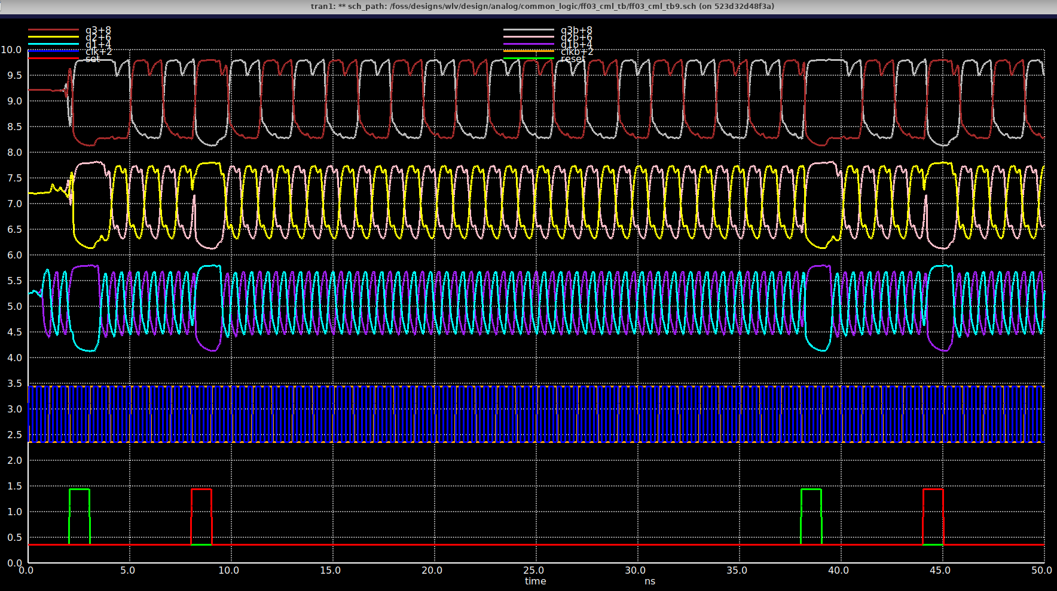
Waveforms tt nom
312.5MHz
625MHz
1.25GHz
2.5GHz
Set
Reset

Slide 9
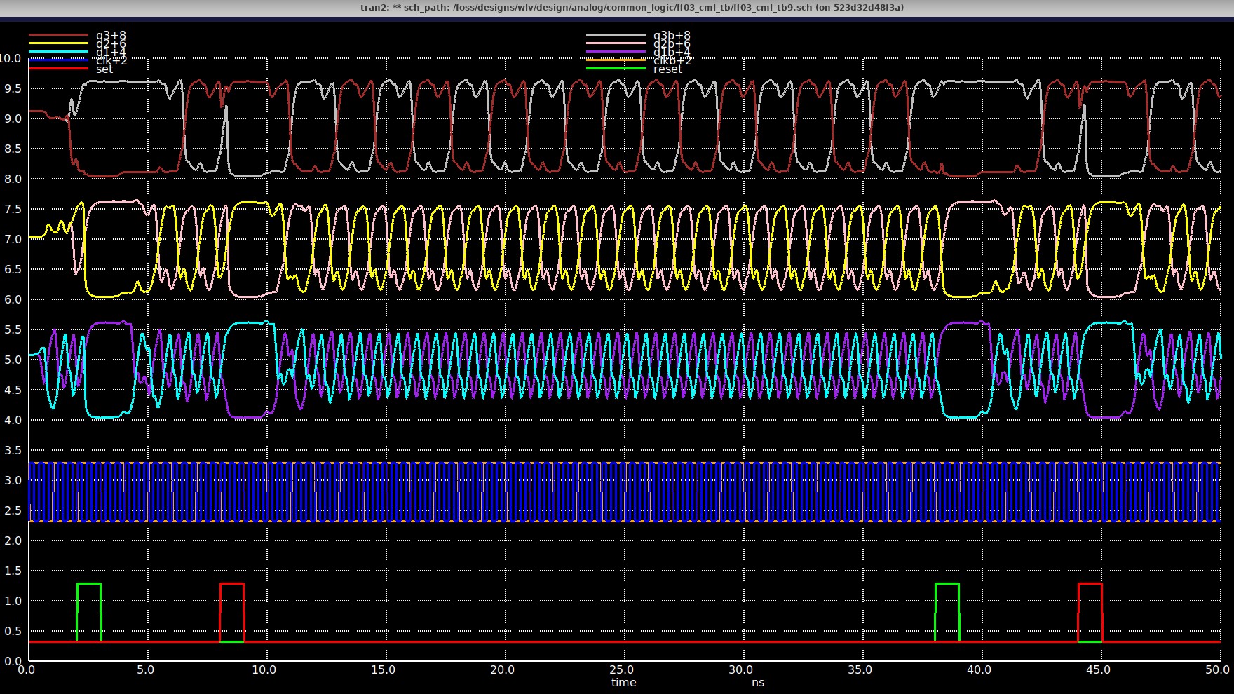
Waveforms ss cld
312.5MHz
625MHz
1.25GHz
Needs ~5 cycles to settle, else DCdiff fail 57%
2.5GHz
Set
Reset

Slide 10
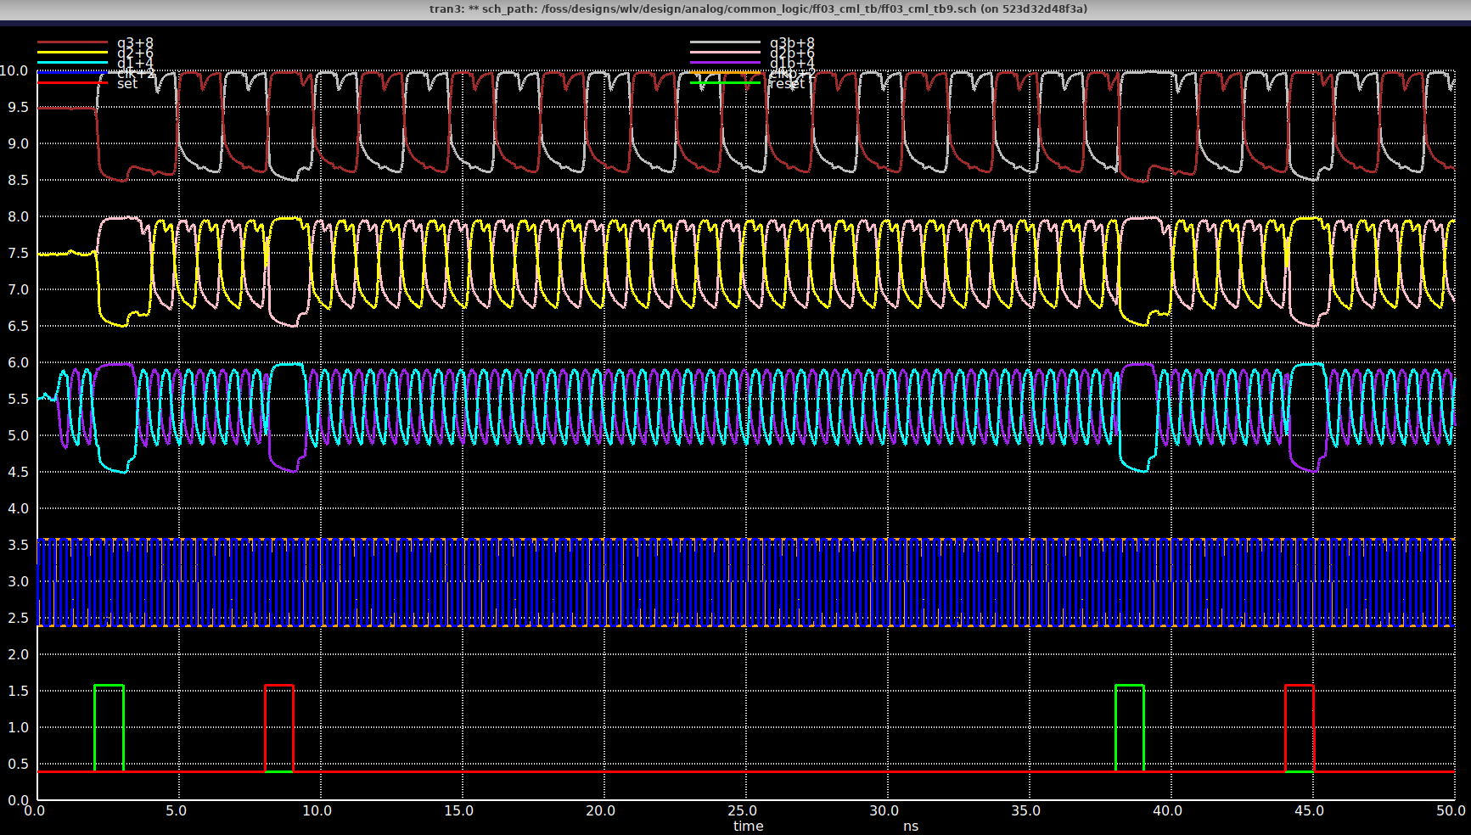
Waveforms ff hot
312.5MHz
625MHz
1.25GHz
2.5GHz
Set
Reset

Slide 11
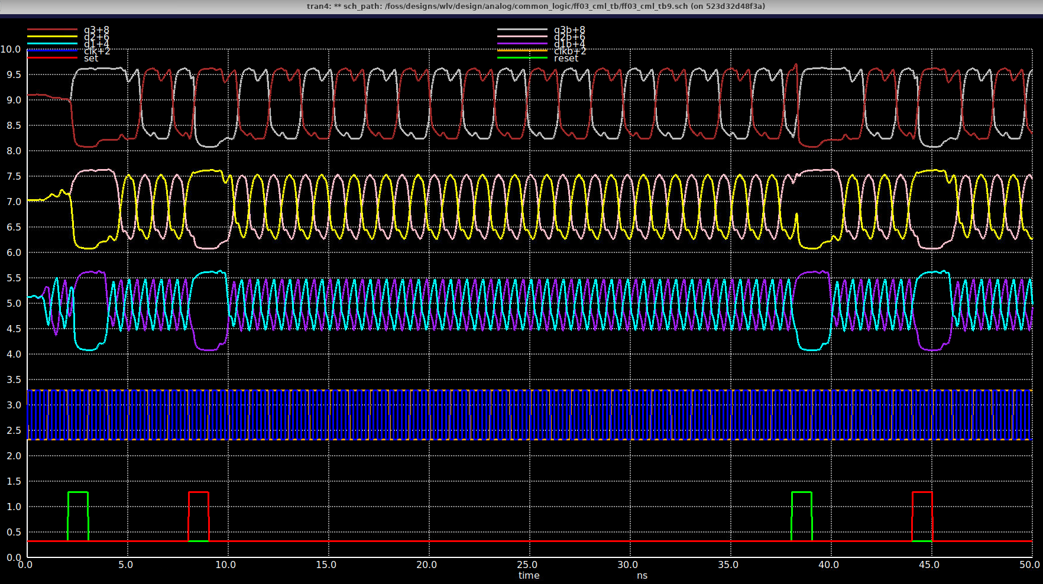
Waveforms ss hot
312.5MHz
625MHz
1.25GHz
2.5GHz
Set
Reset

Slide 12
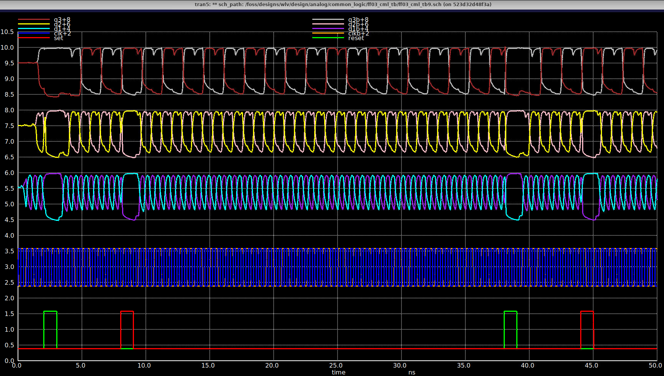
Waveforms ff cld
312.5MHz
625MHz
1.25GHz
2.5GHz
Set
Reset

Slide 13
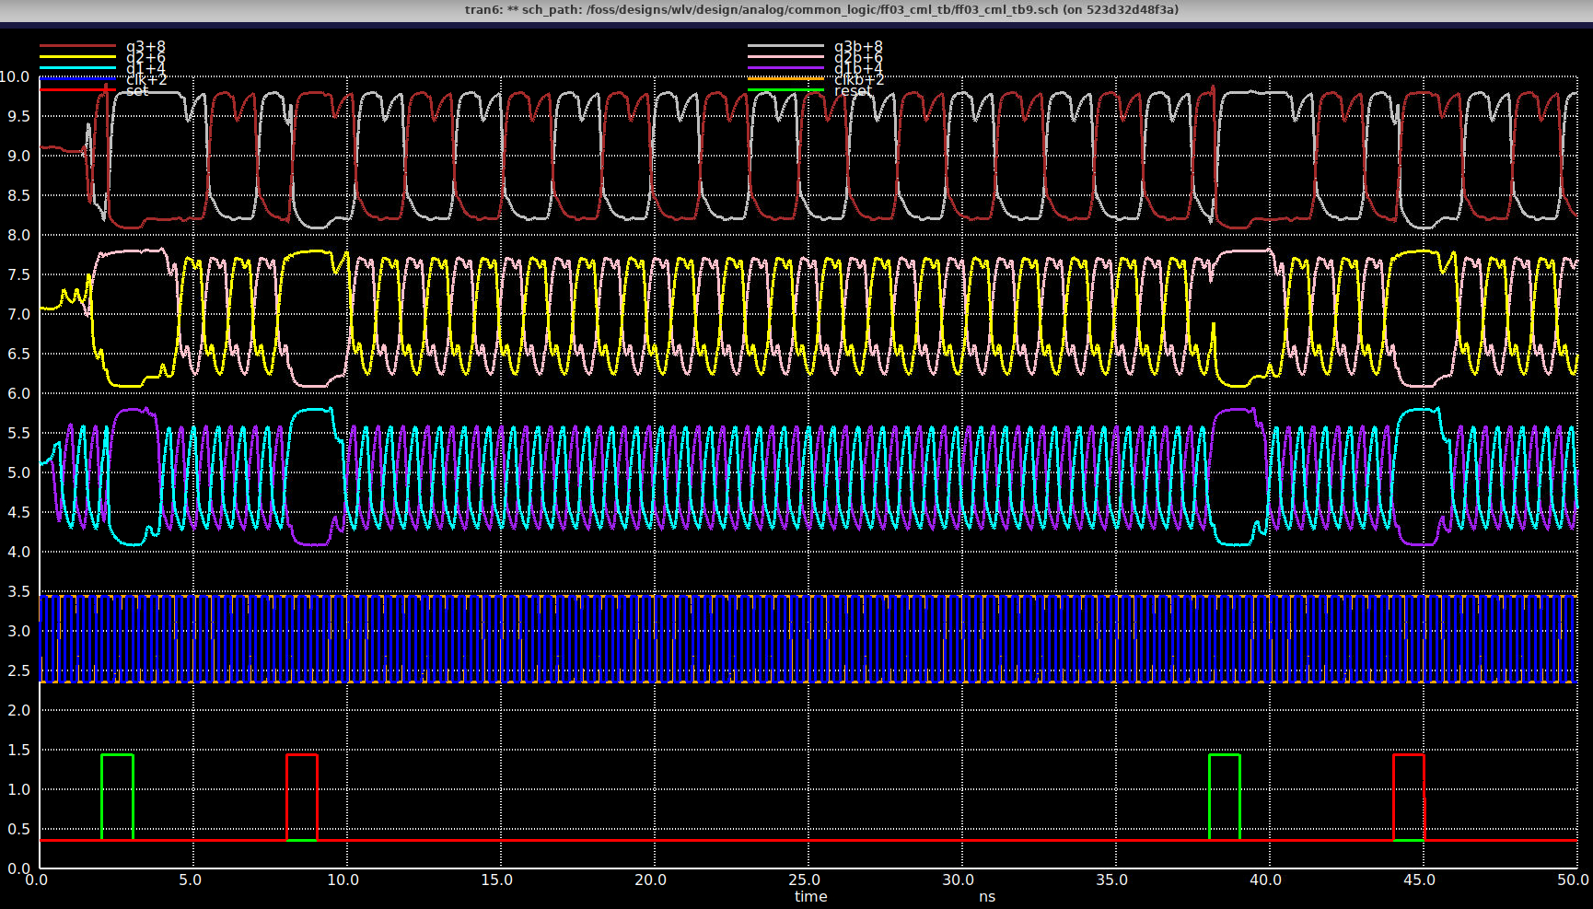
Waveforms sf nom
312.5MHz
625MHz
1.25GHz
2.5GHz
Set
Reset

Slide 14
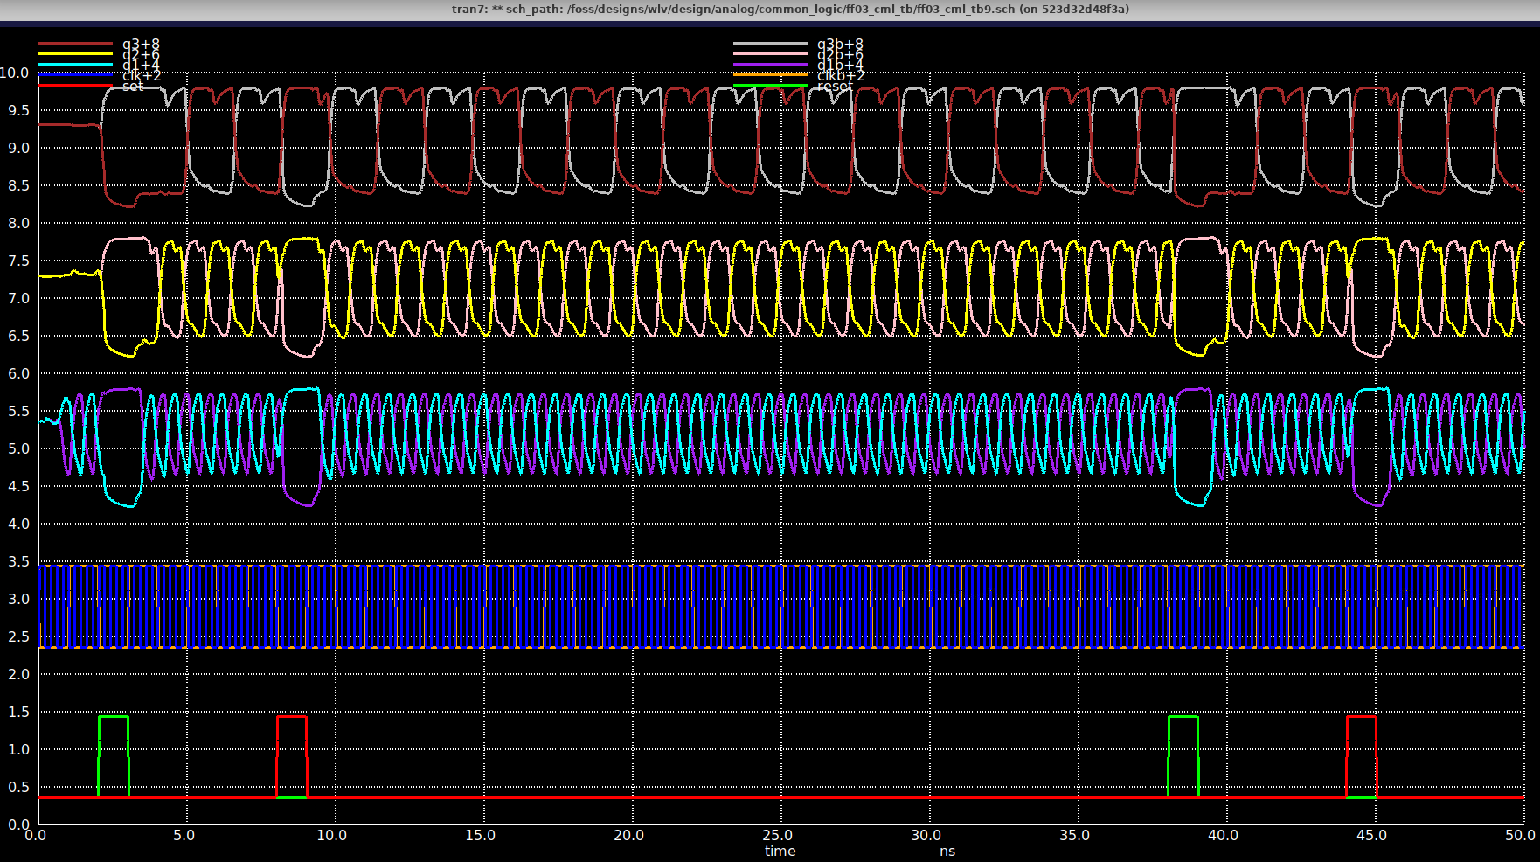
Waveforms fs nom
312.5MHz
625MHz
1.25GHz
2.5GHz
Set
Reset

Slide 15
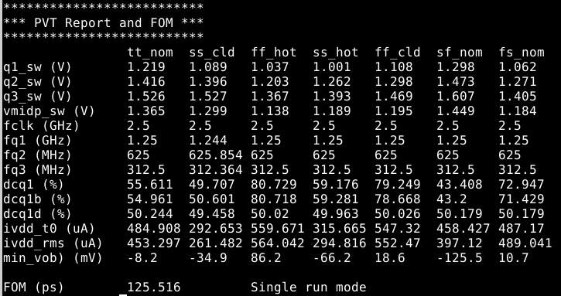
PVT PreL Summary
PASS ✓
PASS ✓
PASS ✓
PASS ✓
/foss/designs/wlv/design/analog/common_logic/FF03_cml_tb/simplex_tb9/FF03_cml_tb9.ctl
DutyCycle diff ss cold 57% fails measured @12ns but pass @15ns. Need ~5cyc to settle.
Biasing (wcs von vov) -66mV before considering sf/fs. To include sf/fs in opt moving fwd.
For -30mV tail goes +250um

Slide 16
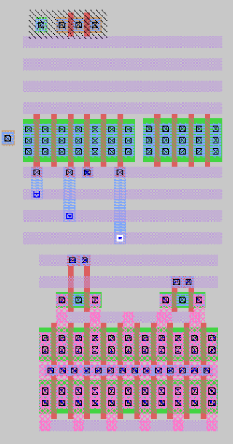
Layout (wip)
Vmidp
Vmidm
Vinp
Vinm
Voutp
Voutm
Setb
Sbuf
Rb
Rbuf
CK
CKB

Slide 17
Conclusions
wlv_DFFcml_05 in specs PreL.
Created a non param version for general use/distribution/release.
ff03_cml_tb9[_nopar] TB (testbech) and .ctl running, reporting and optimizing up to 2.5Ghz and 7PVTs
Waveforms show consistend set reset, normal operation and Div2-8 over PVT.
Layout (wip)
Conclusions

