Slide 1

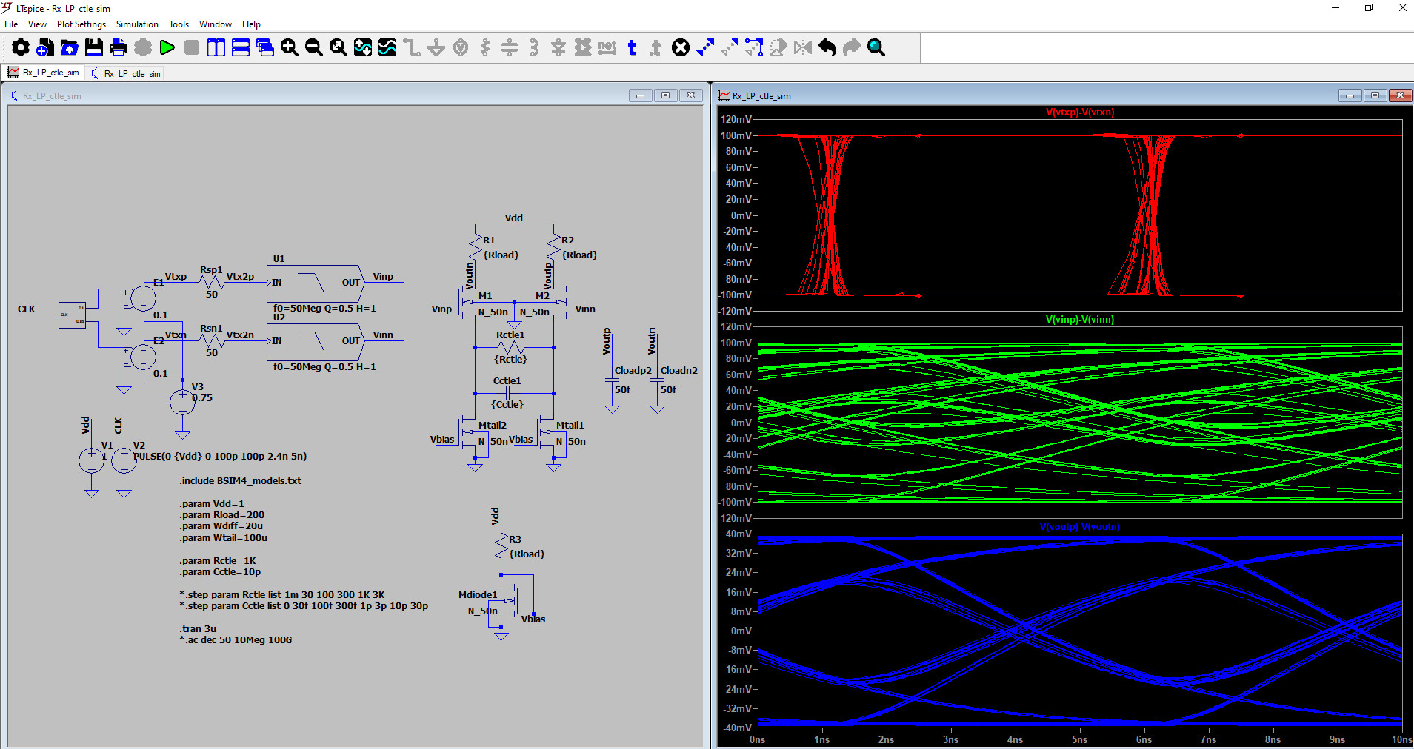
Analog Training 101
6. Memory part 1
Manuel Salim
Circuify Semiconductors
April 4th, 2025
manuel.salim@circuify.com
msalimm@hotmail.com

Slide 2
Overview
Memory Types
SRAM design
Control and Lecture
Floorplanning and Layout
Based on:
Hector Augusto Martinez Gonzalez, Oscar Alejandro Monroy Garcia, Esteban Martinez Guerrero “Metodologia de Construccion de Arreglos de Memorias Modulares”, Reporte de proyecto final de Especialidad, ITESO, Julio 2013.
With permission of the authors.
and ICLabClasses Class09{a-c}.pdf
Slide <number>

Slide 3
Memory Types
Read-Only Memory | Non-Volatile Read-Write Memory | Read-Write Memory
 |  | Random Access | Non-Random Access
Mask-Programmed | EPROM | SRAM | FIFO
 | E²PROM |  | LIFO
Programmable (PROM) | FLASH | DRAM | Shift Register
 | (LDMOS) |  | CAM
Read further:
http://en.wikipedia.org/wiki/Read-only_memory
http://en.wikipedia.org/wiki/Serial_memory_processing
http://www.atmel.com/products/memories/serial/default.aspx
http://en.wikipedia.org/wiki/Flash_memory
http://en.wikipedia.org/wiki/Phase-change_memory
http://en.wikipedia.org/wiki/Static_random-access_memory
http://en.wikipedia.org/wiki/Content-addressable_memory
https://www.pagiamtzis.com/cam/camintro/
EEPROM, EAROM, DRAM, NVRAM, MRAM, FeRAM, PLA, PAL, GAL, Ternary.

Slide 4
Memory types. Cont.
ROM: Read Only Memory. Non-Volatile.
  PROM / OTP: Programmable ROM / One Time PROM. Based in fuses.
  EPROM / EROM: Erasable PROM. Erase with UV 10min. 10Kcyc. 2K-2M.
  EEPROM: Electrically EPROM. Erase with voltages.
    Serial: Serial access to data. 1K-1M EEPROM. Allows low pin count and small pkg size.
    Flash Memory: Commercial 1988, dominant by 2013, several applications (SSD: Solid State Drive). Floating gate Txs. Multi-level/Ternary.
RAM: Random Access Memory. Volatile.
  SRAM: Static RAM. Based on 2 inverters. 2T/8T/10T. Faster but more expensive. Used for Cache.
  DRAM: Dynamic RAM. Main memory of systems. Small 1T/3T. Need refresh. Address is multiplexed.
CAM: Content Addressable Memory. Volatile. Searches entire memory looking for user data word; return list of addresses. Expensive but very fast for search applications. Often used in networking; ternary(1-X-0) in routers.

Slide 5
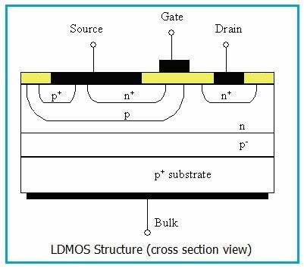
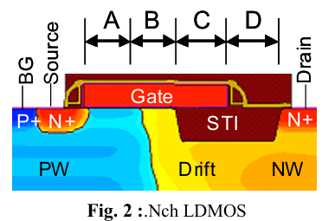
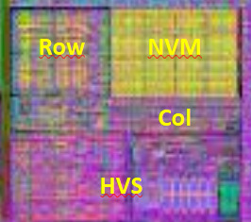
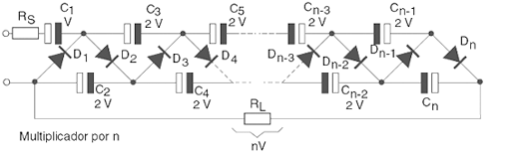
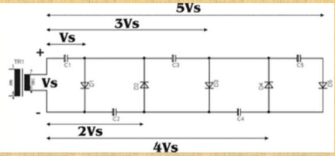
LDmos NVM OTP
Full UHF RFID EPC Class 1 Gen 2 and ISO 18000-6C passive tag IC
Zoom to NMV only
A fully logic CMOS compatible NVM for low power IoT applications
LDMOS Implementation in 0.13μm
https://www.chipus.com.br/documents/Analog_IC_Layout_Services_1v2.pdf
PISCES - Advanced 1D and 2D Device Simulation for Silicon

Slide 6
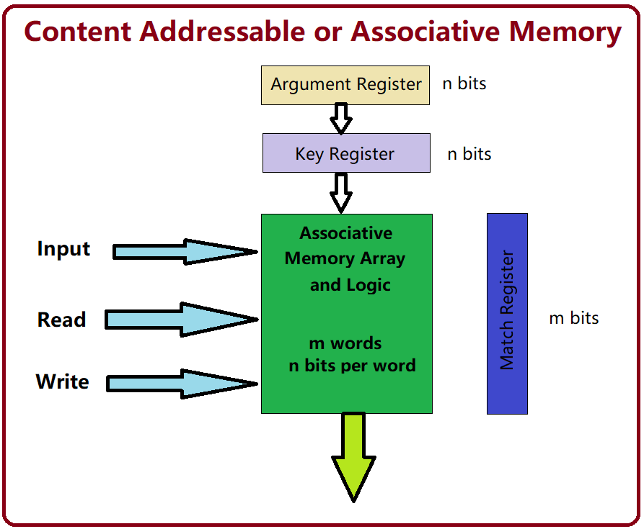
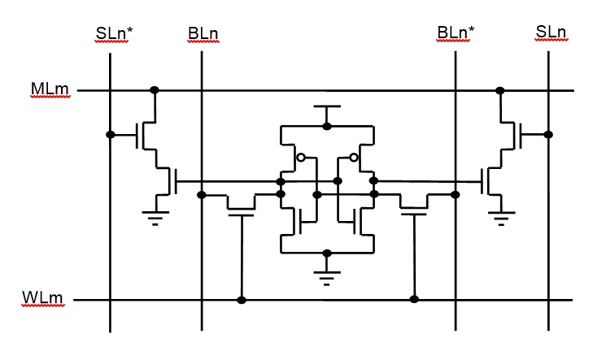
CAM
Content-addressable memory (CAM) is a special type of computer memory used in certain very-high-speed searching applications. It is also known as associative memory or associative storage and compares input search data against a table of stored data, and returns the address of matching data.
Content-addressable memory - Wikipedia

Slide 7
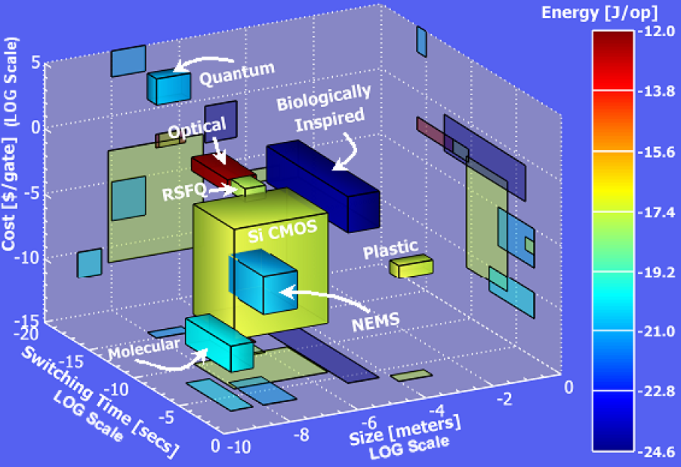
Emerging Memory Technology Trend
[ITRS 2005]
Read further: NEMS, Biological Memory, PCM, NFGM, RSFQ/Single/few electron/quantum memory, Molecuar Memory, FGNVM, Silicon Nanocrystal NVM, Charge Trap Flash (CTF), SONOS (Polysilicon-Oxide-Nitride-Oxide-Silicon), Silicon Nitride/ TANOS (Si-Oxide-SiN-Al2O3-TaN)[2003 IEDM], MRAM (3D?), PCM, Chalcogenide, PMCm, Polymer Memory, Hologram

Slide 8
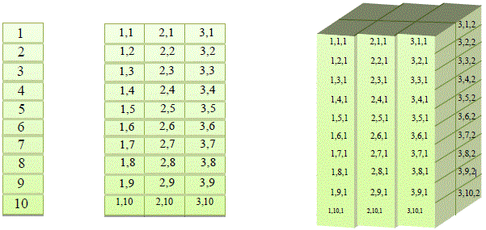
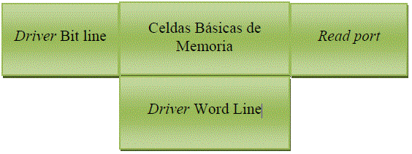
Structure
Types of Memory array per dimension
Driver Bit: Drives bit/data to write into memory cells by row.
Driver Word: Drives write/read signal into memory cells by column.
Read Port: Read/Recover bit/data from the memory array. May be a comparator and may use pre-charge.
Basic Cells/Memory elements: Store bit/data. Array size will depend on Drivers strength/speed and Read port sensitivity/speed.
1D
2D
Most used
3D
Structure of 2D Memory array

Slide 9
Memory elements
Foreground (Registers) VS Background (RAM)
Static VS Dynamic
W3
W3
W2
W2
W1
W1
Bit 1
Bit 1
Bit 2
Bit 2
Bit 1
Bit 1
Bit 2
Bit 2
SRAM
DRAM
Notice Bit/Word orientation is swapped vs previous slide.

Slide 10
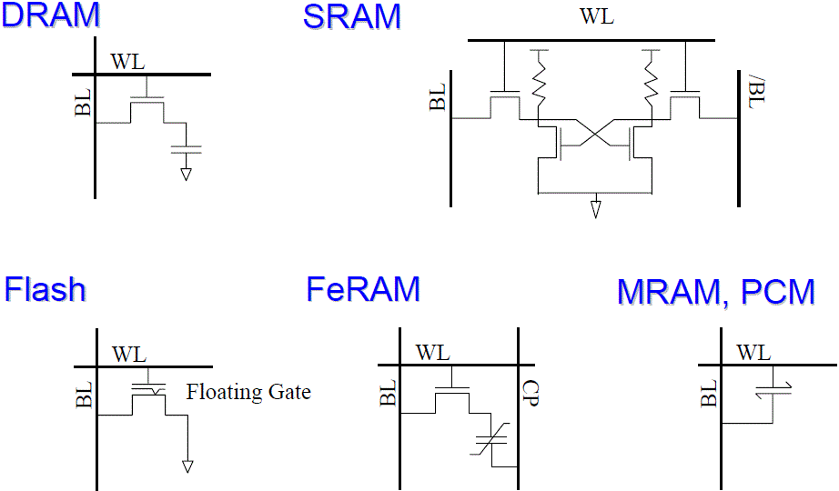
Cell Schematics

Slide 11
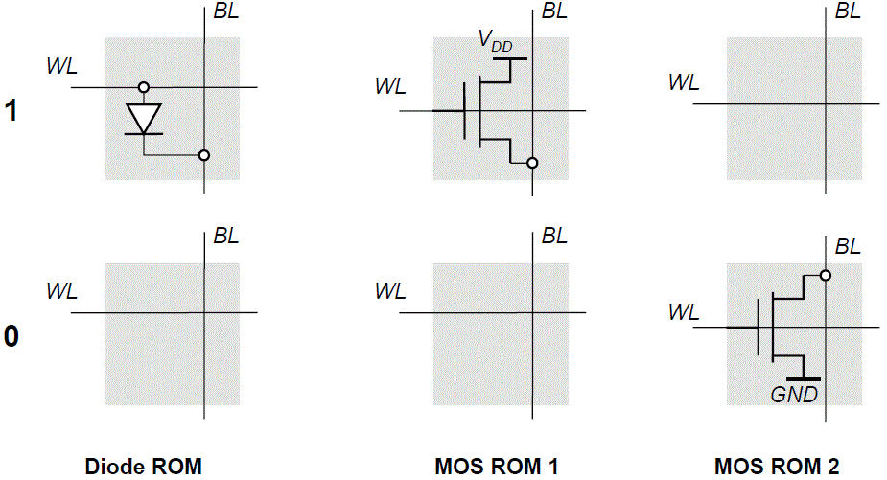
ROM Cells
Read further: ICLabClasses Class09a-Mem.pdf slides 11-24
http://en.wikipedia.org/wiki/Read-only_memory

Slide 12
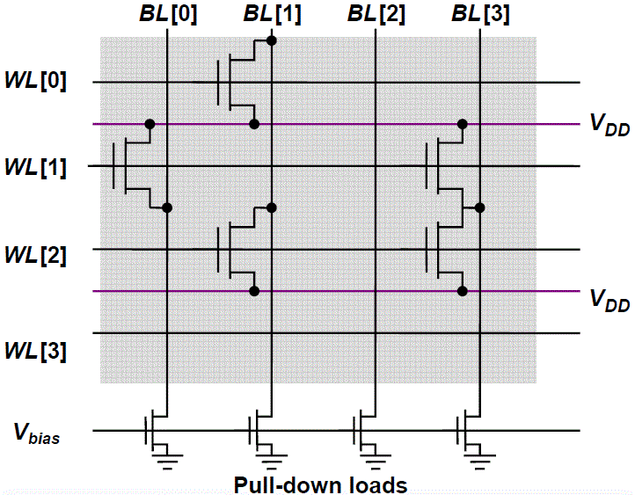
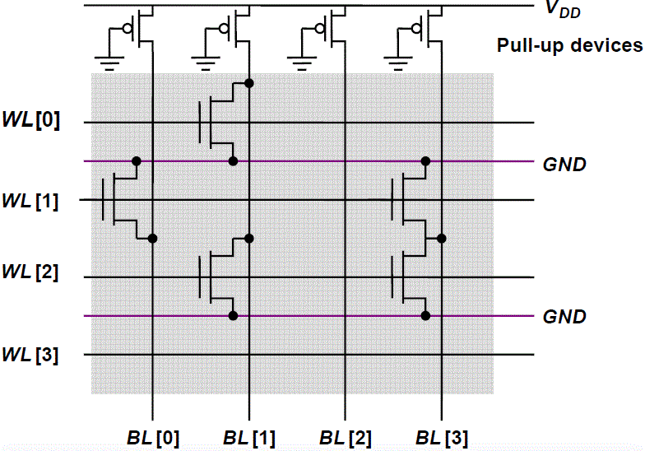
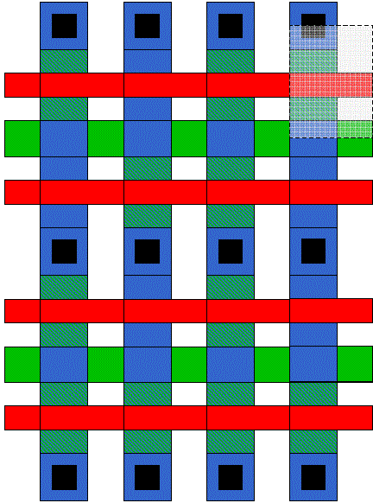
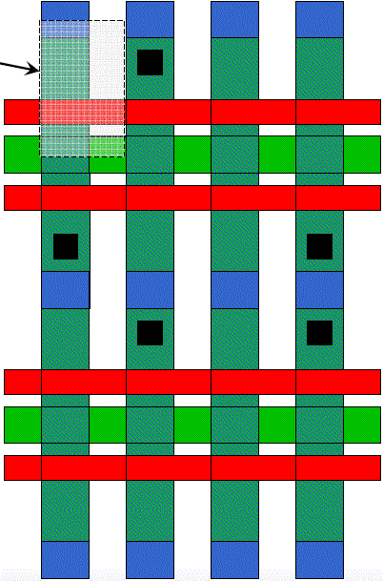
MOS OR/NOR ROM
OR
NOR
Cell(11λx7λ)
Cell(9.5λx7λ)
Programming using the Contact Layer Only
█ Poly
█ M1
█ Diff
█ M1-on-Diff
Programming using the Active Layer Only

Slide 13
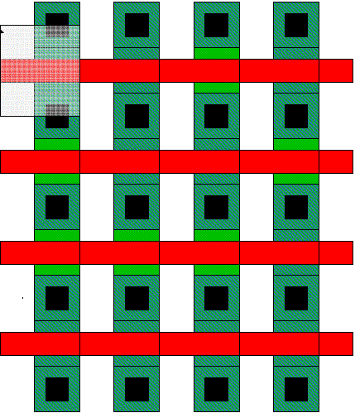
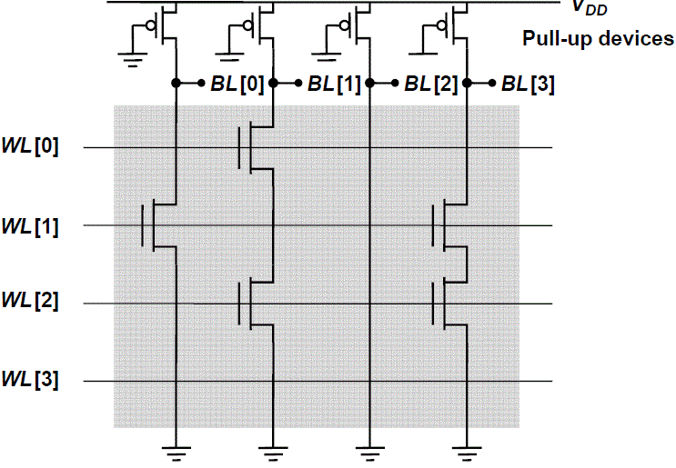
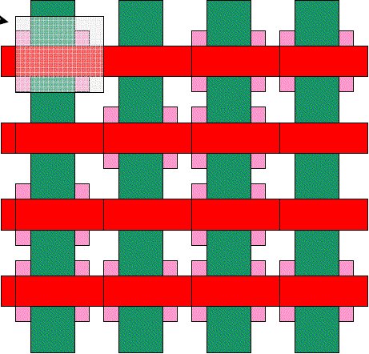
MOS NAND ROM
Programming using M1 only. Cell(8λx7λ)
█ Poly
█ Diff
█ M1-on-Diff
█ Threshold-altering implant
Programming using Implants only. Cell(5λx6λ)
All word lines high by default with exception of selected row.
No contact to Vdd/Gnd necessary; drastically reduce size.
Loss in performance compared to NOR ROM.

Slide 14
Bistability
Latches (Level-sensitive/Transparency)
Registers (Edge-triggered)
Flip-flops (Bistable cross coupled gates)
Vo1 = Vi2
Vo1
Vi2
Vi1 = Vo2
A
Vo1 = Vi2
C
Vi1
Vo2
Cut or Overpower the feedback loop
B
Vi1 = Vo2

Slide 15
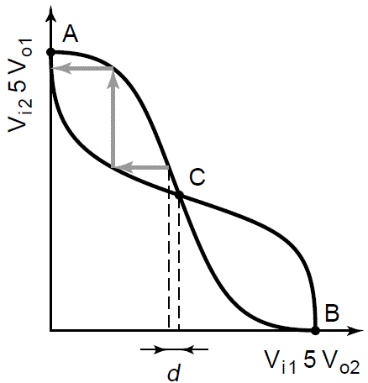
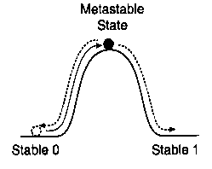
Metastability
Metastable State – signal not 1 or 0 or
oscillating for a nondeterministic length of time
Can occur when insufficient energy is applied to cause a latch to switch to either a 1 or 0.
Examples:
  Dual processor with shared memory
  FIFO with asynchronous input and output
  Processor interrupts
  Yellow traffic light
  Two people meet in hallway
  Dog midway between two food dishes may starve
Read further:
http://en.wikipedia.org/wiki/Metastability
http://en.wikipedia.org/wiki/Metastability_in_electronics
web.cecs.pdx.edu/~mperkows/CLASS_573/.../C_003_metastability.ppt‎
http://www.asic-world.com/tidbits/metastablity.html
http://www-classes.usc.edu/engr/ee-s/552/coursematerials/ee552-G1.pdf
http://www.altera.com/literature/wp/wp-01082-quartus-ii-metastability.pdf

Slide 16
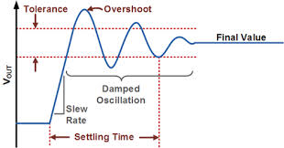
Practice 8. Part 1/2
8.1 Check Metastability in minimum size static memory element (2 inverters back-to-back). Try 5 different initial conditions as in table below (Vi1,Vi2 relative to Vdd) and measure settling times. Explain trend in setting times due to ICs values.
Team | 1 | 2 | 3 | 4 | 5
Tx | 0,0 | ¾,¾ | ½,¼ | ½,0 | ¾,0
Rx | ¼,¼ | 1,1 | ¾,½ | ¾,¼ | 1,¼
Clk | ½,½ | ¼,0 | 1,¾ | 1,½ | 1,0
Vo1 = Vi2
Vi1 = Vo2

Slide 17
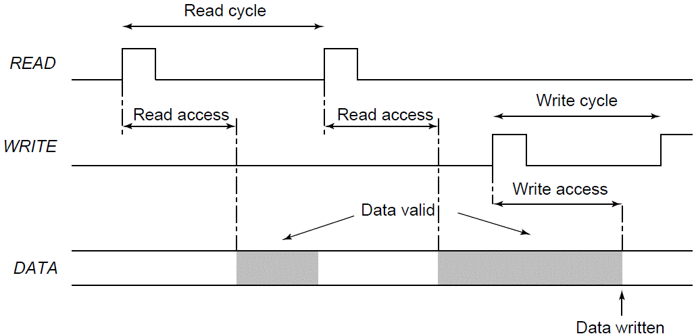
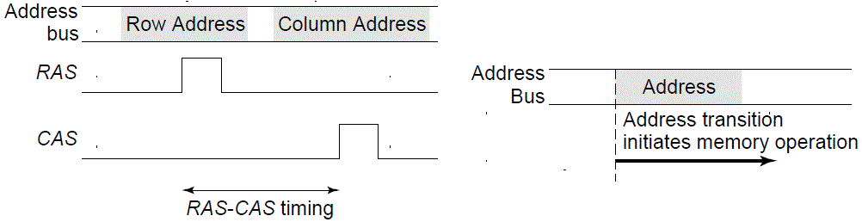
Memory Timing
Definitions:
Approaches:
DRAM Timing Multiplexed Adressing
SRAM Timing Self-timed

Slide 18
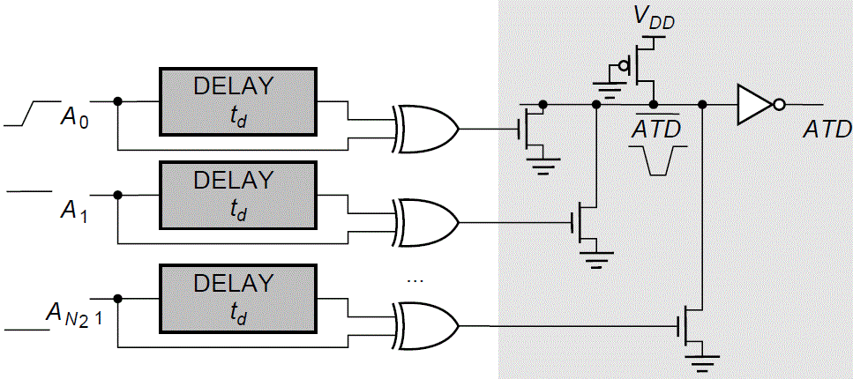
Address Transition Detection

Slide 19
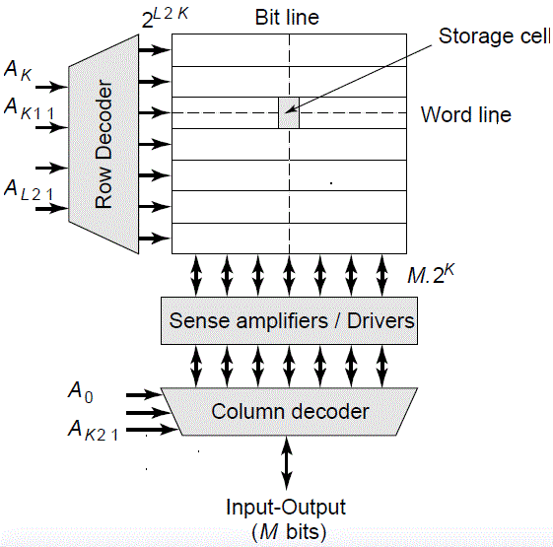
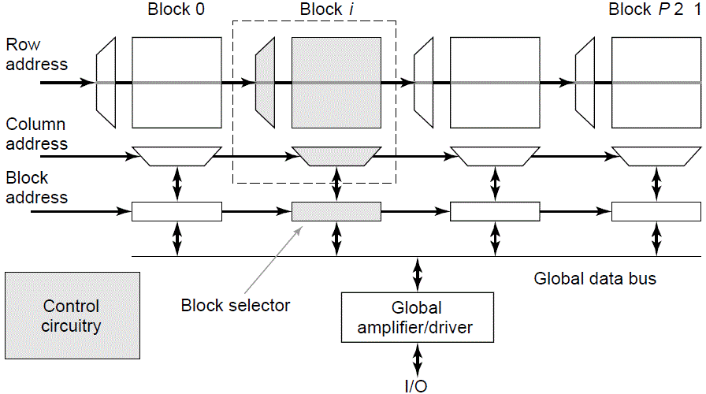
Decoders
Decoder reduces the number of select signals K=log₂N

Slide 20
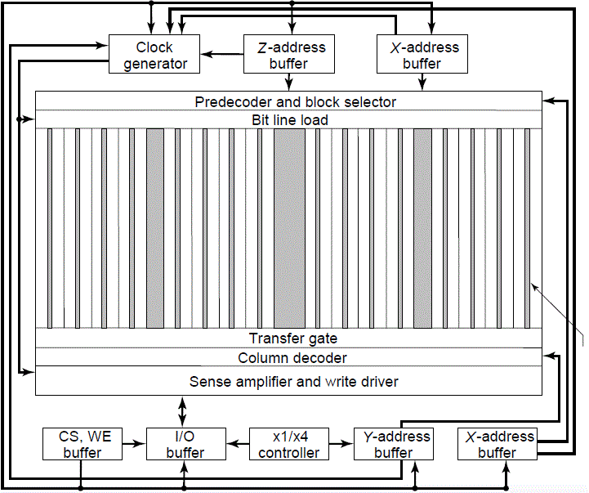
4 Mbit SRAM [Hirose90]

Slide 21
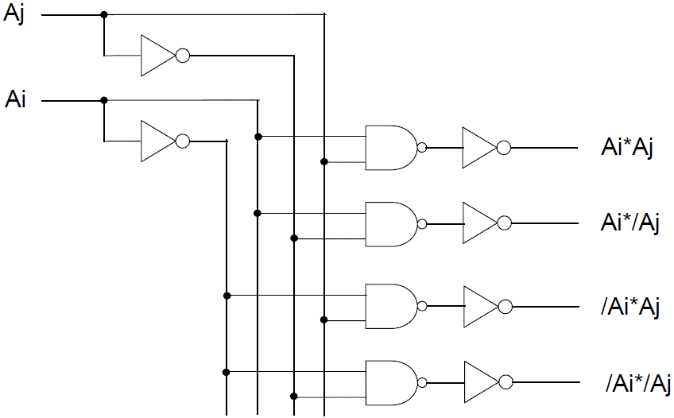
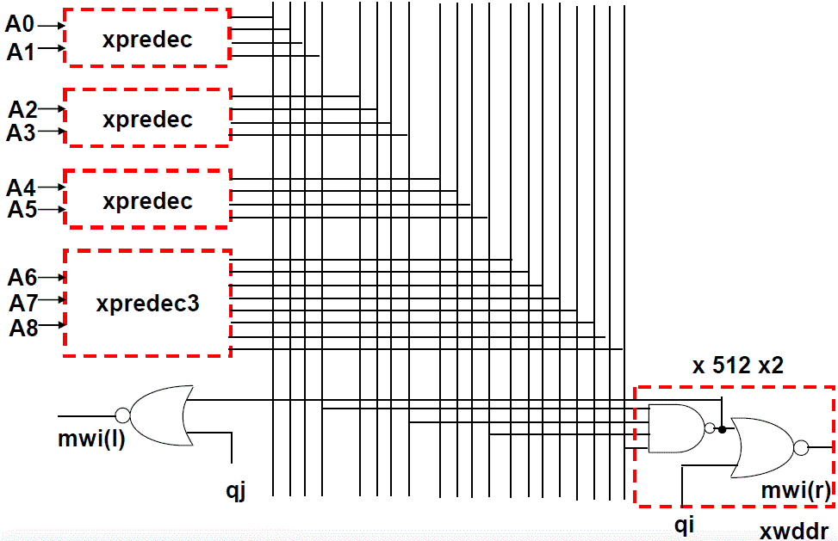
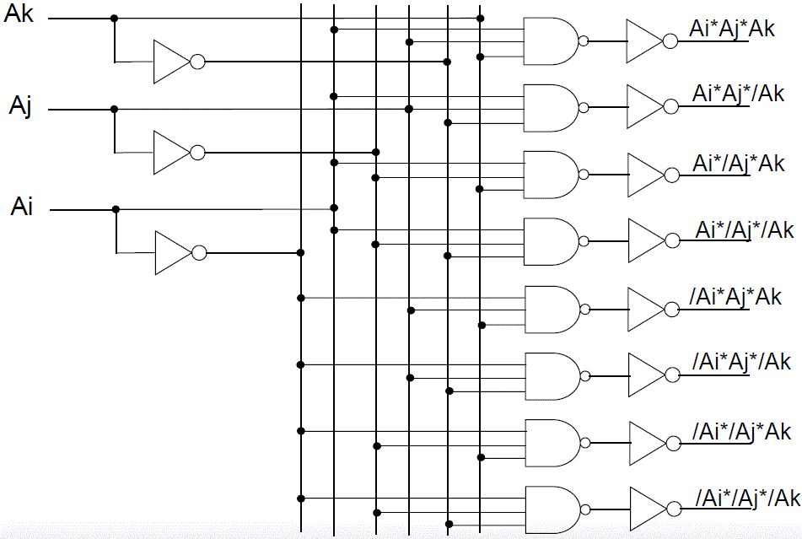
2 bit Pre-Decoder
Row Decoder
PreDecoders
Read further: ICLabClasses
Class09a-Mem.pdf slides 44-49
Class09c-SRAM.pdf slides 6-10, 14-19.
3 bit Pre-Decoder
Slide <number>

Slide 22
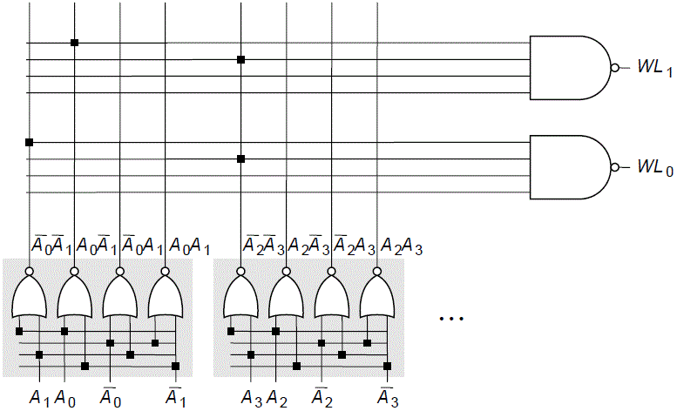
Hierarchical Decoders
Multi-stage implementation improves performance
NAND decoder using 2-input pre-decoders
Read further: ICLabClasses
Class09a-Mem.pdf slides 44-49
Class09c-SRAM.pdf slides 6-10, 14-19.

Slide 23
3-to-8 Word Decoder
E | A | B | C | 0 | 1 | 2 | 3 | 4 | 5 | 6 | 7
1 | 0 | 0 | 0 | 1
1 | 0 | 0 | 1 |  | 1
1 | 0 | 1 | 0 |  |  | 1 |  |  | 0
1 | 0 | 1 | 1 |  |  |  | 1
1 | 1 | 0 | 0 |  |  |  |  | 1
1 | 1 | 0 | 1 |  |  | 0 |  |  | 1
1 | 1 | 1 | 0 |  |  |  |  |  |  | 1
1 | 1 | 1 | 1 |  |  |  |  |  |  |  | 1
0 | X | X | X | 0 | 0 | 0 | 0 | 0 | 0 | 0 | 0
Eb
Ab
Eb
E
Bb
S₀
Ab
Ai
Cb
A₂
Ab
Eb
Bb
S₁
Bb
Bi
Ci
A₁
Ab
Eb
Cb
Ci
Bi
S₂
A₀
Cb
Ab
Eb
Bi
S₃
Ci
Ai
Eb
Bb
S₄
Cb
Ai
Eb
Bb
S₅
A₀₋₂
A₀₋₂
Ci
Ai
Eb
Bi
S₆
Nands
Nors
S₀₋₇
S₀₋₇
Cb
E
Ai
Eb
Bi
S₇
Ci
A₀₋₂
E
A₀₋₂
Slide <number>

Slide 24
12-to-4096 Word Decoder
A₀₋₂
A₀₋₅
A₀₋₈
6-to-64 Decoder:
9-to-512 Decoder:
S₀₋₇
S₀₋₆₃
S₀₋₅₁₁
9-to-512
3-to-8
6-to-64
S₈₋₁₅
S₆₄₋₁₂₇
S₅₁₂₋₁₀₂₃
9-to-512
3-to-8
6-to-64
S₁₆₋₂₃
S₁₂₈₋₁₉₁
S₁₀₂₄₋₁₅₃₅
3-to-8
9-to-512
6-to-64
A₃₋₅
A₆₋₈
A₉₋₁₁
S₂₄₋₃₁
S₁₉₂₋₂₅₅
S₁₅₃₆₋₂₀₄₇
9-to-512
3-to-8
6-to-64
E
E
E
3-to-8
S₃₂₋₃₉
3-to-8
S₂₅₆₋₃₁₉
3-to-8
S₂₀₄₈₋₂₅₅₉
9-to-512
E₀₋₇
3-to-8
E₈₋₁₅
E₁₆₋₂₃
6-to-64
S₄₀₋₄₇
S₃₂₀₋₃₈₃
S₂₅₆₀₋₃₀₇₁
9-to-512
3-to-8
6-to-64
S₄₈₋₅₅
S₃₈₄₋₄₄₇
S₃₀₇₂₋₃₅₈₃
9-to-512
3-to-8
6-to-64
S₅₆₋₆₃
S₄₄₈₋₅₁₁
S₃₅₈₃₋₄₀₉₅
9-to-512
3-to-8
6-to-64
Slide <number>

Slide 25
4KB in 8 banks
512B bank:
A₀₋₈
Prechargers
Prechargers
Prechargers
N
O
R
S
N
O
R
S
N
O
R
S
N
O
R
S
N
A
N
D
S
N
O
R
S
N
O
R
S
N
O
R
S
N
O
R
S
A₀₋₈
E
Sense Amps
A₉₋₁₁
Word
9-to-512 Decoder
Sense Amps
Q
76543210
D
Db
E
Word
Sense Amp. with enable:
Vb

Slide 26
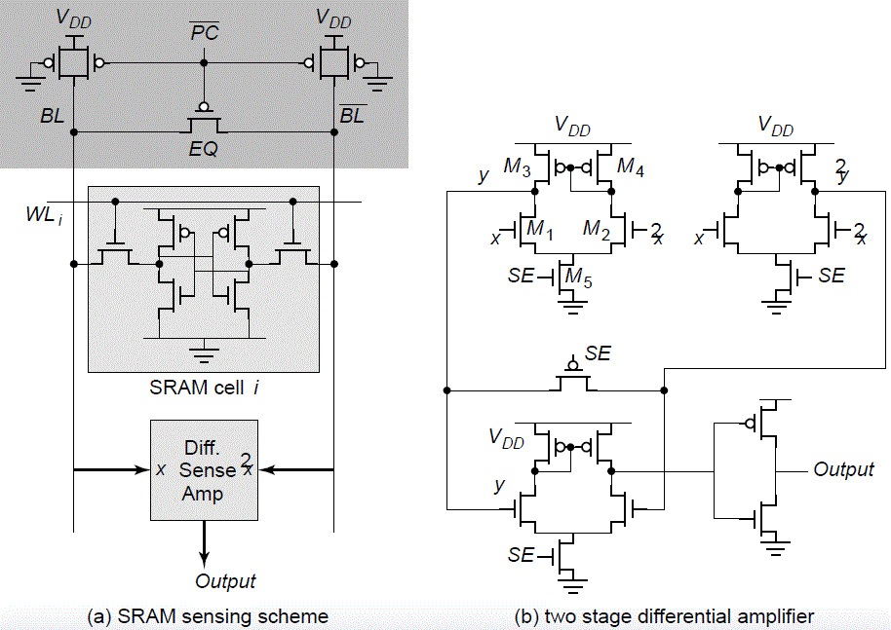
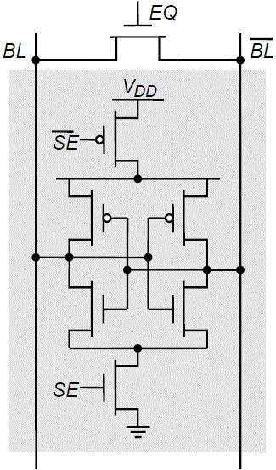
Sense Amp
Latch-Based SA (DRAM)
Initialized in its meta-stable point with EQ.
Once adequate voltage gap created, sense amp enabled with SE.
Positive feedback quickly forces output to a stable operating point.
Slide <number>

Slide 27
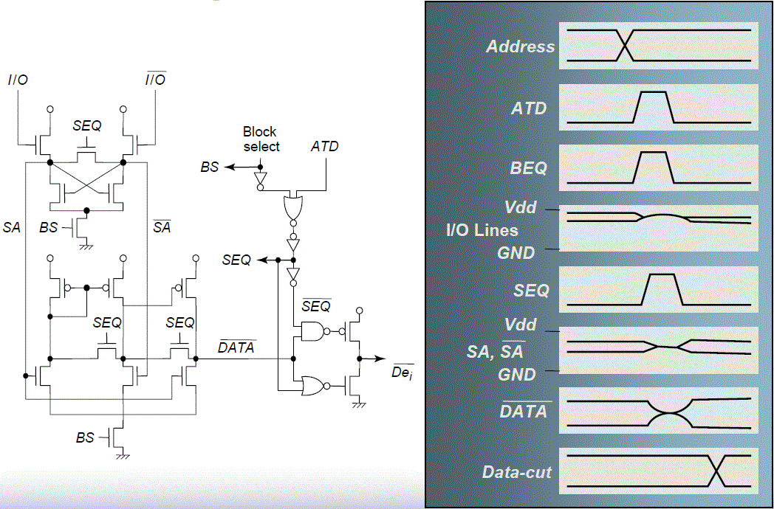
SA waveforms

Slide 28
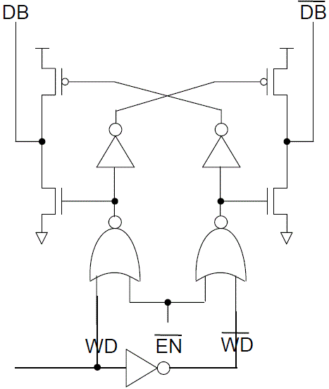
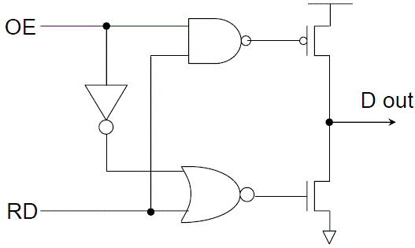
Write Driver and Data Output Buffer
OE | RD | Dout
0 | X | Z
1 | 0 | 0
1 | 1 | 1
Descharge first, charge second.
Saves power at speed cost.

Slide 29
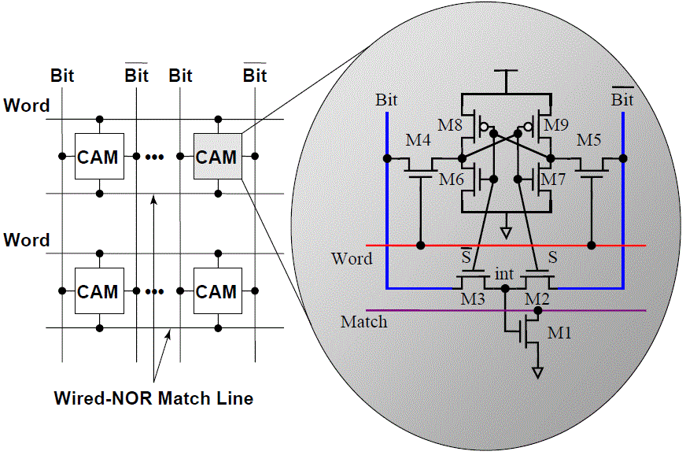
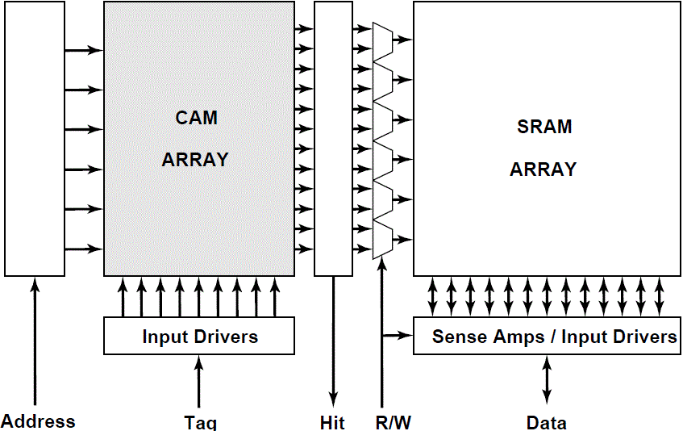
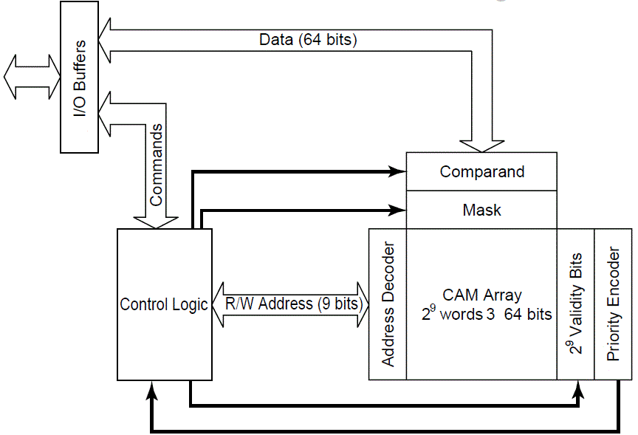
CAM
Static CAM cell
Contents Addressable Memory
CAM in Cache
Read futher:
http://en.wikipedia.org/wiki/Content-addressable_memory
https://www.pagiamtzis.com/cam/camintro/

Slide 30
Truth Table
SRAM
spec
/CS | /WE | /OE | /MODE | I/O OPERATION | POWER
H | X | X | Deselected | High-Z | Stand-by
L | H | H | OutputDisable | High-Z | Active
L | H | L | Read | Data Out | Active
L | L | X | Write | Data In | Active
Recommended DC Operating Conditions
Item | Symbol | Min | Typ | Max | Unit
Supply voltage | V_{CC} | 2.7 | 3.0/3.3 | 3.6 | V
Input high voltage | V_{IH} | 2.2 | - | V_{CC}+0.2 | V
Input low voltage | V_{IL} | -0.2 | - | 0.6 | V
Average operating current. Cycle time=Min, 100% duty, I_{IO}=0mA, /CS=V_{IL}, V_{IN}=V_{IL} or V_{IH}. | I_{CC2} | - | - | 30 | mA
Output Low (I_{OL}=2.1mA) | V_{OL} | - | - | 0.4 | V
Output High (I_{OH}=-1.0mA) | V_{OH} | 2.4 | - | - | V

Slide 31
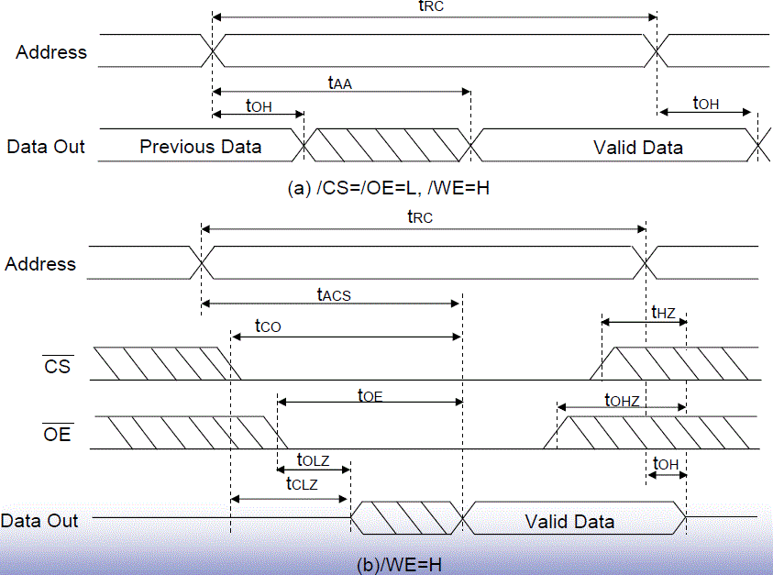
Read Cycle Operation
Parameter | Symbol | Min | Max
Read Cycle Time | tRC | 55ns | -
Address Access | tAA | - | 55ns
Chip Select Access | tACS | - | 55ns

Slide 32
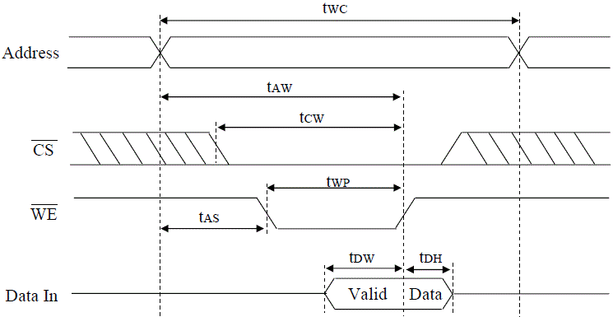
Write Cycle (/WE Controlled)
Parameter | Symbol | Min | Max
Write Cycle Time | tWC | 55ns | -
Write Pulse Width | tWP | 40ns | -
Data to Write Time Overlap | tDW | 25ns | -
Data Hold from Write Time | tDH | 0ns | -

Slide 33
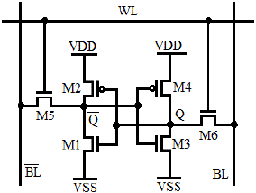
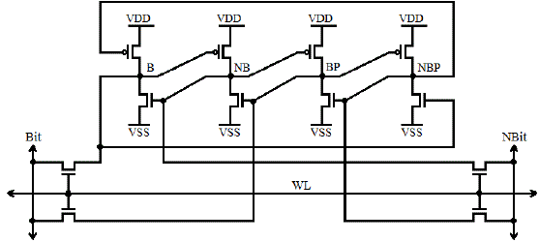
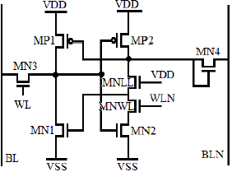
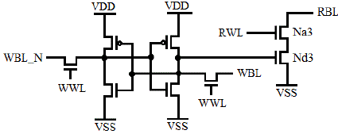
SRAM Cell Topologies
6T
DICE (Dual Interlocked storage Cell)
Robust vs SET (Single Event Transient)
8T
Improved 8T
(Dedicated write/read txs)

Slide 34
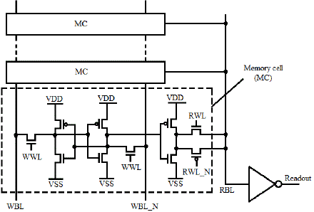
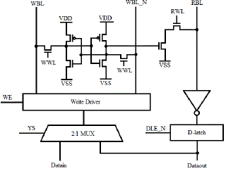
SRAM Read Port
Inverter as Read port for a 10T
☺ Precharge not needed
☹ Only for 10T single ended read bitline
Inverter and Latch
☺ Can re-write through mux
☺ Vdd min lower than 6T
☹ Larger area due to Mux (and latch)
Slide <number>

Slide 35
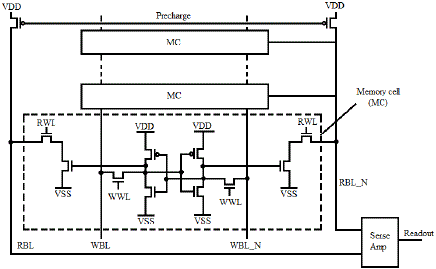

SRAM Read Port. Cont.
Differential Sense Amplifier in Read port and precharge
☺ Larger Op. Freq than 10T
☹ Larger area due to Sense Amplifier and precharge Pmos
Bit-line keeper in Inverter Read port for a 8T’
Faster 1→0
High contention for 0
Design effort for keeper vs delay
Shortcircuit on transitions

Slide 36
Reading operation design
All L are min.
Use Initial Condition (IC) logic 1 in RBL. Assuming a precharge in RBL.
Estimate C_{L} (100fF). Include metal and other Na3’s Csb for at least 8 other cells. RBL routing will run horizontally on M2.
Start with Wmin for both Nd3 and Na3 (220nm in BiCMOS7WL, 1.5um in AMI05).
Simulate and measure delay for RBL to go to 0 when RWL go to 1.
Parametric sweep Nd3 and Na3 from Wmin to 10xWmin.
Pick best tradeoff of delay and W(area).
RWL 0→1
Na3
RBL 1→0
Vdd
Nd3
C_{L}
For the sake of simplicity:
Keeper PMOS is not considered yet.
You can make W_{Nd3}=W_{Na3}
As 7WL picked 3*Wmin=660nm, we can pick 4.5um for AMI05
You may want to check if C_{L} is valid for picked W or 10xWmin range
Slide <number>

Slide 37
Writing operation design
NC
Nd3
All L are min.
Use Initial Condition (IC) Data=1 and Data_N=0. Make WBL=0 and WBL_N=1 to force a writing.
WBL_N
Data_N
WBL
Data
WWL
0→1
WWL
0→1
3. Start with Wmin for all devices, except Nd3 which was already picked for reading.
4. Simulate and measure delay for Data 1→0 and Data_N 0→1 when WWL 0→1.
Parametric sweep Wp and Wn from Wmin to 10xWmin.
Repeat for WBL=1 WBL_N=0 IC:Data=0 Data_N=1.
Pick best tradeoff of delay and W(area).
For the sake of simplicity:
Finite Write Driver strength is not considered yet. If Wdriver>>Wmemory is ok.
You can only measure at Data node since it have more load. Need both tpLH and tpHL.
You can make W_{N}=W_{P}
As 7WL picked 2*Wmin=440nm, we can pick 3um for AMI05.
Slide <number>

Slide 38

Memory Basic Cell Layout
VDD NWELL contacts
(Reserved?)
VDD
M2 line reserved for Readout
PMOS
NMOS Inverter
NMOS Write, VSS
VSS
NMOS Read
Poly
M1
M2
M3

Slide 39
Abutment
RBL
VSS
WBL_N
VSS
WBL
VDD
VDD
VDD
WBL
VSS
WBL_N
VSS
RBL
RBL
VSS
WBL_N
VSS
WBL
VDD
Notice self-abutment and vertical/horizontal flips. Diffusions and contacts are merged.
In addition to DRC and self-abutment, memory basic cell layout must be complaint with standard cells in order to have them all abutted and save area.
Decoders, Muxes and Data Output Buffers can be implemented in standard cells with automated flow.
In this example we have 3 words/columns of 3 bits/rows.
Prefer even rows with PMOS inside array.
RWL WWL WWL RWL RWL WWL
Slide <number>

Slide 40

Abutment. Zoom in.
Not connected
Connected

Slide 41
Vdd
Memory Basic Cell Stick Diagram
WBL
Vss
WBL_N
█ Poly
█ M1
█ M2
█ M3
M3 vertical buses and Nwell contact not drawn
for clarity purposes.
Vss
RBL
WWL
RWL
Slide <number>

Slide 42
RBL
Vss
WBL_N
Vss
WBL
Vdd
WBL
Vss
WBL_N
Vss
RBL
RBL
Vss
WBL_N
Vss
WBL
Vdd
Abutment with Stick Diagrams
Notice self-abutment and vertical/ horizontal flips. Difussions and contacts are merged.
█ Poly
█ M1
█ M2
█ M3
RWL WWL WWL RWL RWL WWL
Slide <number>

Slide 43
Bitline Drivers (WBL/N) design
WBL_N
WBL
All L are min.
Estimate C_{L} (100fF). Include metal and Cds (NMOS write) for at least 8 other cells. WBL/_N routings will run horizontally on M2.
din
C_{L}
C_{L}
Start with Wmin for all devices
Simulate and measure V_{M} and delays for target frequency(7WL 1GHz, AMI05 100Mz).
Parametric sweep Wp and Wn from Wmin to 10xWmin.
Pick best tradeoff of V_{M}, delay and W(area).
For the sake of simplicity:
Finite memory strength is not considered yet. If Wdriver>>Wmemory is ok.
You can make W_{P}=r*W_{n} and even r=2~3.
As 7WL picked 2.2u/880n (for Pmos/Nmos), we can pick 15um/6um for AMI05.

Slide 44
Wordline Drivers (RWL/WWL) design
All L are min.
Consider 2 inverters: Single and double. Single must handle NMOS write, since write have double Cgs than read. Double will be double the size than single.
Estimate C_{L} (500fF). Include metal and Cgs (NMOS write is x2) for as much cells as bits will have the word(32). RWL/WWL routings will run vertically on M3.
out
in
C_{L}
Start with Bitline driver design.
Simulate and measure V_{M} and delays for target frequency(7WL 1GHz, AMI05 100Mz).
You can use all/more area available in standard cell height (Y).
Parametric sweep can be limited to fingers. Until single driver handle operation. Voltage levels must get 10-90% of Vdd.
Pick best tradeoff of V_{M}, delay and W(area).
For the sake of simplicity:
As 7WL picked 3.08u/1.05u=4 (for single), we can pick 21u/7.5u=4 for AMI05. (It is ok a finger of 21u?)
You can make W_{P}=r*W_{n} and even r=2~3.
You may want to know by simulation max C_{L} for your Wordline drivers.
Slide <number>

Slide 45



Drivers layouts
Bitline WBL/_N WL single WL double
All also compatible with memory and standard cells.
Notice lack of Well/substrate contacts.

Slide 46
Drivers Stick Diagrams
Vdd
Vdd
Vdd
in
WBL_N
out
out
WBL
Vss
Vss
Vss
in
in
█ Poly
█ M1
█ M2
█ M3
Bitline WBL/_N WL single WL double
Contact count reduced to 1 for simplicity.
Slide <number>

Slide 47
Read port design
All L are min. W_{Keeper}=2*Wmin.
Consider Precharge, Inverter and keeper Read port.
Estimate C_{L} (50fF).
Estimate C_{RLB} (100fF). Include metal and
Cds (NMOS read) for at least 7 other cells,
one is already depicted. RBL routings will
run horizontally on M2.
Start with W’s as depicted for 7WL. Convert into AMI05 with a 1.5u/220n= 6.818 factor.
440n
Prch
1.1u
1.98u
RWL_Prch
RBL
Readout
RWL
660n
440n
C_{RBL}
C_{L}
Data
660n
Make Data=1 and Prch=RWL=RWL_Prch switch at target frequency(7WL 1GHz, AMI05 100Mz).
Simulate and measure V_{M} and delays at RBL and Readout nodes.
Increase precharge device if RBL do not get to 1 in time.
Design Inverter. Notice current V_{M} is not Vdd/2 due to keeper.
Pick best tradeoff of V_{M}, delay and W(area).
For the sake of simplicity: Dynamic charge sharing from the other cells is not considered.
You can stick to converted sizes for AMI05. But need to verify proper operation.
Slide <number>

Slide 48



Read port layouts
Complete Read Port
Precharge PMOS
Keeper PMOS
Substrate contact
Inverter

Slide 49
Read port Stick Diagram
Pchg
Vdd
Read_out
Vss
RBL
█ Poly
█ M1
█ M2
█ M3 Contact count reduced to 1 and substrate contact not shown.
Slide <number>

Slide 50
Practice 8. Part 2/2
For the following points consider AMI05 100MHz and a complete memory of 32 words of 128bits. Each point have more details in previous slides. Also default result values.
8.2 Design Nd3 and Na3 for Reading operation.
8.3 Design the memory element for Write operation.
8.4 Design the BitLine Drivers.
8.5 Design the WordLine Drivers.
8.6 Design the Readport.

Slide 51
Assembling elements for 1bit 1word
din
data_r
WBL_N
WBL
nwwl
WWL
RWL
Prch
nrwl
RWL
Na3
Nd3
RBL
Data_N
WBL_N
WBL
Data
WWL
WWL
dout_r
C_{L}

Slide 52
din
data_r
WBL_N
RWL1
Prch
WBL
nwwl1
WWL1
Assembling elements for 1bit 3words
WBL_N
WBL
nrwl1
RWL1
WWL1
nwwl2
WWL2
WWL1
RWL2
nrwl2
RWL2
RBL
nwwl3
WWL3
WBL_N
WBL
nrwl3
RWL3
WWL2
WWL2
RWL3
dout_r
WBL_N
WBL
C_{L}
WWL3
WWL3
Slide <number>

Slide 53
Assembling elements for 3bits 1word
RWL
Prch
RBL1
WBL_N1
WBL_N1
din1
data_r1
WBL1
WBL1
dout_r1
WBL_N2
WWL
din2
data_r2
WWL
C_{L1}
WBL2
RWL
Prch
WBL_N3
din3
data_r3
WBL3
RBL2
nwwl
WBL_N2
WWL
WBL2
dout_r2
WWL
nrwl
RWL
WWL
C_{L2}
RWL
Prch
RBL3
WBL_N3
WBL3
dout_r3
WWL
WWL
C_{L3}
Slide <number>

Slide 54
RWL1
Assembling elements for 3bits 3words
WBL_N1
Prch
din1
data_r1
WBL_N1
WBL1
WBL1
WWL1
WWL1
WBL_N2
RWL2
RBL1
din2
data_r2
WBL_N1
WBL2
WBL1
WBL_N3
WWL2
WWL2
din3
data_r3
RWL3
WBL_N1
WBL1
dout_r1
WBL3
C_{L1}
WWL3
WWL3
RWL1
Prch
nwwl1
WWL1
WBL_N2
WBL2
WWL1
WWL1
nrwl1
RWL1
RWL2
RBL2
WBL_N2
WBL2
nwwl2
WWL2
WWL2
WWL2
RWL3
nrwl2
RWL2
WBL_N2
WBL2
dout_r2
WWL3
WWL3
C_{L2}
nwwl3
WWL3
RWL1
Prch
WBL_N3
WBL3
nrwl3
RWL3
WWL1
WWL1
RWL2
RBL3
WBL_N3
WBL3
Notice in following sections, there are bit drivers every 8bits.
WWL2
WWL2
RWL3
WBL_N3
dout_r3
WBL3
C_{L3}
WWL3
WWL3
Slide <number>

Slide 55
Vdd
in
Stick Diagrams for 1bit 1word
WBL
Vss
Read_out
WBL_N
Vss
RBL
Pchg
WWL
RWL
nwwl
Vss
Actually RBL must be aligned in all the array.
Vdd
█ Poly
█ M1
█ M2
█ M3
Vss
nrwl
Slide <number>

Slide 56
Vdd
in
Stick Diagrams for 1bit 3words
WBL
Vss
Read_out
WBL_N
Vss
Notice the flippings and difussions and contacts abutments.
RBL
Pchg
WWL1
RWL3
nwwl1
Vss
nwwl2
nwwl3
nwwl2 exits below with M3. Actually all nwwl must do.
Vdd
█ Poly
█ M1
█ M2
█ M3
Vss
nrwl1
nrwl2
nrwl3
Slide <number>

Slide 57
Vdd
in1
Stick Diagrams for 3bits 1word
WBL_N1
WBL1
Read_out1
Vss
RBL1
Vss
RBL2
WBL_N2
WBL2
Read_out2
in2
Vdd
in3
WBL3
Read_out3
WBL_N3
Vss
RBL3
WWL
RWL
Pchg
nwwl
Vss
█ Poly
█ M1
█ M2
█ M3
Vdd
Vss
nrwl
Slide <number>

Slide 58
Vdd
in3
WBL1
WBL_N1
Read_out1
Vss
RBL1
Stick Diagrams for 3bits 3words
RBL2
Vss
WBL_N2
Read_out2
WBL2
in2
Vdd
in3
WBL3
Read_out3
WBL_N3
Vss
RBL3
WWL1
RWL3
Pchg
nwwl1
Vss
nwwl2
nwwl3
█ Poly
█ M1
█ M2
█ M3
Vdd
Vss
nrwl1
nrwl2
nrwl3

