Slide 1
WageBase
Week 9
Midway Milestone
CS147 Winter 2021

Slide 2


The Team
Girish Kumar
Andy Wang
Saljuk Gondal

Slide 3
Value Proposition
Problem
Solution
Democratizing service worker wage information
Ensuring decent living wages is crucial to economic and environmental sustainability. However, workers within the service industry are often underpaid and over-reliant on unreliable tips for a living wage. A lack of wage transparency makes change difficult.
We want to create a platform for service workers to make their wage information publicly available to inform consumer decisions and incentivize better wage practices.

Slide 4
Heuristic Evaluation Results

Slide 5
Sev 3 & 4 Clarity Issues
Unable to click restaurants on the leaderboard
Dropdowns near the leaderboard on the home page, only the small downward triangle icon is interactive.
Navigation Issues (5 issues)
Not able to navigate back from comparisons page, etc.
FAQ/Help Section

Slide 6
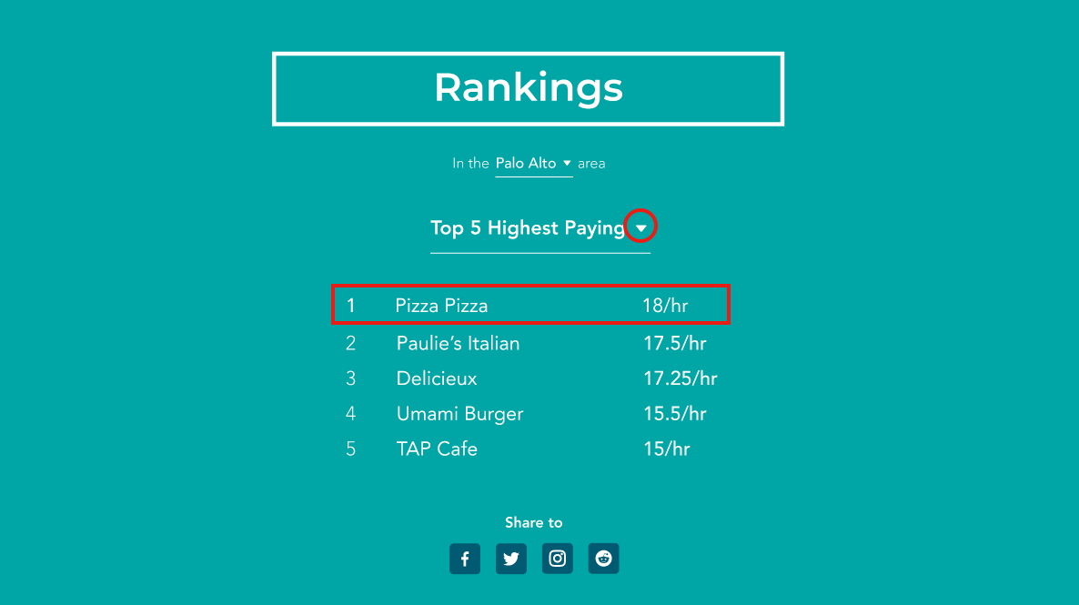
Sev 3 & 4 Clarity Issues - Fixed!
All features intended for high-fidelity!

Slide 7
Recognition/Recall - Sev 3
Comparison page is unclear about its purpose when navigated to.

Slide 8
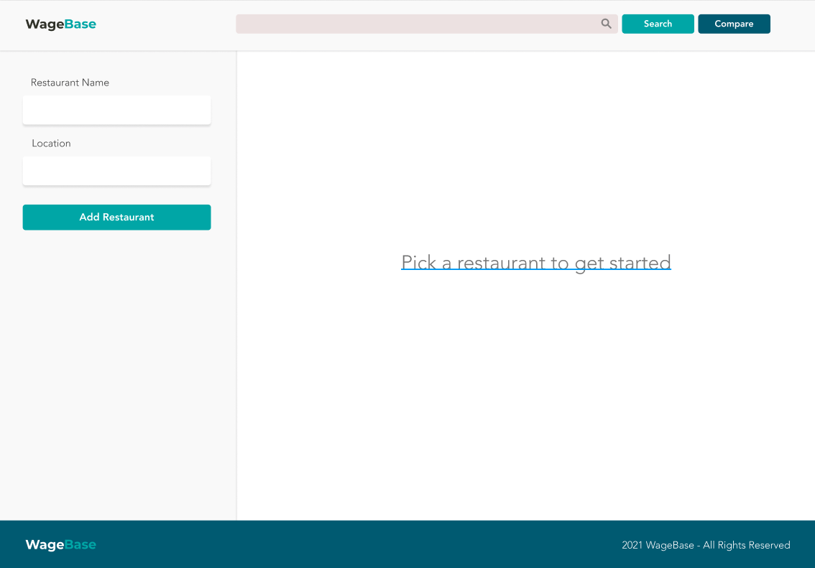
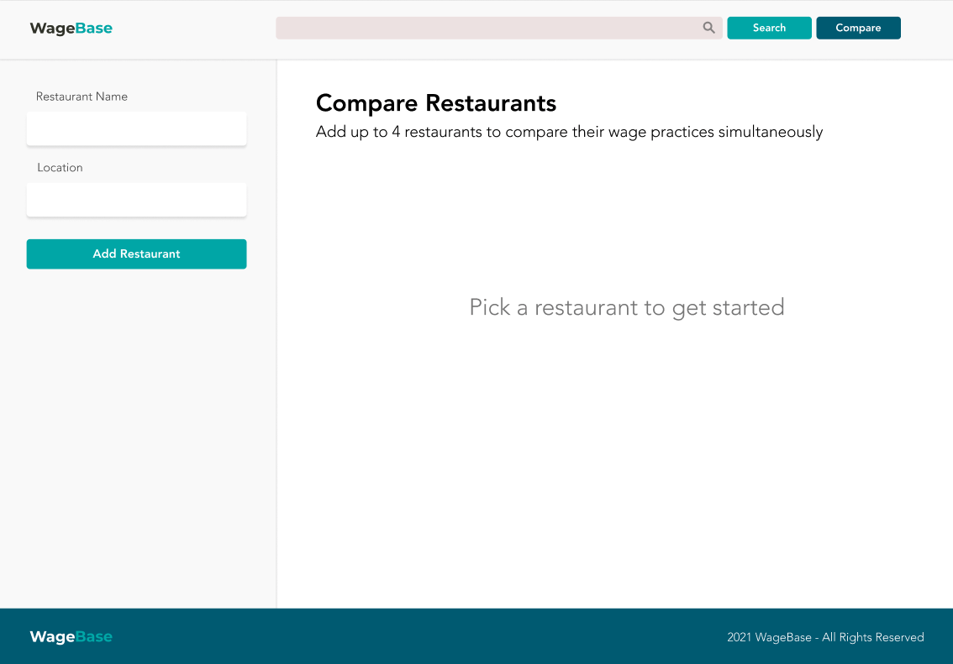
Page Clarity - Sev 3 - Fixed
Added a title for users first coming to the page and a description.
Before
After

Slide 9
Help and Documentation - Sev 4
New users would be unsure how to begin using the site and its purpose

Slide 10
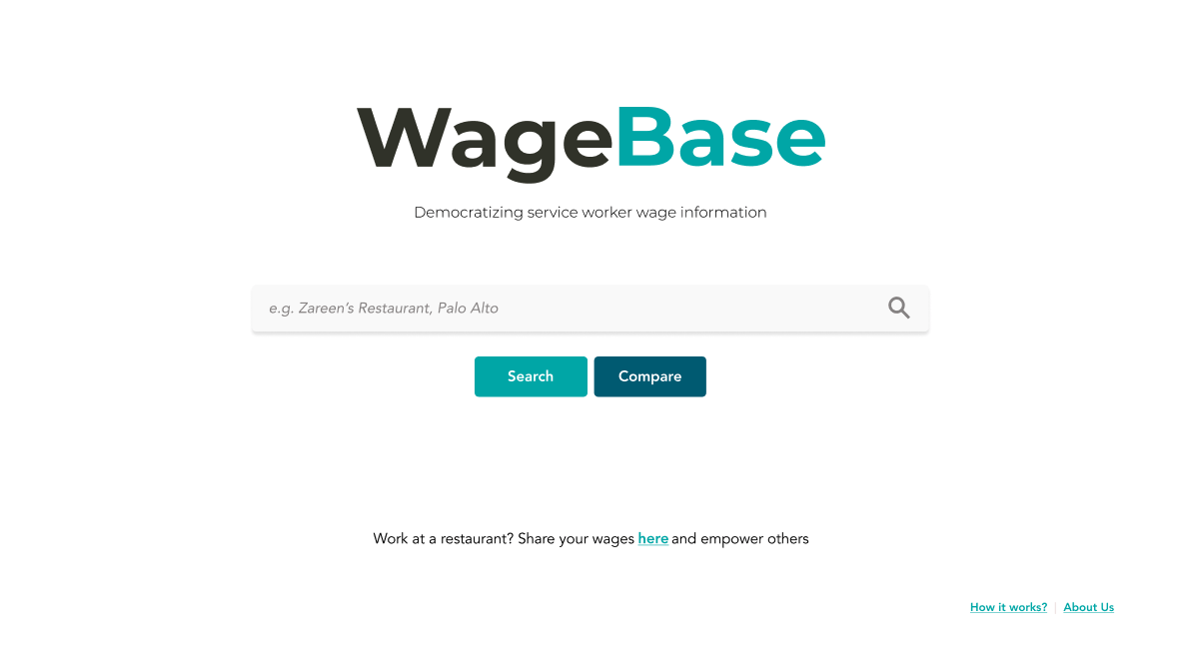
Help and Documentation - Sev 4 - Fixed
Added a tagline and a help section from the first page

Slide 11
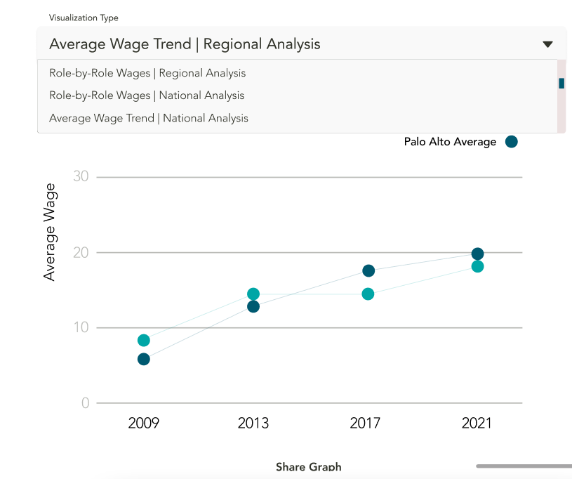
Match b/w System & World - Sev 3
Visualization type labels too technical and potentially unclear to an average user

Slide 12
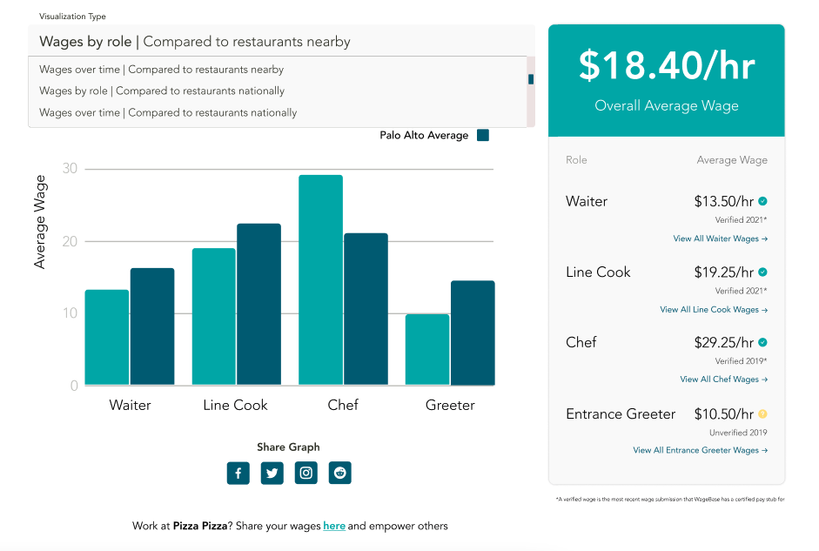

Slide 13
Flexibility & Efficiency of Use - Sev 3
Unable to navigate to restaurants from compare section
Removing a submitted wage
Filtering search results
Location required when searching for restaurants
Bookmark buttons for add/remove in the same position and share a color

Slide 14
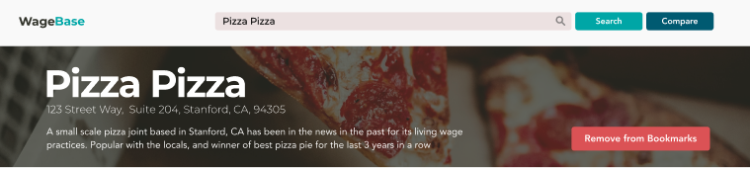
Flexibility & Efficiency of Use - Sev 3 - Fixed
Added more robust navigation between pages
Added functionality to remove a wage
Filtering search results by highest and lowest wages now
Location requirement removed
Bookmark buttons change color on press

Slide 15
Hi-Fi Prototype Implementation

Slide 16


Design/Prototyping Tools
Photoshop + Canva for graphs and data visualizations
Figma for UX design and prototyping
ReactJS for web page design
VSCode IDE

Slide 17
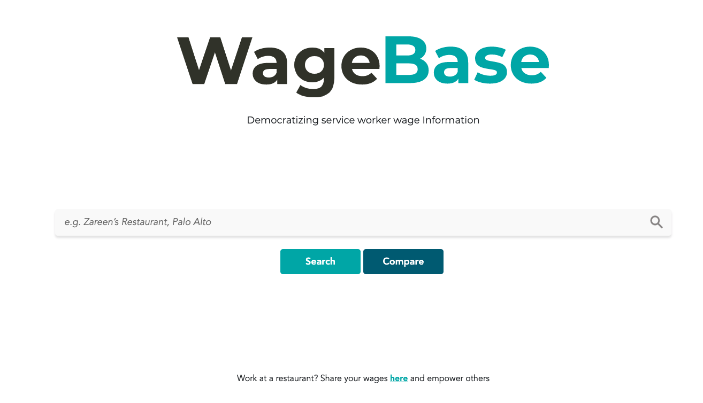
Implemented Features
Search flow and bookmarking
Adding a restaurant
Comparing restaurants
Most crucial heuristic feedback
(Will be shown in demo)

Slide 18
Unimplemented Features
Minor design changes
Minor routing changes

Slide 19
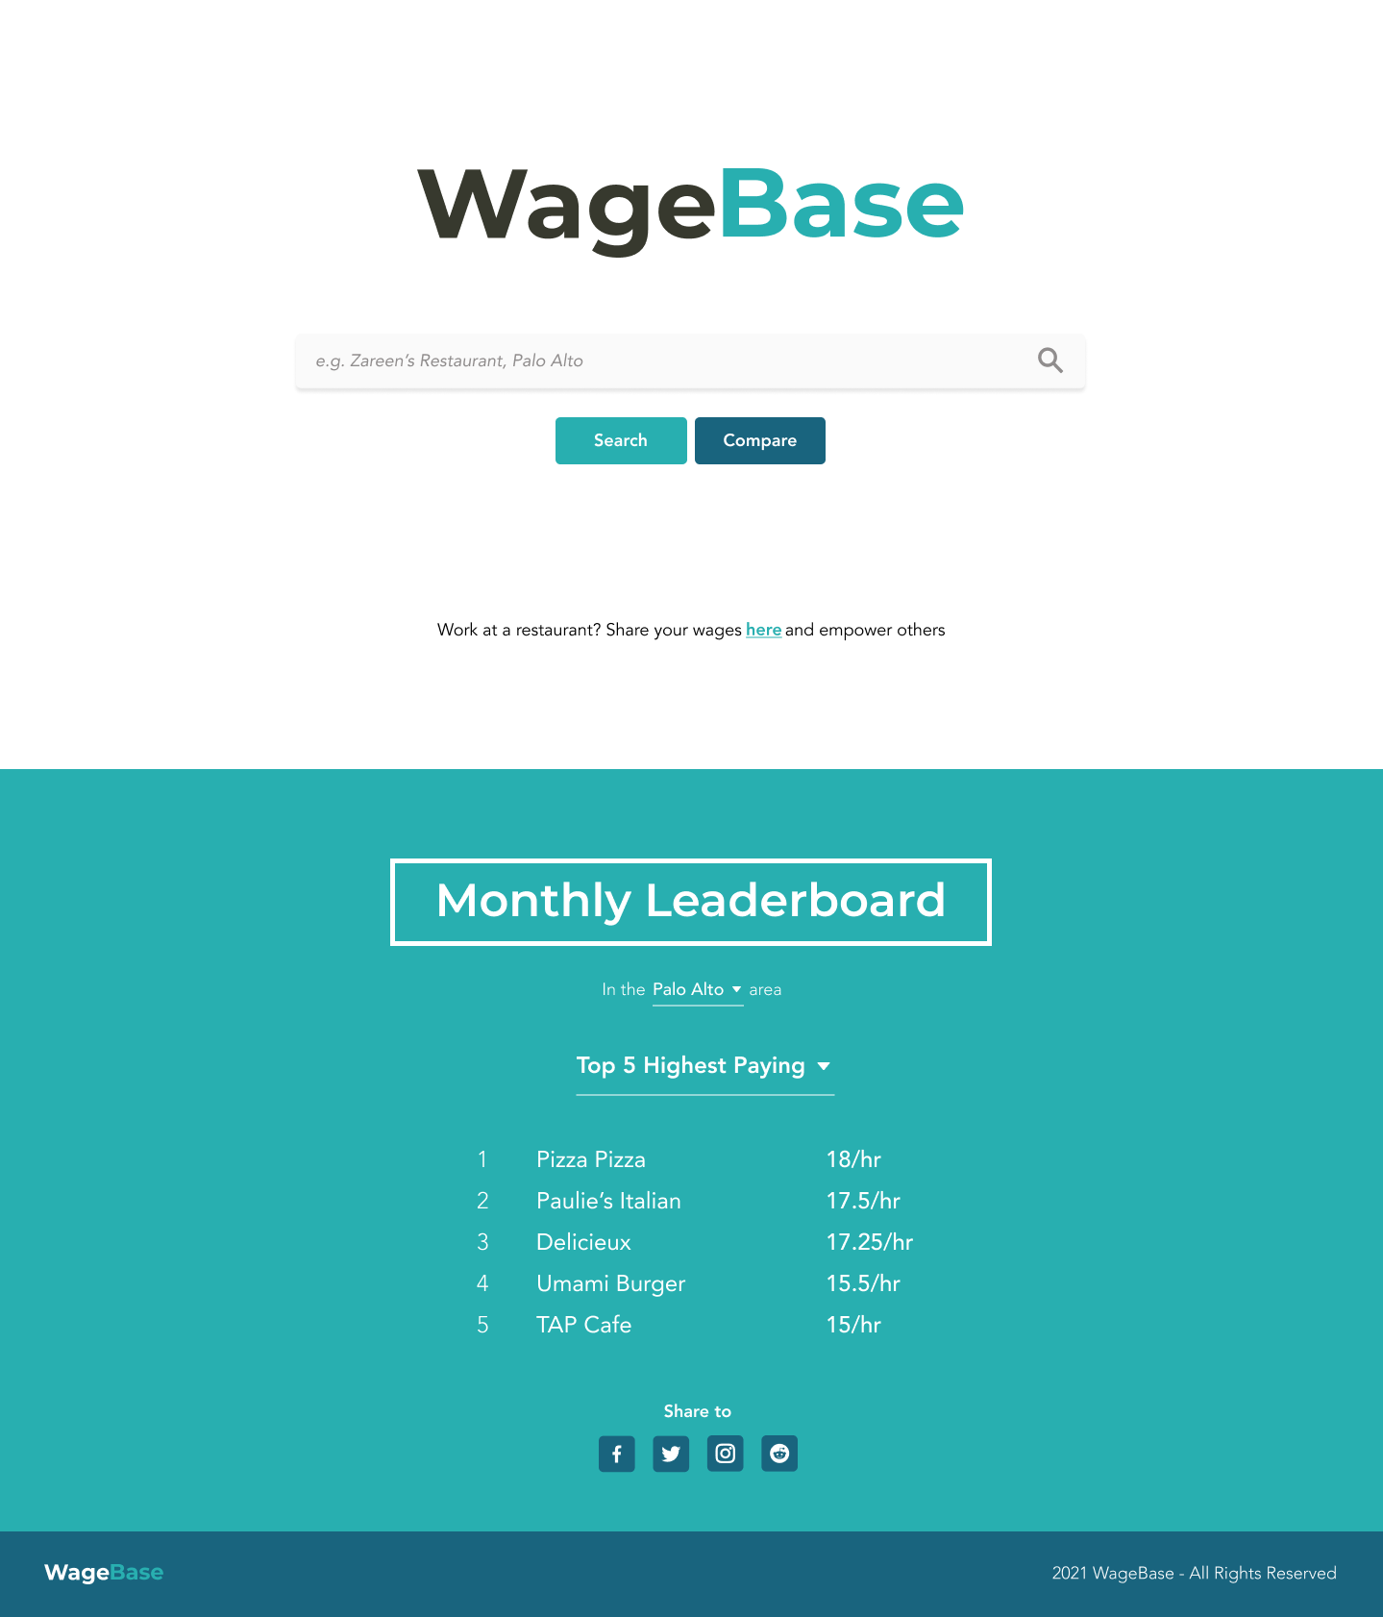
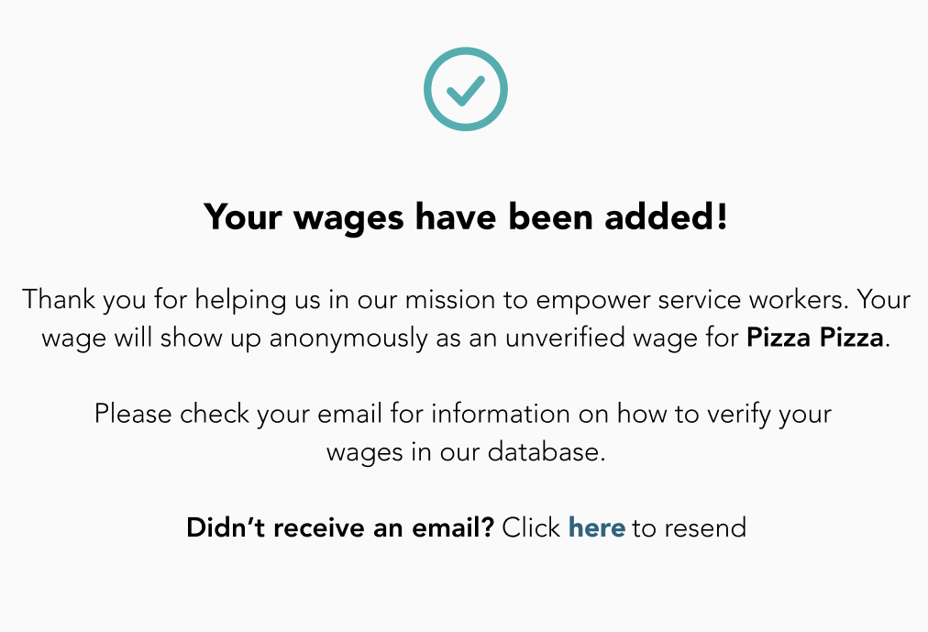
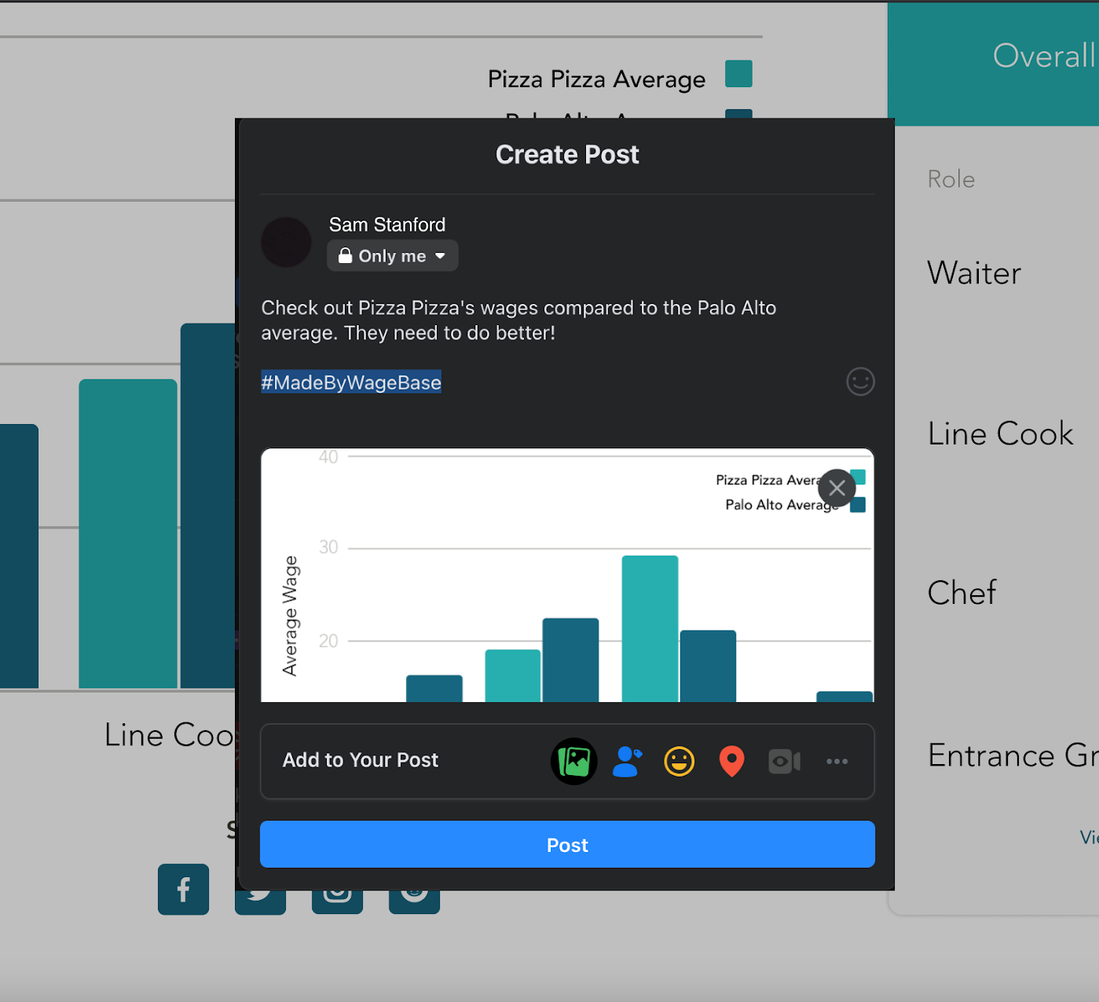
Wizard of Oz Techniques
Location selection
Happens automatically since no way to get user’s location
Wage Verification
Pay stub verification ‘simulated’ over secure email behind the scenes
Share to Social Media
Sign in process to social platform posting is ‘fast-forwarded’

Slide 20
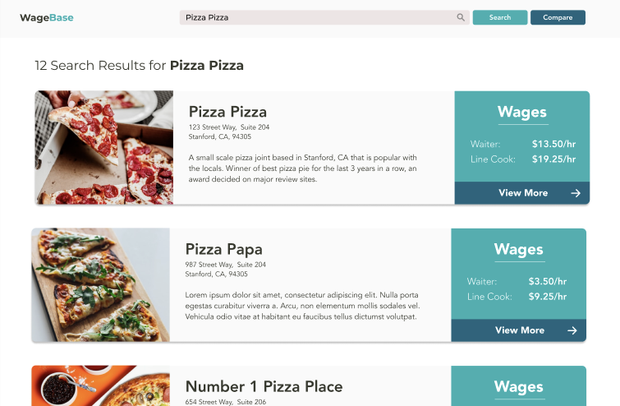
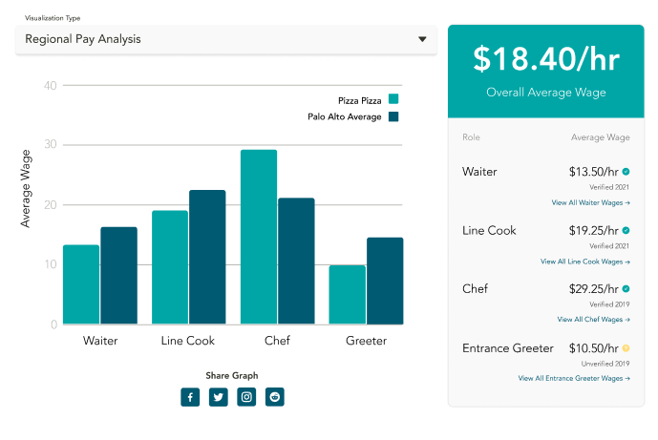
Hardcoded Features
Search Queries (need sample queries to illustrate prototype)
Search results (no backend database)
Graph visualizations (random generated data)

Slide 21
Demo!

Slide 22
Summary
21 changes from heuristic feedback
Demo is basically at finished state with minor QOL changes left
On track for the final deadline

