Slide 1
WageBase
Week 5:
Low-fi Prototyping & Pilot Usability Testing
CS147 Winter 2021

Slide 2


The Team
Girish Kumar
Andy Wang
Saljuk Gondal

Slide 3
Background
Interface Selection
Low-fi Prototype
Prototype Experiment
UI Changes & Summary
Mission Statement
Value Proposition
3 Task Flows
Method Results

Slide 4
Background
Interface Selection
Low-fi Prototype
Prototype Experiment
UI Changes & Summary
Mission Statement
Value Proposition
3 Task Flows
Method Results

Slide 5
Background
Mission Statement
Our mission is to:
Empower workers within the service industry to live more economically and environmentally sustainable lives

Slide 6
Background
Value Proposition
Democratizing service worker wage information
WageBase

Slide 7
Background
Interface Selection
Low-fi Prototype
Prototype Experiment
UI Changes & Summary
Mission Statement
Value Proposition
3 Task Flows
Method Results

Slide 8
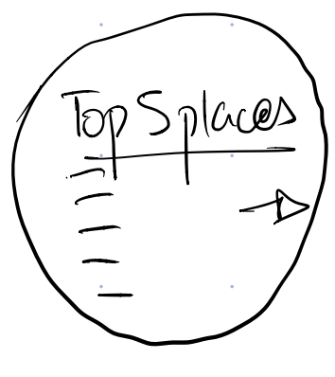
Tried a bunch of interfaces...

Slide 9
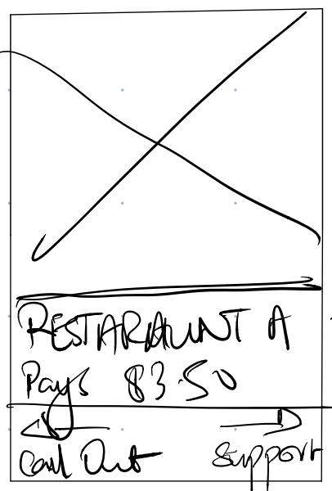
Tried a bunch of interfaces...

Slide 10
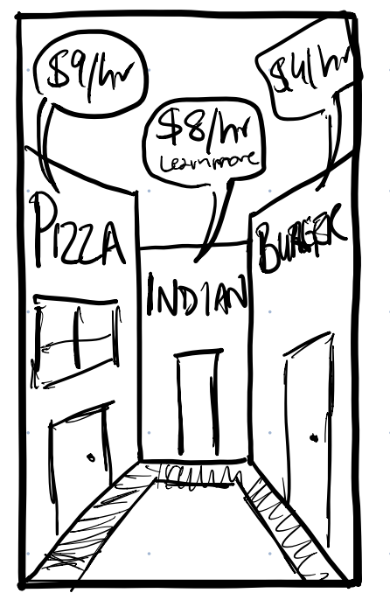
Tried a bunch of interfaces...

Slide 11
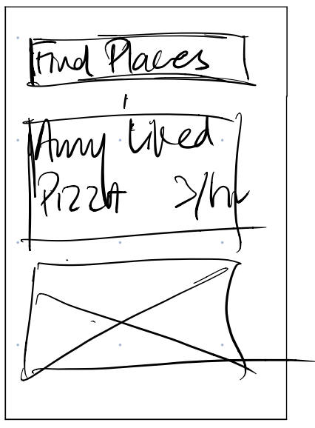
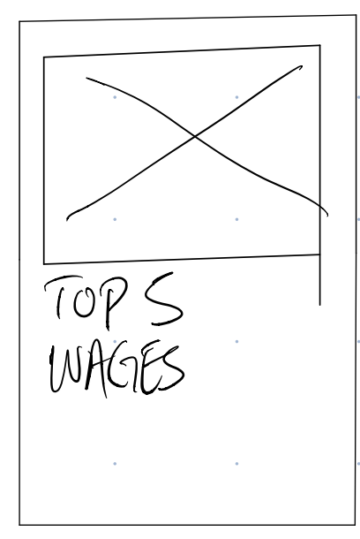
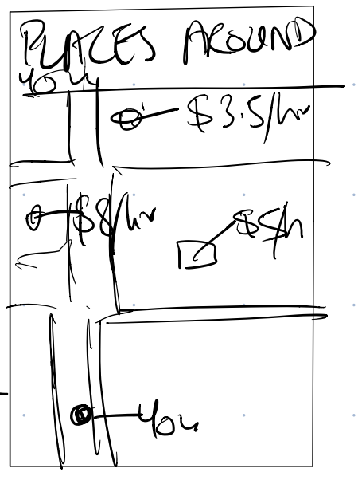
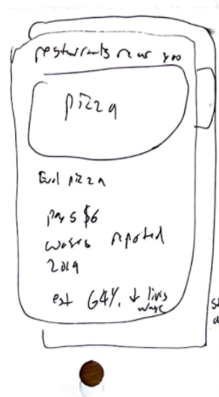
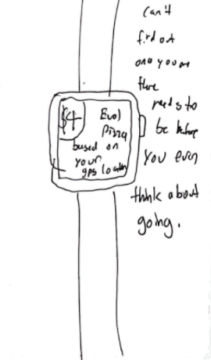
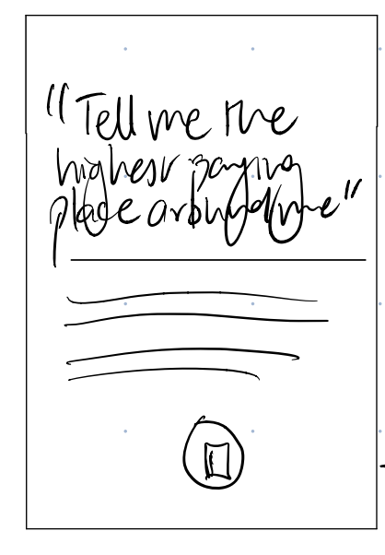
Tried a bunch of interfaces...

Slide 12
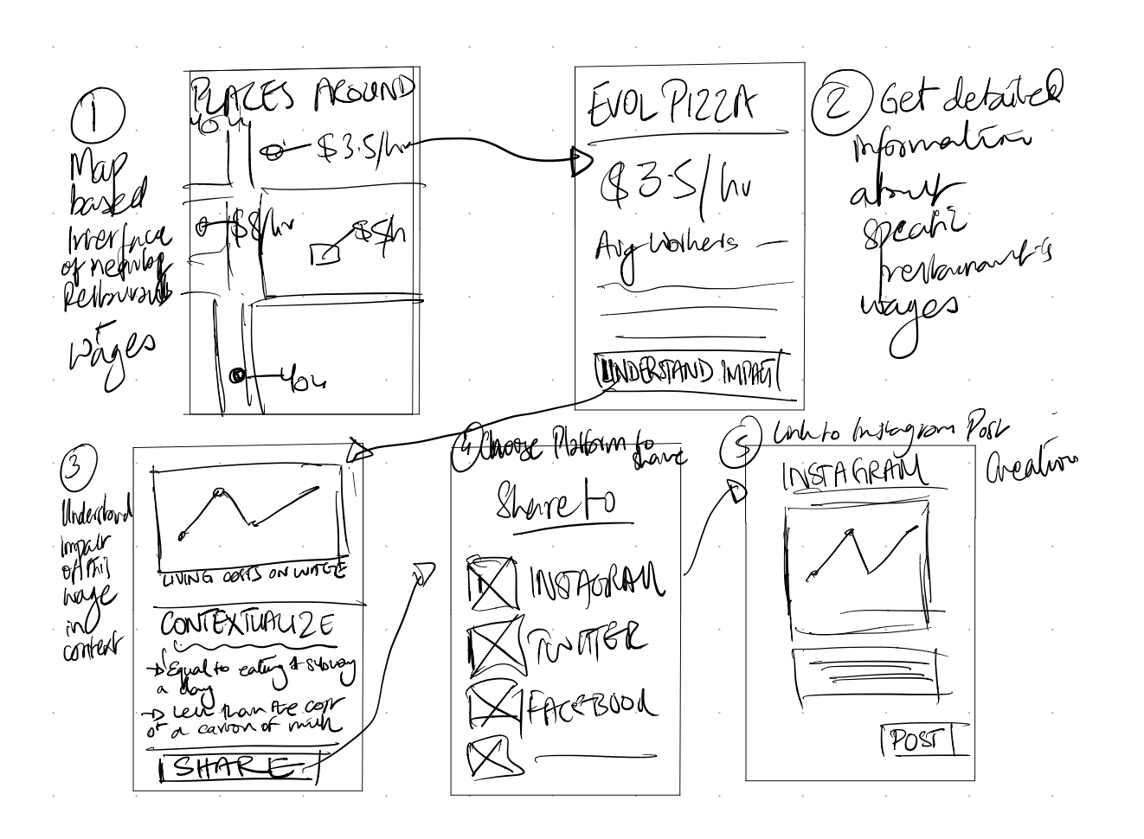
The Final Two
Option 1:
Map-Based Mobile App
Map shows restaurants around your location with their wages prominently labelled

Slide 13
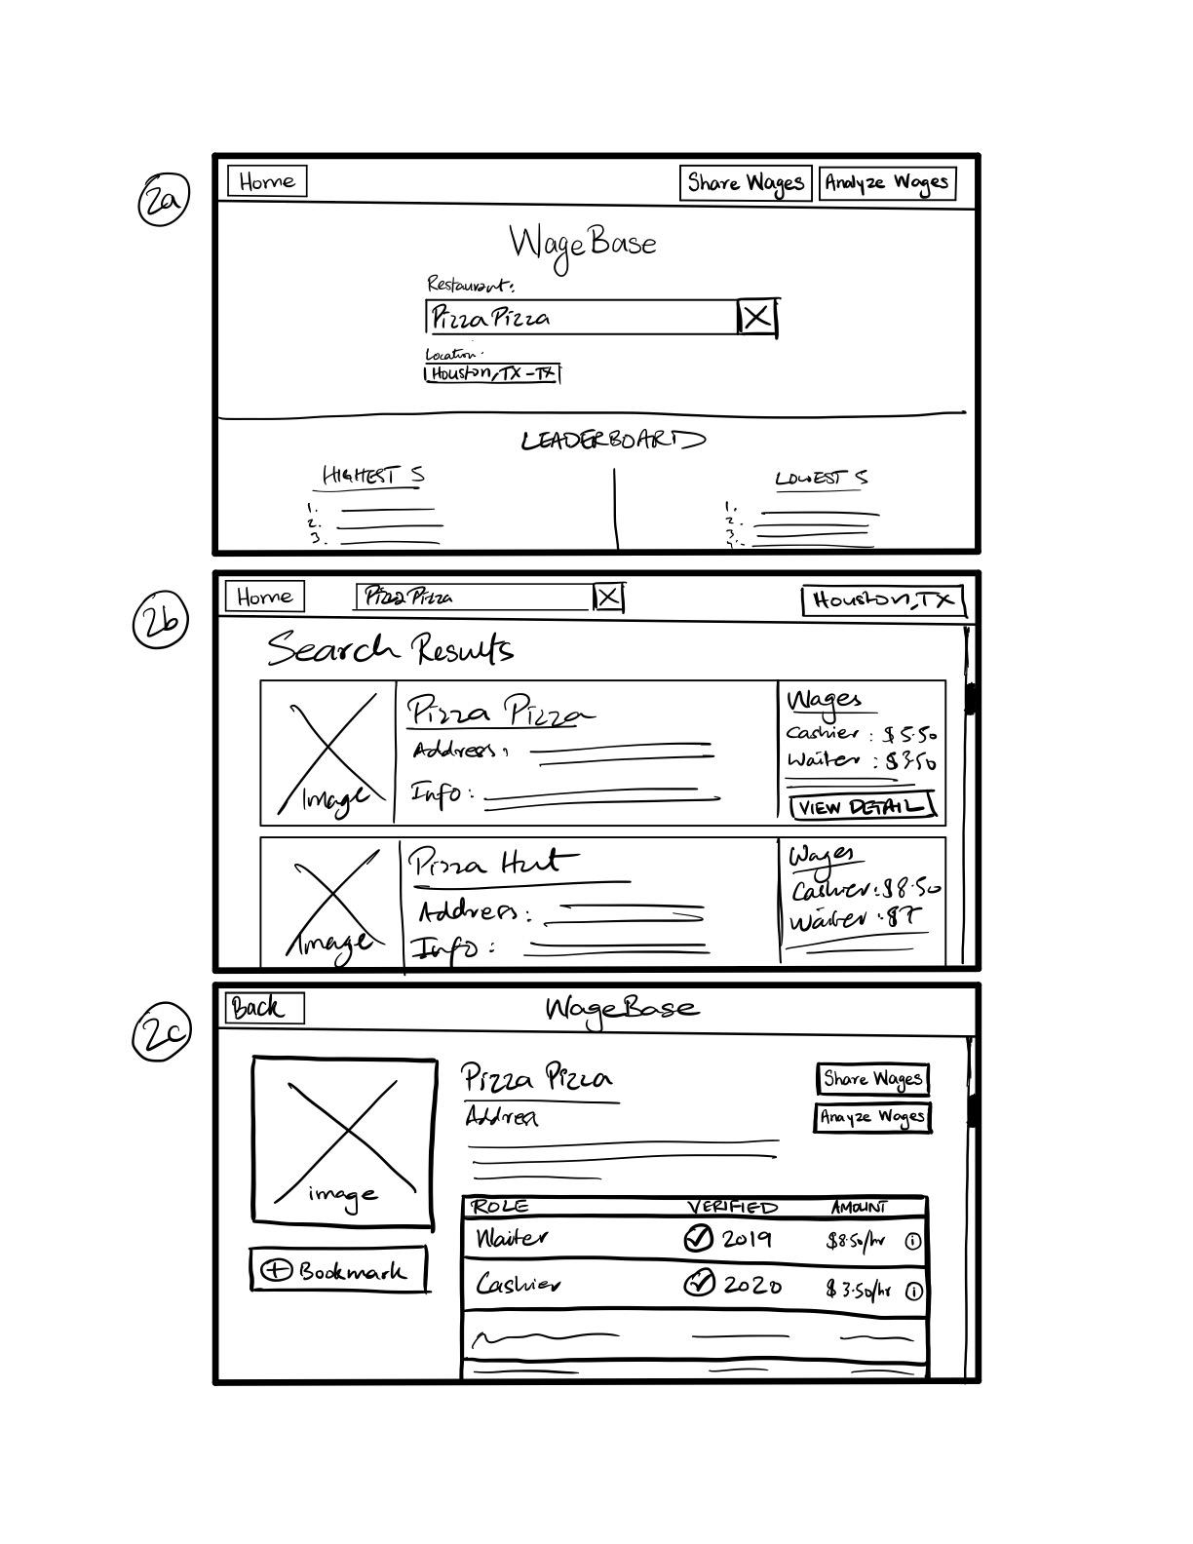
The Final Two
Option 2:
‘Search-Engine’ Web App
Search for restaurants and view information about the top results

Slide 14


Going with ‘Search-Engine’ Web
Activation energy to download mobile app
Wage info- visualizations best work on web/larger viewports
Location emphasis reduces scale of issue

Slide 15
Background
Interface Selection
Low-fi Prototype
Prototype Experiment
UI Changes & Summary
Mission Statement
Value Proposition
3 Task Flows
Method Results

Slide 16
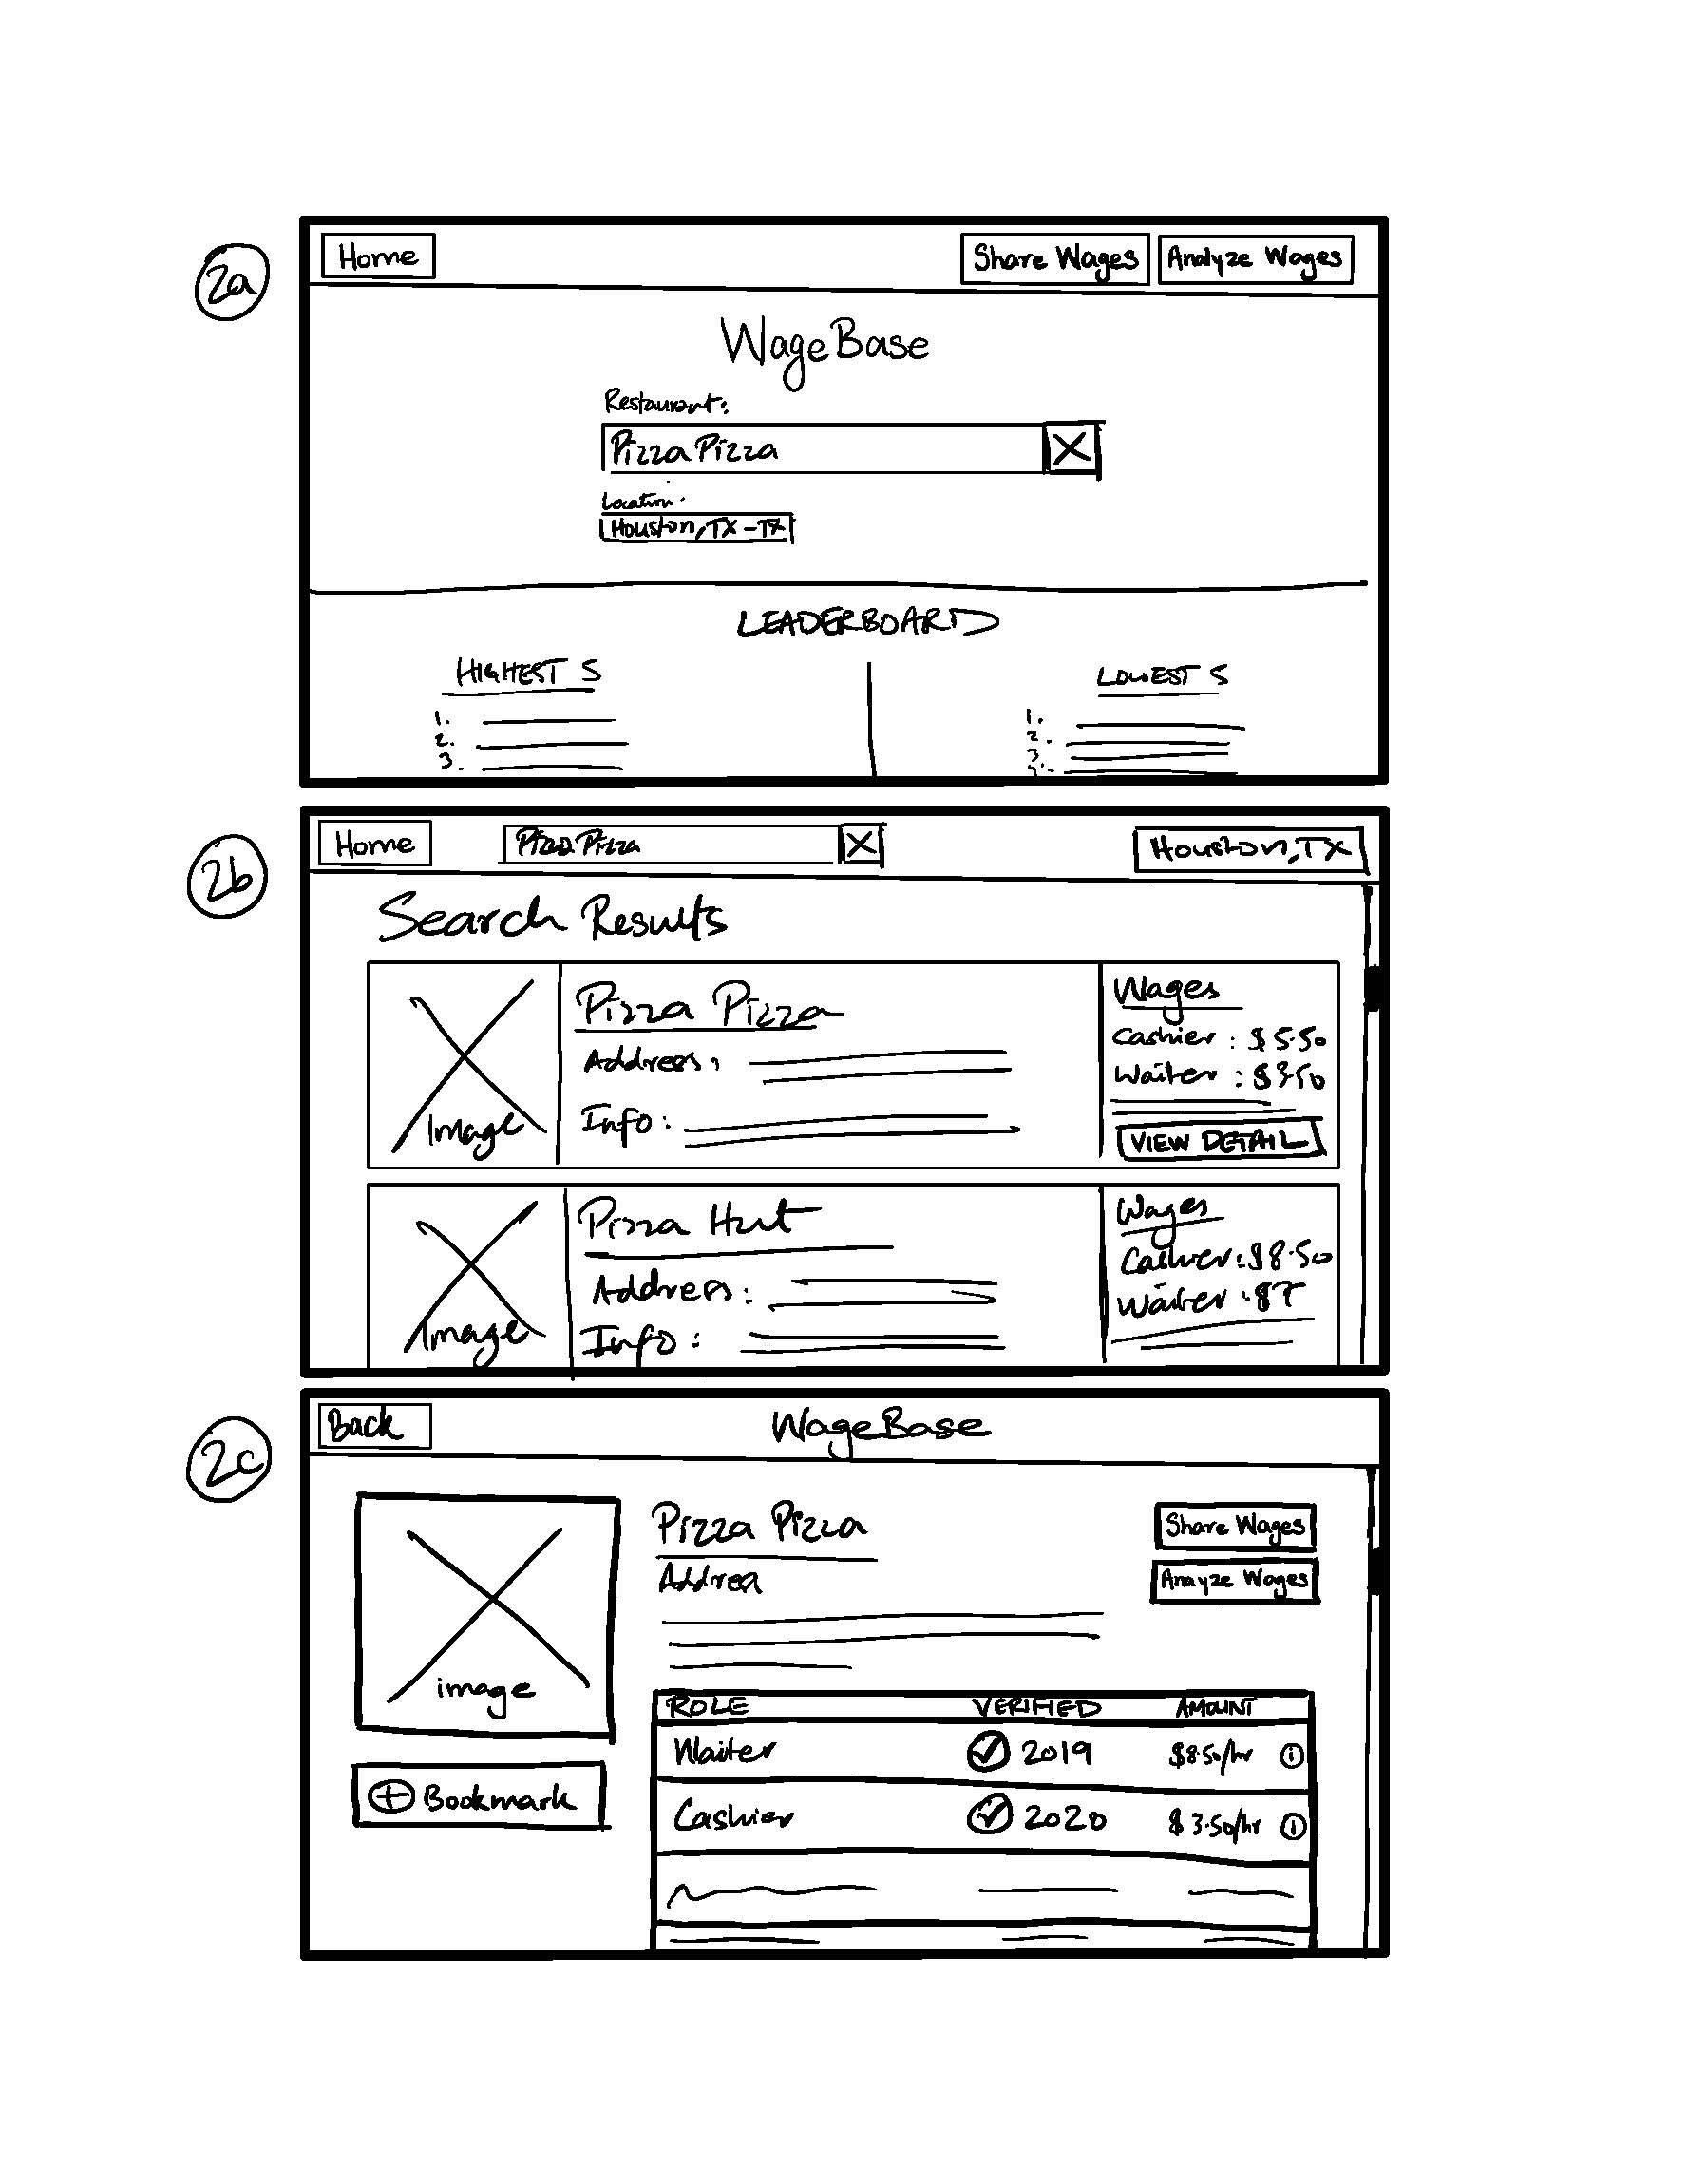
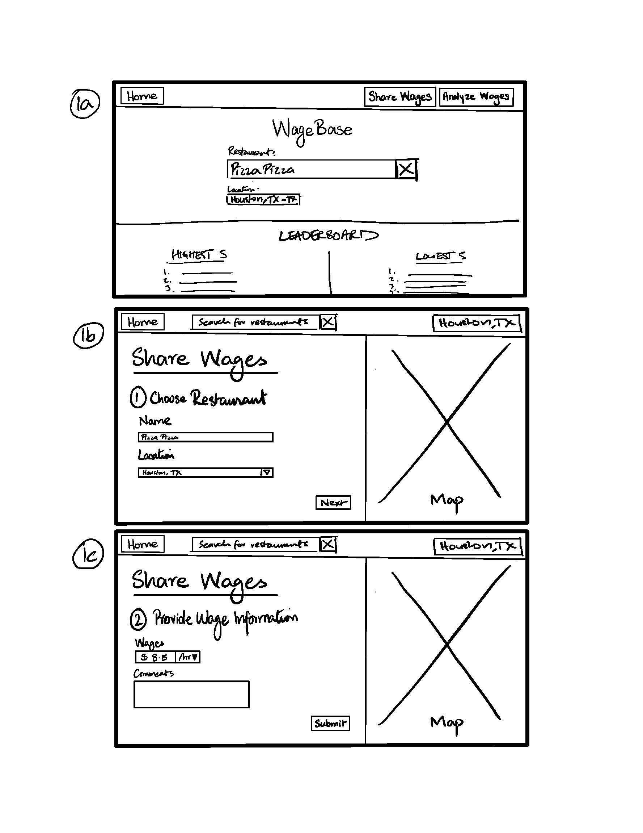
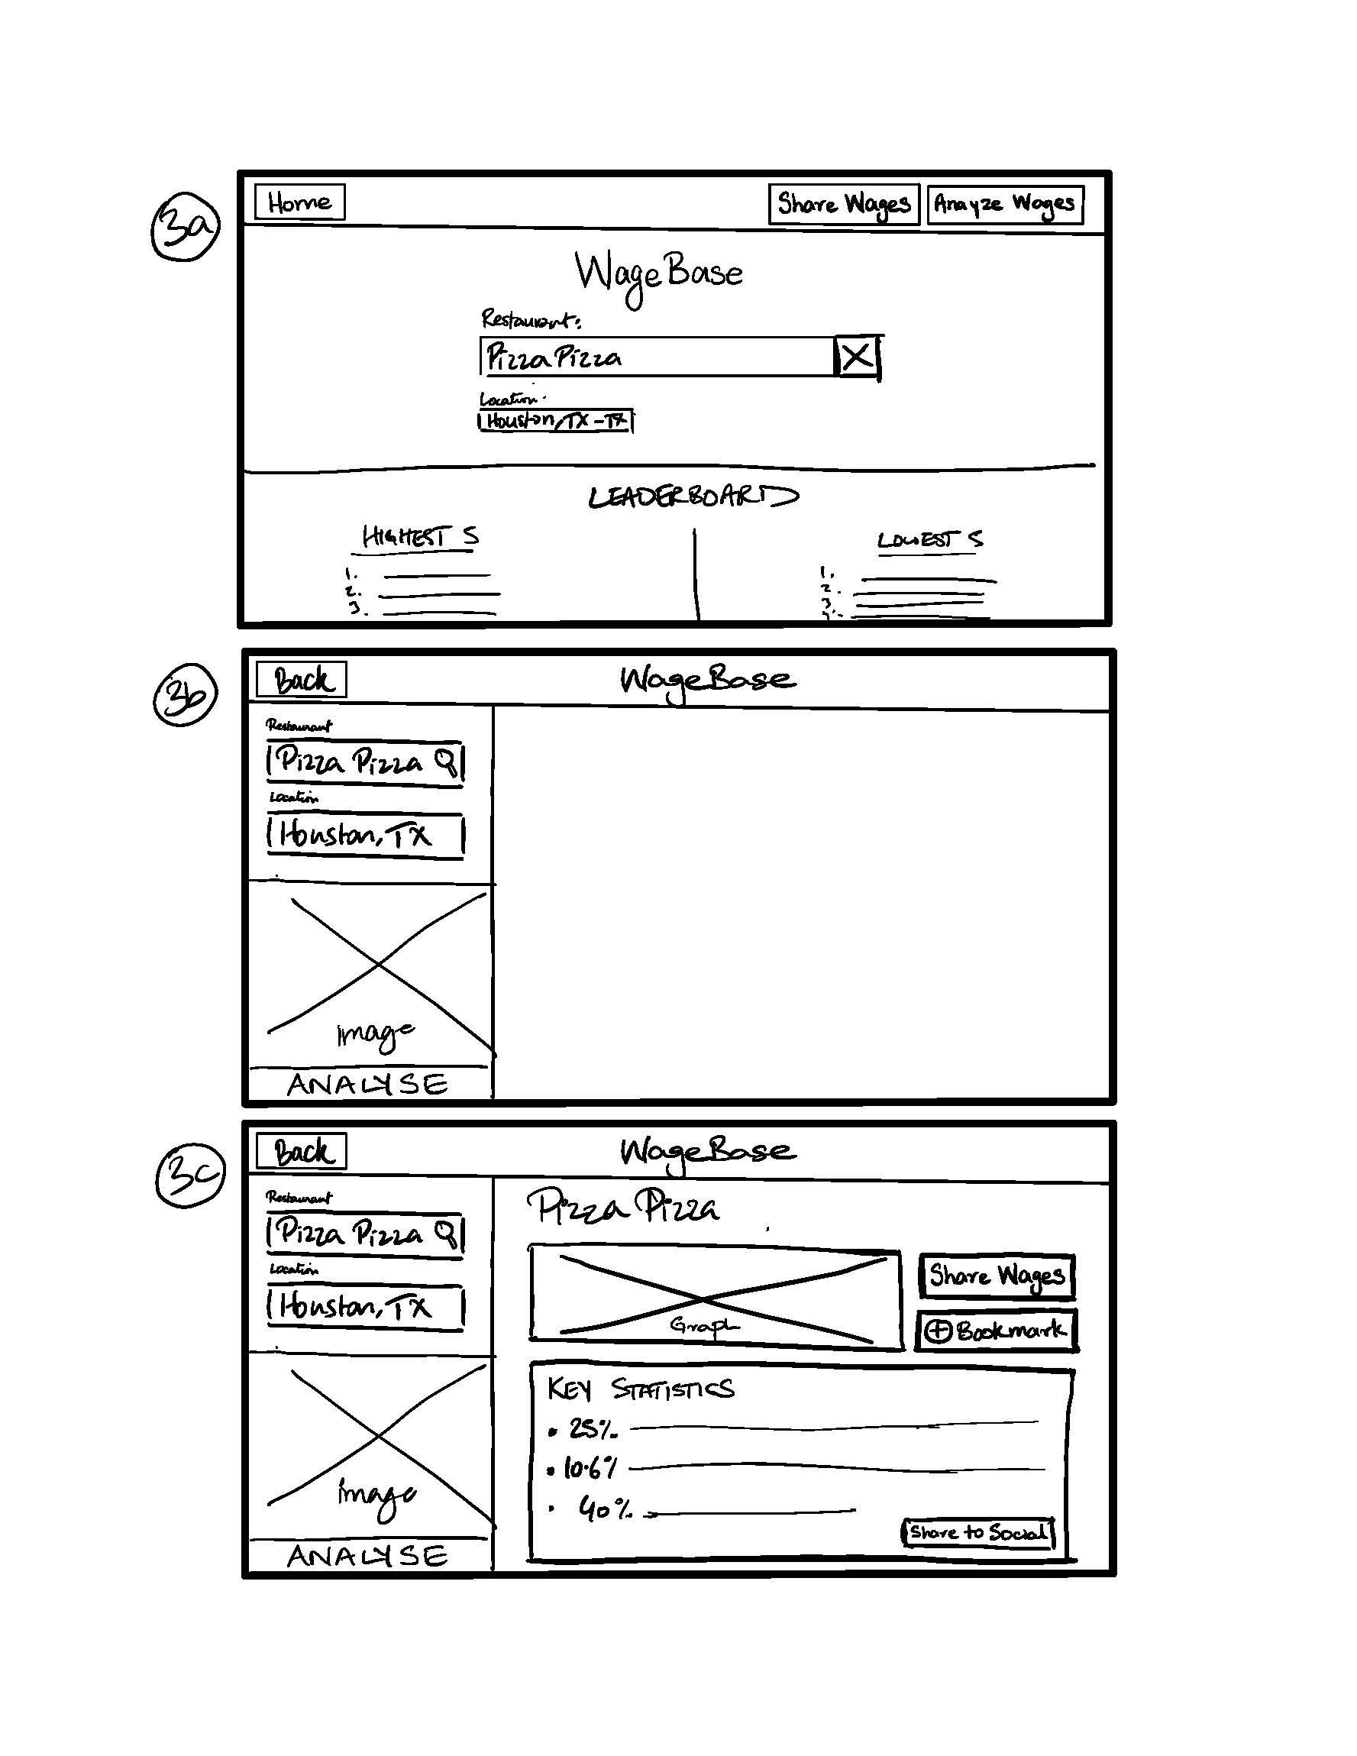
Low-fi Prototype
Paper prototype
Web Interface
Press on ‘clickable’ buttons to interact between different screens

Slide 17
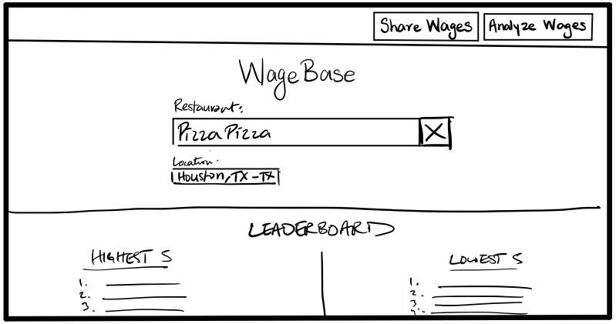
Home Page
Base-ground for all tasks

Slide 18
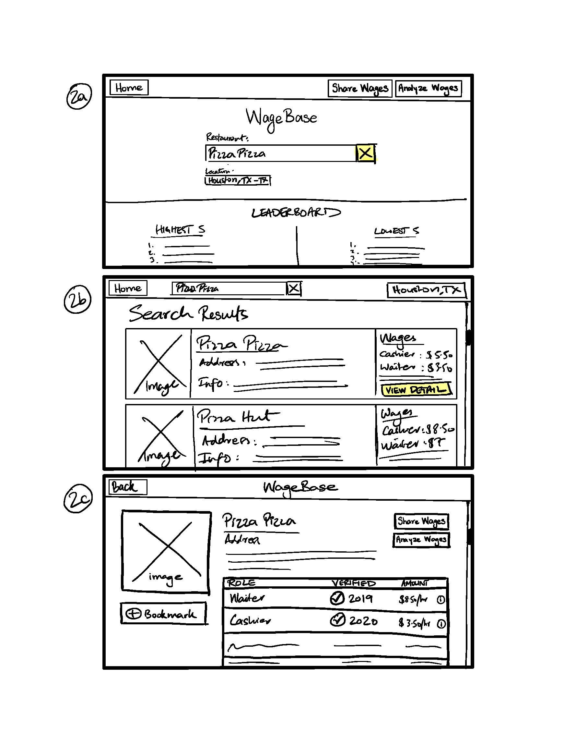
1. Search for restaurant on home page
Task 1
Find information about a restaurant’s wages
2. Select restaurant from search results
3. View wage details of restaurant

Slide 19
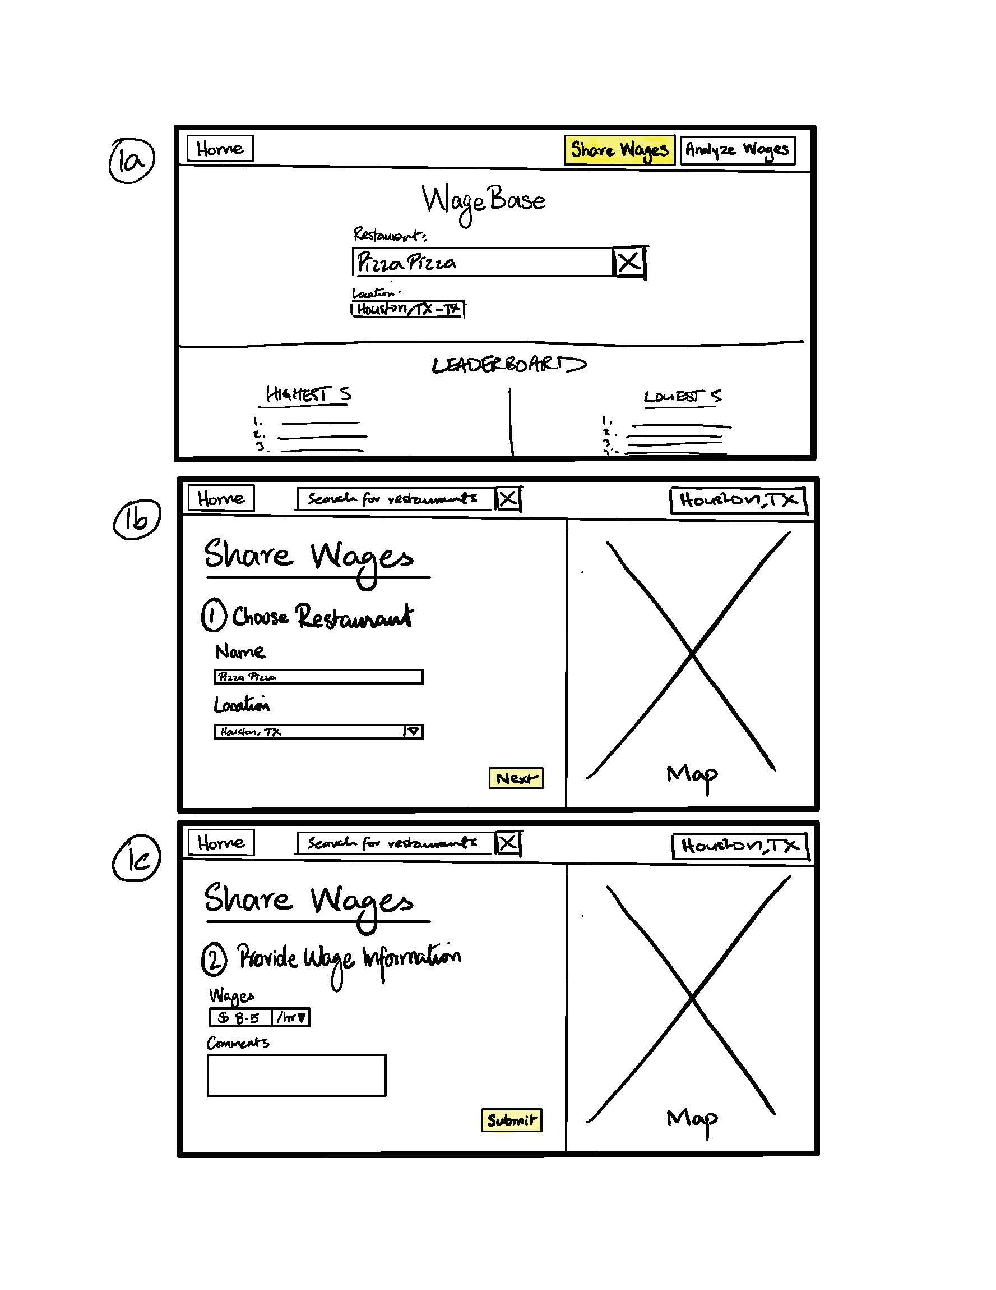
1. Click Share Wages from home page
Task 2
Share information about a restaurant’s wages as a service staff member
2. Choose restaurant for which you wish to share wages
3. Provide wage information and submit

Slide 20
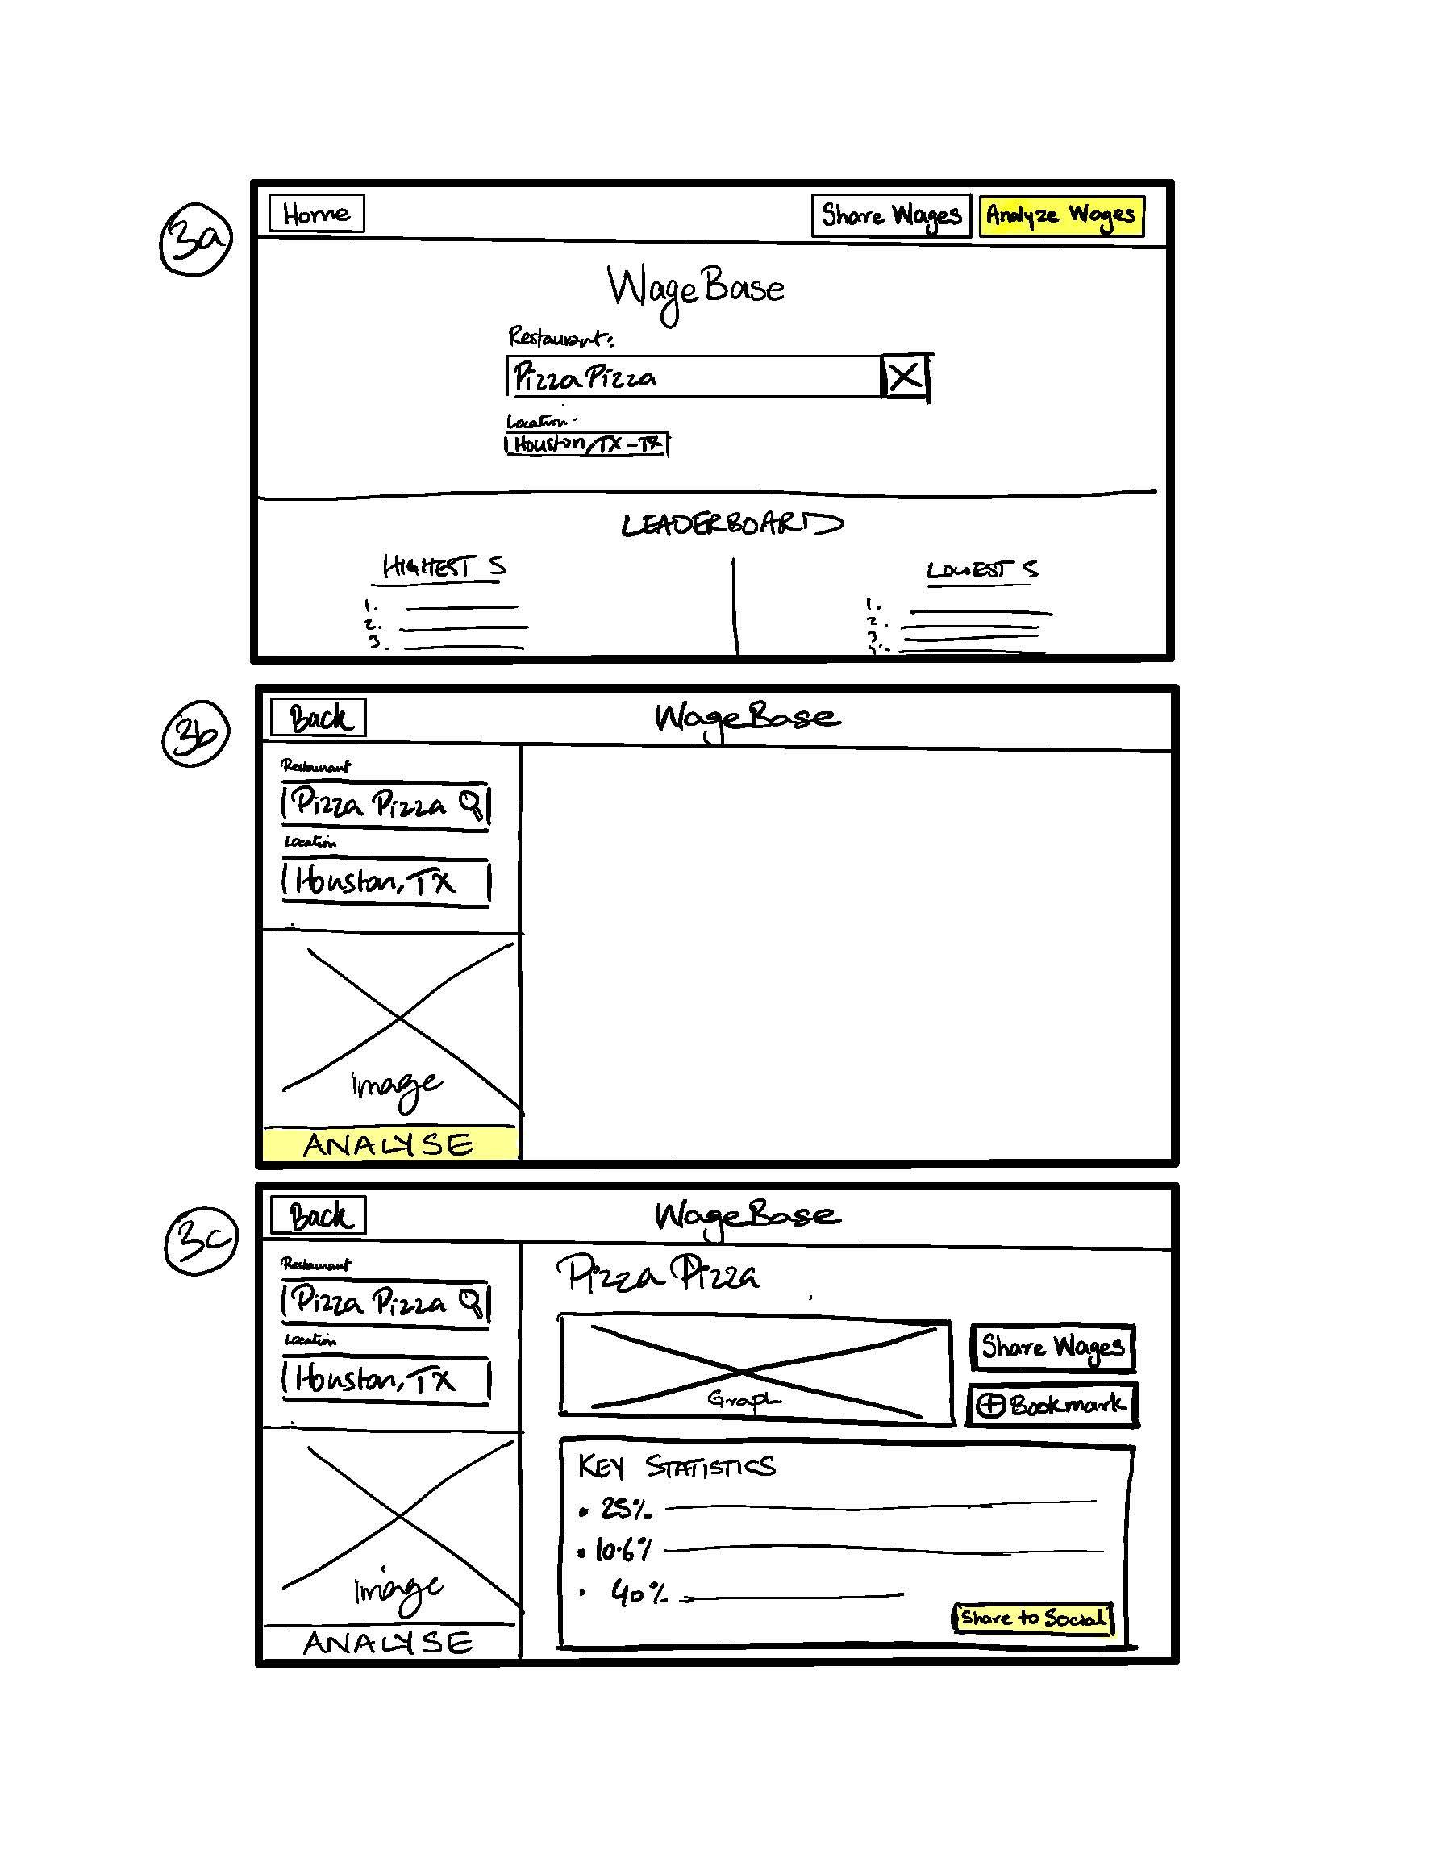
1. Click Analyze Wages from home page
Task 3
Understand how a specific wage shapes worker lifestyles
2. Choose restaurant for which you wish to analyze wages
3. View interactive visualized information and statistics about wage lifestyles. Can share on social media

Slide 21
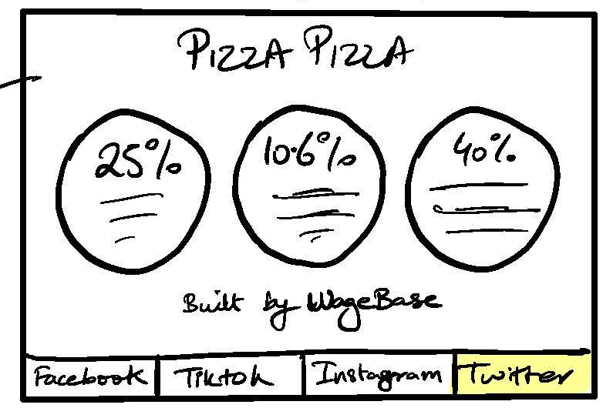
1. Click Analyze Wages from home page
Task 3
Understand how a specific wage shapes worker lifestyles
2. Choose restaurant for which you wish to analyze wages
3. View interactive visualized information and statistics about wage lifestyles. Can share on social media

Slide 22
Background
Interface Selection
Low-fi Prototype
Prototype Experiment
UI Changes & Summary
Mission Statement
Value Proposition
3 Task Flows
Method Results

Slide 23



Experiment
Method
Participants
Sophomore at Wellesley
Waiter at local restaurant
Server at tea shop

Slide 24
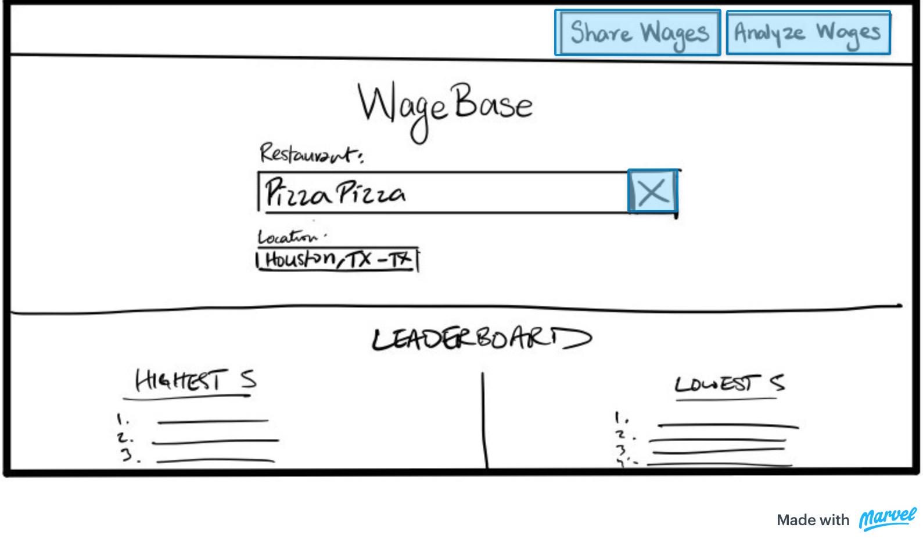
Experiment
Method
Environment/Setup
Zoom interviews
Paper Prototype set up on Marvel POP; had participants share screen so we could monitor their interaction and their reactions
Had them perform our 3 main tasks
Monitored behavior for success and issues, and verbal comments

Slide 25
Experiment
Results
Successes
All participants were able to perform all 3 tasks successfully
The majority of the tasks were found to be very straightforward and took very little time
No errors were made in accomplishing the tasks

Slide 26

Experiment
Results
Issues
Even though all tasks were eventually performed successfully, 2 participants hesitated when confronted with search results page -- clutter
One participant was not sure if they had successfully shared wages -- no feedback
Some confusion between ‘Share’ button for wages and ‘Share’ button for uploading graphics to social media

Slide 27
Experiment
Results
Verbal Comments
Positive
Negative
“Oh I would so use this!” - seemed excited by the platform idea
“I dig the social media integration”
“This seems too easy” - on the ease with which wages was shared. Displayed lack of trust
“I want these graphs to be more prominent” - on the analyze wages task

Slide 28
Background
Interface Selection
Low-fi Prototype
Prototype Experiment
UI Changes & Summary
Mission Statement
Value Proposition
3 Task Flows
Method Results

Slide 29
UI Changes
Build a feedback/confirmation loop in the Share Wages form to establish trust
Simplify Search Results
Modify graph layout in Analyze Wages to have greater emphasis
Clarify distinction between users sharing to social media and service staff sharing wages

Slide 30
Summary
Users were passionate about the platform’s goal; felt it tackles a very pressing problem
Users believed they would use the platform, especially to look up restaurant wages and analyze their impact
Users desired simplicity in searching for restaurant wages and sought greater trust in platform’s sharing of wages (even if makes the process longer)
Easy Social Media Integration is crucial for users

Slide 31
Democratizing service worker wage information
WageBase

