Slide 1

Service Industry
Sustainability
Andy Wang, Girish Kumar, Saljuk Gondal

Slide 2


Patrons
Workers

Slide 3


Walk me through your approach with workers and certain practices you follow?
How do you try to be sustainable?
Did your customers care about wastage?
What would make you avoid a particular place?
What frustrates you the most as a barista?
Would you pay more to eat at a more sustainable restaurant?
What ethical considerations do you take into account when deciding to go to a restaurant, if any?

Slide 4

Chris Oh
“Honestly as a worker and restaurant goer, I care more about the wages/cost. It costs money to be sustainable and it's a sacrifice that is tough to make right now on a student budget.”
Former Barista
(called)

Slide 5

Misha Zahid
“[I’m unsure what I’d do] if that restaurant was treating its workers badly. I don’t want to support it but also don’t want to deprive workers of their income.”
Restaurant enthusiast (zoomed)

Slide 6

Rittik Mitra
If i'm not aware of any bad practices, I don’t [really mind] … but generally wouldn’t pay more to eat at a sustainable restaurant.
Former Service Staff (called)

Slide 7
Results

Slide 8
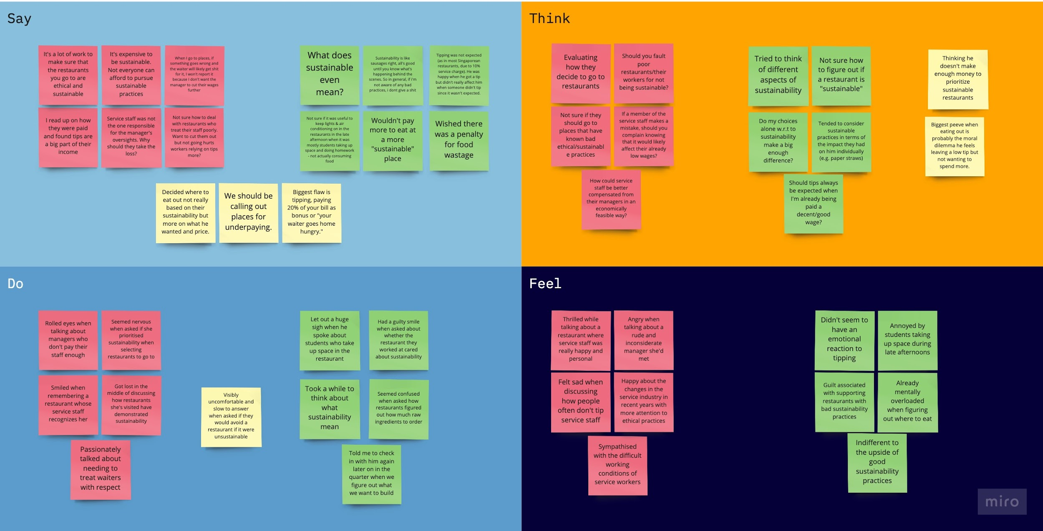

Slide 9
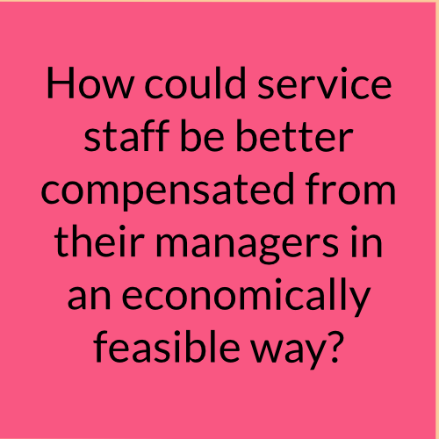
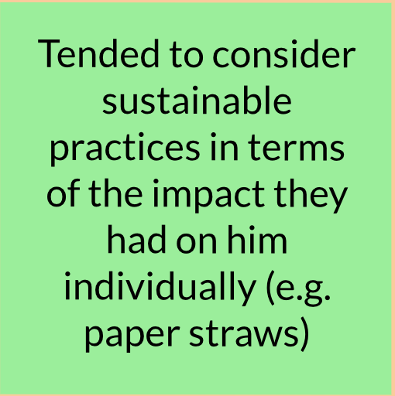
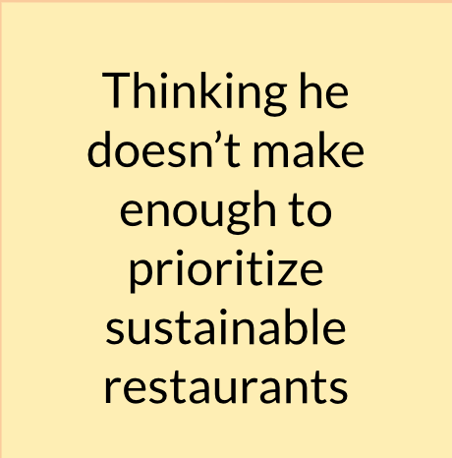
Think
“Do my choices alone w.r.t to sustainability make a big enough difference?”

Slide 10
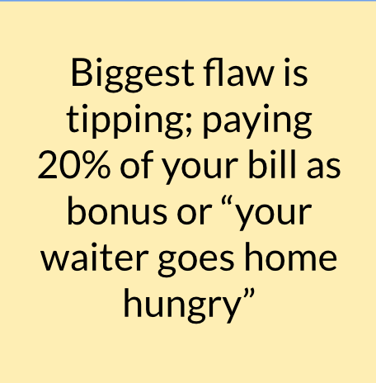
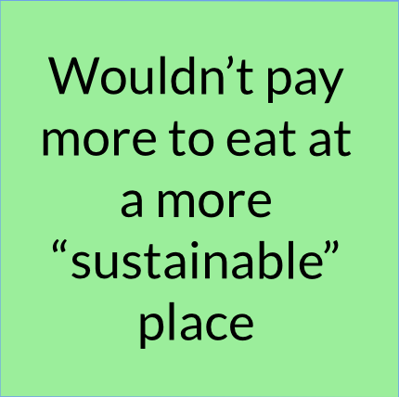
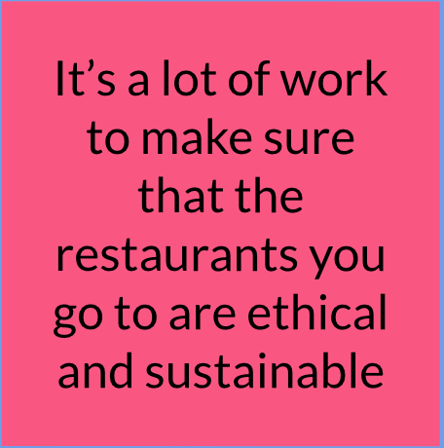
Say
“My worst restaurant experience was a worker yelling at me for leaving a low tip. They come after customers when it’s the managements fault for paying too little.” - Chris Oh

Slide 11
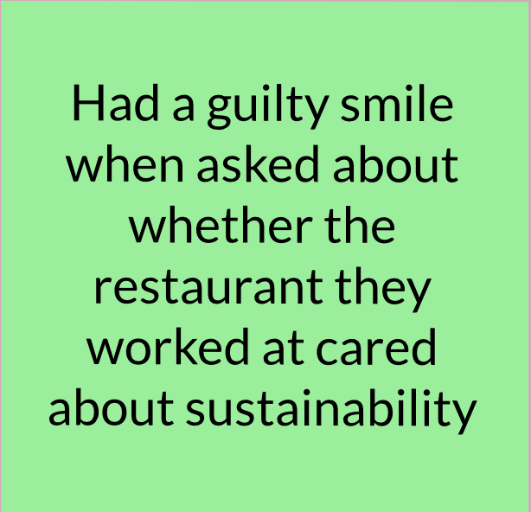
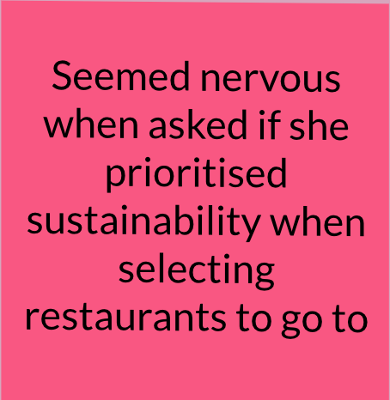
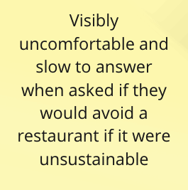
Do
Took a while to think about what sustainability meant

Slide 12
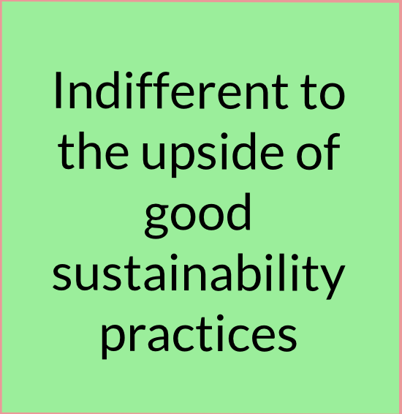
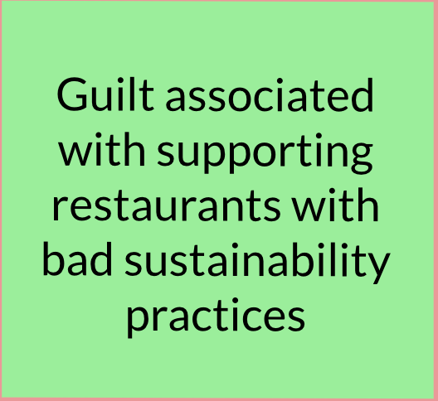
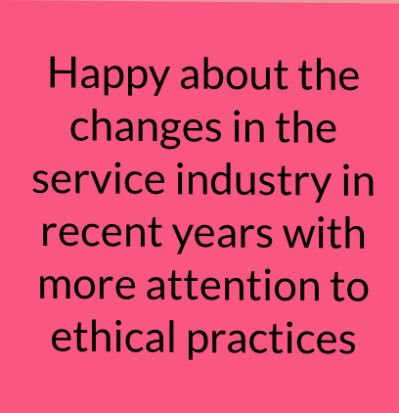
Feel
Already mentally overloaded when figuring out where to eat

Slide 13
Needs, Insights, and Analysis

Slide 14
Insight: Consumers don’t really know much about the operations of restaurants.
“If someone makes me aware of them or if it comes to my attention (Chick-Fil-a - anti lgbt funding), I don’t go. But don’t actively do it myself. ”
Need: Easy ways to access accurate information on things like wages, practices, etc.

Slide 15
Insight: Financial situations really influence sustainability considerations.
“In general, I wouldn’t pay more to eat at a sustainable restaurant. But it also depends on what their definition of sustainable means”
Need: More income

Slide 16
Insight: There’s a lot of tension between consumers and workers regarding tipping.
“As a minimum wage worker, you depend on tips to make enough, but on the other hand it feels weird having to pay 20% more on my bill just to sustain my waiter. ”
Need: More tension shifted onto restaurant owners to pay fair wages.

Slide 17
“I’ve heard some bad things about a restaurant I go to, but most of the time I just forget in the moment. It’s not exactly the first thing I ask myself when I go eat.”
Insight: People feel guilty if they eat at places with poor practices but will still go.
Need: More incentive to avoid such places.

Slide 18
Summary
We’re focused on the restaurant industry
Our interviewees span across both the worker and consumer sides of the industry
People shared similar sentiments that things like sourcing, recycling of food waste, etc. weren’t top priorities when choosing where to eat.
Were more focused on their economic situation and issues like wages as tipping became a contentious topic.

