Slide 1


LLM & Search
Tsinghua University
Web Information Retrieval
Team 4
Mauricio S. Montes 2026480075
Michelle A. Arceo XXXXXXXXXX
Ada J. Vargas 2026480074

Slide 2



I. BACKGROUND & CHALLENGES
A brief history of “Finding”
Lexical Era (BM25)
Standard model for exact-match and named entities based on term frequency and document normalization.
Semantic Era (Dense Retrieval)
Bridges synonyms using latent vector space; shifts from token overlap to learned semantic geometry.
Generative & Agentic Era
RAG grounds LLMs in evidence. Future systems act as agents, iterating until the information goal is reached.

Slide 3


I. Background & Challenges
But…at what cost?
Grounding Failure
Operational Bottlenecks
Hallucinations persist even with retrieval; outputs must be verified for faithfulness and support.
Scaling dual encoders or rerankers involves critical trade-offs in throughput, GPU demand, and token costs.
Latency
Parametric Staleness
Recursive multi-stage pipelines (rewrite-retrieve-rerank) introduce non-trivial latency in production systems.
Parametric memory is static at training; RAG is required to mitigate copyright and bias grounding risks.
[3] Mauricio Montes. (2026). LLM and Search: From Lexical Retrieval to Agentic Information Retrieval. Tsinghua University Technical Report.

Slide 4
II. Approaches
The Pillars of Modern IR
Modern Information Retrieval (IR) has transitioned from static ranking to a multi-paradigm landscape where LLMs intervene in query rewriting, retrieval, and synthesis to optimize for task utility.
01
02
03
Dense Retrieval
RAG
Generative Search
Bridges the vocabulary mismatch by mapping queries and passages into a shared latent semantic vector space.
The default architecture for grounding generation in fresh, domain-specific evidence to mitigate parametric staleness.
Attempts to internalize retrieval by mapping queries directly to document identifiers via differentiable search indices.

Slide 5

II. Approaches
Dense Retrieval (DPR)
01
Mechanism: Bridges vocabulary mismatch by mapping queries and passages into a shared latent semantic vector space via dual encoders.
Constraints:
Sensitive to domain shift and training data quality.
Can collapse critical lexical distinctions for exact-match queries.
Best-Use Scenarios:
Paraphrase-heavy semantic search where intent is indirect.
Open-domain QA requiring semantic understanding.
Semantic Relevance
[3] Mauricio Montes. (2026). LLM and Search: From Lexical Retrieval to Agentic Information Retrieval. Tsinghua University Technical Report.

Slide 6
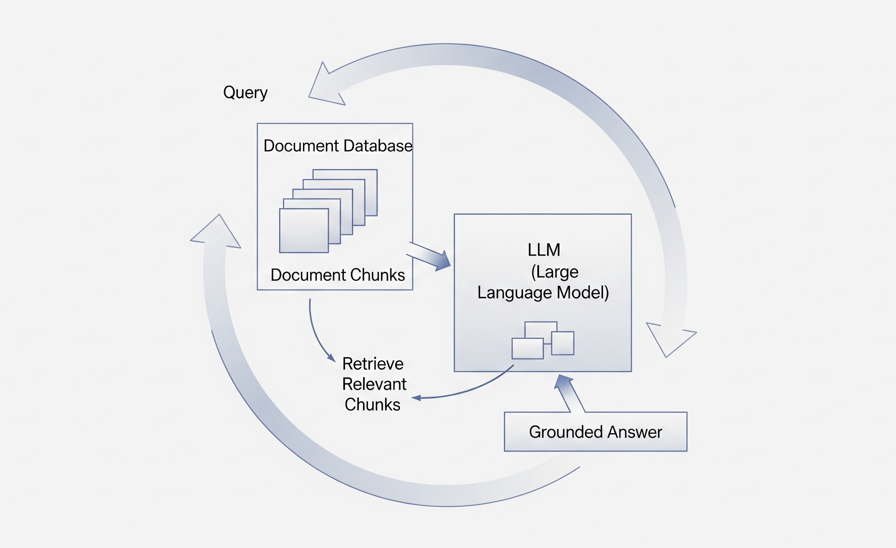
II. Approaches
02
Retrieval-Augmented Generation (RAG)
Mechanism: Retrieves external evidence at inference time to condition the LLM, grounding answers in up-to-date or domain-specific content.
Constraints:
Retrieval Failure: If the retriever misses evidence, the generator cannot recover.
Faithfulness: Models may ignore retrieved context or generate plausible but unsupported text.
Best-Use Scenarios:
Grounding generation in fresh or private data to mitigate parametric staleness.
Enterprise assistants requiring transparency and citations.
[3] Mauricio Montes. (2026). LLM and Search: From Lexical Retrieval to Agentic Information Retrieval. Tsinghua University Technical Report.

Slide 7

II. Approaches
03
Generative Information Retrieval (GenIR)
Mechanism: Maps queries directly to document identifiers (IDs) within the model parameters, internalizing the index and bypassing traditional discrete lookup.
Constraints:
Updateability: Knowledge is entangled in weights; updating for new data requires retraining or fine-tuning.
Scalability: Struggles to scale cleanly to massive, dynamic corpora compared to RAG.
Best-Use Scenarios:
Unified end-to-end retrieval research and specialized small-scale corpora.
Simplified architectures where a traditional external index is undesirable.
[3] Mauricio Montes. (2026). LLM and Search: From Lexical Retrieval to Agentic Information Retrieval. Tsinghua University Technical Report.

Slide 8

III. Future Directions
What’s next ?
The most plausible future is not a single dominant architecture, but a hybrid ecosystem where BM25 remains the sparse backbone, dense retrieval powers semantic candidate generation, and routing methods decide which tool to use per query.
This shift moves IR from static ranking toward autonomous systems that rewrite queries, synthesize grounded answers, and act as search agents.
Beyond simple RAG, the next frontier focuses on task completion rather than document access, using iterative reasoning loops.
smart_toy
Agentic IR & Tool Use
link
Chain-of-Retrieval
account_tree
Structured & Differentiable IR
[3] Mauricio Montes. (2026). LLM and Search: From Lexical Retrieval to Agentic Information Retrieval. Tsinghua University Technical Report.

Slide 9
III. Future Directions
Beyond Static Ranking
The RAG Myth
The RAG Truth
"RAG solves all hallucinations." In reality, systems fail if the retriever misses evidence or the generator ignores it.
RAG is a practical grounding default, but requires multi-objective evaluation: faithfulness and citation accuracy.
The shift from relevance@k to utility: search is now a compositional process of planning, synthesis, and self-critique.
The Context Myth
The Context Truth
Future systems optimize for task completion, ensuring factual grounding and iterative reasoning through agentic loops.
"Long-context LLMs eliminate retrieval." However, they struggle with 'lost in the middle' and high operational costs.
Long-context increases visibility, but retrieval controls attention and remains the most scalable filter for massive corpora.
[3] Mauricio Montes. (2026). LLM and Search: From Lexical Retrieval to Agentic Information Retrieval. Tsinghua University Technical Report.

Slide 10


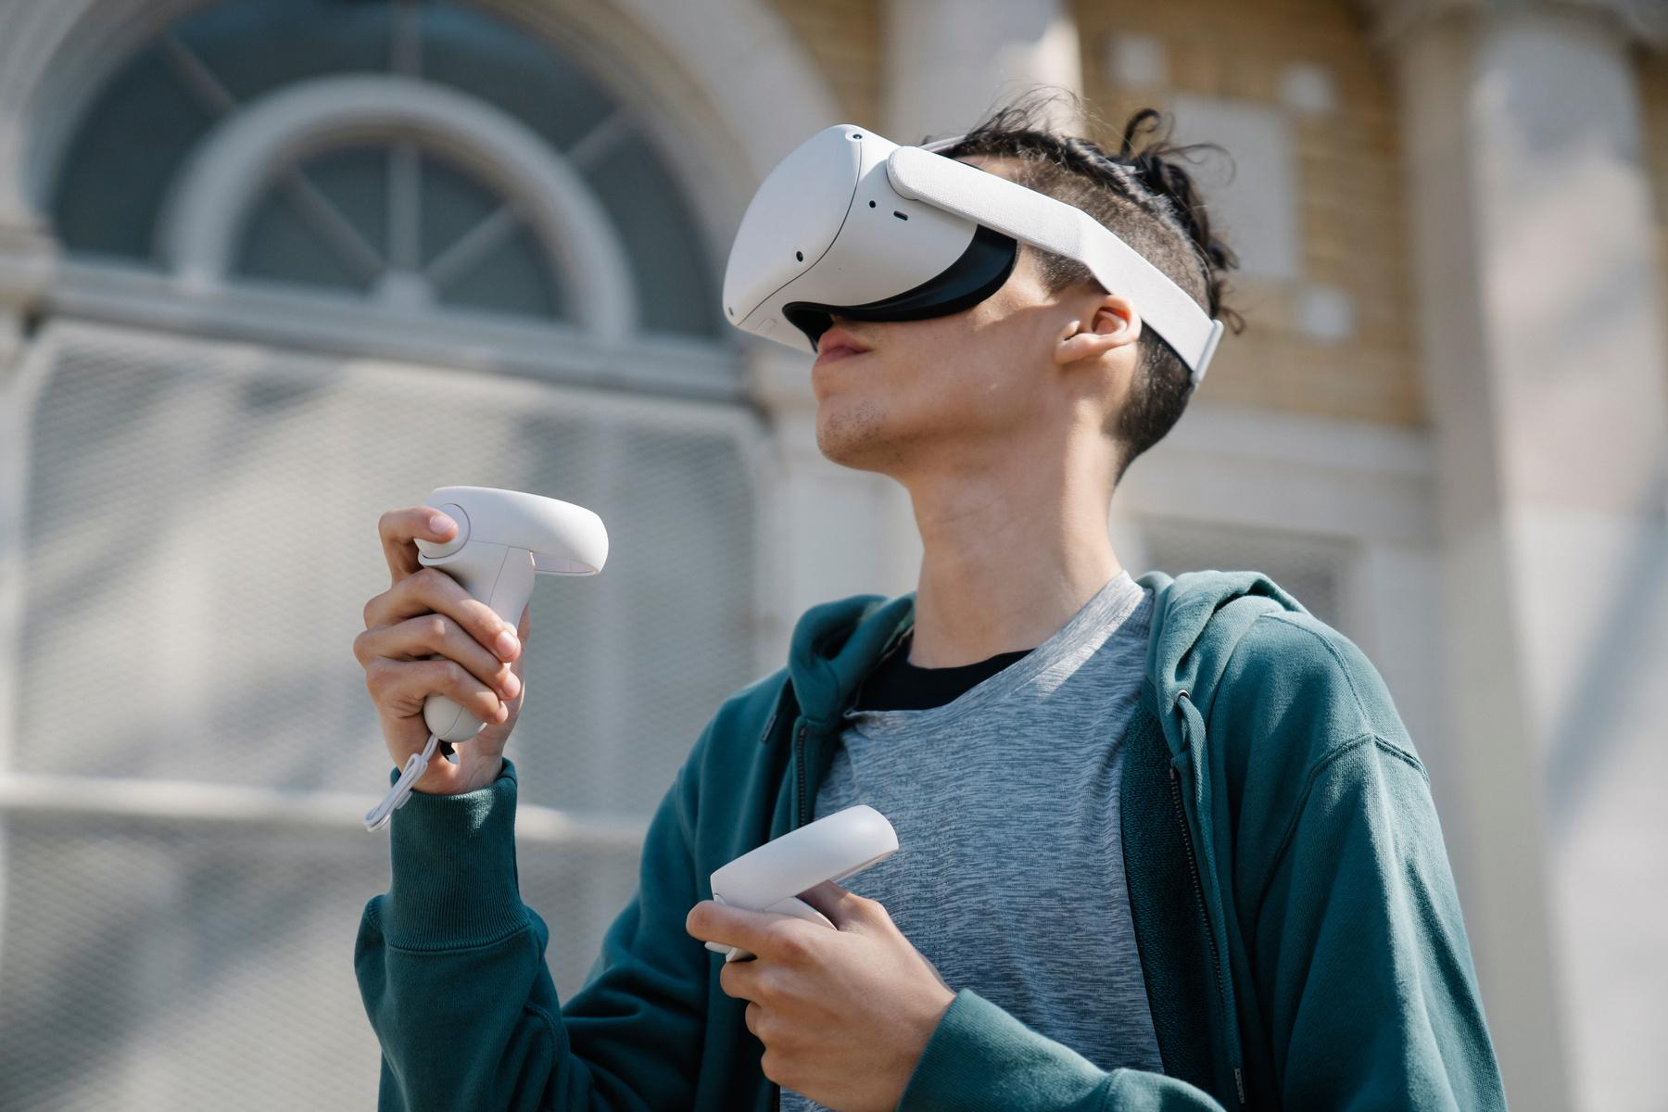

III. Future Directions
Conclusion
The Paradigm Shift in IR
Search has evolved from static item ranking to a compositional process of planning, synthesis, and autonomous action.
Utility now takes precedence over simple relevance, prioritizing factual grounding and task completion through agentic loops.
The future is a hybrid ecosystem: BM25 as the sparse backbone, dense retrieval for semantic recall, and RAG as the default grounding mechanism.

Slide 11
References
Asai, A., Wu, Z., Wang, Y., Sil, A., & Hajishirzi, H. (2024). Self-RAG: Learning to retrieve, generate, and critique through self-reflection. In Proceedings of the International Conference on Learning Representations (ICLR 2024). https://arxiv.org/abs/2310.11511
Karpukhin, V., Oğuz, B., Min, S., Lewis, P., Wu, L., Edunov, S., Chen, D., & Yih, W.-t. (2020). Dense passage retrieval for open-domain question answering. In Proceedings of the 2020 Conference on Empirical Methods in Natural Language Processing (EMNLP). https://arxiv.org/abs/2004.04906
Lewis, P., Perez, E., Piktus, A., Petroni, F., Karpukhin, V., Goyal, N., Küttler, H., Lewis, M., Yih, W.-t., Rocktäschel, T., Riedel, S., & Kiela, D. (2020). Retrieval-augmented generation for knowledge-intensive NLP tasks. In Advances in Neural Information Processing Systems, 33. https://arxiv.org/abs/2005.11401
Li, X., Jin, J., Zhou, Y., Zhang, Y., Zhang, P., Zhu, Y., & Dou, Z. (2024). From matching to generation: A survey on generative information retrieval. arXiv. https://arxiv.org/abs/2404.14851
Li, Z., Li, C., Zhang, M., Mei, Q., & Bendersky, M. (2024). Retrieval augmented generation or long-context LLMs? A comprehensive study and hybrid approach. In Proceedings of the 2024 Conference on Empirical Methods in Natural Language Processing: Industry Track. https://arxiv.org/abs/2407.16833
Tay, Y., Tran, V. Q., Dehghani, M., Ni, J., Bahri, D., Mehta, H., Qin, Z., Hui, K., Zhao, Z., Gupta, J., Schuster, T., Cohen, W. W., & Metzler, D. (2022). Transformer memory as a differentiable search index. In Advances in Neural Information Processing Systems, 35. https://arxiv.org/abs/2202.06991
Wang, X., Chen, Y., Zhang, B., Zhao, J., Wei, C., Xu, C., Guan, Z., Zhao, W., Zhang, W., & Zeng, X. (2026). Differentiable geometric indexing for end-to-end generative retrieval. arXiv. https://arxiv.org/abs/2603.10409
Wang, L., Chen, H., Yang, N., Huang, X., Dou, Z., & Wei, F. (2025). Chain-of-retrieval augmented generation. arXiv. https://arxiv.org/abs/2501.14342

Slide 12
References
Wu, S., Xiong, Y., Cui, Y., Wu, H., Chen, C., Yuan, Y., Huang, L., Liu, X., Kuo, T.-W., Guan, N., & Xue, C. J. (2024). Retrieval-augmented generation for natural language processing: A survey. arXiv. https://arxiv.org/abs/2407.13193
Yao, S., Zhao, J., Yu, D., Shafran, I., Narasimhan, K., & Cao, Y. (2023). ReAct: Synergizing reasoning and acting in language models. In Proceedings of the International Conference on Learning Representations (ICLR 2023). https://arxiv.org/abs/2210.03629
Zhang, W., Liao, J., Li, N., Du, K., & Lin, J. (2024). Agentic information retrieval. arXiv. https://arxiv.org/abs/2410.09713
Zhao, S., Yang, Y., Wang, Z., He, Z., Qiu, L. K., & Qiu, L. (2024). Retrieval augmented generation (RAG) and beyond: A comprehensive survey on how to make your LLMs use external data more wisely. arXiv. https://arxiv.org/abs/2409.14924
Zhu, Y., Yuan, H., Wang, S., Liu, J., Liu, W., Deng, C., Chen, H., Liu, Z., Dou, Z., & Wen, J.-R. (2023). Large language models for information retrieval: A survey. arXiv. https://arxiv.org/abs/2308.07107
Zheng, Y., Li, P., Liu, W., Liu, Y., Luan, J., & Wang, B. (2024). Adaptive and hierarchy-aware reranking for tool retrieval. arXiv. https://arxiv.org/abs/2403.06551
Ma, X., Gong, Y., He, P., Zhao, H., & Duan, N. (2023). Query rewriting for retrieval-augmented large language models. arXiv. https://arxiv.org/abs/2305.14283
Gao, L., Ma, X., Lin, J., & Callan, J. (2022). Precise zero-shot dense retrieval without relevance labels. arXiv. https://arxiv.org/abs/2212.10496

Slide 13
Q & A Time
Notes:
8-10 minutes

Slide 14
Thank you for your attention!

