Slide 1
Distributed Query Processing

Slide 2
Agenda
Recap of query optimization
Transformation rules for P&D systems
Memoization
Query evaluation strategies
Eddies

Slide 3
Introduction
Alternative ways of evaluating a given query
  Equivalent expressions
  Different algorithms for each operation (Chapter 13)
Cost difference between a good and a bad way of evaluating a query can be enormous
  Example: performing a r X s followed by a selection r.A = s.B is much slower than performing a join on the same condition
Need to estimate the cost of operations
  Depends critically on statistical information about relations which the database must maintain
  Need to estimate statistics for intermediate results to compute cost of complex expressions

Slide 4
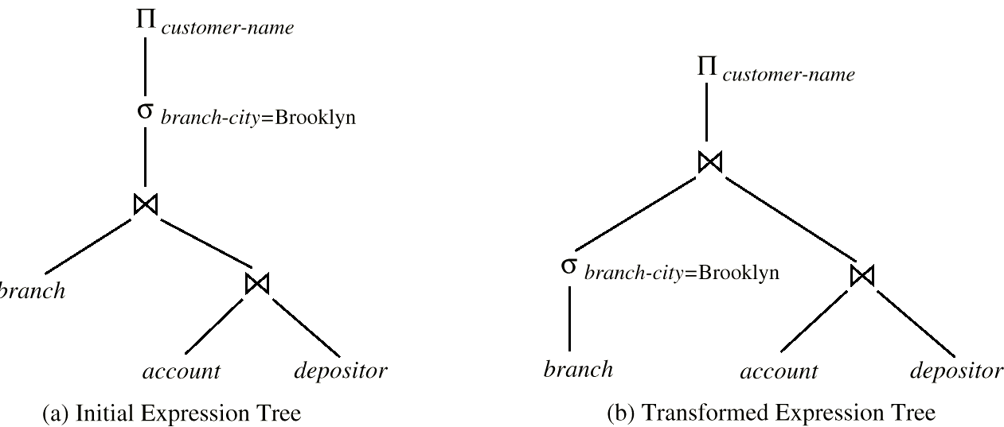
Introduction (Cont.)
Relations generated by two equivalent expressions have the same set of attributes and contain the same set of tuples, although their attributes may be ordered differently.

Slide 5
Introduction (Cont.)
Generation of query-evaluation plans for an expression involves several steps:
  Generating logically equivalent expressions
    Use equivalence rules to transform an expression into an equivalent one.
  Annotating resultant expressions to get alternative query plans
  Choosing the cheapest plan based on estimated cost
The overall process is called cost based optimization.

Slide 6



Equivalence Rules
1. Conjunctive selection operations can be deconstructed into a sequence of individual selections.
2. Selection operations are commutative.
3. Only the last in a sequence of projection operations is needed, the others can be omitted.
Selections can be combined with Cartesian products and theta joins.
  σ_{θ}(E₁ X E₂) = E₁ _{θ} E₂
  σ_{θ1}(E₁ _{θ2} E₂) = E₁ _{θ1∧ θ2} E₂

Slide 7
Equivalence Rules (Cont.)
5. Theta-join operations (and natural joins) are commutative.
E_{1 θ} E₂ = E₂ _{θ} E₁
6. (a) Natural join operations are associative:
(E₁ E₂) E₃ = E₁ (E₂ E₃)
(b) Theta joins are associative in the following manner:
(E_{1 θ1} E₂) _{θ2∧ θ 3} E₃ = E_{1 θ2∧ θ3} (E₂ _{θ2} E₃)
where θ₂ involves attributes from only E₂ and E₃.

Slide 8
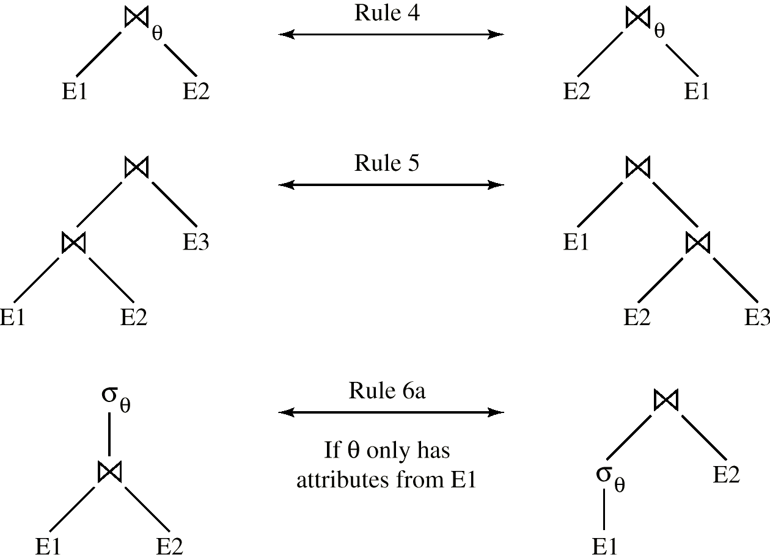
Pictorial Depiction of Equivalence Rules

Slide 9
Equivalence Rules (Cont.)
7. The selection operation distributes over the theta join operation under the following two conditions:
(a) When all the attributes in θ₀ involve only the attributes of one of the expressions (E₁) being joined.
σ_{θ0}(E₁ _{θ} E₂) = (σ_{θ0}(E₁)) _{θ} E₂
(b) When θ ₁ involves only the attributes of E₁ and θ₂ involves only the attributes of E₂.
σ_{θ1}∧_{θ2} (E₁ _{θ} E₂) = (σ_{θ1}(E₁)) _{θ} (σ_{θ2} (E₂))

Slide 10
Equivalence Rules (Cont.)
8. The projections operation distributes over the theta join operation as follows:
(a) if L involves only attributes from L₁ ∪ L₂:
(b) Consider a join E_{1 θ} E₂.
  Let L₁ and L₂ be sets of attributes from E₁ and E₂, respectively.
  Let L₃ be attributes of E₁ that are involved in join condition θ, but are not in L₁ ∪ L₂, and
  let L₄ be attributes of E₂ that are involved in join condition θ, but are not in L₁ ∪ L₂.

Slide 11
Equivalence Rules (Cont.)
The set operations union and intersection are commutative
E₁ ∪ E₂ = E₂ ∪ E₁
E₁ ∩ E₂ = E₂ ∩ E₁
  (set difference is not commutative).
Set union and intersection are associative.
(E₁ ∪ E₂) ∪ E₃ = E₁ ∪ (E₂ ∪ E₃)
(E₁ ∩ E₂) ∩ E₃ = E₁ ∩ (E₂ ∩ E₃)
The selection operation distributes over ∪, ∩ and –.
σ_{θ} (E₁ – E₂) = σ_{θ} (E₁) – σ_{θ}(E₂)
and similarly for ∪ and ∩ in place of –
Also: σ_{θ} (E₁ – E₂) = σ_{θ}(E₁) – E₂
and similarly for ∩ in place of –, but not for ∪
12. The projection operation distributes over union
Π_{L}(E₁ ∪ E₂) = (Π_{L}(E₁)) ∪ (Π_{L}(E₂))

Slide 12
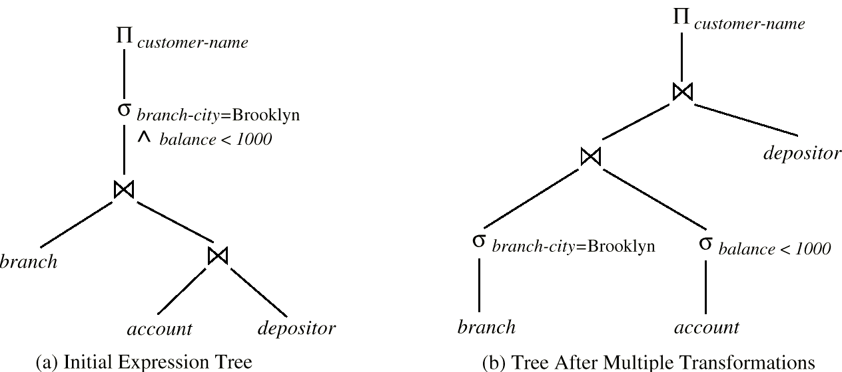
Multiple Transformations (Cont.)

Slide 13
Optimizer strategies
Heuristic
  Apply the transformation rules in a specific order such that the cost converges to a minimum
Cost based
  Simulated annealing
  Randomized generation of candidate QEP
  Problem, how to guarantee randomness

Slide 14
Memoization Techniques
How to generate alternative Query Evaluation Plans?
  Early generation systems centred around a tree representation of the plan
  Hardwired tree rewriting rules are deployed to enumerate part of the space of possible QEP
  For each alternative the total cost is determined
  The best (alternatives) are retained for execution
  Problems: very large space to explore, duplicate plans, local maxima, expensive query cost evaluation.
  SQL Server optimizer contains about 300 rules to be deployed.

Slide 15

Memoization Techniques
How to generate alternative Query Evaluation Plans?
  Keep a memo of partial QEPs and their cost.
  Use the heuristic rules to generate alternatives to built more complex QEPs
  r₁ r₂ r₃ r₄
r₄
Level n plans
r₃
r₃
Level 2 plans
x
r₂ r₁
r₁ r₂
r₂ r₃
r₃ r₄
r₁ r₄
Level 1 plans

Slide 16
Distributed Query Processing
For centralized systems, the primary criterion for measuring the cost of a particular strategy is the number of disk accesses.
In a distributed system, other issues must be taken into account:
  The cost of a data transmission over the network.
  The potential gain in performance from having several sites process parts of the query in parallel.

Slide 17
Par &dist Query processing
The world of parallel and distributed query optimization
  Parallel world, invent parallel versions of well-known algorithms, mostly based on broadcasting tuples and dataflow driven computations
  Distributed world, use plan modification and coarse grain processing, exchange large chunks

Slide 18
Transformation rules for distributed systems
Primary horizontally fragmented table:
  Rule 9: The union is commutative
  E₁ ∪ E₂ = E₂ ∪ E₁
  Rule 10: Set union is associative.
  (E₁ ∪ E₂) ∪ E₃ = E₁ ∪ (E₂ ∪ E₃)
  Rule 12: The projection operation distributes over union
Π_{L}(E₁ ∪ E₂) = (Π_{L}(E₁)) ∪ (Π_{L}(E₂))
Derived horizontally fragmented table:
  The join through foreign-key dependency is already reflected in the fragmentation criteria

Slide 19
Transformation rules for distributed systems
Vertical fragmented tables:
  Rules: Hint look at projection rules

Slide 20
Optimization in Par & Distr
Cost model is changed!!!
  Network transport is a dominant cost factor
The facilities for query processing are not homogenous distributed
  Light-resource systems form a bottleneck
  Need for dynamic load scheduling

Slide 21
Simple Distributed Join Processing
Consider the following relational algebra expression in which the three relations are neither replicated nor fragmented
account depositor branch
account is stored at site S₁
depositor at S₂
branch at S₃
For a query issued at site S_{I}, the system needs to produce the result at site S_{I}

Slide 22
Possible Query Processing Strategies
Ship copies of all three relations to site S_{I} and choose a strategy for processing the entire locally at site S_{I.}
Ship a copy of the account relation to site S₂ and compute temp₁ = account depositor at S₂. Ship temp₁ from S₂ to S₃, and compute temp₂ = temp₁ branch at S₃. Ship the result temp₂ to S_{I}.
Devise similar strategies, exchanging the roles S₁, S₂, S₃
Must consider following factors:
  amount of data being shipped
  cost of transmitting a data block between sites
  relative processing speed at each site

Slide 23
Semijoin Strategy
Let r₁ be a relation with schema R₁ stores at site S₁
Let r₂ be a relation with schema R₂ stores at site S₂
Evaluate the expression r₁ r₂ and obtain the result at S₁.
1. Compute temp₁ ← ∏_{R1 ∩ R2} (r1) at S1.
2. Ship temp₁ from S₁ to S₂.
3. Compute temp₂ ← r₂ temp1 at S₂
4. Ship temp₂ from S₂ to S₁.
5. Compute r₁ temp₂ at S₁. This is the same as r₁ r₂.

Slide 24
Formal Definition
The semijoin of r₁ with r₂, is denoted by:
r₁ r₂
it is defined by:
  ∏_{R1} (r₁ r₂)
Thus, r₁ r₂ selects those tuples of r₁ that contributed to r₁ r₂.
In step 3 above, temp₂=r₂ r₁.
For joins of several relations, the above strategy can be extended to a series of semijoin steps.

Slide 25
Join Strategies that Exploit Parallelism
Consider r₁ r₂ r₃ r₄ where relation ri is stored at site S_{i}. The result must be presented at site S₁.
r₁ is shipped to S₂ and r₁ r₂ is computed at S₂: simultaneously r₃ is shipped to S₄ and r₃ r₄ is computed at S₄
S₂ ships tuples of (r₁ r₂) to S₁ as they produced;
S₄ ships tuples of (r₃ r₄) to S₁
Once tuples of (r₁ r₂) and (r₃ r₄) arrive at S₁ (r₁ r₂) (r₃ r₄) is computed in parallel with the computation of (r₁ r₂) at S₂ and the computation of (r₃ r₄) at S₄.

Slide 26
Query plan generation
Apers-Aho-Hopcroft
  Hill-climber, repeatedly split the multi-join query in fragments and optimize its subqueries independently
Apply centralized algorithms and rely on cost-model to avoid expensive query execution plans.

Slide 27
Query evaluators

Slide 28
Query evaluation strategy
Pipe-line query evaluation strategy
  Called Volcano query processing model
  Standard in commercial systems and MySQL
Basic algorithm:
  Demand-driven evaluation of query tree.
  Operators exchange data in units such as records
  Each operator supports the following interfaces:– open, next, close
    open() at top of tree results in cascade of opens down the tree.
    An operator getting a next() call may recursively make next() calls from within to produce its next answer.
    close() at top of tree results in cascade of close down the tree

Slide 29
Query evaluation strategy
Pipe-line query evaluation strategy
  Evaluation:
    Oriented towards OLTP applications
      Granule size of data interchange
    Items produced one at a time
    No temporary files
      Choice of intermediate buffer size allocations
    Query executed as one process
    Generic interface, sufficient to add the iterator primitives for the new containers.
    CPU intensive
    Amenable to parallelization

Slide 30
Query evaluation strategy
Materialized evaluation strategy
  Used in MonetDB
  Basic algorithm:
    for each relational operator produce the complete intermediate result using materialized operands
  Evaluation:
    Oriented towards decision support queries
    Limited internal administration and dependencies
    Basis for multi-query optimization strategy
    Memory intensive
    Amendable for distributed/parallel processing

Slide 31
Eddies: Continuously Adaptive Query processing
R. Avnur, J.M. Hellerstein
UCB
ACM Sigmod 2000

Slide 32
Problem Statement
Context: large federated and shared-nothing databases
Problem: assumptions made at query optimization rarely hold during execution
Hypothesis: do away with traditional optimizers, solve it thru adaptation
Focus: scheduling in a tuple-based pipeline query execution model

Slide 33
Problem Statement Refinement
Large scale systems are unpredictable, because
  Hardware and workload complexity,
    bursty servers & networks, heterogenity, hardware characteristics
  Data complexity,
    Federated database often come without proper statistical summaries
  User Interface Complexity
    Online aggregation may involve user ‘control’

Slide 34
Research Laboratory setting
Telegraph, a system designed to query all data available online
River, a low level distributed record management system for shared-nothing databases
Eddies, a scheduler for dispatching work over operators in a query graph

Slide 35
The Idea
Relational algebra operators consume a stream from multiple sources to produce a new stream
A priori you don’t now how selective- how fast- tuples are consumed/produced
You have to adapt continuously and learn this information on the fly
Adapt the order of processing based on these lessons

Slide 36
The Idea
JOIN
next
next
JOIN
JOIN
next
next
next
next

Slide 37
The Idea
Standard method: derive a spanning tree over the query graph
Pre-optimize a query plan to determine operator pairs and their algorithm, e.g. to exploit access paths
Re-optimization a query pipeline on the fly requires careful state management, coupled with
  Synchronization barriers
    Operators have widely differing arrival rates for their operands
      This limits concurrency, e.g. merge-join algorithm
  Moments of symmetry
    Algorithm provides option to exchange the role of the operands without too much complications
      E.g switching the role of R and S in a nested-loop join

Slide 38
Nested-loop
R
s

Slide 39
Join and sorting
Index-joins are asymmetric, you can not easily change their role
  Combine index-join + operands as a unit in the process
Sorting requires look-ahead
  Merge-joins are combined into unit
Ripple joins
  Break the space into smaller pieces and solve the join operation for each piece individually
  The piece crossings are moments of symmetry

Slide 40
The Idea
JOIN
Tuple buffer
JOIN
next
JOIN
next
next
next
Eddie
next
next
next
next

Slide 41
Rivers and Eddies
Eddies are tuple routers that distribute arriving tuples to interested operators
  What are efficient scheduling policies?
    Fixed strategy? Random ? Learning?
Static Eddies
Delivery of tuples to operators can be hardwired in the Eddie to reflect a traditional query execution plan
Naïve Eddie
Operators are delivered tuples based on a priority queue
Intermediate results get highest priority to avoid buffer congestion

Slide 42
Observations for selections
Extended priority queue for the operators
  Receiving a tuple leads to a credit increment
  Returning a tuple leads to a credit decrement
  Priority is determined by “weighted lottery”
Naïve Eddies exhibit back pressure in the tuple flow; production is limited by the rate of consumption at the output
Lottery Eddies approach the cost of optimal ordering, without a need to a priory determine the order
Lottery Eddies outperform heuristics
  Hash-use first, or Index-use first, Naive

Slide 43
Observations
The dynamics during a run can be controlled by a learning scheme
  Split the processing in steps (‘windows’) to re-adjust the weight during tuple delivery
Initial delays can not be handled efficiently
Research challenges:
  Better learning algorithms to adjust flow
  Aggressive adjustments
  Remove pre-optimization
  Balance ‘hostile’ parallel environment
  Deploy eddies to control degree of partitioning (and replication)

