Slide 1
Testing of MIDlet based, Adaptive, Context Aware Applications
Michele Sama
University College London
Dept. of Computer Science
Software Systems Engineering Group

Slide 2
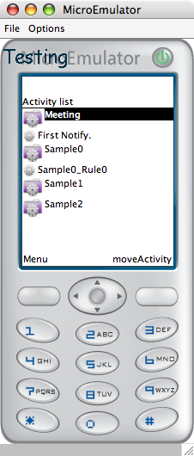
Outline
Introducing AdaptiveReminder
Issues in running testing MIDlet
Introducing TestingEmulator
Emulator Demo
AdaptiveReminder Demo
Future works

Slide 3
Case study: Reminder for a meeting
A few minutes before:
  If the user is not in the meeting room.
  If the user is not near his boss.
Remind him to go to the meeting:
  A silent reminder because he is in his office.
Long before:
  If the user is far from the building.
  If his boss is not next to him.
Remind him to move close to the meeting:
  An invasive reminder because he is not in his office.

Slide 4
Formal specification
Each condition can be represented with a tree of Constraints (a Rule).
Each constraint is related to a specific query to a single Context Condition.
Each context variable is monitored by a specific Handler.
Each Handler notify all the registered Constraints in case of some context change.

Slide 5
From a Sample to a Framework
A constraint based system for event activation.
A decision engine for Activities and Notification activation.
Dynamic allocation and deallocation of ContextHandlers
Dynamic registration and deregistration of Constraints

Slide 6
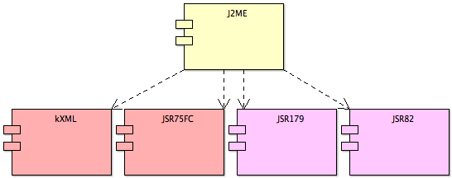
From Abstract to Technology
J2ME
  MIDlet
  JSR82 Blueetooth
  JSR179 Location
  JSR75FC File connection
XML
  A file for each Activity
  http://kxml.sourceforge.net/

Slide 7
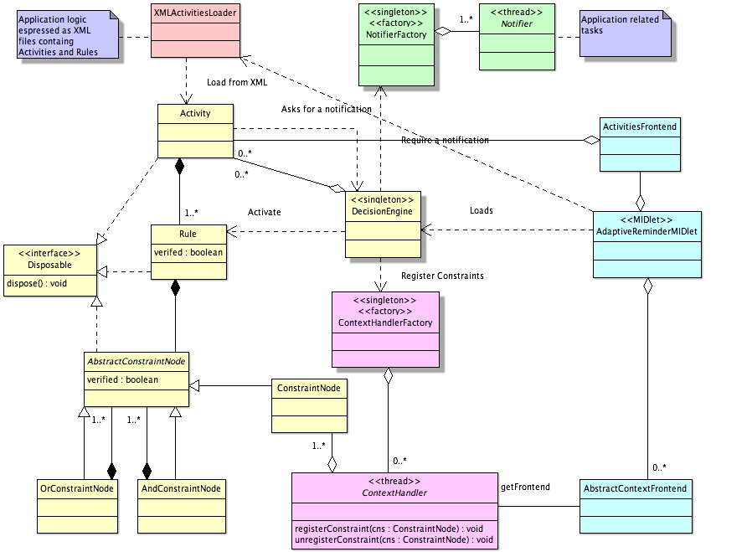

Slide 8
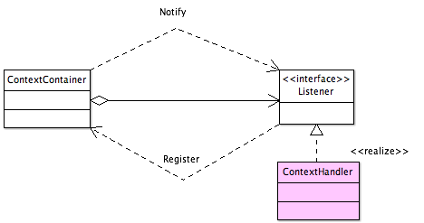
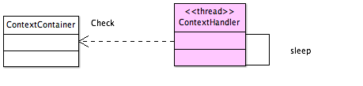
ContextHandlers implementation
Passive Handlers
  They receive notification from an event by the J2ME framework
Active Handlers
  Thread based, they refresh their status with a loop

Slide 9
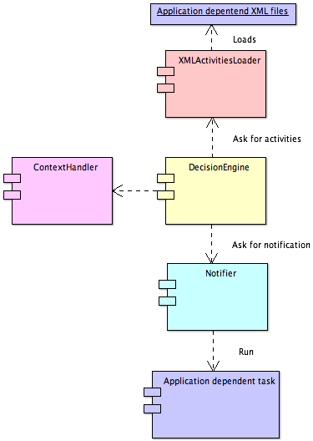
Adaptation
The evolution of the internal status of the application is related to the activation flow of the loaded Activities.
The activation of loaded Rules start some application components.

Slide 10
Future Works
Constraints based Rule life cycle:
  A constraints tree for Rule activation.
  A constraints tree for Rule validation (now).
  A constraints tree for Rule deactivation.
Use Notifiers as Activity loaders:
  Activities can load each others;
  Pre and Post conditional Activities;
  Flow of activities.

Slide 11
Issues in developing, running and testing
J2ME support for some context variables is missing
  Signal level
  Battery status
  Connected networks
Testability
  Real device with uncomfortable support
    Certificates
    Available libraries
  Emulator with no control of the context
Impossibility to create a proper test

Slide 12
What do we need?
From a device:
  Access to context parameters.
  Modify to security level
  Support for standard framework libraries (Device's implementation is partial or missing)
From an emulator:
  Possibility to manipulate the environment.
  Execution of testing script not inside the application itself.
  Direct access to application variables.
An Emulator for testing!

Slide 13
The idea: Running J2ME over J2SE
J2ME is a subset of J2SE
  CLDC classes provide a subset of the methods of the same classes of J2SE
  Compile and preverify with J2ME but run with J2SE
  The same virtual machine but different Classloaders
J2ME provides additional device related libraries
  A stub implementation with JavaBeans allows the emulator to modify the status of the emulated contex

Slide 14
Execution stack
MIDlet
J2ME scheleton
ME JSRs scheleton
Patched Microemulator
Ad hoc Classloader
ME JSRs stub
Additional J2SE libraries
J2SE

Slide 15
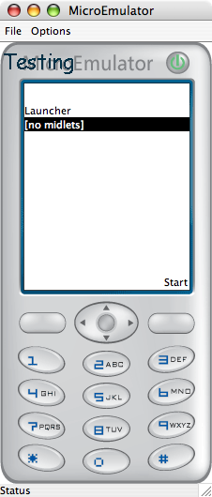
Running and testing capabilities
3 Possibilities:
  Standalone with emulated context
  Standalone using real devices of the host
  Networked testing the cross-evolution of the application in different devices

Slide 16
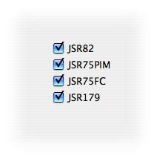
Emulating devices without specific JSRs
Possibility to choose:
  Which library to load.
  Which implementation of the same library.
Emulation of device with some missing support.

Slide 17
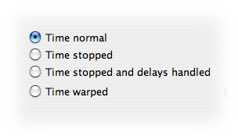
Emulating device time
Time as a context
  What happen when two different time based, collaborating applications run in devices with different times?
  We need to:
    Set the time
    Stop the time
    Handle delays

Slide 18
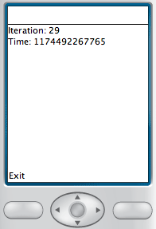
Time and Delays Demo
DelayTest.jar
  A Thread sleeps for 1000 msec and refresh the GUI with the new time.
  Time is loaded from System.currentTimeMillis()
  Delays are created with Thread.sleep(msec)

Slide 19
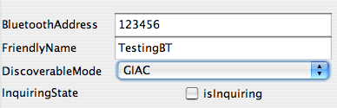
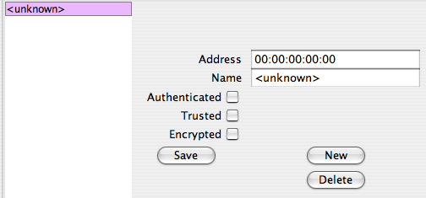
Emulating Bluetooth
Bluetooth
  JavaBeans implementation of the device
  Runtime configuration of the Bluetooth environment

Slide 20
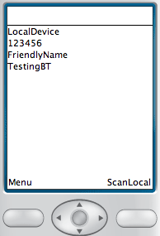
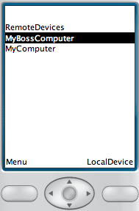
LocalDevice and DiscoveryAgent Demo
LocalDeviceScanner.jar
  Displays local device attributes.
  Scans for discovered remote devices.

Slide 21
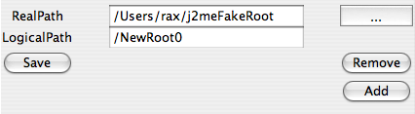
Emulating a FileSystem for the device
JSR75FC
  DeviceRoots mapped into host directories
  Runtime set-up of roots
  Wrapping of JSR75FC file access with J2SE java.io.

Slide 22
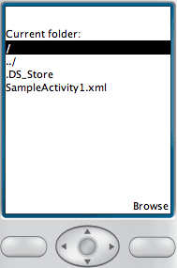
FileSystem Demo
JSR75fcDemo.jar
  Shows all the accessible device roots.
  Browse file and folders.

Slide 23
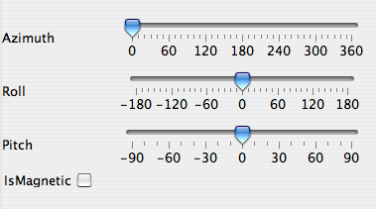
Emulating discovery of Location
JavaBeans implementation
  Device Orientation
  Current Location
  Localization method
  LandmarkStores

Slide 24
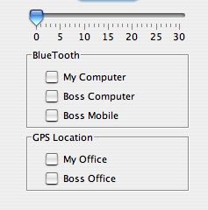
Support for Scripting
Support for dynamic loading of script with Reflection
Access to all the context variables and JavaBeans of the emulator.

Slide 25
State of the art.
To do
  UEI Universal Emulator Interface
  Adding missing JSR
  Profiling
  “Networking”
Alternatives
  PhoneME
    Same stack of the device.
    Open source.
    Closed context.
  WTK2.0
    deprecated.
  MPowerPlayer
    Based on Microemulator.
    Restricted support.

Slide 26
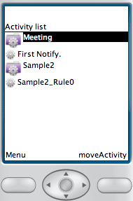
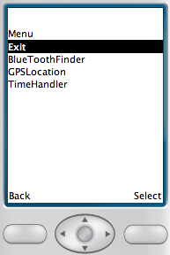
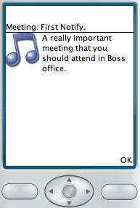
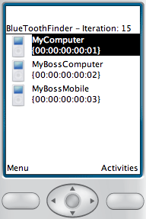
AdaptiveReminder Demo
AdaptiveReminder
  Notification.
  Garbage collecting.
  Meeting.

Slide 27
Networking concept
Emulated
Communication
Emulated
Communication
Context
Context
Context
Network layer wrapper
Global Scenario
Device mobility script

Slide 28
Oracle concept when testing J2ME with J2SE
Emulated Context
Oracle
{J2SE}
MIDlet
{J2ME}
Rules/Constraints

Slide 29
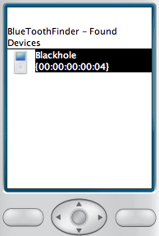
Found and corrected failures:
Frontend dispose
After a notification a disposed Frontend is still displayed
  All the reference to that class are removed but the component is still displayed.
  The failure occurs because of a reference in the Display framework object.

Slide 30
How to contribute
AdaptiveReminder
  Creating more specific context handlers
  Creating other case studies
  Implementing an Oracle
TestingEmulator
  Adding missing JSR
    JSR75PIM
  Improve existing implementation of JSR
  Network support for Mobility Script Support

