Slide 1

Sambit Mohapatra | Nakul Pacheriwala | Akhilesh Chandrashekar
N16309185
N18851689
N11937821

Slide 2
Project Proposal
The pandemic due to Covid-19 and the financial implications of it have caused a deterioration in the mental health of many individuals and/or worsened for those already suffering from it.
Our project aims to help determine the extent of depression and/or anxiety along with various other emotional classifications to assess a person’s mental health condition. Based on the user input, we aim to get an idea to predict the degree of severity of their mental state. Our project aims to provide help/ sources of help which can be beneficial to the individual and provide a dashboard to track their daily indicators and motivate them to better themselves.

Slide 3
















Amazon Cognito
User Pool
Endpoint
LF1
Git push
Git webhook
Amazon SageMaker
Third-party Git repository
Amazon Elastic Compute Cloud (Amazon EC2)
Amazon API Gateway
LF2
mhcc_history
Amazon DynamoDB
Frontend
Streamlit
Amazon Simple Storage Service (Amazon S3)
AWS Identity and Access Management (IAM)

Slide 4
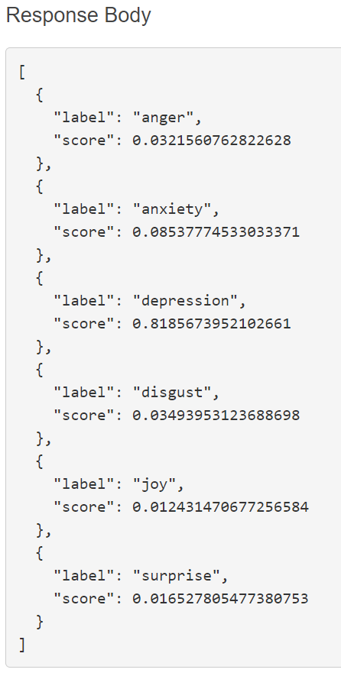
parameters = {'return_all_scores’: True}
Model.predict( {
'inputs': 'I am not well. It has not been a good week. ', 'parameters': parameters
})

Slide 5
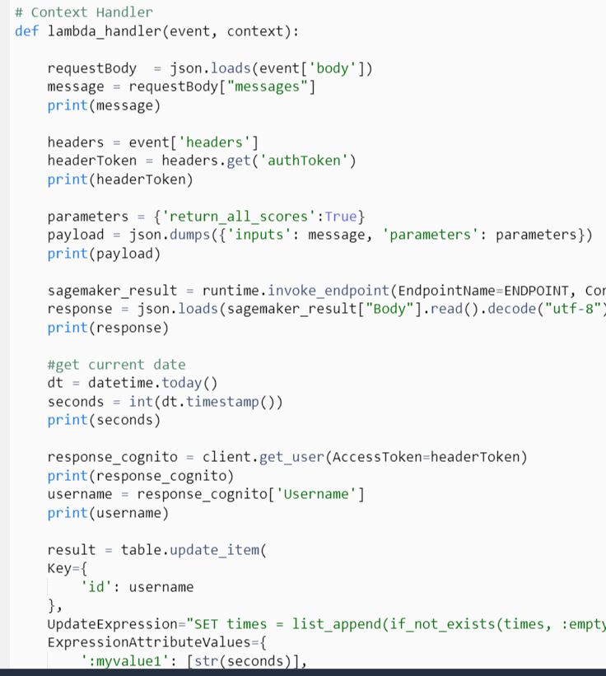
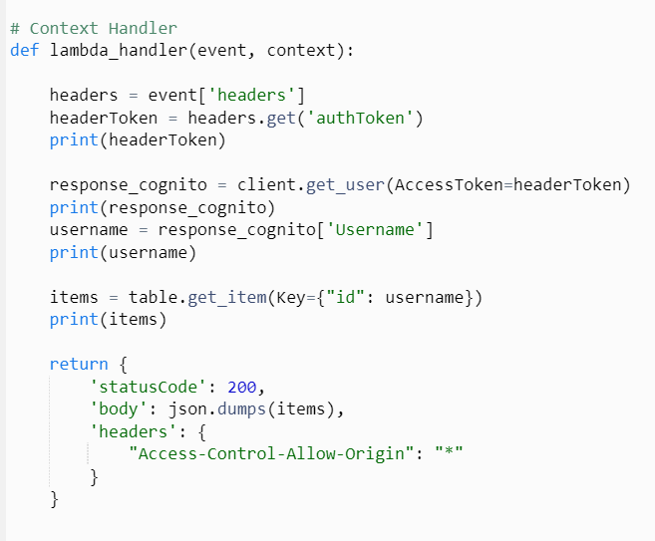

Slide 6
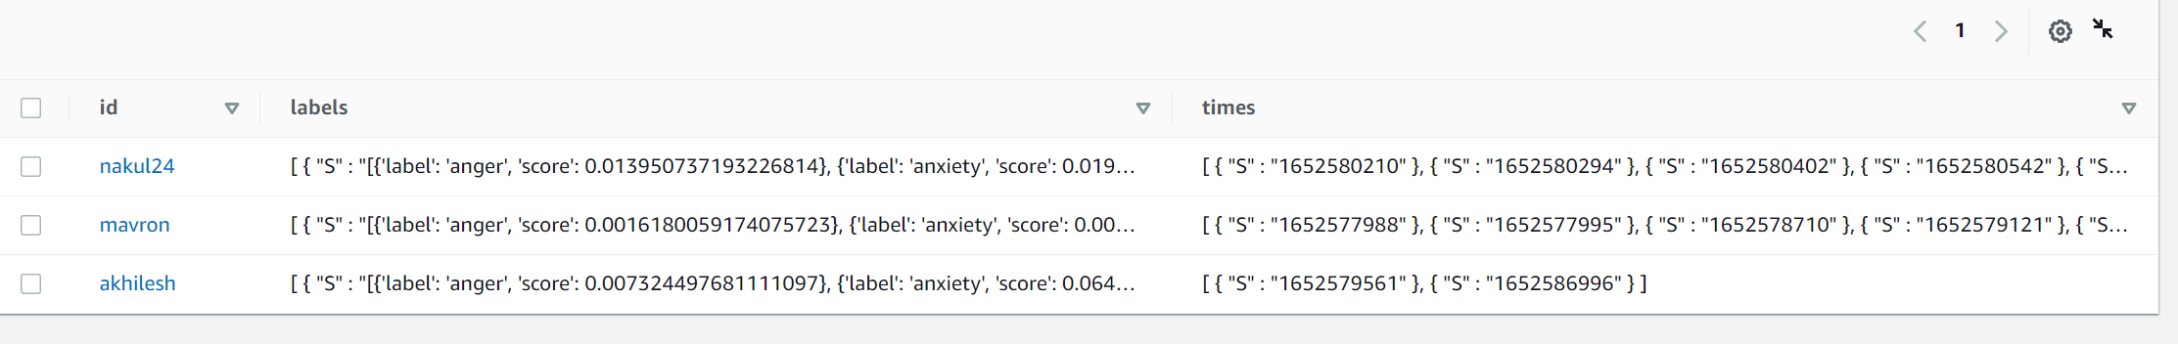

Slide 7
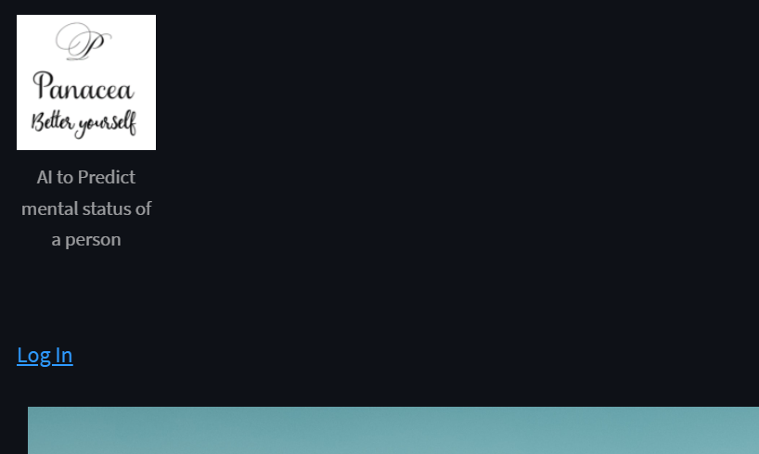
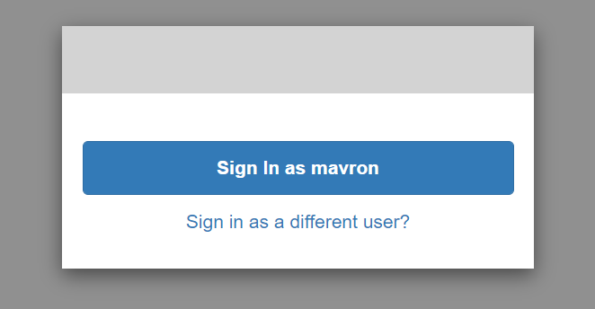
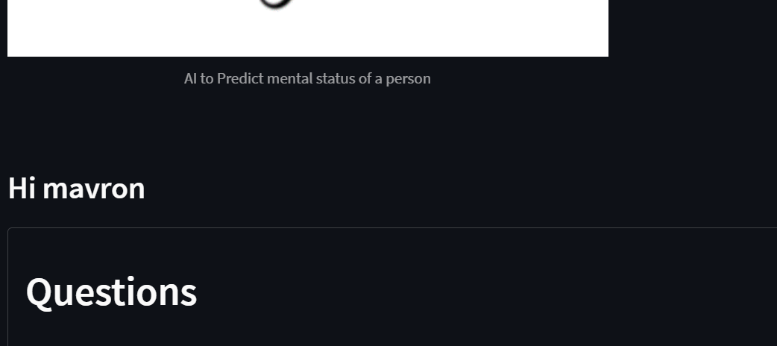

Slide 8
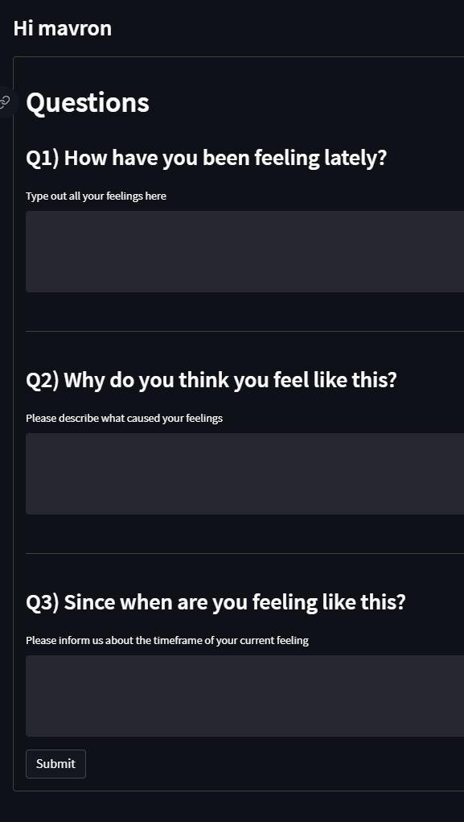
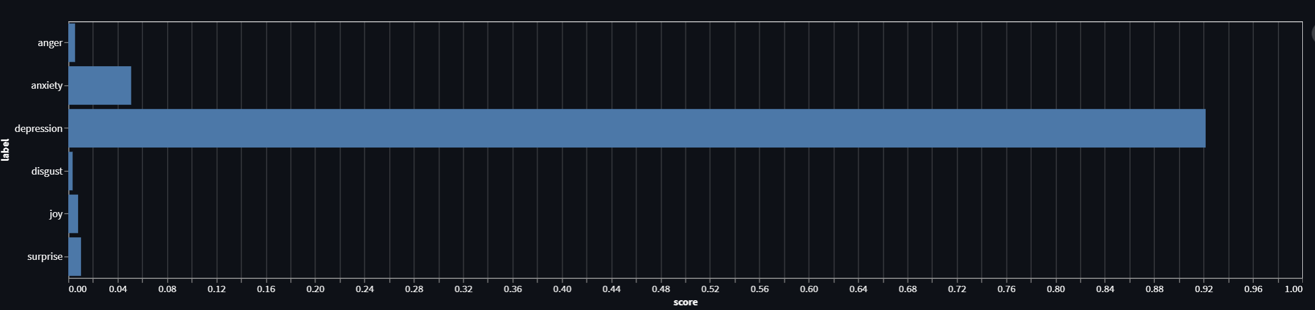
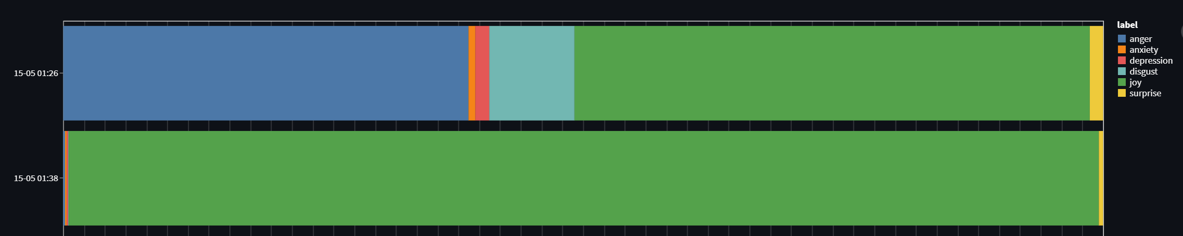

Slide 9
Future Scope
Gather input from other user activities (image / live video feed - multimodal view) to gather more information
Implementing a conversational Chatbot to give interactive experience to users
Providing better resources to help the person. ( Integrating with NYU Wellness)
Provide more detailed tracker information about the user’s emotional history

