Slide 1
Movie Analysis
Muhammad Sami Javed

Slide 2
Summary
Microsoft wants to move into movie industry bus is clueless about it. I have been asked to look into the data and give a give them solutions about it.

Slide 3
Outline
Business Problem
Data
Methods
Results
Conclusions

Slide 4

Business Problem

Slide 5
Methods
The methods use were:
Data exploration.
Data preparation.
Data frame merging.
Visualisation.

Slide 6
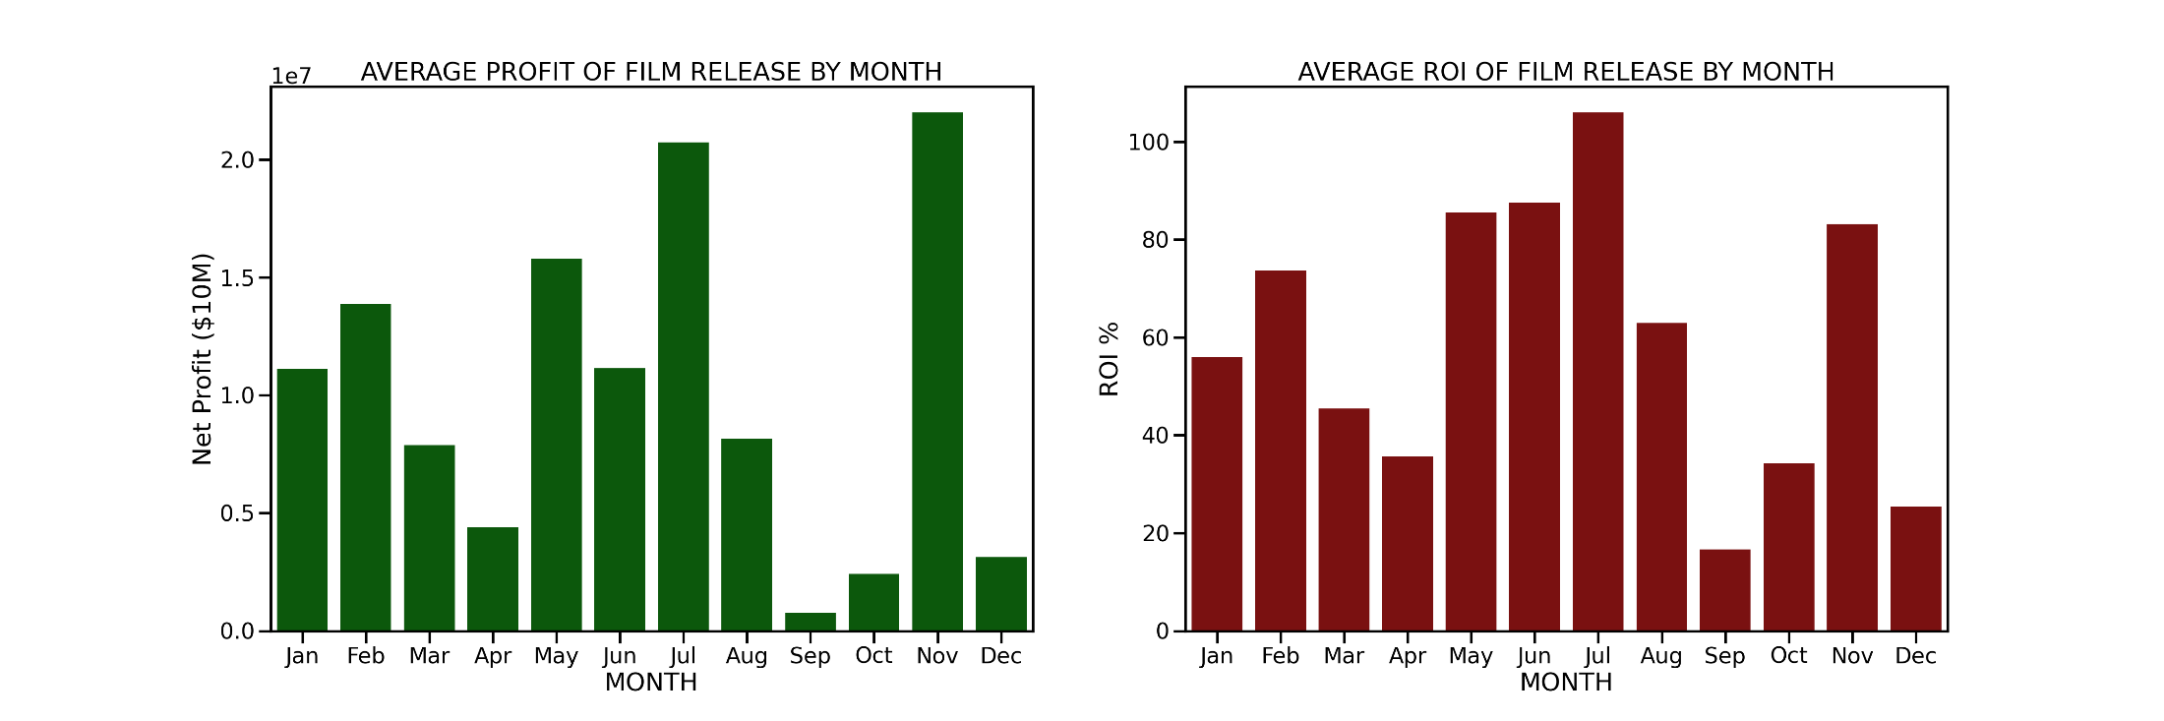
Results
Movies released in the months of May, June, July and November had the highest ROI's compared to other months with September, October and December having the lowest ROI's.

Slide 7
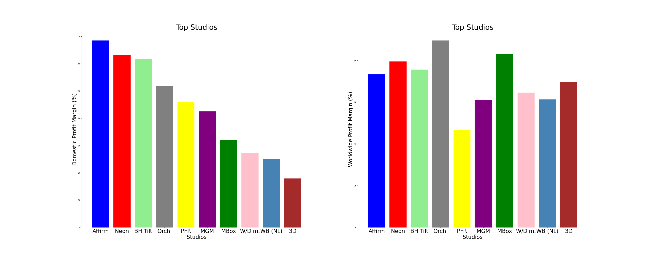
Results
From the plot below, Affirm studio was the top earner domestically,however, it ranked fifth in the top grossing studios globally. This shows a difference in the top grossing studios with reference to domestic and worlwide profit margins. Movie studios that performed well domestically did really mean that they would be top earners globally.

Slide 8
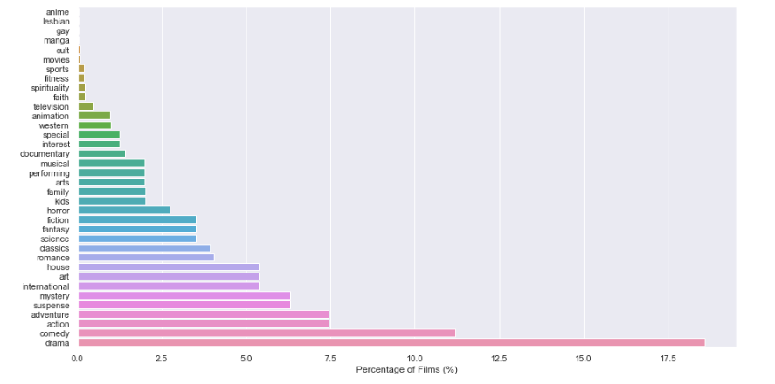
Results
It would be ideal if Microsoft produced movies of the most common genres,i.e, action, comedy and drama.

Slide 9
Conclusions
Microsoft could consider acquiring either of the top grossing studios: BH Tilt,Neon or Orchard film studios.
Movies released in the months of May, June, July and November had the highest ROI's compared to other months with September, October and December having the lowest ROI’s.
It would be ideal if Microsoft produced movies of the most common genres,i.e, action, comedy and drama.

Slide 10
Thank You!
Email: msami05591@gmail.com
GitHub: msami05
LinkedIn: linkedin.com/in/muhammad-javed-9a3aa2142

