Slide 1
Capstone Project - Firewallers
Bao Vuong
Momin Humayon
Samil Tekinoglu

Slide 2
Our Goal
- Design a realistic end-to-end cyber attack scenario
- Exploit a real-world vulnerability (CVE)
- Deploy a stealthy implant on the target system
- Establish a command and control (C2) channel
- Securely exfiltrate sensitive data
- Ensure the operation is undetectable and cleans up after itself

Slide 3
Scenario
- We are running a company
- We suspect an employee is leaking private company files
- We decided to perform an internal investigation
- The aim is to quietly access employee’s device and grab key files

Slide 4
Assumptions
- The employee uses a Windows machine inside the company network
- The machine runs a vulnerable Tomcat server for internal tools
- Partial PUT requests are enabled on the Tomcat server
- Write access to the default servlet is enabled

Slide 5
Tools and Techniques
- Sliver C2 Framework
- Apache Tomcat 9
- Java Server Pages
- Remote Code Execution via CVE-2025-24813
- Obfuscation of Payload Communication
- C2 server/implant secure communication via mTLS

Slide 6
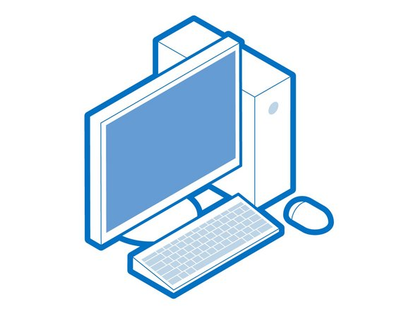


remote Implant download and execution
mTLS
Employee machine
mTLS
Fishing + CVE
mTLS
mTLS
C2 server

Slide 7
Implant & CVE-2025-24813
Incorrectly treats internal dot paths (e.g., file.Name) as equivalent to normal paths.
Combined with partial PUT support and write-enabled default servlet, attackers can write files outside intended directories
Upload restrictions are bypassed using specially crafted filenames
Allows remote upload of executable files such as .jsp or serialized .session payloads
If a .session is uploaded and PersistentManager is enabled, Tomcat may deserialize and execute the payload automatically

Slide 8
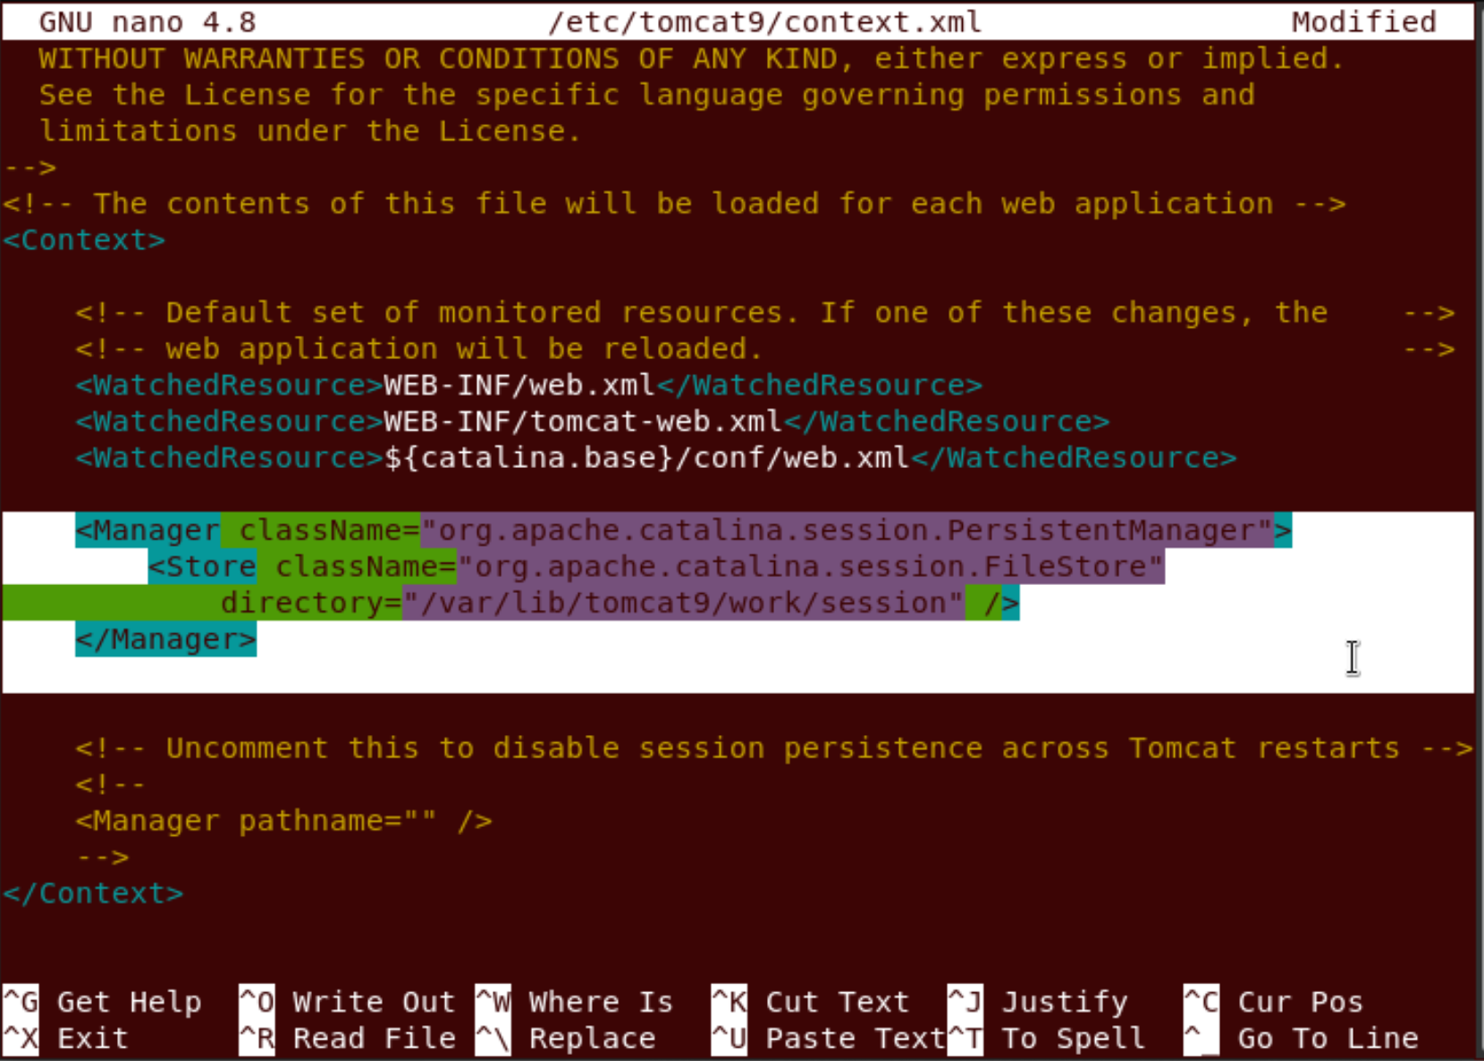
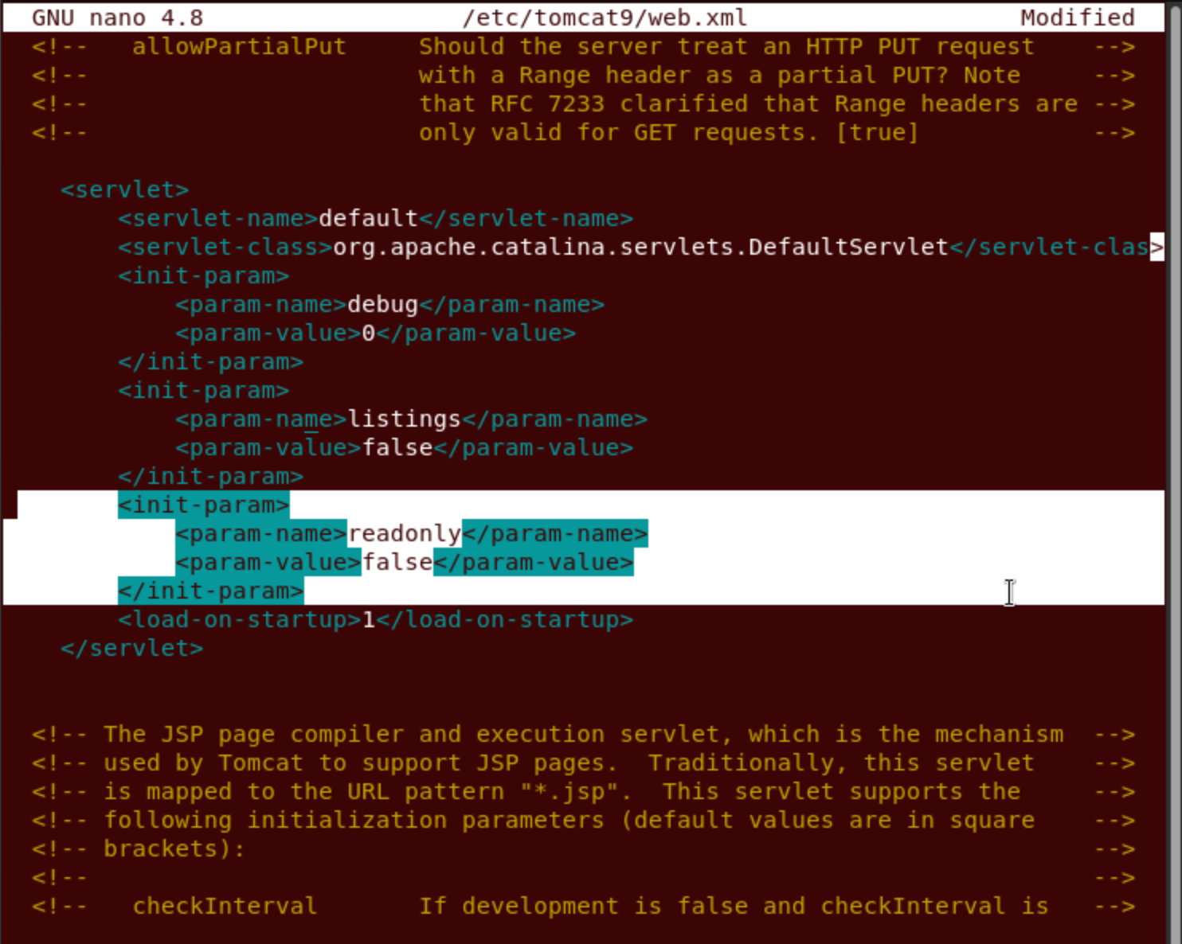
CVE-2025-24813

Slide 9
Check-In App
/var/lib/tomcat9/webapps/
└── checkin/ ← Deployed WAR is extracted here
├── index.jsp ← Main user interface + (check-in form + implant trigger)
└── WEB-INF/ ← Application configuration files
├── web.xml ← Deployment descriptor (servlet configs)

Slide 10
C2 Design and steps
The implant binary is obfuscated upon creation.
Stageless initial implant.
Secure communication via mTLS preventing eavesdropping on communication between server and implant since it is encrypted.
The implant has the ability to migrate itself into another active process.
Destruction after migration

