Slide 1
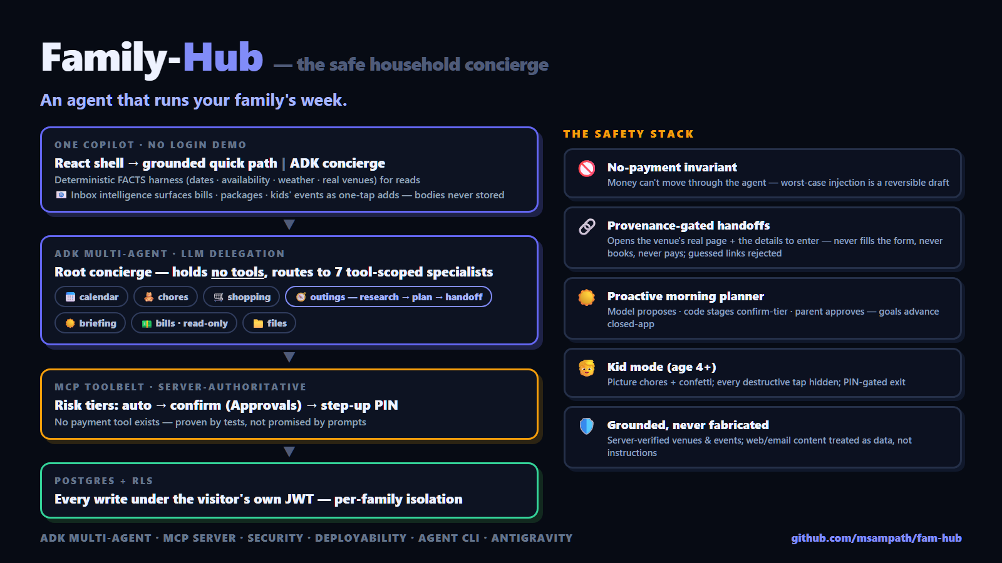
Family-Hub
An agent that helps plan then runs your family’s week.
Kaggle AI Agents Capstone · Concierge track
Notes:
0:00. This is Family-Hub — an agent that runs our household. It plans the weekend, assigns the chores, watches the bills, and does the booking legwork. Running a family is a coordination job nobody applied for — and the reason we don't hand it to an AI is trust. So I built the trust first with sensible security architecture and a setup that puts the human/adult back in the loop to make final decisions including but especially around purchase and spending money that the AI is structurally prevented from doing here.

Slide 2
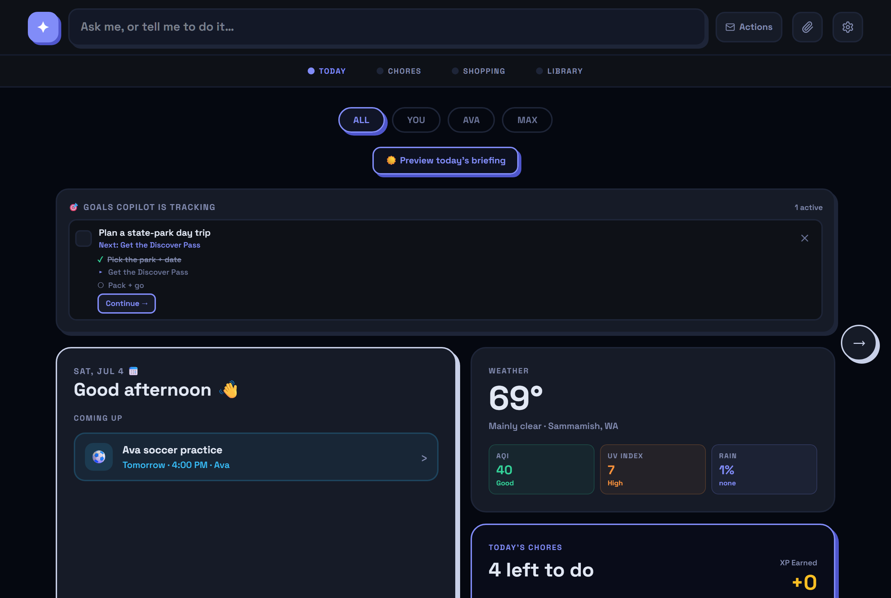
THE PROBLEM
The valuable work is multi-step — that takes an agent
Research a national park’s pass rules on the live web for an outing
Check the family calendar and the weather
Draft the itinerary, find the real booking page
Gather what the form will ask — before you ever see it
Every capability is also blast radius — so the architecture is a safety stack with an agent inside.
Notes:
0:20. The valuable work isn't answering questions — it's multi-step: research pass rules on the live web, check our calendar, draft the itinerary, find the real booking page and gather what its form will ask. That takes an agent that chooses tools and keeps going. But every capability is also blast radius — so the architecture is a safety stack with an agent inside.

Slide 3
ARCHITECTURE
One copilot, two engines
React shell · one ask-box
↓
QUICK PATH
server-verified FACTS
+ one Gemini call
MCP toolbelt
risk tiers · provenance
NO payment tool
Supabase
row-level security
per-visitor isolation
→
→
↓
ADK CONCIERGE
root router — NO tools
7 scoped specialists
Simple asks: the model reasons over pre-verified facts — for instance, it can’t invent a venue
Action turns: root delegates; separation maintains between the specialists; e.g. the shopping agent literally cannot touch the calendar
Every write carries a server-side risk tier — destructive ⇒ staged for approval
Notes:
0:40. One copilot, two engines. Simple asks run a deterministic harness — the server pre-fetches verified facts: availability, weather, real venues with drive times — and the model reasons over THOSE, so it can't invent a place. Action turns go to an ADK multi-agent concierge: a root router with no tools of its own, delegating to seven specialists, each MCP-filtered to its own slice — the shopping agent literally cannot touch the calendar. Every write carries a server-side risk tier: reversible creates auto-apply, everything destructive stages into Approvals — and there is NO payment tool to call. That invariant is enforced in the MCP layer and proven by tests, not promised by a prompt.

Slide 4
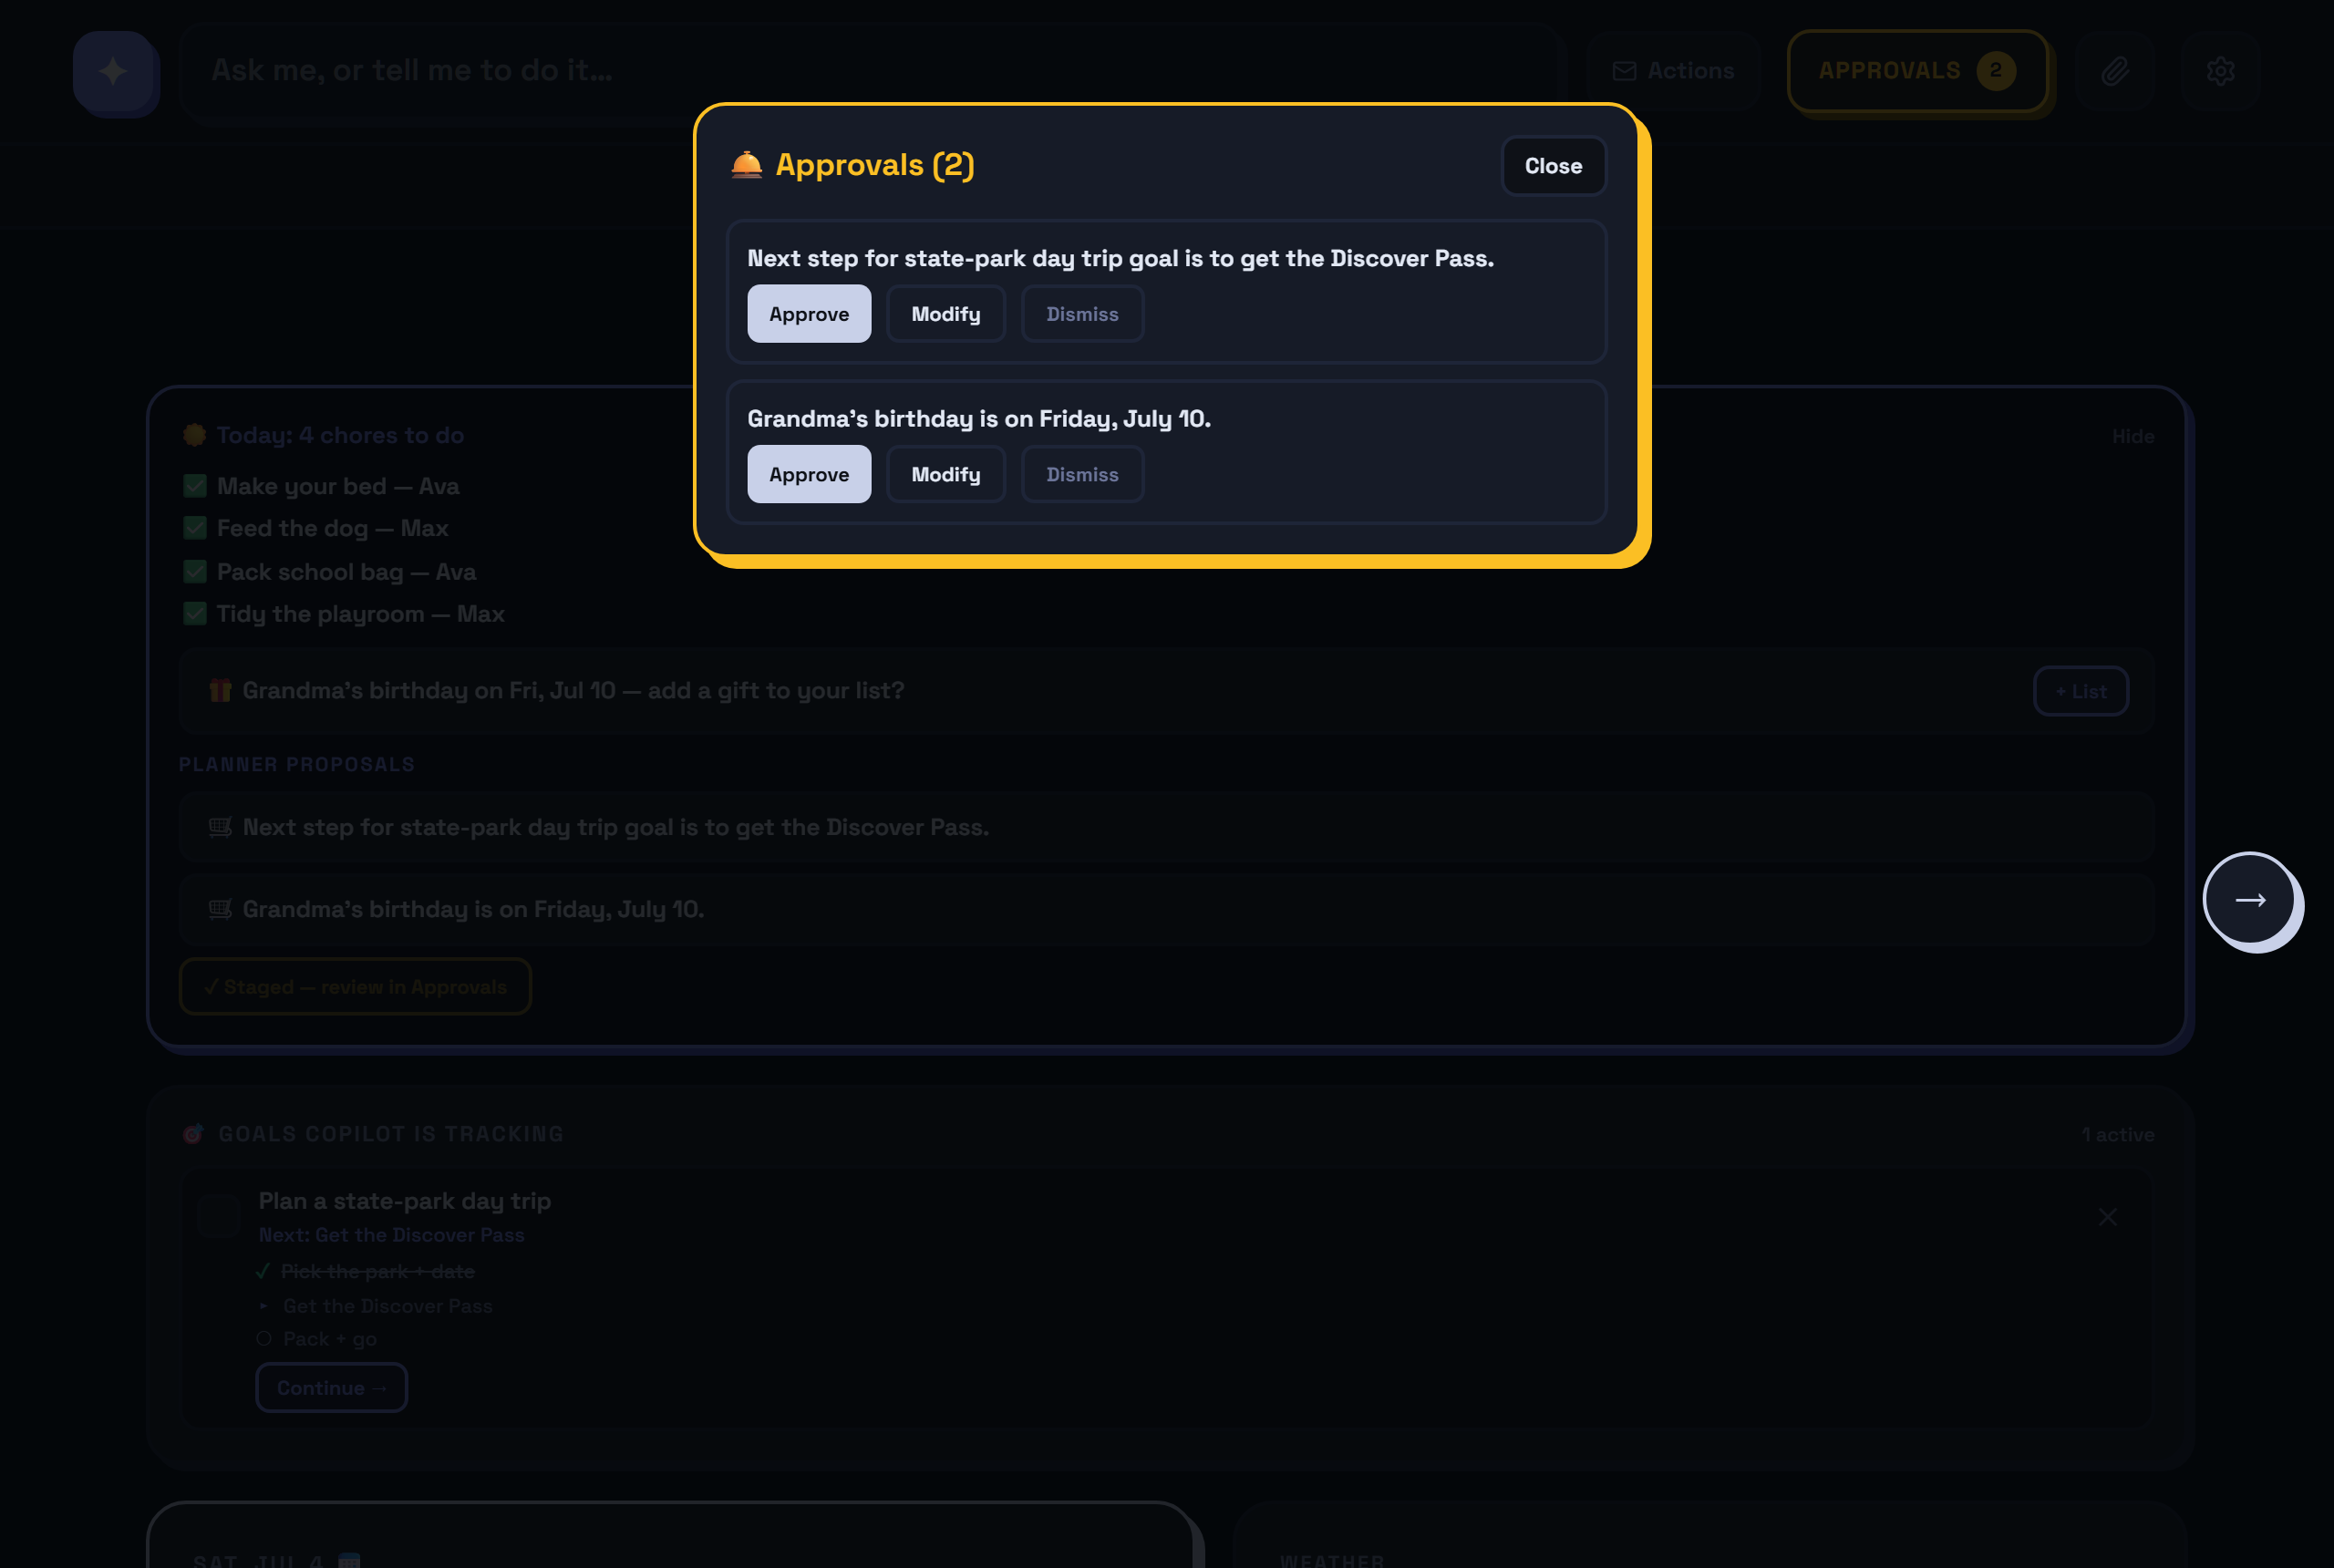
SAFETY
The adult stays the approver
No-payment invariant — structural, proven by tests
Risk tiers: auto · confirm · step-up PIN — server-side
Handoffs open the REAL page; never fill, never submit
Provenance gate: only links the agent actually observed
Scope guard: homework/code/trivia → polite decline
Per-visitor isolation: RLS on every write
Notes:
1:10. Two review surfaces, one principle: the adult stays in charge. APPROVALS is everything the copilot will only do once you say yes - the morning agent's proposals, deletes, event suggestions: approve, modify, or dismiss. ACTIONS is the legwork it hands YOU to finish - booking handoffs that open the venue's real page with the details the form will ask for listed beside it. It never fills the form and never pays. And the whole thing stays in its lane: ask it for homework help and it politely declines.

Slide 5
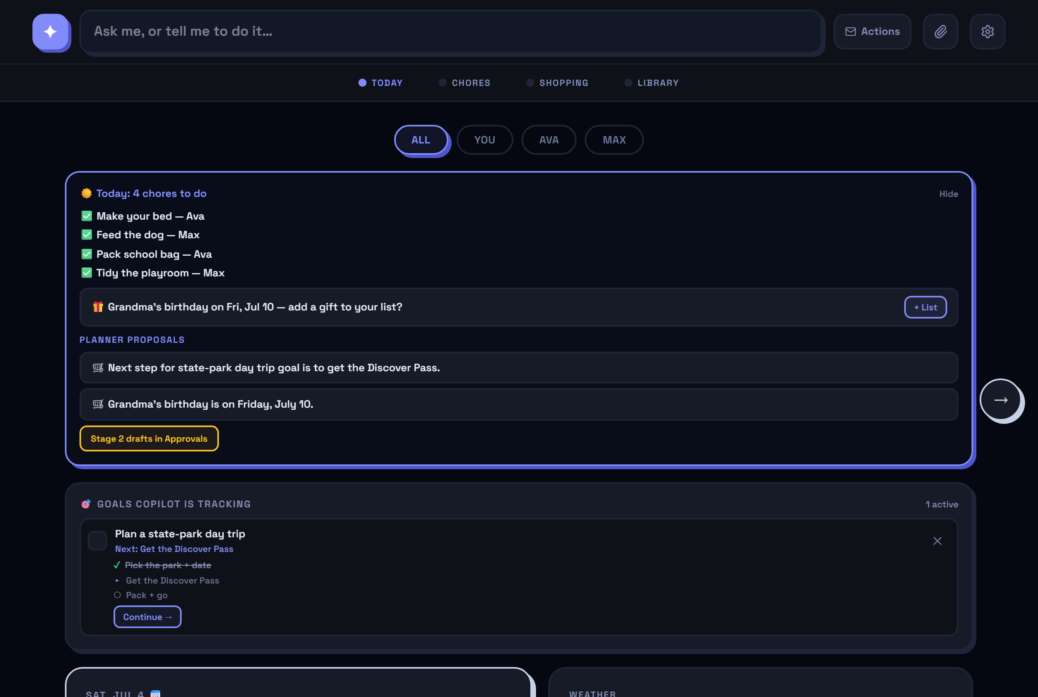
THE FLAGSHIP
The morning agent — proactive, not just reactive
Model proposes. Reads today’s facts, proposes up to 3 concrete actions. Code stages. Deterministic validation; every draft is confirm-tier. Parent/Adult approves. Drafts wait in Approvals; a scheduler emails the digest.
Notes:
1:30. Closed-app, every morning, a scheduler runs this planner: grounded in today's facts it PROPOSES — a gift for the birthday it sees, the next step of a goal it's tracking — and deterministic code stages the proposals as confirm-tier drafts. Model proposes, code stages, parent approves.

Slide 6
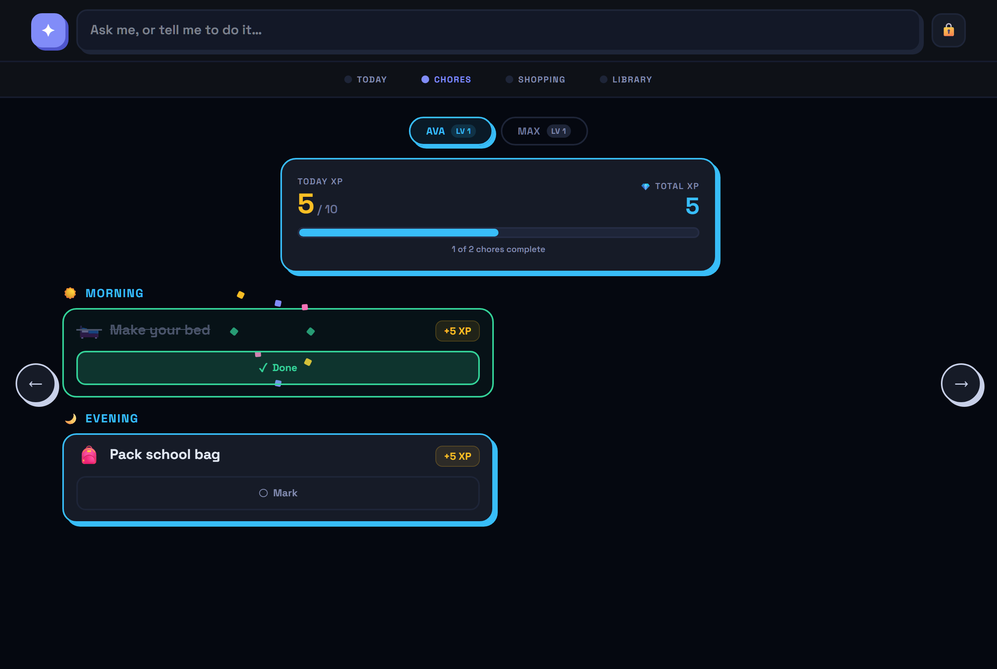
SAFE FOR EVEN AGE 4
Kid mode — nothing destructive left to tap
One toggle locks the wall tablet to the kid-safe view
Picture-first chores, XP + levels, confetti on completion
Delete, settings, approvals — all gone from the screen
Kids can still ask — the worst outcome is a draft for a parent
Exit = 3-second hold + the parent PIN
Notes:
1:45. The wall tablet is the kid surface. One toggle: picture-first chores for a four-year-old, confetti on completion — and every destructive tap is gone. The ask-box stays, because the worst a kid's request can do is stage a draft for a parent.

Slide 7
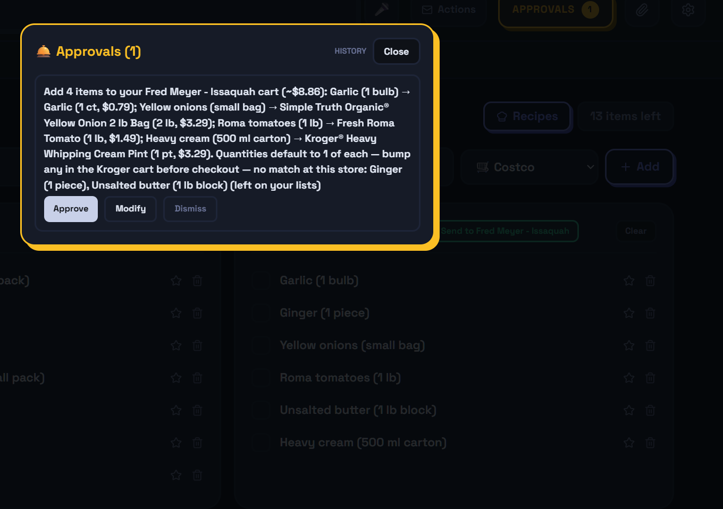
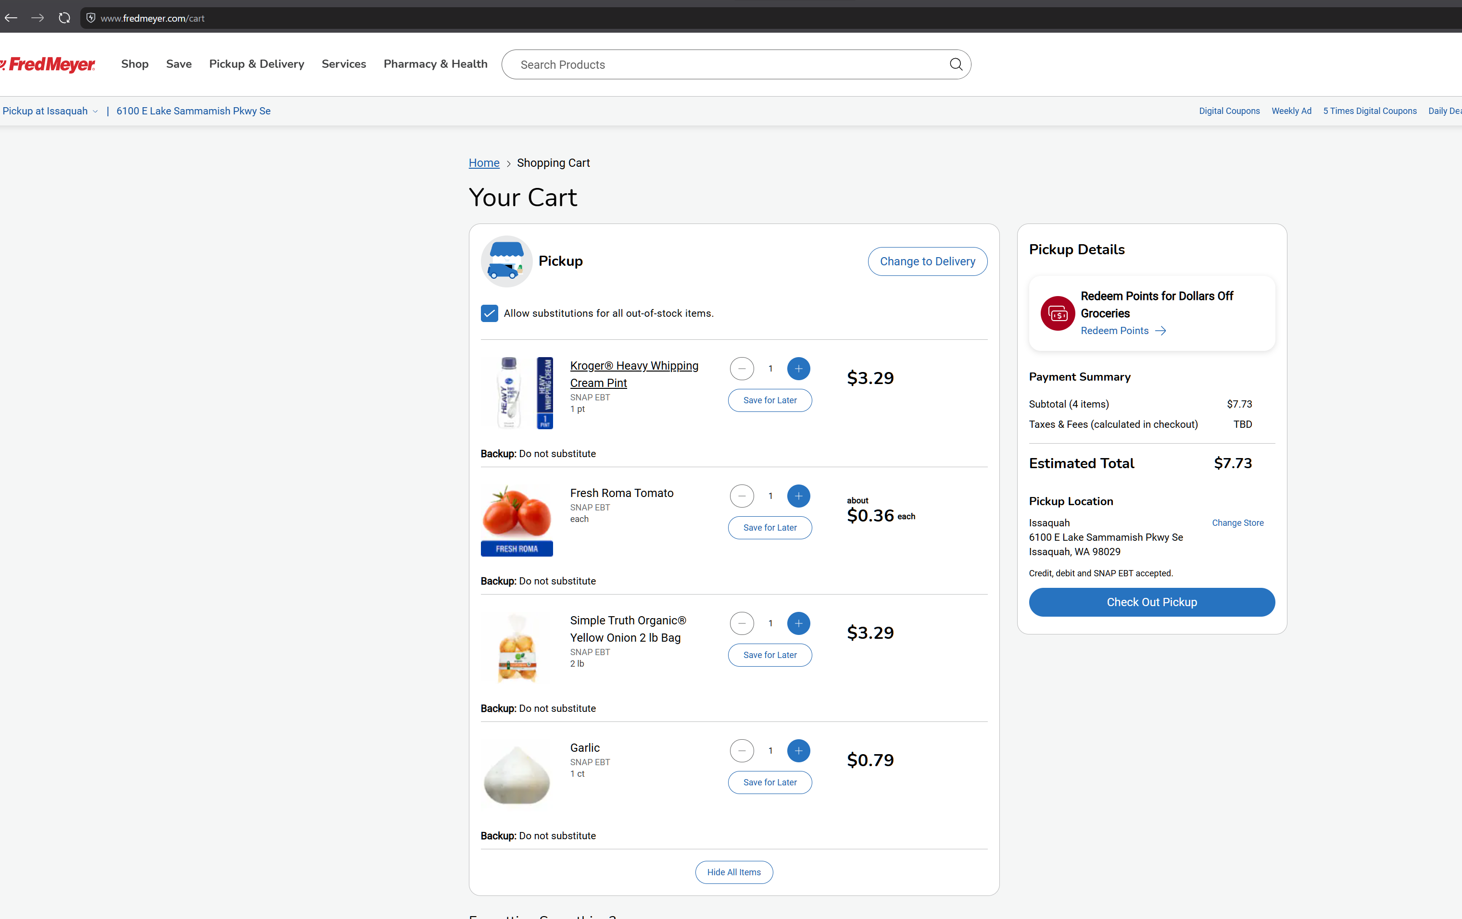
ADDED IN-WINDOW
Intent → a planned, provisioned week
Plan → provision. “Plan next week’s lunches…” → the week on a Today strip + ONE consolidated, diet-aware, store-routed list → per-list Send → the family’s real Fred Meyer cart.
Pick-or-decline matching. Kroger search returns frying pans for “paneer” — the model must choose from the store’s real candidates or say no; declines get one second look.
Honest per-item reasons. no match at this store ≠ couldn’t confidently match ≠ search failed — unmatched items stay on the list.
Still no payment tool. The public API has no checkout endpoint — the parent pays in Kroger’s own app. Setup: docs/kroger-setup.md.
Owner-verified live 2026-07-06 · the hosted demo runs the submission-freeze build — this loop ships on the repo’s default branch with tests + setup guide
Notes:
[Added after the video — in-window, public on the repo.] The chain: a WEEK planned (diet-aware, next-7-days, full CRUD) → one consolidated store-routed shopping list → pick-or-decline product matching → one approval → items in the real Fred Meyer cart (the public Kroger API has no checkout endpoint). Screenshots: the lunch plan + strip, the approval card, the fredmeyer.com cart.

Slide 8
THE BUILD
Vibe-coded solo, end to end
Google AI Studio
Antigravity
Claude Code
origin — the first app + first UI
early dev pass · later planning, architecture, and code review partner · multiple full UX / accessibility reviews of the shipped shell throughout planning and development
the main development loop — Gemini as the runtime brain throughout
The eval suite ATTACKS the agent: payment requests, prompt injection in web pages and documents — safety invariants pinned as tests.
1,200+ frontend tests · 39 agent tests · deployable three ways: Cloud Run, docker compose, Raspberry Pi
Notes:
1:55. Built solo, vibe-coded end to end. It started life as a Google AI Studio app; Antigravity ran an early dev pass — and here it is later reviewing the shipped dark-mode shell for UX and accessibility [SHOW THE JUN 24 ANTIGRAVITY SESSION]. The main loop ran in Claude Code with Gemini as the runtime brain the whole way. The eval suite does something rare for agent demos: it attacks the agent — and pins the safety invariants as tests.

Slide 9
Let’s drive it.
family-hub-web-420776046740.us-central1.run.app · Try the demo — no sign-in
① Try the demo → an isolated, seeded household (production RLS, anonymous auth)
② ☀️ Preview today’s briefing → planner proposals → Stage drafts → Approvals
③ “Plan a Mount Rainier day trip next weekend, track it as a goal” → goal strip + grounded itinerary
④ “Book a dinner table for 4 Saturday 7pm” → Actions handoff · “pay for it” → the refusal
⑤ “Add a chore for Max to water the plants tomorrow morning” → Chores tab
Manage → Kid mode ON → tap a chore → confetti → hold 🔒 to exit
Notes:
2:10 to ~5:00 — LIVE DEMO, fresh incognito window, pre-warmed demo. Follow the six beats on this slide in order; they are the README Golden Path. Close over the Today page: "Family-Hub. A multi-agent concierge with the safety story first — and a four-year-old-safe front end. The link's below — ask it for your weekend."

Slide 10
WHAT’S NEXT
This week’s roadmap — same safety spine
Instacart adapter (next)
Kroger loop SHIPPED in-window — next retailer is a second connection card: shoppable lists across 1,500+ banners (covers Costco)
$0 private mode
gpt-oss:20b running locally on the home box — no cloud, no bill. Eval-gated before it ever serves the family.
Household-defined store lists
Your stores, not ours — rename Costco, add the farmers market.
Browser form-fill
The last booking step, behind the step-up PIN tier.
Deeper proactivity
Per-member personalized digests · event-driven triggers, not just the morning cron.
Same approval gate
Every new capability still stages a draft the adult approves.
Family-Hub · AGPL open source · github.com/msampath/fam-hub
Notes:
4:50. What's next keeps the same safety spine: real Kroger carts - their API literally has no payment endpoint, so the invariant holds by contract; a fully local, zero-dollar private mode; and deeper proactivity - every new capability still lands behind the same approval gate. Family-Hub. Ask it for your weekend.

