Slide 1
ASOPRS IMAGE LIBRARY
Acquired Laxity
7 resources · 24 figures · curriculum order
Review draft · Section 1

Slide 2
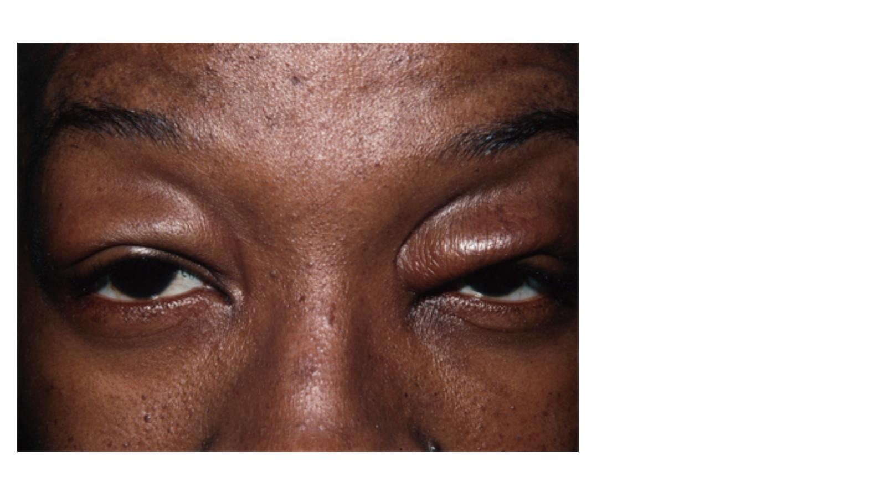
Blepharochalasis Syndrome
Figure 1 · Page 2
DESCRIPTION
Figure 1. Blepharochalasis. Courtesy Rona Z. Silkiss, MD, FACS.
Source: Eyelid-Eyebrow/Blepharochalasis Syndrome.pdf

Slide 3
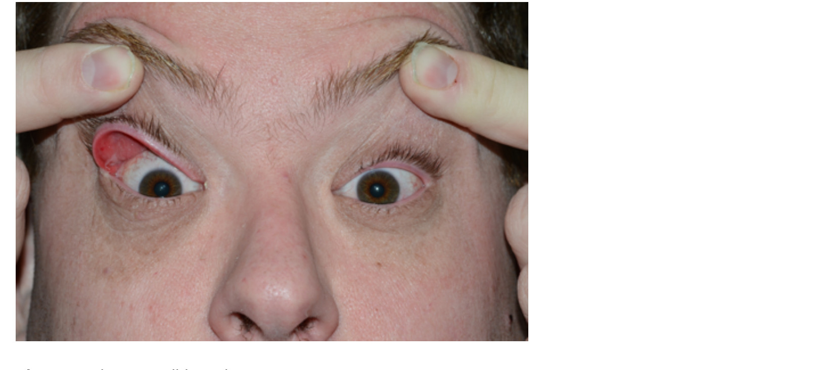
Floppy Eyelid Syndrome
Figure 1 · Page 3
DESCRIPTION
Figure 1. Floppy eyelid syndrome.
Source: Eyelid-Eyebrow/Floppy Eyelid Syndrome.pdf

Slide 4
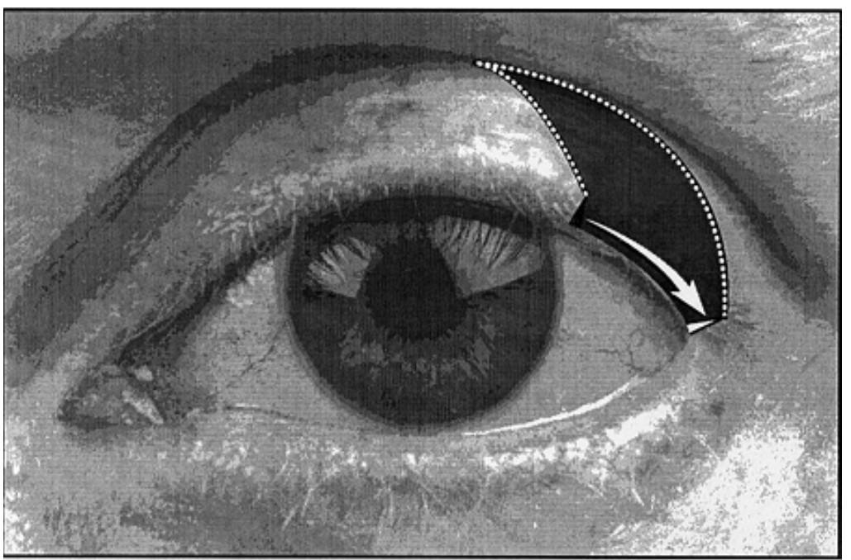
Floppy Eyelid Syndrome
Figure 2 · Page 5
DESCRIPTION
Figure 2. 2–3-mm incisions perpendicular to the lateral canthal angle and curvilinear lid crease incision.
Source: Eyelid-Eyebrow/Floppy Eyelid Syndrome.pdf

Slide 5
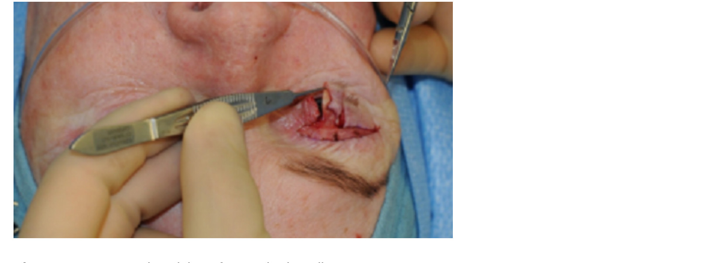
Floppy Eyelid Syndrome
Figure 3 · Page 6
DESCRIPTION
Figure 3. Pentagonal excision of posterior lamella.
Source: Eyelid-Eyebrow/Floppy Eyelid Syndrome.pdf

Slide 6
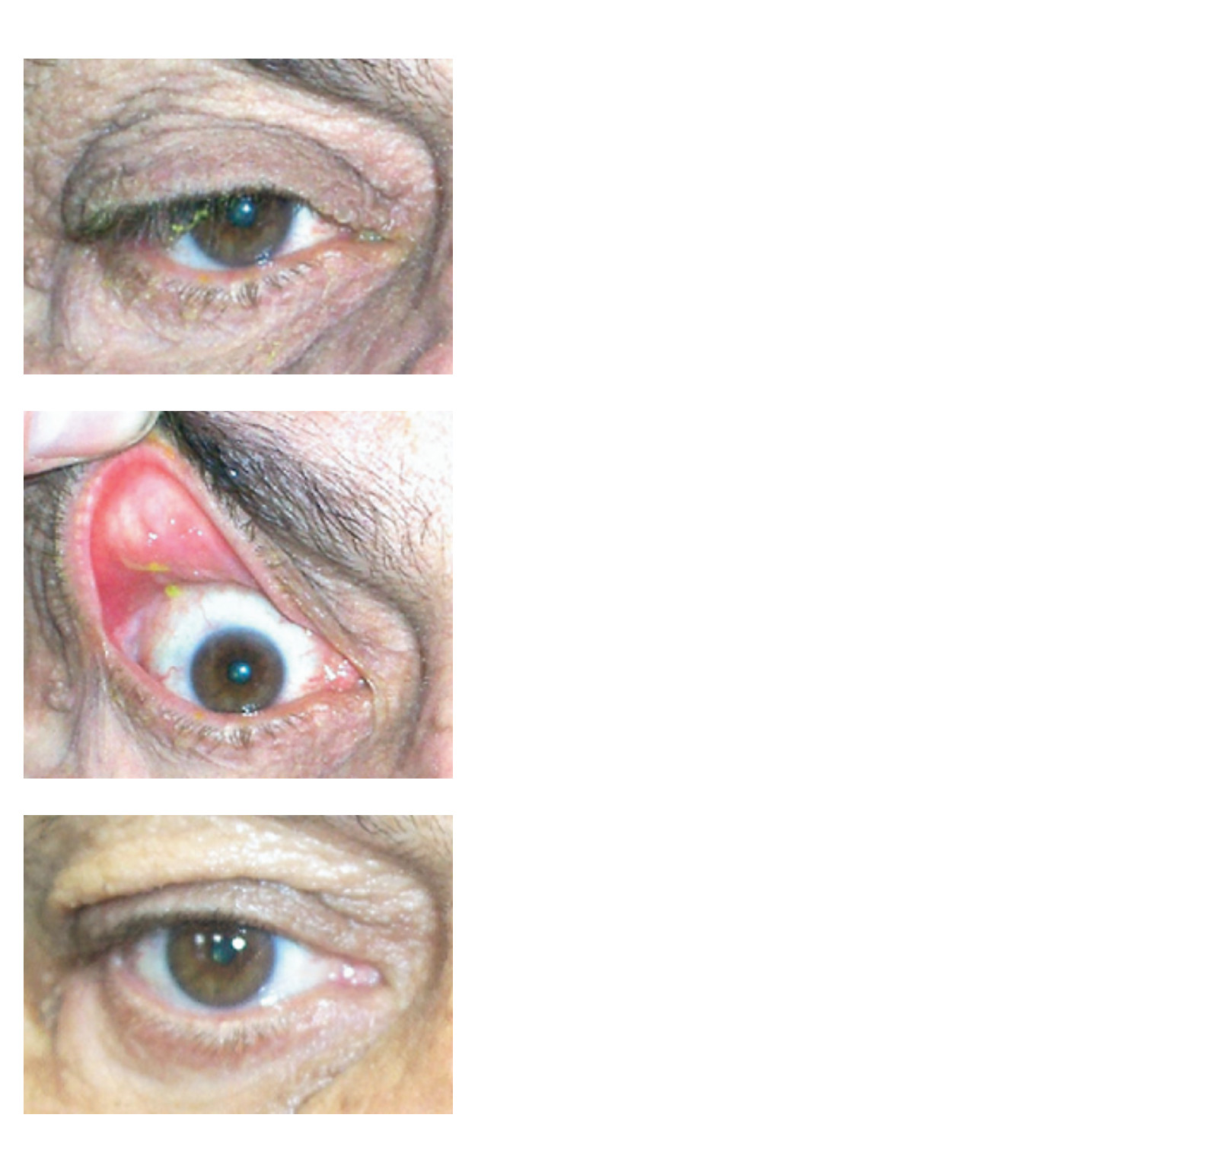
Floppy Eyelid Syndrome
Figure 4 · Page 7
DESCRIPTION
Figure 4. Elevation of lid margin.
Source: Eyelid-Eyebrow/Floppy Eyelid Syndrome.pdf

Slide 7
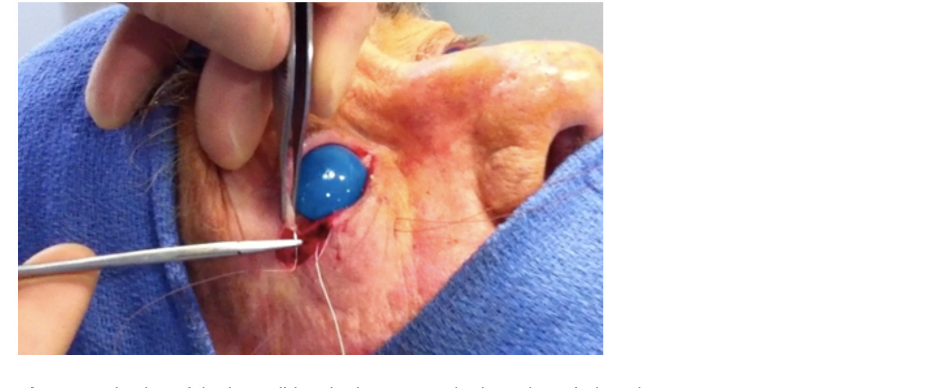
Horizontal Eyelid Tightening
Figure 1 · Page 3
DESCRIPTION
Figure 1. Fixation of the lower lid to the intact superior lateral canthal tendon.
Source: Eyelid-Eyebrow/Horizontal Eyelid Tightening.pdf

Slide 8
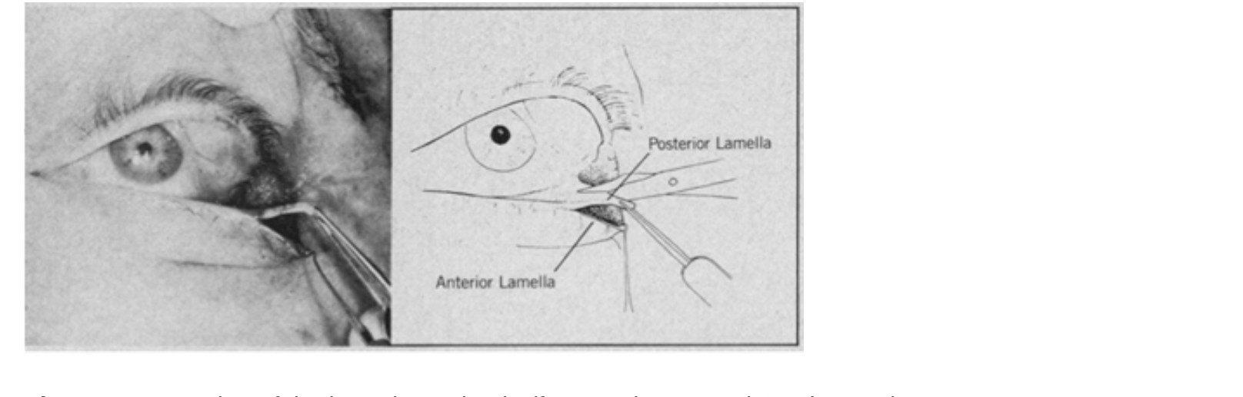
Horizontal Eyelid Tightening
Figure 2 · Page 3
DESCRIPTION
Figure 2. Formation of the lateral tarsal strip (from Anderson and Gordy 1979).
Source: Eyelid-Eyebrow/Horizontal Eyelid Tightening.pdf

Slide 9
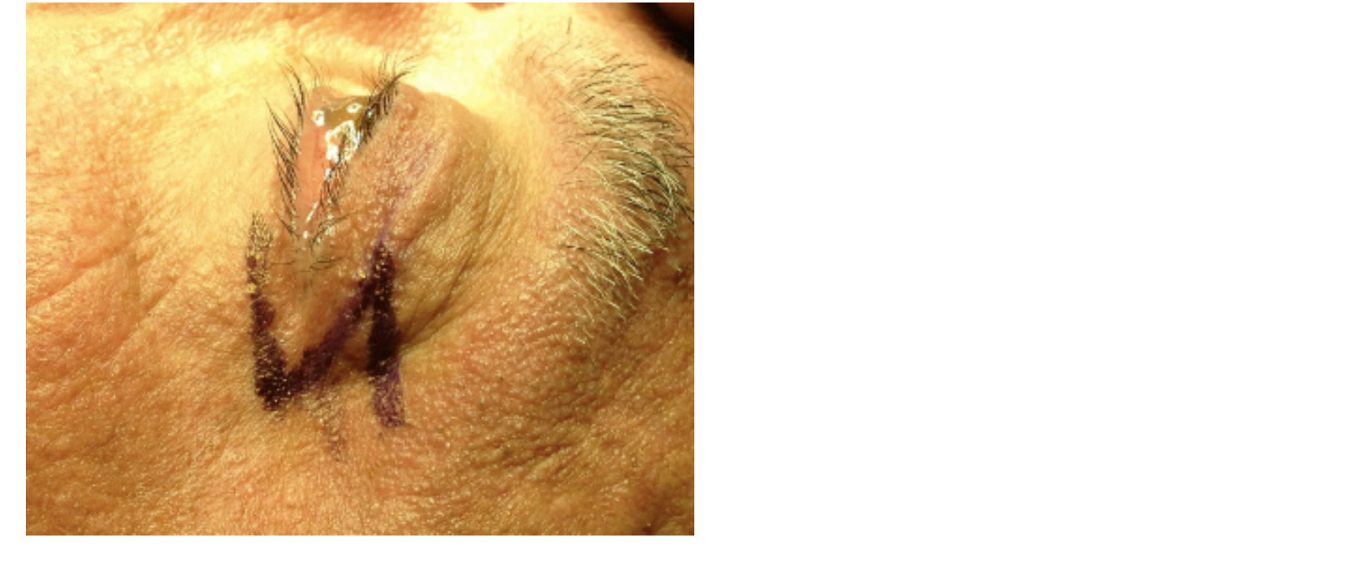
Horizontal Eyelid Tightening
Figure 3 · Page 4
DESCRIPTION
Figure 3. Marking of the Z-plasty.
Source: Eyelid-Eyebrow/Horizontal Eyelid Tightening.pdf

Slide 10
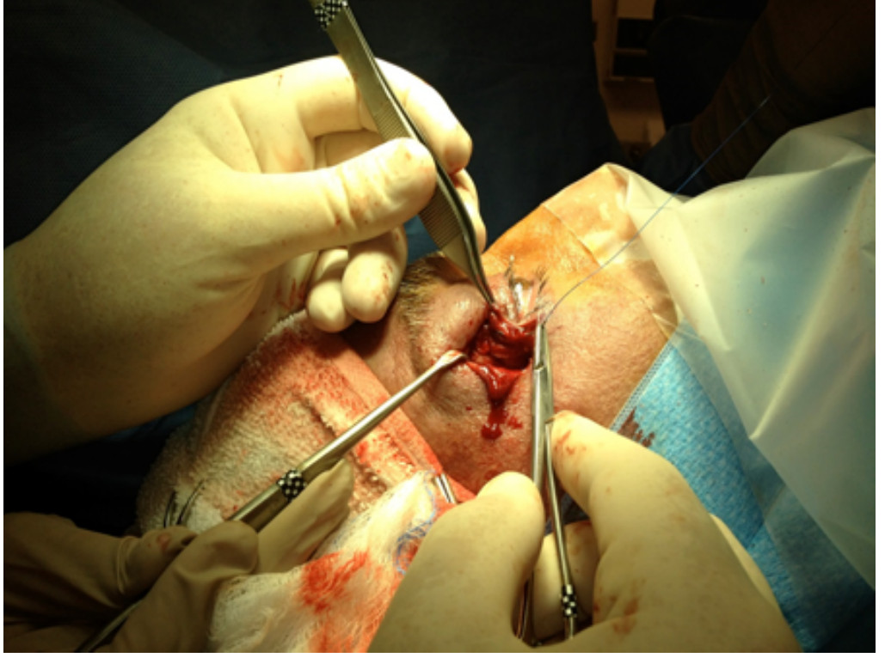
Horizontal Eyelid Tightening
Figure 4 · Page 4
DESCRIPTION
Figure 4. En bloc elevation of lateral canthus via subperiosteal dissection and placement of permanent suture through the canthal body.
Source: Eyelid-Eyebrow/Horizontal Eyelid Tightening.pdf

Slide 11
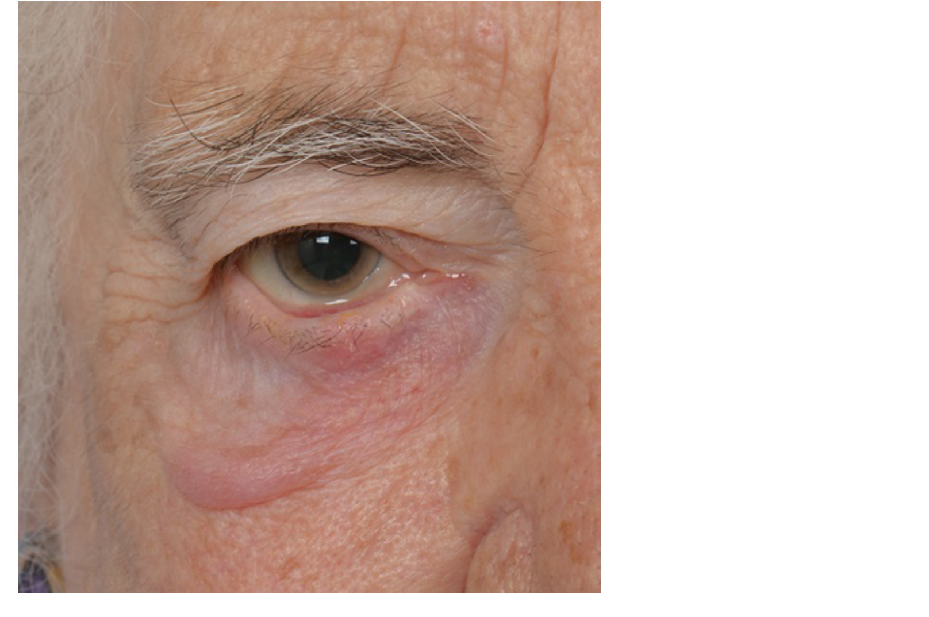
Lateral and Medial Canthoplasty
Figure 1 · Page 2
DESCRIPTION
Figure 1. Involutional right lower lid ectropion.
Source: Eyelid-Eyebrow/Lateral and Medial Canthoplasty.pdf

Slide 12
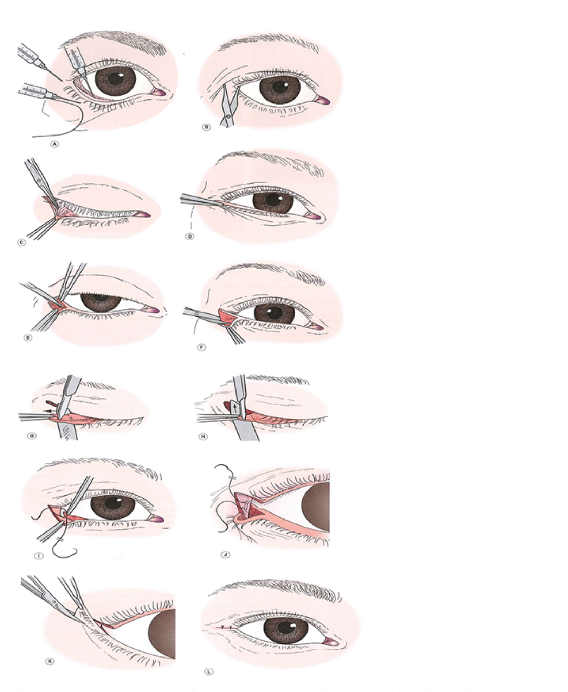
Lateral and Medial Canthoplasty
Figure 2 · Page 10
DESCRIPTION
Figure 2. Lateral tarsal strip procedure. From Nerad JA, Techniques in Ophthalmic Plastic Surgery, 2010.
Source: Eyelid-Eyebrow/Lateral and Medial Canthoplasty.pdf

Slide 13
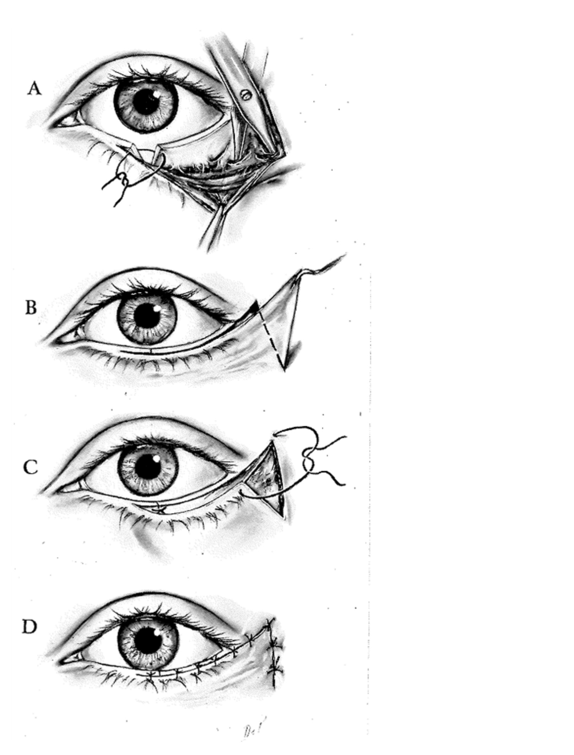
Lateral and Medial Canthoplasty
Figure 3 · Page 16
DESCRIPTION
Figure 3. Kuhnt-Szymanowski procedure. From Callahan A. Reconstructive Surgery of the Eyelids and Ocular Adnexa, 1966.
Source: Eyelid-Eyebrow/Lateral and Medial Canthoplasty.pdf

Slide 14
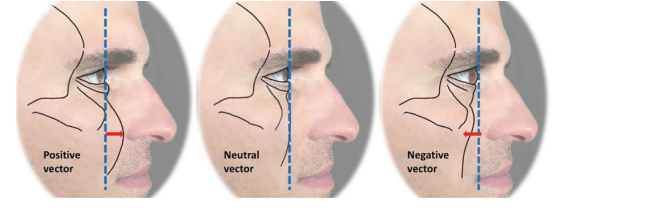
Lower Eyelid Blepharoplasty
Figure 1 · Page 2
DESCRIPTION
Figure 1. Positive, neutral, and negative vectors. A vertical line is drawn from the center of the pupil to the infraorbital rim. Patients with a positive vector have anterior projection of the rim, whereas those with a negative vector have anterior projection of the globe compared with the rim.
Source: Eyelid-Eyebrow/Lower Eyelid Blepharoplasty.pdf

Slide 15
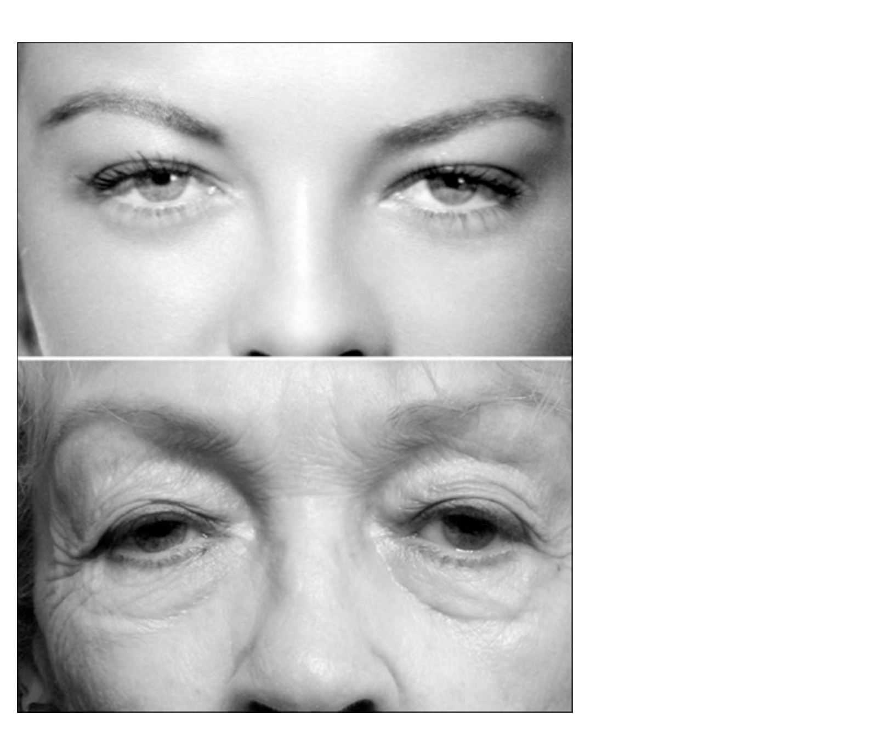
Periorbital Hollows
Figure 1 · Page 2
DESCRIPTION
Figure 1. Aging changes are characterized by deflation, with loss of volume along the superior and inferior orbital rim.
Source: Eyelid-Eyebrow/Periorbital Hollows.pdf

Slide 16
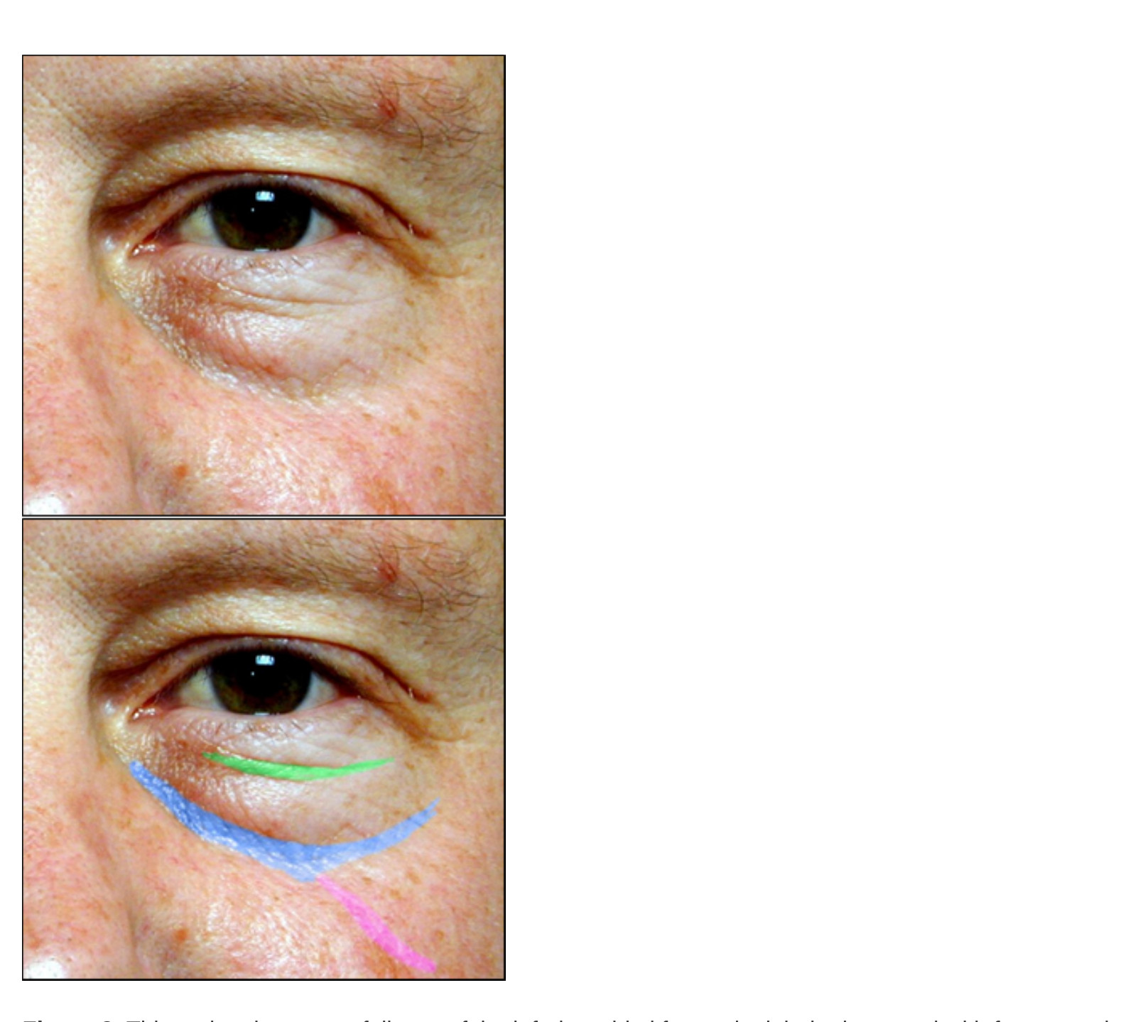
Periorbital Hollows
Figure 2 · Page 3
DESCRIPTION
Figure 2. This patient has some fullness of the inferior orbital fat and might be improved with fat removal, but a more natural and effective rejuvenation recognizes and treats the periorbital hollows. Blue: orbital rim hollow. Purple: zygomatic hollow. Green: septal confluence hollow.
Source: Eyelid-Eyebrow/Periorbital Hollows.pdf

Slide 17
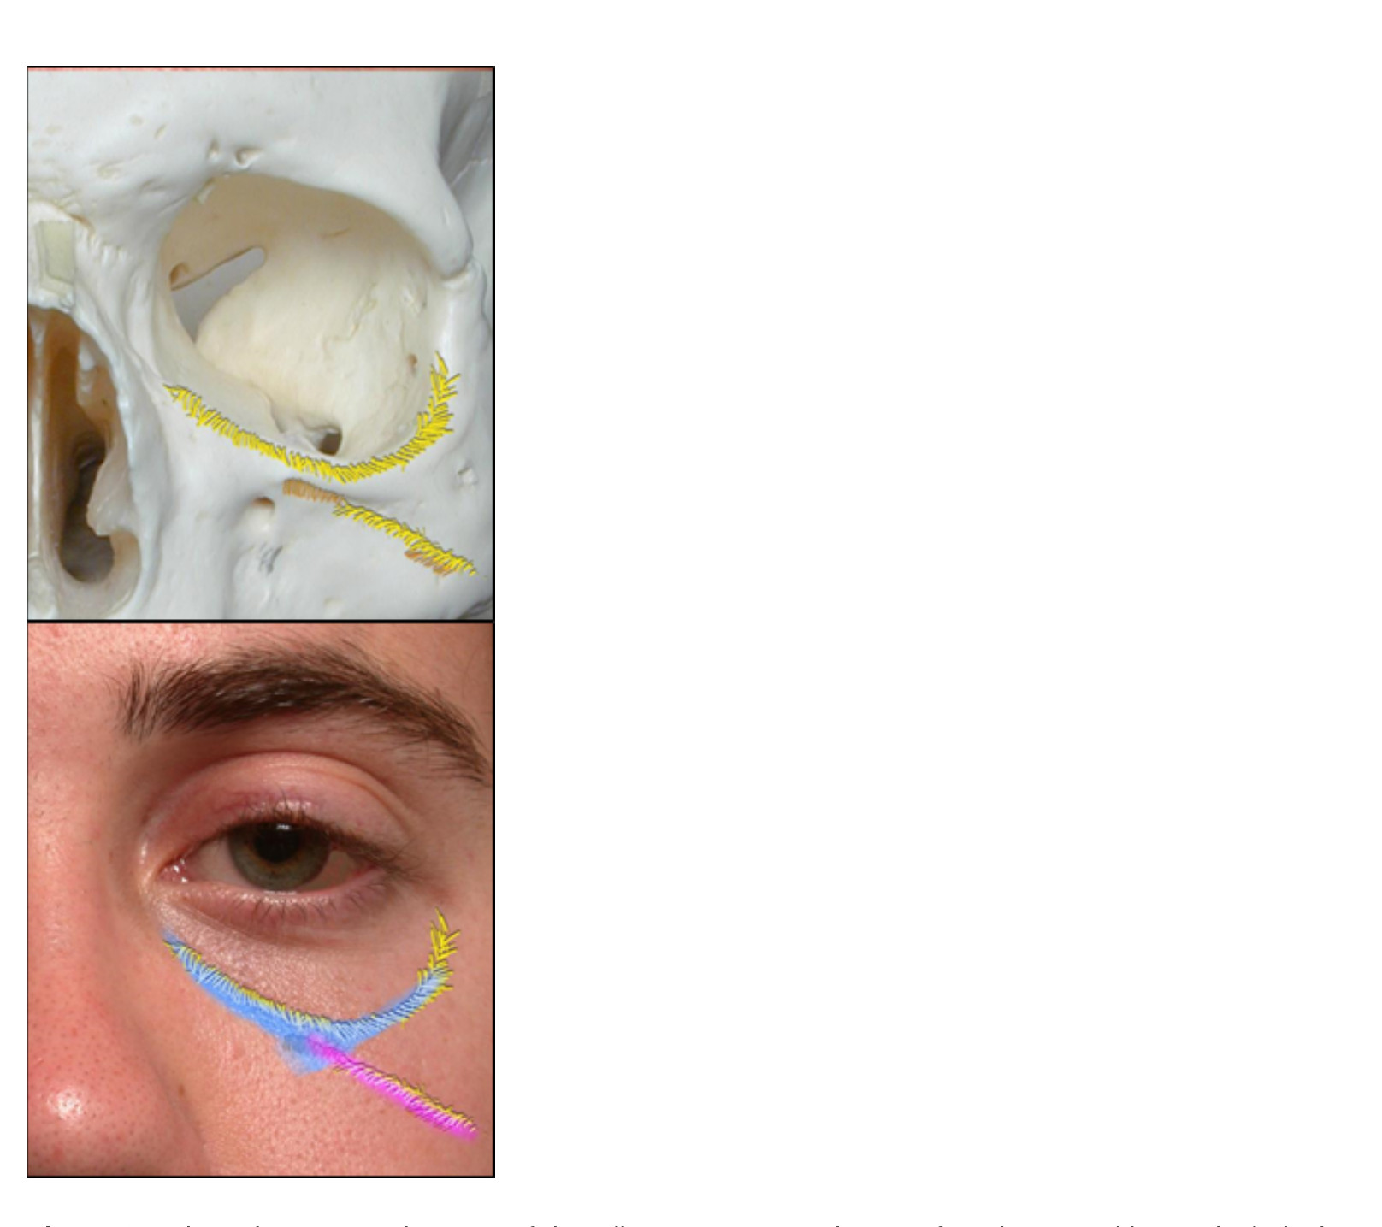
Periorbital Hollows
Figure 3 · Page 4
DESCRIPTION
Figure 3. Volume loss occurs in areas of deep ligamentous attachments from bone to skin, particularly the orbital rim ligament (blue) and zygomatic ligament (purple).
Source: Eyelid-Eyebrow/Periorbital Hollows.pdf

Slide 18
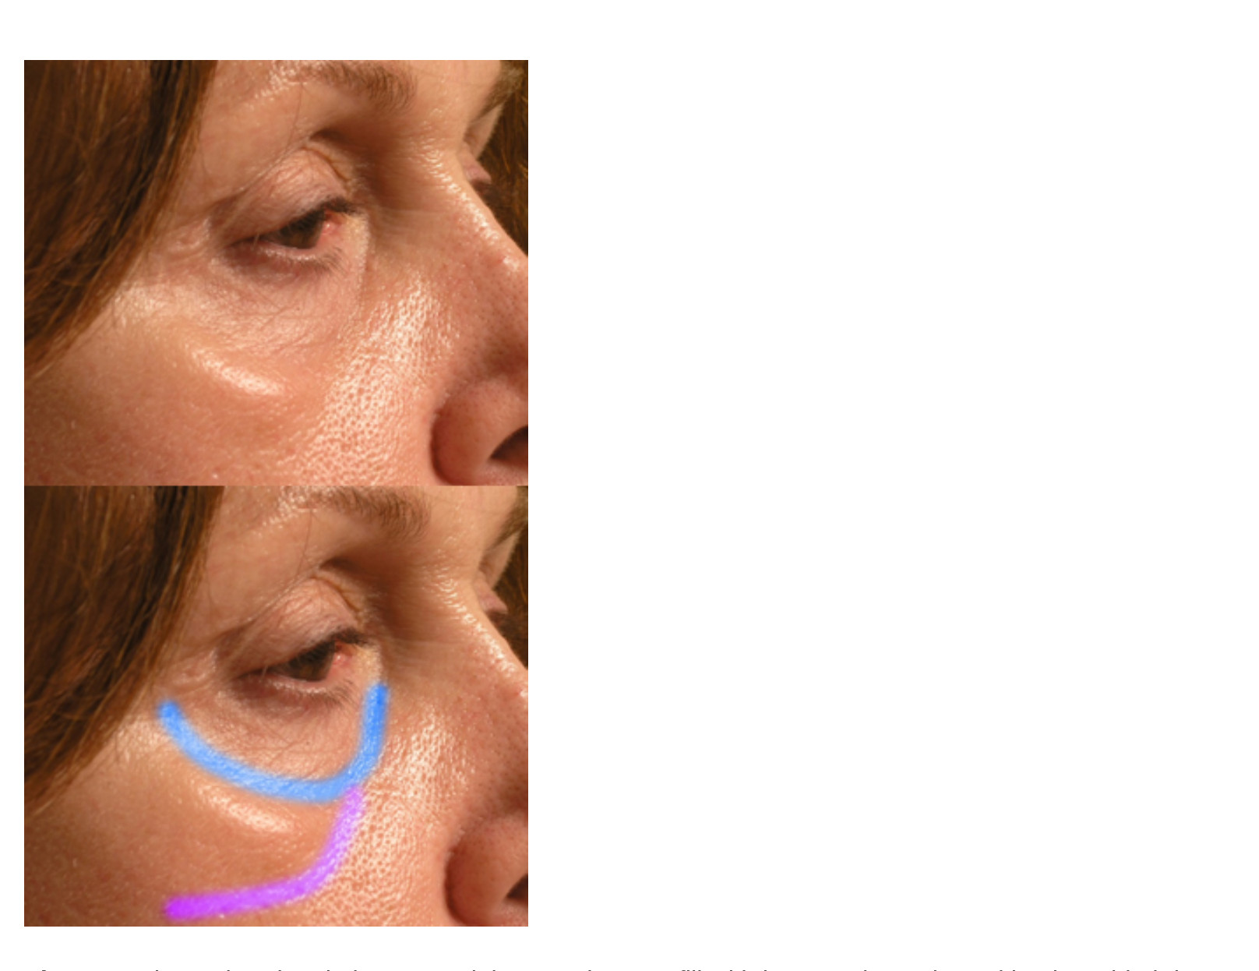
Periorbital Hollows
Figure 4 · Page 5
DESCRIPTION
Figure 4. The malar triangle is a potential space that can fill with boggy edema, bound by the orbital rim ligament (blue) and the zygomatic ligament (purple).
Source: Eyelid-Eyebrow/Periorbital Hollows.pdf

Slide 19
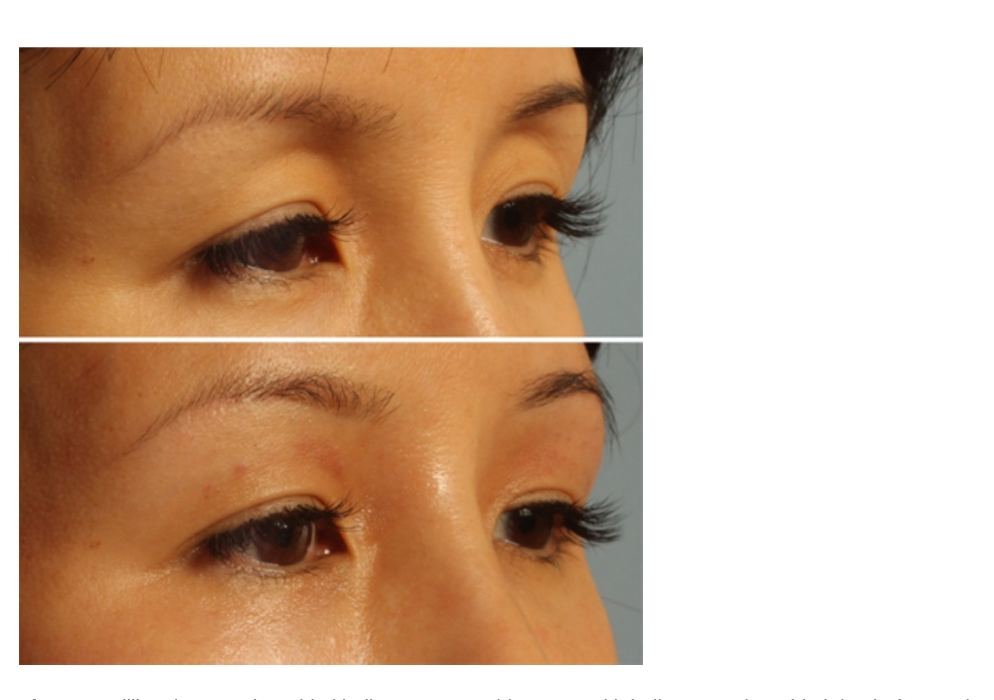
Periorbital Hollows
Figure 5 · Page 6
DESCRIPTION
Figure 5. Filling the superior orbital hollow. A 39-year-old woman with a hollow superior orbital rim, before and after 1 mL Restylane filling.
Source: Eyelid-Eyebrow/Periorbital Hollows.pdf

Slide 20
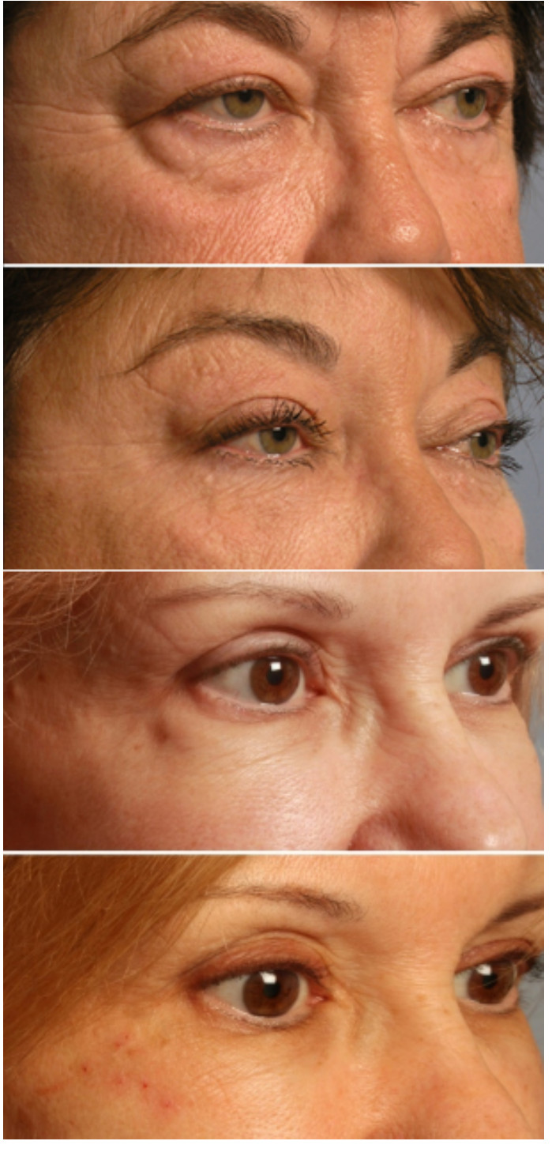
Periorbital Hollows
Figure 6 · Page 7
DESCRIPTION
Figure 6. The lateral ‘Charlie Brown’ hollow forms between the lateral orbital fat pad and adjacent malar fat. Upper: debulking the puffy lateral fat pad with blepharoplasty improves the contour, here combined with midface lift. Lower: another option is conservative, feathered filling of the hollow.
Source: Eyelid-Eyebrow/Periorbital Hollows.pdf

Slide 21
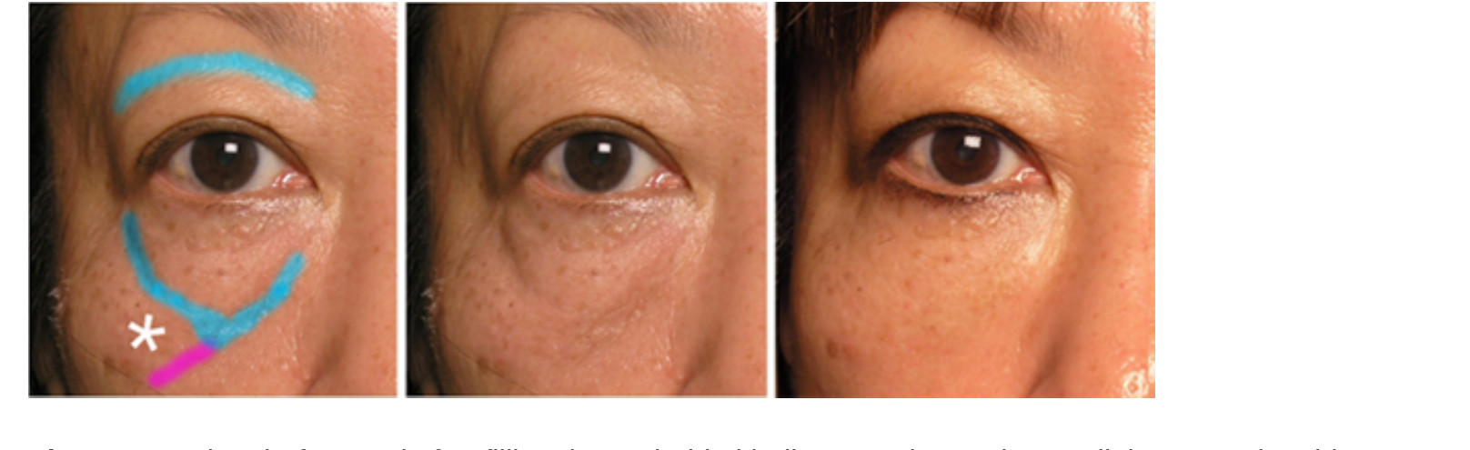
Periorbital Hollows
Figure 7 · Page 9
DESCRIPTION
Figure 7. Patient before and after filling the periorbital hollows, with 1 mL Restylane split between the sides. Blue: orbital rim hollow. Purple: zygomatic hollow.
Source: Eyelid-Eyebrow/Periorbital Hollows.pdf

Slide 22
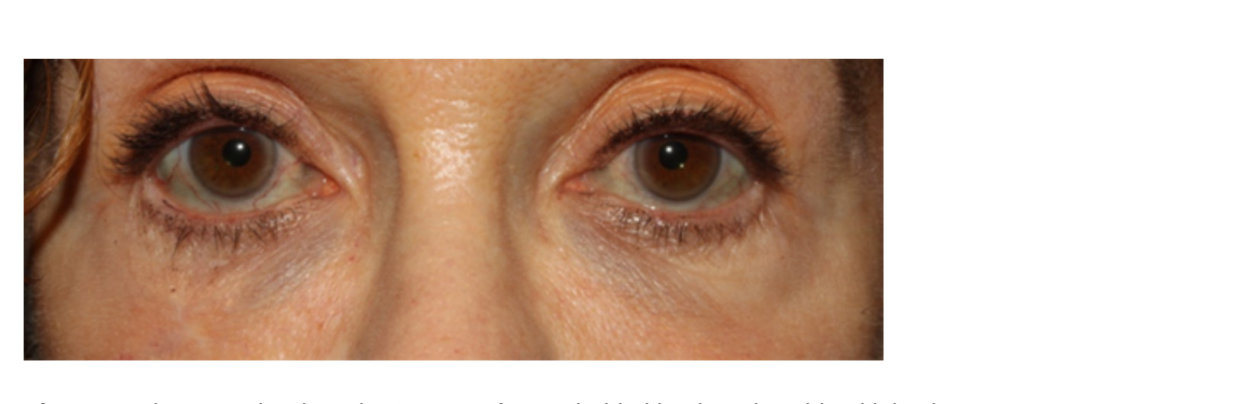
Periorbital Hollows
Figure 8 · Page 11
DESCRIPTION
Figure 8. Blue grey dyschromia, 2 years after periorbital hyaluronic acid gel injections
Source: Eyelid-Eyebrow/Periorbital Hollows.pdf

Slide 23
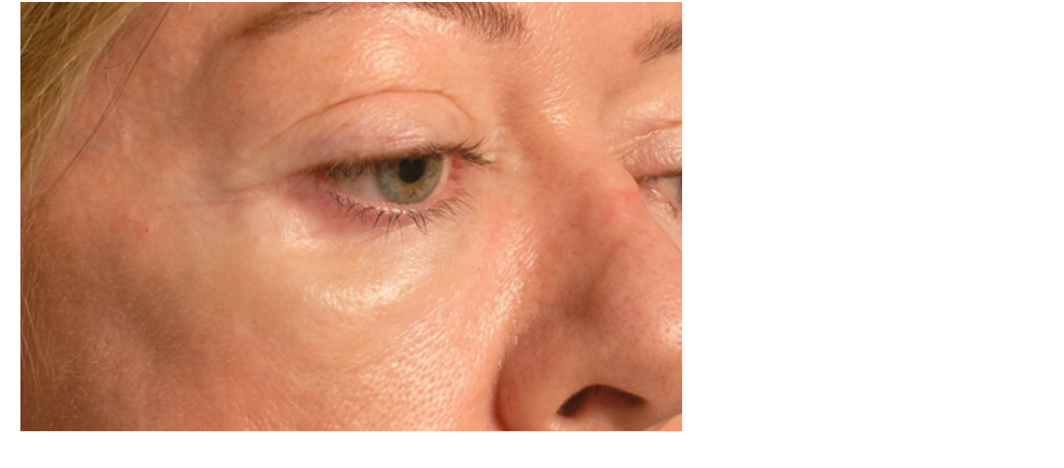
Periorbital Hollows
Figure 9 · Page 11
DESCRIPTION
Figure 9 Late boggy edema, 1 year after periorbital hyaluronic acid gel injections.
Source: Eyelid-Eyebrow/Periorbital Hollows.pdf

Slide 24
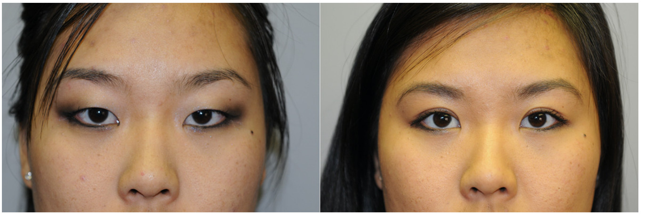
Upper Eyelid Blepharoplasty- Cosmetic and Functional Surgery
Figure 1 · Page 9
DESCRIPTION
Figure 1. Before and after upper trapezoidal blepharoplasty to create a double eyelid in an East Asian patient. Courtesy Robert Fante, MD.
Source: Eyelid-Eyebrow/Upper Eyelid Blepharoplasty- Cosmetic and Functional Surgery.pdf

Slide 25
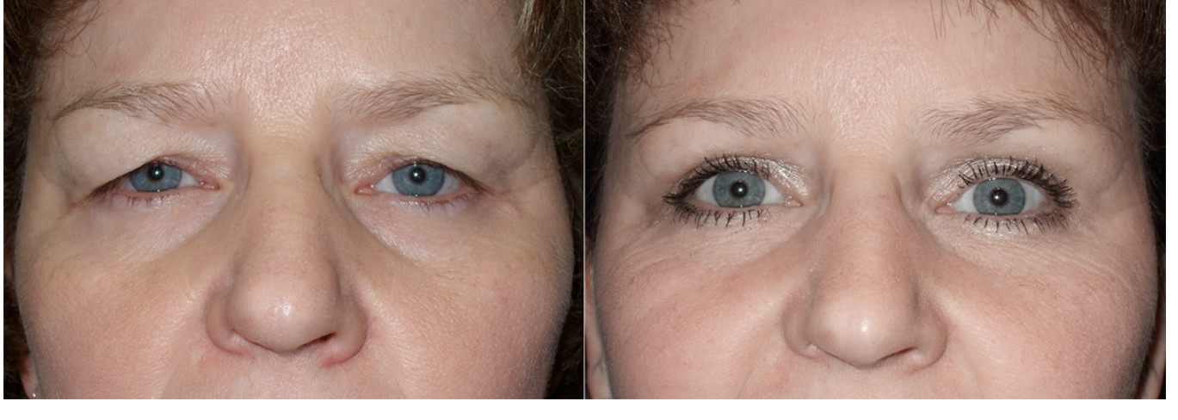
Upper Eyelid Blepharoplasty- Cosmetic and Functional Surgery
Figure 2 · Page 9
DESCRIPTION
Figure 2. Before and after upper blepharoplasty in a Caucasian patient using lid-crease fixation. Courtesy Robert Fante, MD.
Source: Eyelid-Eyebrow/Upper Eyelid Blepharoplasty- Cosmetic and Functional Surgery.pdf

