Slide 1

Securing and Monitoring your AVD enviroment
Marius Sandbu
Guild Lead Public Cloud @ TietoEVRY
Twitter @msandbu
msandbu@gmail.com
Blog → https://msandbu.org
Code/Script/Visuals/Presentation repo for this session → https://github.com/msandbu/community

Slide 2

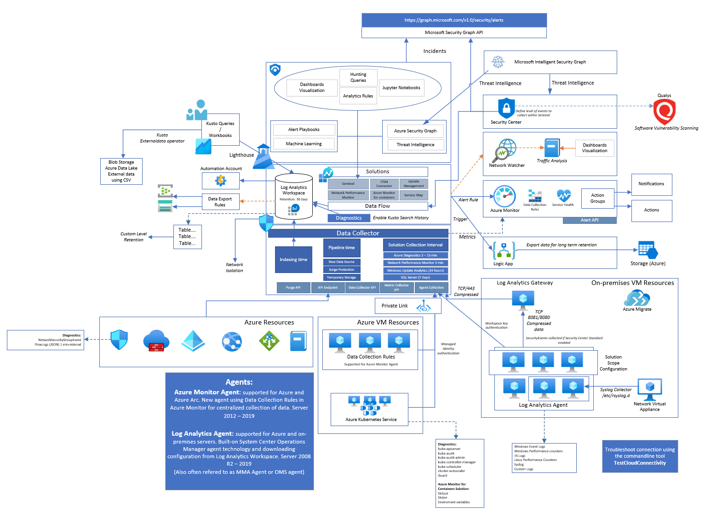

What I’m going to cover
Also how to monitor... Stuff in here
With this (hopefully...)
From getting in here
How to stop people in hoodies

Slide 3
Agenda
The Microsoft Security Ecosystem
Azure Monitoring Capabilities (and log sources)
Azure Sentinel, Defender and other goodies
Building Security and Governance in Azure
Managing your keetle in AVD
Automate all the things!
N.B:! Most Services mentioned are not free so....use with caution unless you have black belt in Azure pricing :D

Slide 4

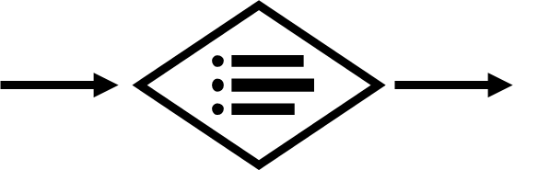



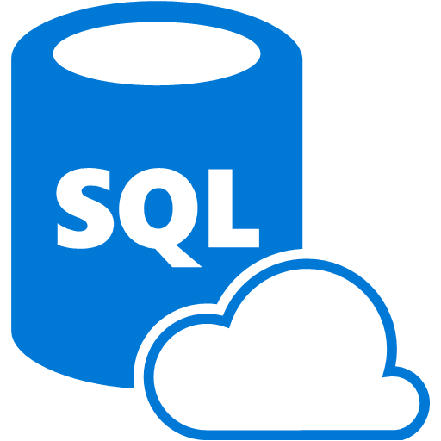

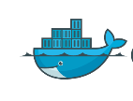











Microsoft Security Ecosystem
Identity & Access
Security Information and Event Management (SIEM)
Analytics/Automation
Azure Sentinel
Information Protection
Azure Active Directory
Cloud App
Security
Azure
Defender
Microsoft Defender
Office 365
Azure
Advanced Threat Protection (ATP)
Conditional Access – Identity Perimeter Management
Cloud App Security
Azure AD Identity Protection
Leaked cred protection
Behavioral Analytics
Graph Security API – 3rd Party Integration
Azure Information Protection (AIP)
Azure Defender
Configuration Hygiene
Just in Time VM Access
Office 365
Azure Firewall
Security Appliances
Adaptive App Control
Azure AD PIM
NGFW
Azure SQL
Threat Detection
Multi-Factor Authentication
Edge DLP
SSL Proxy
SQL Encryption & Data Masking
Azure AD B2B
IPS/IDS
Azure SQL Info Protection
MIM PAM
Azure Policy
Azure Key Vault
Storage Encryption
Microsoft Defender ATP
Azure ATP
Azure WAF
Azure Antimalware
DDoS Mitigation
Active Directory
Application & Network Security Groups
Backup & Site Recovery
Confidential Computing

Slide 5
Some of the main API’s
Two main resources for automation
Graph API (Microsoft 365)
Rest API, PowerShell, Terraform
Access to Graph API
Azure Resource Manager (Azure services)
Rest API, PowerShell, Terraform, Bicep, Pulimi etc
Access to ARM using custom role on defined scope
Custom API’s and endpoints for
Defender ATP
Cloud App Security
Office 365
Service Communication API
Management API

Slide 6
Some things you should have in place
Install-Module Microsoft.Graph
Update-Module Microsoft.Graph
Install-Module AzureAD
Install-Module AzureADPreview
Install-Module Az
az config set extension.use_dynamic_install=yes_prompt
Install-Module MCAS
Install-Module ExchangeOnlineManagement
Install-Module MicrosoftTeams
Install-Module MicrosoftGraphSecurity
Install-Module Az.ResourceGraph
Choco install Terraform
Quickstart - Configure Terraform using Azure Cloud Shell | Microsoft Docs
NOTE: Currently there are some overlapping PowerShell modules…
Some VS Code extensions:
Installed from CLI
code --install-extension hashicorp.terraform
code --install-extension ms-vscode.azure-account
code --install-extension msazurermtools.azurerm-vscode-tools
code --install-extension ms-vscode.azurecli
code --install-extension AzurePolicy.azurepolicyextension

Slide 7
Super quick intro to Terraform
Providers: Integration to a specific platform (Azure RM Provider)
State: Metadata stored of current configuration (By default stored locally)
Can be stored in Azure Blob Storage for instance as a backend
Commands (Terraform.exe Init)
Init (Make sure provider, state and folders are in place)
Plan (Make a plan file with changes that will happen)
Apply (Actually doing the changes)
Destroy (What is says...)
Main.tf
Backend.tf
Network.tf
Monitoring.tf
Remote State
Azure Provider
Azure
Terraform
Google Provider
Google Cloud
Secrets
Kubernetes Provider
Kubernetes

Slide 8
Working with Azure - Automation
How to handle access to the environment?
1: Have a defined service principal with access to the environment
Local development
2: Managed System Identity for Automated deployments (Azure DevOps/ GitHub Actions)
Azure PowerShell:
Connect-AzAccount –Identity
Terraform: provider "azurerm" {
version = "~> 1.23“ use_msi = true
}

Slide 9
Building Blocks of an Secure Azure foundation
Access Management – RBAC and use of least-privilege access
Azure Policies – Defining Policies that can audit and handle configuration management
Azure Defender – Threat detection and security governance
Azure Monitor / Log Analytics / Sentinel – Monitoring, logging and some security mechanisms
Azure Backup – Backup of IaaS stateful resources
Azure Update Management and Change Tracking – Patch management and file tracking
Network Landing zone – Different level of firewall mechanisms, controlling traffic flow and insight
Naming and tagging prefix – Resource Consistency
Azure Services – Logging enabled, Service Endpoint, Private Links
Azure Resource Graph – Inventory, Asset management

Slide 10
Many things that can go wrong
Error with session host(s)
Error with networking (affecting latency and reliability)
Error with underlying service (RD Gateway)
Error with supporting services (Azure AD or AADDC)
Error with a region or availabilty zone (West Europe)
Intermittent issues (Network, Internet, Endpoint Availability)

Slide 11
Some Log Sources
Audit Item | Category | Enabled by Default | Retention
User Activity | Microsoft 365 Security | No | 90 Days (1 year for P2)
Admin Activity | Microsoft 365 Security | No | 90 Days (1 year for P2)
Mailbox Audit | Exchange Online | Yes | 90 Days
Sign-In Activity | Azure AD | Yes | 30 Days (AAD P1)
Users at Risk | Azure AD | Yes | 7 Days (30 Days, P1/P2)
Risky Sign-ins | Azure AD | Yes | 7 Days (30 Days, P1/P2)
Azure MFA Usage | Azure AD | Yes | 30 Days
Directory Audit | Azure AD | Yes | 7 Days (30 Days, P1/P2)
Intune Activity Log | Intune | Yes | 1 Year (Graph API)

Slide 12
More Log Sources
Audit Item | Category | Enabled by Default | Retention
Azure Resource Manager | Azure | Yes | 30 Days
Network Security Group Flow Logs | Azure | No | Depending on Configuration
Azure Diagnostics Logs | Azure | No | Depending on Configuration
Azure Application Insight | Azure | No | Depending on Configuration
VM Event Logs | OS | Yes | Size defined in Group Policy
Custom Logs | OS | N/A | Application specific logs
Azure Security Center | Azure | No (Cost per host/PaaS) | Depending on Log Analytics
SaaS Usage | N/A | No | Requires Cloud App Discovery
Custom Sources** | N/A | No | Depending on Configuration

Slide 13
Understanding what data is collected
To see the full picture you need multiple datasets
Example:
Azure Defender
Flow Logs NSG
VMConnection – Service Map
Event Logs
Defender: Malicious traffic from 8.8.8.8
Flow Logs: Traffic from 8.8.8.8 going to IP 1.1.1.1 on Port 3389 and was allowed
VMConnect: svchost.exe accepted connection on port 3389 currently established
Event Logs: Successful logged on AD user with username domain\administrator from IP 8.8.8.8

Slide 14
Log Analytics and Sentinel
Log Analytics is a log collection service
Data and processing within a region
Default retention 30 days (for entire database)
Also used for Azure Monitor
Data stored in different tables
Depending on data source
Can collect «any» type of data
Different time intervals for each solution
Sentinel is an addon solution to Log Analytics
Log Analytics has a lot of different solutions
Provides data collection rules

Slide 15
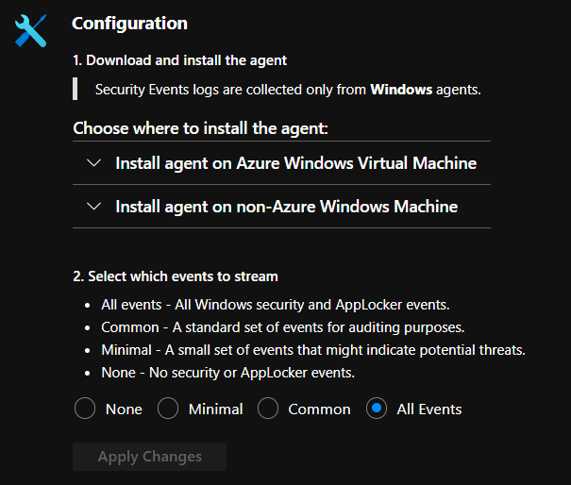
Log Analytics
Can collect logs/metrics from native services
Azure AD, Microsoft 365, Microsoft Azure
OS Events, Syslog
Change tracking
(NOT Security Events from VM’s by default)
Can be configured in Sentinel or Defender (not both)
Data collection enhanced by solutions
Two types of Agents
Log Analytics Agent (Based upon SCOM agent)
MMA Agent (New way to define data collection)
Now GA from last week!
Retention is defined on Workspace
Can also be defined custom retention per table
Changing log retention on a specific table in Log Analytics

Slide 16
Log Sources in Azure
Different services in Azure have its own log structure and format
Logging can be configured using Diagnostics settings in Azure
Data can be exported to
Log Analytics (w/Sentinel)
Event Hub
Storage Account
NOTE: Other SIEM tools often integrate with Event Hub to fetch logs and import

Slide 17
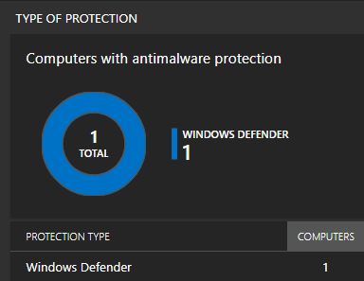
Log Analytics and other solutions
Log Analytics has many different addons
Sentinel
Update Management (Requires configuration)
AntiMalware (Requires config on VM)
Change Tracking (Requires configuration)
DNS Analytics (Requires configuration)
Infrastructure Insight
VM Insight
Adding a solution will update the client configuration
Adding other solutions requires only change to product name in code
resource "azurerm_log_analytics_solution" "la-antimalware" {
solution_name = "AntiMalware"
location = azurerm_resource_group.mainrg.location
resource_group_name = azurerm_resource_group.mainrg.name
workspace_resource_id = azurerm_log_analytics_workspace.mainrg-la.id
workspace_name = azurerm_log_analytics_workspace.mainrg-la.name
plan {
publisher = "Microsoft"
product = "OMSGallery/AntiMalware"
}
}

Slide 18
Sentinel Configuration
Create Resource Group
Create Log Analytics Workspace
Add SecurityInsight Solution
Retention will automatically be extended to 90 days
resource "azurerm_log_analytics_workspace" "mainrg-la" {
name = "mms-workspace-demo"
location = azurerm_resource_group.mainrg.location
resource_group_name = azurerm_resource_group.mainrg.name
sku = "PerGB2018“
retention_in_days = 30
daily_quota_gb = 4
}
## Define Log Analytics Solutions
resource "azurerm_log_analytics_solution" "la_sentinel" {
solution_name = "SecurityInsights"
location = azurerm_resource_group.mainrg.location
resource_group_name = azurerm_resource_group.mainrg.name
workspace_resource_id = azurerm_log_analytics_workspace.mainrg-la.id
workspace_name = azurerm_log_analytics_workspace.mainrg-la.name
plan {
publisher = "Microsoft"
product = "OMSGallery/SecurityInsights"
}
}

Slide 19
Sentinel Analytics Rules
Scheduled Query Rules
- Missing option to define Alert Rule action ☹
Free samples for hunting queries
Azure-Sentinel/Hunting Queries GitHub
Microsoft Security Rules Asymmertic API SecurityInsight GitHub
resource "azurerm_sentinel_alert_rule_scheduled" "alert_ad_audit" {
name = "alert_ad_audit"
log_analytics_workspace_id = azurerm_log_analytics_workspace.mainrg-la.id
display_name = "Check AD Audit Logs for Failed Logon"
severity = "High"
query = <<QUERY
AzureActivity |
where OperationName == "Create or Update Virtual Machine" or OperationName =="Create Deployment" |
where ActivityStatus == "Succeeded" |
make-series dcount(ResourceId) default=0 on EventSubmissionTimestamp in range(ago(7d), now(), 1d) by Caller
QUERY
}
resource "azurerm_sentinel_alert_rule_ms_security_incident" "azsen_mcas" {
name = "mcas-incident-alert-rule"
log_analytics_workspace_id = azurerm_log_analytics_workspace.mainrg-la.id
product_filter = "Microsoft Cloud App Security"
display_name = "MCAS Incidents"
severity_filter = ["High"]
}

Slide 20
Example hunting queries – Wrong logon
Define Source table
let timeRange=ago(14d);
SigninLogs
| where TimeGenerated >= timeRange
| where AppDisplayName contains "Azure Portal" , "Windows Virtual Desktop Client"
// 50126 - Invalid username or password, or invalid on-premises username or password.
// 50020? - The user doesn't exist in the tenant.
| where ResultType in ( "50126" , "50020")
| extend OS = DeviceDetail.operatingSystem, Browser = DeviceDetail.browser
| extend StatusCode = tostring(Status.errorCode), StatusDetails = tostring(Status.additionalDetails)
| extend State = tostring(LocationDetails.state), City = tostring(LocationDetails.city)
| summarize StartTimeUtc = min(TimeGenerated), EndTimeUtc = max(TimeGenerated), IPAddresses = makeset(IPAddress), DistinctIPCount = dcount(IPAddress),
makeset(OS), makeset(Browser), makeset(City), AttemptCount = count()
by UserDisplayName, UserPrincipalName, AppDisplayName, ResultType, ResultDescription, StatusCode, StatusDetails, Location, State
| extend timestamp = StartTimeUtc, AccountCustomEntity = UserPrincipalName
| sort by AttemptCount
Filter based upon AppDisplayName
Filter based upon EventID
Filter based upon EventID

Slide 21
Example hunting queries - Externaldata
Externaldata Operator
let BlockList = (externaldata(ip:string)
[@"https://rules.emergingthreats.net/blockrules/compromised-ips.txt",
@"https://raw.githubusercontent.com/stamparm/ipsum/master/levels/5.txt",
@"https://cinsscore.com/list/ci-badguys.txt",
@"https://infosec.cert-pa.it/analyze/listip.txt",
@"https://feodotracker.abuse.ch/downloads/ipblocklist_recommended.txt"
]
with(format="csv")
| where ip matches regex "(^(25[0-5]|2[0-4][0-9]|[01]?[0-9][0-9]?)\\.(25[0-5]|2[0-4][0-9]|[01]?[0-9][0-9]?)\\.(25[0-5]|2[0-4][0-9]|[01]?[0-9][0-9]?)\\.(25[0-5]|2[0-4][0-9]|[01]?[0-9][0-9]?)$)"
| distinct ip
);
SigninLogs
| where IPAddress in (BlockList)
| where ResultType == "0"
Data Sources - CSV
Filter based upon Regex
Data Source and filter based upon data
All Azure AD Event ID’s

Slide 22

Azure Monitor – Action Groups
Alert Rule used to create monitoring based upon metrics/events
Resource – Subscription, Resource Group or Resource
Condition – Metric or Log Activity
Action Group – Notification or Action
Notification – Email, SMS, Voice
Can be a mix of multiple channels
Action – Azure Function, ITSM, Logic App, Webhook, Automation
Can be a mix of multiple actions that can be triggered
Integrate with Service Now (Automating Azure ITSM Connector with Service Now)
Alert Rule stored in a Resource Group
Should be stored with the resource (lives/dies with service)
Action Group should be stored within management group
Monitor Azure Virtual Desktop glossary - Azure | Microsoft Docs
Resource
All VM’s
Alert Rule
«Network Flow over 90%»
Severity 1
Condition
Inbound Flow Greater then 50/s
Action Group
Action
Logic App
Notification
Email

Slide 23
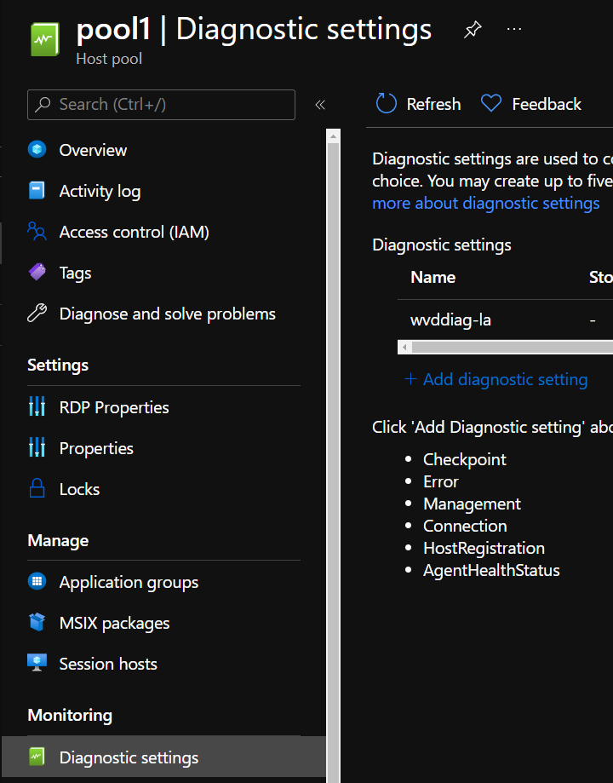
Azure Monitor – for AVD
Remember to Enable Diagnostics on resources
For Host Pools
Management Activities:
Find out who managed to delete a Host Pool during the day?!
Feed:
If users can use the Client Feed
Connections:
When users initiate and complete connections to the service.
Host registration:
Was the session host successfully registered? Or did we forget to type the right UPN?
Errors:
Users struggling with connections, (such as 3G on the cabin trying to use CAD
Checkpoints:
Intermediate steps while establishing and running a connection
All data stored in Log Analytics using table prefix with WVD
NOTE: Sessions using full desktop is not tracked in WVDCheckpoints Table
NOTE: Entries in WVDErrors with ServiceError=True, go to Microsoft Support

Slide 24
Alert Rule Example
Needs to have Resource Group, Workspace and Action Group defined first
resource "azurerm_monitor_scheduled_query_rules_alert" "example" {
name = “awesomerule1"
location = azurerm_resource_group.example.location
resource_group_name = azurerm_resource_group.example.name
action {
action_group = [azurerm_monitor_action_rule_action_group.example.id]
}
data_source_id = azurerm_log_analytics_workspace.mainrg-la.id
description = "Alert when blocked traffic with more then X entries"
enabled = true
# Count all requests with server error result code grouped into 5-minute bins
query = <<-QUERY
AzureDiagnostics
| where OperationsName == “AzureFirewallNetworkRuleLog”
| summarize count () by msg_s
QUERY
severity = 1
frequency = 5
time_window = 30
trigger {
operator = "GreaterThan"
threshold = 10
}
}
Alert Rule
Source from Log Analytics
Kusto Query
Severity of alert and trigger

Slide 25
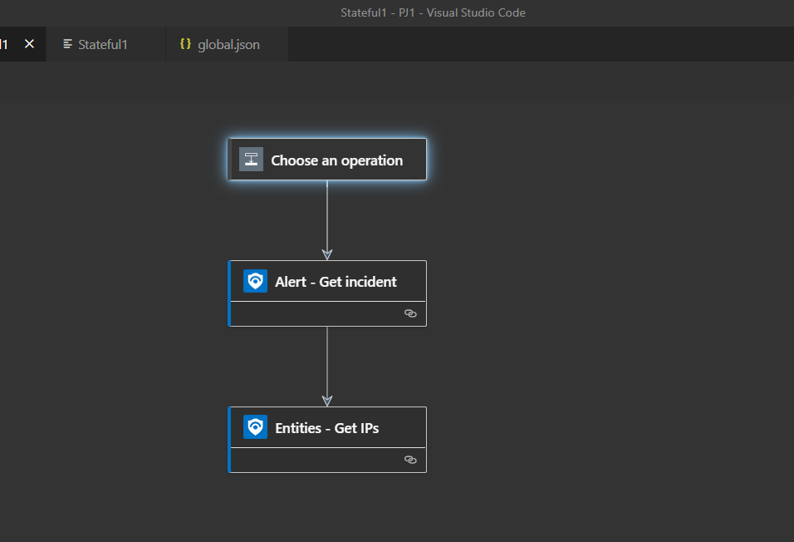
Azure Logic App deployment
Logic App used for automated remediation for Sentinel and Security Center
Not straightforward deployed using Terraform
Simplest is ARM based deployment via Terraform or just ARM
Azure-Sentinel/Hunting Queries at master · Azure/Azure-Sentinel (github.com)
Proper deployment using SystemManagedIdentity
"identity": {
"type": "SystemAssigned"
Logic Apps can be created directly in VS Code
Visual Studio Code - Azure Logic Apps

Slide 26
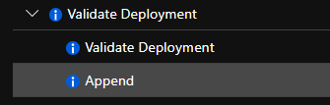
Azure Policies
Provides evaluation of Azure resources compared to business rules
If X deny creation = Creating Azure Resources in Non-approved region
If X property equals Z, then do Y = If Virtual Machine is new then install agent
Azure Policy Logic can apply at
At resource creation or evaluated after creation
After creation evaluation
AuditifnotExists, DeployIfNotExists
Policies can be assigned to (or part of an initiative)
Management Group, Subscription, Resource Group or Resource

Slide 27
Deployment of Azure Policies
Check if Built-in Policies provide enough control
azure-policy/built-in-policies/policyDefinitions at master · Azure/azure-policy (github.com)
or build Custom Policies
Azure Security Center Defaults
PowerShell
$rg = Get-AzResourceGroup -Name '<resourceGroupName>’ $definition = Get-AzPolicyDefinition | Where-Object { $_.Properties.DisplayName -eq 'Audit VMs that do not use managed disks’ } New-AzPolicyAssignment -Name 'audit-vm-manageddisks' -DisplayName 'Audit VMs without managed disks Assignment' -Scope $rg.ResourceId -PolicyDefinition $definition

Slide 28
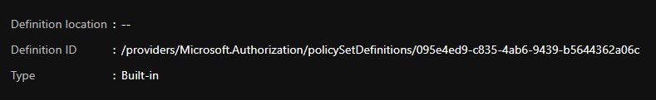
Deployment of Azure Policies
Terraform with built-in policies (Just referencing definition ID)
resource "azurerm_policy_assignment" "auditvms" {
name = "Audit Disk without Managed Disks"
scope = "/subscriptions/00000000-0000-0000-000000000000"
policy_definition_id = "/providers/Microsoft.Authorization/policyDefinitions/06a78e20-9358-41c9-923c-fb736d382a4d"
description = "Shows all virtual machines not using managed disks"
display_name = "Audit VMs without managed disks Assignment"
}

Slide 29
Deployment of Azure Policies
Terraform with custom policy
Create a policy definition
Create an Azure Policy Assigment
Reference definition as part of assignment
NOTE: Policies with deployifnotexists requires a management identity
Use the built-in definitions, saves a lot of time
resource "azurerm_policy_definition" "IaaSAntiMalwarePolicy" {
name = "IaaSAntiMalwarePolicy"
policy_type = "Custom"
mode = "All"
display_name = "Get antimalware checked"
policy_rule = <<POLICY_RULE
{
“if”:
“then”: “Effect”
resource "azurerm_policy_assignment" "IaaSAntiMalwarePolicyAssignment" {
name = "IaaSAntiMalwarePolicyAssignment"
scope = "/subscriptions/00000000-0000-0000-000000000000"
policy_definition_id = azurerm_policy_definition.IaaSAntiMalwarePolicy.id
description = "Policy Assignment created via an Acceptance Test"
display_name = "IaaSAntiMalwarePolicyAssignment“
PARAMETERS
location = "westeurope"
identity {
type = "SystemAssigned"
}

Slide 30
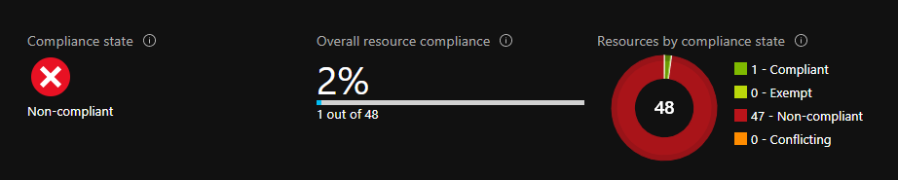
Azure Policies and monitoring compliance
Problem with Non-compliant resources is visibility
Policy evaluation is logged into Azure Monitor/LA
Kusto Query (Show case Compliance Check History)
AzureActivity | where CategoryValue == "Policy" | where parse_json(Properties).isComplianceCheck == "False" | extend resource_ = tostring(Properties_d.resource)
PowerShell (Get actual Compliance State)
Get-AzPolicyState -filter "ComplianceState eq 'NonCompliant'" -Apply "groupby((ResourceId))"
Azure Monitoring alerting rule to notify on non-compliant resources | Marius Sandbu (msandbu.org)

Slide 31
Azure Defender
Threat detection against multiple resources
VM’s, SQL, Web App, Storage Accounts, ARM, DNS and IoT
Can be added per resource on a global level
Security Assessments
Secure Score, Compliance
Assessment and Alerts can be exported to Log Analytics
EDR for Servers
Vulnerability Scanning (Qualys)
For Server only
Just-in-time access (public endpoints)
Please use Bastion instead…
resource "azurerm_security_center_subscription_pricing" "asc_pricing" {
tier = "Standard"
resource_type = "VirtualMachines"
}
resource "azurerm_security_center_workspace" "example" {
scope = "/subscriptions/e081f6b1-78ea-4640-baa6-c67dd1d71cf8"
workspace_id = azurerm_log_analytics_workspace.mainrg-la.id
}
resource "azurerm_virtual_machine_extension" "qualys" {
name = "qualys"
virtual_machine_id = azurerm_windows_virtual_machine.vm.id
publisher = "Qualys"
type = "WindowsAgent.AzureSecurityCenter"
type_handler_version = "1.0"
auto_upgrade_minor_version = true

Slide 32
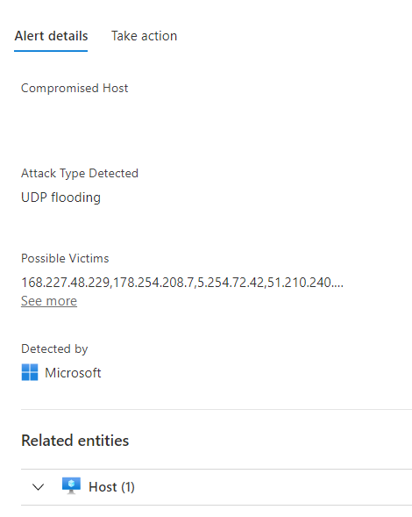
Azure Sentinel vs Azure Defender
Azure Defender
Threat Intelligence – Intelligent Security Graph API
Many predefined Security Alerts / Best-pratices
3.party vulnerability assessment (Qualys)
IPFIX based samples enriched with Security Graph
PaaS services Threat Protection (ARM, DNS, App Services)
EDR for virtual machines
File integrity Monitoring
Fileless attack detection
Monitors for changes to Registry, Processes, Files
Monitors for running processes, network communication

Slide 33
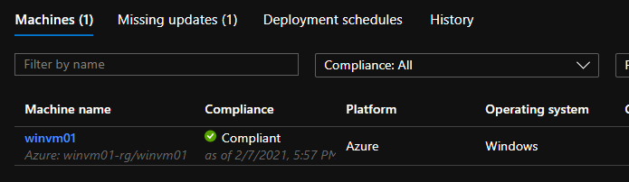
Azure Update Management
Uses Log Analytics and Azure Automation
Configures Guest VM’s running as Hybrid Workers
Supported for Windows Server
Must install Update Management Solution on Log Analytics
Then link Automation account and Log Analytics Workspace
Guest VM’s need to have Log Analytics Agent installed
Schedules coming in Terraform soon!
azurerm_automation update management
plan {
publisher = "Microsoft"
product = "OMSGallery/Updates"
}
}
resource "azurerm_automation_account" "aaa" {
name = "aaa-prod-we"
location = azurerm_resource_group.mainrg.location
resource_group_name = azurerm_resource_group.mainrg.name
sku_name = "Basic"
tags = {
environment = "development"
}
}
resource "azurerm_log_analytics_linked_service" "aaa-la-link" {
resource_group_name = azurerm_resource_group.mainrg.name
workspace_id = azurerm_log_analytics_workspace.mainrg-la.id
read_access_id = azurerm_automation_account.aaa.id
}

Slide 34
Azure VM Guest Security
Boot Diagnostics
Install Antimalware Extension
Install Antimalware Solution on Log Analytics first
Update Management
By Update Management
Or by Platform
Install VM Insight
Apply VM Backup
Backup Center
(Supports tag-based backup) in Preview - Policy
resource "azurerm_windows_virtual_machine" "winvm01-vm" {
name = "winvm01"
resource_group_name = azurerm_resource_group.winvm01.name
location = azurerm_resource_group.winvm01.location
size = "Standard_F2"
boot_diagnostics {} ## Sets Boot Diagnostics using Managed
patch_mode = "AutomaticByPlatform” ##Default to ByOS
plan { ## Defined on Log Analytics Workspace Solutions
publisher = "Microsoft"
product = "OMSGallery/AntiMalware"
}
plan {
publisher = "Microsoft"
product = "OMSGallery/VMInsights"
}
resource "azurerm_backup_protected_vm" "vm1" {
resource_group_name = azurerm_resource_group.rgrv01.name
recovery_vault_name = azurerm_recovery_services_vault.arsv.name
source_vm_id = azurerm_windows_virtual_machine.winvm01-vm.id
backup_policy_id = azurerm_backup_policy_vm.bp01.id
}

Slide 35
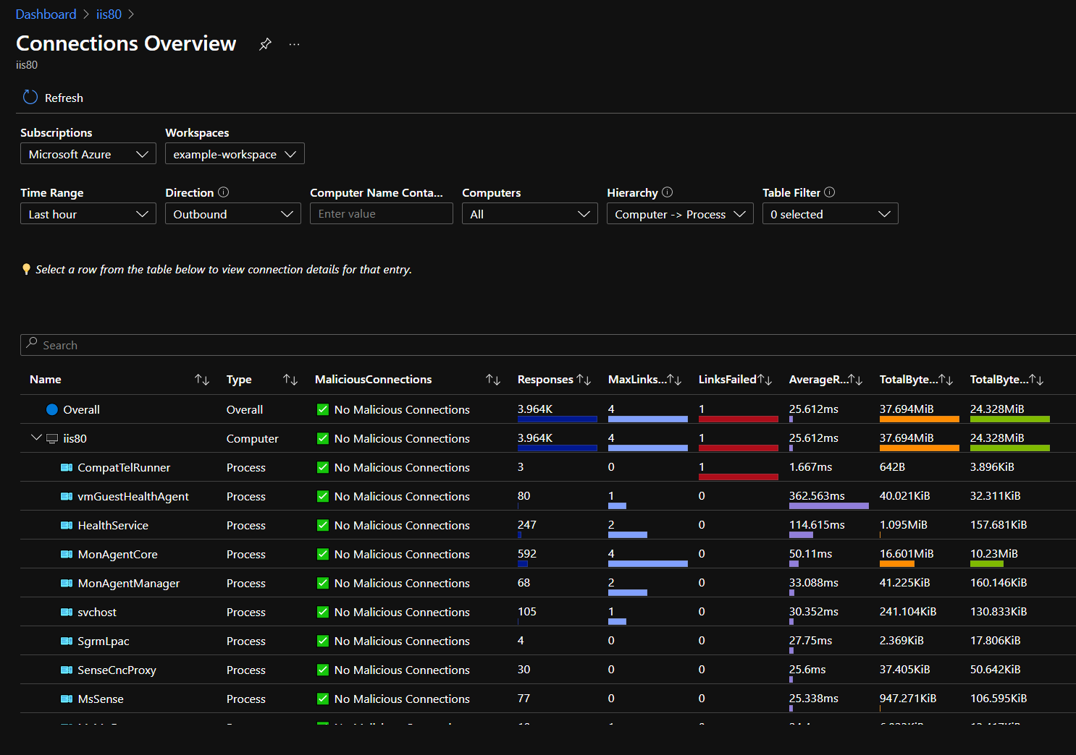
Monitoring AVD Azure VM
VM Insight
Traffic flow mapped to processes
Data stored in Log Analytics
Useful to show traffic flow
VM Performance metrics
Network flows / Bandwidth
Disk metrics
Disk Burst / Disk Baseline
Cache Hit / Cache
VM Uncached IOPS
Process monitoring
Sysmon with predefined filters upload to Log Analytics
Custom alert rule based upon events

Slide 36
Monitoring AVD – Using Workbook
Predefined Azure Workbook
Collection of Kusto Queries / Dashboard / Event Collection rules
Collects AVD WVD Events
Collects Host Metrics
Collect Host Event Logs
PrintServices
TerminalServices
FSLogix
Application
NOTE: You can configure custom event log collection as well

Slide 37
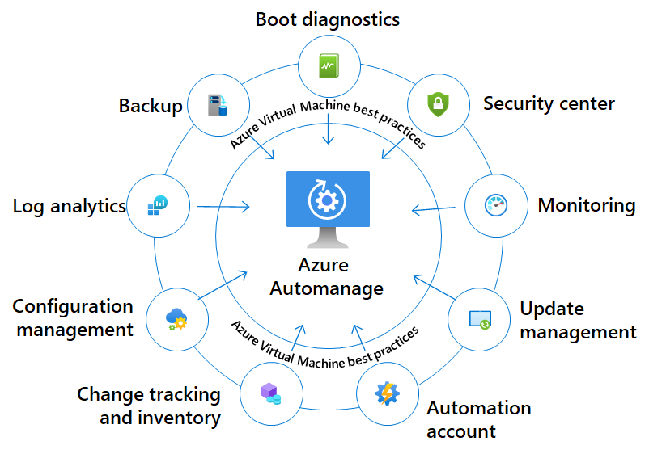
Azure Automanage
Configures automatically much of the settings
DSC Guest Baseline (Windows Security baseline)
Change Tracking, Automatic Patching
Security Center / Defender / Antimalware
Boot Diagnostics
Supported for Server OS
Backup, Anti-virus, Automated patching
Can only customize backup retention and antimalware policy

Slide 38
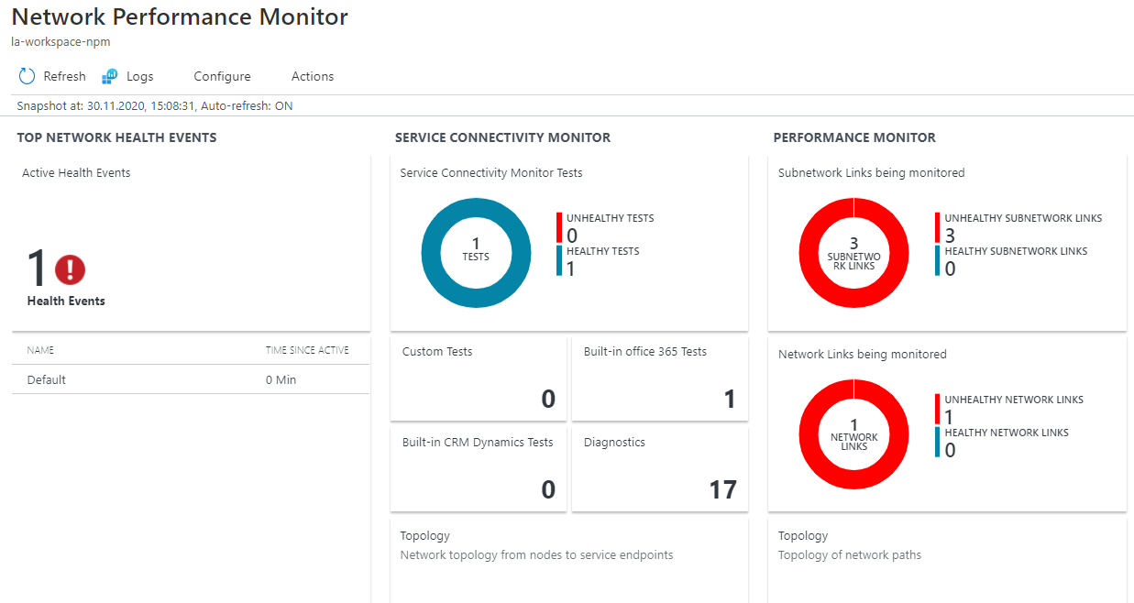
Monitoring Network
Network Performance Monitor
Between hosts and outside / on-premises
Built-in health checks for O365 / Dynamics
Custom Probes as well
Monitor Packet Loss / Latency
Monitoring VPN Health
https://<YourVirtualNetworkGatewayIP>:8081/healthprobe
Monitoring AVD components (should be done from a third-party service)
Monitor latency and availability on TCP/443
rdgateway.wvd.microsoft.com (Usually hosted in all datacenters)
rdbroker.wvd.microsoft.com (Usually hosted in West Europe)
rdweb.wvd.microsoft.com (Usually hosted in West Europe)

Slide 39
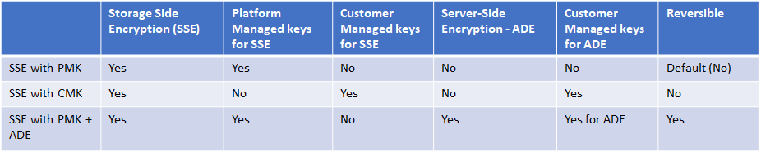
Azure Storage + Disk Encryption
Provides different ways to encrypt data
At-Rest or Disk based
SSE (At-rest) is default
SSE + CMK cannot be used with ADE
Disk Encryption is not availble for VM’s without temp disk
Using in-guest encryption (example bitlocker)
Requires KeyVault configured

Slide 40
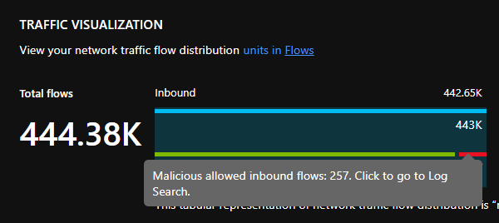
Azure Public Services
Network Flow Logs applied on NSG level
Should be enabled for Public Services
Enabled together with Network Watcher and Traffic Analytics
Integrated into Log Analytics
resource "azurerm_network_watcher_flow_log" "nwfl" {
network_watcher_name = azurerm_network_watcher.nw.name
resource_group_name = azurerm_resource_group.vnetprodrg.name
network_security_group_id = azurerm_network_security_group.vnetprod-nsg.id
storage_account_id = azurerm_storage_account.sa-we.id
enabled = true
retention_policy {
enabled = true
days = 7
}
traffic_analytics {
enabled = true
workspace_id = azurerm_log_analytics_workspace.mainrg-la.workspace_id
workspace_region = azurerm_log_analytics_workspace.mainrg-la.location
workspace_resource_id = azurerm_log_analytics_workspace.mainrg-la.id
interval_in_minutes = 10
}
}

Slide 41
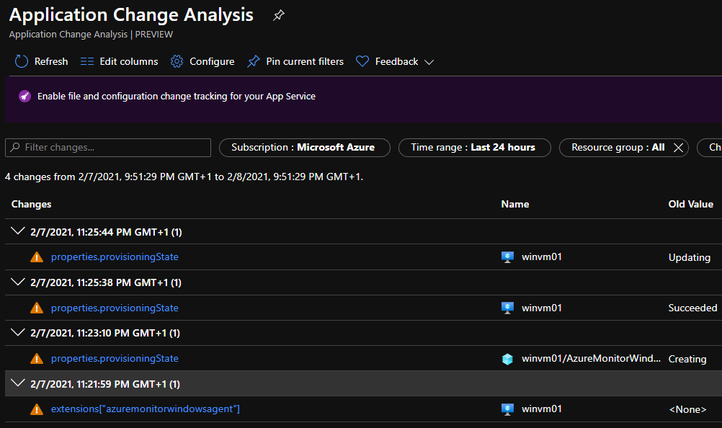
Azure Resource Graph
Azure Resource Graph is a way to query Azure inventory
Can be used to show change history on ARM objects
Register-AzResourceProvider -ProviderNamespace "Microsoft.ChangeAnalysis"
Supported for: VM’s, App Services, AKS, Functions, Networking, Storage
Kusto based queries
Easily way to find
Azure Security Score
Find list of Public IP addresses
Find non-attached disks
Advisor recommendations
PowerShell
az graph query -q "advisorresources
| where type == 'microsoft.advisor/recommendations’
| where properties.category == 'Cost’
| extend resources = tostring(properties.resourceMetadata.resourceId), savings = todouble(properties.extendedProperties.savingsAmount), solution = tostring(properties.shortDescription.solution), currency = tostring(properties.extendedProperties.savingsCurrency) | summarize dcount(resources), bin(sum(savings), 0.01) by solution, currency | project solution, dcount_resources, sum_savings, currency | order by sum_savings desc"

Slide 42
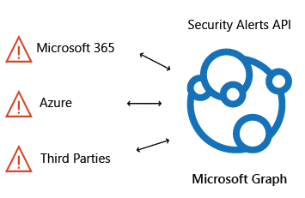
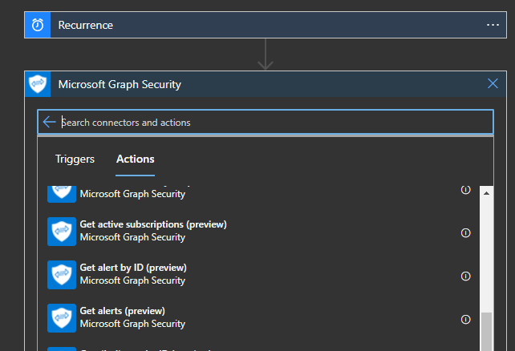
Azure Security Graph API
All security products in Security Ecosystem interact with the Security Graph API
Integration using the Security Graph API and ITSM/Monitoring tool
Use Logic App with built-in connectors.
Use the filter
Status eq 'NewAlert'

Slide 43
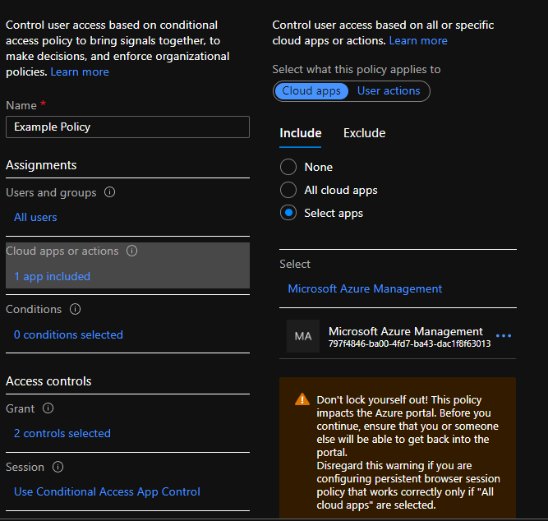
Azure Active Directory Conditional Access
GrantControls
MFA
CompliantDevice
termsofuse
New-MgIdentityConditionalAccessPolicy -DisplayName ’AVD CA Policy' `
-GrantControls @{ `
BuiltInControls = @('mfa'); `
Operator = 'OR' `
} `
-State 'disabled' `
-Conditions @{ `
Applications = @{includeApplications = '9cdead84-a844-4324-93f2-b2e6bb768d07'}; `
Users = @{includeUsers = 'none'} `
}
SessionControls
Cloudappsecurity
Persistentbrowser
Signinfrequency
applicationenforcedrestrictions
Applications
IncludeApplications
AppID
Excludeapplications
Includeuseractions
Conditions
userRiskLevels
Signinrisklevels
clientappTypes
Platforms
Locations
Applications
users

Slide 44
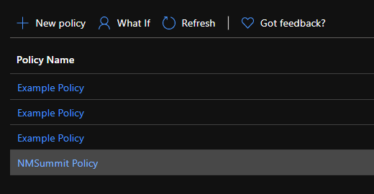
Azure Active Directory CA - Example
Remember don’t run New script… multiple times
You can have multiple CA’s with the same name
They have a unique ID which is created
Update-MgIdentityConditionalAccessPolicy –ConditionalAccessPolicyId a48817cf-c2dc-45d3-9f33-a5797c527e92 -DisplayName ’UKAVD User Policy' `
-GrantControls @{ `
BuiltInControls = @('mfa','compliantDevice'); `
Operator = 'OR' `
} `
-State 'disabled' `
-Conditions @{ `
Applications = @{includeApplications = '797f4846-ba00-4fd7-ba43-dac1f8f63013'}; `
Users = @{includeUsers = 'none'} `
}

Slide 45
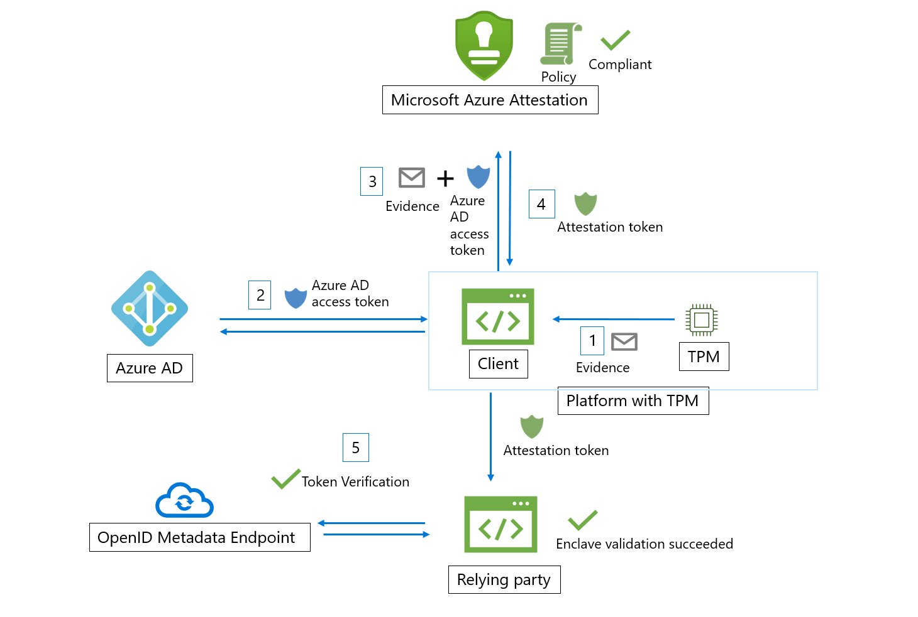
What about Windows 11?
Uses Azure Attestation Service natively
Hello I’m Secure! To Azure to be used to provide secure access to Services
It will be recommended by Microsoft to use Trusted Launch
Should TPM 2.0 Chip in place (Requires Trust Launch for Azure)
Trusted launch also introduces vTPM for Azure VMs. This is a virtualized version of a hardware Trusted Platform Module, compliant with the TPM2.0 spec.
Secure boot mandatory
Trusted Launch only available in certain Azure Regions, only on certain VM SKU’s and is currently in Preview. (North and West Europe) Sorry UK...
Windows 11, is TPM required and how it will work in the Cloud? | Marius Sandbu (msandbu.org)
Time to start planning
Microsoft will continue to support Windows 10 through October 14, 2025.

Slide 46
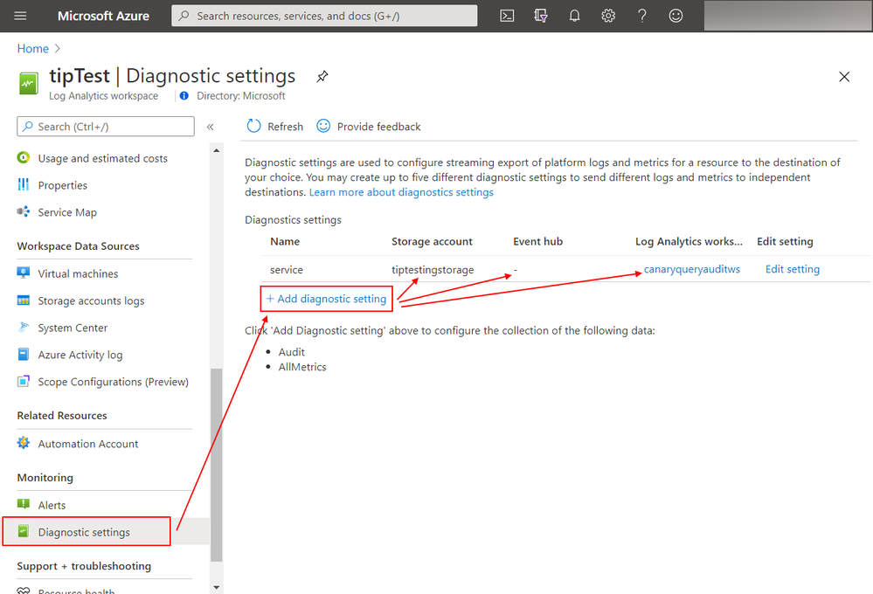
Some best-pratices tips for Secure Implementation
Integrate Security Graph API with alerting/ITSM system
For Windows Domains look at current logging Group Policy and setup according to best-pratice
Audit Policy Recommendations | Microsoft Docs
Configure Diagnotics on Log Analytics/AVD/Other Services that are used
Not kidding! Provides insight into who has run queries against the dataset
Collected into the LAQueryLogs table
Also configure Diagnostics on Azure Subscription level
Create table level-based access
"Actions": [
"Microsoft.OperationalInsights/workspaces/read",
"Microsoft.OperationalInsights/workspaces/query/read",
"Microsoft.OperationalInsights/workspaces/query/Heartbeat/read",
"Microsoft.OperationalInsights/workspaces/query/AzureActivity/read"
],

Slide 47
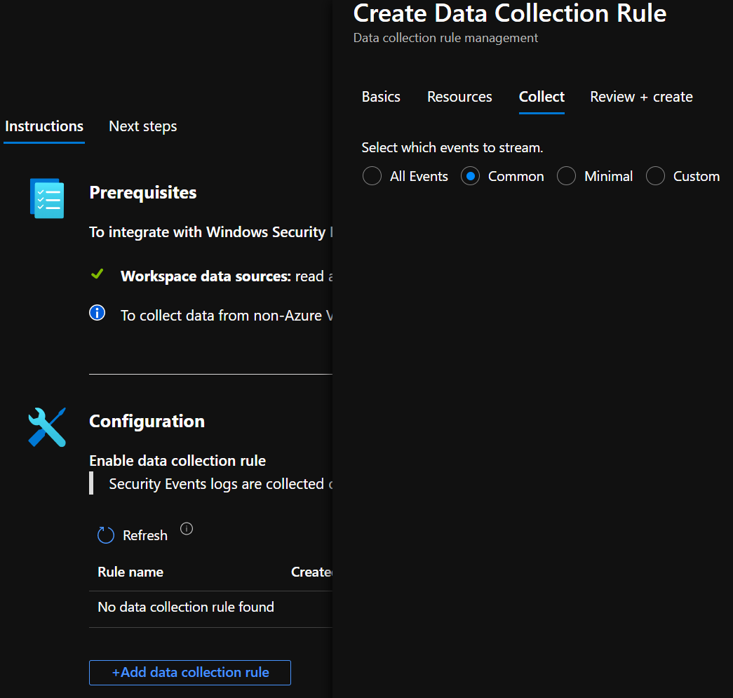
Some best-pratices tips for Secure Implementation
Use DNS and Security Events Connectors for Sentinel
Configure atleast Common event ID’s
Event ID (Event ID 4625 Failed logon), (4740 locked), 1100)
Don’t send all WVD data to Sentinel Workspace (reduce cost)
Use Built-in Security Policies for Azure Defender
Use Built-in Windows Security Baseline for Guest Config
For Windows Server → Install Qualys Vulnerability Agent
Look at how long latency delay is for data coming in
AzureDiagnostics | where TimeGenerated > ago(8h)
| extend E2EIngestionLatency = ingestion_time() - TimeGenerated
| extend AgentLatency = _TimeReceived - TimeGenerated
| summarize percentiles(E2EIngestionLatency,50,95), percentiles(AgentLatency,50,95)
by ResourceProvider
Using Log Analytics to notify on non-compliant resources
Azure Monitoring alerting rule to notify on non-compliant resources | Marius Sandbu (msandbu.org)

Slide 48
What else?
Big ecosystem of security & governance services
Some services can be defined as code as state some used for monitoring/needs
Having Security/Monitoring/Governance as code makes it easier to
Have it documented
Makes changes easier
Change Control
Things going sluggish?
Don’t worry have a blog about that too :D
→ Why is my VM running so slow in Azure? | Marius Sandbu (msandbu.org)

Slide 49
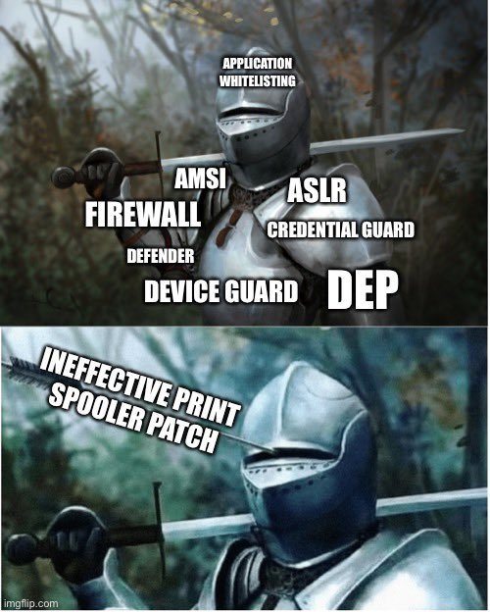
Final slide I promise!
Questions?
Email: msandbu at gmail.com
Twitter: msandbu
Last thing I want to mention!
New high severity vulnerability in print spooler service, dubbed #PrintNightmare
Can potentially give full admin access from any authenticated domain user
Disable Print Spooler service on not needed servers (such as DCs)
More info here → https://msandbu.org/printnightmare-cve-2021-1675/

