Slide 1



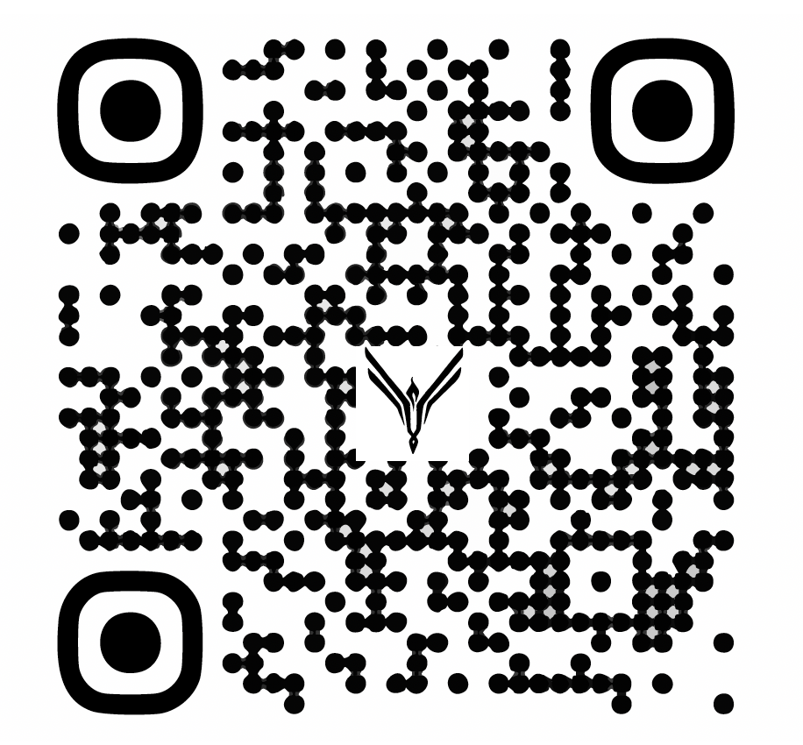
linkedin.com/company/euchtechdk
Notes:
#IMPORTANT EUCTECHDK GUIDELINES SLIDE TO BE PUT IN AS FIRST SLIDE IN YOUR PRESENTATION TO HELP PROMOTE OUR PAGE AT LINKEDIN

Slide 2
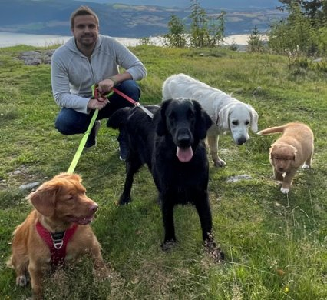
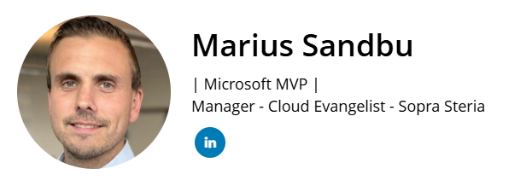
Revolutionizing the Workspace: The Future State of End-User Computing
Actually have 6 of these now..
Notes:
#You are welcome to use this template if you dont have one yourself# **You are welcome to use your own template You can take picture ”from our platform under SPEAKERS https://euctechdenmark.zohobackstage.eu/EUCtechDenmark#/speakers Find your name + eventually co-speakers and add in to your presentation to keep a clean slide

Slide 3
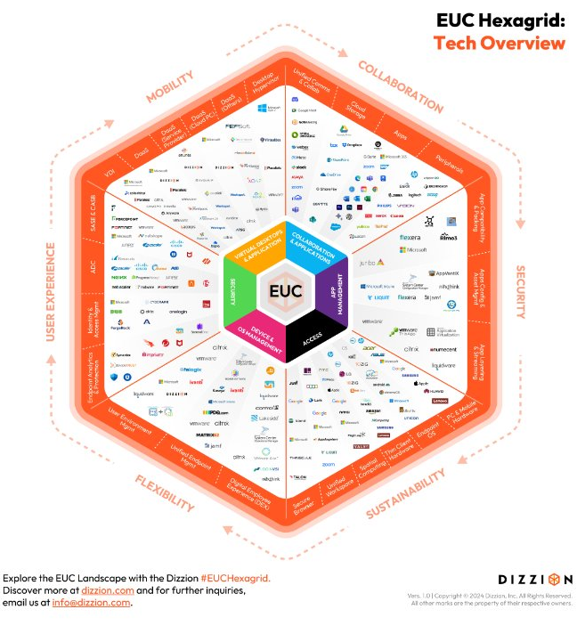
Where we at?
Many struggling with….
Combining the old and the new Remote access – simple and secure High technical debt Navigating all the vendors and changes Cybersecurity
Not utilizing capabilities in licenses
Limited insight into user experience
AI FOMO

Slide 4
The end goal?

Slide 5


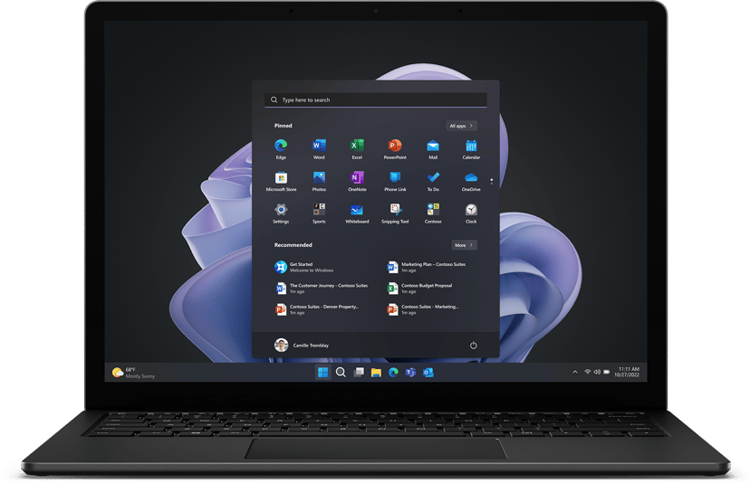
Consolidated workspace
Network Access
SaaS services
Virtual Apps & Desktops
Self-service
Web applications
Data
Legacy Services
NoCode/Lowcode
Cloud
AI Assistants / Agents
Services
Your boss wants to know your ETA on that security report
Access
Digital User Experience (DEX)
Access based on health signals using passkeys
Software
Personal AI Assistant
Microsoft Teams has issues again..
Regardless of OS
Identity
Device
Session
Zero-Trust based access

Slide 6
How do we get there?

Slide 7
Generative AI Evolution from 2022 - 2025
99% Cost reduction of token inferencing
From 6% to 0.7% hallucination (using RAG)
Can process 400x more data
15x lower latency
Larger models can handle 1,5 hour of video
Over 3000 public models available from cloud
Can run everywhere - (GPU/NPU)
New protocols MCP and A2A
Integration using Computer Use API and Web Browser

Slide 8
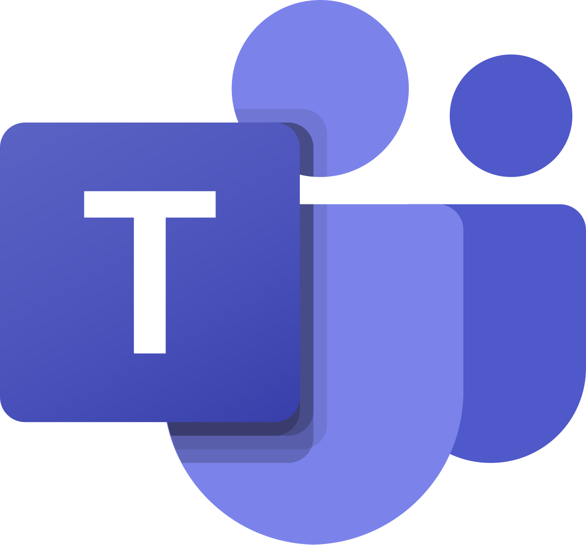
Virtual Agents
Team of Agents
Channel - Teams
Service Desk Agent
LLM
Instructions
Handle new incidents
Integrations
ITSM System
Data Sources
E-mail

Slide 9

BE CAREFUL OF AGENT SPRAWL

Slide 10




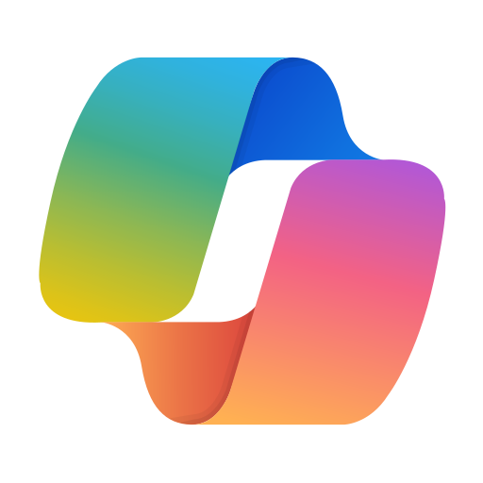
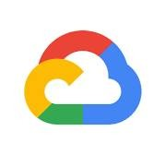




Cloud agent platforms
Open-source frameworks
Taskade
Langgraph
CrewAI
AWS Bedrock
Google AgentSpace
Agno
Langflow
Microsoft Copilot Studio
Service Now
Atlassian
Google Agent Development Kit
Microsoft Autogen

Slide 11

New protocols and standards for integrations and communication
MCP*
Retrieve info
A2A*
User
Execute Action
Agent
Agent
Agent
Event
A2A* = Agent2Agent Protocol MCP* = Model Context Protocol

Slide 12
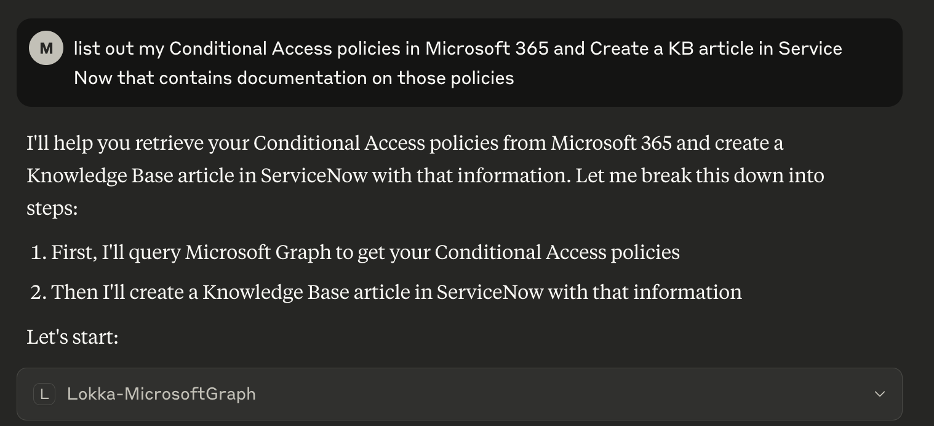
MCP = Welcome back MicroApps
Microsoft 365
Jira
Active Directory
Google
Github
Slack
Service Now
Windows
File Shares
Bunch of others
Setting up MCP Server to Entra ID / Graph with Lokka - msandbu.org

Slide 13
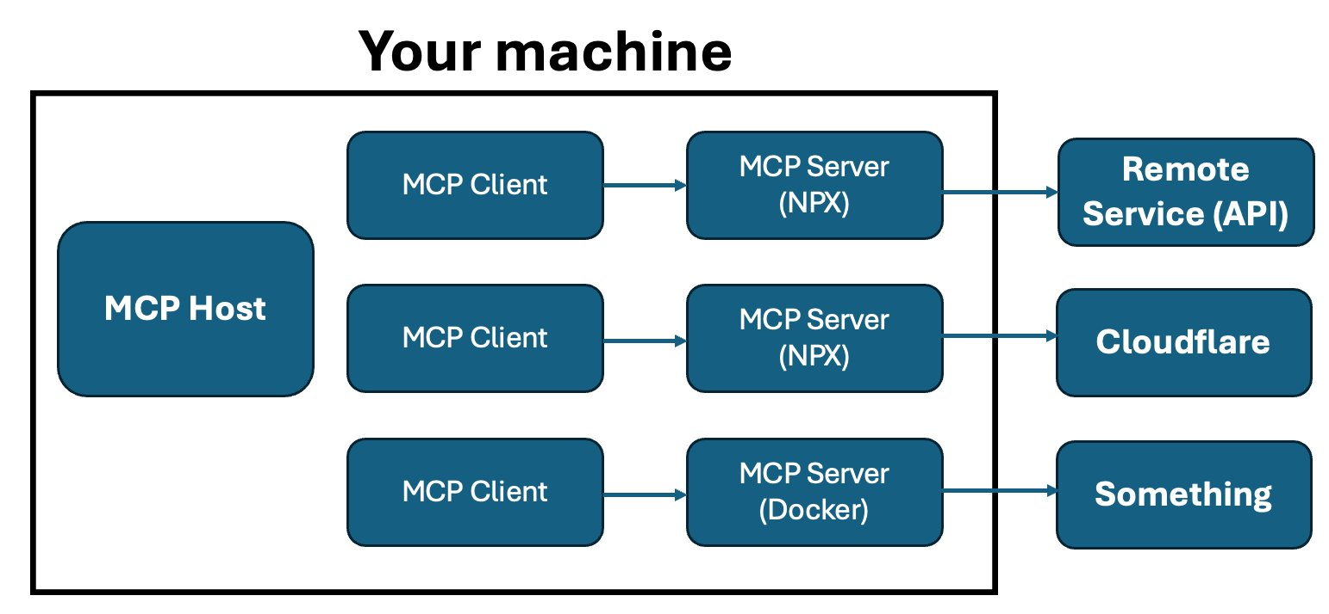
Requires a desktop app that supports MCP
Currently limited to Claude, VS Code or Clive

Slide 14
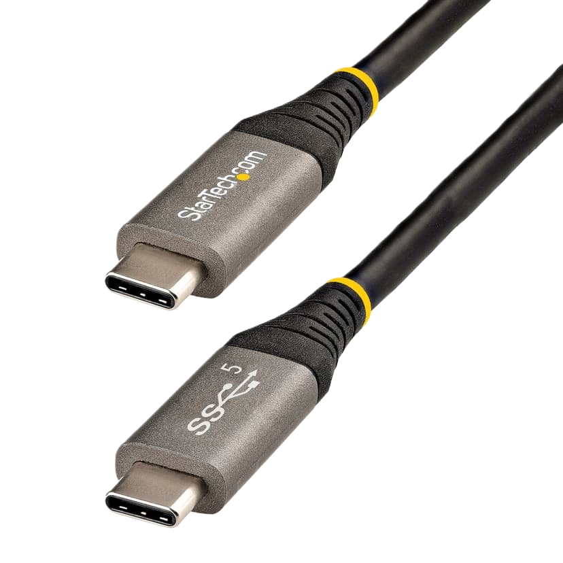
The future Workspace?
Summarize Incident
Application X
MCP Client
MCP Server
Application Y
Create KB article based upon incident
Enter vacation for week 33
Application Z
Announcing the updated Teams AI Library and MCP support

Slide 15
Microsoft Copilot ecosystem
Runs locally on device

Slide 16
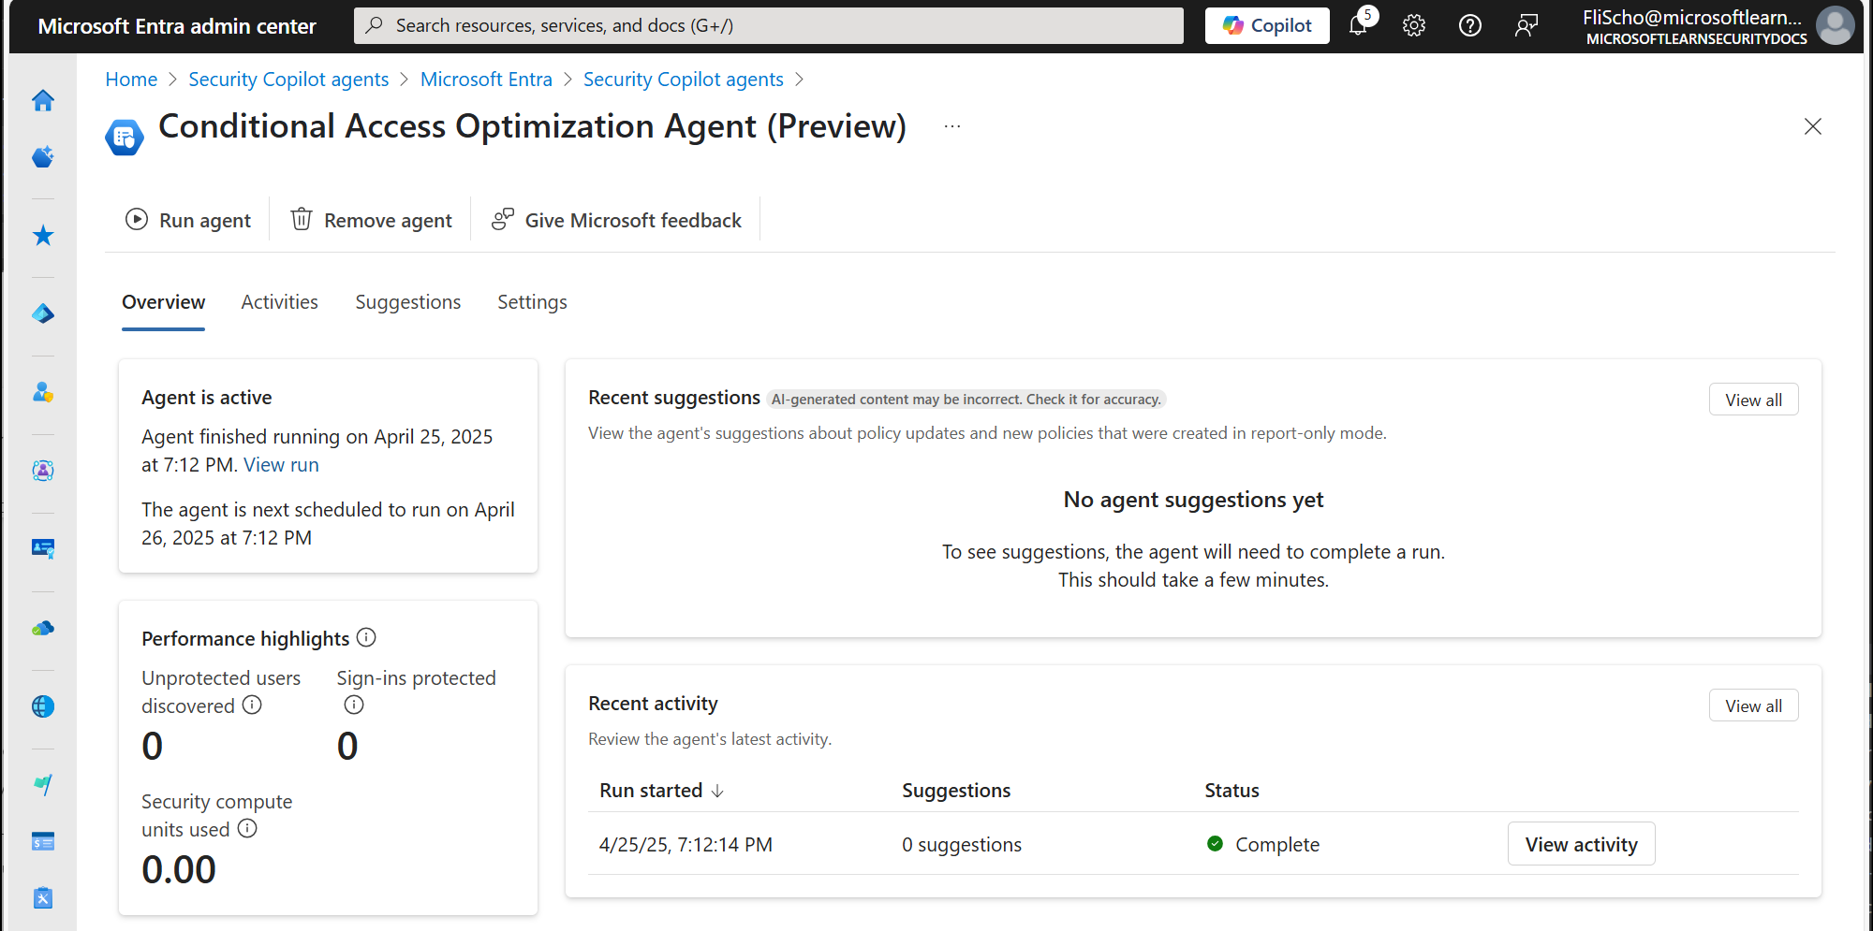
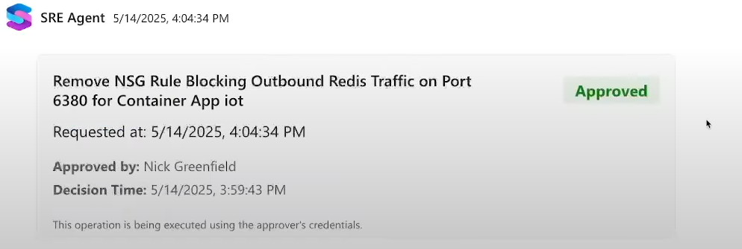

Slide 17
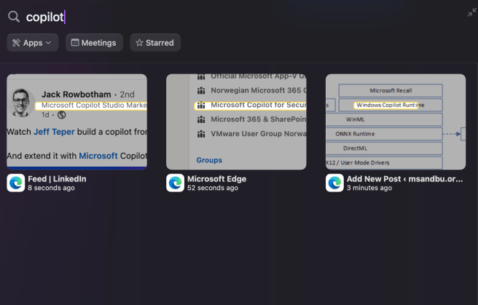
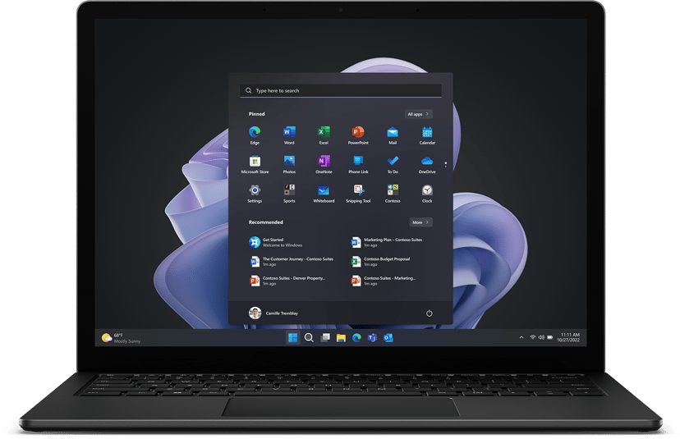
Copilot for Windows and features
Other features
Windows Recall
New file Search
Click to-do
Photo-editing
Windows Copilot Runtime
Deepseek or Phi-3
Local AI models
“Hey, Copilot!”
NPU
GPU
CPU

Slide 18
Copilot for Windows future from Build
Provides the ability to trigger any type of action against a Windows machine / server
LoRa
Copilot Runtime
MCP Host
RAG
GenAI Models
Windows AI Foundry
Fine-tuning for Phi-4 models
Provides CLI management
NPU
GPU
CPU

Slide 19

What happened within the VDI/DaaS Space?
WARNING: There might be features/product updates missing that I forgot. The best feedback will be rewarded with Norwegian Chocolate

Slide 20
What's happened in the VDI world?
Big shake-up with the VMware/Broadcom changes
Many reducing footprint, simplifying VDI → AVD/W365
Some expanding the use of DaaS
Secure Development environments
Many looking for alternatives for both virtualization and VDI
Is this the year of Thin Clients?!
Windows 365 Link, Unicon and more considering ChromeOS Flex

Slide 21
Platform support
Platform support​ | Azure Virtual Desktop​ | Windows 365​ | Dizzion Frame | Citrix​ | Omnissa​
Microsoft Azure​ | Yes​ | Yes​ | Yes​ | Yes | Yes
Google Cloud | No | No | Yes | Yes | No
VMware ESXi​ | No​ | No​ | No​ | Yes​ | Yes
Nutanix​ | No​ | No​ | Yes​ | Yes | Beta
XenServer​ | No​ | No​ | No | Yes | No​
Azure Local​ | Yes | No | No | Yes (SCVMM) | No​
Proxmox​ | No | No | No | No | No
Red Hat OpenShift | No | No | No | (Preview ) | No
IBM Cloud | No | No | Yes | Yes (PVS) | No
NOTE: Plattform support can be a combination of power management and provisioning capabilities

Slide 22
News from Microsoft?
Windows 10 EOL - October 2025
Microsoft Office 365 Apps no longer supported after Oct 2025
For Windows 10 / Server 2016 / Server 2019
VBScript, NTLM and WSUS Deprecated
HotPatch for Windows 11 available
Windows Protected Print Mode
Azure Stack HCI = Azure Local
GPU-P Support for Azure Local
Autoscale and Start on VM Connect for AVD on Azure Local
Since AVD On-prem is billed by vCPU per hour

Slide 23
AVD vs 3.party on-prem licensing
AVD Service fee
Requires E3* or similar
Price per vCPU / hour
8 vCPU = 59$ per month) (~30 users)
3.Party license
Requires Windows RDS CAL
User or Concurrent license
Ranging from 12$ to 30$ per concurrent user
300 users = 590$ (730 hours) 300 users = 295$ (365 hours)
300 users = 3,600$ (if 12$ per license)
This is a simplified cost comparison and does not show the whole picture
* Excluding Azure Local service fee * Microsoft M3 starts at 33$ per user

Slide 24
News from Microsoft?
Azure Files Premium Metadata Caching
Provides faster IOPS for smaller read/writes
Free just need to sign up for the feature
NVads V710 available (new AMD vGPU SKU)
Enhanced Host Pool Management for AVD
Windows 365 for Frontline Workers
Sunsetting Remote Desktop app for Windows
New Windows App - Supports token protection
Does not support AVD with Private Link…
Hardware acceleration with H.264 (GA) and H.265 (public preview)
Global TURN Relay support for AVD and W365
Unidirectional clipboard
Performance Plus for Premium Disks Azure

Slide 25
Disk types and performance Azure
Disk type | Max Write I/O per sec | Max Throughput (MB/s) | Max Read I/O per Sec | Access Time
Premium SSD ZRS – Bursting + Performance Plus + Accelerated Network + Read/Write Cache | 30596 | 672 MB/s | 32718 | 0.079 MS
Premium SSD ZRS – Bursting + Performance Plus + Accelerated Network | 30615 | 815 MB/s | 30473 | 1.86 MS
Premium SSD ZRS – Performance Plus + Accelerated Network | 8159 | 304 MB/s | 8158 | 1.92 MS
Premium SSD ZRS – Performance Plus | 8157 | 304 MB/s | 8157 | 2.19 MS
Premium SSD ZRS | 5101 | 203 MB/s | 5099 | 1.02 MS
Premium SSD ZRS – Bursting | 25131 | 585 MB/s | 30550 | 2.02 MS
Premium SSD v2 (Default with 8000 IOPS and 300 MB) | 8159 | 305 MB/s | 8160 | 0.330 MS
Premium SSD v2 (40000 IOPS and 1200 MB) | 40776 | 814 MB/s | 40769 | 0.353 MS
Premium SSD ZRS – Accelerated Network | 5099 | 203 MB/s | 5099 | 2.02 MS

Slide 26
App Attach and App-V
3. Party integration:
Liquidware FlexApp
Numecent Cloudpager
Omnissa App Volumes
App-V supported only for App Attach
Sequence and client no longer EOL
Operating System | MSIX Support | App Attach Support
Windows Server 2019 | Yes | No
Windows Server 2022 | Yes | No
Windows 10/11 Single Session | Yes | Yes
Windows 10/11 Multisession | Yes | Yes
New App Attach supports Entra ID authentication and run two versions of the same app on the same session host
NOTE: While Azure Virtual Desktop is supported on Azure Local, App Attach is not supported.
Note: Currently an issue currently impacts CimFS images with Windows 11, version 24H2 fix awaited in June

Slide 27
News from Citrix?
Aquired Unicon, DeviceTrust and Strong Networks
GA Support for Nutanix Prism Central
Session Remote Start
Intune and Entra ID joined MCS catalog
Boot to Desktop with Linux Workspace App
Integration with Device Posture from Linux client
More features in Device Posture
Azure GPU Hibernation support
Cost modeling for Azure workloads
UberAgent now part of VDA
Conditional Authentication for Citrix Cloud
Multple iDP support
Citrix and Google Chrome Enterprise Premium
Will need to integrate DeviceTrust into Posture Service
A lot of focus on support new features and capabilites from Azure

Slide 28
Citrix HXD Updates
H.264 and H.265 hardware decoding Linux
H.264 for seamless apps
AV1 Codec
Intelligent Build to Lossless feature
EDT MTU Discovery
Audio Quality Enhancer
Great review on the codecs: https://www.go-euc.com/comparative-quality-analysis-of-citrix-codecs/

Slide 29
Does the protocol matter anymore?
Metrics | AVD w/Shortpath H.265 | HDX H.265
Avg. FPS | 48,57 fps | 52,58 fps
Avg. Bandwidth Consumption | 16,44 Mbit/s | 13,89 Mbit/s
Total Bandwidth Usage | 10,56 GB | 7,84 GB
Metrics | AVD HTML5 (H.264) | HDX HTML5 (H.264)
Avg. FPS | 38,23 fps | 51,56 fps
Avg. Bandwidth Consumption | 15,93 Mbit/s | 13,42 Mbit/s
Total Bandwidth Usage | 9,02 GB | 7,41 GB
Source: Julian Jakob - Microsoft AVD - vGPU with and without HDX

Slide 30
News from Omnissa?
Support for AWS Workspace Core
Horizon Cloud Service for On-Premises Capacity using Next-Gen Architecture
Security Events Service integration with Identity Providers
Ensures identity security signals are sent to iDP
Microsoft Edge for Business integration
Device Trust connection
Building further on Secure Browser experience
Announced partnership with Nutanix AHV
App Volumes Everywhere! (Physical, AWS, AVD w/AppAttach)
Windows Server for UEM in Beta
Horizon to remove PCoIP support in 2025
Discontinued support for Workspace UEM On-premises

Slide 31
Zero-Trust Network Access
Identity Posture
Never Trust Always Verify
Device Posture
ZTNA Magic
SaaS
TCP/UDP
Web Apps
Windows Apps
File Storage
Jumphost
End-user
Condition based access
Location
Time
Data
Session
Network Transport

Slide 32
With Microsoft Private Access
Entra ID
Entra ID joined machine
Defender and Intune
CA Policy Engine
Application or services
End-user
Conditional Access policies
Location
Time
Or.…..
Cloudflare
Palo Alto
Citrix
ZScaler
Data
Session
Microsoft Global Secure Access

Slide 33

How do they compare?
Feature/Vendor | Microsoft | Citrix | Cloudflare | ZScaler
Zero-Trust Network Access | Entra ID Private Access | Citrix Secure Private Access | Cloudflare Zero-Trust | ZPA (Secure Private Access)
Deployment Options (and traffic flow) | A Combination of Cloud with self-hosted Windows machines | Self-hosted Appliance or Cloud based deployment | Container or Service on Server trough cloud-based data plane. | Cloud based with on-premises connector or self-hosted (Server or Container)
Devices and OS Support | Windows, Mac, Android and iOS | Windows, Mac, Linux and mobile devices | Windows, Mac, Linux and mobile devices | Windows, Mac, Linux and mobile devices
Support for Entra ID joined devices | Yes | Yes | Yes | Yes
Protocol | GRPC over R-TCP | Direct tunnel | MASQUE | Z-Tunnel
Identity Services (Supported sources) | Entra ID | SAML, LDAP, Citrix Cloud | Entra ID, SAML, Okta, OIDC +++ | Entra ID, SAML, Okta, OIDC ++++
Identity Risk Management | Identity Protection / Conditional Access | Citrix Analytics | Depending on iDP | User Risk Scores
Device Posture support | Intune and Defender | Own device posture | Custom attributes or 3.party EDR | Defender for Endpoint or Crowdstrike
Remote Browser Isolation | None (Cloud App Proxy) | Citrix Enterprise Browser | Remote Browser Isolation | Zscaler Remote Isolation
Performance

Slide 34
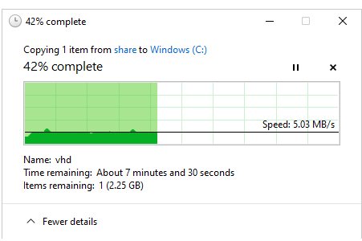
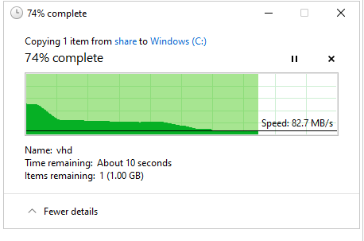
Performance difference between two vendors
Point of presence in the same region
Difference is in the protocol / driver
Ergo = PROTOCOL STILL MATTERS

Slide 35
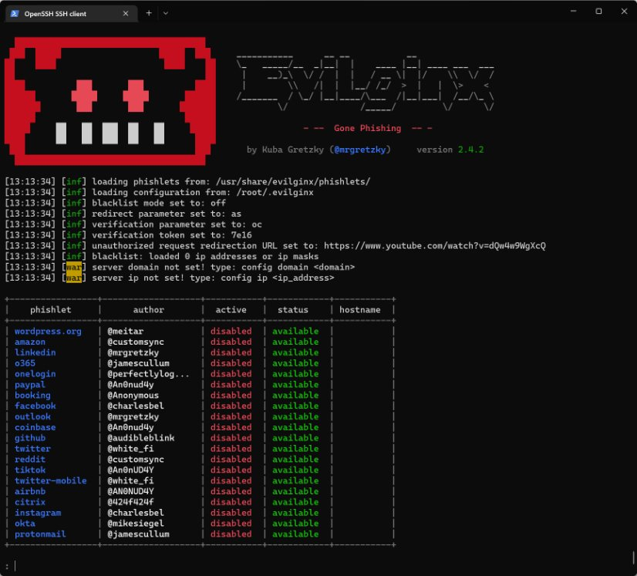
What about Identity?
Increasing amount of AiTM attacks (Stealing of tokens)
99% of all identity attacks are still password spray or breach replay
Over 7000 Password attacks every second (Entra ID)

Slide 36
Method​ | Protects against AiTM​
Passwordless phone sign-in​ | ❌​
Phone number + SMS​ | ❌​
Username and password​ | ❌​
(M365) Microsoft Authentication App + Number | ❌​
Application Bound Encryption (Browser setting)​ | ❌ (Protects against infostealers)​
FIDO2 / Passkeys (Entra ID)​ | ✅​
Certificate-based authentication​ | ✅​
(M365) Conditional Access (Compliant Device)​ | ✅​
(M365) Conditional Access Trusted Locations​ | ✅​
(M365) Require device to be marked as Hybrid Entra ID joined device​ | ✅​
(M365) Global Secure Access – Compliant Networks​ | ✅​
Device Bound Session Credentials (DBSC) ​ | ✅ (Not an official standard yet, still being developed)​
Conditional Access Token Protection​ | ❌ (Only applicable for Exchange, SharePoint) and requires server configuration​ and now AVD
Now available in Entra ID

Slide 37
DEX - What is the user experience actually like?
Workspace One Experience Management
Endpoint + URL (early days of synthetic monitoring)
RCA + Freestyle Orchestrator
Good insight into (Desktop and Mobile devices including Application health)
Citrix Director + UberAgent?
Mostly focused on the VDA and App Monitoring
Can be installed in full using Splunk ELK or other backends
Microsoft Intune Endpoint Analytics
Only focusing on the endpoint
Limited capabilities outside “Device Health”
Some capabilities only available as part of Intune advanced SKU
None of these solutions are as advanced as Nexthink or ControlUp
Consider what the scope is and also if you want to buy DEX as part of your VDI platform or not

Slide 38

The future (part) of DEX?
Can run offline to interact directly with the end-user
Based on the error message and info in our internal KB I created an ticket on your behalf
User-device
DEX Agent
Event logs
ITSM
Knowledge Base ( Wiki)
RAG
MCP
Monitoring tools
Audio
Image
Text
Local GenAI Models

Slide 39
What is the future state?
Virtual Agents
VDI/SaaS
Cybersecurity
Will appear everywhere both as personal and companywide
Many will shift platforms in the coming years, mainly toward AVD
More adoption of ZTNA or Secure Browser serivces to replace legacy VPN solutions

