Slide 2
Marius Sandbu @ Sopra Steria Cloud Evangelist – AI MVP msandbu.org
Azure Networking Deep-dive

Slide 3
13 years of experience summarized
Waited 15 minutes?
Stuff not working?!
START
Firewall issues
Check again
Routing issues
Some semi-documented limitation that is listed in one of the FAQ docs at Microsoft at the bottom
Someone did something…
DNS issues

Slide 4
Core Networking stuff
165,000 miles (2/3 of the distance to the moon) of private fiber spanning more than 60 regions and more than 170 network points of presence (POPs)
<2 MS latency Inter-AZ performance
<95μs VM-VM TCP latency with Accelerated Networking
SmartNICs with FPGA
Offloading to the NIC in terms of routing, firewall, switching & encryption
Essentially virtual network functions
VXLAN encap/decap
SDN = Bypass 4096 VLANs limit and in theory have 16 million virtual networks
16 million virtual network limit is per region
Without AccNet it goes up to <300 μs

Slide 5
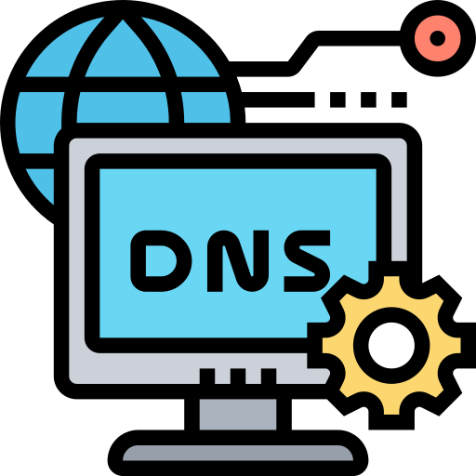
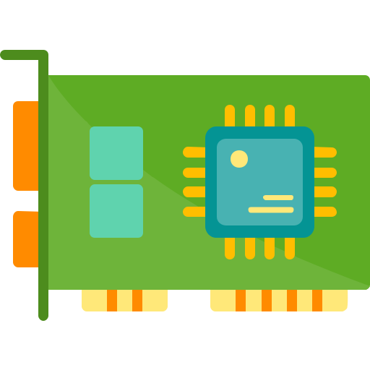
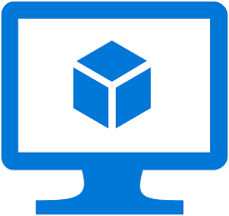
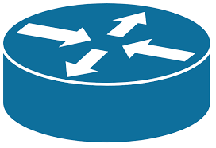
Core networking components Azure
VIP within each VNET 168.63.129.16
ARM Resource Provider Microsoft.Network
Virtual Network
Subnet
Router is a NFV feature does not support ICMP
No OSI Layer 2/3 nonsense..
No Multicast or broadcast
No DHCP
No GARP/RARP
Drops OOO packets
(Some SDN) VXLAN
Uses OneCore edition
Red dog OS – Cloud Host
SONiC / DASH / SAI
Physical Fabric

Slide 6
VM (VNET-VNET) Outbound Traffic flow
Source VNET
Dest VNET
Flow State
NSG Rules
Peered VNET
VM 10.0.0.4
VNI Lookup
ENI Lookup
Conntrack lookup
ACLs
Network 10.0.2.1/24
Underlay Routing
Metering Policy
Routing
VXLAN Decap
VXLAN Encap
BGP with Dest
Traffic bytes
User Defined Routes

Slide 7
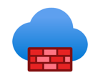


How to monitor stuff
VMInsight
Packet Capture
Effective Routes
Metrics
VNET Flow logs and Traffic Analytics
Diagnostic Logs
----

Slide 8
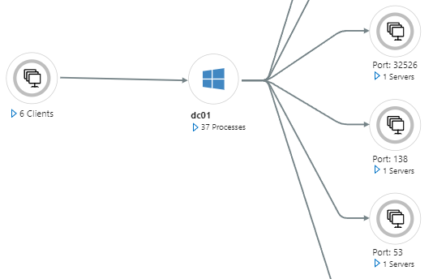
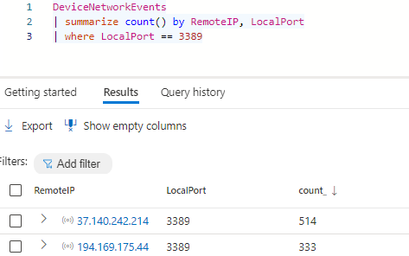
How to monitor networking stuff
VMInsight
Defender for Servers

Slide 9
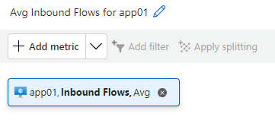
How to monitor networking stuff
A VM in Azure has QoS limiting bandwidth and Network flows (supports 500K flows)
Inbound Flows

Slide 10
Network Watcher
Connection Monitor
IP Flow verify
Connection Troubleshoot
Packet Capture
Agent to monitor VM-VM or VM-TCP/URL
Slow and unstable
TCP/UDP rule check against NSG Rules
Requires Network Watcher extension on a VM
PCAP capture from inside a VM

Slide 11
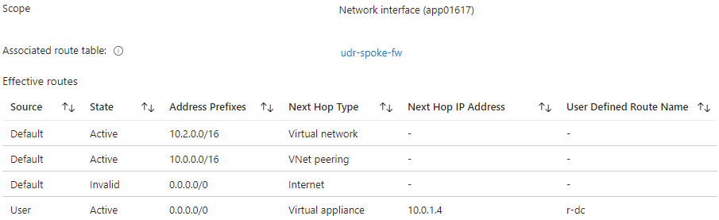
How to monitor stuff
The only good way to view routes of a VM
Effective Routes

Slide 12
VNET Flow logs
Enriches VNET Flow logs with threat data and Azure tags
Log Analytics
Traffic Analysis
Storage Account
Supports VMs, API, AppGW, ER and VPN Gateway. DOES NOT support VWAN HUB
VNET
VNET Flow logs

Slide 13
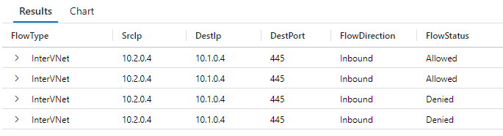
Traffic Analysis KQL
NTANetAnalytics
| where FlowType == "InterVNet"
| project FlowType, SrcIp, DestIp, DestPort,FlowDirection, FlowStatus

Slide 14
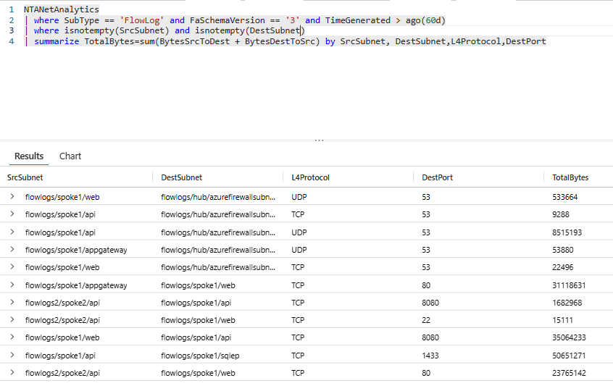
Traffic Analysis KQL
View traffic summary from and to spokes

Slide 15


Azure Firewall
Public LB
Does SNAT for Application Rules
Does SNAT for Network Rules if there are FQDN filtering in Network rules
10.0.0.6
Waited 15 minutes?
Internal Standard LB 10.0.0.4
Is a Virtual machine scale set
10.0.0.7

Slide 16
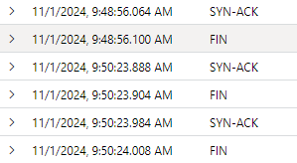
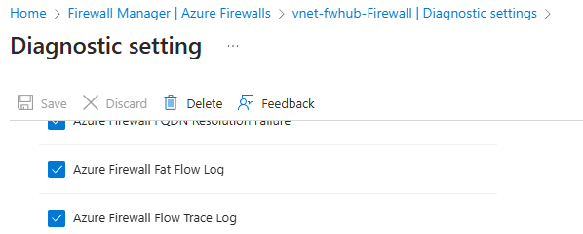
Flow Trace logs
Can see TCP Handshake in Logs, yay!
Register-AzProviderFeature -FeatureName AFWEnableTcpConnectionLogging -ProviderNamespace Microsoft.Network

Slide 17

How to monitor stuff
No support for Flow logs 😐
No way to view NSG rules or Route tables
Creates a read-only NIC
Remember to use SNAT traffic rules
Can be “Managed” using Network Security Policies Allows UDR and NSG
Injects itself as a /32 route for all peered VNETs

Slide 18
Scenarios

Slide 19
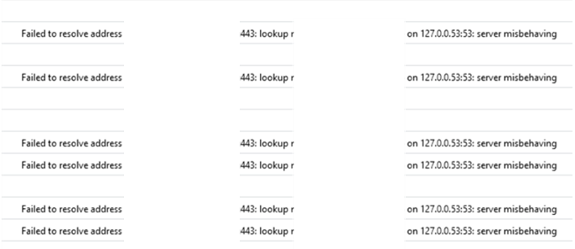
Case 1: DNS – Where art thou?
Hub and spoke with Azure Firewall and outbound API calls
Traffic allowed sporadically trough the Firewall on HTTPS traffic
Long DNS Timeouts
1 Of 1600 DNS requests timeout
Port UDP 65330 not used
Reserved port on all VNETs (by design from Microsoft)

Slide 20
Case 1: DNS – Demo!

Slide 21
Case 1: DNS – Where art thou?
Resolution:
Azure Firewall caches positive DNS requests 1 hour
FQDN Rules in Application Rules leverages the DNS Proxy
Domain Controllers were blocked from communicating with the second Azure Firewall instance (10.1.0.7)
Stuff not working?!
START
Firewall issues

Slide 22
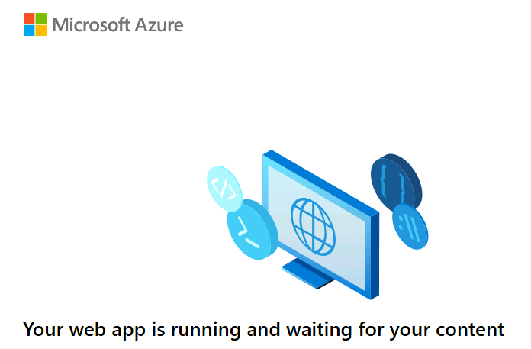
Case 2: Private Endpoint – Going Rogue
Private Endpoint communication
Web Apps private endpoints were not working
Hub and spoke
Traffic from spoke-hub-spoke
Storage private endpoints were working 😐
Traffic from same VNET was working

Slide 23
Case 2: Private Endpoints – Demo!

Slide 24
Case 2: Private Endpoint – Going Rogue
Resolution:
Asymmetric traffic flow
Reconfigured to use Application Rules on Azure Firewall to do SNAT
DNS Private Zone not linked to the right virtual network
FYI: Does not apply for 3.party providers anymore Generally Available: Private endpoint support without NVA source network address translation
disableSnatOnPL
Stuff not working?!
START
Routing issues

Slide 25

Case 3: Azure NetApp Files – One at a time please!
Azure Kubernetes with NetApp Files for RW NFS Share
Using Docker Enterprise
Using Trident CSI Drivers
Using Azure-CNI where each pod had its own IP
Was performing great ☺
Until…

Slide 26
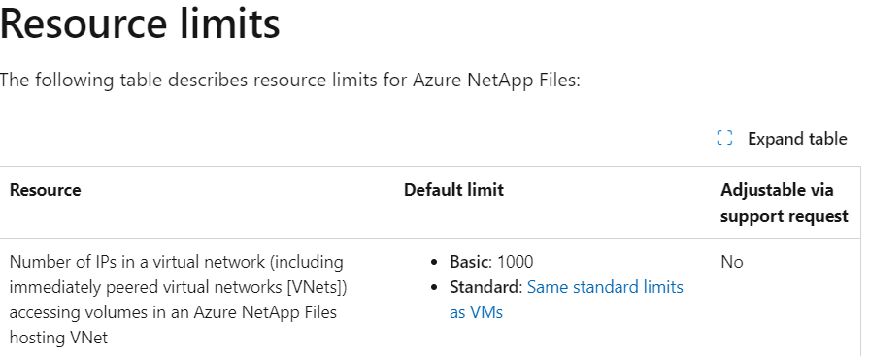
Case 3: Azure NetApp Files – No demo…
Number of allocated IPs within the virtual networks were over 1024…..
At the time we had NO Standard Network configuration
No way to adjust using support either
Resolution? - Ceph
Some undocumented limitation that is listed in one of the FAQ docs at Microsoft at the bottom

Slide 27
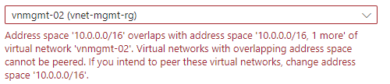
Case 4: The Ultimate Game of 'Who’s Talking to Who?
Merging of multiple environments
Super critical virtual machines and requires connectivity
Multiple VNETs with 10.0.0.0/16 allocation 😐 😐
And no…we could not rebuild (at least not straight away)

Slide 28
Case 4: Who’s talking to who! Demo!

Slide 29
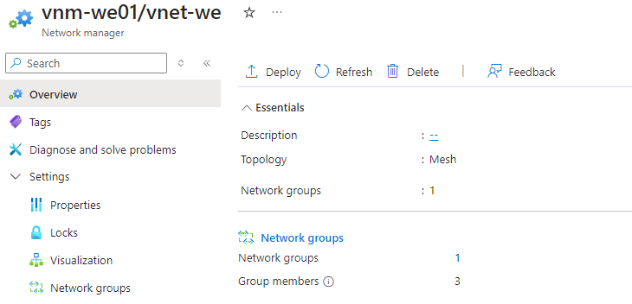
Case 4: Who’s talking to who! Demo!
Virtual Network Manager supports VNET Peering across (even if IP overlapping)
Only for Mesh deployment
Overlapping IPs are dropped
Remote forwarding is not enabled
Could probably use Subnet-to-Subnet peering instead now
NAT features on VPN Gateway for traffic on-premises

Slide 30
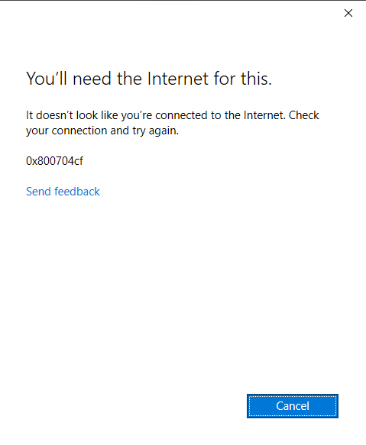
Case 5: Exhausted Azure Network
Traffic stopped on a large environment
Hub-and-spoke with all traffic routed via Azure Firewall
Consisted of multiple workloads, AKS, AVD and bunch of infrastructure components.
No changes to the environment

Slide 31

Case 5: Demo!
Hard to demo, but here is a picture of one of my dogs

Slide 32
Case 5: Exhausted Azure Firewall
Office Apps can use upwards to 50 TCP ports ACTIVE per session
Each PIP can handle 2495 SNAT sessions
SNAT Port monitoring with Azure Firewall
Extend with either more PIP or NAT Gateway (64,512 SNAT ports per PIP)
Not supported with secured virtual hub and no global deployment

Slide 33
Case 6: Service Endpoints vs Private Endpoint
Customer with many hundred storage accounts for IoT data processing and AKS
Hub and spoke virtual network
Security says private endpoint
Finance says whatever is cheaper please
I didn’t care ☺
Private endpoint costs (730 hours) =80,- a month
100GB (50/50) processing
Endpoint processing = 11,-
VNET Peering * 2 = 40,-
Azure Firewall = 20,-

Slide 34
Case 6: Service Endpoints vs Private Endpoint
This was VM-to-PE monitoring (without NVA)
Service | Public IP RTT | Private Endpoint RTT | Public/Private Ratio
Azure Blob Storage | 0.491 ms | 0.483 ms | 1.01
Azure File Storage | 0.563 ms | 0.598 ms | 0.94
Azure KeyVault | 0.776 ms | 0.748 ms | 1.03
Azure WebApp | 0.650 ms | 0.689 ms | 0.94

Slide 35
Demo setting up service endpoints with policies

Slide 36
Case 6: Service Endpoints vs Private Endpoint
Total cost for Private Endpoints were <50,000,- a month
Moved over to Service Endpoints with policies to reduce cost
Remember that service endpoints ONLY handles inbound
Verify each service and check with your (friendly) compliance officer ☺

Slide 37

Case 7: More NVAs please
Required to have multiple services externally available (TCP/HTTPS)
Required to have load regional load balancing across a bunch of VMs
PCI-DSS compliance required
Before Secure Hub with 3.party NVA was supported
Application Gateway
Azure Firewall
Public Load Balancer

Slide 38

Case 7: More NVAs please
Gateway can be chained to a public LB or directly to a VM
Gateway load balancer
Packets not altered by NVE Since it sees the entire VXLAN packet
Palo Alto VM
VXLAN
Palo Alto VM
Using Admin State as well
VXLAN decapsulation
Azure Load Balancer
VMs
VMs

Slide 39
Thanks for listening to my ramblings!
Questions? Ill be here! Or…
Marius.sandbu@soprasteria.com
Slides: github.com/msandbu/nic2024

