Slide 2
Marius Sandbu @ Sopra Steria Cloud Evangelist – AI MVP msandbu.org
Microsoft Security Copilot deep-dive

Slide 3
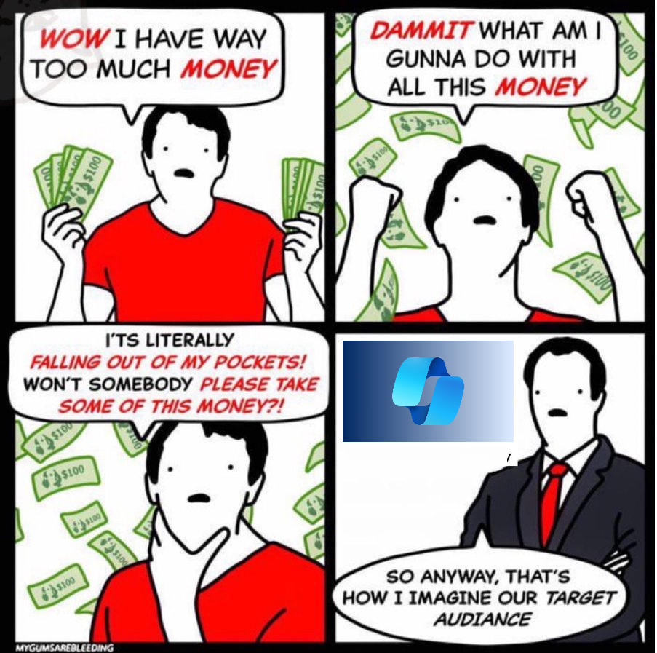

Slide 4
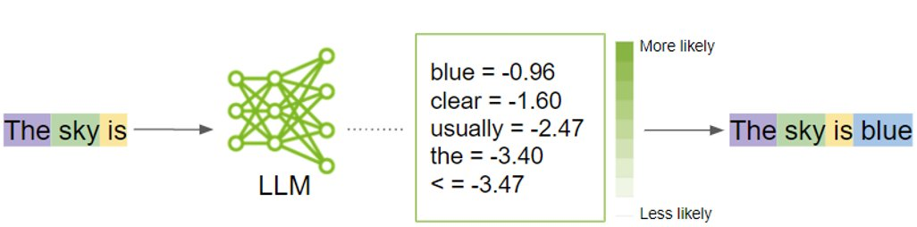
Tokens = are individual pieces of text (like words or subwords) that the model processes and generates
All about probability = What is the most likely next word in each context

Slide 5
LLM and GPT - 101
GPT 3.5 ~2500 words
GPT-4 12000 words
GPT-4 Turbo 100,000 words
Wikipedia (4%)
What is Copilot for Security?
Encoder
Other arcives (60%)
Dataset
Transformer Neural Network
OpenWeb Text2 (22%)
Copilot for Security is a new service from Microsoft
Decoder

Slide 6
Not just context but quality
ChatGPT 3.5
November 2022
Text only 4000 tokens ~ 3500 words TruthfulQA = 53% NIHS =95%
ChatGPT 4o
May 2024
Text and image
128000 tokens ~ 100.000 words
TruthfulQA = 81%
NIHS = 100%
Parallel function calls JSON mode
Streaming API

Slide 7
GPT and Functions
functions = [
"name": "get_current_weather”
What is the temprature in Oslo now?
Weather info (yr.no)
Weather information JSON-format
LLM w/functions
Language Model
Its really COLD!
NB: API via OpenAI, you can have up to 128 different functions defined (even parallel function)

Slide 8
How can we use our LLM’s with our own data?
Prompt Information directly into a prompt
1: Prompts
2: Fine-tuning
3: Grounding (RAG)
LLMs with our own data
Fine-tuning
Train the language model on your own data sources.
Prompts
Grounding (RAG)
Make data available outside the language model. Using search to retrieve data (aka Azure AI Search)

Slide 9
RAG - (Retrieval Augmented Generation)
Vector Search
LLM
Vector Database
Search
Convert data to vectors
Embeddings File ......0,1
«What is our policy on»
«This is our company policy
File splitter
Data

Slide 10
Fine-tuning
gpt-4o
Fine-Tuning
Fine-tuned language model
Requires datasets in a properly defined format
Dataset
Prompt
Format of Q&A Q: What is the Kusto query to find IP address from table NTAIP
Requires that the LLM supports fine-tuning (not all do)

Slide 11
So, what is Copilot for Security?
Portal
Embedded
API
Orchestrator
Microsoft data
3. Party
Custom datasources
Plugins/Skills
Fine-tuned LLM using GPTv4 (Azure OpenAI)
NOTE: Abuse Monitoring is disabled
SCU (Secure Compute Units)

Slide 12
How it works (Does not support workflows)
Geography : EU: West Europe
Prompt
Prompt: Check Greynoise if there is anything about the IP address 8.8.8.8
2# Grounding and Skills
3# LLM Processing
Copilot Orchestrator
Microsoft Copilot SCU
Virtual Agent and Tasks
Azure OpenAI Fine-tuned LLM (GPT4)
Answer: The machine with IP 8.8.8.8 and is according to Greynoise linked to Google
Skills/Plugins (GPT Functions)
3.Part sources: Greynoise
Make output

Slide 13
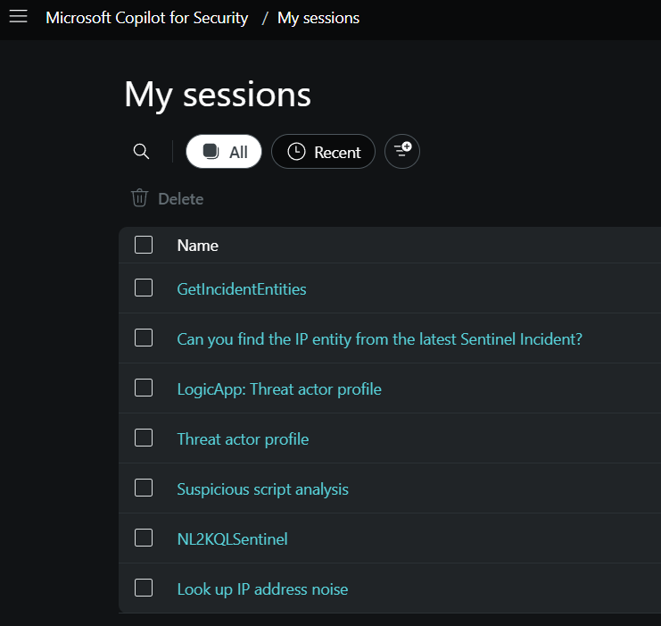
Stored independently of the SCU
Each session and data is stored 30 days

Slide 14

Keep an eye out for the SCU’s
One unit = ~40 NOK per hour
Not performance but quota of information
The quota is refreshed each hour
Compute Unit
X Amount of tokens
Compute Unit
X Amount of tokens
Compute Unit
X Amount of tokens
= ~100.000 NOK/MONTH
X = Not documented how much information you can process

Slide 15
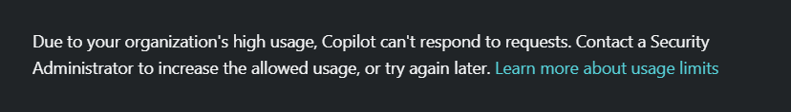

Keep an eye out for the SCU’s
Sometimes it is visible, sometimes you see it in the HTTP request failing

Slide 16
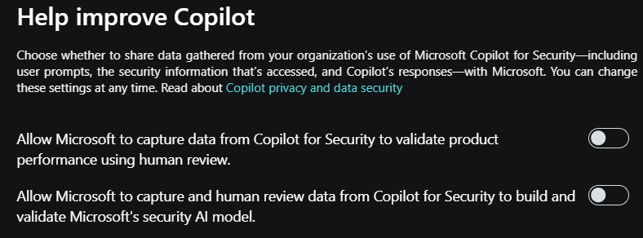
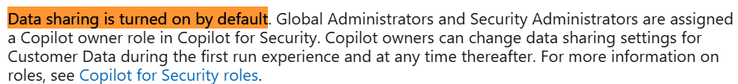
Some information stuff about data

Slide 17
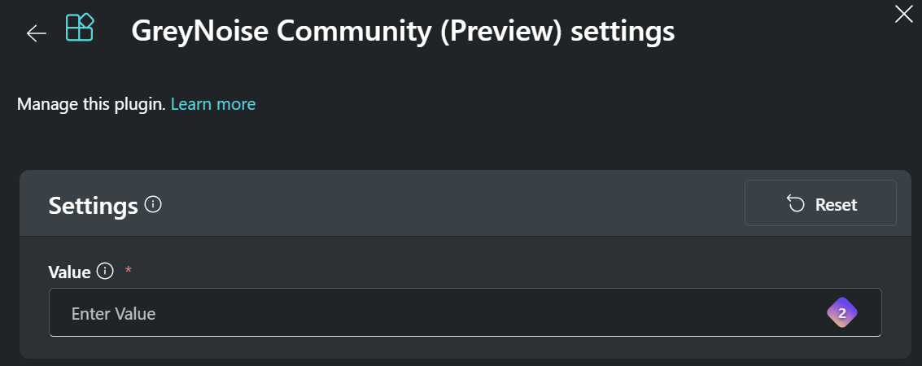
Integrations and plugins
Microsoft plugins (uses on-behalf authentication)
Azure AI Search (Use against your own data sources)
Security documentation or other data you have
Separate service
Must be called specifically via "Azure AI Search” 3. Party solutions (Service Now)
Often requires your own integrations (API keys)
Can also upload your own data (20mb)
Copilot for Security plugin
API, KQL or GPT

Slide 18
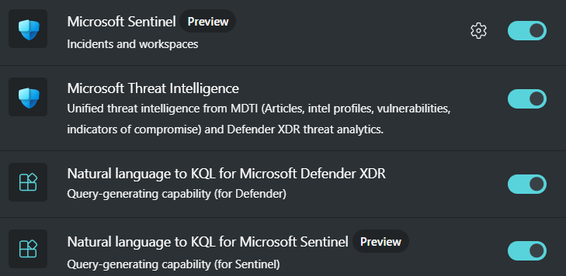
Microsoft integrations
Some integrations require “some” configuration
Some functions use external RAG data sources from Microsoft

Slide 19
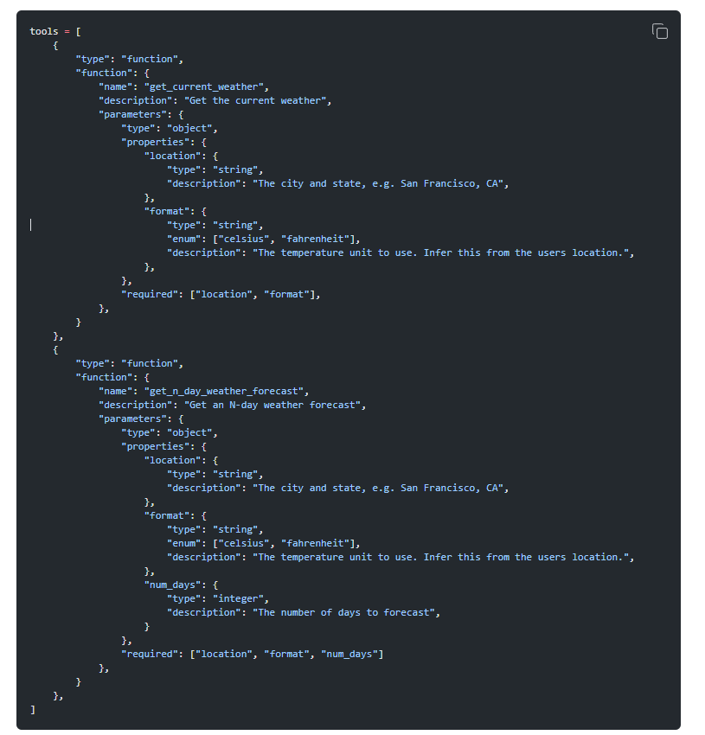
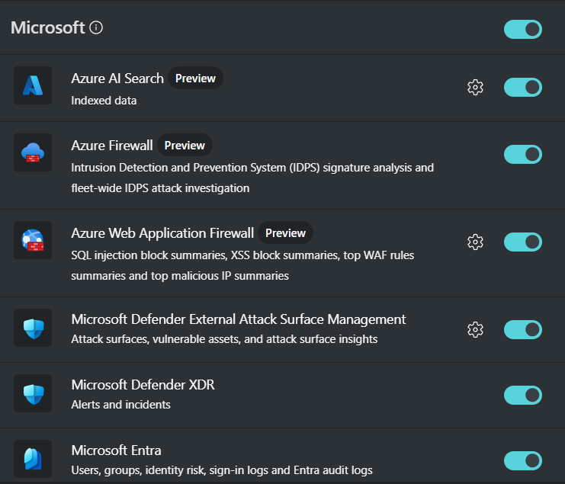
Integrations and plugins
For each integration enabled the System Prompt will become larger = AKA using more tokens

Slide 20
Copilot for Security Plugin
Prompt:
Can you find information about this IP address in Shodan?
Descriptor:
Name: Shodan
Description: Sample API
SupportedAuthTypes:
- APIKEY
Authorization:
Type: APIKEY
API
GPT
KQL
Custom skill
Copilot for Security

Slide 21
Copilot Security plugin
Descriptor:
Name: Get Shodan IP Address Information
DisplayName: Get Shodan IP Address Information.
Description: Get detailed information from Shodan about an IP Address.
#Examples
#Can you summarize the Shodan information for the IP 185.220.101.140?
SupportedAuthTypes:
- ApiKey
Authorization:
Type: APIKey
Key: key
Location: QueryParams
AuthScheme: ''
SkillGroups:
- Format: API
Settings:
OpenApiSpecUrl: https://raw.githubusercontent.com/msandbu/securitycopilot/main/Shodanspec.yaml
Automatically creates API structure based on OpenAPI spec

Slide 22
Copilot Security plugin
Descriptor:
Name: Summarize Sentinel Cost details for a specified time and date range.
DisplayName: "Sentinel KQL: Sentinel Cost Details"
Description: Skills that lookup recent Sentinel Cost Details from Sentinel workspace.
SkillGroups:
- Format: KQL
Skills:
- Name: GetSentinelCost
DisplayName: Get Sentinel Cost
Description: Fetches all the Sentinel Cost details for each table for the specified time and date range from Sentinel.
Inputs:
- Name: fromDateTime
- Name: toDateTime
Settings:
Template: |-
let fromDateTime=datetime('{{fromDateTime}}');
let toDateTime=datetime('{{toDateTime}}');
Usage
Have to defined workspace ID to allow query

Slide 23
Integrations with own sources with RAG (AI Search)
Same method used by Copilot 365 with Semantic Index
Copilot for Security
LLM (SCU)
Vector Search
Search
Vector Database
Convert content to vectors
«How should we handle these types of incidents?»
«Based upon internal docs this is how we handle»
Embedding
Data

Slide 24
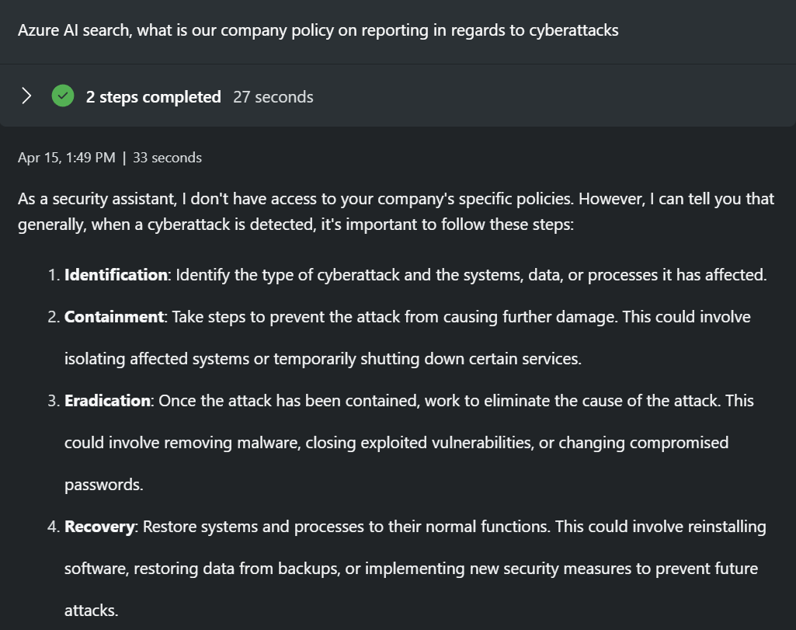
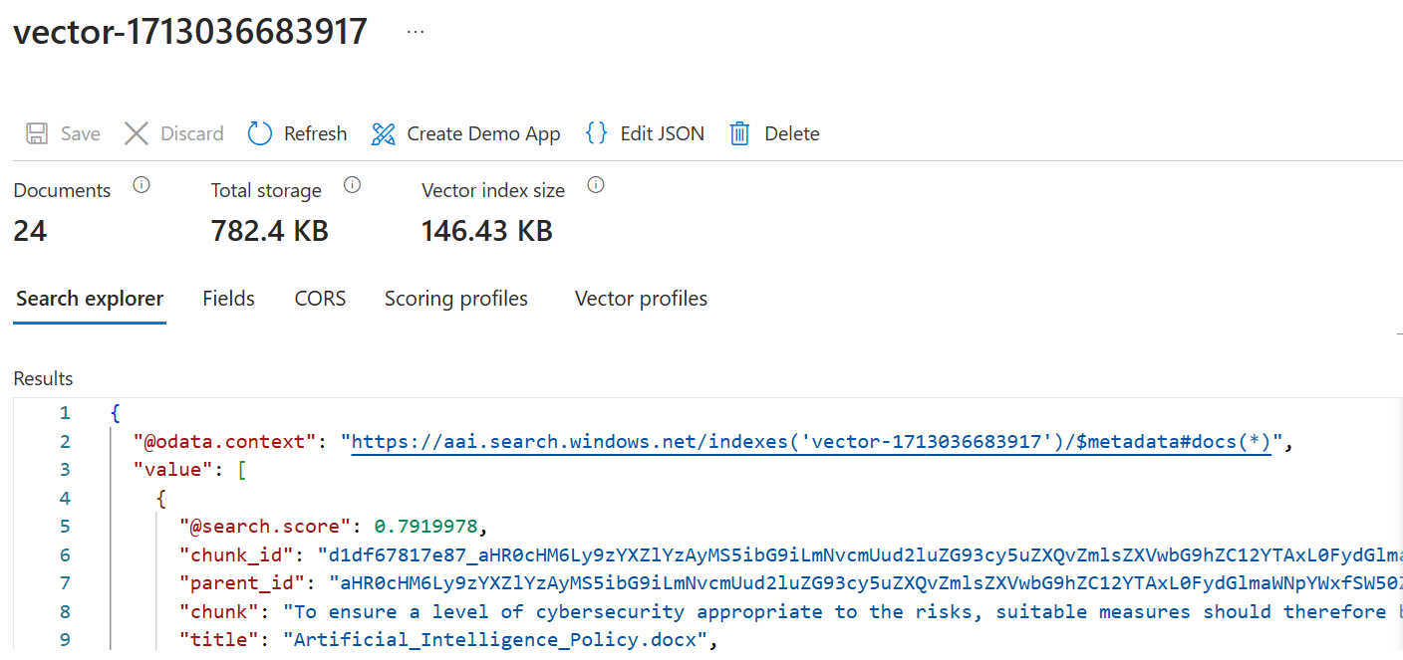
Integrations with your own data sources
Azure AI Search or uploaded files

Slide 25
Azure AI Search with own data
Vectorization
Data Storage / SharePoint
Azure AI Search
Azure OpenAI
text-embedding-ada-002
Security Copilot
DOES NOT WORK WITH NEWER EMBEDDING

Slide 26
How to write the right prompt
Write in English
Norwegian works, but cannot guarantee that the function works
Address the prompt as (You should do X)
Describe what it will do
Describe the correct context
Summarize incident in Defender XDR
Write a summary of the incident for a CISO
Do you know where to apply? Use System Capabilities
No need for the orchestrator to "interpret"
Will translate it to English…
Uses about 1/5 of the tokens compared

Slide 27
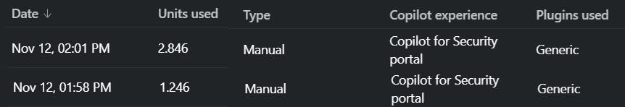

Just asked the orchestrator
Uses System Prompt to do Code analysis
Just asked the Orchestrator without any integrations

Slide 28
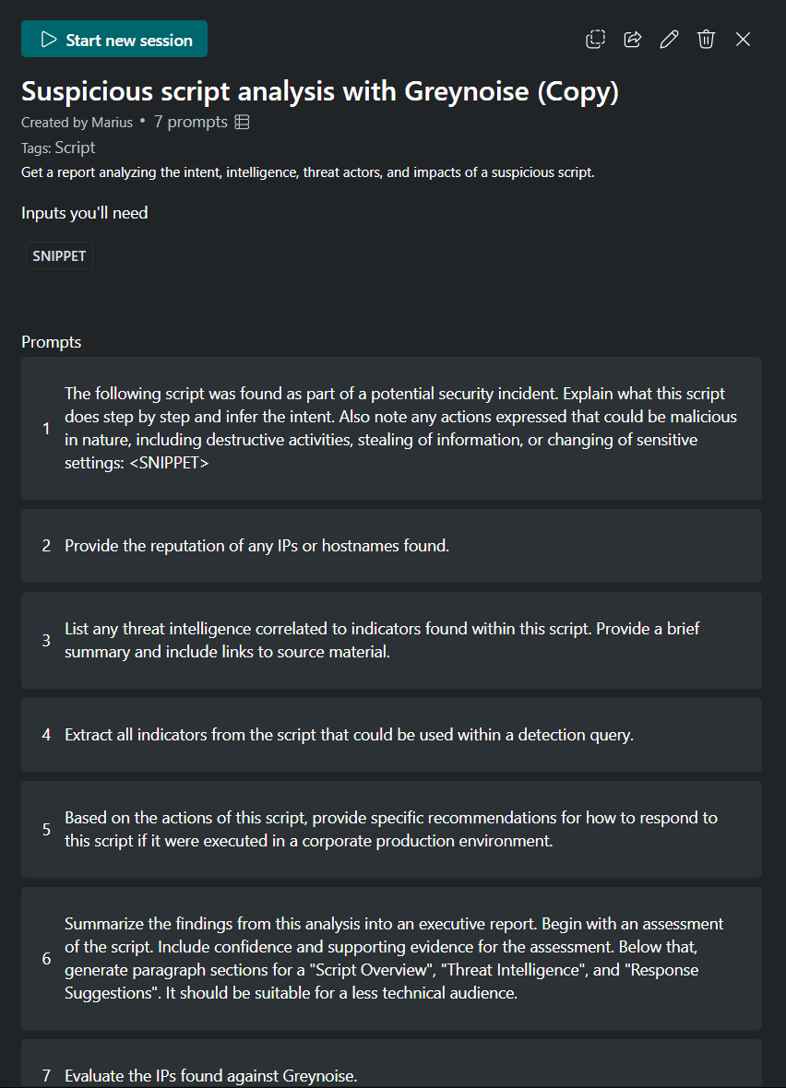
Promptbook
Set a series of prompts to run different activities
All of the information here is stored in the context of the LLM
Can use data against different sources/skills between different prompts
Not directly accessible via the API

Slide 29
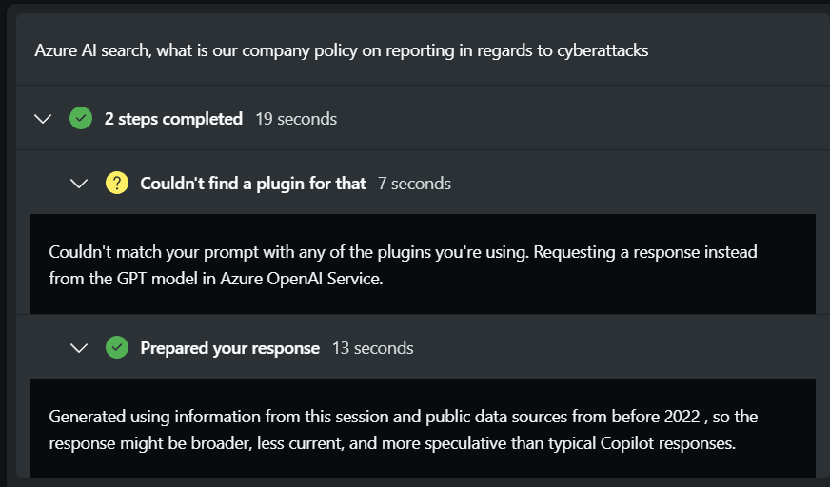
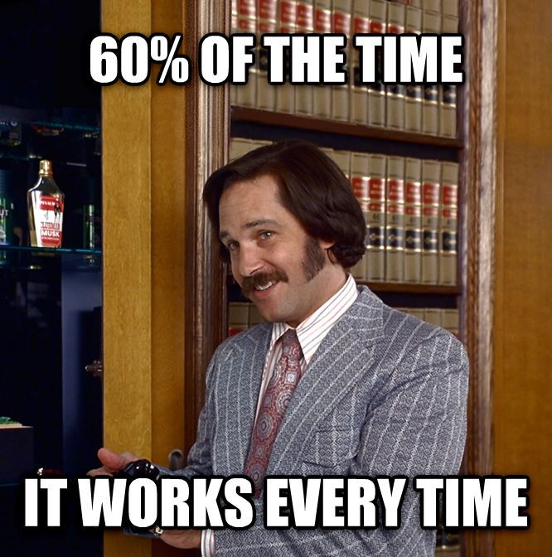
It's still generative AI for better or worse...

Slide 30
So, what to think of Copilot for Security?
Great framework
Easy to plugin new data sources
Fortunately locked to Microsoft fine-tuned model
Cannot bring your own model (Llama, GPT4o1) or capacity
Will always “lag” behind with newer models

Slide 31
Thanks for listening to my ramblings!
Questions? Ill be here! Or…
Marius.sandbu@soprasteria.com
Slides: github.com/msandbu/nic2024

