Slide 1

Governance and Security as Code
Marius Sandbu
Guild Lead Public Cloud @ TietoEVRY
Twitter @msandbu
msandbu@gmail.com
Blog → https://msandbu.org
Code & Script repo for this session → bit.ly/msandbunv

Slide 2



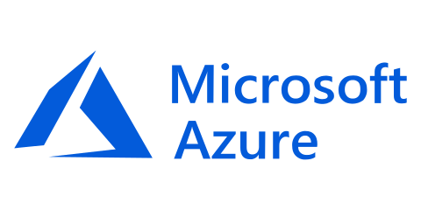

What I’m going to cover

Slide 3
Agenda
The Microsoft Security Ecosystem
API’s against the different services
Building Security and Governance in Azure
Graph API and Microsoft 365
Covering different scenarioes and how to automate
Summary

Slide 4

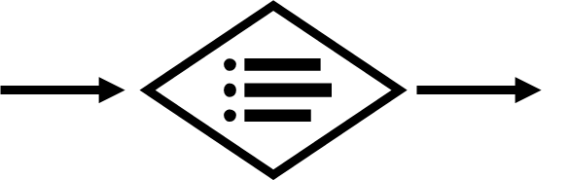



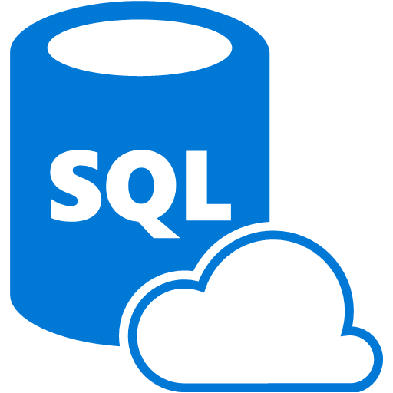

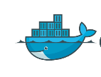



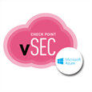







Microsoft Security Ecosystem
Identity & Access
Security Information and Event Management (SIEM)
Analytics/Automation
Azure Sentinel
Information Protection
Azure Active Directory
Cloud App
Security
Azure
Security Center
Microsoft Defender
Office 365
Azure
Advanced Threat Protection (ATP)
Conditional Access – Identity Perimeter Management
Cloud App Security
Azure AD Identity Protection
Leaked cred protection
Behavioral Analytics
Graph Security API – 3rd Party Integration
Azure Information Protection (AIP)
Azure Defender
Configuration Hygiene
Just in Time VM Access
Office 365
Azure Firewall
Security Appliances
Adaptive App Control
Azure AD PIM
NGFW
Azure SQL
Threat Detection
Multi-Factor Authentication
Edge DLP
SSL Proxy
SQL Encryption & Data Masking
Azure AD B2B
IPS/IDS
Azure SQL Info Protection
MIM PAM
Azure Policy
Azure Key Vault
Storage Encryption
Microsoft Defender ATP
Azure ATP
Azure WAF
Azure Antimalware
DDoS Mitigation
Active Directory
Application & Network Security Groups
Backup & Site Recovery
Confidential Computing

Slide 5
Some of the main API’s
Two main resources for automation
Graph API (Microsoft 365)
Rest API, PowerShell, Terraform
Access to Graph API
Azure Resource Manager (Azure services)
Rest API, PowerShell, Terraform, Bicep, Pulimi etc
Access to ARM using custom role on defined scope
Custom API’s and endpoints for
Defender ATP
Cloud App Security
Office 365
Service Communication API
Management API

Slide 6
Some things you should have in place
Install-Module Microsoft.Graph
Update-Module Microsoft.Graph
Install-Module AzureAD
Install-Module AzureADPreview
Install-Module Az
az config set extension.use_dynamic_install=yes_prompt
Install-Module MCAS
Install-Module ExchangeOnlineManagement
Install-Module MicrosoftTeams
Install-Module MicrosoftGraphSecurity
Install-Module Az.ResourceGraph
Choco install Terraform
Quickstart - Configure Terraform using Azure Cloud Shell | Microsoft Docs
NOTE: There are some overlapping PowerShell modules…
Some VS Code extensions:
Installed from CLI
code --install-extension hashicorp.terraform
code --install-extension ms-vscode.azure-account
code --install-extension msazurermtools.azurerm-vscode-tools
code --install-extension ms-vscode.azurecli
code --install-extension AzurePolicy.azurepolicyextension

Slide 7
Super quick intro to Terraform
Providers: Integration to a specific platform (Azure RM Provider)
State: Metadata stored of current configuration (By default stored locally)
Can be stored in Azure Blob Storage for instance as a backend
Commands (Terraform.exe Init)
Init (Make sure provider, state and folders are in place)
Plan (Make a plan file with changes that will happen)
Apply (Actually doing the changes)
Destroy (What is says...)
Main.tf
Backend.tf
Network.tf
Monitoring.tf
Remote State
Azure Provider
Azure
Terraform
Google Provider
Google Cloud
Secrets
Kubernetes Provider
Kubernetes

Slide 8
Working with Azure
How to handle access to the environment?
1: Have a defined service principal with access to the environment
Local development
2: Managed System Identity for Automated deployments (Azure DevOps/ GitHub Actions)
Azure PowerShell:
Connect-AzAccount –Identity
Terraform: provider "azurerm" {
version = "~> 1.23“ use_msi = true
}

Slide 9
Building Blocks in Azure
Access Management – RBAC and use of least-privilege access
Azure Policies – Defining Policies that can audit and handle configuration management
Azure Security Center – Threat detection and security governance
Azure Monitor / Log Analytics / – Monitoring, logging and some security mechanisms
Azure Update Management and Change Tracking – Patch management and file tracking
Network Landing zone – Different level of firewall mechanisms, controlling traffic flow and insight
Naming and tagging prefix – Resource Consistency
Azure Services – Logging enabled, Service Endpoint, Private Links
Azure Resource Graph – Inventory, Asset management

Slide 10
Log Analytics and Sentinel
Log Analytics is a log collection service
Data and processing within a region
Default retention 30 days (for entire database)
Also used for Azure Monitor
Data stored in different tables
Depending on data source
Can collect «any» type of data
Different time intervals for each solution
Sentinel is an addon solution to Log Analytics
Log Analytics has a lot of different solutions
Provides data collection rules

Slide 11
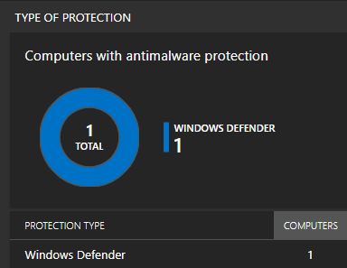
Log Analytics and other solutions
Log Analytics has many different addons
Sentinel
Update Management (Requires configuration)
AntiMalware (Requires config on VM)
Change Tracking (Requires configuration)
DNS Analytics (Requires configuration)
Infrastructure Insight
VM Insight
Adding a solution will update the client configuration
Adding other solutions requires only change to product name in code
resource "azurerm_log_analytics_solution" "la-antimalware" {
solution_name = "AntiMalware"
location = azurerm_resource_group.mainrg.location
resource_group_name = azurerm_resource_group.mainrg.name
workspace_resource_id = azurerm_log_analytics_workspace.mainrg-la.id
workspace_name = azurerm_log_analytics_workspace.mainrg-la.name
plan {
publisher = "Microsoft"
product = "OMSGallery/AntiMalware"
}
}

Slide 12
Sentinel Configuration
Create Resource Group
Create Log Analytics Workspace
Add SecurityInsight Solution
Retention will automatically be extended to 90 days
resource "azurerm_log_analytics_workspace" "mainrg-la" {
name = "mms-workspace-demo"
location = azurerm_resource_group.mainrg.location
resource_group_name = azurerm_resource_group.mainrg.name
sku = "PerGB2018“
retention_in_days = 30
daily_quota_gb = 4
}
## Define Log Analytics Solutions
resource "azurerm_log_analytics_solution" "la_sentinel" {
solution_name = "SecurityInsights"
location = azurerm_resource_group.mainrg.location
resource_group_name = azurerm_resource_group.mainrg.name
workspace_resource_id = azurerm_log_analytics_workspace.mainrg-la.id
workspace_name = azurerm_log_analytics_workspace.mainrg-la.name
plan {
publisher = "Microsoft"
product = "OMSGallery/SecurityInsights"
}
}

Slide 13
Sentinel Analytics Rules
Scheduled Query Rules
- Missing option to define Alert Rule action ☹
Free samples for hunting queries
Azure-Sentinel/Hunting Queries GitHub
Microsoft Security Rules Asymmertic API SecurityInsight GitHub
resource "azurerm_sentinel_alert_rule_scheduled" "alert_ad_audit" {
name = "alert_ad_audit"
log_analytics_workspace_id = azurerm_log_analytics_workspace.mainrg-la.id
display_name = "Check AD Audit Logs for Failed Logon"
severity = "High"
query = <<QUERY
AzureActivity |
where OperationName == "Create or Update Virtual Machine" or OperationName =="Create Deployment" |
where ActivityStatus == "Succeeded" |
make-series dcount(ResourceId) default=0 on EventSubmissionTimestamp in range(ago(7d), now(), 1d) by Caller
QUERY
}
resource "azurerm_sentinel_alert_rule_ms_security_incident" "azsen_mcas" {
name = "mcas-incident-alert-rule"
log_analytics_workspace_id = azurerm_log_analytics_workspace.mainrg-la.id
product_filter = "Microsoft Cloud App Security"
display_name = "MCAS Incidents"
severity_filter = ["High"]
}

Slide 14

Azure Monitor – Action Groups
Alert Rule used to create monitoring based upon metrics/events
Resource – Subscription, Resource Group or Resource
Condition – Metric or Log Activity
Action Group – Notification or Action
Notification – Email, SMS, Voice
Can be a mix of multiple
Action – Azure Function, ITSM, Logic App, Webhook, Automation
Can be a mix of multiple
Alert Rule stored in a Resource Group
Should be stored with the resource (lives/dies with service)
Action Group should be stored within management group
Resource
All VM’s
Alert Rule
«Network Flow over 90%»
Severity 1
Condition
Inbound Flow Greater then 50/s
Action Group
Action
Logic App
Notification
Email

Slide 15
Alert Rule Example
Needs to have Resource Group, Workspace and Action Group defined first
resource "azurerm_monitor_scheduled_query_rules_alert" "example" {
name = “awesomerule1"
location = azurerm_resource_group.example.location
resource_group_name = azurerm_resource_group.example.name
action {
action_group = [azurerm_monitor_action_rule_action_group.example.id]
}
data_source_id = azurerm_log_analytics_workspace.mainrg-la.id
description = "Alert when caller IP from known source"
enabled = true
# Count all requests with server error result code grouped into 5-minute bins
query = <<-QUERY
AzureActivity
| where TimeGenerated > ago(24h)
| where CallerIpAddress == "94.102.41.133"
QUERY
severity = 1
frequency = 5
time_window = 30
trigger {
operator = "GreaterThan"
threshold = 3
}
}
Alert Rule
Source from Log Analytics
Kusto Query
Severity of alert and trigger

Slide 16
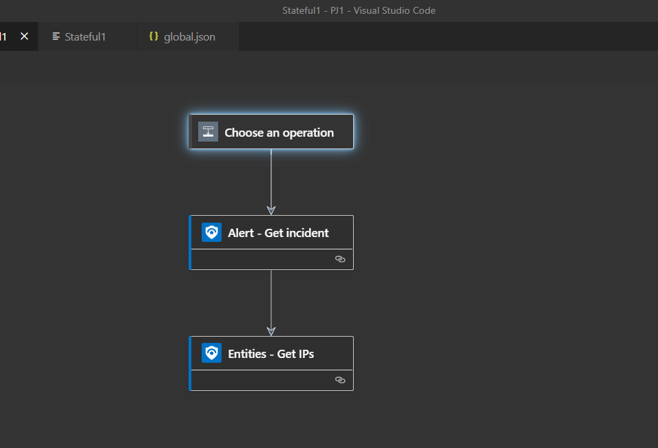
Azure Logic App deployment
Logic App used for automated remediation for Sentinel and Security Center
Not straightforward deployed using Terraform
Simplest is ARM based deployment via Terraform or just ARM
Azure-Sentinel/Hunting Queries at master · Azure/Azure-Sentinel (github.com)
Proper deployment using SystemManagedIdentity
"identity": {
"type": "SystemAssigned"
Logic Apps can be created directly in VS Code
Visual Studio Code - Azure Logic Apps

Slide 17
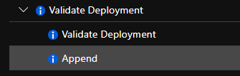
Azure Policies
Provides evaluation of Azure resources compared to business rules
If X deny creation = Creating Azure Resources in Non-approved region
If X property equals Z, then do Y = If Virtual Machine is new then install agent
Azure Policy Logic can apply at
At resource creation or evaluated after creation
After creation evaluation
AuditifnotExists, DeployIfNotExists
Policies can be assigned to (or part of an initiative)
Management Group, Subscription, Resource Group or Resource

Slide 18
Deployment of Azure Policies
Check if Built-in Policies provide enough control
azure-policy/built-in-policies/policyDefinitions at master · Azure/azure-policy (github.com)
or build Custom Policies
Azure Security Center Defaults
PowerShell
$rg = Get-AzResourceGroup -Name '<resourceGroupName>’ $definition = Get-AzPolicyDefinition | Where-Object { $_.Properties.DisplayName -eq 'Audit VMs that do not use managed disks’ } New-AzPolicyAssignment -Name 'audit-vm-manageddisks' -DisplayName 'Audit VMs without managed disks Assignment' -Scope $rg.ResourceId -PolicyDefinition $definition

Slide 19
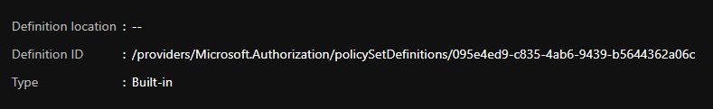
Deployment of Azure Policies
Terraform with built-in policies (Just referencing definition ID)
resource "azurerm_policy_assignment" "auditvms" {
name = "Audit Disk without Managed Disks"
scope = "/subscriptions/00000000-0000-0000-000000000000"
policy_definition_id = "/providers/Microsoft.Authorization/policyDefinitions/06a78e20-9358-41c9-923c-fb736d382a4d"
description = "Shows all virtual machines not using managed disks"
display_name = "Audit VMs without managed disks Assignment"
}

Slide 20
Deployment of Azure Policies
Terraform with custom policy
Create a policy definition
Create an Azure Policy Assigment
Reference definition as part of assignment
NOTE: Policies with deployifnotexists requires a management identity
resource "azurerm_policy_definition" "IaaSAntiMalwarePolicy" {
name = "IaaSAntiMalwarePolicy"
policy_type = "Custom"
mode = "All"
display_name = "Get antimalware checked"
policy_rule = <<POLICY_RULE
{
“if”:
“then”: “Effect”
resource "azurerm_policy_assignment" "IaaSAntiMalwarePolicyAssignment" {
name = "IaaSAntiMalwarePolicyAssignment"
scope = "/subscriptions/00000000-0000-0000-000000000000"
policy_definition_id = azurerm_policy_definition.IaaSAntiMalwarePolicy.id
description = "Policy Assignment created via an Acceptance Test"
display_name = "IaaSAntiMalwarePolicyAssignment“
PARAMETERS
location = "westeurope"
identity {
type = "SystemAssigned"
}

Slide 21
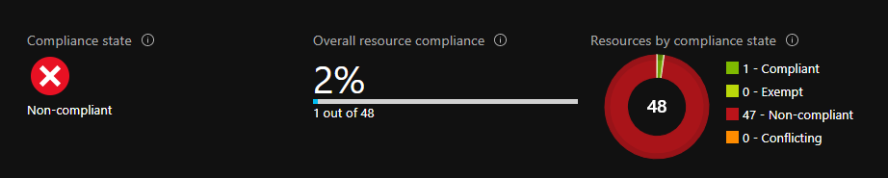
Azure Policies and monitoring compliance
Problem with Non-compliant resources is visibility
Policy evaluation is logged into Azure Monitor/LA
Kusto Query (Show case Compliance Check History)
AzureActivity | where CategoryValue == "Policy" | where parse_json(Properties).isComplianceCheck == "False" | extend resource_ = tostring(Properties_d.resource)
PowerShell (Get actual Compliance State)
Get-AzPolicyState -filter "ComplianceState eq 'NonCompliant'" -Apply "groupby((ResourceId))"
Azure Monitoring alerting rule to notify on non-compliant resources | Marius Sandbu (msandbu.org)

Slide 22
Azure Defender
Threat detection against multiple resources
VM’s, SQL, Web App, Storage Accounts, ARM, DNS and IoT
Can be added per resource on a global level
Security Assessments
Secure Score, Compliance
Assessment and Alerts can be exported to Log Analytics
EDR for Servers
Vulnerability Scanning (Qualys)
Just-in-time access (public endpoints)
resource "azurerm_security_center_subscription_pricing" "asc_pricing" {
tier = "Standard"
resource_type = "VirtualMachines"
}
resource "azurerm_security_center_workspace" "example" {
scope = "/subscriptions/e081f6b1-78ea-4640-baa6-c67dd1d71cf8"
workspace_id = azurerm_log_analytics_workspace.mainrg-la.id
}
resource "azurerm_virtual_machine_extension" "qualys" {
name = "qualys"
virtual_machine_id = azurerm_windows_virtual_machine.vm.id
publisher = "Qualys"
type = "WindowsAgent.AzureSecurityCenter"
type_handler_version = "1.0"
auto_upgrade_minor_version = true

Slide 23
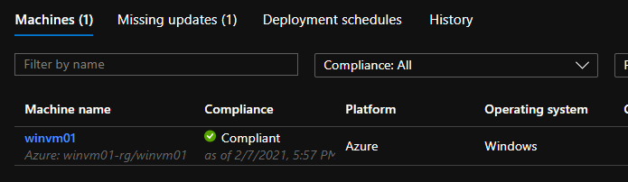
Azure Update Management
Uses Log Analytics and Azure Automation
Configures Guest VM’s running as Hybrid Workers
Must install Update Management Solution on Log Analytics
Then link Automation account and Log Analytics Workspace
Guest VM’s need to have Log Analytics Agent installed
Schedules coming in Terraform soon!
azurerm_automation update management
plan {
publisher = "Microsoft"
product = "OMSGallery/Updates"
}
}
resource "azurerm_automation_account" "aaa" {
name = "aaa-prod-we"
location = azurerm_resource_group.mainrg.location
resource_group_name = azurerm_resource_group.mainrg.name
sku_name = "Basic"
tags = {
environment = "development"
}
}
resource "azurerm_log_analytics_linked_service" "aaa-la-link" {
resource_group_name = azurerm_resource_group.mainrg.name
workspace_id = azurerm_log_analytics_workspace.mainrg-la.id
read_access_id = azurerm_automation_account.aaa.id
}

Slide 24
Azure VM Guest Security
Boot Diagnostics
Install Antimalware Extension
Install Antimalware Solution on LA first
Update Management
By Update Management
Or by Platform
az feature register -n InGuestAutoPatchVMPreview --namespace Microsoft.Compute.
Install VM Insight
Apply VM Backup
Backup Center
(Supports tag-based backup) in Preview - Policy
resource "azurerm_windows_virtual_machine" "winvm01-vm" {
name = "winvm01"
resource_group_name = azurerm_resource_group.winvm01.name
location = azurerm_resource_group.winvm01.location
size = "Standard_F2"
boot_diagnostics {} ## Sets Boot Diagnostics using Managed
patch_mode = "AutomaticByPlatform” ##Default to ByOS
plan { ## Defined on Log Analytics Workspace Solutions
publisher = "Microsoft"
product = "OMSGallery/AntiMalware"
}
plan {
publisher = "Microsoft"
product = "OMSGallery/VMInsights"
}
resource "azurerm_backup_protected_vm" "vm1" {
resource_group_name = azurerm_resource_group.rgrv01.name
recovery_vault_name = azurerm_recovery_services_vault.arsv.name
source_vm_id = azurerm_windows_virtual_machine.winvm01-vm.id
backup_policy_id = azurerm_backup_policy_vm.bp01.id
}

Slide 25
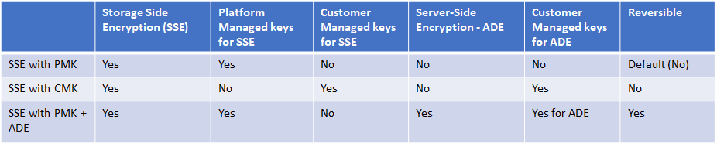
Azure Storage + Disk Encryption
Provides different ways to encrypt data
At-Rest or Disk based
SSE (At-rest) is default
SSE + CMK cannot be used with ADE
Disk Encryption is not availble for VM’s without temp disk
Using in-guest encryption (example bitlocker)
Requires KeyVault configured

Slide 26
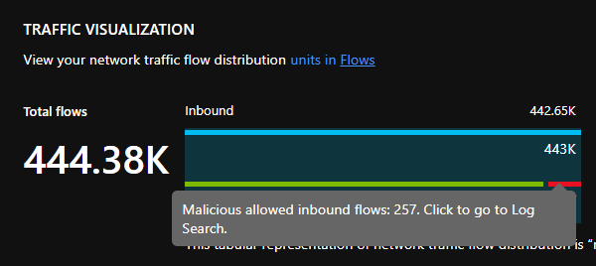
Azure Public Services
Network Flow Logs appled on NSG level
Should be enabled for Public Services
Enabled together with Network Watcher and Traffic Analytics
Integrated into Log Analytics
resource "azurerm_network_watcher_flow_log" "nwfl" {
network_watcher_name = azurerm_network_watcher.nw.name
resource_group_name = azurerm_resource_group.vnetprodrg.name
network_security_group_id = azurerm_network_security_group.vnetprod-nsg.id
storage_account_id = azurerm_storage_account.sa-we.id
enabled = true
retention_policy {
enabled = true
days = 7
}
traffic_analytics {
enabled = true
workspace_id = azurerm_log_analytics_workspace.mainrg-la.workspace_id
workspace_region = azurerm_log_analytics_workspace.mainrg-la.location
workspace_resource_id = azurerm_log_analytics_workspace.mainrg-la.id
interval_in_minutes = 10
}
}

Slide 27
Azure AG Web Application Firewall
Web Application Firewall + Load Balancing
Private or Public Endpoints
Can define custom file upload and HTTP request size
Prebuilt OWASP Rules or custom rules
Geo restrictions as well
Prebuilt rules on Bot Protection
Detection or Block
Custom SSL/TLS Policies
Remember v2 SKU

Slide 28
AAG WAF – Custom Rules
Defines rules to Allow/Block/Log
Match variable
RemoteAddr RequestMethod
QueryString
PostArgs
RequestUri/Headers/Body/Cookies
Operator
Example: GeoMatch (yes case sensitive)
Match Values
Action
resource "azurerm_web_application_firewall_policy" "aagwaf" {
name = "example-wafpolicy"
resource_group_name = azurerm_resource_group.example.name
location = azurerm_resource_group.example.location
custom_rules {
name = "block_US_traffic"
priority = 10
rule_type = "MatchRule"
match_conditions {
match_variables {
variable_name = "RemoteAddr"
}
operator = "GeoMatch"
negation_condition = false
match_values = ["US"]
}
action = "Block"
}

Slide 29
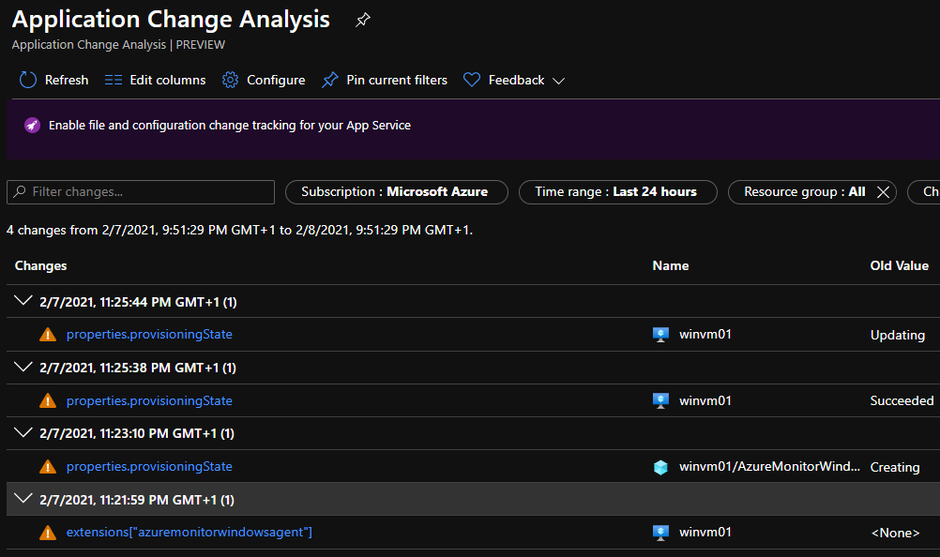
Azure Resource Graph
Azure Resource Graph is a way to query Azure inventory
Can be used to show change history on ARM objects
Register-AzResourceProvider -ProviderNamespace "Microsoft.ChangeAnalysis"
Supported for: VM’s, App Services, AKS, Functions, Networking, Storage
Kusto based queries
Easily way to find
Azure Security Score
Find list of Public IP addresses
Find non-attached disks
Advisor recommendations
PowerShell
az graph query -q "advisorresources
| where type == 'microsoft.advisor/recommendations’
| where properties.category == 'Cost’
| extend resources = tostring(properties.resourceMetadata.resourceId), savings = todouble(properties.extendedProperties.savingsAmount), solution = tostring(properties.shortDescription.solution), currency = tostring(properties.extendedProperties.savingsCurrency) | summarize dcount(resources), bin(sum(savings), 0.01) by solution, currency | project solution, dcount_resources, sum_savings, currency | order by sum_savings desc"

Slide 30
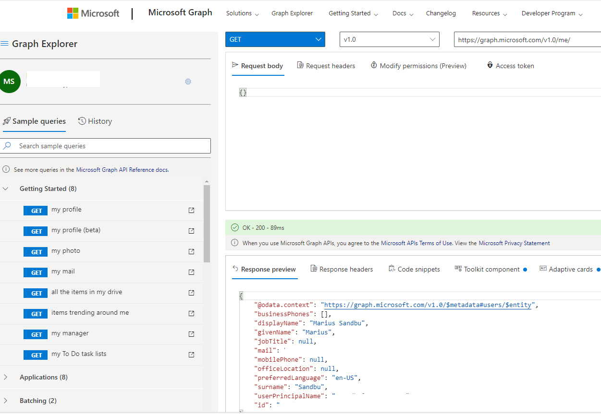
Working with the Graph API & M365
Graph API has two endpoints - v1 or beta endpoint
Rest API or PowerShell
Graph Explorer - Microsoft Graph
Can Switch between endpoints: Select-MgProfile -Name "beta"
Connect-MgGraph -Scopes "User.Read.All","Group.ReadWrite.All","SecurityEvents.ReadWrite.All","Policy.ReadWrite.ConditionalAccess","Policy.Read.All","Directory.Read.All","Agreement.Read.All","Application.Read.All"
Get-Command -Module Microsoft.Graph.Security
Get-Command –Module Microsoft.Graph.Identity.SignIns
Not all M365 products are available trough the Graph API

Slide 31
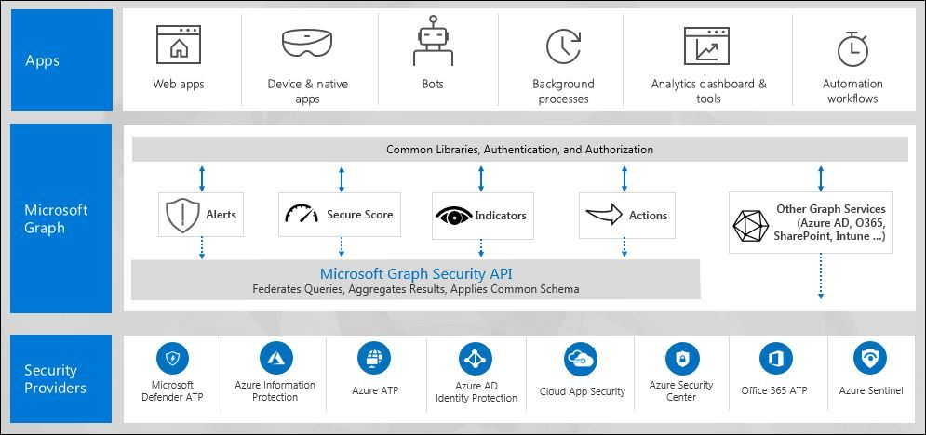
Working with the Graph API & M365
Security Graph API surfaces alerts from the different Security services in Azure and M365
Supported providers:
Azure Defender
Azure Identity Protection
Microsoft Cloud App Security
Microsoft Defender
Azure ATP
Azure Sentinel
Azure Information Protection
Microsoft 365
Not working in the current Graph PowerShell cmdlet...
Use the Security Graph PowerShell Module or API → http://bit.ly/3oYBYVB
Logic App Playbook → http://bit.ly/3rvILrw

Slide 32

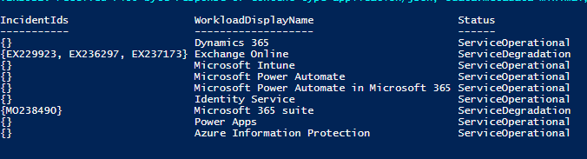
Office 365 Service Communication
Allows you to collect status of Office 365 services (Requires ServiceHealth.Read)
/Services – Get list of Services
/CurrentStatus
/HistoricalStatus
/Messages (Service Incident, Planned Maintance or Message Center)
$TenantID = ‘tenantid' #The Directory ID from Azure AD
$ClientID = ‘clientid' #The Application ID of the registered app
$ClientSecret = ‘clientsecret' #The secret key of the registered app
# ------------------------------------------------------
$body = @{grant_type="client_credentials";resource="https://manage.office.com";client_id=$ClientID;client_secret=$ClientSecret }
$oauth = Invoke-RestMethod -Method Post -Uri "https://login.microsoftonline.com/$($tenantID)/oauth2/token?api-version=1.0" -Body $body
$token = @{'Authorization' = "$($oauth.token_type) $($oauth.access_token)" }
# ------------------------------------------------------
$ServiceStatus = Invoke-RestMethod -Uri "https://manage.office.com/api/v1.0/$($TenantID)/ServiceComms/CurrentStatus" -Headers $token -Method Get -Verbose
$ServiceStatus.Value | Format-Table IncidentIDs,WorkloadDisplayName,Status

Slide 33
Microsoft Defender ATP
Not covered as part of Graph API uses custom API
No official PowerShell module yet
Community Module → alexverboon/PSMDATP:
Only Security Alerts from Defender will appear in Security Graph API
For better performance change API to the closest API
api-us.securitycenter.microsoft.com
api-eu.securitycenter.microsoft.com
api-uk.securitycenter.microsoft.com
$tenantId = '' # Paste your own tenant ID here
$appId = '' # Paste your own app ID here
$appSecret = ' ' # Paste your own app secret here
$resourceAppIdUri = 'https://api.securitycenter.microsoft.com'
$oAuthUri = "https://login.microsoftonline.com/$TenantId/oauth2/token"
$body = [Ordered] @{
resource = "$resourceAppIdUri"
client_id = "$appId"
client_secret = "$appSecret"
grant_type = 'client_credentials'
}
$response = Invoke-RestMethod -Method Post -Uri $oAuthUri -Body $body -ErrorAction Stop
$aadToken = $response.access_token
$query = 'RegistryEvents | limit 10' # Paste your own query here
$url = "https://api.securitycenter.microsoft.com/api/advancedqueries/run"
$headers = @{
'Content-Type' = 'application/json'
Accept = 'application/json'
Authorization = "Bearer $aadToken"
}
$body = ConvertTo-Json -InputObject @{ 'Query' = $query }
$webResponse = Invoke-WebRequest -Method Post -Uri $url -Headers $headers -Body $body -ErrorAction Stop
$response = $webResponse | ConvertFrom-Json
$results = $response.Results
$schema = $response.Schema

Slide 34
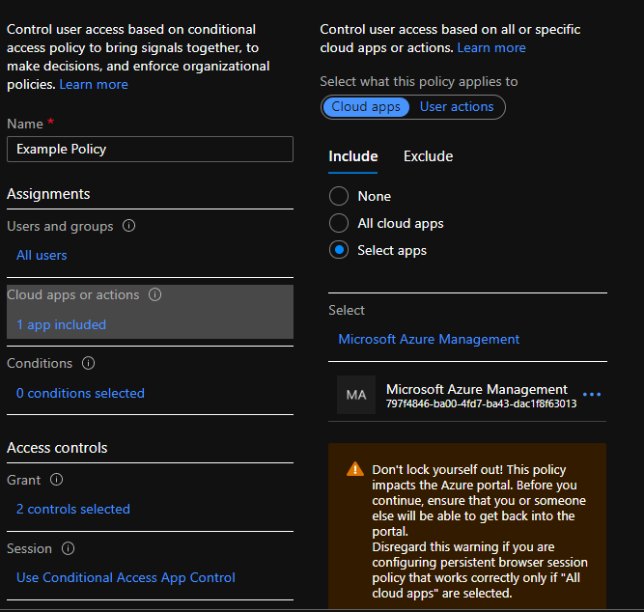
Azure Active Directory Conditional Access
GrantControls
MFA
CompliantDevice
termsofuse
New-MgIdentityConditionalAccessPolicy -DisplayName ’Example Policy' `
-GrantControls @{ `
BuiltInControls = @('mfa'); `
Operator = 'OR' `
} `
-State 'disabled' `
-Conditions @{ `
Applications = @{includeApplications = 'none'}; `
Users = @{includeUsers = 'none'} `
}
SessionControls
Cloudappsecurity
Persistentbrowser
Signinfrequency
applicationenforcedrestrictions
Applications
IncludeApplications
AppID
Excludeapplications
Includeuseractions
Conditions
userRiskLevels
Signinrisklevels
clientappTypes
Platforms
Locations
Applications
users

Slide 35
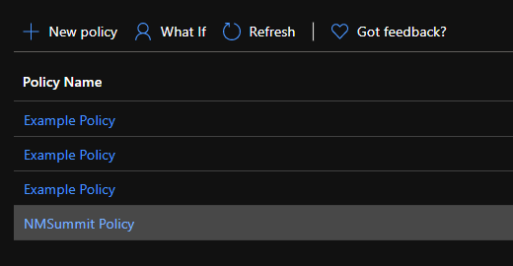
Azure Active Directory CA - Example
Remember don’t run New script… multiple times
You can have multiple CA’s with the same name
They have a unique ID which is created
Update-MgIdentityConditionalAccessPolicy –ConditionalAccessPolicyId a48817cf-c2dc-45d3-9f33-a5797c527e92 -DisplayName ’NMSummit Policy' `
-GrantControls @{ `
BuiltInControls = @('mfa','compliantDevice'); `
Operator = 'OR' `
} `
-State 'disabled' `
-Conditions @{ `
Applications = @{includeApplications = '797f4846-ba00-4fd7-ba43-dac1f8f63013'}; `
Users = @{includeUsers = 'none'} `
}

Slide 36
Summary
Big ecosystem of security & governance services
Not a single way to manage all the products under the same API set
Some services can be defined as code as state some used for monitoring/needs
Much is becoming available in Graph API (But still missing some products)
Custom API available
Having Security/Monitoring/Governance as code makes it easier to
Have it documented
Makes changes easier
Change Control
Hopefully consolidated PowerShell cmdlets will make it easier to standardize ☺

Slide 37
Thank you!
MSEndPointMgr.com#MSEndPointMgr
System Center User Group
Finland
#SCUGFI
System Center User Group Denmark
#SCUGDK
System Center User Group Sweden
#SCUGSE
Modern Management User Group Norway
#MMUGNO

