Slide 1

Using Azure Sentinel to catch the bad guys
Marius Sandbu
Guild Lead Public Cloud @ TietoEVRY
@msandbu
Email → msandbu@gmail.com
Blog → https://msandbu.org
Code & Script repo for this session → https://bit.ly/msandbunv

Slide 2
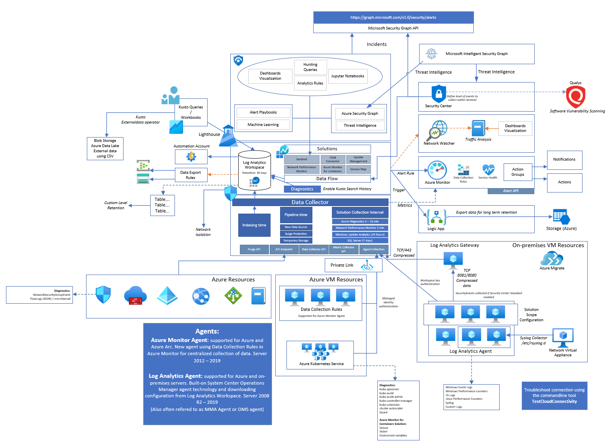

What I’m going to cover
With this (hopefully...)
Want this Visio? Github!
From getting in here
How to stop people in hoodies

Slide 3
Agenda
The threat landscape
Understading the Microsoft Security ecosystem
Deep-dive into the components
Detection rules vs Threat Intelligence
Best-pratices when setting up Sentinel
Automation of setting up Sentinel and rules
Automation of setting up detection and response rules

Slide 4
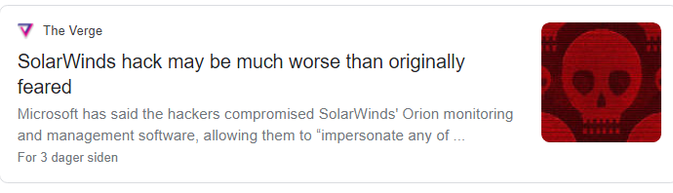
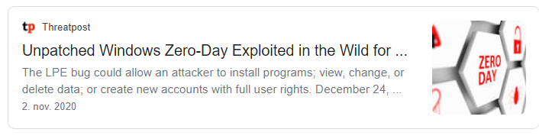
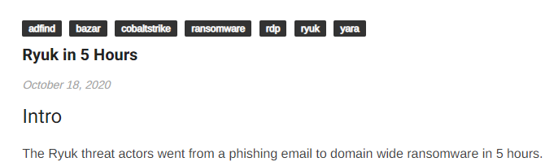
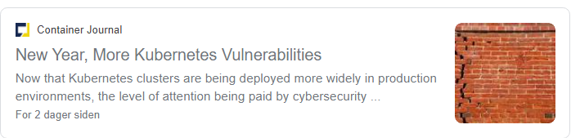
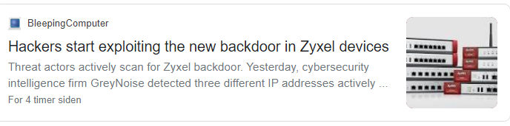
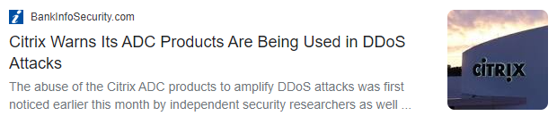
The threat landscape

Slide 5
Ransomware on the rise
Ransomware attacks are happening every 11 seconds
So approx ~245 attacks during this session
Attackers using a combination of phising, vulnerabilities & reusing credentials to get access
More big severity vulnerabilities in Q3 2020 compared to entire 2019
More incentives for fiding bugs/vulnerabilities
Unfortunately Ransomware is big buisness 😐 😐
Ransomware 2.0 - Data protection more important then ever!

Slide 6
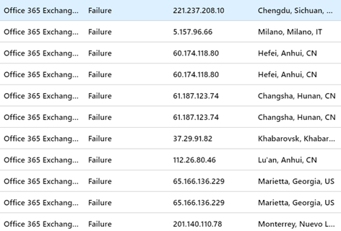
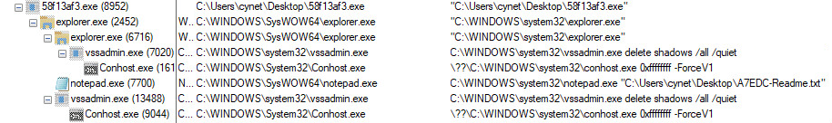
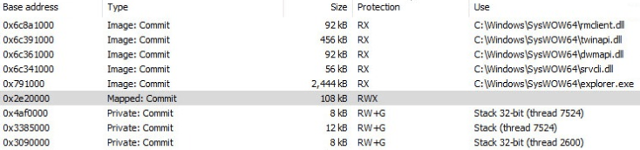
Example attack - Netwalker
Compromised user account using brute-force attack (legacy auth)
Using compromised user to send org-wide email with attachment

Slide 7
Example attack - Netwalker
Machine Y – Compromised
Using a range of different tools to do credential dump and assessment
Procdump, Mimikatz, ADFind.
Utilized Zerologon vulnerability against domain controllers
Compromised domain controllers and used for setting up C2 process
PowerShell, PSEXEC and Group Policy used for distrubution of payload
Infected numerous servers and endpoints

Slide 8
So where does it start?
Phising
Over 100,000 NEW domains daily setup for use to suspicious traffic
Phising campaign, C&C domains
End-goal: Compromise endpoint used for lateral movement
Exploiting vulnerable publicly available services
VPN / RDP / VDI / Web Application
Last year: vulnerable Citrix, Microsoft RDP, Pulse VPN, Fortinet
End-user identity compromised
Identity brute-force
Credential Stuffing

Slide 9
Great...so where to look for clues?
Logs, logs and Logs
Azure AD, Office 365, Windows Security Event Logs, Syslog
Network Traffic
Example: Flow Logs in Microsoft Azure
Vulnerability Detection & processes
Azure Defender w/Qualys
Azure Update Management
Azure Defender and EDR
Digging into the logs or Threat Intelligence
Intelligent Security Graph API

Slide 10
Some Log Sources
Audit Item | Category | Enabled by Default | Retention
User Activity | Microsoft 365 Security | No | 90 Days (1 year for E5)
Admin Activity | Microsoft 365 Security | No | 90 Days (1 year for E5)
Mailbox Audit | Exchange Online | Yes | 90 Days
Sign-In Activity | Azure AD | Yes | 30 Days (AAD P1)
Users at Risk | Azure AD | Yes | 7 Days (30 Days, P1/P2)
Risky Sign-ins | Azure AD | Yes | 7 Days (30 Days, P1/P2)
Azure MFA Usage | Azure AD | Yes | 30 Days
Directory Audit | Azure AD | Yes | 7 Days (30 Days, P1/P2)
Intune Activity Log | Intune | Yes | 1 Year (Graph API)

Slide 11
Some other Log Sources
Audit Item | Category | Enabled by Default | Retention
Azure Resource Manager | Azure | Yes | 30 Days
Network Security Group Flow Logs | Azure | No | Depending on Configuration
Azure Diagnostics Logs | Azure | No | Depending on Configuration
Azure Application Insight | Azure | No | Depending on Configuration
VM Event Logs | OS | Yes | Size defined in Group Policy
Custom Logs | OS | N/A | Application specific logs
Azure Security Center | Azure | No (Cost per host/PaaS) | Depending on Log Analytics
SaaS Usage | N/A | No | Requires Cloud App Discovery
Custom Sources** | N/A | No | Depending on Configuration

Slide 12
Log Sources in Azure
Different services in Azure have its own log structure and format
Logging can be configured using Diagnostics settings in Azure
Data can be exported to
Log Analytics (w/Sentinel)
Event Hub
Storage Account
NOTE: Other SIEM tools often integrate with Event Hub to fetch logs and import

Slide 13
Log Analytics / Monitor / Sentinel
Log Analytics is a log collection service
Data and processing within a region
Default retention 30 days (for entire database)
Also used for Azure Monitor
Data stored in different tables
Depending on data source
Can collect «any» type of data
Different time intervals for each solution
Sentinel is an addon solution to Log Analytics
Log Analytics has a lot of different solutions
Provides data collection rules

Slide 14
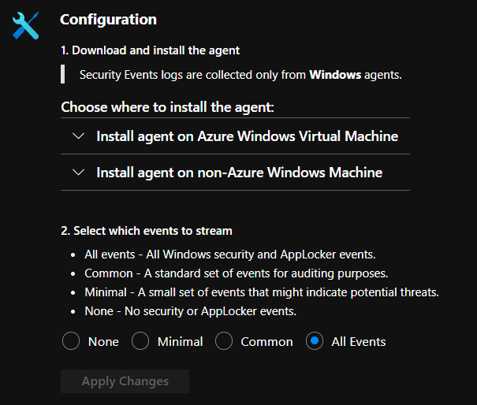
Log Analytics
Can collect logs/metrics from native services
Azure AD, Microsoft 365, Microsoft Azure
OS Events, Syslog
Change tracking
(NOT Security Events from VM’s by default)
Data collection enhanced by solutions
Two types of Agents
Log Analytics Agent (Based upon SCOM agent)
MMA Agent (New way to define data collection)
Retention is defined on Workspace
Can also be defined custom retention per table
Changing log retention on a specific table in Log Analytics

Slide 15
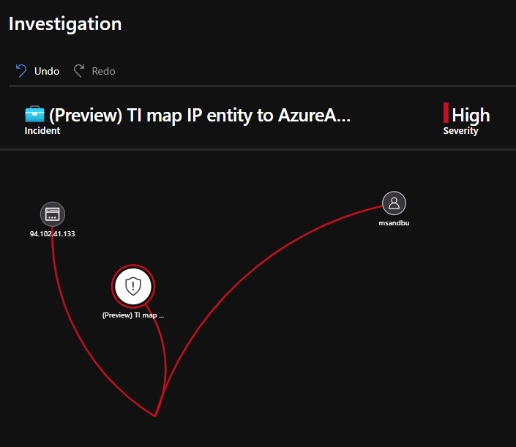
Azure Sentinel
Sentinel Provides SIEM and SOAR capabilities
Analytics
Scheduled Queries (Kusto based)
Microsoft Security predefined
Fusion (Detecting Multistage attacks)
Hunting Queries
Playbooks (Automated response)
Case Management
Threat Intelligence
Analytics Rule & Incident Handling

Slide 16
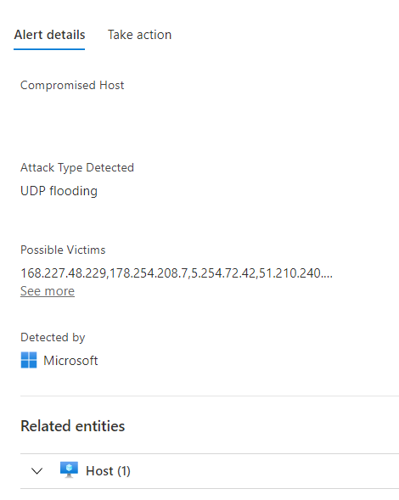
Azure Sentinel vs Azure Defender
Azure Defender
Threat Intelligence – Intelligent Security Graph API
Many predefined Security Alerts / Best-pratices
3.party vulnerability assessment (Qualys)
IPFIX based samples enriched with Security Graph
PaaS services Threat Protection (ARM, DNS, App Services)
EDR for virtual machines
File integrity Monitoring
Fileless attack detection
Monitors for changes to Registry, Processes, Files
Monitors for running processes, network communication

Slide 17
Azure Sentinel vs Azure Defender
Sentinel (Log Analytics)
Performance Metrics
Event Logs
Process Events
Azure Diagnostics Logs
Custom Logs
Application Logs
Syslog
Microsoft Defender ATP
Registry Events
Process Events
Network Events
File Events
Software Inventory
Vulnerability Scanning (-Windows Server)

Slide 18
Setting up Azure Sentinel
Create a Log Analytics Workspace
Create a Sentinel Workspace
Connect Data Sources
Create Analytics Queries
Create Automation Rules
Amazon
Azure AD
Azure Activity
Azure Security Center
Microsoft 365
Citrix
F5
Cisco
VMware
Example: Looking for failed Logon attempts against Azure Active Directory and Active Directory

Slide 19
Building Sentinel Automated
Easily be setup using (insert flavour IaC)
Setup Log Analytics & define solution
Quick script example using Terraform
Setup resource group
Setup Log analytics
Install Sentinel solution
Log Analytics workspace name needs to be unique
Solution block can also be used to install other solutions
Terraform is missing data connectors ☹
Can be done using PowerShell
Install-Module -Name Az.SecurityInsights
New-AzSentinelDataConnector
resource "azurerm_resource_group" "rgcore" {
name = "rg-example-management"
location = "westeurope"
}
resource "azurerm_log_analytics_workspace" "rgcore-la" {
name = "la-example-utv-weu"
location = "${azurerm_resource_group.rgcore.location}"
resource_group_name = "${azurerm_resource_group.rgcore.name}"
sku = "PerGB2018"
retention_in_days = 90
}
resource "azurerm_log_analytics_solution" "la-opf-solution-sentinel" {
solution_name = "SecurityInsights"
location = "${azurerm_resource_group.rgcore.location}"
resource_group_name = "${azurerm_resource_group.rgcore.name}"
workspace_resource_id = "${azurerm_log_analytics_workspace.rgcore-la.id}"
workspace_name = "${azurerm_log_analytics_workspace.rgcore-la.name}"
plan {
publisher = "Microsoft"
product = "OMSGallery/SecurityInsights"
}
}

Slide 20
Understanding what data is collected
To see the full picture you need different datasets
Example:
Azure Defender
Flow Logs NSG
VMConnection – Service Map
Event Logs
Defender: Malicious traffic from 8.8.8.8
Flow Logs: Traffic from 8.8.8.8 going to IP 1.1.1.1 on Port 3389 and was allowed
VMConnect: svchost.exe accepted connection on port 3389 currently established
Event Logs: Successful logged on AD user with username domain\administrator from IP 8.8.8.8

Slide 21
Building Sentinel Rules Automated
Analytics Scheduled rules are based upon KQL (Kusto)
Read-only query rules
Specify table and conditions
Can also look outside dataset with Externaldata operator
Analytics rules based upon either
Example:
Microsoft prebuilt incident detection
Against Microsoft products
Azure AD, Azure ATP, Security Center, MCAS, IoT Defender
Example:
Scheduled Analytics Rules
Looking at new deployments in AzureActivity log
resource "azurerm_sentinel_alert_rule_ms_security_incident" "azsen_mcas" {
name = "mcas-incident-alert-rule"
log_analytics_workspace_id = azurerm_log_analytics_workspace.mainrg-la.id
product_filter = "Microsoft Cloud App Security"
display_name = "MCAS Incidents"
severity_filter = ["High"]
}
resource "azurerm_sentinel_alert_rule_scheduled" "alert_ad_audit" {
name = "alert_ad_audit"
log_analytics_workspace_id = azurerm_log_analytics_workspace.mainrg-la.id
display_name = "Check AD Audit Logs for Failed Logon"
severity = "High"
query = <<QUERY
AzureActivity |
where OperationName == "Create or Update Virtual Machine" or OperationName =="Create Deployment" |
where ActivityStatus == "Succeeded" |
make-series dcount(ResourceId) default=0 on EventSubmissionTimestamp in range(ago(7d), now(), 1d) by Caller
QUERY
}

Slide 22
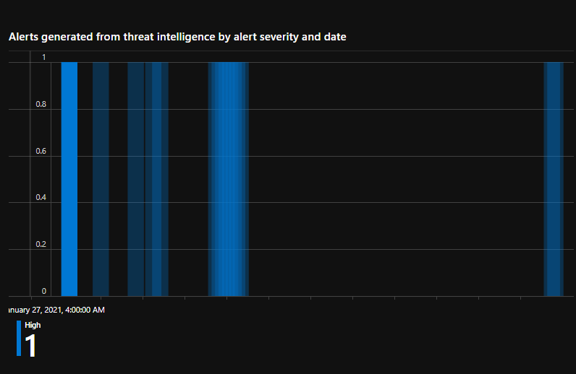
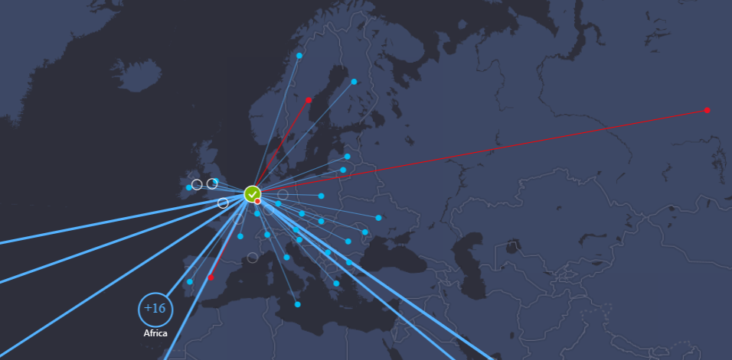
Other methods to look at data
Threat Intelligence
Supported 3.party provider
Supported TAXII server
(Preview) Custom indicators (domain, file, ip, url)
Threat Intelligence indicators from Microsoft
VM Connection
NSG Flow Logs (Traffic Analysis)
Azure Security Center
Azure Firewall

Slide 23
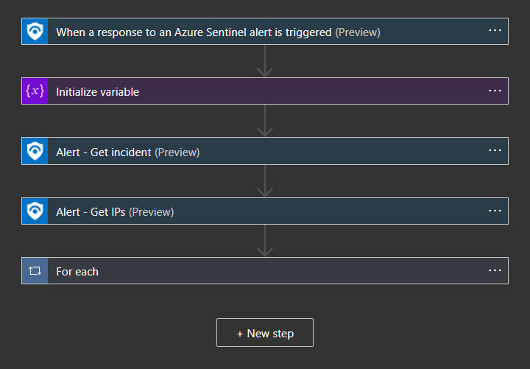
Building Automated response
Logic Apps used for Automated response
Can also be run manually based upon incident
Can be used for
Automatic remediation
Enriching the data
Notification
Or a mix of everything
Automatic or User interaction based
One alert can trigger multiple playbooks
Playbooks editor can now be created in VS Code
Run Playbook(s)
Analytics Rule
Threshold reached
Incident Created
Run Playbook(s)

Slide 24
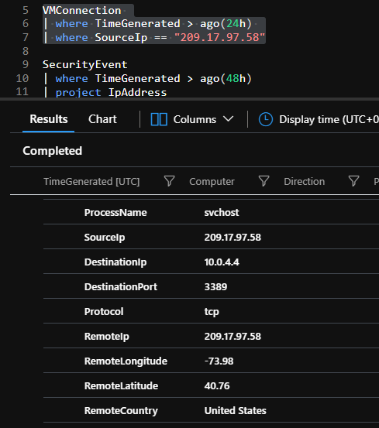
Example Kusto Queries
AzureNetworkAnalytics_CL
| where SubType_s == 'FlowLog' and FlowType_s == 'MaliciousFlow'
| where SrcIP_s == "209.17.97.58"
VMConnection
| where SourceIp == "209.17.97.58"
SecurityEvent
| where TimeGenerated > ago(48h)
| project IpAddress
| summarize count() by IpAddress
CheatSheet: bit.ly/azscheat

Slide 25
Example hunting queries
Define Source table
let timeRange=ago(14d);
SigninLogs
| where TimeGenerated >= timeRange
| where AppDisplayName contains "Azure Portal"
// 50126 - Invalid username or password, or invalid on-premises username or password.
// 50020? - The user doesn't exist in the tenant.
| where ResultType in ( "50126" , "50020")
| extend OS = DeviceDetail.operatingSystem, Browser = DeviceDetail.browser
| extend StatusCode = tostring(Status.errorCode), StatusDetails = tostring(Status.additionalDetails)
| extend State = tostring(LocationDetails.state), City = tostring(LocationDetails.city)
| summarize StartTimeUtc = min(TimeGenerated), EndTimeUtc = max(TimeGenerated), IPAddresses = makeset(IPAddress), DistinctIPCount = dcount(IPAddress),
makeset(OS), makeset(Browser), makeset(City), AttemptCount = count()
by UserDisplayName, UserPrincipalName, AppDisplayName, ResultType, ResultDescription, StatusCode, StatusDetails, Location, State
| extend timestamp = StartTimeUtc, AccountCustomEntity = UserPrincipalName
| sort by AttemptCount
Filter based upon AppDisplayName
Filter based upon EventID
Filter based upon EventID

Slide 26
Example analytics Queries – use of privileged AD
Create defined list
let List = datatable(VIPUser:string, Domain:string) ["ADMIN", «nvsummit.local", "Administrator", «nvsummit", "msandbu", «nvsummit.LOCAL"];
let timeframe = 10d;
List | extend Account = strcat(Domain,"\\",VIPUser) | join kind= inner (
SecurityEvent
| where TimeGenerated > ago(timeframe)
| where EventID == "4625"
| where AccountType == "User"
| where LogonType == "2" or LogonType == "3"
) on Account
| summarize StartTimeUtc = min(TimeGenerated), EndTimeUtc = max(TimeGenerated), FailedVIPLogons = count() by LogonType, Account
| where FailedVIPLogons >= 1
| extend timestamp = StartTimeUtc, AccountCustomEntity = Account
Define data source
Filter based upon EventID

Slide 27
Example hunting queries - Externaldata
Externaldata Operator
let BlockList = (externaldata(ip:string)
[@"https://rules.emergingthreats.net/blockrules/compromised-ips.txt",
@"https://raw.githubusercontent.com/stamparm/ipsum/master/levels/5.txt",
@"https://cinsscore.com/list/ci-badguys.txt",
@"https://infosec.cert-pa.it/analyze/listip.txt",
@"https://feodotracker.abuse.ch/downloads/ipblocklist_recommended.txt"
]
with(format="csv")
| where ip matches regex "(^(25[0-5]|2[0-4][0-9]|[01]?[0-9][0-9]?)\\.(25[0-5]|2[0-4][0-9]|[01]?[0-9][0-9]?)\\.(25[0-5]|2[0-4][0-9]|[01]?[0-9][0-9]?)\\.(25[0-5]|2[0-4][0-9]|[01]?[0-9][0-9]?)$)"
| distinct ip
);
SigninLogs
| where IPAddress in (BlockList)
| where ResultType == "0"
Data Sources - CSV
Filter based upon Regex
Data Source and filter based upon data

Slide 28
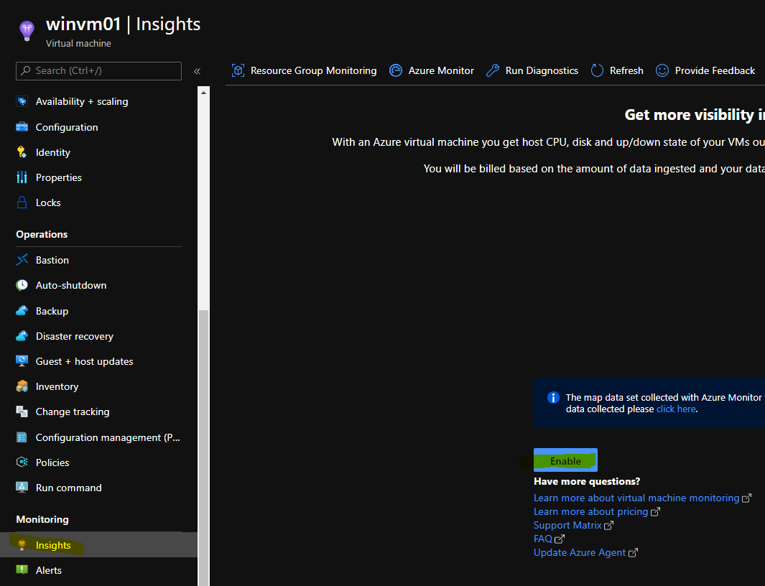
Example hunting queries – Initial Access
VMProcess
| where ExecutableName in ("lsass", "powershell", "cmd", "rundll32", "control", "wscript", "javaw", "csc", "regsvr32", "reg", "certutil", "bitsadmin", "schtasks", "wmic", "eqnedt32", "msiexec", "cmstp", "mshta", "hh", "curl", "installutil", "regsvcs/regasm", "at", "msbuild", "sc", "cscript", "msxsl", "runonce")
Data Source
Looking at certain processes
Requires VM Insight Enabled

Slide 29
So let’s look at some suspicious traffic
Case: Have a simple VM called «Honeypot» in Azure
Collecting NSG Flow Logs
Collecting VMConnection using Service Map
Collecting Security Event Logs
Is behaving wierd and getting complaints from end-users
Action: Inspect log traffic, investigating a case and apply remediation
Want to setup a similar setup? Example here →
https://github.com/msandbu/nvsummit

Slide 30
Some best-pratices tips for design
As few Log Analytics Workspaces as possible = preferably one
Multi-homing not recommended and not support for most features
Unless fleet of VM’s that can use Data Collection Rules
Deploy Workspaces within regions that are in use
Deployment of VM agents using Policy or Azure Defender
ASC or use Built-in Microsoft Policy
It if is not logging, how do you know it happened?
Diagnostics should be enabled for all resources
Define table-level retention
You don’t need all data stored for 90 days (or more)
Export data long term to Azure Storage
Define alerts as code – Easier maintance and adding new rules
Look at spikes at log data sources (often)
search "*" | summarize count() by $table | sort by count_ desc

Slide 31
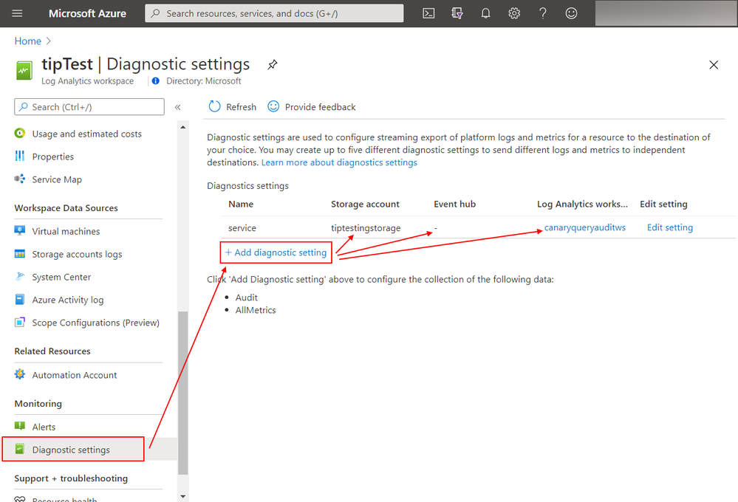
Some best-pratices tips for Implementation
Integrate Security Graph API with alerting/ITSM system
For Windows Domains look at current logging Group Policy and setup according to best-pratice
Configure Diagnotics on Log Analytics
Not kidding! Provides insight into who has run queries against the dataset
Collected into the LAQueryLogs table
Create table level-based access
"Actions": [
"Microsoft.OperationalInsights/workspaces/read",
"Microsoft.OperationalInsights/workspaces/query/read",
"Microsoft.OperationalInsights/workspaces/query/Heartbeat/read",
"Microsoft.OperationalInsights/workspaces/query/AzureActivity/read"
],

Slide 32
Other smart tricks
Looking at what table is collecting most data
search "*" | summarize count() by $table | sort by count_ desc
Look at how long latency delay is for data coming in
AzureDiagnostics | where TimeGenerated > ago(8h)
| extend E2EIngestionLatency = ingestion_time() - TimeGenerated
| extend AgentLatency = _TimeReceived - TimeGenerated
| summarize percentiles(E2EIngestionLatency,50,95), percentiles(AgentLatency,50,95)
by ResourceProvider
Setup Log Analytics Data export (export spesicifc tables to EventHub)
az monitor log-analytics workspace data-export create --resource-group test-export-rg
--workspace-name la-test-wrg --name ruleexport1 --tables Heartbeat --destination
/subscriptions/subid/resourceGroups/rg/providers/Microsoft.EventHub/namespaces/
eventhubnamespace/eventhubs/logexport
Using Log Analytics to notify on non-compliant resources
Azure Monitoring alerting rule to notify on non-compliant resources | Marius Sandbu (msandbu.org)
Pay attention to the updates!
Azure updates | Microsoft Azure

Slide 33
Thank you!
MSEndPointMgr.com#MSEndPointMgr
System Center User Group
Finland
#SCUGFI
System Center User Group Denmark
#SCUGDK
System Center User Group Sweden
#SCUGSE
Modern Management User Group Norway
#MMUGNO

