Slide 1
Project Presentation on
Stock Price Prediction By Sandeep Kumar Meena (11710147) Suraj Kumar Chaudhary (11710150) Ajay (11710173)
Under the Supervision of
Prof. Sanjay Jain

Slide 2
Introduction
Stock price prediction is one of the complex problem of Machine Learning.
Stock price is the value given for every share issued by a publicly traded company .
It reflects the company’s value which the public is willing to pay for a piece of the company
Stock price value can rise and fall , based on a variety of factors in the global landscape and within the company itself .
Stock price depends upon a no. of factors. But , in this project we tried to predict the closing value of a stock price.
We did the technical analysis of various approach for stock price prediction proposed in the past.
After learning about the available approaches for prediction we implemented them and compared their result using root mean square error as metrics .

Slide 3
Problem and Approach
Problem Statement:
The challenge of this project is to accurately predict the future closing value of the stock price of a company across a period of time.
Goal:
Explore stock prices.
Implement a basic model using Linear regression.
Implement other machine learning model like KNN and SVM .
Implement deep learning models like RNN and DNN.
Implement LSTM and then its improved version to increase the accuracy .
Compare the results of all the implemented models.
Performance Metrices:
For measuring performance of models we will be using Mean Squared Error(MSE) and Root Mean Squared Error(RMSE), which can be calculated as the difference between the predicted and actual closing price of the targeted stock price.

Slide 4
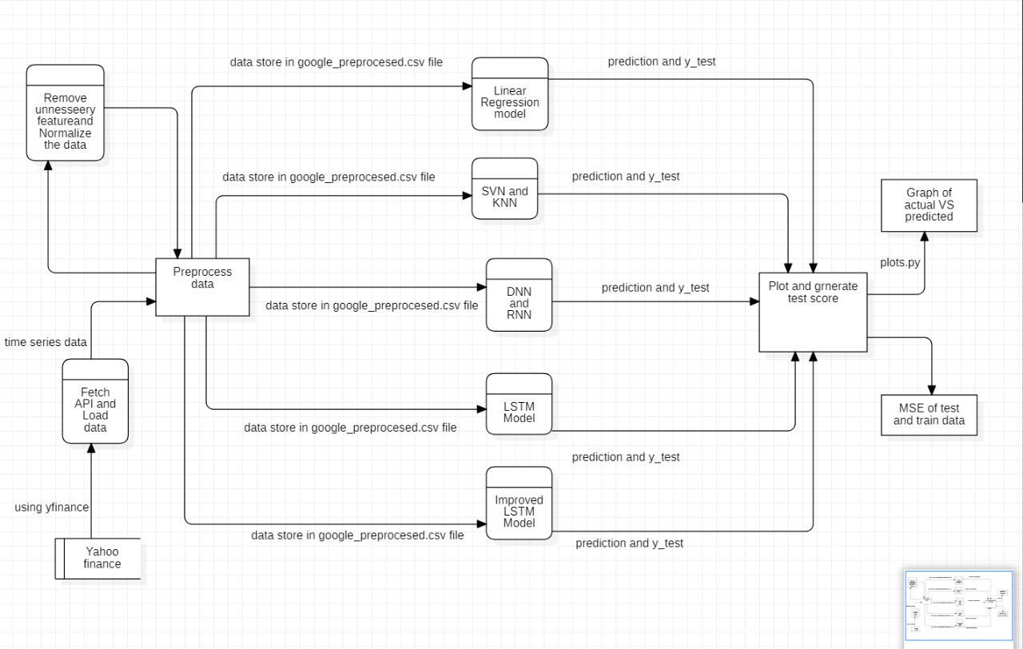
DFD

Slide 5
Feature Selection and Normalization
Date : Day on which the stock is traded
Open : Daily Opening Price
High : Highest price during the day
Low : Lowest price during the day
Close : Last trading price of the session
Volume : Number of shares traded
Date | Open | High | Low | Close | Volume
2009-05-01 | 196.777435 | 198.052643 | 195.043930 | 196.109940 | 4873599
2009-05-04 | 198.341568 | 200.448669 | 196.657883 | 20.239456 | 6430011
‘Date’ , ‘High’ and ‘Low’ attributes are dropped
Denormalized Dataset
Normalized Dataset
Open | Close | Volume
196.777435 | 196.109940 | 4873599
198.341568 | 202.39456 | 6430011
Open | Close | Volume
0.001400 | 0.001378 | 0.163537
0.002106 | 0.003225 | 0.215848
Data Normalization Using MinMaxScalar

Slide 6
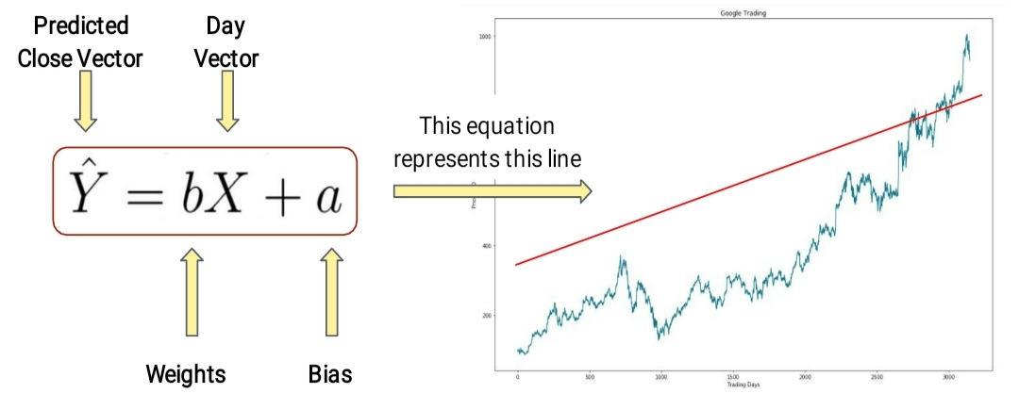
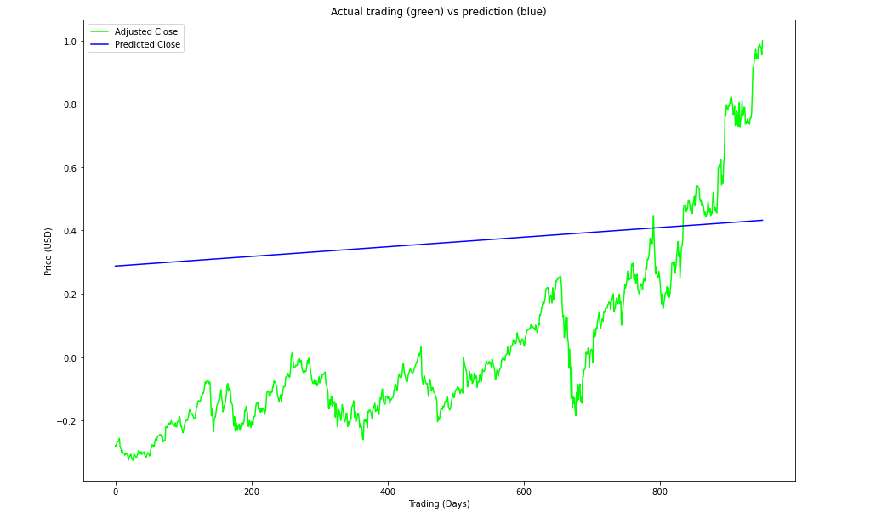
Linear Regression Model
Linear regression is used for predictive modelling to show the relationship between a scalar dependent variable “Y” ( i.e. ‘Close’ attribute ) and one or more independent variable “X” ( i.e. ‘ Trading day ‘ attribute ) .
RMSE for test data : 0.41140883

Slide 7
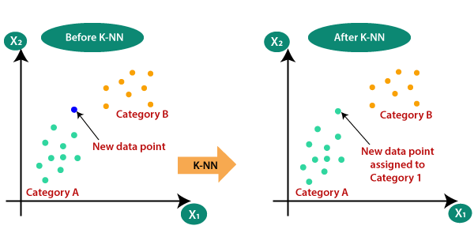
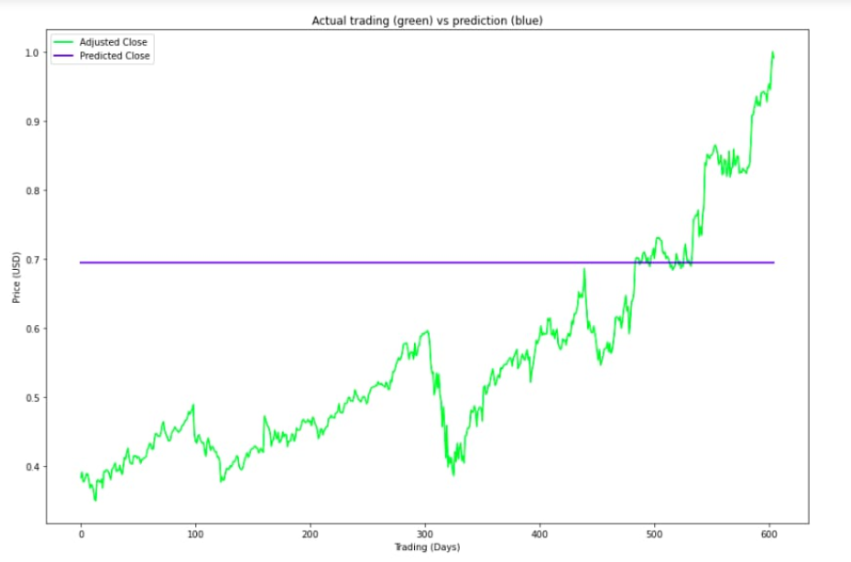
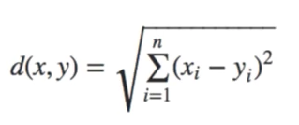
KNN
K – Nearest Neighbours is a lazy learning instance based regression algorithm .
New data point is calculated by taking average of ‘ K closest points ’ .
Euclidean distance is used as metric for calculating distance between points
Choosing Value of k :
Large K value minimise error rate but over smooth boundaries
Small k value consider only nearby points but will lead to noisy decision boundaries .
So , K = square root of no. of training samples lead to better results .
RMSE for test data: 0.23067884456887236

Slide 8
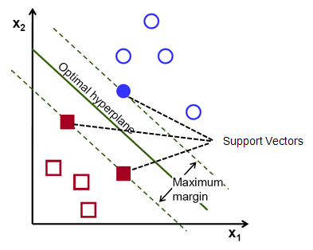
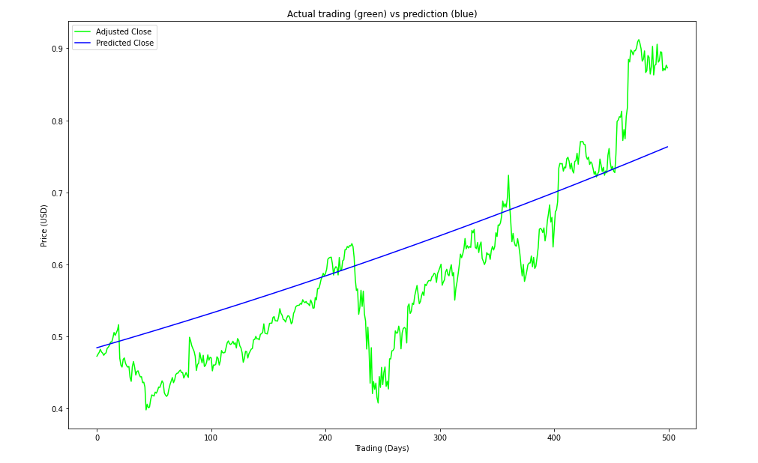
SVM
Support Vector Machine is a classifier which outputs an hyperplane which categorizes new data point.
It uses non linear mapping to convert training data points into higher dimension .
Decision Boundary is the optimal linear separating hyperplane which separates classes .
Margin is the perpendicular distance between closest data point ( Support Vector ) and the hyperplane .
Value of C
Large -> Overfitting
Small -> Underfitting
Gamma decides influence of hyperplane
Low Gamma -> Consider far points to hyperplane
High Gamma -> Consider close points to hyperplane
Kernels are mathematical function used for transforming data .
Support Vector Regression ( SVR ) : SVM used for regression
RMSE for test data: 0.6789937199116884

Slide 9
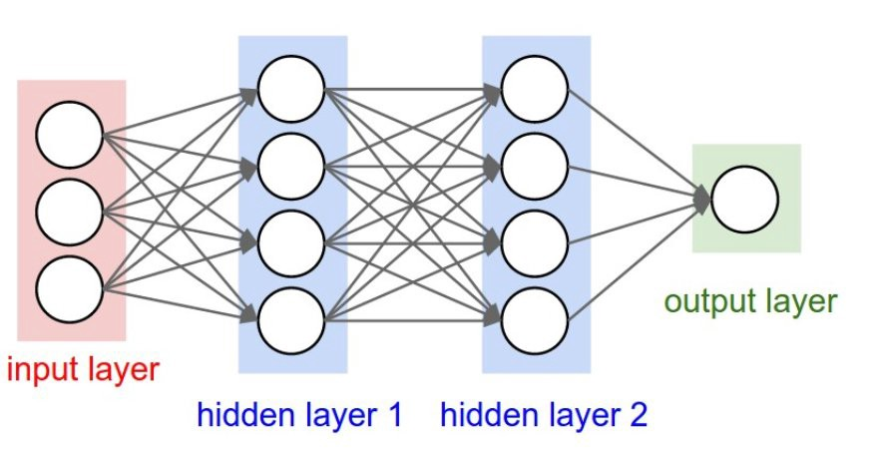
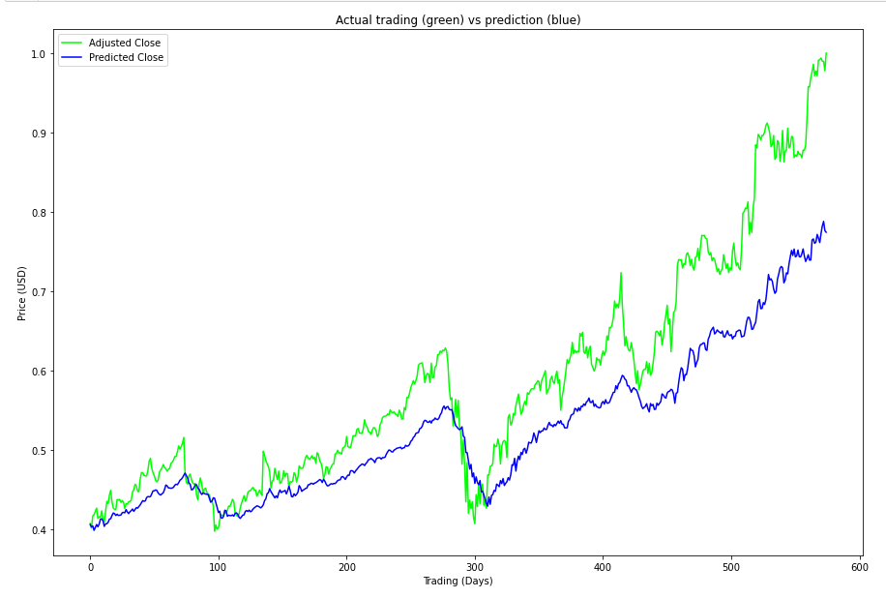
DNN
Deep Neural Networks are computing systems inspired by biological neurons to mimic the functionality of the human brain .
It consists of a large number of neurons which are divided into input , hidden and output layers .
Weight of neurons are initialised with some random values , and are multiplied with inputs and then passed through an activation function , the obtained value is passed to next layer and this process repeats until the output layer .
Error is calculated as the difference between the actual output and the predicted output .
This Error at the output layer is minimised by updating weights during the backpropagation phase .
RMSE for test data: 0.08

Slide 10
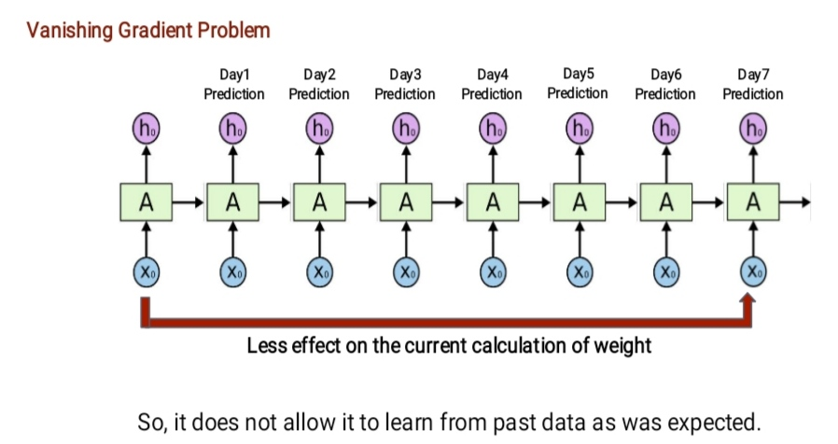
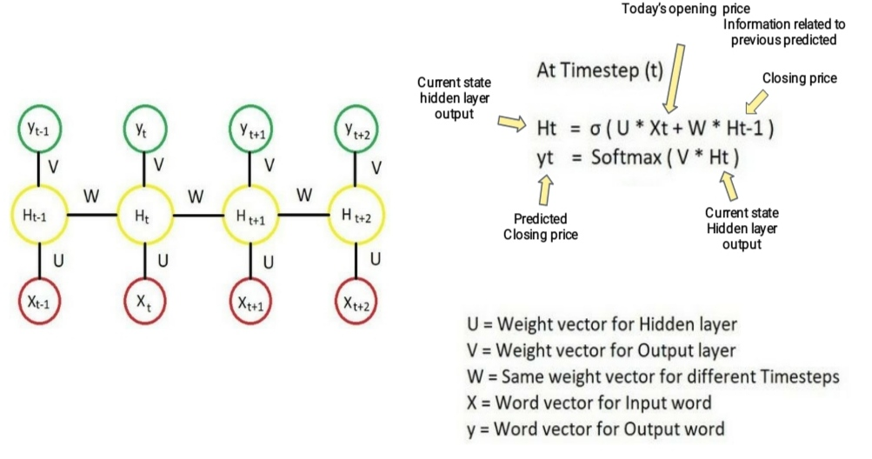
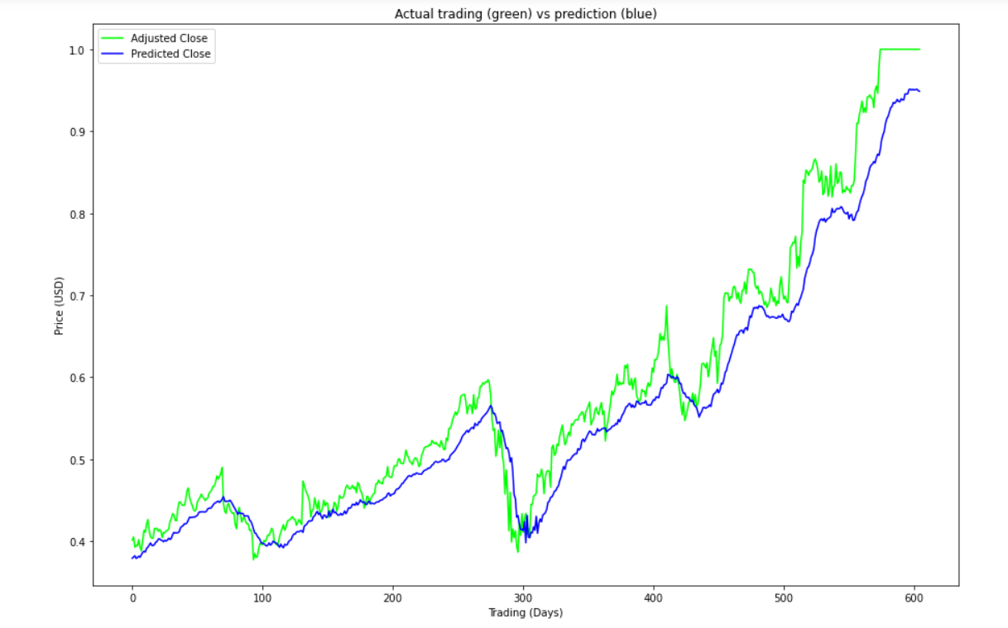
RNN
Recurrent Neural Network are a type of neural network where connection between nodes form a directed graph along a temporal sequence , which allows it to exhibit temporal dynamic behaviour .
Test: Root Mean Squared Error(RMSE): 0.04

Slide 11
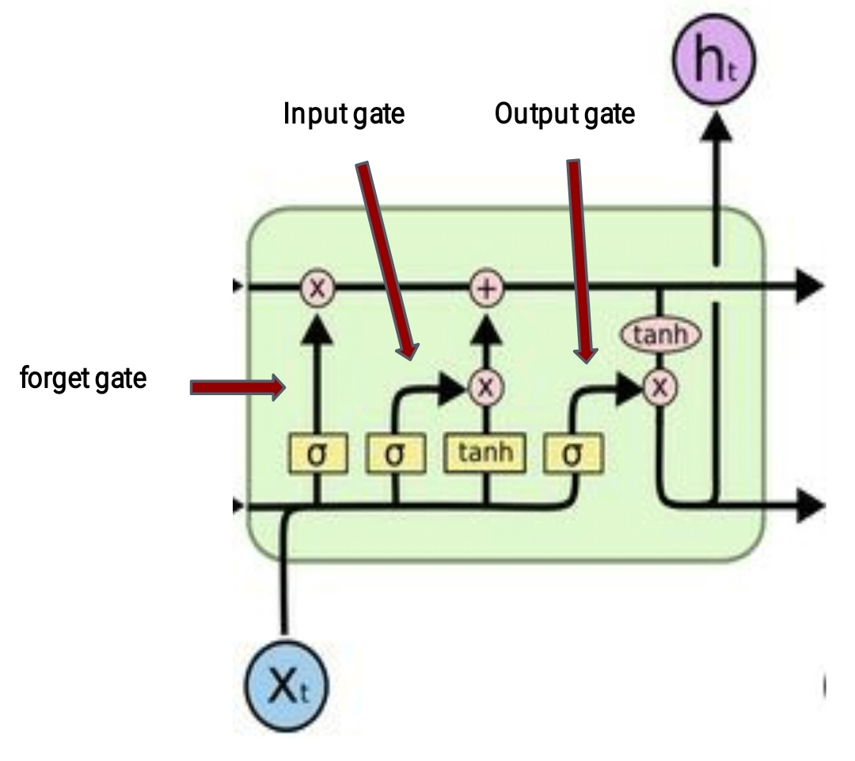
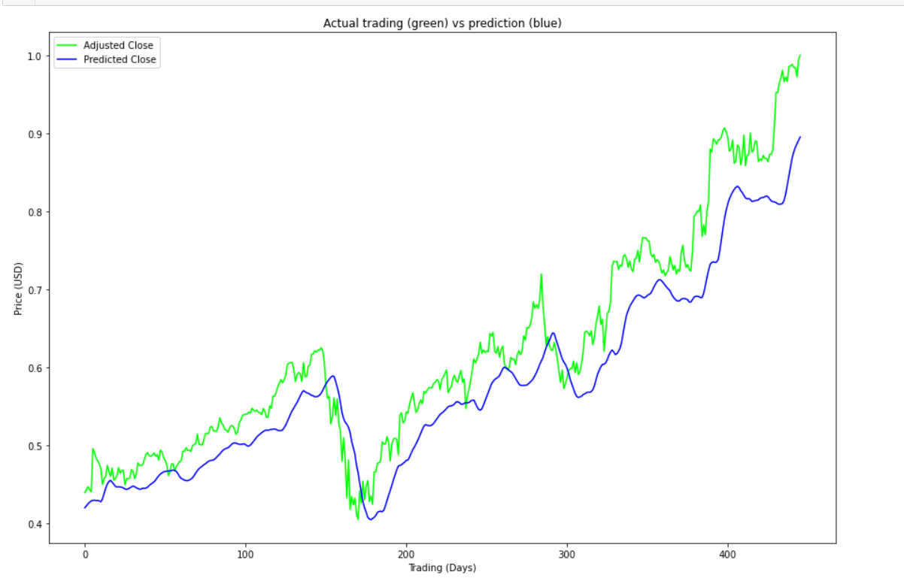
LSTM
Long Short Term Memory is explicitly designed to avoid the long term dependency problem , remembering information for long periods of time is their default behaviour , not something they struggle to learn .
Memory cell state is the key to LSTM which stores the information down the entire chain .
LSTM adds or remove information to these cell states , regulated by structures called gates which are composed of sigmoid neural net layer and a multiplication operation .
There are three gates to protect and control the cell states :
Forget Gate
Input Gate
Output Gate
Test Score: 0.00604687 MSE (0.07776165 RMSE)

Slide 12
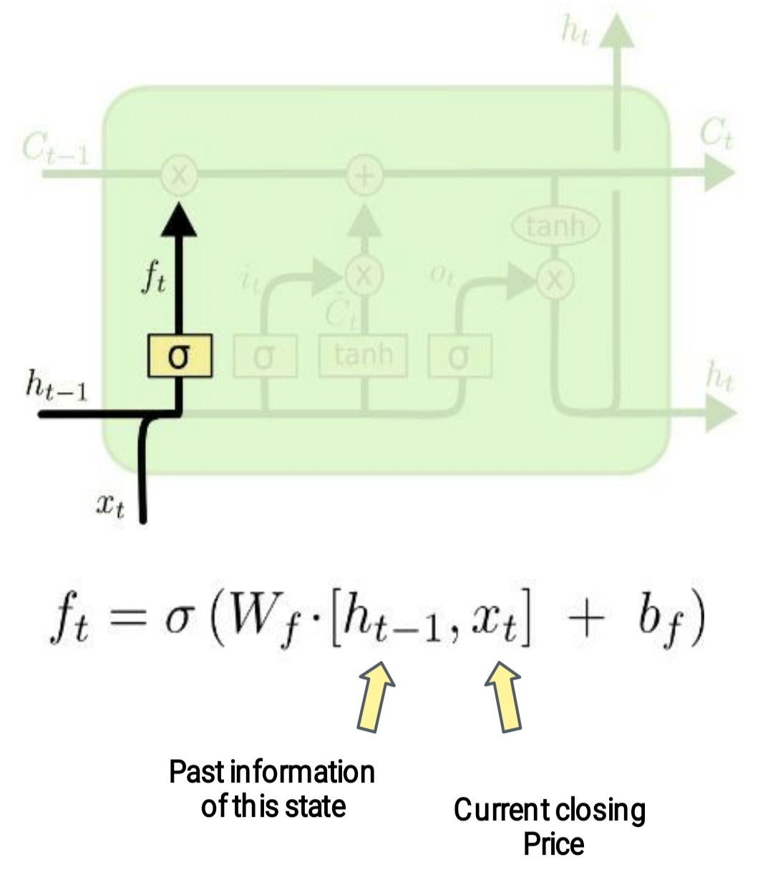
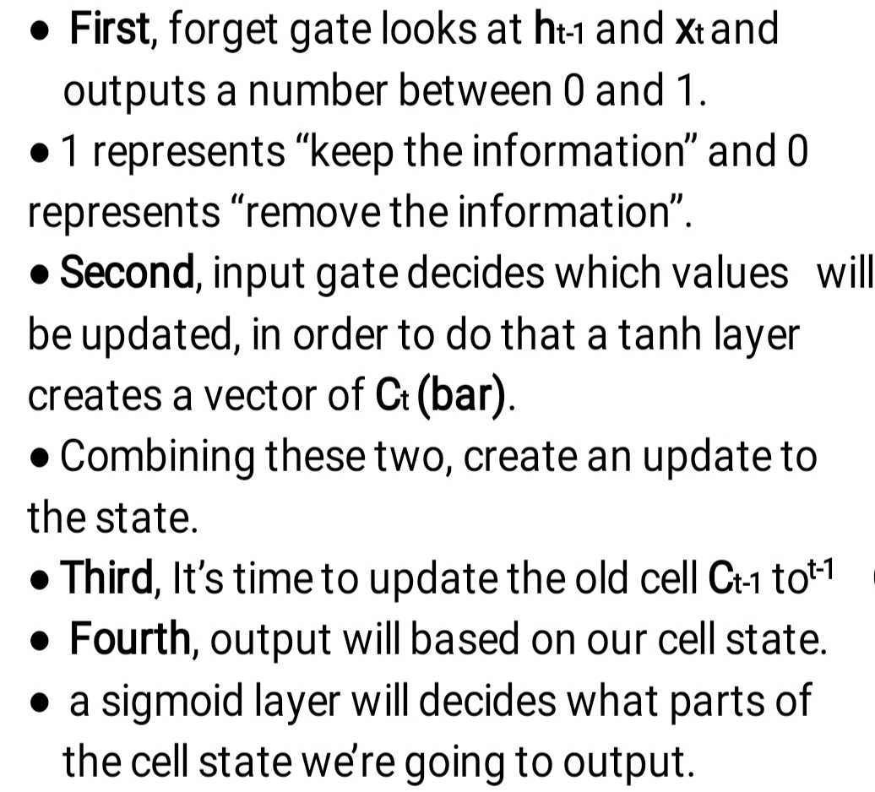
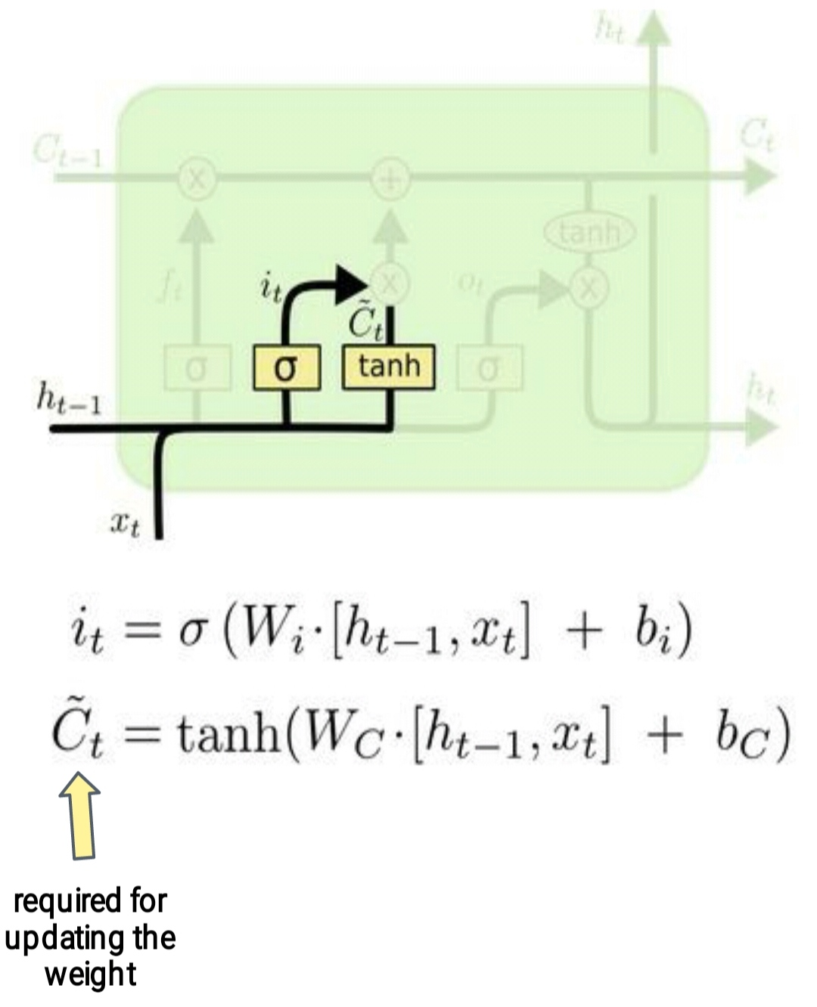
LSTM ( Working )

Slide 13
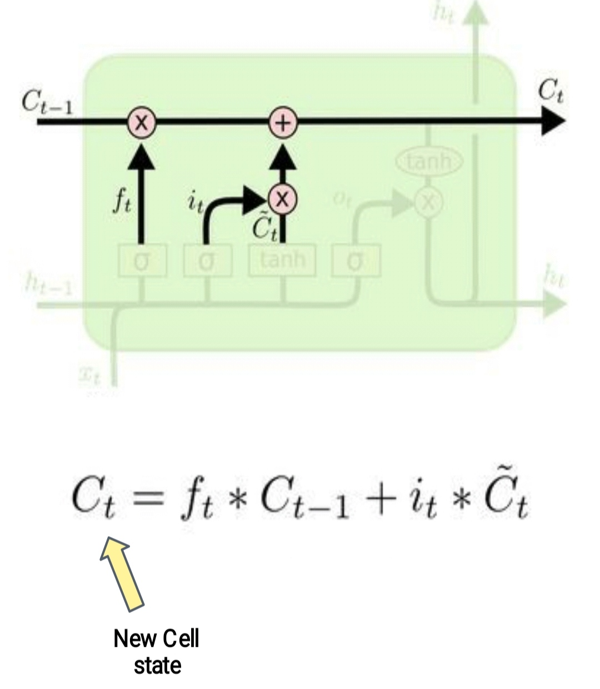
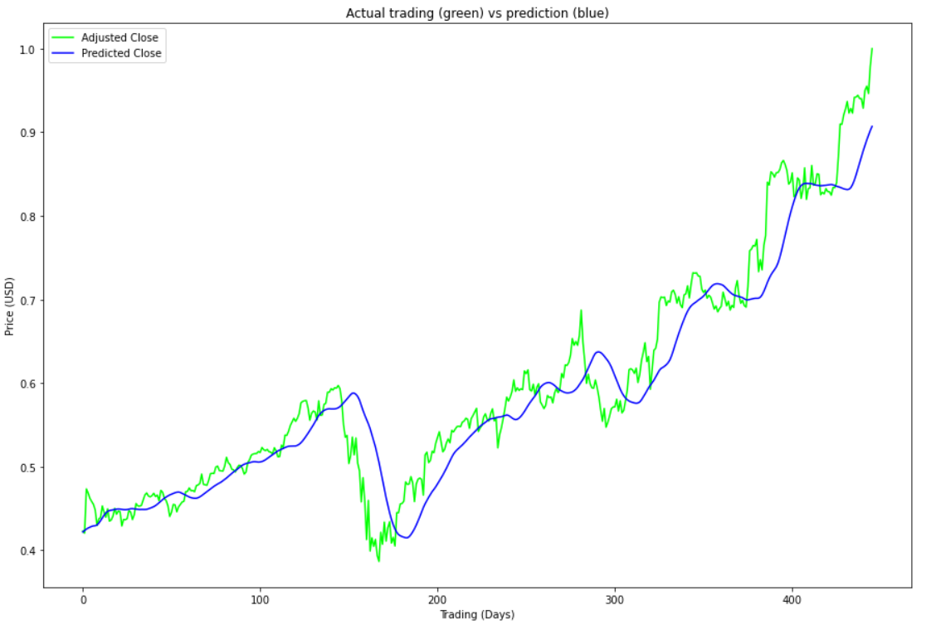
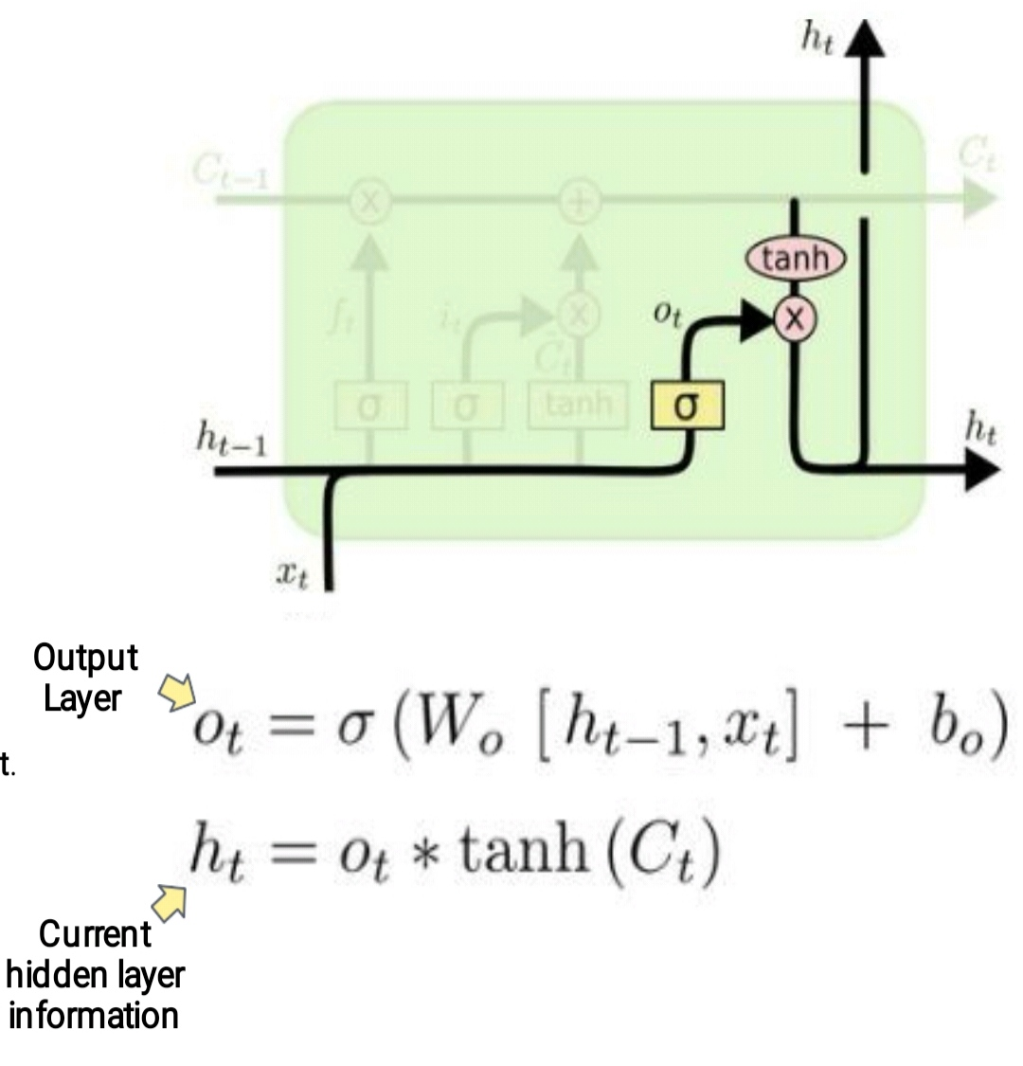
Improved LSTM
Test Score: 0.00189071 MSE (0.04348234 RMSE)

Slide 14
Conclusion
In this project we tried to predict the future closing price of a stock using Technical analysis.
We started with linear regression model as our benchmark model whose RMSE value was 0.41140883 which is not so good.
Machine Learning model like , KNN performed well on the training dataset but not that good on the test data , SVR was significant improvement over KNN with RMSE value 0.6789937199116884 .
Deep Learning Models performed best among the past models with RMSE value 0.08 for DNN and 0.04 for RNN , as RNN suffers from the problem of vanishing gradient , due to which it does not learn from the past data , so we moved forward to LSTM .
LSTM are explicitly designed to avoid the long term dependency problem , it performed quite well with RMSE value of 0.04348234 which is significant improvement over our previous models .
Although we get good result from the above model but we can’t completely depend on the above model for predicting stock price as it does not include fundamental analysis factors , but , we can still improve the model by adding the factors like textual analysis .
So we can say that using advance deep learning models like LSTM we can get some picture of how the stock prices will act. But for getting the whole picture we should include other non technical factors as well.

Slide 15
Future Plans
For improving the result we can add other non-technical factors for predicting the stock price.
There is no user interaction provide in this project. So We can definitely add a UI so that user can check the value of future dates.
Here we used stock of Alphabet Incorporation only. We can surely add more companies in the list so that we can make this project more comprehensive.

Slide 16
References
[1] Anita Yadava, C K Jhaa , Aditi Sharan , Optimizing LSTM for time series prediction in Indian stock market,16 july,2020
[2] Elijah Joseph , Amit Mishra Forecast on Close Stock Market Prediction using Support Vector Machine (SVM), 2february 2019
[3] Guangyu Ding, Liangxi Qin, Study on the prediction of stock price based on the associated
network model of LSTM, 30 november 2019, pp 1307-1317
[4] Hiransha M ,Gopalakrishnan E.A,Vijay Krishna Menon,Soman K.P, NSE Stock Market Prediction Using Deep Learning Models,2017,pp 1353-1361
[5] Murtaza Roondiwala1, Harshal Patel, Shraddha Varma, Predicting Stock Prices Using LSTM,4 April 2017,pp 1754-1756
[6] Khalid Alkhatib,Hassan Najadat2 ,Ismail Hmeidi ,Mohammed K. Ali Shatnawi , Stock Price Prediction Using K-Nearest Neighbor (kNN) Algorithm,2 March 2013
[7] colah's blog,Understanding LSTM Networks,August 27, 2015
[8] Vaibhav Kumar, Devlopers cornerHands-On Guide To LSTM Recurrent Neural Network For Stock Market Prediction, 27 March 2020
[9] Yang Lyla, TDS, A Quick Deep Learning Recipe: Time Series Forecasting with Keras in Python, 29 March 2020

Slide 17
Thank You

