Slide 1
CHATEHR LAB REVIEW
What You Discovered
HINF 6117 | Fordham University | Spring 2026
Notes:
Welcome back. Last week you got your hands on a simulated EHR with a Gemini-powered clinical assistant, and I've now read through all 23 of your submissions. Today we're going to debrief — go over the correct answers for each case, highlight the strongest responses, and lock in the key lessons about AI-assisted clinical decision-making. Let's get into it.

Slide 2
OPENING
What We Did
Three Missions — 60 Minutes
• Mission A: Eleanor Vance (LAB-001) — Medication safety review
• Mission B: Marcus Thorne (LAB-002) — RAG ON vs RAG OFF comparison
• Mission C: Chloe Davis (LAB-003) — Minimum necessary context decision
Team Structure
• Navigator + Driver + Scribe — rotating roles across missions
• Each team submitted a reflection with three scored questions (Q1/Q2/Q3)
Notes:
Here's what you did last week. Three patients, three missions, 60 minutes. Each mission tested something different. Eleanor was about catching an unsafe medication recommendation. Marcus was about seeing the difference RAG makes. And Chloe was about the privacy tradeoff — how much context should the AI actually see? You worked in teams with rotating roles, and every team submitted a scored reflection. Let's see how you did.

Slide 3
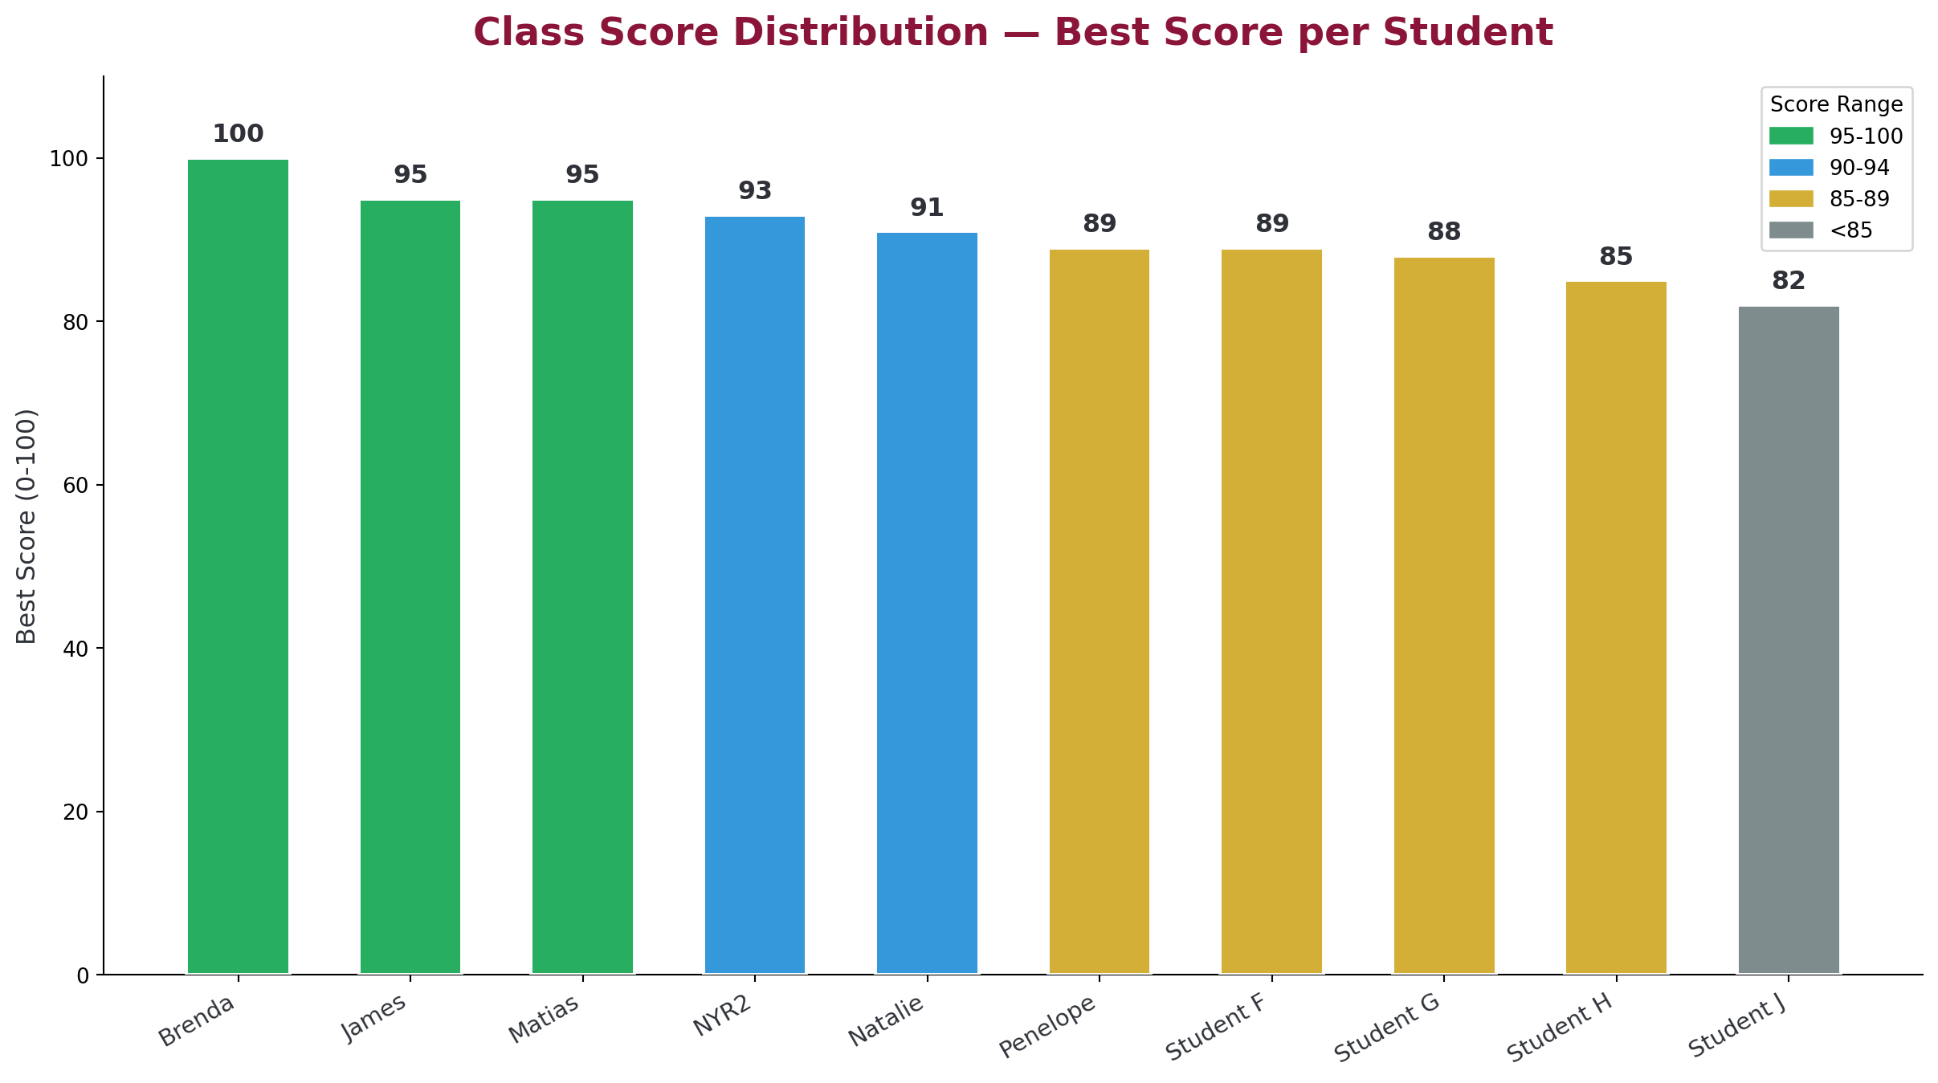
OPENING
Class Score Distribution
Best score per student across all submissions
Notes:
So here's the big picture. Most of you scored in the high 80s to 100 range, which tells me you understood the core concepts. Brenda's team hit 100 on their best submission. A few of you submitted multiple times as you refined your answers, which is exactly what I wanted — that iterative improvement is part of the learning. The scores here show your single best submission.

Slide 4
OPENING
Participation Summary
• 10 unique students submitted reflections
• 23 total submissions (some students refined and resubmitted)
• 3 Health Bench advanced task submissions
• 1 Extra Credit submission (Brenda — Bronx population analysis)
• Average best score: ~91 across all students
• Most common strength: identifying medication risks with chart evidence
Notes:
Ten of you submitted, and several submitted more than once. That's 23 total reflections I read through. Three of you attempted the Health Bench — that's the advanced task where you evaluated the AI's clinical reasoning against a rubric. And Brenda went further with the extra credit, doing a population-level analysis on the Bronx patient panel. I'm going to highlight specific responses as we go through each case.

Slide 5
Mission A: Eleanor Vance
Medication Safety Review
Notes:
Alright, let's start with Eleanor. This was the medication safety case. Your job was to ask the AI assistant about pain management for a heart failure patient and then evaluate whether its recommendation was safe.

Slide 6
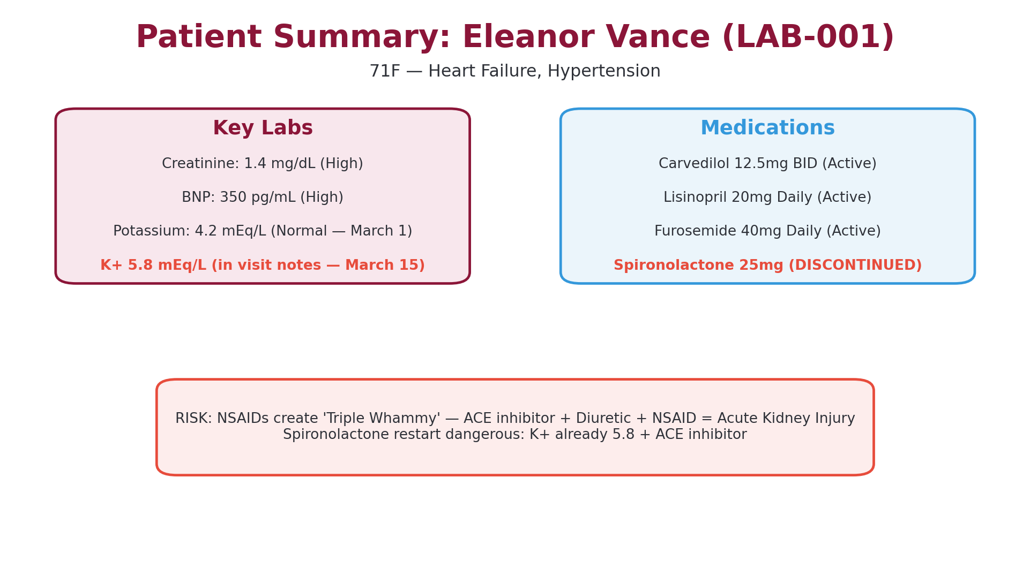
Q1 — ELEANOR VANCE
Eleanor Vance — The Case
Notes:
Here's Eleanor at a glance. 71-year-old woman with heart failure and hypertension. Her structured labs from March 1 show a creatinine of 1.4 — that's already borderline — a BNP of 350, and a potassium of 4.2 which looks normal. She's on Carvedilol, Lisinopril, and Furosemide — that's a beta blocker, an ACE inhibitor, and a loop diuretic. And notice that Spironolactone is listed as discontinued. Hold onto that — it matters.

Slide 7
Q1 — ELEANOR VANCE
The Unsafe Recommendation
UNSAFE: NSAIDs
SAFER Alternatives
• Creates the 'Triple Whammy'
• ACE inhibitor + Diuretic + NSAID
• Reduces renal blood flow
• Risk of acute kidney injury
• Creatinine already elevated (1.4)
• Acetaminophen (Tylenol) first-line
• Topical analgesics (lidocaine patches)
• Non-pharmacological approaches
• If NSAID needed: lowest dose, shortest duration
• Monitor renal function closely
Notes:
This is the core teaching point. If the AI recommended NSAIDs — ibuprofen, naproxen, anything in that class — that's a safety issue. Eleanor is already on an ACE inhibitor and a diuretic. You add an NSAID to that combination and you get what's called the 'Triple Whammy' — three drugs that all reduce renal perfusion in different ways. With her creatinine already at 1.4, that's a real risk for acute kidney injury. The safe answer is acetaminophen as first-line, or topical options.

Slide 8
Q1 — ELEANOR VANCE
Your Best Answers
NYR2 / Group 3
• "Identified the triple whammy — ACE inhibitor + diuretic + NSAID — and cited BNP 350 as evidence of active heart failure"
Penelope & Natalie
• "Flagged the Spironolactone restart risk — K+ was 5.8 with an ACE inhibitor already on board, making hyperkalemia dangerous"
Matias
• "Do not take potassium supplements — K+ already 5.8 mEq/L. Clear, specific, grounded in the chart"
Notes:
Let me highlight a few standout answers. NYR2's group nailed the triple whammy identification and didn't just name it — they cited the BNP of 350 as evidence that her heart failure is active, which makes the NSAID risk even worse. Penelope and Natalie caught something else: the spironolactone restart risk. Even though it's discontinued, some of your AI assistants suggested restarting it. But the visit notes reveal her potassium was 5.8 — that's dangerously high for someone on an ACE inhibitor. And Matias gave a really clean, specific warning about potassium supplements.

Slide 9
Q1 — ELEANOR VANCE
The Hidden Lesson
Two Different Potassium Values — Two Different Locations
• Labs tab (structured data, March 1): K+ = 4.2 mEq/L — Normal
• Visit notes (narrative text, March 15): K+ = 5.8 mEq/L — Dangerous
Why This Matters
• The structured labs look reassuring — potassium is normal
• But the visit note reveals outside labs from ~March 12 with K+ 5.8
• The plan and notes sections of the visit contain the real clinical story
• If you only checked the Labs tab, you'd miss the most important finding
Notes:
Here's the hidden lesson in this case, and it's one of the most important takeaways from the whole lab. The Labs tab shows potassium of 4.2 — that's from March 1, and it looks perfectly normal. But if you read the visit note from March 15 — the plan and notes sections — Dr. Chen mentions that outside labs drawn three days earlier showed a potassium of 5.8. That's a critically different number. The structured data and the narrative data tell different stories, and the newer, more dangerous value is buried in the note. This is exactly what happens in real EHRs. The AI assistant with RAG can surface this, but you as the clinician need to know where to look.

Slide 10
Q1 — ELEANOR VANCE
Q1 Takeaway
• Always cite specific chart evidence — don't just say 'there's a risk'
• Check visit notes, not just structured lab tabs — key values hide in narrative
• Active vs. discontinued status matters — discontinued doesn't mean safe to restart
• The 'Triple Whammy' (ACE + diuretic + NSAID) is a classic med safety pattern
• Elevated K+ (5.8) + ACE inhibitor = do NOT add spironolactone or K+ supplements
Notes:
So here are your takeaways from Eleanor. First, specificity matters — cite the actual values, dates, and medications. Second, the Labs tab doesn't have the full picture. The visit notes contain values that haven't been entered as structured data yet. Third, just because a medication is discontinued doesn't mean the AI or you should recommend restarting it without checking why it was stopped. And fourth, the triple whammy and the K+ 5.8 — these are the kind of patterns that a well-informed clinician catches. The AI can help surface them, but only if you're reading critically.

Slide 11
Mission B: Marcus Thorne
RAG ON vs RAG OFF
Notes:
Now let's talk about Marcus. This was the RAG comparison case. You ran the same clinical question with RAG turned off and then on, and compared the responses. This is where a lot of you had real 'aha' moments.

Slide 12
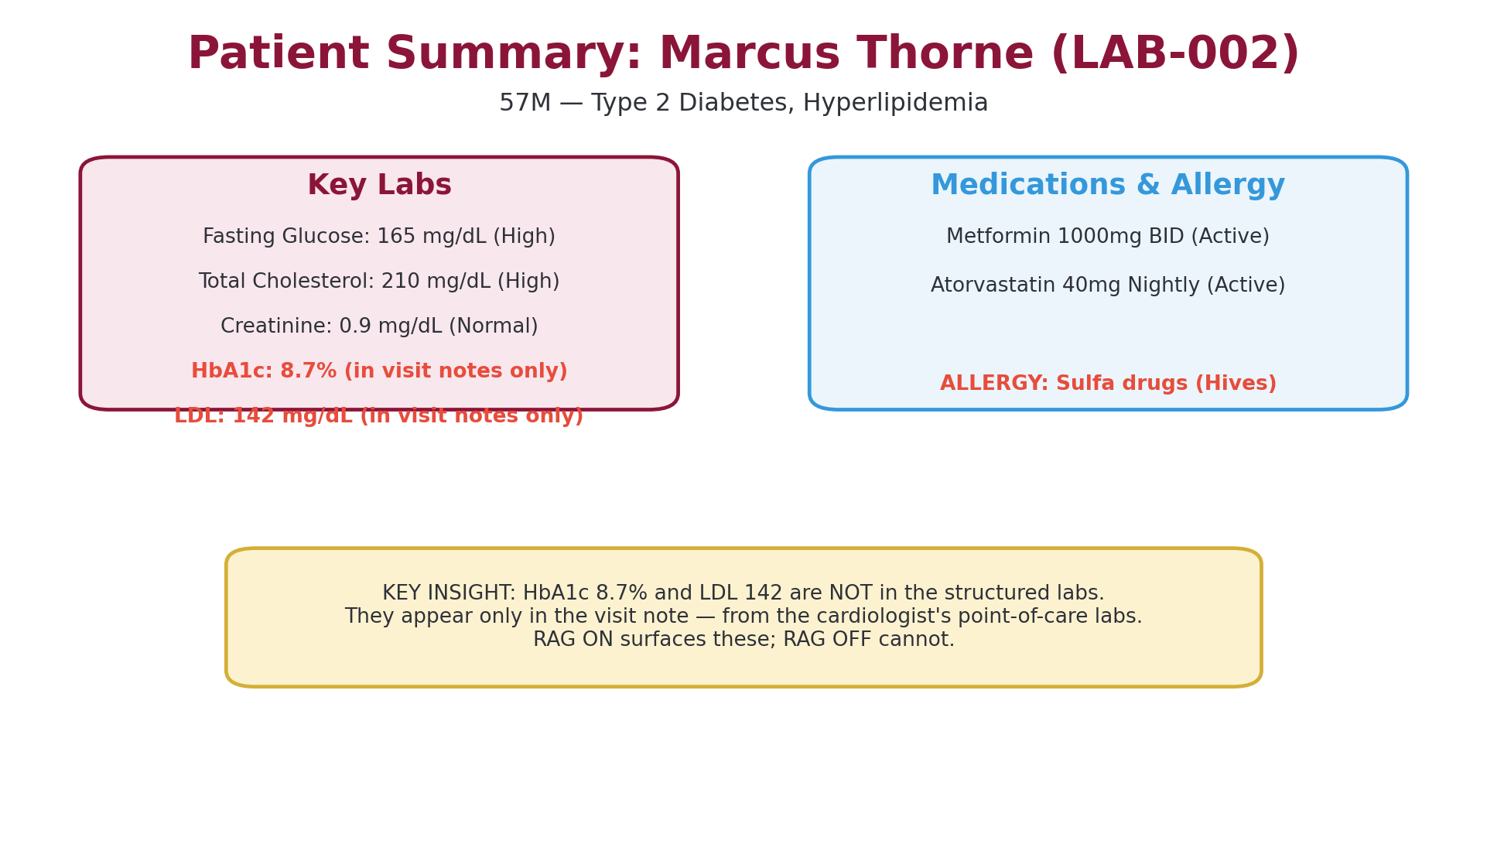
Q2 — MARCUS THORNE
Marcus Thorne — The Case
Notes:
Marcus is a 57-year-old man with type 2 diabetes and hyperlipidemia. His structured labs show fasting glucose of 165 — that's high — and total cholesterol of 210. Creatinine is normal at 0.9. He's on Metformin 1000mg twice daily and Atorvastatin 40mg. And he has a sulfa allergy. But here's the key: his HbA1c of 8.7% and LDL of 142 are NOT in the Labs tab. They only appear in the visit note, where the provider mentions they came from point-of-care labs done by his cardiologist.

Slide 13
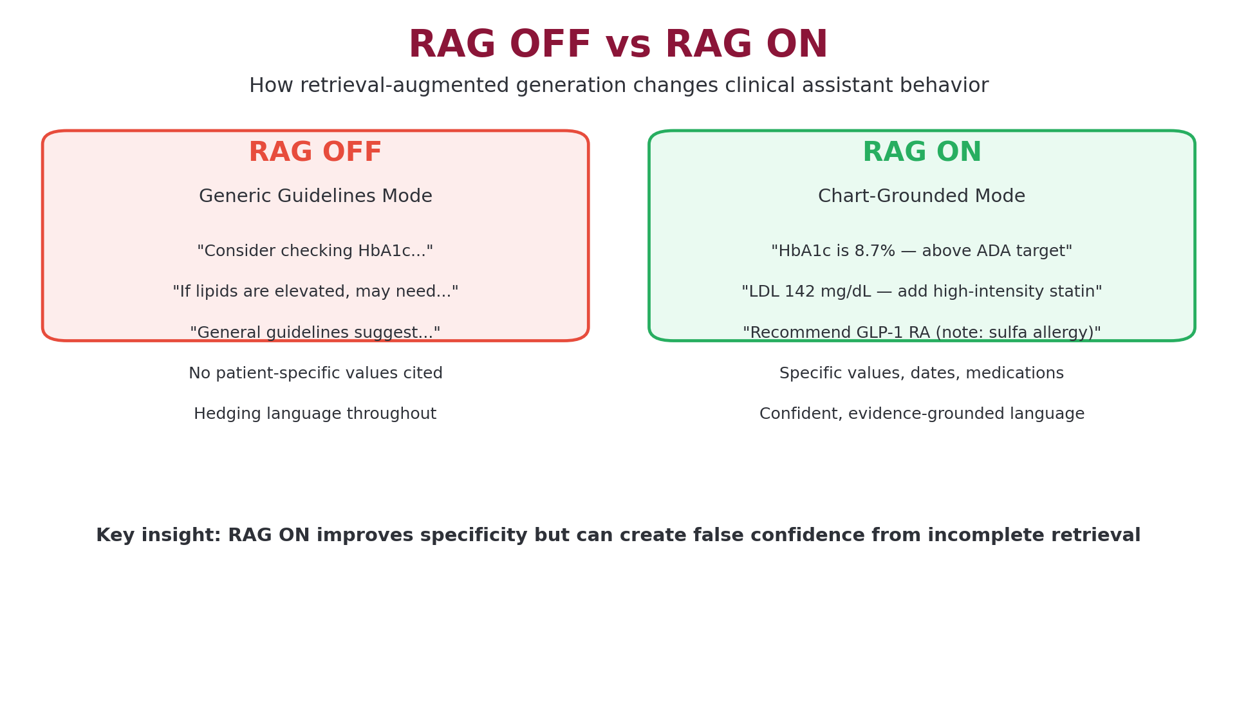
Q2 — MARCUS THORNE
RAG OFF vs RAG ON
Notes:
Here's the comparison side by side. With RAG off, the AI gives you textbook guidelines. 'Consider checking HbA1c.' 'If lipids are elevated, may need to '— it hedges constantly because it has no patient data to ground on. Everything is conditional. With RAG on, it can see Marcus's chart. It says, 'HbA1c is 8.7 percent, above the ADA target of 7 percent. Recommend adding a GLP-1 receptor agonist.' It cites the LDL of 142 and suggests escalating statin therapy. Night and day difference. The language shifts from uncertain to confident, from generic to specific.

Slide 14
Q2 — MARCUS THORNE
What You Found
Key Observations Across Submissions
• RAG ON responses were 2-3x more specific in medication recommendations
• RAG ON cited actual lab values (HbA1c 8.7%, LDL 142) vs. generic thresholds
• RAG OFF used hedging language: 'consider,' 'if indicated,' 'may need'
• RAG ON used confident language: 'recommend,' 'should be added,' 'is above target'
• Several teams noted RAG ON correctly flagged the sulfa allergy when recommending meds
• HbA1c and LDL were only available via visit notes — RAG ON surfaced them
Notes:
Across your submissions, a few themes jumped out. Everyone noticed the specificity increase — that's the obvious one. But several of you caught subtler things. The language shift from hedging to confident. The fact that RAG ON could pull HbA1c and LDL from the visit note even though they weren't in the structured labs. And some of you noticed that RAG ON correctly flagged the sulfa allergy when suggesting medications — that's the kind of safety check that only works when the AI can actually see the chart.

Slide 15
Q2 — MARCUS THORNE
Student Highlights
Brenda
• "RAG OFF is honest but clinically useless... every recommendation becomes a generic 'it depends'"
Matias
• "RAG OFF provides same result but grounded less on evidence... RAG ON more certain in language"
James
• Provided a full structured comparison with evidence grounding checks — systematically evaluated each recommendation against chart data
Notes:
Three quotes that stuck with me. Brenda's is probably the most quotable — 'RAG OFF is honest but clinically useless.' That's a perfect summary. The AI isn't wrong when RAG is off — it's just so generic that it can't help you make a decision for this specific patient. Matias noticed the grounding difference and the language certainty shift. And James did something really impressive — he built a structured comparison where he checked each recommendation against the actual chart evidence. That's the kind of systematic evaluation we want to see.

Slide 16
Q2 — MARCUS THORNE
The Catch: False Confidence
RAG ON Isn't Perfect
• Grounding does not equal correctness — the AI can confidently cite a value and still make a wrong recommendation
• Incomplete retrieval: if the RAG system misses a document, the AI won't know what it doesn't know
• Brenda's insight: 'RAG ON introduces false confidence from incomplete retrieval'
The Clinician's Role
• RAG makes the AI more useful — but verification is still required
• Always cross-check AI recommendations against the full chart
• The AI's confidence level should not replace your own clinical judgment
Notes:
But here's the catch, and Brenda nailed it in her submission. RAG ON makes the AI sound more confident. It cites specific values, gives specific recommendations. But what if the retrieval missed something? What if there's a relevant lab or a contraindication that didn't get pulled into the context window? The AI won't say, 'Hey, I might be missing something.' It'll just give you a confident answer based on incomplete data. That's what Brenda calls 'false confidence from incomplete retrieval.' And that's why the clinician still has to verify. RAG makes the AI more useful, but it doesn't make it infallible.

Slide 17
Q2 — MARCUS THORNE
Q2 Takeaway
• RAG dramatically improves specificity and clinical usefulness
• Without RAG, AI gives generic guidelines — with RAG, it gives patient-specific advice
• Key values (HbA1c 8.7%, LDL 142) can hide in narrative notes, not structured data
• Watch for overconfidence — grounded language doesn't guarantee correctness
• Clinician verification is non-negotiable, even with RAG ON
Notes:
So your takeaways for Marcus. RAG is a massive improvement — no question. But it's an improvement that comes with a new risk: overconfidence. The shift from 'consider checking' to 'HbA1c is 8.7 percent' feels authoritative. And it is grounded in real data. But grounded doesn't mean complete, and complete doesn't mean correct. Your job as the clinician is to use that grounded information as a starting point, not an endpoint.

Slide 18
Mission C: Chloe Davis
Minimum Necessary Context
Notes:
Our last case. Chloe was the privacy decision. This one had no single right answer — it was about reasoning through the tradeoff between clinical usefulness and privacy exposure.

Slide 19
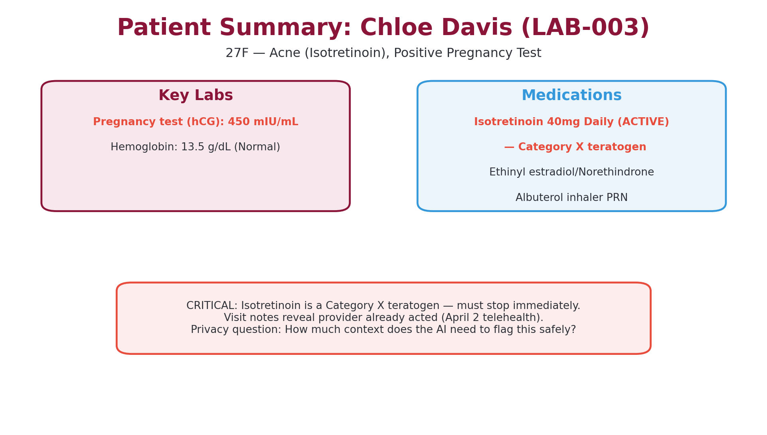
Q3 — CHLOE DAVIS
Chloe Davis — The Case
Notes:
Chloe is 27, being treated for severe acne with Isotretinoin — that's Accutane — which is a Category X teratogen. It causes severe birth defects. And she just had a positive pregnancy test — hCG of 450. She's also on birth control, so this was a contraceptive failure. The visit note from April 2 reveals that Dr. Patel already acted — counseled Chloe to stop isotretinoin immediately and referred her to high-risk OB. Your question was: how much context does the AI need to safely flag this situation?

Slide 20
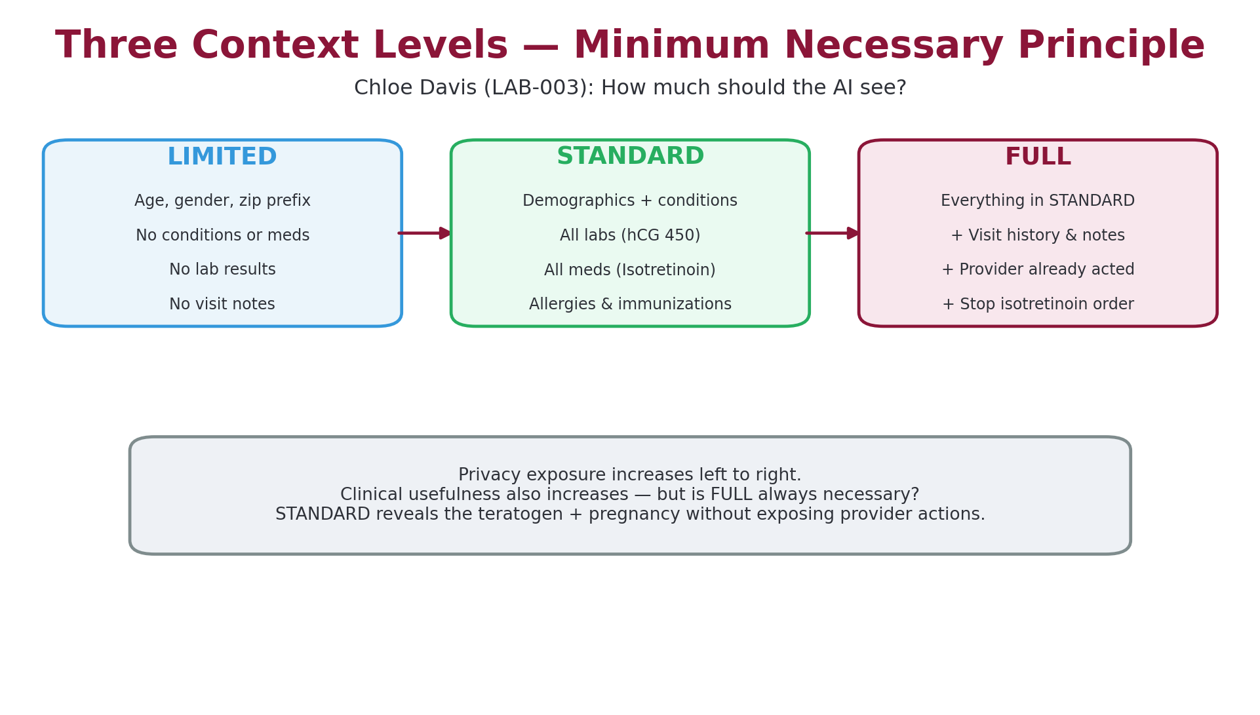
Q3 — CHLOE DAVIS
Three Context Levels
Notes:
Here are the three levels. LIMITED gives the AI almost nothing — age, gender, zip code. It can't identify any medication risk because it can't see the medication list. STANDARD gives it demographics, conditions, labs, and meds. So it can see the isotretinoin, it can see the positive hCG — that's enough to flag the teratogen risk. FULL adds the visit history and notes, so the AI also knows that the provider already acted on April 2. Each level reveals more, but also exposes more of the patient's private information to the AI system.

Slide 21
Q3 — CHLOE DAVIS
Your Choices
Most Teams Chose STANDARD
• Enough to flag Isotretinoin + pregnancy without exposing visit narrative
• Balanced clinical usefulness with privacy protection
Some Teams Chose FULL
• Needed to see the April 2 note where the provider already acted
• Argument: without this context, the AI might duplicate an urgent intervention
Strongest Reasoning: NYR2, Natalie, Penelope
• Explained why STANDARD over LIMITED and why STANDARD over FULL
• Didn't just pick a level — justified what each level adds and what it costs
Notes:
Most of you chose STANDARD, and that's a defensible answer. STANDARD gives the AI enough to see the isotretinoin and the positive pregnancy test — that's sufficient to flag the teratogen risk. But some of you chose FULL, and your reasoning was interesting. You argued that without the visit notes, the AI doesn't know the provider already acted. It might generate an urgent alert that's redundant. The strongest submissions — NYR2, Natalie, Penelope — didn't just pick a level. They explained what each level adds, what it costs in privacy exposure, and why their choice was the right balance.

Slide 22
Q3 — CHLOE DAVIS
Student Highlights
NYR2
• "STANDARD provides high clinical usefulness with moderate privacy risk"
Matias
• "With both limited and standard, the EHR assistant cannot make a grounded response... With full context, it makes a specific response"
James
• "Full context is necessary to understand the urgency of the intervention already taken"
Notes:
Three different perspectives here. NYR2 gave a clean cost-benefit framing — clinical usefulness versus privacy risk. That's the HIPAA minimum necessary principle in action. Matias made an interesting argument that even STANDARD wasn't enough for a truly grounded response — though I'd push back on that a bit, since STANDARD does include the medication list and pregnancy test. And James argued for FULL because he wanted the AI to know about the intervention that already happened. All three are reasonable — the point is that you reasoned through the tradeoff.

Slide 23
Q3 — CHLOE DAVIS
Q3 Takeaway
• 'Minimum necessary' is context-dependent — there's no universal right answer
• More data does not always equal better care
• Privacy exposure should match clinical need — justify what you include AND exclude
• STANDARD catches the teratogen risk; FULL adds awareness of prior action
• The best answers explained the tradeoff, not just the choice
Notes:
Here's the takeaway. Minimum necessary isn't a fixed rule — it's a judgment call that depends on the clinical scenario. More data gives the AI more to work with, but it also exposes more of the patient's private information to the system. The best answers in this section didn't just pick LIMITED, STANDARD, or FULL. They explained what each level reveals, what it hides, and why the balance they chose was appropriate for this specific patient. That's the skill I want you to carry forward.

Slide 24
WRAP-UP
Health Bench & Extra Credit
Student | Task | Score
Brenda | Health Bench | 100
James | Health Bench | 90
Matias | Health Bench | 90
Brenda | Extra Credit (Bronx Panel) | 90
Notes:
Three of you attempted the Health Bench — that's the advanced task where you evaluated the AI's clinical reasoning against a structured rubric. Brenda scored a perfect 100. James and Matias both hit 90. And Brenda also did the extra credit, running a population-level analysis on the Bronx patient panel. Her key findings: 34 out of 50 patients had flu shots on record, and 12 out of 50 had an A1c of 8 or higher — which tells you something about the diabetes burden in that simulated population. These advanced tasks showed real depth of engagement with the system.

Slide 25
WRAP-UP
Common Patterns Across Submissions
What Went Well
Growth Areas
• Strong medication risk identification
• Good use of specific chart evidence
• Thoughtful RAG comparison observations
• Most teams caught the triple whammy
• RAG uncertainty calibration — some accepted RAG ON at face value
• Privacy reasoning sometimes stayed general vs. case-specific
• Citing dates alongside values (March 1 vs. March 15 matters)
• Checking visit notes, not just Labs tab
Notes:
Let me give you the honest assessment. On the strengths side, most of you were good at identifying medication risks and citing evidence from the chart. The RAG comparison observations were thoughtful. On the growth side, some of you accepted RAG ON's output without questioning whether the retrieval might be incomplete — that's the false confidence trap. And on the privacy question, a few submissions gave general essays about HIPAA rather than case-specific reasoning about Chloe. The best submissions were specific, evidence-grounded, and self-critical.

Slide 26
WRAP-UP
Five Things to Remember
• 1. Always read visit notes, not just structured tabs — key values hide in narrative
• 2. RAG improves grounding but can create false confidence from incomplete retrieval
• 3. "Minimum necessary" means justify what you include AND what you exclude
• 4. Cite specific values, dates, and medications — not vague claims
• 5. AI governance = knowing when to trust, when to verify, and what to withhold
Notes:
Five things. Write these down. One: read the visit notes. The Labs tab doesn't have everything. Two: RAG is powerful but not perfect — don't let confident language replace your own verification. Three: minimum necessary is a two-way justification — you need to explain both what you share and what you don't. Four: be specific. 'The patient has elevated potassium' is not the same as 'K+ was 5.8 mEq/L on March 12 per outside labs.' Five: AI governance isn't just about whether the AI is accurate. It's about when to trust it, when to double-check it, and when to limit what it sees.

Slide 27
WRAP-UP
Debrief Discussion
Take 2 minutes to discuss with your neighbor, then we'll share out
Questions for the Room
• 1. "If you could redesign one thing about the ChatEHR interface to improve patient safety, what would it be?"
• 2. "When should a clinician override an AI recommendation — even if the AI cites chart evidence to support it?"
• 3. "How would you explain the minimum necessary principle to a hospital administrator who wants to give AI full access to all patient data?"
Notes:
Let's open it up. Three questions for you. First, if you could change one thing about the ChatEHR interface — maybe how it displays information, how the AI presents its answers, how the context levels work — what would you change to make it safer? Second, when should you override the AI even when it's citing real chart data? This gets at the false confidence issue. And third, imagine you're talking to a hospital administrator who says, 'Just give the AI full access to everything — it'll be more accurate.' How do you push back on that using what you learned from the Chloe case?

Slide 28
Thank You
Next week: Module continues — bring your questions
HINF 6117 | ChatEHR Lab Review | Fordham University
Notes:
Great work this week. The fact that most of you scored in the high 80s to 100 tells me you're getting it. But more importantly, the quality of your reasoning — the way you caught the triple whammy, questioned RAG's confidence, and thought through the privacy tradeoffs — that's what matters. See you next week.

