Slide 1
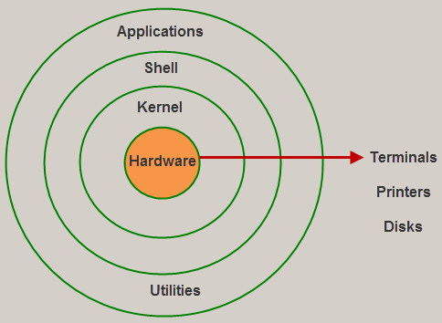
Linux System Architecture
Notes:
Linux System Architecture

Slide 2
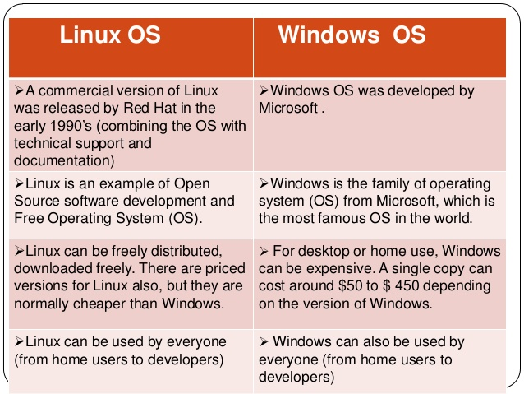
Difference Between Linux and windows

Slide 3
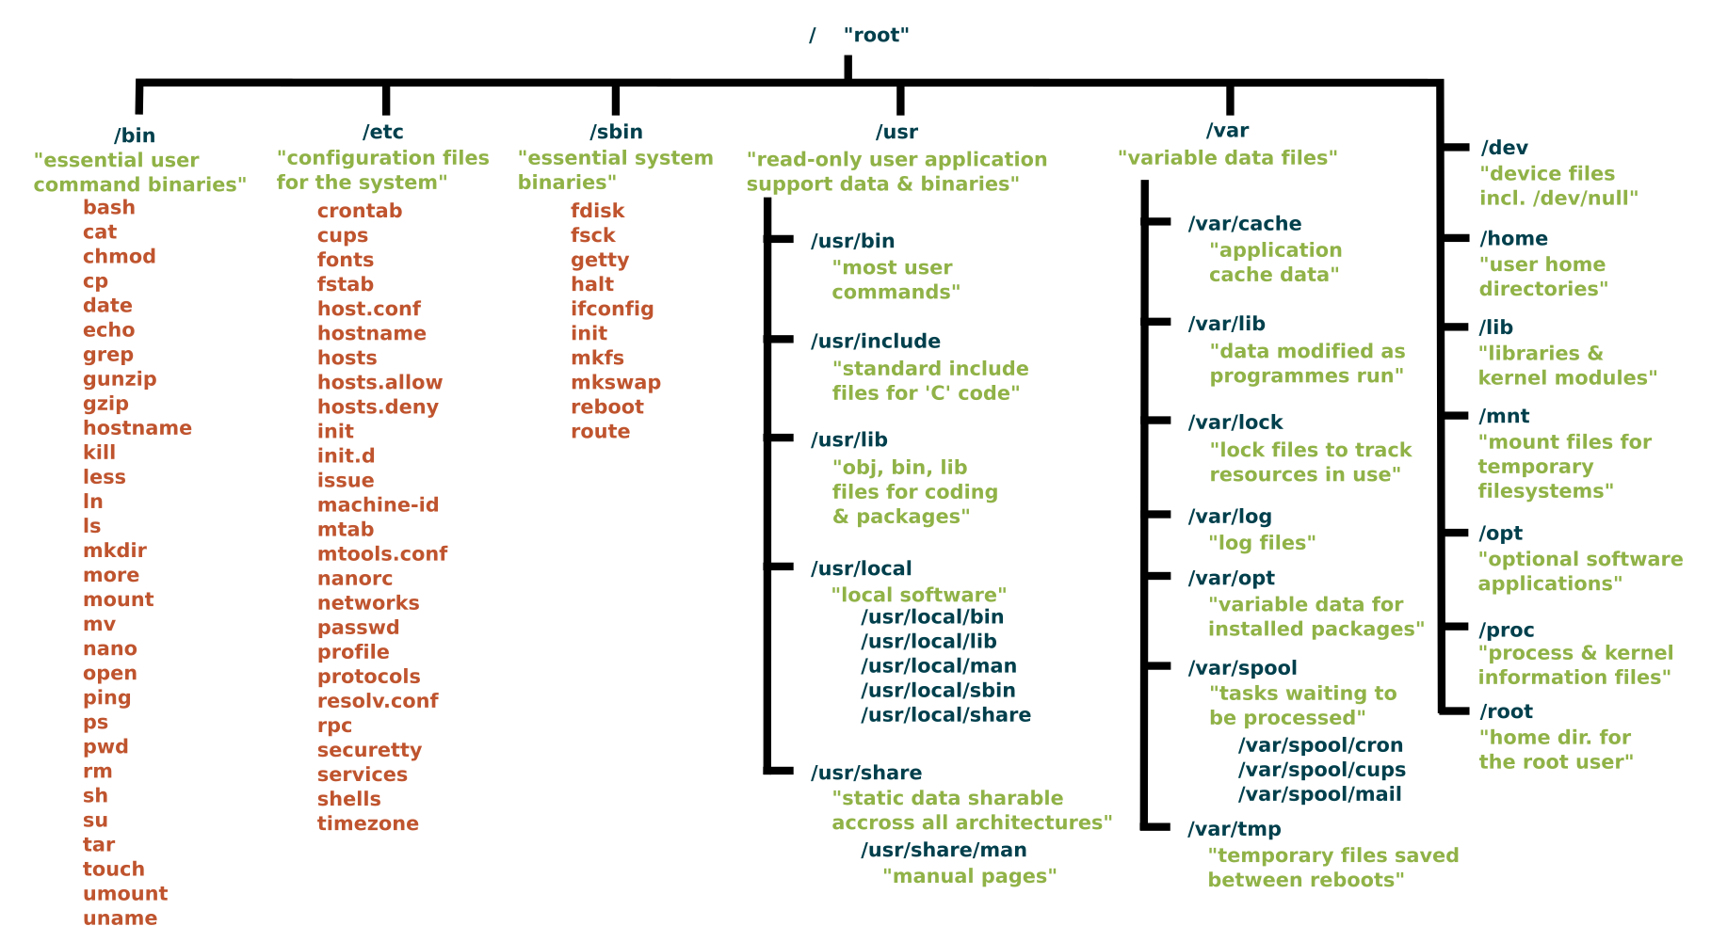
Linux OS FILE STRECTURE

Slide 4
Putty
MobaXtreme
Cloud shell
Cloud9

Slide 5
Admin –root
User
Other

